Slide 1

Traffic Analysis: Network Flow Watermarking
Amir Houmansadr
CS660: Advanced Information Assurance
Spring 2015

Slide 2
Previously
Two popular forms of anonymous communications
Onion Routing (Tor)
Mix Networks
They aim to be low-latency to be used for interactive application, e.g., web browsing, IM, VoIP, etc.
Gives birth to attacks

Slide 3
Attacks on anonymity systems
Traffic analysis attacks
Intersection attacks
Fingerprinting attacks
DoS attacks
…

Slide 4
Who Wants to Attack Tor?
Who has the ability to attack Tor?

Slide 5
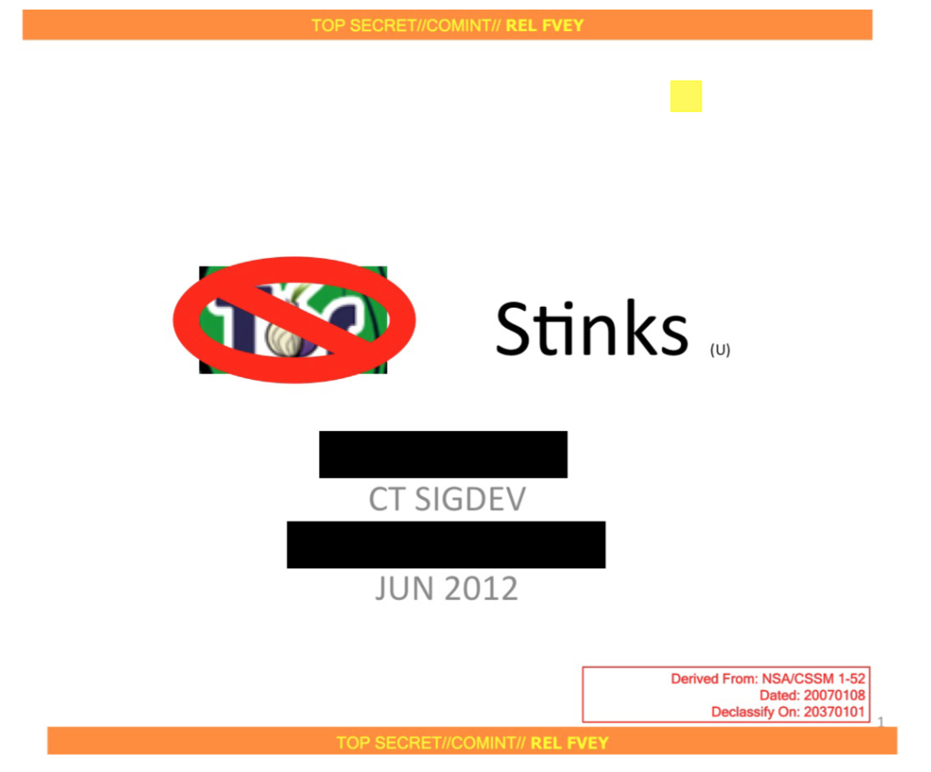
How NSA tries to break Tor
Tor stinks

Slide 6
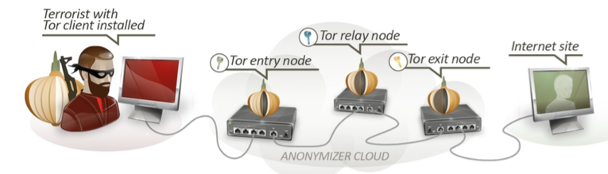
Why do they want to break Tor (or, what do they say?)

Slide 7
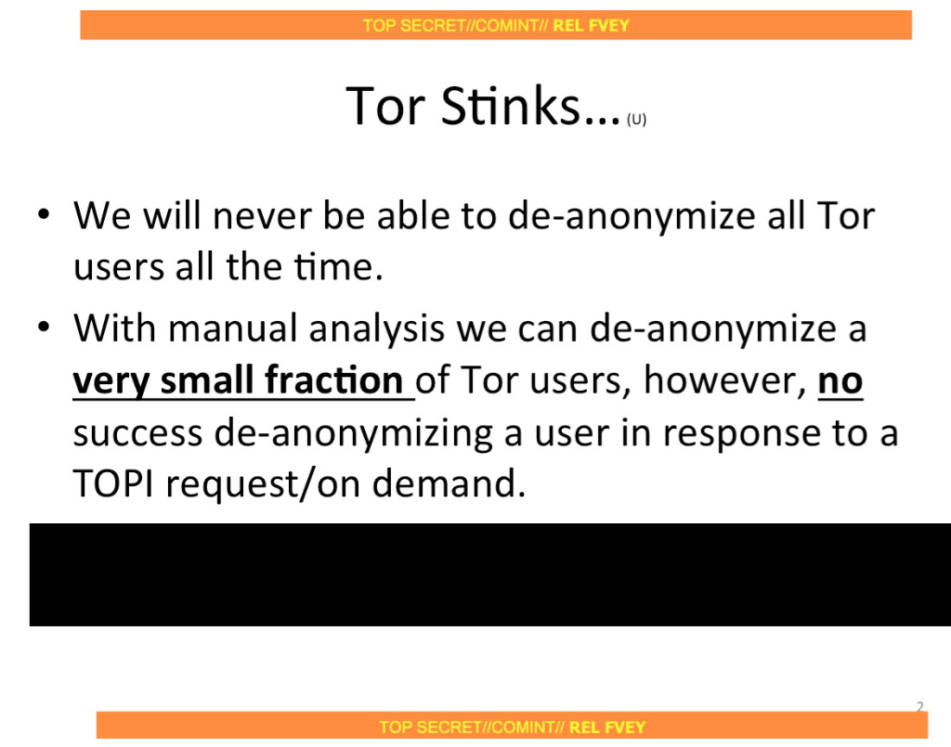

Slide 8
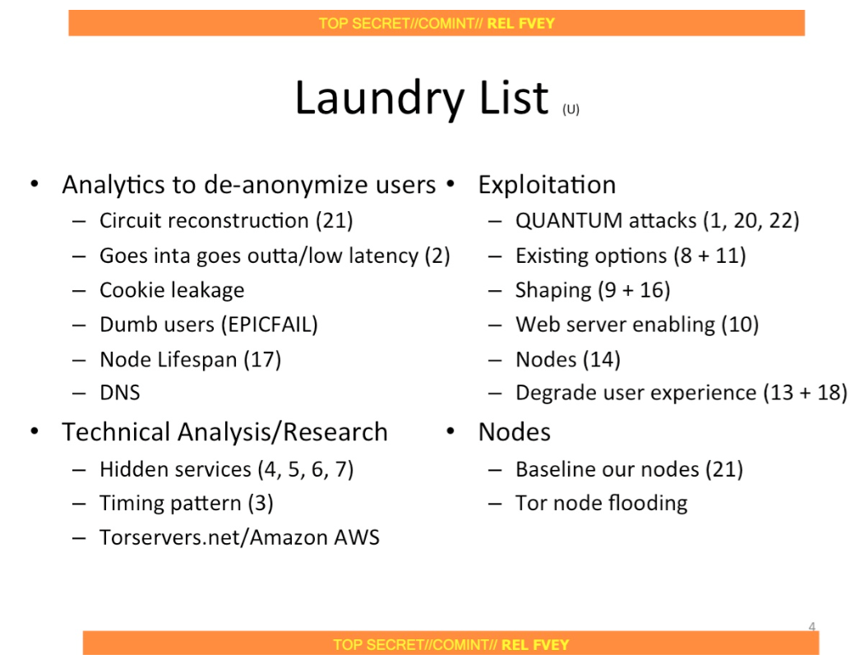

Slide 9
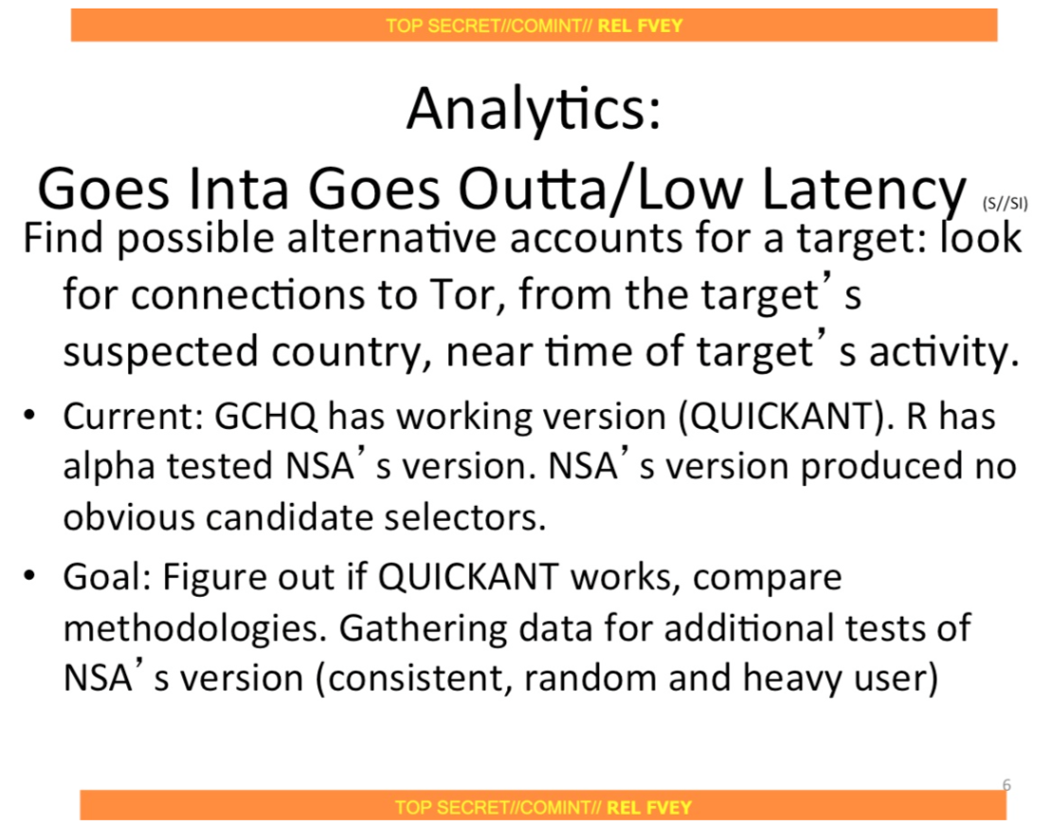

Slide 10
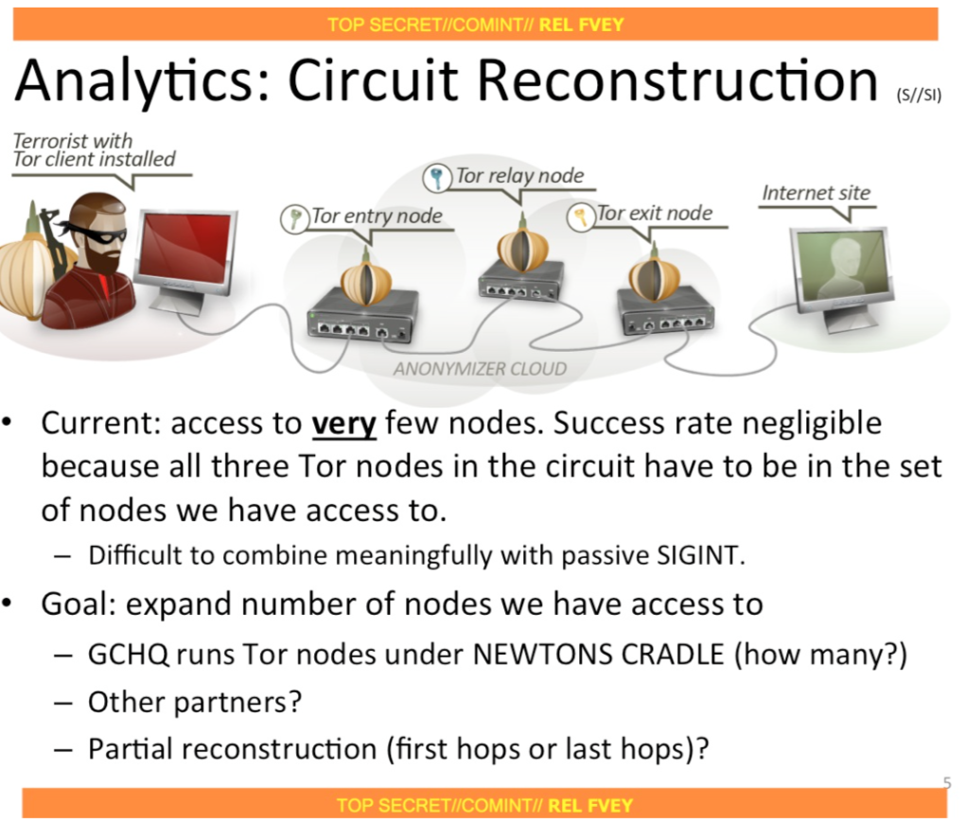

Slide 11
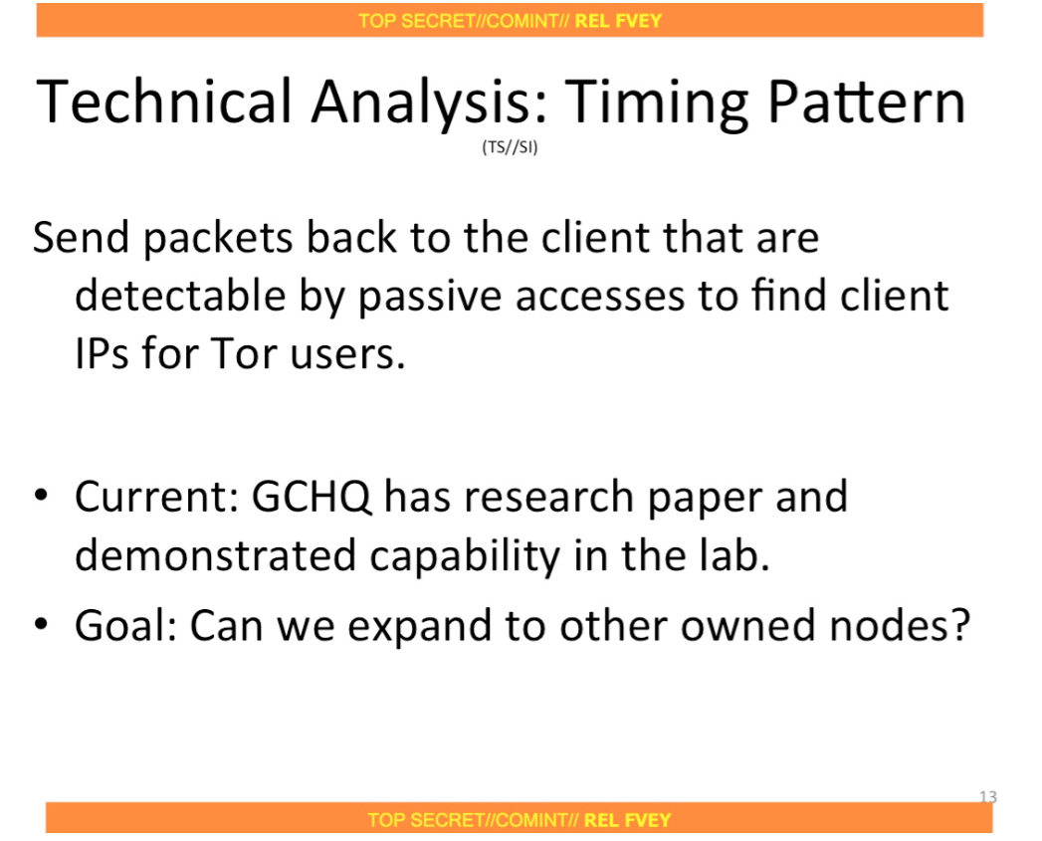

Slide 12
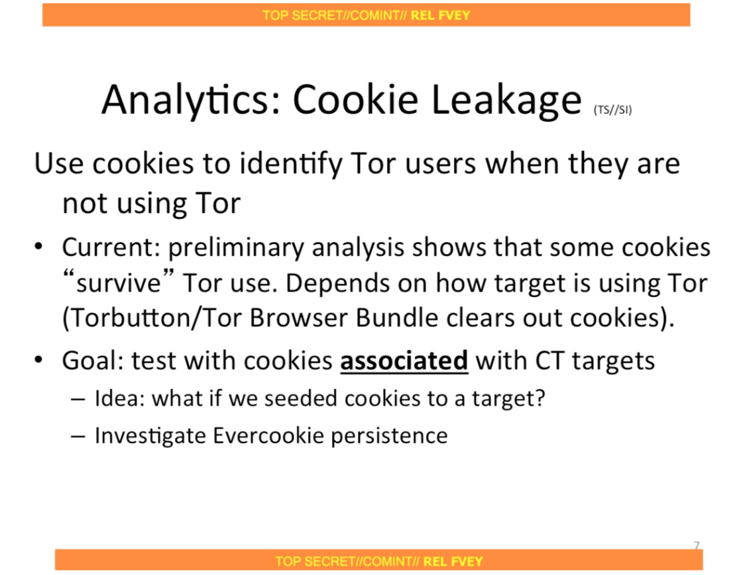

Slide 13
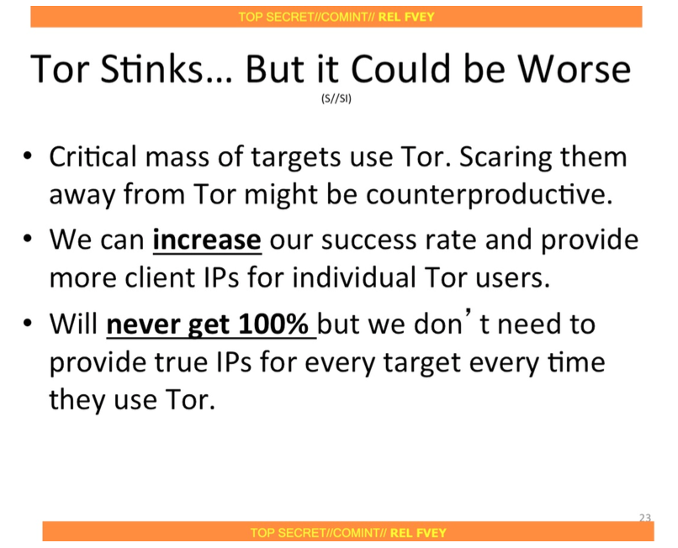

Slide 14
Discussion
Should privacy-enhancing technologies (e.g., Tor) have backdoors for the law-enforcement?

Slide 15
Traffic Analysis
Definition: inferring sensitive information from communication patterns, instead of traffic contents, no matter if encrypted
Related fields
Traffic shaping
Data mining

Slide 16
Use cases of traffic analysis
Inferring encrypted data (SSH, VoIP)
Inferring events
Linking network flows in low-latency networking applications
…

Slide 17
Outline
Traffic analysis in low-latency scenarios
Passive traffic analysis
Active traffic analysis: watermarks

Slide 18

Compromising anonymity
B
A
Anonymous network

Slide 19




Stepping stone attack

Slide 20
Passive Traffic analysis
Analyzing network flow patterns by only Observing traffic:
Packet counts
Packet timings
Packet sizes
Flow rate
…

Slide 21
Some literature
Stepping stone detection
Character frequencies [Staniford-Chen et al., S&P’95]
ON/OFF behavior of interactive connections [Zhang et al., SEC’00]
Correlating inter-packet delays [Wang et al., ESORICS’02]
Flow-sketches [Coskun et al., ACSAC’09]
Compromising anonymity
Analysis of onion routing [Syverson et al., PET’00]
Freedom and PipeNet [Back et al., IH’01]
Mix-based systems: [Raymond et al., PET’00], [Danezis et al., PET’04]

Slide 22
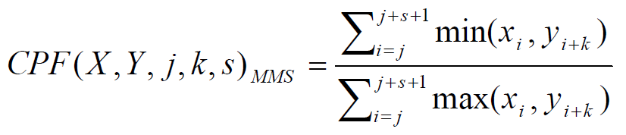
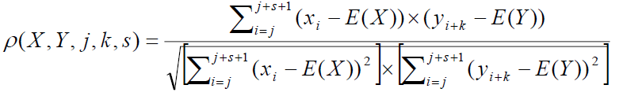
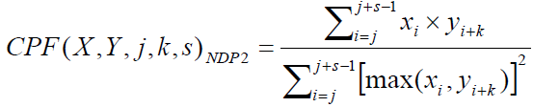
Passive Traffic analysis
Based on inter-packet delays of network flows [Wang et al., ESORICS’02]
Min/Max Sum Ratio (MMS)
Statistical Correlation (STAT)
Normalized Dot Product (NDP)

Slide 23
Passive Traffic analysis
ON/OFF behavior of interactive connections [Zhang et al., SEC’00]
Based on flow sketches [Coskun et al., ACSAC’09]

Slide 24
Issues of passive traffic analysis
Intrinsic correlation of flows
High false error rates
Need long flows for detection

Slide 25
Compromising anonymity
A
B
Anonymity network

Slide 26
Issues of passive traffic analysis
Intrinsic correlation of flows
High false error rates
Need long flows for detection
Massive computation and communication
Not scalable: O(n) communication, O(n²) computation

Slide 27
Compromising anonymity
A
B
Anonymity network

Slide 28
Flow watermarks: Active traffic analysis

Slide 29
Flow watermarking
Traffic analysis by perturbing network traffic
Packet timings
Packet counts
Packet sizes
Flow rate
…

Slide 30
Compromising anonymity
A
B
Anonymity network

Slide 31

Stepping stone detection
Enterprise network

Slide 32
Active Traffic Analysis
Improve detection efficiency (lower false errors, fewer packets)
O(1) communication and O(n) computation, instead of O(n) and O(n²)
Faster detection

Slide 33
Compromising anonymity
A
B
Anonymity network

Slide 34
Watermark features
Detection efficiency
Invisibility
Robustness
Resource efficiency

Slide 35
Inter-Packet Delay vs. Interval-Based Watermarking
Inter-Packet Delay (IPD) watermarking
Interval-Based Watermarking
Robustness to packet modifications
IBW[Infocom’07], ICBW[S&P’07], DSSS[S&P’07]
CLEAR
LOAD

Slide 36
RAINBOW: Robust And Invisible Non-Blind Watermark
NDSS 2009
With Negar Kiyavash and Nikita Borisov

Slide 37
RAINBOW Scheme
Non-Blind watermarking: provide invisibility
IPD Database
IPD
IPD
Sender
IPD
Watermarker
IPD^{W}
IPD^{R}
Detector
Receiver
WM
Insert spread spectrum watermark within Inter-Packet Delay (IPD) information
At the watermarker: IPD^{W}= IPD + WM
At the detector: IPD^{R} - IPD = WM + Jitter
IPD Database
Last n packets, removed after connection ends
Low memory resources for moderate-size enterprises

Slide 38
Detection Analysis
Using the last n samples of IPD
Y= IPD^{R} - IPD = WM + Jitter
Normalized correlation
Detection threshold η
System parameters:
a: watermark amplitude
b: standard deviation of jitter
represents the SNR
n: watermark length
Detection analysis: Hypothesis testing
IPD Database
Detector
IPD
Watermark
IPD^{R}
Y
Subtraction
Normalized Correlation
Decision

Slide 39
System Design
Cross-Over Error Rate (COER) versus system parameters
Increasing
Lower error, more visible
Increasing n
lower error, slower detection
a can be traded for n
a should be adjusted to jitter

Slide 40
Evaluation
Devise a selective correlation to compensate for packet-level modifications
Sliding window
Invisibility analyzed using
Kolmogorov-Smirnov test
Entropy-based tools of [Gianvecchio, CCS07]
Performance summary
Fast detection
Detection time ≈ 3 min of SSH traffic (400 packets)
False errors of order 10⁻⁶

Slide 41
Other applications
Linking flows in low-latency applications
Stepping stone detection
Compromising anonymous networks
Long path attack
IRC-based botnet detection
VoIP de-anonymization
…

Slide 42

Long-path attack
Tor network

Slide 43
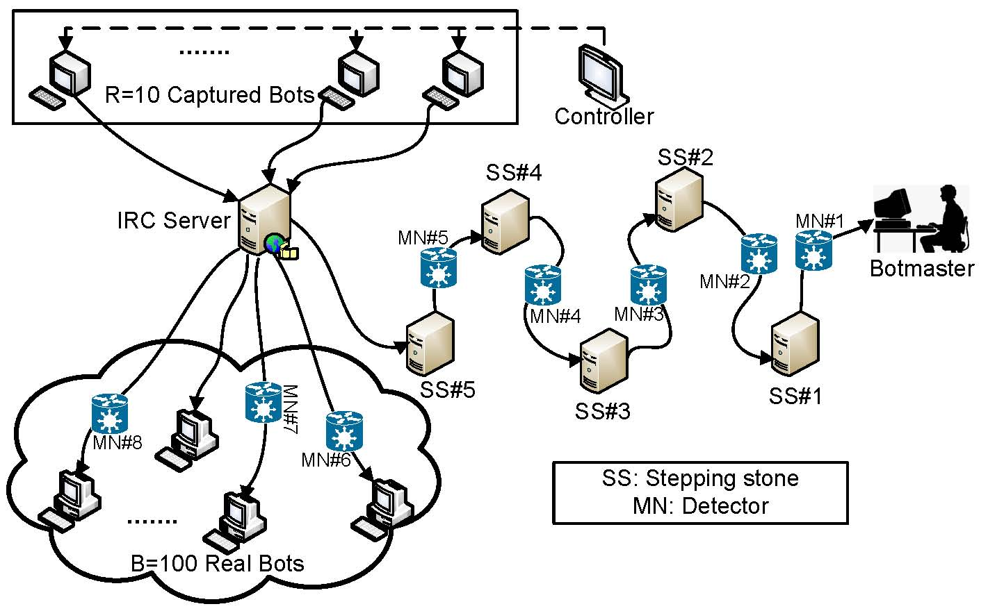
IRC-based botnets

Slide 44
Acknowledgement
Some of the slides, content, or pictures are borrowed from the following resources, and some pictures are obtained through Google search without being referenced below:
Tor stinks

