Slide 1

Information Hiding: Covert Channels
Content may be borrowed from other resources.
See the last slide for acknowledgements!
Amir Houmansadr
CS660: Advanced Information Assurance
Spring 2015

Slide 2
Classes of Information Hiding
Digital watermarking
Steganography
Covert channels
Anonymous communication
Protocol obfuscation

Slide 3
Covert Channels
Definition: Communicate information between two computer processes that are not allowed to communicate, by hiding information into shared resources
Steganography: hiding information into digital media

Slide 4

Prisoners’ problem
Alice, Bob, and Walter

Slide 5
Applications, or Why Use Covert Channels
Bypass security policy by malicious/compromised computer processes
Evade surveillance
Bypass communication restrictions
Etc.

Slide 6
What Is the Importance?
Difficult to detect
Can operate for a long time and leak a substantial amount of classified data
Can compromise an otherwise secure system, including one that has been formally verified!

Slide 7
Classification: Hiding Method
Storage channel
Data transmitted by writing or abstaining from writing, e.g., writing into RAM
Timing channel
Data modulated into the timing, or occurrence of events, e.g., the times between network packets

Slide 8
Classification: Shared Resources
Network resource: an existing, legitimate communication channel designed for some purpose
Remote (network) covert channels
Computer resource: RAM, HardDisk, CPU, etc.
Local covert channels

Slide 9
Local Channels

Slide 10
Virtual Machines
Shared resources:
CPU
RAM
Disk
Network
Examples?

Slide 11
Smartphones
Shared resources:
CPU
RAM
Disk
Network
Microphone/speaker
Battery
Examples?

Slide 12
Remote (Network) Channels

Slide 13
What is the shared resource here?

Slide 14
Types
Timing
E.g., packet timings
Storage
E.g., packet headers
How about the information hidden in packet payload?
Steganography

Slide 15
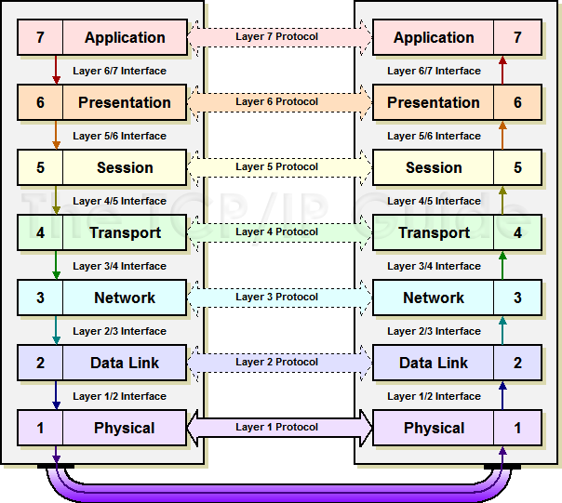
Protocol Stack

Slide 16
Packet Header Hiding
20-64 bytes
20-64 bytes
0-65,488 bytes
IP Header
TCP Header
DATA
This is Information
Assurance Class
TCP Source Port
TCP Destination Port
TCP/IP Header can serve as a carrier for acovert channel
IP Source Address
IP Destination Address

Slide 17
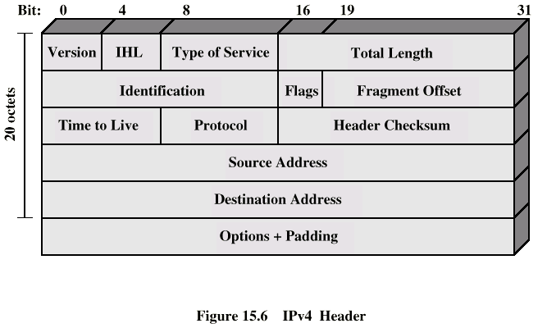
IP Header
0-44
bytes
Fields that may be used to embed covert data

Slide 18
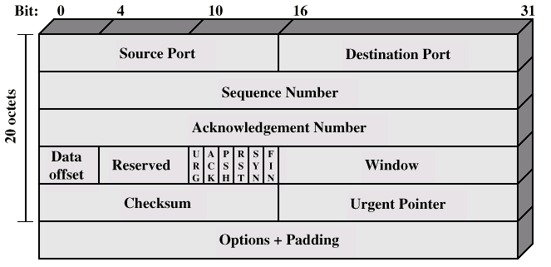
TCP Header
0-44
bytes
Timestamp

Slide 19
Storage Based
Information is embedded by hiding data in packet header fields
IP identification
Offset
Options
TCP Checksum
TCP Sequence Numbers

Slide 20
Timing Channels
Information is hidden by triggering or delaying events at specific time intervals

Slide 21
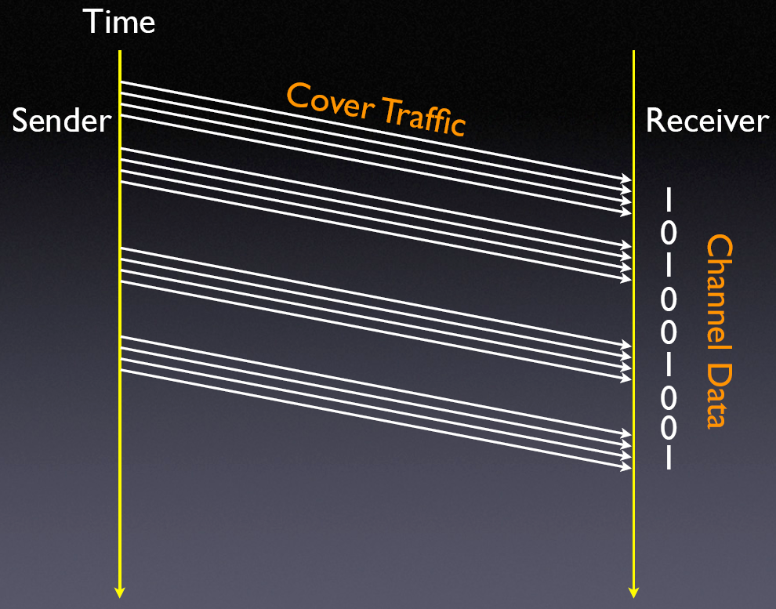
Timing Channels

Slide 22
Detection Mechanisms
Storage-based
Data analysis
Timing-based
Timing analysis

Slide 23
Threat Model
Passive Warden Threat Model
Detect, then remove
Active Warden Threat Model
Modify traffic regardless of suspicion
Constraint?

Slide 24
IP ID and TCP ISN Implementation
Two fields which are commonly used to embed covert data are the IP ID and TCP ISN
Due to their construction, these fields contain some structure
Partially unpredictable

Slide 25
Detection of TCP/IP Covert Channels
Each operating system exhibits well defined characteristics in generated TCP/IP fields
can be used to identify any anomalies that may indicate the use of steganography
Suite of tests
applied to network traces to identify whether the results are consistent with known operating systems

Slide 26
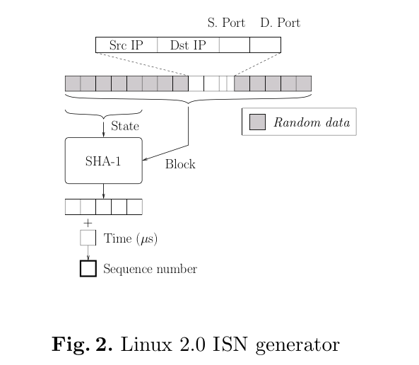

Slide 27
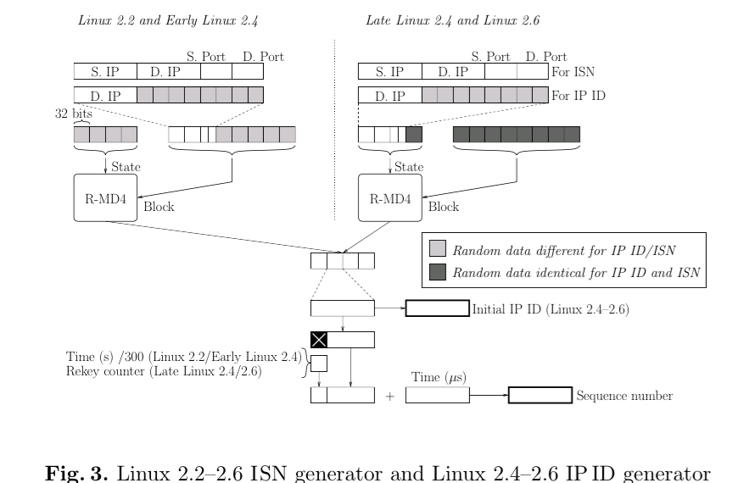

Slide 28
IP ID Characteristics
Sequential Global IP ID
Sequential Per-host IP ID
IP-ID MSB Toggle
IP-ID Permutation

Slide 29
TCP ISN Characteristics
Rekey Timer
Rekey Counter
ISN MSB Toggle
ISN Permutation
Zero bit 15
Full TCP Collisions
Partial TCP Collisions

Slide 30
Explicit Steganography Detection
12. Nushu Cryptography
encrypts data before including it in the ISN field
results in a distribution which is different from normally generated by Linux and so will be detected by the other TCP tests

Slide 31
13. TCP Timestamp
If a low bandwidth TCP connection is being used to leak information
a randomness test can be applied to the least significant bits of the timestamps in the TCP packets
If “too much“ randomness is detected in the LSBs → a steganographic covert channel is in use

Slide 32
14. Other Anomalies
unusual flags (e.g. DF when not expected, ToS set)
excessive fragmentation
use of IP options
non-zero padding
unexpected TCP options (e.g. timestamps from operating systems which do not generate them)
excessive re-ordering

Slide 33
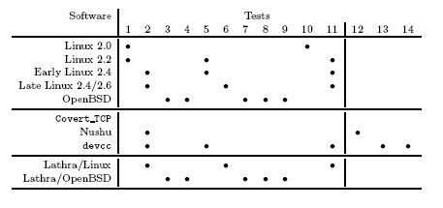
Results

Slide 34
Accuracy
No false negatives
Possible false positives
The accuracy depends on the size of observation

Slide 35
Detection-Resistant Schemes
Lathra - Robust scheme, using the TCP ISNs generated by OpenBSD and Linux as a steganographic carrier
Simply encoding data within the least significant 24 bits of the ISN could be detected by the warden

Slide 36
Other Network Channels

Slide 37

ICMP Channels
www.erg.abdn.ac.uk/users/gorry
ICMP echo request/reply can tunnel arbitrary user data
Payload capacity depends on path MTU (this feature often used to measure PMTU)
Sohn, Noh, Moon 2003, “Support Vector Machine Based ICMP Covert Channel Attack Detection”

Slide 38
HTTP Channels
Fields in the header
Infranet
StegoTorus

Slide 39
DNS Channels
DNS can hold arbitrary text in its various fields
High bandwidth: 110-220 bytes per request!
Used for SSH, streaming audio
Not yet filtered by firewalls
Proof of concept available: OzyManDNS (http://www.doxpara.com)

Slide 40
Channel Detection and Analysis

Slide 41
Analysis Techniques
Information flow
Operates at high-level language level
Often overestimates flows, flags non-existant flows
Noninterference
Analysis performed on abstract model, not real system
Shared Resource Matrix
Very popular with systems folks
Sabelfeld, Myers 2003, “Language-Based Information-Flow Security”

Slide 42
Shared Resource Matrix
Kemmerer 1983, “Shared Resource Matrix Methodology: An Approach to Identifying Storage and Timing Channels”

Slide 43
Active Channel Mitigation

Slide 44
Fuzzy Time
All covert timing channels rely on accurate clock
You can either attempt to disrupt the timing of the channel (add noise or slow it down), or reduce the accuracy of the clock
VAX security kernel slows down timer interrupt periods to be uniformly distributed with a mean of 20 ms.
Randomly modifies the completion time of I/O requests, so they can’t be used as a clock
Hu 1991, “Reducing Timing Channels with Fuzzy Time”

Slide 45
Lattice Scheduling
Many local covert channels require simultaneous operation of spy and Trojan
Process scheduler can be modified to prevent this situation
Hu 1992, “Lattice Scheduling and Covert Channels”

Slide 46
Wrapping Up
Do covert channels pose a real threat?
Some are difficult to exploit, requiring a skillful attacker
Others are fairly easy to exploit:
Acoustic keylogger
HTTP tunnels
Definitely a threat!

Slide 47
Classes of Information Hiding
Digital watermarking
Steganography
Covert channels
Anonymous communication
Protocol obfuscation

Slide 48
Side Channels
Similar to covert channels, but information is leaked unintentionally
Examples?

Slide 49
Acknowledgement
Some of the slides, content, or pictures are borrowed from the following resources, and some pictures are obtained through Google search without being referenced below:
TCP/IP covert channels -UMBC
Covert Channels, by Michael LeMay @UIUC

