Slide 1

Side Channels
Content may be borrowed from other resources.
See the last slide for acknowledgements!
Amir Houmansadr
CS660: Advanced Information Assurance
Spring 2015

Slide 2
Classes of Information Hiding
Digital watermarking
Steganography
Covert channels
Anonymous communication
Protocol obfuscation

Slide 3
Side Channels
A side-channel attack is any attack based on information gained from the physical implementation of a system (process), rather than theoretical weaknesses in the algorithms
Similar to covert channels, but information is leaked unintentionally
Usually, some shared resource

Slide 4
Types
System (computer) channels
Network channels

Slide 5
System channels
Example: crytosystems

Slide 6
Fault Attacks
Faults may be unintentional or induced by …
Heat
Cold
Low power
Microwaves
…etc.

Slide 7
Timing Attacks
How long does it take to perform a decryption?

Slide 8
Timing Attacks
How long does it take to perform a decryption?
The answer may be data-dependent.

Slide 9
Timing Attacks
How long does it take to perform a decryption?
The answer may be data-dependent.
For instance…

Slide 10
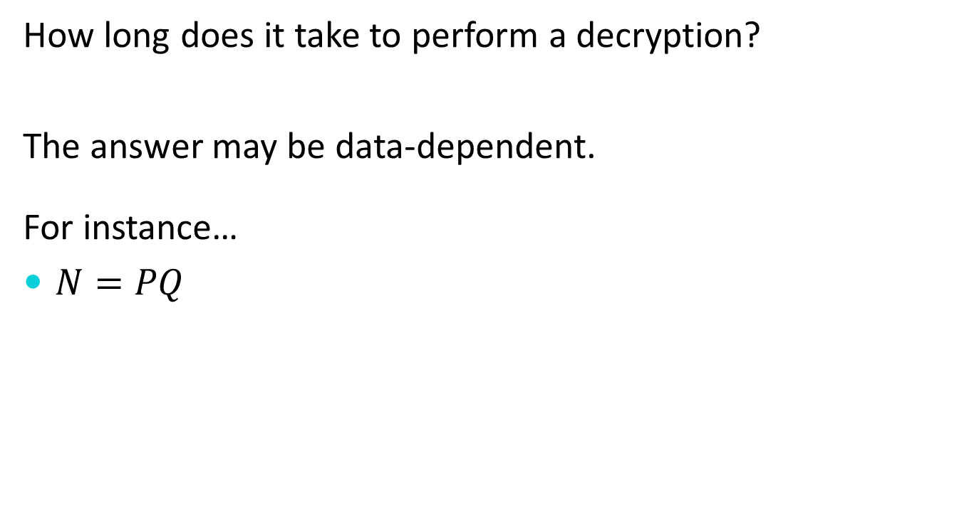
Timing Attacks
How long does it take to perform a decryption?
The answer may be data-dependent.
For instance…
$N=PQ$

Slide 11
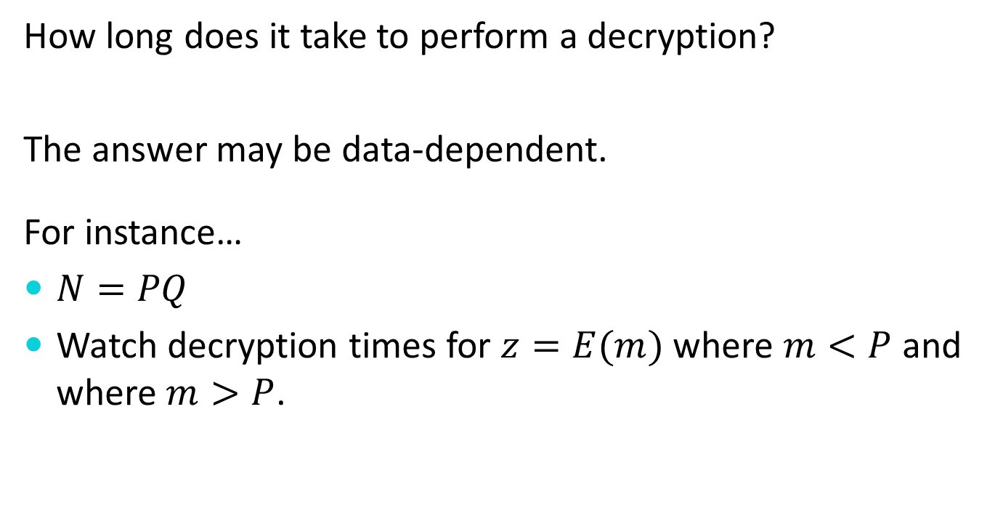
Timing Attacks
How long does it take to perform a decryption?
The answer may be data-dependent.
For instance…
$N=PQ$
Watch decryption times for $z=E(m)$ where $m<P$ and where $m>P$.

Slide 12
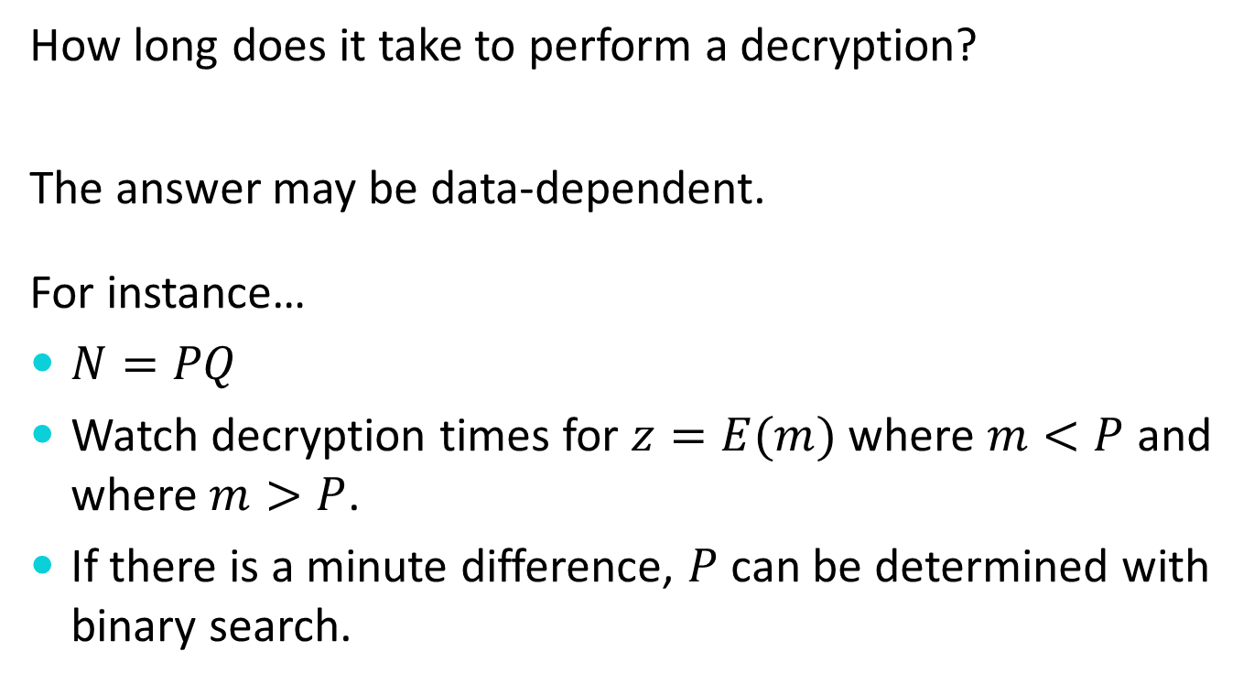
Timing Attacks
How long does it take to perform a decryption?
The answer may be data-dependent.
For instance…
Watch decryption times for where and where .
If there is a minute difference, can be determined with binary search.

Slide 13
Cache Attacks
If you can run code on the same device where a decryption is being performed, you may be able to selectively force certain cache lines to be flushed.
Decryption times may vary in a key-dependent manner based upon which lines have been flushed.

Slide 14
Power Analysis
Power usage of a device may vary in a key-dependent manner.

Slide 15
Power Analysis
Power usage of a device may vary in a key-dependent manner.
Careful measurement and analysis of power consumption can be used to determine the key.

Slide 16
Electromagnetic Emissions
One can record electromagnetic emissions of a device – often at a distance.

Slide 17
Electromagnetic Emissions
One can record electromagnetic emissions of a device – often at a distance.
Careful analysis of the emissions may reveal a secret key.

Slide 18
Acoustic Emissions
Modular exponentiation is done with repeated squaring and conditional “side” multiplications.

Slide 19
Acoustic Emissions
Modular exponentiation is done with repeated squaring and conditional “side” multiplications.
It can actually be possible to hear whether or not these conditional multiplications are performed.

Slide 20
Information Disclosures
(N.B. Bleichenbacher Attack)
A protocol may respond differently to properly and improperly formed data.

Slide 21
Information Disclosures
(N.B. Bleichenbacher Attack)
A protocol may respond differently to properly and improperly formed data.
Careful manipulation of data may elicit responses which disclose information about a desired key or decryption value.

Slide 22
Types
Passive
Active

Slide 23
System Side-Channel Attacks
Examples:
Fault Attacks
Timing Attacks
Cache Attacks
Power Analysis
Electromagnetic Emissions
Acoustic Emissions
Information Disclosure

Slide 24
Acknowledgement
Some of the slides, content, or pictures are borrowed from the following resources, and some pictures are obtained through Google search without being referenced below:
Josh Benaloh and Brian LaMacchia, Practical Aspects of Modern Cryptography, Winter 2011.

