Slide 1

Information Hiding: Anonymous Communication
Content may be borrowed from other resources.
See the last slide for acknowledgements!
Amir Houmansadr
CS660: Advanced Information Assurance
Spring 2015

Slide 2
Classes of Information Hiding
Digital watermarking
Steganography
Covert channels
Anonymous communication
Protocol obfuscation

Slide 3
Definition
Hiding the identitie(s) of the parties involved in digital communications from each other, or from third-parties
“Who you are” from the communicating party
“Who you are talking to” from everyone else

Slide 4
Why be Anonymous?
If you are a cyber-criminal!
DRM infringement, hacker, spammer, terrorist, etc.
But, also if you are:
Journalist
Whistleblower
Human rights activist
Business executive
Military/intelligence personnel
Abuse victims

Slide 5
Why be Anonymous?
How about normal people?
Avoid tracking by advertising companies
Protect sensitive personal information from businesses, like insurance companies, banks, etc.
Express unpopular or controversial opinions
Have a dual life
A professor who is also a pro in World of Warcraft!
Try uncommon things
…
It feels good to have some privacy!

Slide 6
Bottomline: Anonymity is not for criminals only!

Slide 7
But, It’s Hard to be Anonymous!
Your network location (IP address) can be linked directly to you
ISPs store communications records
Usually for several years (Data Retention Laws)
Law enforcement can subpoena these records
Your application is being tracked
Cookies, Flash cookies, E-Tags, HTML5 Storage
Centralized services like Skype, Google voice
Browser fingerprinting
Your activities can be used to identify you
Unique websites and apps that you use
Types of links that you click

Slide 8
But, It’s Hard to be Anonymous!
Your Internet access point can be wiretapped
Wireless traffic can be trivially intercepted
Airsnort, Firesheep, etc.
Wifi and Cellular traffic!
Encryption helps, if it’s strong
WEP and WPA are both vulnerable!
Tier 1 ASs and IXPs are compromised
NSA, GCHQ, “5 Eyes”
~1% of all Internet traffic
Focus on encrypted traffic

Slide 9
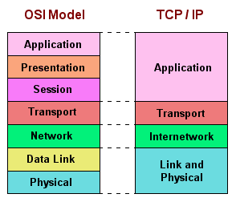
You Have to Protect at All Layers!
Challenge:
Maintain Performance

Slide 10
Definitions

Slide 11
Types of Anonymity
Sender anonymity
Receiver anonymity
Sender-Receiver anonymity

Slide 12
Properties
Unlinkability: the inability of link two or more items of interests to break anonymity, like packets, events, people, actions, etc.
Unobservability: items of interest are indistinguishable from all other items

Slide 13














Quantifying Anonymity
How can we calculate how anonymous we are?
Anonymity Sets
Suspects (Anonymity Set)
Who sent this message?
Larger anonymity set = stronger anonymity

Slide 14
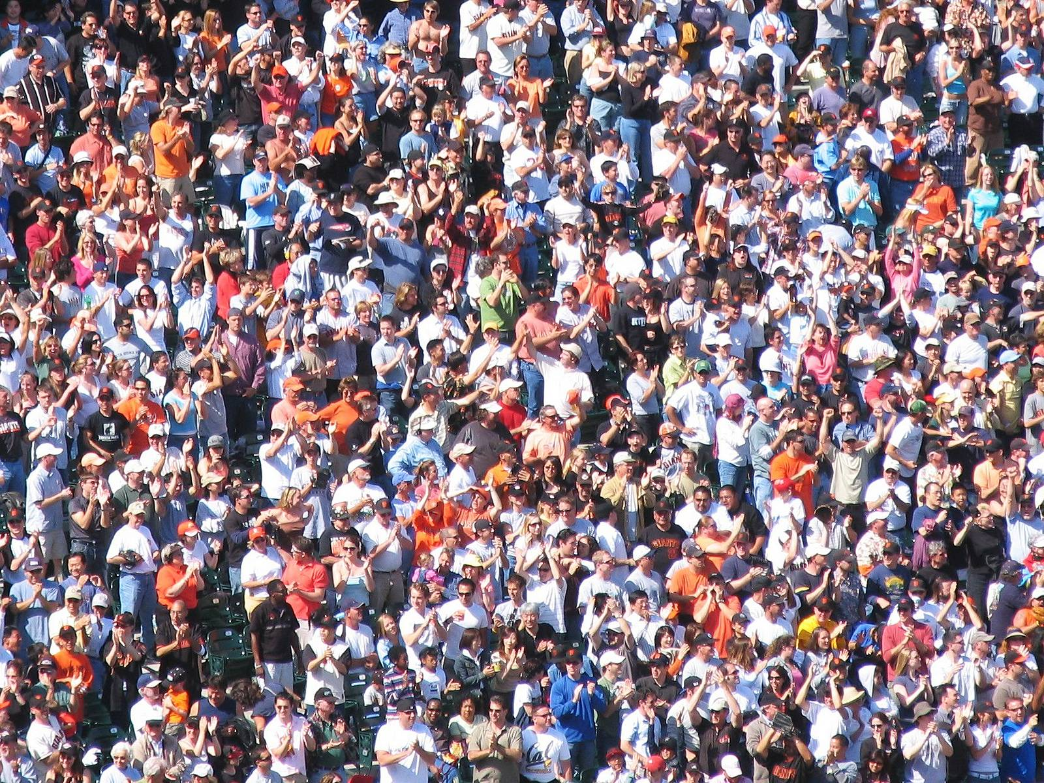

Slide 15
Anonymity Systems

Slide 16


Crypto (SSL)
Data Traffic
Content is unobservable
Due to encryption
Source and destination are trivially linkable
No anonymity!

Slide 17








Anonymizing Proxies
HTTPS Proxy
No anonymity!
Source is known
Destination anonymity
Destination is known
Source anonymity

Slide 18

Anonymizing VPNs
VPN Gateway
No anonymity!
Source is known
Destination anonymity
Destination is known
Source anonymity

Slide 19
Using Content to Deanonymize
HTTPS Proxy
Reading Gmail
Looking up directions to home
Updating your G+ profile
Etc…
No anonymity!
Fact: the NSA leverages common cookies from ad networks, social networks, etc. to track users

Slide 20
Data To Protect
Personally Identifiable Information (PII)
Name, address, phone number, etc.
OS and browser information
Cookies, etc.
Language information
IP address
Amount of data sent and received
Traffic timing

Slide 21
Some Crypto Background

Slide 22
Crypto Algorithms
Symmetric algorithms
Conventional algorithms
Encryption and decryption keys are the same
Examples: DES, 3DES, AES, Blowfish
Asymmetric algorithms
Commonly known as Public Key algorithms
Encryption key and decryption key are different
Examples: Diffie-Hellman, RSA, Elliptic curve

Slide 23
Symmetric Key Crypto
Let’s say we have a plaintext message M
… a symmetric encryption algorithm E
… and a key K
M → E(K, M) = C → E(K, C) = M
Advantages:
Fast and easy to use
Disadvantages
How to securely communicate the key?
Cyphertext C
Symmetric encryption is reversible

Slide 24
Public Key Crypto
Let’s say we have plaintext message M
… a public key algorithm F
… and two keys K_{P} (public) and K_{S} (private)
M → F(K_{P}, M) = C → F(K_{S}, C) = M
M → F(K_{S}, M) = C → F(K_{P}, C) = M
Encrypt with the public key…
Decrypt with the private key

Slide 25


Public Key Crypto in Action
K_{P}
<K_{P}, K_{S}>
K_{P}
Safe to distribute the public key K_{P}
Can only decrypt with the private key K_{S}
Computationally infeasible to derive K_{S} from K_{P}

Slide 26
Crowds

Slide 27
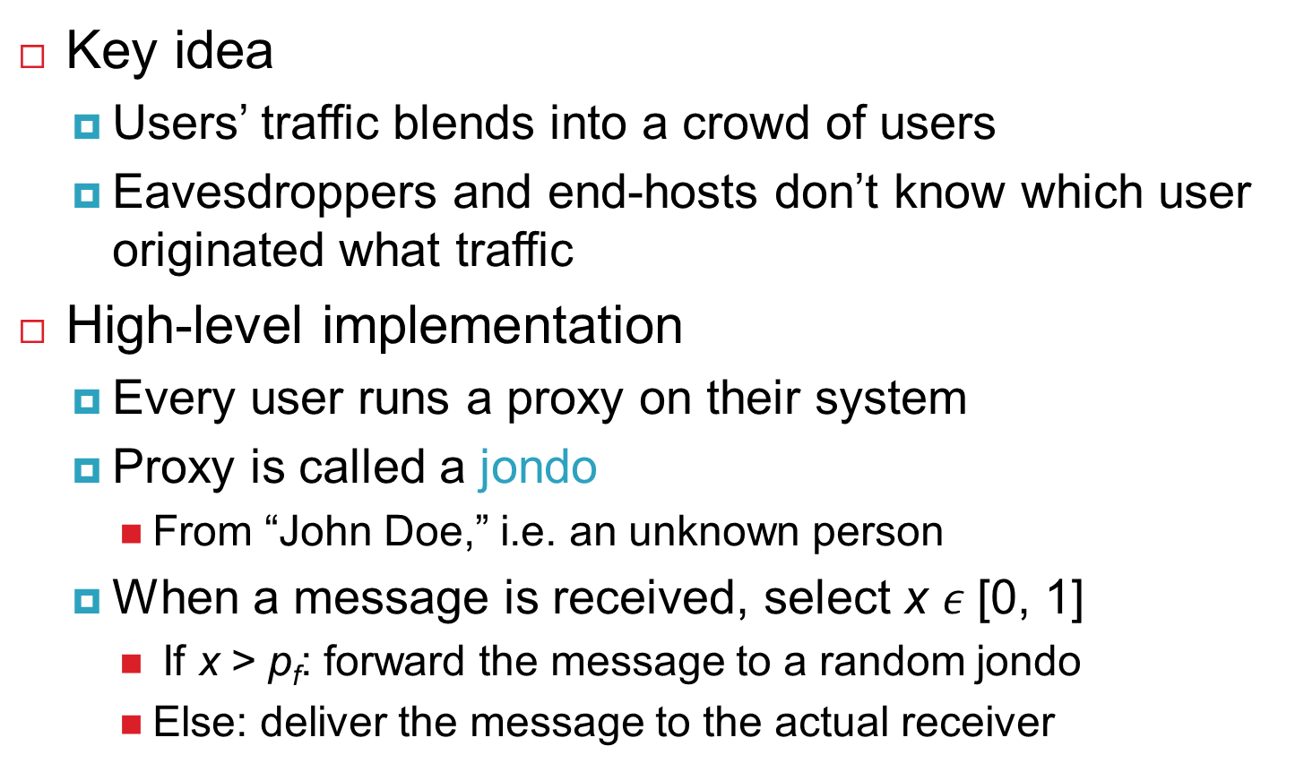
Crowds
Key idea
Users’ traffic blends into a crowd of users
Eavesdroppers and end-hosts don’t know which user originated what traffic
High-level implementation
Every user runs a proxy on their system
Proxy is called a jondo
From “John Doe,” i.e. an unknown person
When a message is received, select x [0, 1]
If x > p_{f}: forward the message to a random jondo
Else: deliver the message to the actual receiver

Slide 28
Crowds Example
Links between users use public key crypto
Users may appear on the path multiple times
Final Destination

Slide 29
Anonymity in Crowds
No source anonymity
Target receives m incoming messages (m may = 0)
Target sends m + 1 outgoing messages
Thus, the target is sending something
Destination anonymity is maintained
If the source isn’t sending directly to the receiver

Slide 30
Anonymity in Crowds
Source and destination are anonymous
Source and destination are jondo proxies
Destination is hidden by encryption

Slide 31
Anonymity in Crowds
Destination is known
Obviously
Source is anonymous
O(n) possible sources, where n is the number of jondos

Slide 32
Anonymity in Crowds
Destination is known
Evil jondo is able to decrypt the message
Source is somewhat anonymous
Suppose there are c evil jondos in the system
If p_{f} > 0.5, and n > 3(c + 1), then the source cannot be inferred with probability > 0.5

Slide 33
Other Implementation Details
Crowds requires a central server called a Blender
Keep track of who is running jondos
Kind of like a BitTorrent tracker
Broadcasts new jondos to existing jondos
Facilitates exchanges of public keys

Slide 34
Summary of Crowds
The good:
Crowds has excellent scalability
Each user helps forward messages and handle load
More users = better anonymity for everyone
Strong source anonymity guarantees
The bad:
Very weak destination anonymity
Evil jondos can always see the destination
Weak unlinkability guarantees

Slide 35
Mixes

Slide 36
Mix Networks
A different approach to anonymity than Crowds
Originally designed for anonymous email
David Chaum, 1981
Concept has since been generalized for TCP traffic
Hugely influential ideas
Onion routing
Traffic mixing
Dummy traffic (a.k.a. cover traffic)

Slide 37




Mix Proxies and Onion Routing
Encrypted Tunnels
Mix
[K_{P} , K_{P} , K_{P}]
<K_{P}, K_{S}>
<K_{P}, K_{S}>
<K_{P}, K_{S}>
<K_{P}, K_{S}>
<K_{P}, K_{S}>
<K_{P}, K_{S}>
<K_{P}, K_{S}>
<K_{P}, K_{S}>
E(K_{P} , E(K_{P} , E(K_{P} , M))) = C
Non-encrypted data
Mixes form a cascade of anonymous proxies
All traffic is protected with layers of encryption

Slide 38
Another View of Encrypted Paths
<K_{P}, K_{S}>
<K_{P}, K_{S}>
<K_{P}, K_{S}>

Slide 39
Return Traffic
In a mix network, how can the destination respond to the sender?
During path establishment, the sender places keys at each mix along the path
Data is re-encrypted as it travels the reverse path
<K_{P1} , K_{S1}>
K_{P1}
K_{P2}
K_{P3}
<K_{P2} , K_{S2}>
<K_{P3} , K_{S3}>

Slide 40



Traffic Mixing
Mix collects messages for t seconds
Messages are randomly shuffled and sent in a different order
Hinders timing attacks
Messages may be artificially delayed
Temporal correlation is warped
Problems:
Requires lots of traffic
Adds latency to network flows
Arrival Order
Send Order
1
1
4
2
2
3
3
4

Slide 41
Dummy / Cover Traffic
Simple idea:
Send useless traffic to help obfuscate real traffic

Slide 42
Tor
Well, not Thor!

Slide 43
Tor: The 2nd Generation Onion Router
Basic design: a mix network with improvements
Perfect forward secrecy
Introduces guards to improve source anonymity
Introduces sessions for long term communicatios
Takes bandwidth into account when selecting relays
Mixes in Tor are called relays
Introduces hidden services
Servers that are only accessible via the Tor overlay

Slide 44

Deployment and Statistics
Largest, most well deployed anonymity preserving service on the Internet
Publicly available since 2002
Continues to be developed and improved
Currently, ~5000 Tor relays around the world
All relays are run by volunteers
It is suspected that some are controlled by intelligence agencies
500K – 900K daily users
Numbers are likely larger now, thanks to Snowden

Slide 45

Celebrities Use Tor

Slide 46
How Do You Use Tor?
Download, install, and execute the Tor client
The client acts as a SOCKS proxy
The client builds and maintains circuits of relays
Configure your browser to use the Tor client as a proxy
Any app that supports SOCKS proxies will work with Tor
All traffic from the browser will now be routed through the Tor overlay

Slide 47
Selecting Relays
How do clients locate the Tor relays?
Tor Consensus File
Hosted by trusted directory servers
Lists all known relays
IP address, uptime, measured bandwidth, etc.
Not all relays are created equal
Entry/guard and exit relays are specially labelled
Why?
Tor does not select relays randomly
Chance of selection is proportional to bandwidth
Why? Is this a good idea?

Slide 48

Attacks Against Tor Circuits
Source: known
Dest: known
Source: known
Dest: unknown
Source: unknown
Dest: unknown
Source: unknown
Dest: known
Entry/
Guard
Middle
Exit
Tor users can choose any number of relays
Default configuration is 3
Why would higher or lower number be better or worse?

Slide 49
Predecessor Attack
Assumptions:
N total relays
M of which are controlled by an attacker
Attacker goal: control the first and last relay
M/N chance for first relay
(M-1)/(N-1) chance for the last relay
Roughly (M/N)² chance overall, for a single circuit
However, client periodically builds new circuits
Over time, the chances for the attacker to be in the correct positions improves!
This is the predecessor attack
Attacker controls the first and last relay
Probability of being in the right positions increases over time

Slide 50
Guard Relays
Guard relays help prevent attackers from becoming the first relay
Tor selects 3 guard relays and uses them for 3 months
After 3 months, 3 new guards are selected
Only relays that:
Have long and consistent uptimes…
Have high bandwidth…
And are manually vetted may become guards
Problem: what happens if you choose an evil guard?
M/N chance of full compromise

Slide 51
Hidden Services
Tor is very good at hiding the source of traffic
But the destination is often an exposed website
What if we want to run an anonymous service?
i.e. a website, where nobody knows the IP address?
Tor supports Hidden Services
Allows you to run a server and have people connect
… without disclosing the IP or DNS name
Many hidden services
Tor Mail, Tor Char
DuckDuckGo
Wikileaks
The Pirate Bay
Silk Road (2.0)

Slide 52

Hidden Service Example
Introduction Points
https://go2ndkjdf8whfanf4o.onion
Hidden
Service
Rendezvous Point
Onion URL is a hash, allows any Tor user to find the introduction points

Slide 53
Perfect Forward Secrecy
In traditional mix networks, all traffic is encrypted using public/private keypairs
Problem: what happens if a private key is stolen?
All future traffic can be observed and decrypted
If past traffic has been logged, it can also be decrypted
Tor implements Perfect Forward Secrecy (PFC)
The client negotiates a new public key pair with each relay
Original keypairs are only used for signatures
i.e. to verify the authenticity of messages
An attacker who compromises a private key can still eavesdrop on future traffic
… but past traffic is encrypted with ephemeral keypairs that are not stored

Slide 54
Discussion
Main challenges?
Performance
Scalability
Resourceful adversaries
…
Alternatives to Tor?
Peer-to-peer structures

Slide 55
Classes of Information Hiding
Digital watermarking
Steganography
Covert channels
Anonymous communication
Protocol obfuscation

Slide 56
Acknowledgements
Some of the slides, content, or pictures are borrowed from the following resources, and some pictures are obtained through Google search without being referenced below:
Most of the slides borrowed (with some changes) from Prof. Christo Wilson’s presentation in NEU CS4700

