Slide 1

Censorship Resistance: Parrots
Content may be borrowed from other resources.
See the last slide for acknowledgements!
Amir Houmansadr
CS660: Advanced Information Assurance
Spring 2015

Slide 2
Classes of Information Hiding
Digital watermarking
Steganography
Covert channels
Anonymous communications
Protocol obfuscation

Slide 3
Definition
Protocol obfuscation: Concealing the type of the underlying network protocol from a traffic monitoring entity

Slide 4
Why Hide the Protocol?
Bypass ISP restrictions:
BitTorrent blocked on campus
Skype blocked in some corporate networks
Bypass nation-state censorship (censorship circumvention):
Tor is blocked by various countries
VPN is blocked by the Great Firewall of China

Slide 5
Types of Protocol Obfuscation
De-identification: look like nothing
Impersonation: look like some other protocol

Slide 6
Internet Censorship

Slide 7
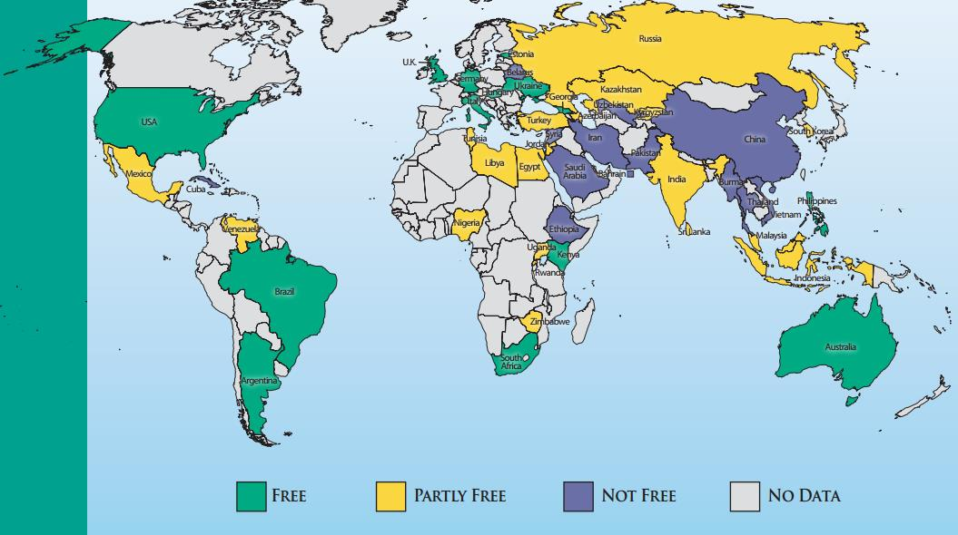

Slide 8



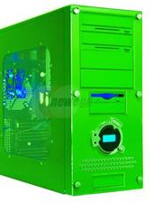
Censorship model
A.B.C.D
X
Gateway
(IP=A.B.C.D)
The Non-Democratic
Republic of
Repressistan
Notes:
Repressistan

Slide 9






Censorship circumvention

Slide 10


Using Tor for circumvention
Easily recognizable
at the network level
Deep Packet Inspection
(DPI)
Tor Network
Gateway
Tor Bridge
Active probes
Insider attacks
Not effective anymore!
Blocked
Destination
The Non-Democratic
Republic of
Repressistan
Notes:
Is a complex network of proxies
+ add survivability

Slide 11
Challenge!
We need unobservable circumvention
Censors should not be able to easily identify circumvention traffic or end-hosts through passive, active, or proactive techniques

Slide 12

Hide and seek!
Gateway
Tor Network
Gateway
Tor Bridge
Gateway
Blocked
Destination
Gateway
Gateway
The Non-Democratic
Republic of
Repressistan
Notes:
Regain, reclaim, restore

Slide 13
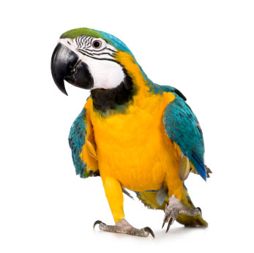
Parrot systems
Imitate a popular protocol
SkypeMorph (CCS’12)
StegoTorus (CCS’12)
CensorSpoofer (CCS’12)

Slide 14



SkypeMorph (CCS’12)
Tor Network
SkypeMorph
Client
SkypeMorph
Bridge
Blocked
Destination
Traffic Shaping
Skype Client
The Non-Democratic
Republic of
Repressistan
Notes:
Repressistan

Slide 15


StegoTorus
The Internet
Censorship Region
HTTP
HTTP
Skype
StegoTorus
Client
StegoTorus
Bridge
A Tor node
Ventrilo
HTTP

Slide 16


CensorSpoofer
The Internet
Censorship Region
SIP
server
Spoofer
Censored
destination
RTP downstream
RTP upstream
CensorSpoofer
Client
Dummy
host

Slide 17

The Parrot is Dead: Observing Unobservable Network Communications
Amir Houmansadr, Chad Brubaker, Vitaly Shmatikov
IEEE S&P (Oakland) 2013
Received the Best Practical Paper Award

Slide 18
Detecting SkypeMorph
Tor Network
Tor Bridge
Blocked
Destination
SOM
TCP control stream
The Non-Democratic
Republic of
Repressistan
Notes:
Colors, blue for skype, others red. Circle users on the top. Tor link not red

Slide 19

No, no..... no,
'e's stunned!

Slide 20
SkypeMorph+
Let’s imitate the missing parts!
Problem: hard to mimic dynamic behavior in response to active tests

Slide 21
Dropping UDP packets

Slide 22
Other tests
Test | Skype | SkypeMorph+
Flush Supernode cache | Serves as a SN | Rejects all Skype messages
Drop UDP packets | Burst of packets in TCP control | No reaction
Close TCP channel | Ends the UDP stream | No reaction
Delay TCP packets | Reacts depending on the type of message | No reaction
Close TCP connection to a SN | Initiates UDP probes | No reaction
Block the default TCP port | Connects to TCP ports 80 and 443 | No reaction

Slide 23
Now that's what
I call a dead parrot.

Slide 24
Unobservability by imitation is
fundamentally flawed!
Notes:
Not the list
Bugs, implementation quirks, …
Mention lessons from other fileds

Slide 25
Perfect imitation of a complex real system is extremely hard
Not enough to mimic a "protocol," need to mimic
a specific implementation with all its quirks
A complex protocol in it entirety
Inter-dependent sub-protocols with
complex, dynamic behavior
Bugs in specific versions of the software
User behavior
Notes:
We not only need to mimic all the details and dynamic dependencies and behavior, but we should also imitat a specific imple
Lessones learned in other areas of CS

Slide 26
So, what is the real problem?
Notes:
Imititiating is hard, lets find things that are alreafy popular, and already have channels to outisde repressistan. What could that pipe be? We have lots of candidates, github, cloud, video streaming. __> titile they don’t block the, because collateral damage. How do we
All previous attemps based on making your own tunnel, lets find an existing tunnel
It’s indistiniguishable from real torrent, because it’s the real tunnel

Slide 27
X
Tor (and its flavors)
Tor relays
Custom tunnels are easy to recognize!
X
Ultrasurf
Ultrasurf
proxies
X
Psiphon
Psiphon
proxies
The Non-Democratic
Republic of
Repressistan
Notes:
Circm systems design new protocols that work as tunnels to exchange data between cens users and blocked destinations.
However, these tunnels are detected and compromised after some time, so they need to frequently improve/complicate themselves.
However, there are already tunnels used for other communicatiosn, such as voip… that are not blocked, and are used to exchange other types of informmation.
Why not using these Tunnels to exchange circumvtion data?

Slide 28
Wait! We already have
lots of encrypted tunnels!

Slide 29
Cloud storage
Cloud servers
(e.g., Amazon EC2)
Email
Email servers
(e.g., Gmail)
VoIP
VoIP servers
(e.g., Skype)
Tor
File sharing
File hosts
(e.g., BitTorent)
Online games
Gaming servers
(e.g., Warcraft)
The Non-Democratic
Republic of
Repressistan
Notes:
Circm systems design new protocols that work as tunnels to exchange data between cens users and blocked destinations.
However, these tunnels are detected and compromised after some time, so they need to frequently improve/complicate themselves.
However, there are already tunnels used for other communicatiosn, such as voip… that are not blocked, and are used to exchange other types of informmation.
Why not using these Tunnels to exchange circumvtion data?

Slide 30
Hide-within circumvention (or, parasites!)
Notes:
Imititiating is hard, lets find things that are alreafy popular, and already have channels to outisde repressistan. What could that pipe be? We have lots of candidates, github, cloud, video streaming. __> titile they don’t block the, because collateral damage. How do we
All previous attemps based on making your own tunnel, lets find an existing tunnel
It’s indistiniguishable from real torrent, because it’s the real tunnel

Slide 31
Definition
Tunneling circumvention traffic through a popular service provider via an allowed, already deployed network protocol
Notes:
Infranet: its operation is not independent of network entities.
Collage: it is not in the applciation layer (hence, high latency)

Slide 32
I Want My Voice to Be Heard: IP over Voice-over-IP for Unobservable Censorship Circumvention
Amir Houmansadr, Thomas Riedl , Nikita Borisov, Andrew Singer
NDSS 2013

Slide 33
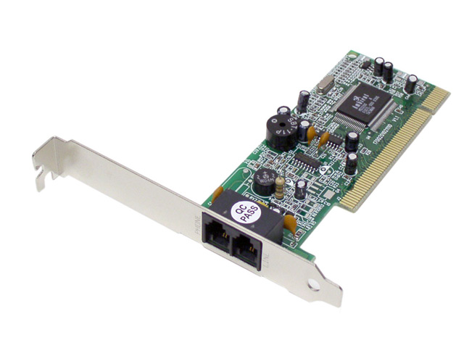
FreeWave: IP over Voice-over-IP
Target protocol: Voice-over IP (VoIP)
Why VoIP
Widely used
Encrypted
Many VoIP provider options
How to hide?
The dial-up modems are back!

Slide 34

FreeWave architecture
Tor Network
X
Gateway
Tor Bridge
Blocked
Destination
34
The Non-Democratic
Republic of
Repressistan

Slide 35

System components

Slide 36
MoDem component
A typical acoustic modem
QAM modulation
Reliable transmission
Turbo codes
Use Preambles

Slide 37
Unobservability

Slide 38
Unobservability in hide-within
Hide-within systems
7. Application
6. Presentation | Data
5. Session
4. Transport | Segments
3. Network | Packet/Datagram
2. Data link | Bit/Frame
1. Physical | Bit
Parrot systems
The OSI model
Notes:
BOXES around layers

Slide 39


Costs of censorship
More resource-intensive
Slower
More false positives
Hide-within
Machine learning
Statistical analysis
Proactive probing
Active probing
Inspecting protocol signatures
Inspecting keywords
IP filtering
Traditional systems
Cheap and fast
Doable at line speed
Very accurate
Notes:
Spectrum of censorship techniques
Exhaust the censors resources

Slide 40
Some of the tools used to analyze the attacks
Probability theory to model types of traffic
E.g., Chernoff bound, stochastic processes
Detection and estimation theory to distinguish instances of a traffic type
E.g., hypothesis testing, LRT tests
Statistics to find deviations from a type
E.g., K-S test, Q-Q plot
Information theory to derive the bounds of deviation
Notes:
Machine learning classifiers (fuzzy clustering)

Slide 41
Unique properties of hide-within systems

Slide 42
1. Resistant to partial compromise

Slide 43
Tor
X
Gateway
Tor Network
X
Gateway
Tor Bridge
X
Gateway
Blocked
Destination
43
Detecting one user makes it
easier to detect other users
The Non-Democratic
Republic of
Repressistan

Slide 44
Hide-within
Circumvention user
X
Circumvention user
Oblivious
server
Tor
Benign user
Benign user
Detecting one user
does not help
detect others
The Non-Democratic
Republic of
Repressistan

Slide 45



FreeWave
Gateway
Tor Network
X
Gateway
FreeWave
Tor Bridge
Gateway
Blocked
Destination
45
Gateway
Gateway
The Non-Democratic
Republic of
Repressistan

Slide 46
This is a big step forward!

Slide 47
2. Censorship causes collateral damage

Slide 48
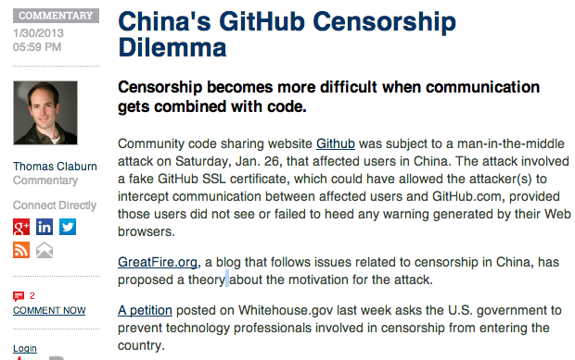
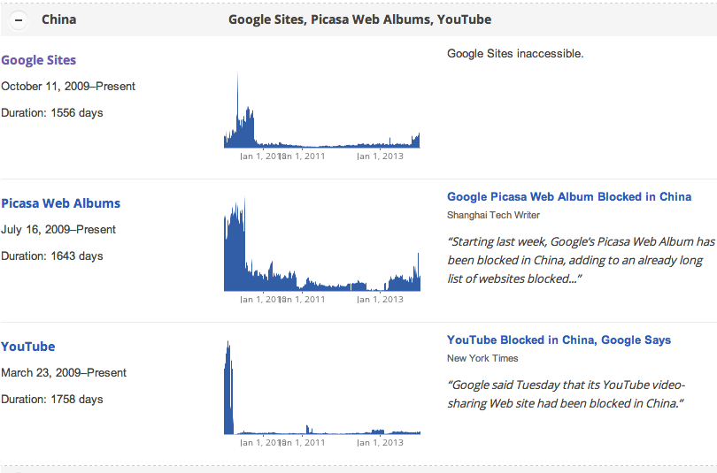
Censors are rational!

Slide 49
Tor
X
Gateway
Tor Network
X
Gateway
Tor Bridge
X
Gateway
Blocked
Destination
49
Censoring Tor bridges has
zero impact on benign users
The Non-Democratic
Republic of
Repressistan

Slide 50
Hide-within
X
Circumvention user
X
X
Circumvention user
X
Oblivious
server
Tor
Benign user
X
Benign user
Censoring
disrupts benign users as well
The Non-Democratic
Republic of
Repressistan

Slide 51
FreeWave
X
Gateway
Tor Network
X
Gateway
FreeWave
Tor Bridge
X
Gateway
X
Gateway
Blocked
Destination
51
X
Gateway
Censoring FreeWave bridges
disrupts benign users as well
(collateral damage)
The Non-Democratic
Republic of
Repressistan

Slide 52
This is another big step forward!

Slide 53
Challenge:
designing efficient hide-within systems

Slide 54
Hide-within designs
FreeWave v2
Encode directly in video stream
Bandwidth and latency sufficient for interactive web browsing
Additional hide-within designs:
SWEET (Email)
CloudTransport (Cloud services)
Under development:
BitTorrent

Slide 55
Acknowledgement
Some pictures are obtained through Google search without being referenced

