Slide 1

Privacy-preserving Services: Social Networks
Content may be borrowed from other resources.
See the last slide for acknowledgements!
Amir Houmansadr
CS660: Advanced Information Assurance
Spring 2015

Slide 2
Online Social Networks (OSN)
Online Web services connecting people to socialize
Find friends, make friends
Follow celebrities and companies
Join groups
Share photos, videos
Communicate via messages, live chats
Etc.

Slide 3
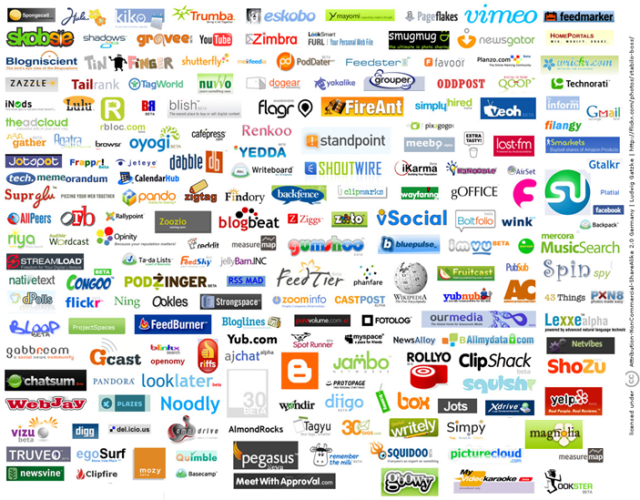

Slide 4
OSN Popularity
Over 900 million Facebook users worldwide
Over 150 million in U.S.
Over 450 million access via mobile
300 million pictures uploaded to Facebook daily
Over 140 million Twitter users; over 340 million Tweets sent daily
Over 175 million LinkedIn members in over 200 countries
Statistics from 2012

Slide 5
Privacy Issues in OSNs

Slide 6
Challenges of Privacy in OSNs
Protect user data from:
Other users/people
Friends, FOF, general public
Protection provided by most OSNs
Applications
Right to use user data?
What data?
OSN providers
Benefit in examining and sharing
Pressure from censors

Slide 7
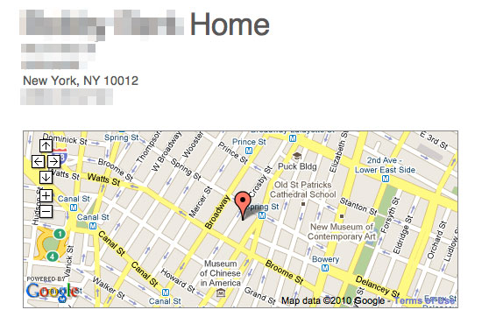



Privacy leakage instances
Information posted on OSNs is generally public
Unless you set privacy settings appropriately
“I’ll be on vacation” post plus geolocation invites burglars, i.e., “Please Rob Me”
Indiscreet posts can lead to nasty consequences

Slide 8
Privacy leakage instances
Employers, insurers, college admissions officers, et al. already screen applicants using OSNs
Recent report from Novarica, research consultancy for finance and insurance industries:
“We can now collect information on buying behaviors, geospatial and location information, social media and Internet usage, and more…Our electronic trails have been digitized, formatted, standardized, analyzed and modeled, and are up for sale. As intimidating as this may sound to the individual, it is a great opportunity for businesses to use this data.”

Slide 9
Privacy leakage instances
Posts that got people fired:
Connor Riley: “Cisco just offered me a job! Now I have to weigh the utility of a [big] paycheck against the daily commute to San Jose and hating the work.”
Tania Dickinson: compared her job at New Zealand development agency to “expensive paperweight”
Virgin Atlantic flight attendants who mentioned engines replaced 4 times/year, cabins with cockroaches
Recent pizza girl got fired before starting the first day!

Slide 10
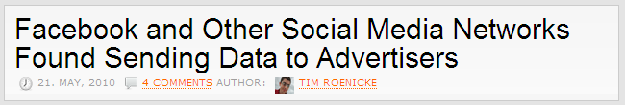
Privacy leakage instances
OSNs don’t exactly safeguard posted info…
Facebook
“You hereby grant Facebook an irrevocable, perpetual, non-exclusive, transferable, fully paid, worldwide license (with the right to sublicense) to (a) use, copy, publish, stream, store, retain, publicly perform or display, transmit, scan, reformat, modify, edit, frame, translate, excerpt, adapt, create derivative works and distribute (through multiple tiers), any User Content you (i) Post on or in connection with the Facebook Service or the promotion thereof subject only to your privacy settings or (ii) enable a user to Post, including by offering a Share Link on your website and (b) to use your name, likeness and image for any purpose, including commercial or advertising, each of (a) and (b) on or in connection with the Facebook Service or the promotion thereof. You may remove your User Content from the Site at any time. If you choose to remove your User Content, the license granted above will automatically expire, however you acknowledge that the Company may retain archived copies of your User Content.”
LinkedIn
Additionally, you grant LinkedIn a nonexclusive, irrevocable, worldwide, perpetual, unlimited, assignable, sublicenseable, fully paid up and royalty-free right to us to copy, prepare derivative works of, improve, distribute, publish, remove, retain, add, process, analyze, use and commercialize, in any way now known or in the future discovered, any information you provide, directly or indirectly to LinkedIn, including but not limited to any user generated content, ideas, concepts, techniques or data to the services, you submit to LinkedIn, without any further consent, notice and/or compensation to you or to any third parties. Any information you submit to us is at your own risk of loss.

Slide 11
Privacy-preserving OSNs: Decentralized Systems

Slide 12
Persona
Decentralized structure
Encrypt by group without many copies
Precise Group control mechanism
Groups created by one user should be available for use, both in enc/dec by friends
Can be added onto existing applications

Slide 13
Group Key Management
Data is encrypted with attribute-based encryption, any user could retrieve the data, but can decrypt it only if he’s a member of the group.
Each Persona user is identified by a single public key, and stores their encrypted data in storage service. Users exchange public key and storage locations out of band

Slide 14
Revocation
Removing a member requires re-keying
Data encrypted with old key stays visible to revoked member
Notes:
All remaining group members must be given a new key

Slide 15
EASiER
Encryption-based Access Control in Social Networks with Efficient Revocation
Using a minimal trusted proxy in decryption
Enforce revocation constraints
Proxy cannot perform decryption or grant access
Notes:
Can be implemented by a centralized service with minimal risk

Slide 16
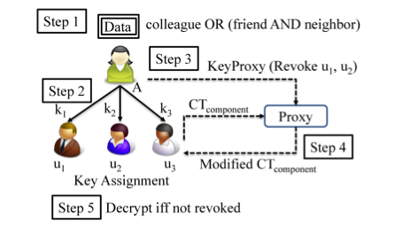
EASiER

Slide 17
Frientegrity
See Slides Here

Slide 18
Acknowledgement
Some of the slides, content, or pictures are borrowed from the following resources, and some pictures are obtained through Google search without being referenced below:
Adam C. Champion and Dong Xuan, Social Networking Security
Dan Zhang’s presentation at CS691

