Slide 1
Data Acquisition and Web Scraping
MSA 8040: Data Management for Analytics
Houping Xiao
hxiao@gsu.edu

Slide 2
Overview
Data Management for Analytics
Section 1:
Introduction
Section 2:
MySQL
Section 3:
NoSQL
Section 4:
Web Scraping
Section 5:
Text Mining
Work Based Projects
Database
concepts
Design concepts
MySQL
Functions
Operators
NoSQL
Types
Pro & Con
Beautiful Soup
Regular
expression
Unstructured
data
Textual data
ER model
ER diagrams’
Normalization
MongoDB
CURD
Aggregation
Selenium
Navigating
Locating
elements
Topic Modeling
LDA
Dynamic LDA
SQL
Statement
syntax
Advanced SQL
Procedure
Trigger
Sentiment analysis
Neural network
SVM
Decision tree
Relational model
Twitter API
From Query to Analytics

Slide 3
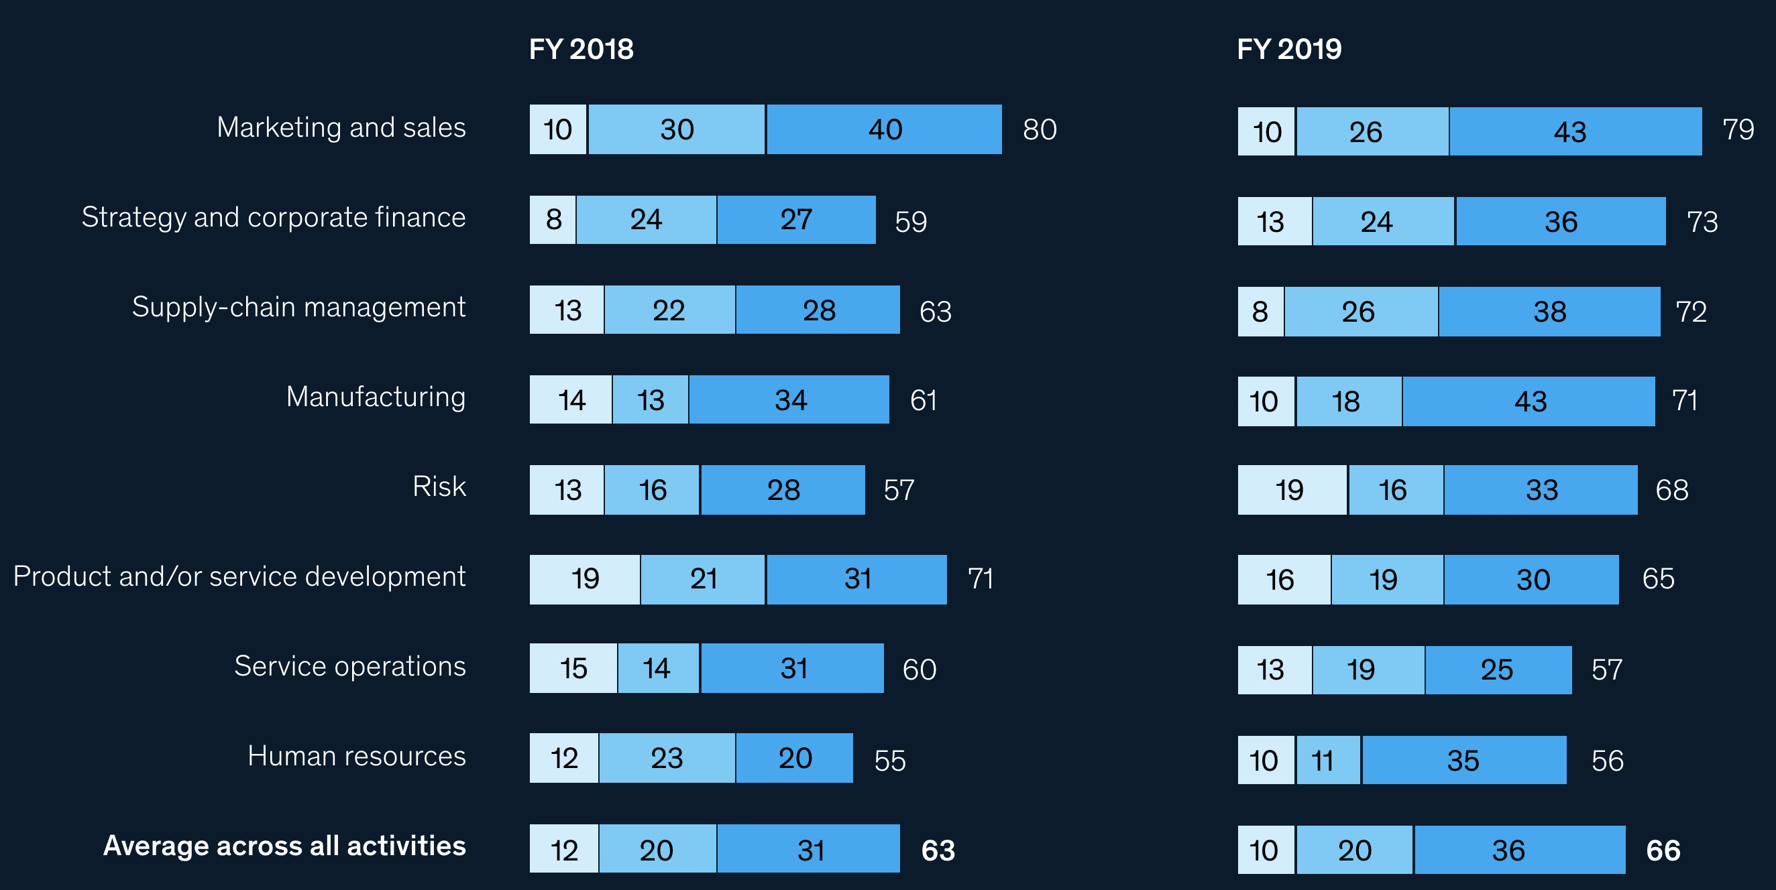
Machine Learning and Deep Learning in Industry
Revenue increase from AI adoption by function, % of respondents
https://www.mckinsey.com/business-functions/mckinsey-analytics/our-insights/global-survey-the-state-of-ai-in-2020

Slide 4
Machine Learning Applications in Industry
Retail:
Recommendation, chatbot, demand forecasting
Healthcare:
Heart failure prediction, disease identification
Finance:
Fraud detection, Portfolio management
Automobile:
self-driving

Slide 5
Machine Learning Workflow & Challenges
Monitor Model Performance
More data?
New models?
Problem Formulation
Data Collection & Data Process
Model Training & Model Fine-Tuning
Model Deployment
Most impactful industrial problems
High-quality data is scarce
Privacy issues
Model complexity
Data-hungry
Model with high complexity not suitable for real-time inference

Slide 6
Flow Chart for Data Acquisition
Machine Learning Application
Generate Data
Generation methods, GAN
Having enough data?
Are there external datasets available?
Web Scraping
No
No
Yes
Yes
Deal with raw data!
Model Selections
Kaggle
Google
Open Data AWS

Slide 7
Web Scraping
The goal is to extract data from website
Converting unstructured documents into structured information
Many datasets are obtained by web scraping, such as ImageNet
Web scrawling
Indexing whole pages on Internet
Web scraping
Scraping the particular data from web pages of a website

Slide 8
Legal Consideration
Web scraping isn’t illegal by itself
But you should
NOT scrape data have sensitive information (e.g., private data involving username, password, personal health or medical information)
NOT scape. Copyrighted data (e.g., YouTube videos, Flickr photos)
Follow the Terms of Service that explicitly prohibits web scraping
Always consult a lawyer if you are doing it for profit
Both the department and I will not be responsible for your action if you use Web Scraping Illegally!

Slide 9
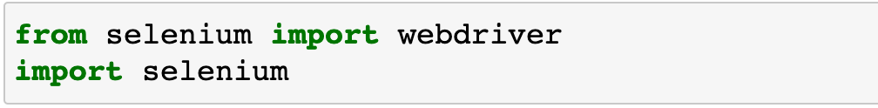
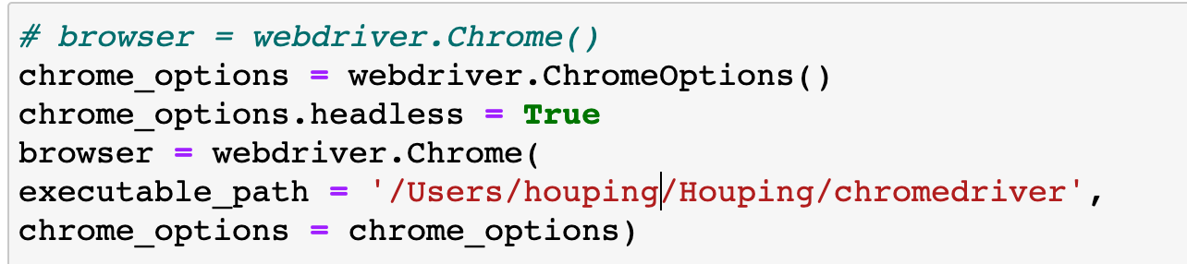
Tools
CURL often doesn’t work, as website owners use various ways to stop bots
Solution: use headless browser
A web browser without a GUI
May need lots of IPs

Slide 10
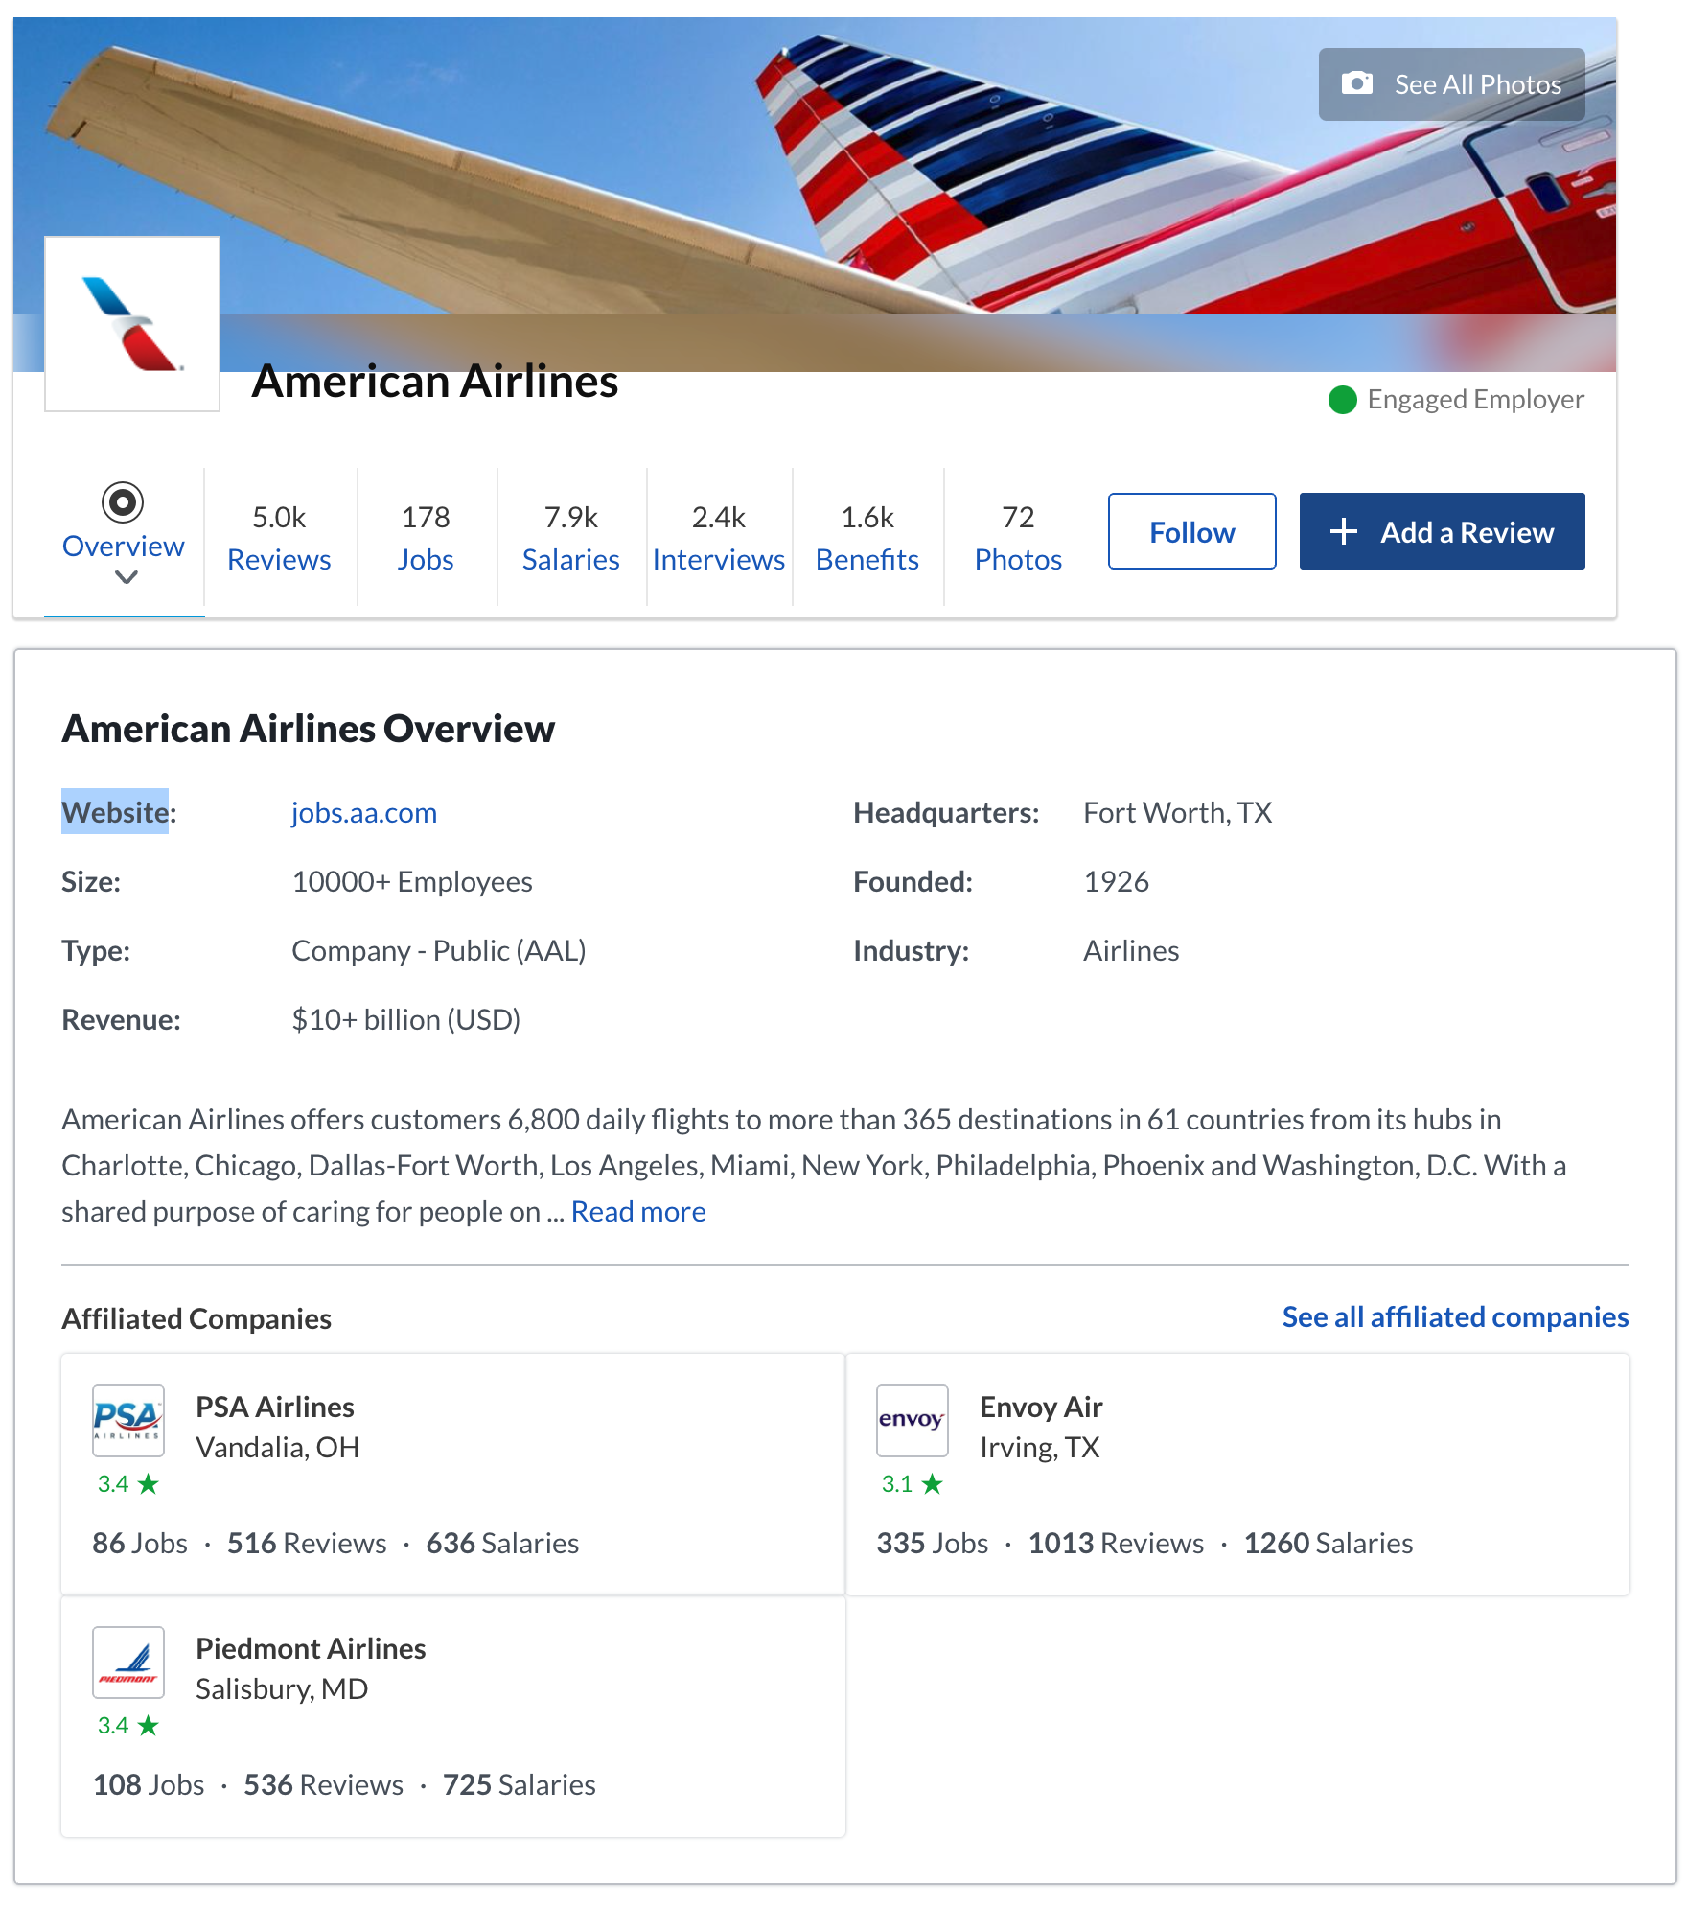
Case Study
Query company information
https://www.glassdoor.com/Overview/Working-at-Aon-EI_IE53.11,14.htm
You can replace the company name in the URL for other company’s information

Slide 11
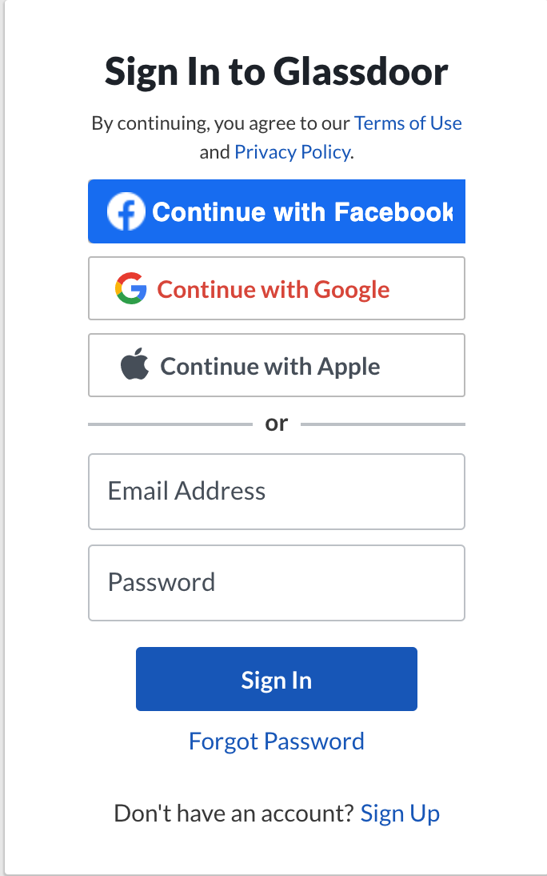
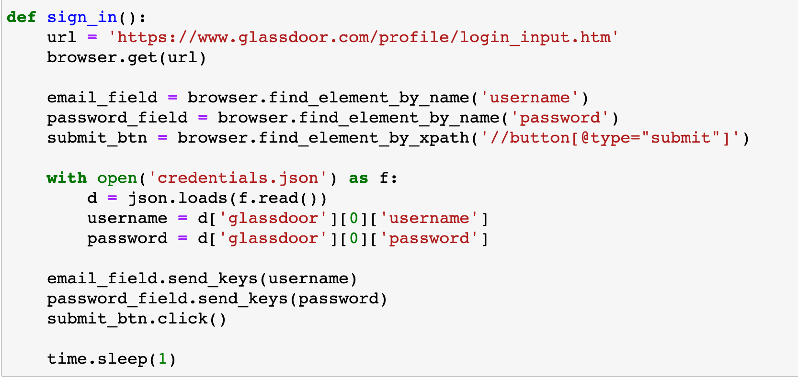
Sign In
Sign in to Glassdoor using your username and password
{"glassdoor":
[{"username": ”xxxx@gmail.com",
"password": ”sssssss"}]}

Slide 12
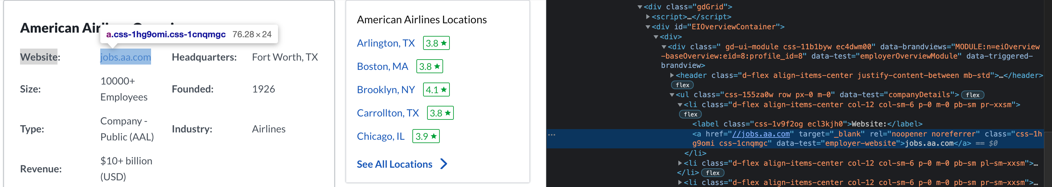
Data Extraction
Identify the HTML elements through Inspect

Slide 13
Locating Elements
There are various strategies to locate elements in a page.
find_element_by_id: return only the first matched element
Return a list of matched elements
find_element_by_name
find_element_by_xpath
find_element_by_tag_name
find_element_by_class_name
find_element_by_link_text
find_element_by_partial_link_text
find_element_by_css_selector

Slide 14
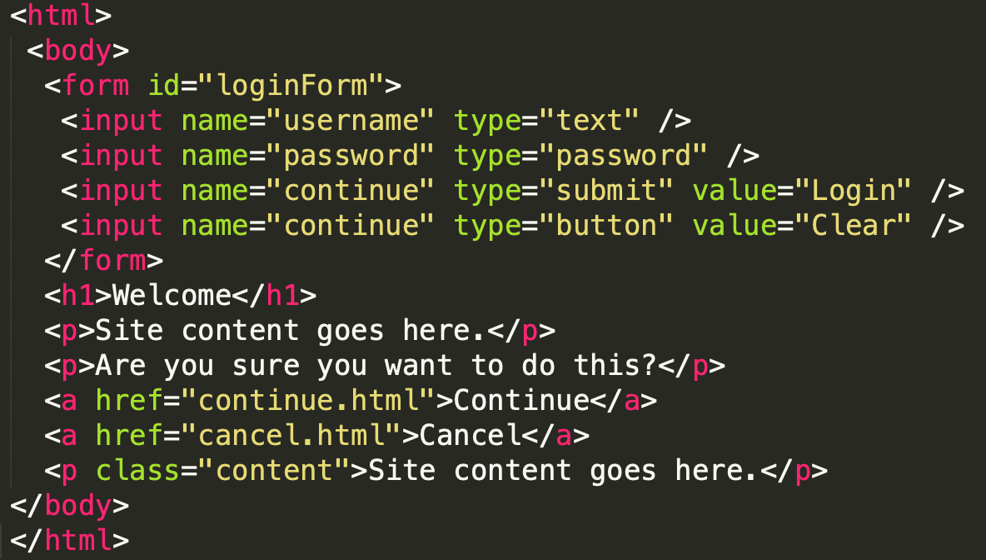
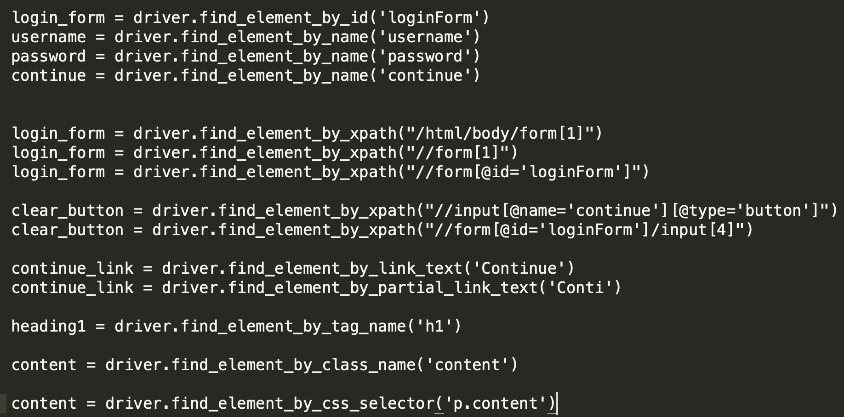
Example

Slide 15
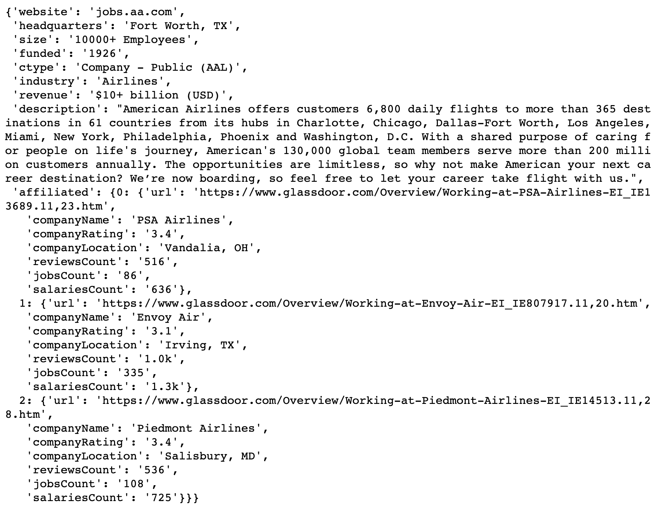
Data Extraction
Repeat the previous process to extract other field data

Slide 16
Be cautious to use it
properly and legally!

Slide 17
