Slide 1
Relational Model; Relational Algebra
MSA 8040: Data Management for Analytics
Houping Xiao
hxiao@gsu.edu

Slide 2
Overview
Data Management for Analytics
Section 1:
Introduction
Section 2:
MySQL
Section 3:
NoSQL
Section 4:
Web Scraping
Section 5:
Text Mining
Work Based Projects
Database
concepts
Design concepts
MySQL
Functions
Operators
NoSQL
Types
Pro & Con
Beautiful Soup
Regular
expression
Unstructured
data
Textual data
ER model
ER diagrams’
Normalization
MongoDB
CURD
Aggregation
Selenium
Navigating
Locating
elements
Topic Modeling
LDA
Dynamic LDA
SQL
Statement
syntax
Advanced SQL
Procedure
Trigger
Sentiment analysis
Neural network
SVM
Decision tree
Relational model
Twitter API
From Query to Analytics

Slide 3
The Relational Model

Slide 4
Why Study the Relational Model?
Most widely used model
Vendors: IBM, Microsoft, Oracle, Sybase, etc.
Referred to as a legacy systems
Recent competitor: object-oriented model
ObjectStore, Versant, ONTOS
A synthesis emerging:
Informix Universal Server, UniSQL, O2, Oracle, DB2

Slide 5
Relational Database: Definitions
Relational database: a set of relations (e.g., tables)
Relation (table):
Instance: a table, with rows (tuple) and columns (fields or attributes)
Schema: specifies name of relation, name and type of each column
E.g., Student(stu_num: integer, stu_lname: string, stu_fname: string, stu_init: string, stu_dob: date, stuhrs: integer, stu_class: string, stu_gpa: decimal, stu_transfer: string, dept_code: string, stu_phone: integer, prof_num: integer)

Slide 6
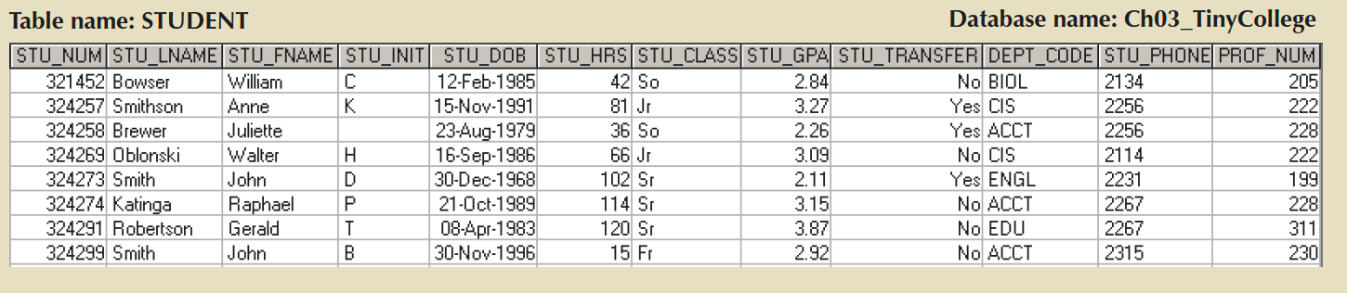
What are Components of A Relation (Table)?
Abstract Table
(STU_NUM, STU_LNAME, STU_FNAME, STU_INIT, STU_DOB, STU_HRS, STU_CLASS,
STU_GPA, STU_TRANSFER, DEPT_CODE, STU_PHONE, PROF_NUM)

Slide 7
What are Components of A Relation (Table)?
Two-dimensional structure
Distinct name
Domain
An attribute
Unique identifiers (keys)
Tuple: a single entity occurrence
Concrete Table
A single data value
The Order of rows doesn’t matter
Abstract Table
(STU_NUM, STU_LNAME, STU_FNAME, STU_INIT, STU_DOB, STU_HRS, STU_CLASS,
STU_GPA, STU_TRANSFER, DEPT_CODE, STU_PHONE, PROF_NUM)

Slide 8
Integrity Constraints
Integrity Constraints: condition that must be true for any instance of the database; e.g., domain constraints
Integrity Constraints are specified when schema is defined
Integrity Constraints are checked when relations are modified

Slide 9
How many types of Keys and what are they?
(STU_NUM, STU_LNAME,STU_FNAME,STU_INIT,STU_DOB,STU_HRS,STU_CLASS,
STU_GPA,STU_TRANSFER,DEPT_CODE,STU_PHONE,PROF_NUM)
Super Key
Primary Key
Composite Key
Candidate Key
Foreign Key

Slide 10
Primary Key Constraints
A set of fields is a key for a relation if:
No two distinct tuples can have same values in all key fields, and
This is not true for any subset of the key.
Part 2 false? A super key
If there is more than one key for a relation, one of the keys is chosen (by DBA) to be the primary key.
For instance, STU_NUM is a key for Students.
What about STU_LNAME?
What about (STU_NUM, STU_GPA)?

Slide 11
Entity Integrity
Requirement: condition that each row in the table has its own unique identity
All primary key entries are unique, and
No part of a primary key may be null
Purpose: Each row will have a unique identity, and foreign key values can properly reference PK values
Example:
No student can have a duplicate student number, nor can it be null

Slide 12
Foreign Keys, Referential Integrity
Foreign key: set of fields in one relation that is used to “refer” to a tuple in another relation
Like a ”logical pointer”
must correspond to primary key of the second relation
For instance, STU_NUM is a foreign key in Enrollment, referring to Students
Enrollment(STU_NUM: integer, COURSE_NUM: string, GRADE: string)
If all foreign key constraints are enforced, referential integrity is achieved, i.e., no dangling references

Slide 13
Enforcing Referential Integrity
E.g., Only students listed in the Students relation should be allowed to enroll for courses
STU_NUM in Enrollment is a foreign key that references Students
What should be done if an Enrolled tuple with a non-existent student num is inserted?
What should be done if a Students tuple is deleted?
Also delete all Enrollment tuples that refer to it
Disallow deletion of a Students tuple that is referred to
Set STU_NUM in Enrollment tuples that refer to it to a default value, such as NULL

Slide 14
Referential Integrity
Requirement: A foreign key may have either a null entry, if it is not a part of its table’s PK, or an entry that matches the PK value in a table to which it is related
Purpose:
An attribute can have a corresponding null value but cannot have an invalid entry
Cannot delete a row in one table whose PK has mandatory matching foreign key values in another table

Slide 15
Relational Algebra

Slide 16
Relational Query Languages
Query languages: Allow manipulation and retrieval of data from a database
Relational model supports simple, powerful query languages:
Strong formal foundation based on logic
Allows for much optimization
Relational Algebra: a mathematical query languages form the basis for “real” languages (e.g., SQL), and for implementation
More operational, very useful for representing execution plans

Slide 17
Preliminaries
A query is applied to relation instances, and the result of a query is also a relation instance
Schemas of input relations for a query are fixed
The schema for the result of a given query is also fixed; determined by definition of query language constructs

Slide 18
Example Instances
“Sailors” and “Reserves” relations for our examples
S1
sid | sname | rating | age
22 | dustin | 7 | 45.0
31 | lubber | 8 | 55.5
58 | rusty | 10 | 35.0
R1
sid | bid | date
22 | 101 | 10/10/96
58 | 103 | 11/12/96
S2
sid | sname | rating | age
28 | yuppy | 9 | 35
31 | lubber | 8 | 55.5
44 | groppy | 5 | 35.0
58 | rusty | 10 | 35.0

Slide 19
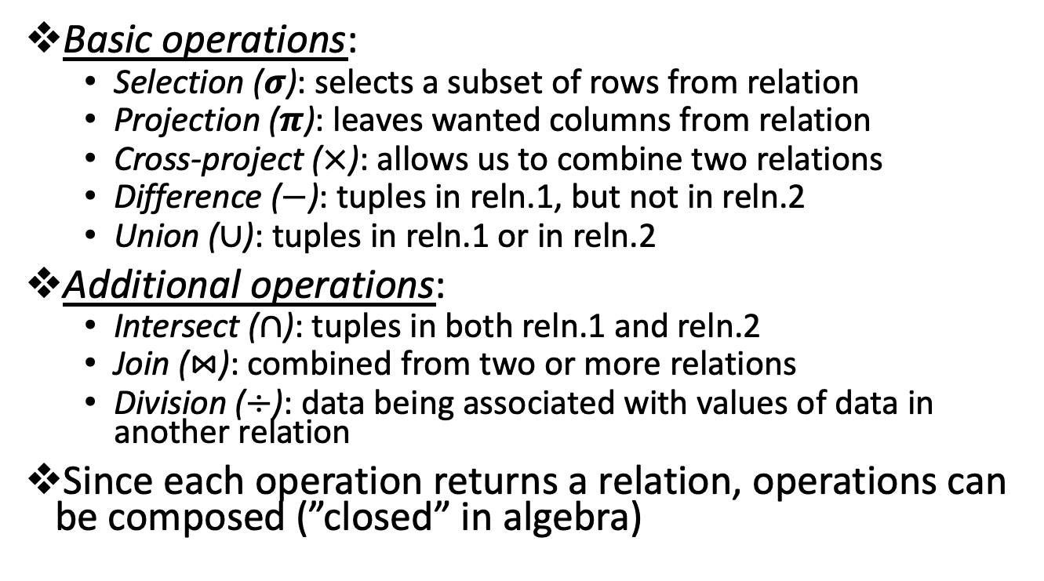
Relational Algebra
Basic operations:
Selection ($σ$): selects a subset of rows from relation
Projection ($π$): leaves wanted columns from relation
Cross-project ($×$): allows us to combine two relations
Difference ($−$): tuples in reln.1, but not in reln.2
Union ($∪$): tuples in reln.1 or in reln.2
Additional operations:
Intersect ($∩$): tuples in both reln.1 and reln.2
Join ($⋈$): combined from two or more relations
Division ($÷$): data being associated with values of data in another relation
Since each operation returns a relation, operations can be composed (”closed” in algebra)

Slide 20



Projection $π_{projection_list}$
sname | rating
yuppy | 9
lubber | 8
groppy | 5
rusty | 10
Yields attributes in projection list
Schema of result contains exactly the fields in the projection list, with the same names that they had in the input relation
Later we can rename the attributes
Projection operator has to eliminate duplicates!
Note: real systems typically don’t do duplicate elimination unless the user explicitly asks for it.
Using “distinct”
$π_{sname,rating}(S2)$
age
55.5
35.0
$π_{age}(S2)$

Slide 21



Selection $σ_{condition}$
Selects rows that satisfy selection condition
No duplicates in result!
Schema of result identical to that of input relation
Result relation can be the input for another relation algebra operation! (operator composition)
sid | sname | rating | age
28 | yuppy | 9 | 35
58 | rusty | 10 | 35.0
$σ_{rating≥9}(S2)$
sname | rating
yuppy | 9
rusty | 10
$π_{sname,rating}(σ_{rating≥9}\left(S2\right))$

Slide 22



Union, Intersect, Difference
All of these operations take two input relations, which must be union-compatible:
Same number of fields
“corresponding” fields have the same type
What is the schema of result?
sid | sname | rating | age
22 | dustin | 7 | 45.0
31 | lubber | 8 | 55.5
58 | rusty | 10 | 35.0
44 | groppy | 5 | 35.0
28 | yuppy | 9 | 35.0
$S1∪S2$
sid | sname | rating | age
31 | lubber | 8 | 55.5
58 | rusty | 10 | 35.0
sid | sname | rating | age
22 | dustin | 7 | 45.0
$S1−S2$
$S1∩S2$

Slide 23

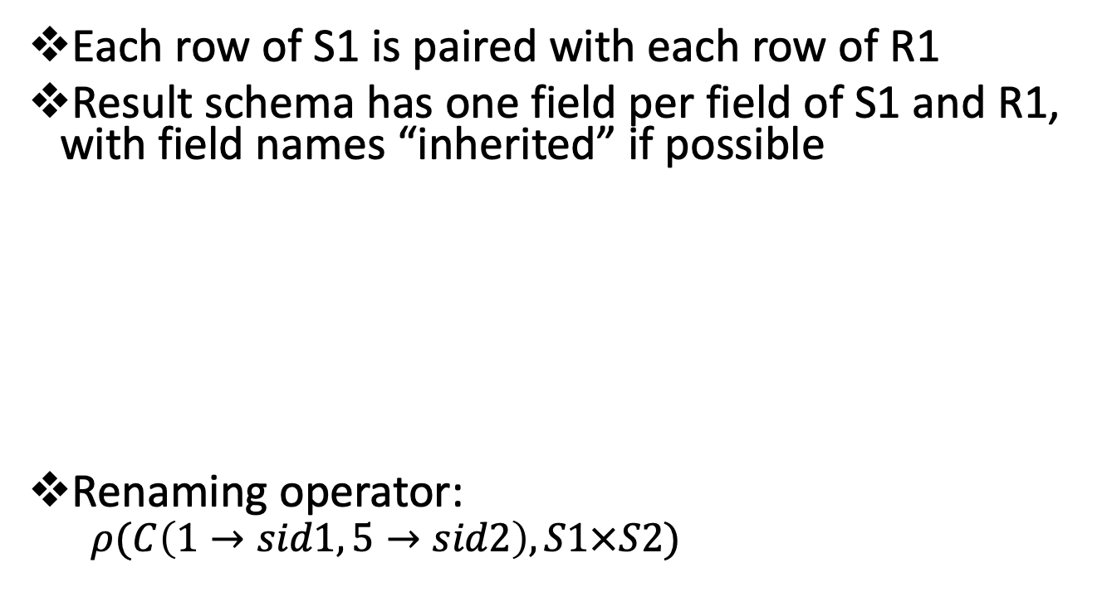
Cross-Product (or Product)
Each row of S1 is paired with each row of R1
Result schema has one field per field of S1 and R1, with field names “inherited” if possible
Renaming operator:
$ρ(C\left(1→sid1, 5→sid2\right), S1×S2)$
(sid) | sname | rating | age | (sid) | bid | date
22 | dustin | 7 | 45.0 | 22 | 101 | 10/10/96
22 | dustin | 7 | 45.0 | 58 | 103 | 11/12/96
31 | lubber | 8 | 55.5 | 22 | 101 | 10/10/96
31 | lubber | 8 | 55.5 | 58 | 103 | 11/12/96
58 | rusty | 10 | 35.0 | 22 | 101 | 10/10/96
58 | rusty | 10 | 35.0 | 58 | 103 | 11/12/96
$$S1×S2$$

Slide 24

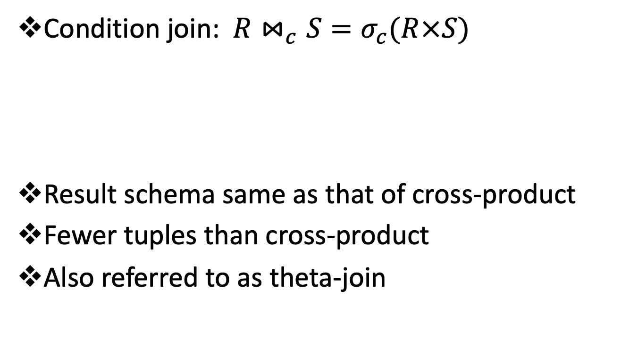
Joins
Condition join: $R⋈_{c}S=σ_{c}(R×S)$
Result schema same as that of cross-product
Fewer tuples than cross-product
Also referred to as theta-join
(sid) | sname | rating | age | (sid) | bid | date
22 | dustin | 7 | 45.0 | 58 | 103 | 11/12/96
31 | lubber | 8 | 55.5 | 58 | 103 | 11/12/96
$$S1⋈_{S1.sid<R1.sid}R1$$

Slide 25

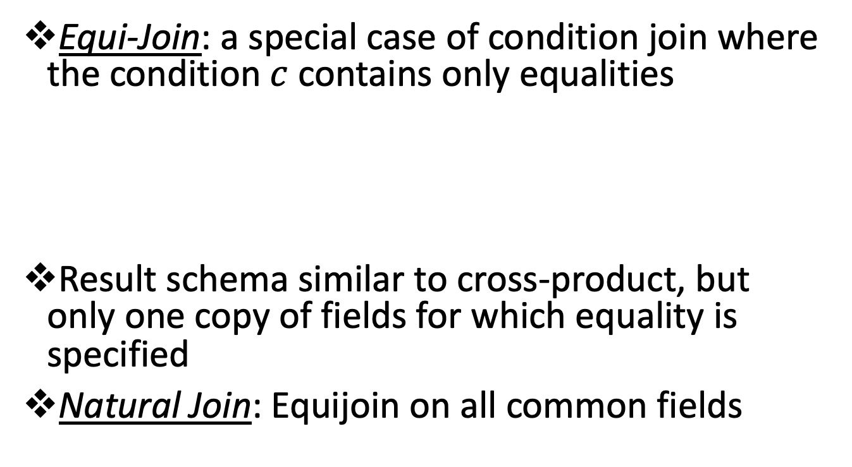
Joins
Equi-Join: a special case of condition join where the condition $c$ contains only equalities
Result schema similar to cross-product, but only one copy of fields for which equality is specified
Natural Join: Equijoin on all common fields
sid | sname | rating | age | bid | date
22 | dustin | 7 | 45.0 | 101 | 11/12/96
58 | rusty | 10 | 35.0 | 103 | 11/12/96
$$S1⋈_{sid}R1$$

Slide 26
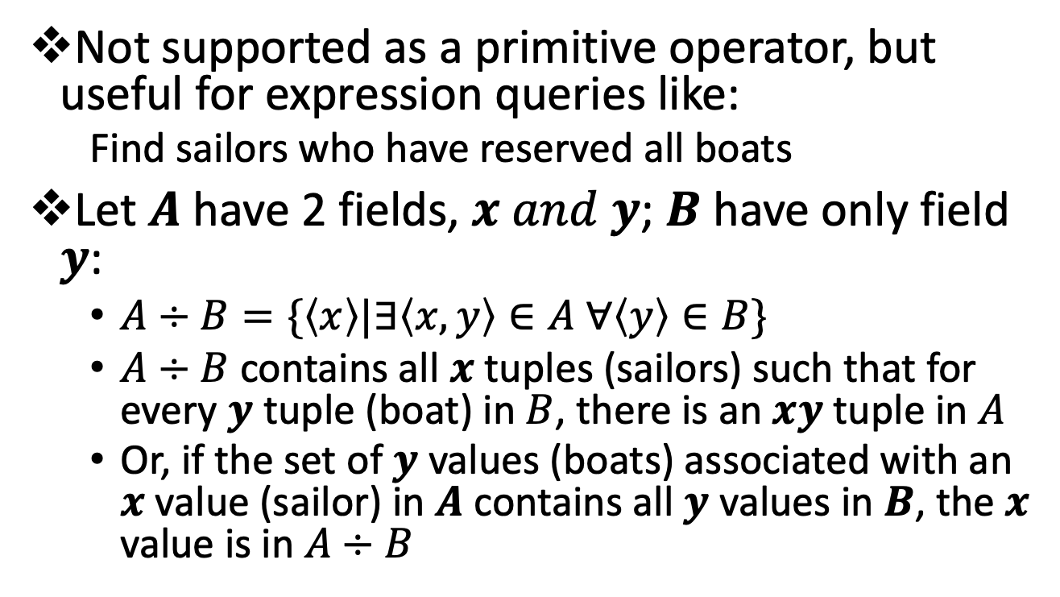
Division
Not supported as a primitive operator, but useful for expression queries like:
Find sailors who have reserved all boats
Let $A$ have 2 fields, $x and y$; $B$ have only field $y$:
$A÷B=\{\left\langle x\right\rangle |∃\left\langle x,y\right\rangle ∈A ∀\left\langle y\right\rangle ∈B\}$
$A÷B$ contains all $x$ tuples (sailors) such that for every $y$ tuple (boat) in $B$, there is an $xy$ tuple in $A$
Or, if the set of $y$ values (boats) associated with an $x$ value (sailor) in $A$ contains all $y$ values in $B$, the $x$ value is in $A÷B$

Slide 27








Examples of Division $A÷B$
sid | bid
s1 | b1
s1 | b2
s1 | b3
s1 | b4
s2 | b1
s2 | b2
s3 | b2
s4 | b2
s4 | b4
bid
b2
bid
b2
b4
bid
b1
b2
b4
$$B_{1}$$
$$B_{2}$$
$$B_{3}$$
sid
s1
s2
s3
s4
sid
s1
s4
sid
s1
$$A÷B_{3}$$
$$A$$
$$A÷B_{2}$$
$$A÷B_{1}$$

Slide 28
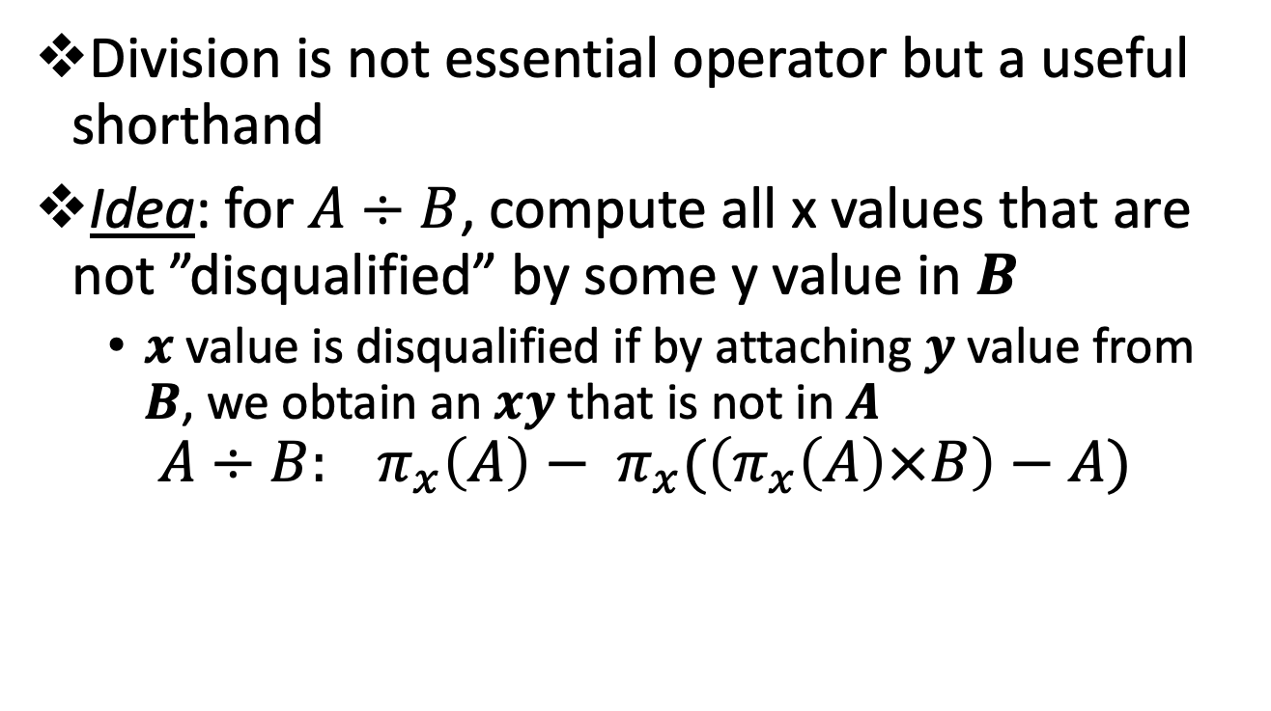


Expressing $A÷B$ Using Basic Operators
Division is not essential operator but a useful shorthand
Idea: for $A÷B$, compute all x values that are not ”disqualified” by some y value in $B$
$x$ value is disqualified if by attaching $y$ value from $B$, we obtain an $xy$ that is not in $A$
$$A÷B: π_{x}\left(A\right)− π_{x}(\left(π_{x}\left(A\right)×B\right)−A)$$
disqualified $x$ values

Slide 29
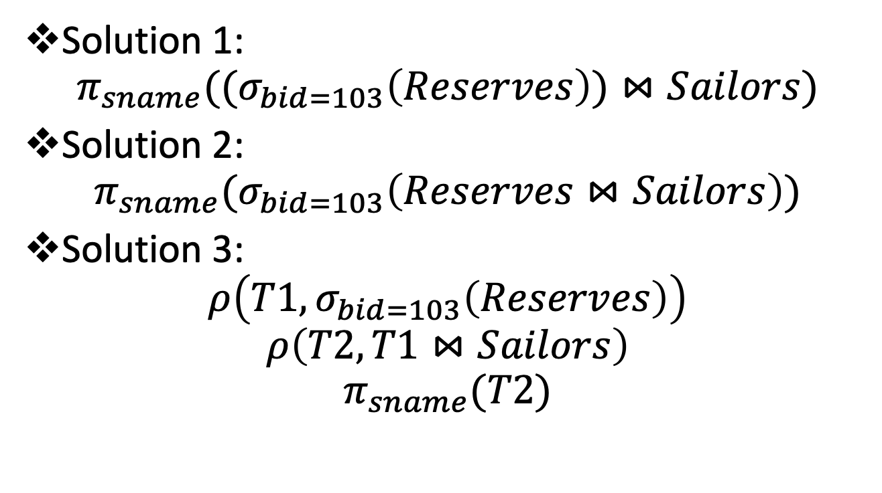
Exercise 1: Find names of sailors who’ve reserved boat #103
Solution 1:
$$π_{sname}((σ_{bid=103}\left(Reserves\right))⋈Sailors)$$
Solution 2:
$$π_{sname}(σ_{bid=103}\left(Reserves⋈Sailors\right))$$
Solution 3:
$$ρ\left(T1, σ_{bid=103}\left(Reserves\right)\right)$$
$$ρ\left(T2, T1⋈Sailors\right)$$
$$π_{sname}(T2)$$

Slide 30
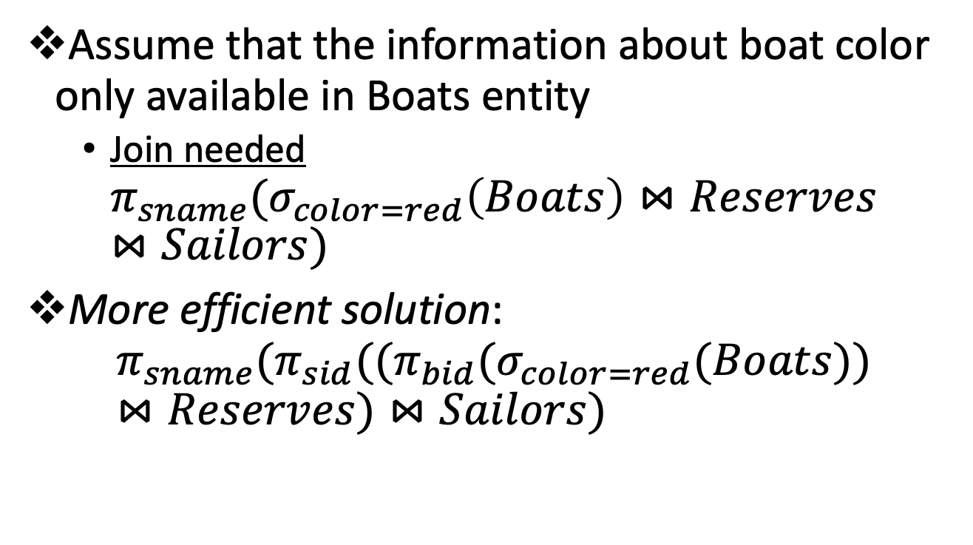
Exercise 2: Find names of sailors who’ve reserved a red boat
Assume that the information about boat color only available in Boats entity
Join needed
$$π_{sname}(σ_{color=red}\left(Boats\right)⋈Reserves⋈Sailors)$$
More efficient solution:
$$π_{sname}(π_{sid}((π_{bid}{(σ}_{color=red}(Boats))⋈Reserves)⋈Sailors)$$

Slide 31
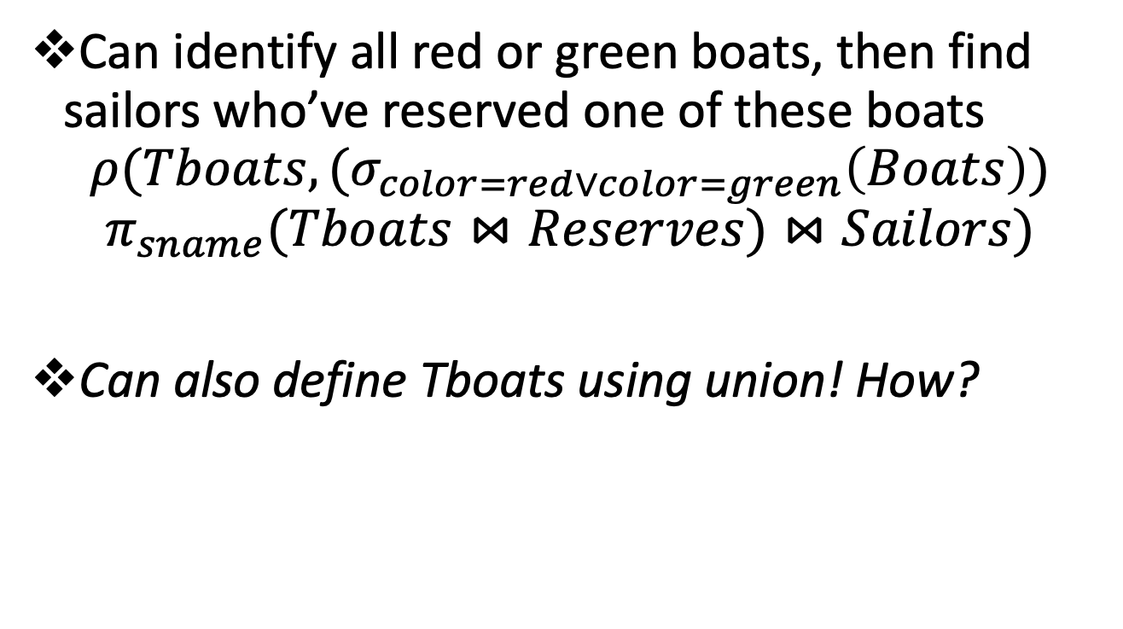
Exercise 3: Find names of sailors who’ve reserved a red boat or a green boat
Can identify all red or green boats, then find sailors who’ve reserved one of these boats
$${ρ(Tboats, (σ}_{color=red∨color=green}\left(Boats\right))$$
$$π_{sname}(Tboats⋈Reserves)⋈Sailors)$$
Can also define Tboats using union! How?

Slide 32
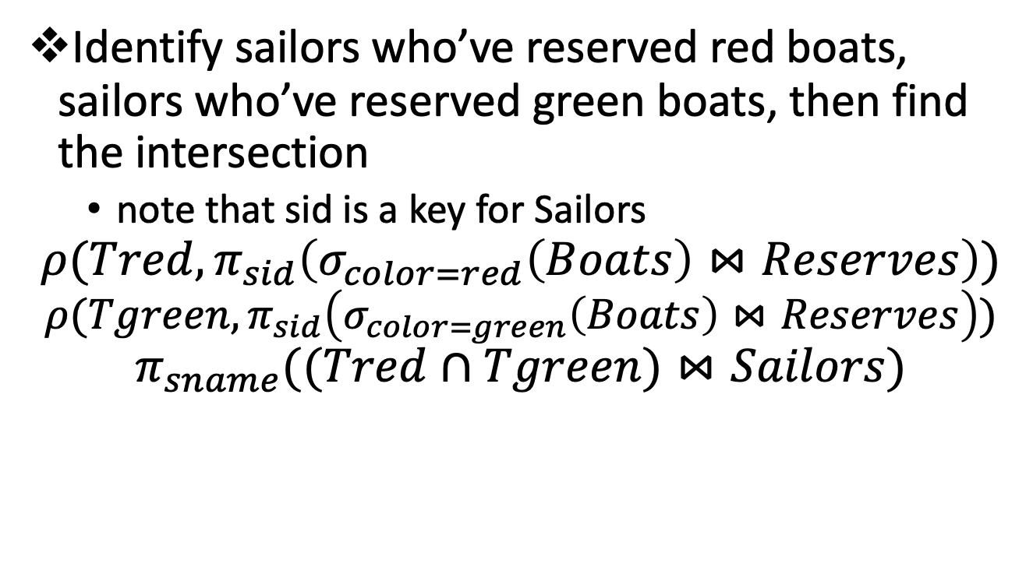
Exercise 4: Find sailors who’ve reserved a red and a green boat
Identify sailors who’ve reserved red boats, sailors who’ve reserved green boats, then find the intersection
note that sid is a key for Sailors
$$ρ(Tred,π_{sid}\left(σ_{color=red}\left(Boats\right)⋈Reserves\right))$$
$$ρ(Tgreen,π_{sid}\left(σ_{color=green}\left(Boats\right)⋈Reserves\right))$$
$$π_{sname}((Tred∩Tgreen)⋈Sailors)$$

Slide 33
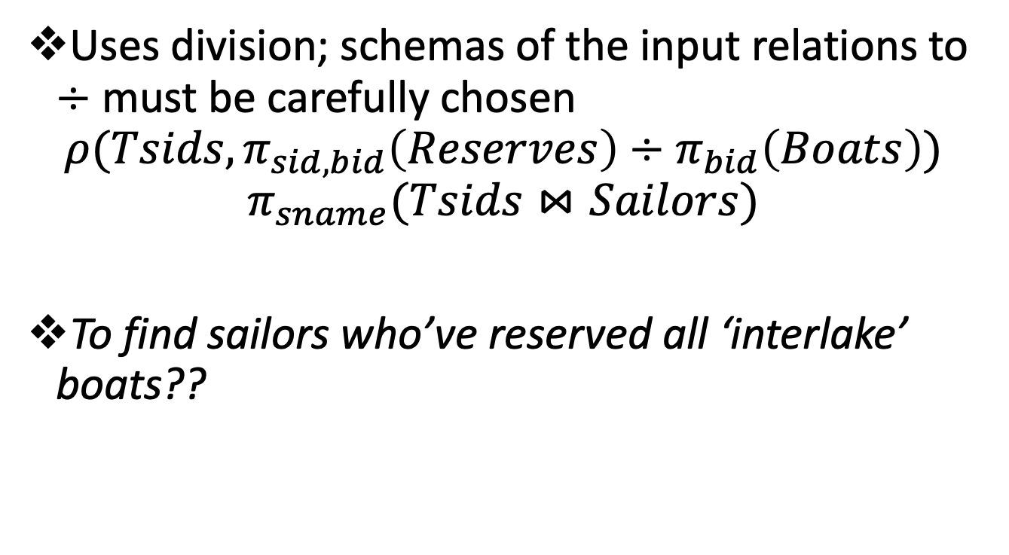
Exercise 5: Find the names of sailors who’ve reserved all boats
Uses division; schemas of the input relations to $÷$ must be carefully chosen
$$ρ(Tsids, π_{sid,bid}\left(Reserves\right)÷π_{bid}\left(Boats\right))$$
$$π_{sname}(Tsids⋈Sailors)$$
To find sailors who’ve reserved all ‘interlake’ boats??

Slide 34
Relational Model: Summary
A tabular representation of data
Simple and intuitive, currently the most widely used
Integrity constraints can be specified by the DBA, based on application semantics
Domain constraints
Primary and foreign keys
Entity integrity and referential integrity

Slide 35
Relational Algebra: Summary
The relational model has rigorously defined query languages that are simple and powerful
Relational algebra is more operational; useful as internal representation for query evaluation plans
Several ways of expressing a given query; a query optimizer should choose the most efficient version

