Slide 1
Introduction
MSA 8040: Data Management for Analytics
Houping Xiao
hxiao@gsu.edu

Slide 2
Course information
Instructor: Houping Xiao
Office: Room 329@Buckhead Center
Room 1640@55 Park Place
Office hour: 2:00pm~4:00pm Thursday
Email: hxiao@gsu.edu
Lecture Location: GSU Buckhead Room 1203
Website: https://houpingx.github.io/database.html (materials)
iCollege, https://icollege.gsu.edu/ (announcements)
It’s highly recommended to enable notifications for this course (all courses) to receive announcements, updates, etc
Software: MySQL, MongoDB, Python (packages including Beautiful Soup, Selenium, etc)

Slide 3
Teaching Assistant
Keerthi Vardhan Kondepati
Email: kkondepati1@student.gsu.edu
Office hours:
Mondays 6:00pm-8:30pm (Online)
https://gsumeetings.webex.com/gsumeetings/j.php?MTID=m52c9c3919b07c971e66521eb68f28f24
Wednesdays 6:00pm-8:30pm (Buckhead Campus)

Slide 4
Overview
Data Management for Analytics
Section 1:
Introduction
Section 2:
MySQL
Section 3:
NoSQL
Section 4:
Web Scraping
Section 5:
Text Mining
Work Based Projects
Database
concepts
Design concepts
MySQL
Functions
Operators
NoSQL
Types
Pro & Con
Beautiful Soup
Regular
expression
Unstructured
data
Textual data
ER model
ER diagrams’
Normalization
MongoDB
CURD
Aggregation
Selenium
Navigating
Locating
elements
Topic Modeling
LDA
Dynamic LDA
SQL
Statement
syntax
Advanced SQL
Procedure
Trigger
Sentiment analysis
Neural network
SVM
Decision tree
Relational model
Twitter API
From Query to Analytics

Slide 5

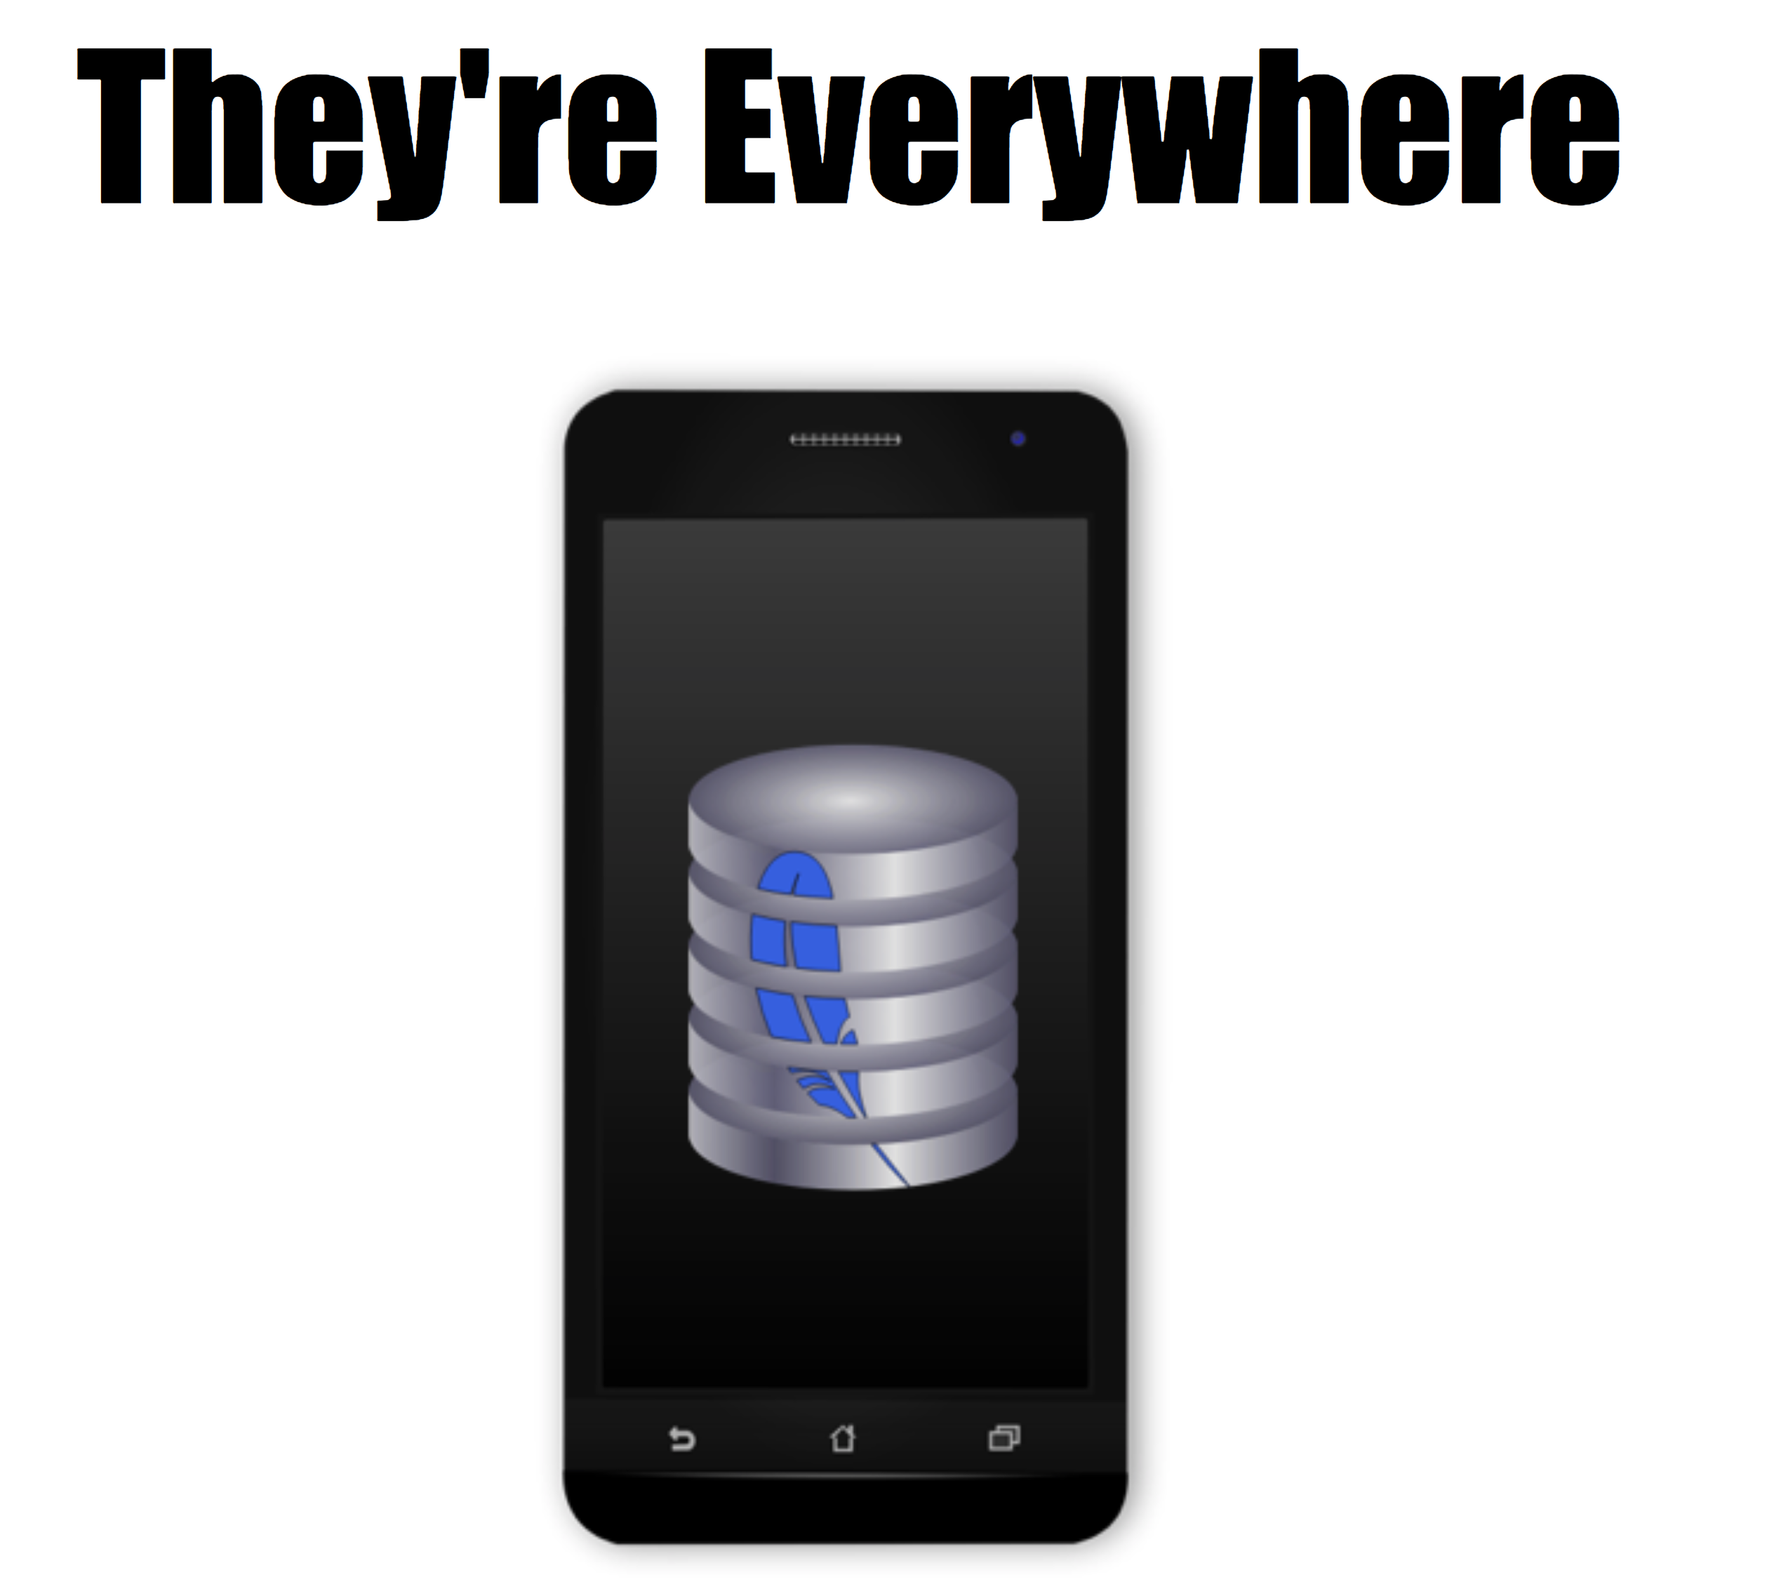
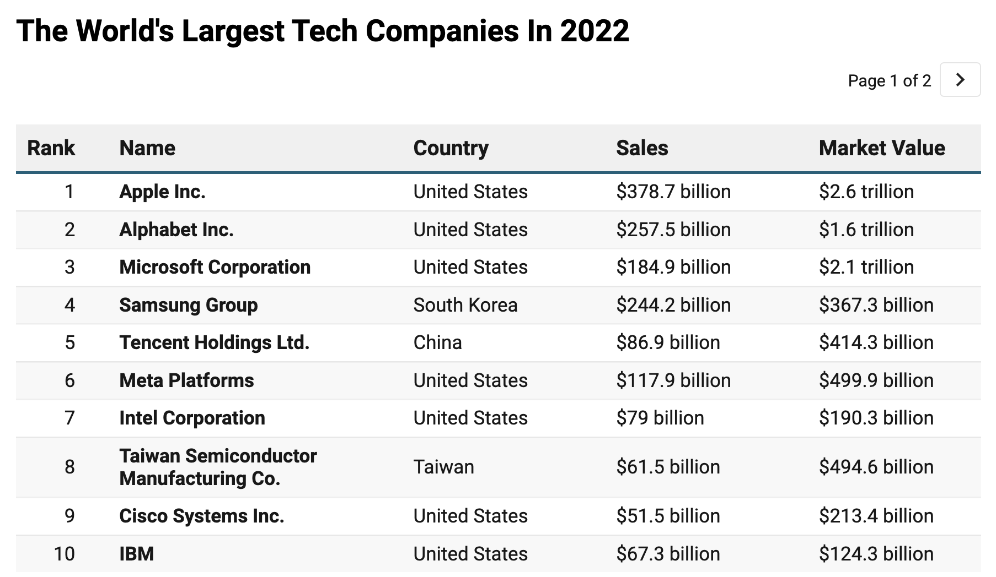





Why Study Databases??
Computation
Information
Many Top Tech Companies Have its Own
Data Management System

Slide 6
Files and Databases
File: A collection of records or documents
Manual (paper) files
Computer files
Database: A collection of similar records, along with their relationships

Slide 7
What Is a Database??
Shared, integrated computer structures that store data
Components:
End-user data: raw facts of interest to end user
Metadata: data about data, integrating & managing end-user data
Describes data characteristics and relationships
Examples: the name of each data element, the type of values (numeric, dates, or text) stored on each data element, and whether the data element can be left empty
A Database management system (DBMS) is a
Collection of programs
Manages the database structure
Controls access to data stored in the database

Slide 8
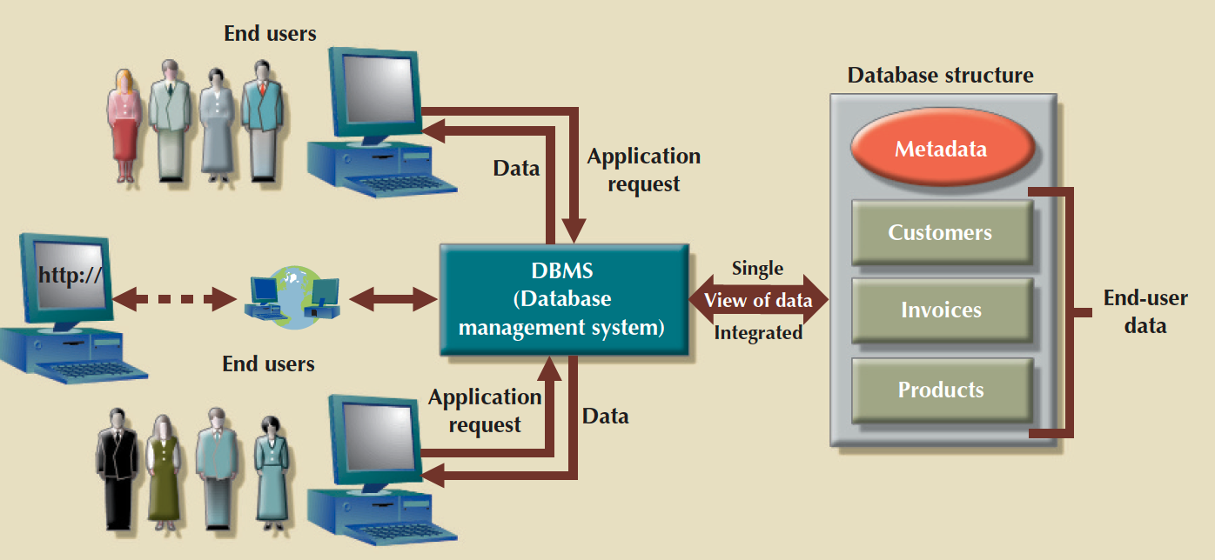
What Is a Database??

Slide 9
Why Use a DBMS??
Minimal data redundancy
Data consistency, data integration, and data sharing
Ease of application development, reduced program maintenance
Uniform security, privacy, and integrity controls
Data accessibility and responsiveness
Data independence

Slide 10
DBMS Functions
Data dictionary management
Data dictionary: stores definitions of data elements and their relationships
Data storage management
Performance tuning ensures efficient performance
Data transformation and presentation
Data is formatted to conform to logical expectations
Security management
Enforces user security and data privacy

Slide 11
DBMS Functions
Multiuser access control
Sophisticated algorithms ensure that multiple users can access the database concurrently without compromising its integrity
Backup and recovery management
Enables recovery of the database after a failure
Data integrity management
Minimizes redundancy and maximizes consistency

Slide 12
DBMS Functions
Database access languages and application programming interfaces
Query language: lets the user specify what must be done without having to specify how
Structured Query Language (SQL): de facto query language and data access standard supported by the majority of DBMS vendors
Database communication interfaces
Accept end-user requests via multiple, different network environments

Slide 13
Data Modeling Creating a specific data model before building your databases.

Slide 14
Data Models
A data model is a collection of concepts for describing data
A schema is description of a particular collection of data, using the a given data model
The relational model of data is the most widely used model today
Main concept: relation, basically a table with rows and columns
Every relation has a schema, which describes the columns, or fields

Slide 15
Data Model Basic Building Blocks
Entity: Data to be collected and stored
Attribute: characteristics of an entity
Relationship: an association among entities
One-to-many (1:M or 1..*)
Many-to-many (M:N or *..*)
One-to-one (1:1 or 1..1)
Constraint: restriction placed on data
Ensures data integrity
Business rules: Brief, precise, and unambiguous description of a policy, procedure, or principle

Slide 16
Translating Business Rules into Data Model Components
Business rules set the stage for the proper identification of entities, attributes, relationships, and constraints
Nouns translate into Entities
Verbs translate into Relationships among entities
Relationships are bidirectional
Questions to identify the relationship type:
How many instances of B are related to one instance of A?
How many instances of A are related to one instance of B?
In class exercises

Slide 17
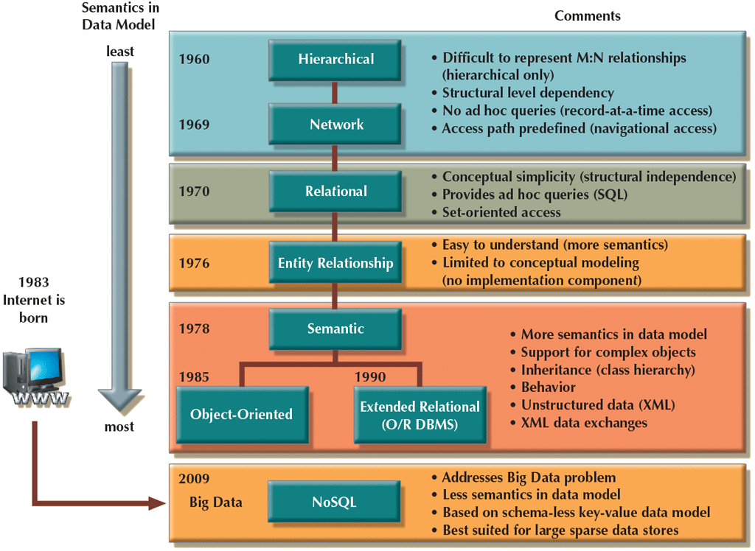
Evolution of Data Models

Slide 18
Relational Model (1980’s)
Provides a conceptually simple model for data as relations (typically considered “tables”) with all data visible.
attribute
tuple
Relation=table

Slide 19
Entity Relationship (ER) Model (ERM)
Describes relationships (1:1, 1:M, and M:N) among entities
PAINTER
PAINTING
paints
EMPLOYEE
SKILL
learns
EMPLOYEE
STORE
manages
Crow’s Foot Notation

Slide 20
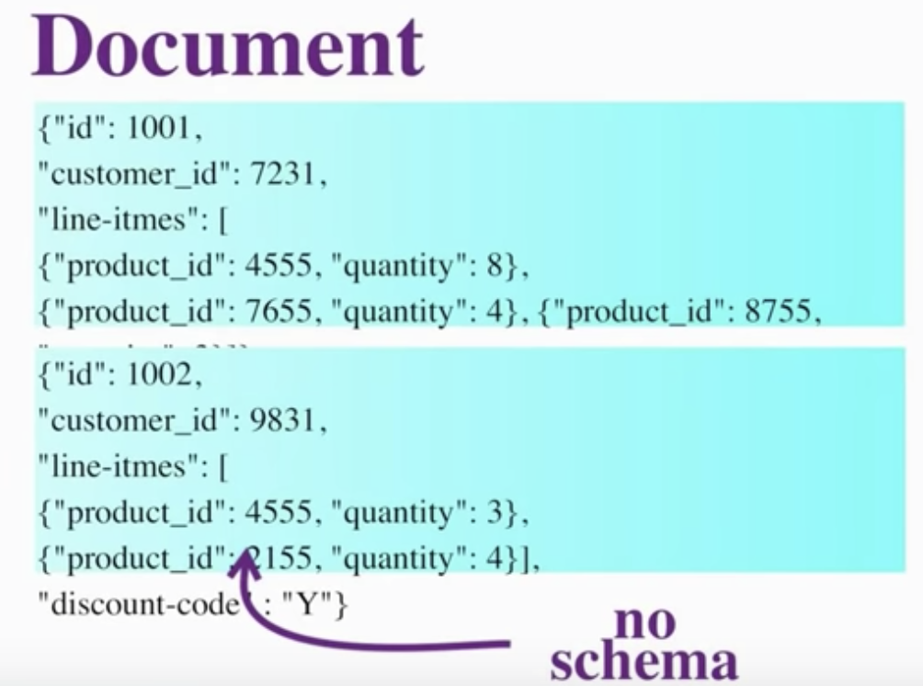
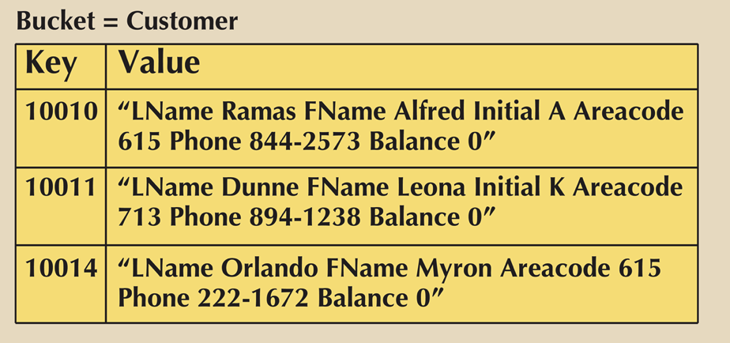
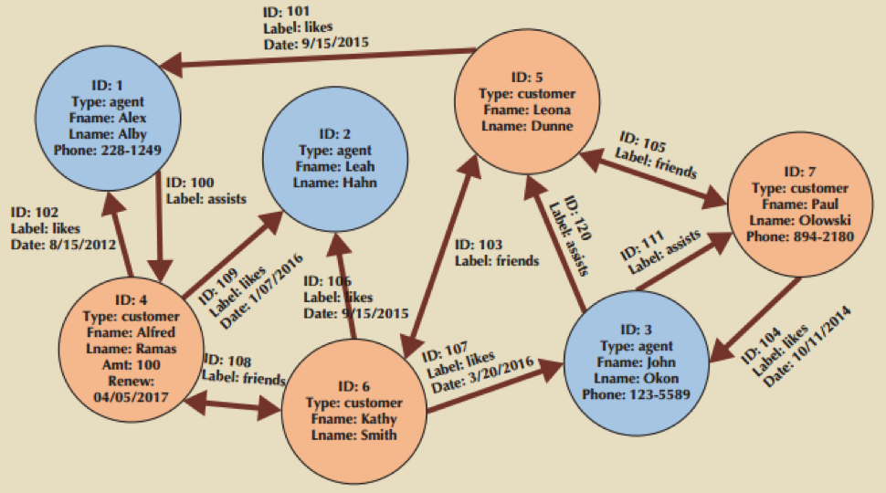
NoSQL Databases
Usually very simple key/value search operations
May use distributed parallel processing (grid/cloud, e.g. MongoDB + Hadoop)
Semantic Web “TripleStores” are one type

Slide 21
Level of Abstraction
Many views, single conceptual (logical) schema and physical schema
Views describe how users see the data
Conceptual schema defines logical structure
Physical schema describes the files and indexes used
View 1
View 1
View 1
Conceptual Schema
Physical Schema

Slide 22
Example: University Database
Conceptual schema:
Students(sid: string, name: string, login: string, age: integer, gpa: real)
Courses(cid: string, cname: string, credits: integer)
Enrolled(sid: string, cid: string, grade: string)
Physical schema:
Relations stored as unordered files
Index on first column of Students
External Schema (View):
Course_info(cid: string, enrollment: integer)

Slide 23
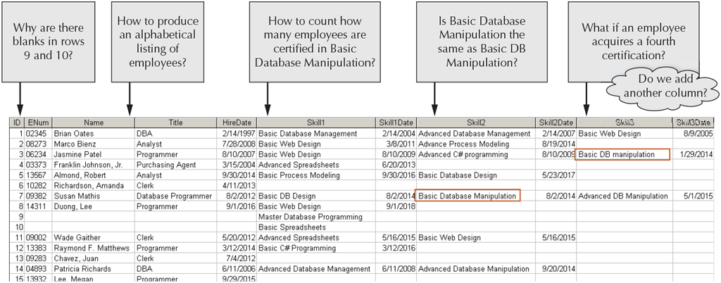
Poor-designed DBs Hurt Data Management
An organization to keep records about its employees and their skills

Slide 24
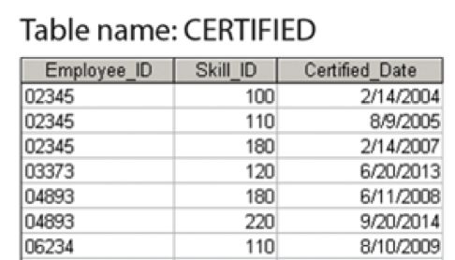
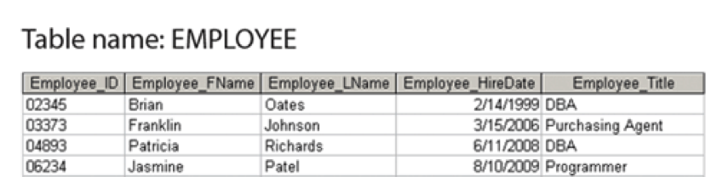
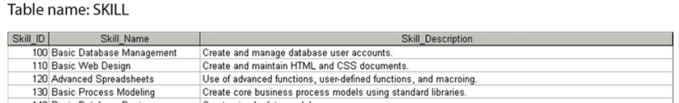
Well-designed DBs Facilitate Data Management

Slide 25
Data Independence*
Applications insulated from how data is structured and stored
Logical data independence: Protection from changes in logical structure of data
Physical data independence (Structural independence): Protection from changes in physical structure of data
* One of the most important benefits of using a DBMS!
ENum | Name | Email | AdviserLastName | AdviserEmail | Department | AdminLastName
02345 | Brian Oates | oates@xxx.co | Baker | lbaker@xxx.co | Sale | Smith
… | … | … | … | … | … | …
Add a new attribute for Employee
ENum | Name | … | AdviserEmail | Department | AdminLastName | Birthday
02345 | Brian Oates | … | lbaker@xxx.co | Sale | Smith
… | … | … | … | … | …

Slide 26
Avoid Data Redundancy
Issues of Data Redundancy:
Poor data security; Data inconsistency; Data-entry errors; Data integrity problems
ENum | Name | Email | AdviserLastName | AdviserEmail | Department | AdminLastName
02345 | Brian Oates | oates@xxx.co | Baker | lbaker@xxx.co | Sale | Smith
08273 | Marco Bienz | bienz@xxx.co | Tom | tom1@xxx.co | Product | Chaplin
06234 | Jasmine Patel | patel@xxx.co | Baker | lbaker@xxx.co | Sale | Smith
01567 | Franklin Johnson | johnson@xxx.co | Tang | stang@xxx.co | Sale | Smith
10282 | Almond, Robert | robert@xxx.co | Tom | tom2@xxx.co | Product | Chaplin
09382 | Susan Mathis | mathis@xxx.co | Tang | stang@xxx.co | Hardware | Regan
14311 | Duong, Lee | lee@xxx.co | Tran | ktran@xxx.co | Product | Smith

Slide 27
Avoid Update Anomalies
Question1: Baker is changed to Tang?
Question2: changed to Tom?
ENum | Name | Email | AdviserLastName | AdviserEmail | Department | AdminLastName
02345 | Brian Oates | oates@xxx.co | Baker | lbaker@xxx.co | Sale | Smith
08273 | Marco Bienz | bienz@xxx.co | Tom | tom1@xxx.co | Product | Chaplin
06234 | Jasmine Patel | patel@xxx.co | Baker | lbaker@xxx.co | Sale | Smith
01567 | Franklin Johnson | johnson@xxx.co | Tang | stang@xxx.co | Sale | Smith
10282 | Almond, Robert | robert@xxx.co | Tom | tom2@xxx.co | Product | Chaplin
09382 | Susan Mathis | mathis@xxx.co | Tang | stang@xxx.co | Hardware | Regan
14311 | Duong, Lee | lee@xxx.co | Tran | ktran@xxx.co | Product | Smith

Slide 28
Avoid Deletion Anomalies
Question1: Delete 2nd row?
Question2: Delete 7th row?
ENum | Name | Email | AdviserLastName | AdviserEmail | Department | AdminLastName
02345 | Brian Oates | oates@xxx.co | Baker | lbaker@xxx.co | Sale | Smith
08273 | Marco Bienz | bienz@xxx.co | Tom | tom1@xxx.co | Product | Chaplin
06234 | Jasmine Patel | patel@xxx.co | Baker | lbaker@xxx.co | Sale | Smith
01567 | Franklin Johnson | johnson@xxx.co | Tang | stang@xxx.co | Sale | Smith
10282 | Almond, Robert | robert@xxx.co | Tom | tom2@xxx.co | Product | Chaplin
09382 | Susan Mathis | mathis@xxx.co | Tang | stang@xxx.co | Hardware | Regan
14311 | Duong, Lee | lee@xxx.co | Tran | ktran@xxx.co | Product | Smith

Slide 29
Avoid Insertion Anomalies
Question: Add a new department ‘Analytic’?
ENum | Name | Email | AdviserLastName | AdviserEmail | Department | AdminLastName
02345 | Brian Oates | oates@xxx.co | Baker | lbaker@xxx.co | Sale | Smith
08273 | Marco Bienz | bienz@xxx.co | Tom | tom1@xxx.co | Product | Chaplin
06234 | Jasmine Patel | patel@xxx.co | Baker | lbaker@xxx.co | Sale | Smith
01567 | Franklin Johnson | johnson@xxx.co | Tang | stang@xxx.co | Sale | Smith
10282 | Almond, Robert | robert@xxx.co | Tom | tom2@xxx.co | Product | Chaplin
09382 | Susan Mathis | mathis@xxx.co | Tang | stang@xxx.co | Hardware | Regan
14311 | Duong, Lee | lee@xxx.co | Tran | ktran@xxx.co | Product | Smith
 |  |  |  |  | Analytic | Stevens

Slide 30
A Well-Designed DB Should Avoid Structure & Data Dependence, Data Redundancy, Data Anomalies as many as possible!

Slide 31
Concurrency Control
Concurrent execution of user programs is essential for good DBMS performance
Because disk access are frequent, and relatively slow, it is important to keep the cpu humming by working on several user programs concurrently
Interleaving actions of different user programs can lead to inconsistency: e.g., check is cleared while account balance is being computed
DBMS ensures such problem don’t arise: users can pretend they are using a single-user system

Slide 32
Transaction: An Execution of a DB Program
Key concept is transaction, an atomic sequence of database actions (reads/writes)
Each transaction, executed completely, must leave the DB in a consistent state if DB is consistent when the transaction begins
Users can specify some simple integrity constraints on the data, and the DBMS will enforce these constraints.
Beyond this, the DBMS does not really understand the semantics of the data. (e.g., it does not understand how the interest on a bank account is computed)
Thus, ensuring that a transaction (run alone) preserves consistency is ultimately the user’s responsibility

Slide 33
Scheduling Concurrent Transactions
DBMS ensures that execution of {T1, …, Tn} is equivalent to some serial execution T1’, …, Tn’
Before reading/writing an object, a transaction requests a lock on the object, and waits till the DBMS gives it the lock. All locks are released at the end of the transaction. (strict 2PL locking protocol)
Idea: If an action of Ti (say, writing X) affects Tj (which perhaps reads X), one of them, say Ti, will obtain the lock on X first and Tj is forced to wait until Ti completes; this effectively orders the transactions.
What if Tj already has a lock on Y and Ti later requests a lock on Y? (Deadlock!) Ti or Tj is aborted and restarted!

Slide 34
Ensuring Atomicity
DBMS ensures atomicity (all-or-nothing property) even if system crashes in the middle of Xact
Idea: Keep a log (history) of all actions carried out by the DBMS while executing a set of Xacts:
Before a change is made to the database, the corresponding log entry is forced to a safe location. (WAL protocol: OS support for this is often inadequate)
After a crash, the effects of partially executed transactions are undone using the log. (Thanks to WAL, if log entry wasn’t saved before the crash, corresponding change was no applied to the database!)

Slide 35
The Log
The following actions are recorded in the log:
Ti writes an object: the old value and the new value
Log record must go to disk before the changed page!
Ti commits/aborts: a log record indicating this action
Log records chained together by Xact id, so it’s easy to undo a specific Xact (e.g., to resolve a deadlock)
Log is often duplexed and archived on “stable” storage
All log related activities (and in fact, all CC related activities such as lock/unlock, dealing with deadlocks etc.) are handled transparently by the DBMS

Slide 36
Databases Make These Folks HAPPY …
End users and DBMS vendors
DB application programmers
E.g., smart webmasters
Database administrator (DBA)
Designs logical /physical schemas
Handle security and authorization
Data availability, crash recovery
Database tuning as needs evolve
Must understand how a DBMS works!

Slide 37
Structure of a DBMS
A typical DBMS has a layered architecture
The figure does not show the concurrency control and recovery components
This is one of several possible architectures; each system has its own variations
query optimization and execution
relational operators
files and access methods
These layers must consider concurrency control and recovery
buffer management
disk space management
DB

Slide 38
Summary
DBMS used to maintain, query large datasets
Benefits include recovery from system crashes, concurrent access, quick application development, data integrity and security
Levels of abstraction give data independence
A DBMS typically has a layered architecture
DBAs hold responsible jobs and are well-paid
DBMS R&D is one of the broadest, most exciting areas in CS

