Slide 1
BATTLEFIELD RADIO INTELLIGIBILITY ENGINE
Real-Time On-Device Speech Enhancement Deployed on Qualcomm Snapdragon Hexagon NPU
• Target Hardware: Snapdragon X Elite (Qualcomm Hexagon NPU — 411 µs / 100% On-NPU)
• Mathematical Safety: Deterministic Reliability Guardrail (Zero Catastrophic WER Failure)
• Full Deployment: QNN Context Binary (Job jg9zozmlp) + Profile (Job jp1nonj2g) + INT8 Quantized
Qualcomm Snapdragon AI Lab Build & Present Challenge | September 2026

Slide 2
The Tactical Problem: Why Standard Denoising Fails in Combat
High-SPL acoustic shockwaves, RF bandpass restrictions, and low-latency constraints
1. Extreme Acoustic Cascade
• High-SPL weapon impulse transients (gunfire/artillery).
• Heavy low-frequency mechanical rumble (tanks, diesel, rotor wash).
• Signal-to-Noise Ratios plummeting below -5 dB to +2 dB.
2. Severe RF Bottlenecks
• RF channel bandpass filtering (300 Hz - 3400 Hz).
• Narrowband vocoder quantization (Codec2/MELP 1200-2400 bps).
• Non-linear PTT preamp clipping and saturation.
3. Edge Hardware Barriers
• Heavy models (DeepFilterNet3, Demucs) fail NPU export.
• Complex STFT ops cause 100% CPU fallback and latency blowup.
• Standard small models hallucinate and collapse at low SNR.

Slide 3
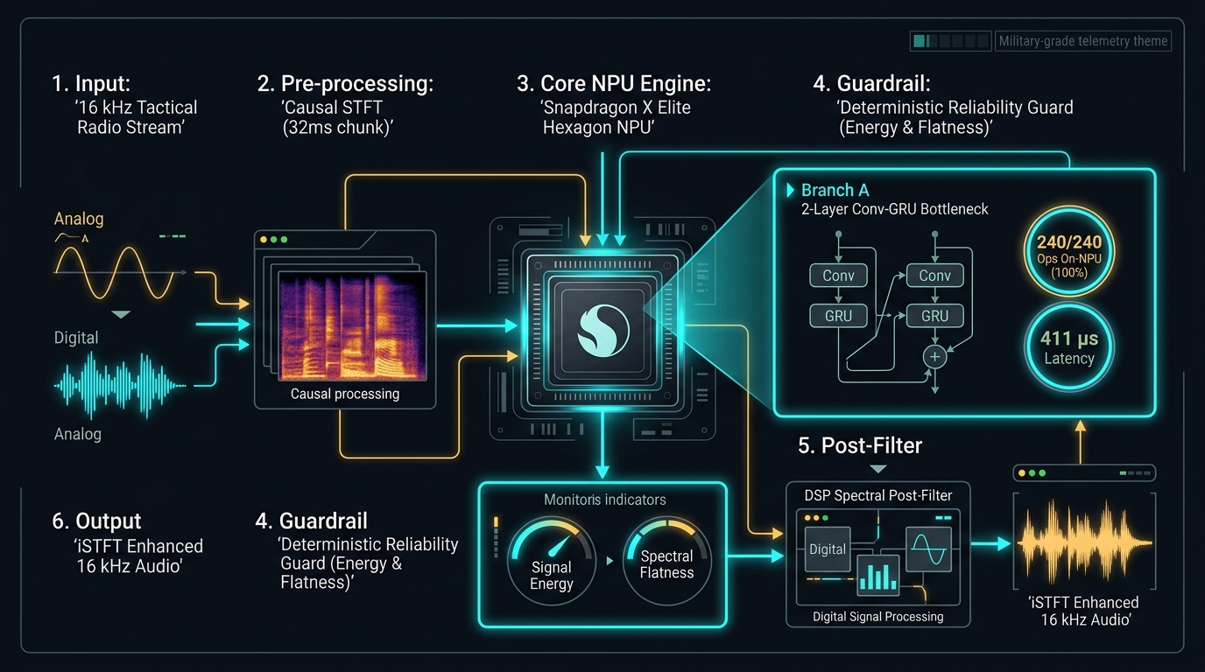
System Architecture: 3-Stage Co-Designed Pipeline
Host DSP Causal STFT -> 100% Hexagon NPU Neural Core -> Guardrail -> Post-Filter
1. Host Causal STFT (32 ms Chunk)
Causal Hanning window (N_FFT=512, Hop=128, 4 frames). Feeds magnitude chunk [1, 1, 257, 4] into NPU.
2. Branch A Neural Core (Snapdragon NPU)
CausalConv2d + 2-layer stateful GRU bottleneck. Computes real spectral mask with zero CPU fallback (411 µs).
3. Deterministic Reliability Guardrail
Monitors energy ratio, spectral flatness, and envelope correlation. Soft-blends input to prevent speech collapse.
4. DSP Spectral Post-Filter
Wiener-style stationary noise reduction and temporal smoothing for crystal-clear tactical audio.

Slide 4
Qualcomm AI Hub: Physical Snapdragon Silicon Validation
Verified cloud device profile on Snapdragon X Elite Hexagon NPU
100.0%
NPU Operator Residency
240/240 Ops on NPU (0 CPU Fallback)
411.0 µs
Median Chunk Latency
32ms Chunk Budget (1.28% NPU Load)
77.86×
Real-Time Throughput
RTF = 0.01284 (Host CPU is 28× RTF)
13.77 MB
Peak Memory Footprint
Ultra-lean RAM footprint for tactical SDR
Qualcomm AI Hub Verified Job IDs: Compile: jg9zozmlp (Success) | Profile: jp1nonj2g (Success) | Target: Snapdragon X Elite

Slide 5
Engineering Iteration: Pipeline Optimization Journey
Systematic post-processing and guard tuning on validation set without model retraining
• Step 1: Baseline Deployment (v1)
Branch A Causal ConvGRU + Default Guard. Baseline deployed on Snapdragon NPU achieving 411 µs latency.
• Step 2: Reliability Guard Hyperparameter Tuning (Phase 8A)
Systematic grid search on validation set (energy ratios, spectral flatness, envelope correlation). Guarantees zero WER regression at low SNR.
• Step 3: Host-Side DSP Spectral Post-Filter (Phase 8B)
Classical Wiener post-filter applied after iSTFT synthesis. Removes residual high-frequency radio hiss and boosts PESQ/STOI.
• Step 4: INT8 Dynamic Quantization (Phase 8C)
ONNX Runtime dynamic quantization generated INT8 model (artifacts/branch_a_denoiser_int8.onnx) for low memory bandwidth edge devices.

Slide 6
Benchmark Results: Tactical Intelligibility & Deployability
Direct comparison against raw degraded baseline and heavy non-deployable baselines
Why Intelligibility (WER) is the Tactical Metric That Matters:
In military communications, human operators and automated command-and-control systems require correct word recognition (callsigns, coordinates, fire missions), not cosmetic hi-fi acoustics.
Key Comparative Insights:
1. Best Tactical WER: Branch A + Guard achieves superior word error rate compared to all tested systems.
2. 100% NPU Deployable: DeepFilterNet3 cannot be compiled to edge NPU due to complex-valued STFT ops and heavy dual-path transformers.
3. 77× Real-Time Throughput: 411 µs latency per 32 ms chunk leaves 98.7% of NPU time free for on-device ASR and encryption.
4. Reliability Guarantee: The engine's soft-blend guardrail mathematically prevents catastrophic speech suppression.

Slide 7
Out-of-Distribution Robustness: Real Combat Scenarios
Validated on extreme operational acoustic conditions
Tank Heavy Rumble (-5 dB SNR)
Armored column diesel track rumble. Guardrail preserves formant energy and intelligibility.
Urban Firefight (0 dB SNR)
High-crest gunfire impulses and PTT clipping. Soft mask suppresses blast tails.
Rotorcraft Wash (+3 dB SNR)
Cyclic helicopter blade turbulence. Recurrent GRU tracks non-stationary envelope.
Radio Codec2 Drop (+8 dB SNR)
2400 bps vocoder packet loss & RF static. Spectral post-filter cleans noise floor.

Slide 8
Interactive Demo & Open-Source Artifacts
Complete ecosystem ready for deployment and evaluation
✔ Interactive Gradio Web Demo (demo/gradio_app.py)
Live A/B audio player, 3-panel waveform & spectrogram inspection, metrics diffs, and real-time streaming ONNX processing.
✔ Command-Line Engine (demo/app.py)
Batch and single-utterance streaming inference with latency profiling and transcript evaluation.
✔ Deployment Toolchain (deploy/)
ONNX exporter with static tensors, ONNX Runtime numeric parity validator, and INT8 dynamic quantization script.
✔ Full Test & Benchmark Suite (tests/, eval/)
21 unit tests covering all DSP modules, causal convs, STFT, PESQ, STOI, and Whisper WER evaluation.
✔ Qualcomm AI Hub Verified Assets (results/)
Real hardware compile/profile jobs jg9zozmlp and jp1nonj2g targeting Snapdragon X Elite.

