Slide 1
clk
led4_button4
reset
leds(3:0)
incr
buttons(3:0)

Slide 2
D
Q
CE

Slide 3
ROM
RISC CPU

Slide 4
zybo_z7_10
Power-on Reset
Synchroniser (retime)
sw(3:0)
4
reset
led4_button4
buttons(3:0)
leds(3:0)
led(3:0)
Synchroniser (retime)
4
clk
btn(3:0)
7 Segment Display Decoder
leds(3:0)
External clock
PLL
clk
sevseg(6:0)

Slide 5
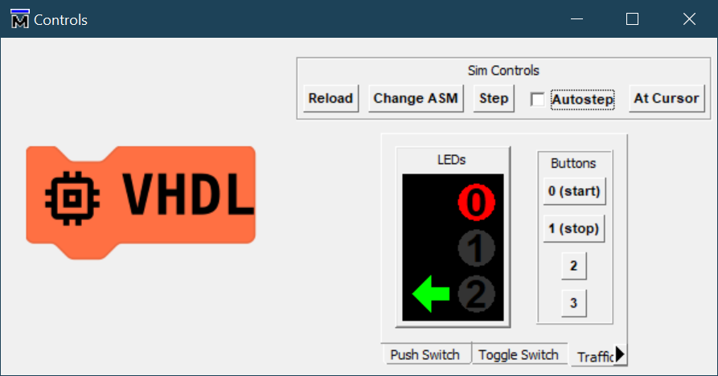
file. asm
test_zybo_z7_10
customasm
reset
led4_button4
clk
Stimulus
ROM
clk
reset
file.o
led4_button4
buttons(3:0)
leds(3:0)
RISC CPU
buttons(3:0)
reg(6)
reg(7)
leds(3:0)
reset
clk

Slide 6
Restart the simulation and reset the GUI
Set Assembly File for ROM
Step Emulation
Start Emulation
Make the display reflect the state under the cursor
Four buttons
Three tabs for different displays and button types

Slide 7
o <- a op b
op
o
a
b
Assembled instructions are 13-bits long
12:9
8:6
5:3
2:0
6 registers, but no RAM. 2 “special” registers
r0
r1
r2
r3
ALU
r4
r5
btns
leds

Slide 8
Plain Text
Cipher Text
Plain Text
led(3)
led(1)
led(0)
button(3)
message
D
Q
D
Q
CE
CE
Encryption Key Generator
Decryption Key Generator
enable
enable
button(2)
D
Q
D
Q
key enable
CE
CE
Provides synchronisation between ends. Not realistic!
run
led(2)
run_d

Slide 9
button(0)
transmission error
Plain Text
Cipher Text
Plain Text
led(3)
led(1)
led(0)
button(3)
message
D
Q
D
Q
CE
CE
key
key
button(2)
Encryption Key Generator
Decryption Key Generator
D
Q
D
Q
key enable
CE
CE
run
led(2)
run_d

Slide 10
Cryptography Demo
button(0)
Transmission error
Plain Text
Cipher Text
Plain Text
led(3)
led(1)
led(0)
button(3)
message
D
Q
D
Q
CE
CE
Symmetric Key
key
key
Symmetric Key
Encryption Key Generator
Decryption Key Generator

Slide 11
Cryptography Demo
Try encrypting your own generated data stream
How do we prevent a “man-in-the-middle” listening in?
How do we generate “key material” to encipher the plain text?
Random Number Generators?
How do we ensure the key material on reception is “in synchronisation” with the cipher text?
How does the recovered plain text survive transmission errors?
Try inserting transmission errors in the demonstrator

