Slide 1

Introduction to Arduino
Presented by House 4 Hack
What will you build next?

Slide 2
Housekeeping
We will be busy from 10:00 to 15:00
It will be practical and interactive
Feel free to move around, go for a smoke break, etc
This presentation and code samples: https://github.com/house4hack/arduino-introduction.git
We will have a formal break half way through
Experiment!
Ask!
Enjoy!

Slide 3

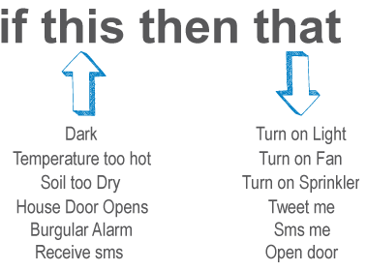
Interactive computing
digital inputs and outputs and PWM
USB
9v
input
power
analogue

Slide 4
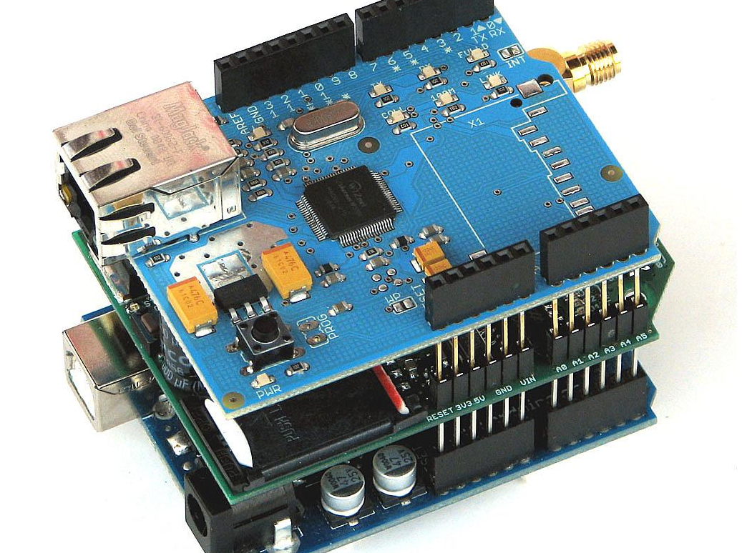
Shields for the Arduino
Shield Examples
Voice recognition
Joystick
Bluetooth
Wifi
RF
Touch TFT LCD
Relay
Gameduino

Slide 5
Arduino Kit
Check that you have everything in your goodie bag
Arduino UNO
Breadboard
USB A-male to B-male
Components
  Resistors: 100Ω,220Ω, 1kΩ, 10kΩ, 100kΩ
  LED: red, yellow, green, RGB
  Tactile Switch
  Rotary pot 10kΩ
  LDR – light dependant resistor
  Relay, transistor and diode
  Servo
  1000 uF Capacitor

Slide 6
Blink Example
Getting Started
Make sure IDE is installed
Make sure USB drivers are installed
  http://arduino.cc/en/Guide/HomePage
Connect Arduino to USB
Run the Arduino software
First Project (Code is caseSensitive)
Go to File > Examples > 01.Basics >Blink
Compile and load to board (Errors?)
Pin 13 on Arduino has a LED connected already

Slide 7
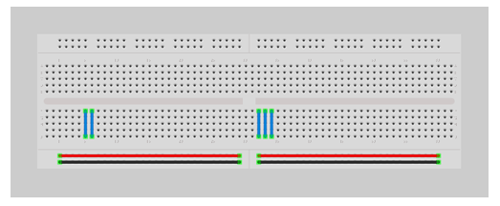
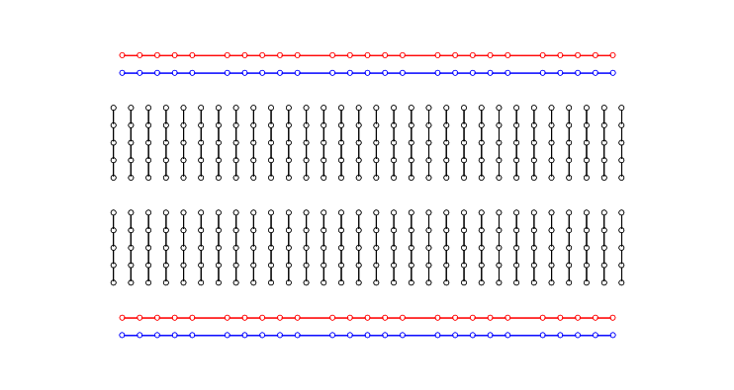
Breadboard

Slide 8
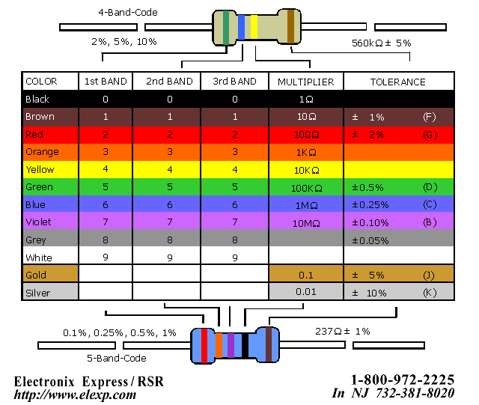
Resistor Chart
220Ω
Current limiting for LED
10kΩ
Pull down resistor for buttons

Slide 9
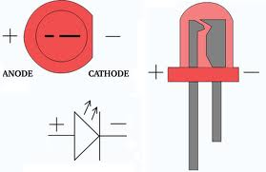
LED – Light Emitting Diode
Positive
Long pin
Rounded side
Negative
Short pin
Flat side
Remember to use your 220Ω resistor to
reduce the current through the LED

Slide 10
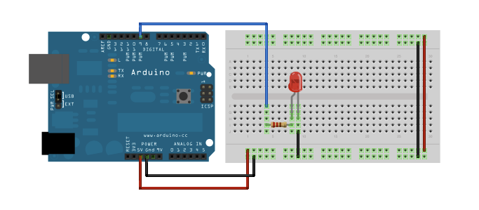
Blink Example on Breadboard

Slide 11
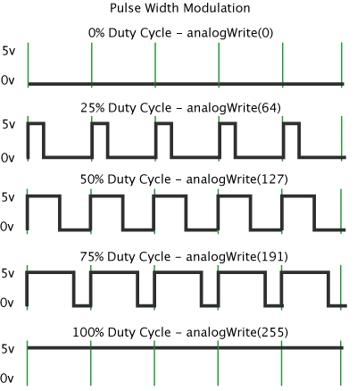
Fade Example
Fading an LED from ON to OFF
Open the "Fade" example
Compile and load to board
Notice the ~ on certain IO
Things to note
Pulse Width Modulation
Vary with 255 values
Use analogWrite
PWM(0) ~ 0V
PWM(127) ~ 2.5V
PWM(255) ~ 5V

Slide 12
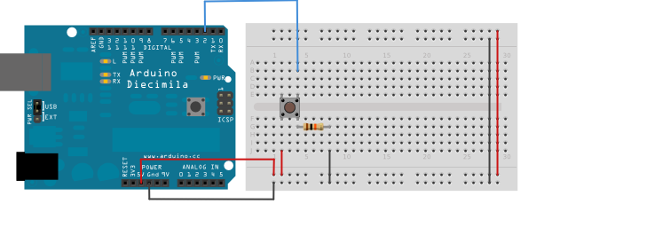
DigitalReadSerial Example
Using a push button with Serial Monitor
10k resistor (Pull Down to prevent floating)
Push Button
Upload to board and open serial monitor
Serial.begin(9600);
Press the button

Slide 13
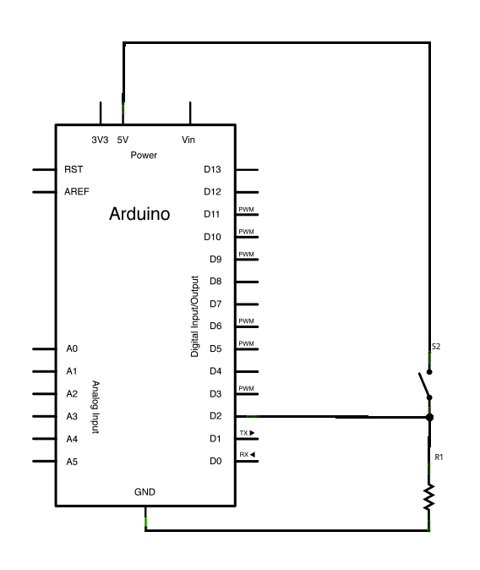
DigitalReadSerial Example
...continued
When you draw the "breadboard" layout in Fritzing it automatically creates the circuit diagram, you can even do basic PCB layouts from the schematic

Slide 14
Structure of a sketch
// Global variables go here
int variable1;
long variable2 = 100;
double variable3;
void setup() {
// This only runs once
pinMode(9, OUTPUT); // for output
}
void loop() {
// This is the super-loop, keeps executing
int localvariable = 1;
}

Slide 15
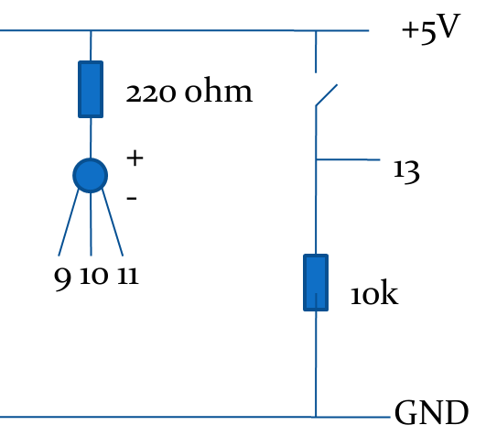
Press the Button to change RGB Color
void loop(){
sensorValue = digitalRead(sensorPin);
if(sensorValue != lastSensorValue) {
if(sensorValue) {
mode ++;
if(mode==3) mode=0;
}
}
analogWrite(redPin,255);
analogWrite(bluePin,255);
analogWrite(greenPin,255);
if(mode == 0){
analogWrite(redPin,0);
} else if (mode==1){
analogWrite(greenPin,0);
} else {
analogWrite(bluePin,0);
}
}

Slide 16
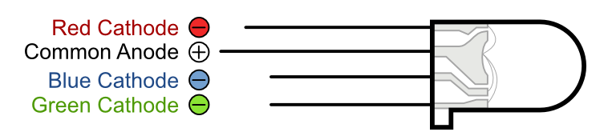
RGB LED
Red, Green and Blue in one LED.
void setup() {
pinMode(9, OUTPUT);
pinMode(10, OUTPUT);
pinMode(11, OUTPUT);
}
void loop() {
analogWrite(9, random(255));
analogWrite(10, random(255));
analogWrite(11, random(255));
delay(500);
}
+5V
220 ohm
+
-
9 10 11

Slide 17
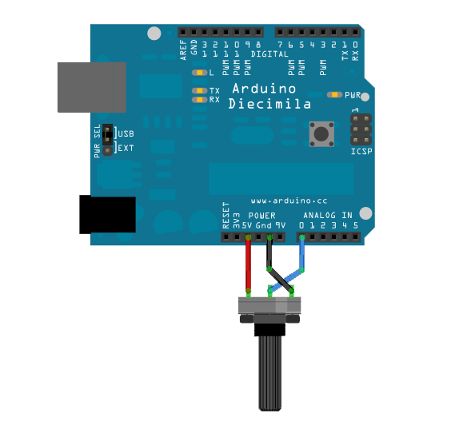
AnalogReadSerial Example
Connect on breadboard
Middle pin goes to A0
Open Serial Monitor
Serial.begin(9600);

Slide 18
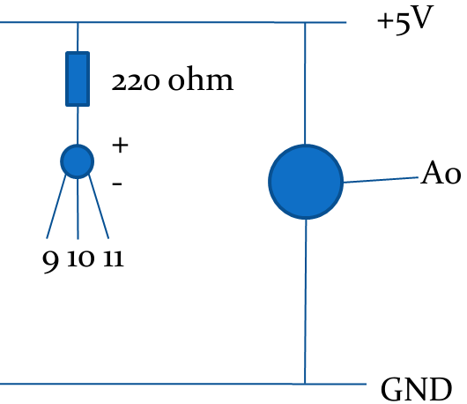
Turn Pot to Change RGB Color
void loop(){
sensorValue = analogRead(sensorPin);
analogWrite(redPin,255);
analogWrite(bluePin,255);
analogWrite(greenPin,255);
if(sensorValue < 330){
analogWrite(redPin,0);
} else if (sensorValue < 660){
analogWrite(greenPin,0);
} else {
analogWrite(bluePin,0);
}
}

Slide 19
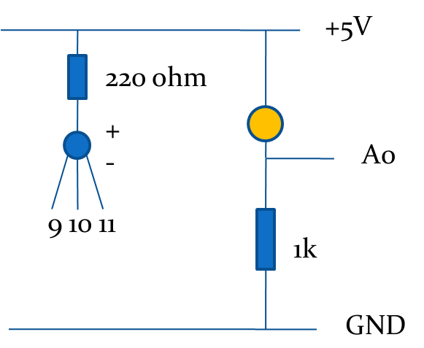
LDR – Light Dependant Resistor
Add your own code:
As the light level changes - changes the RGB LED values?

Slide 20
Set color using serial data
void setup(){
// initialize the serial communication:
Serial.begin(9600);
…....
}
void loop() {
byte brightness;
// check if data has been sent from the computer:
if (Serial.available()) {
// read the most recent byte (which will be from 0 to 255):
brightness = Serial.read();
…....
}
}

Slide 21
Server Status
Server status to LED color
echo -n "1" > /dev/ttyUSB0
stty -F /dev/ttyACM0 cs8 9600 ignbrk -brkint -icrnl -imaxbel -opost -onlcr -isig -icanon -iexten -echo -echoe -echok -echoctl -echoke noflsh -ixon -crtscts
http://playground.arduino.cc/Interfacing/LinuxTTY#.Uy_CCKF1XyU

Slide 22
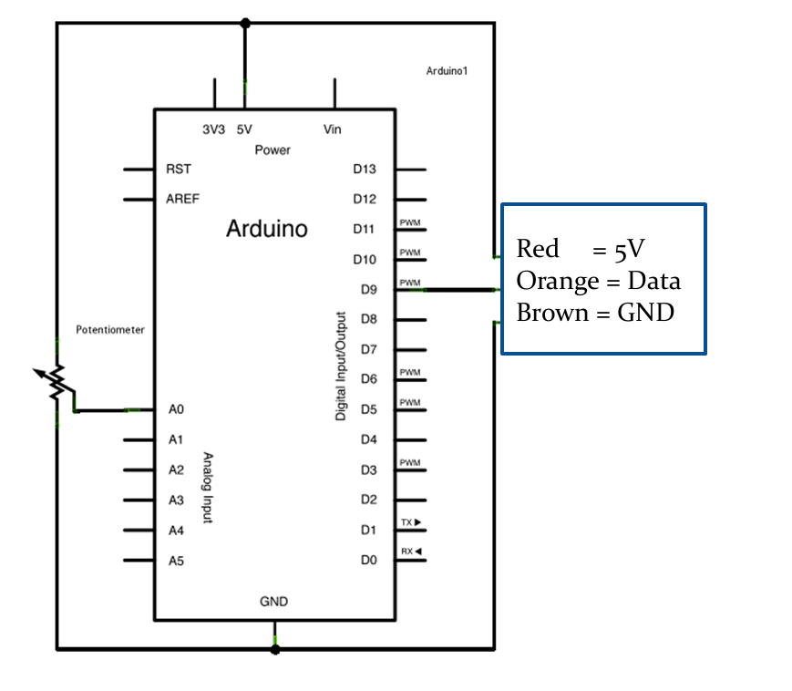
Servo – Knob Example
Servo Library
"Knob" example
Servo driven by PWM
The servo you have can only rotate 180 degrees
This one heavy on the juice (500mA)
Use the big cap to sort out your power supply!
Note:
Servo colors may vary, e.g. Red, White, Black – consult the datasheet for pinouts

Slide 23
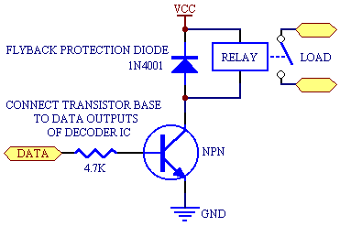
Relay
External circuits:
Irrigation System
Fan
Arduino maximum current out per pin 40 – 50 mA

Slide 24

Acknowledgements
Tutorials from Arduino.cc, and various authors on countless forums. To these authors our thanks and acknowledgement

Slide 25
Contact info
Email
Schalk: schalk.heunis@gmail.com
Guy: guy.vandenberg@microsmart.co.za
Find us
h4h website: http://www.house4hack.co.za/
h4h Google group: https://groups.google.com/forum/#!forum/house4hack

Slide 26
Upcoming courses
Advanced Arduino
  AT Tiny
  SD Card
  SPI, I²C
Internet of Things
  Build an online electricity meter!

