Slide 1

Evolving Energy Demand Estimation Models over Macroeconomic Indicator
Lourenco, N. – Colmenar, M. – Hidalgo, I. – Salcedo-Sanz, S.
Genetic and Evolutionary Computation Conference, July 2020
Rémy Jumpertz, Antoni Garzon, Shuang Hou, Nicolas Mousset

Slide 2
Context
Important for policy maker
Indicator of the economic growth of a country
Impacted by the health of the economy
Energy Demand
Use of a Structured Grammar Evolution (SGE) hybridized with Differential Evolution (DE) to predict Energy Demand in Spain based on 14 Economic Variable

Slide 3
Data
The paper focuses on Spain and uses 14 macro-economic variable :
Data gathered between 1980 – 2011 : 15 years for the definition of the model and 16 years for testing.
Gross Domestic Product | 8) GDP per unit of energy used
2) Population | 9) Energy imports net
3) Exports | 10) Fossil fuel consumption
4) Imports | 11) Electric power consumption
5) Energy production | 12) CO2 emissions
6) Electricity power transport | 13) Unemployment
7) Electricity production | 14) Diesel consumption

Slide 4
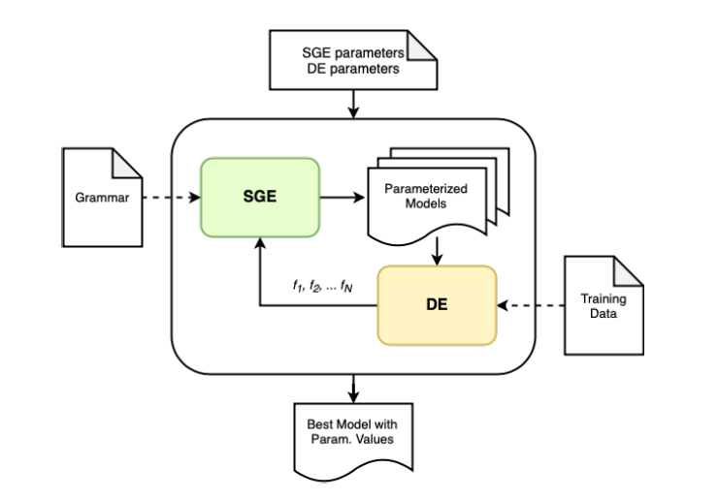
Proposed Algorithm

Slide 5
Structured Grammar Evolution (1)
Evolutionary computation technique proposed by Conor, Colins and O’Neill in 1998.
Aimed at finding an executable (fragment of a) code that will achieve a good fitness value for a given objective function.
Grammar
Evolution
Improved version of GE aimed at reducing GE’s limitation, proposed in 2016 by Lourenco, Pereira and Costa.
Main difference is in the genotype representation.
Structured
Grammar
Evolution
Here the objective is to find a model for the Energy Demand

Slide 6
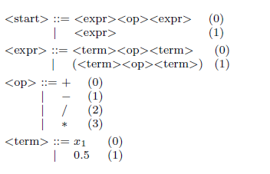
Structured Grammar Evolution (2)
How does it work ?
Grammar definition :
Based on the problem, the used defines a set of rules that limits the number of the possible expressions.

Slide 7
The grammar of our problem
(I) <start> ::= w[0] <op> <recExpr>
(II) <recExpr> ::= <expr> | <expr> <op> <recExpr>
(III) <expr> ::= <param> <op> <var> | <param> <op> (<var>)**(<param>) |
exp(abs(<param> <op> <var> )) | log(abs(<param> <op> <var> ))
<param> ::= w[1] | w[2] | w[3] | w[4] | w[5] | w[6] | w[7] | w[8] | w[9] |
w[10] | w[11] | w[12] | w[13] | w[14]
(V) <var> ::= x[1] | x[2] | x[3] | x[4] | x[5] | x[6] | x[7] | x[8] | x[9] | x[10] | x[11] |
x[12] | x[13] | x[14]
(VI) <op> ::= + | - |*

Slide 8
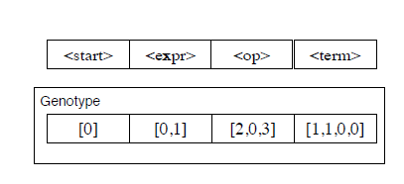
Structured Grammar Evolution (3)
How does it work ?
Grammar definition
Genotype definition :
Based on the grammar, the genotype structure is defined. Restrictions apply on :
number of genes
size of each gene
possible values of gene

Slide 9
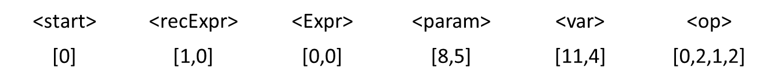
Genotype Definition of our problem
There are 6 rules in the grammar. Then each individual must have 6 genes :
One possible genotype is given by:
 | <start> | <recExpr> | <Expr> | <param> | <var> | <op>
Max val | 0 | 1 | 3 | 13 | 13 | 3

Slide 10
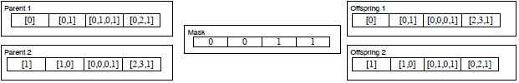

Structured Grammar Evolution (3)
How does it work ?
Grammar definition
Genotype definition
Population evolution
First population is created at random. Fitness is computed and evolutionary techniques are used to evolve the population.

Slide 11
SGE : our problem
Let’s decode our genotype :
Always begin with the <start> symbols and decode each symbol using the most leftward unused value. Here:
I) w[0] <op> <recExpr> ([] [1,0] [0,0] [8,5] [11,4] [0,2,1,2])
II) w[0] + <expr> <op> <recExpr> ([] [0] [0,0] [8,5] [11,4] [2,1,2])
iii) w[0] + <param> <op> <var> <op> <recExpr> ([] [0] [0] [8,5] [11,4] [2,1,2])
iv) w[0] + w[9] * x[12] - <recExpr> ([] [0] [0] [5] [4] [2])
v) w[0] + w[9] * x[12] - <Expr> ([] [] [0] [5] [4] [2])
vi) w[0] + w[9] * x[12] - <param> <op> <var> ([] [] [] [5] [4] [2])
vii) w[0] + w[9] * x[12] – w[6]*x[5] ([] [] [] [] [] [])

Slide 12
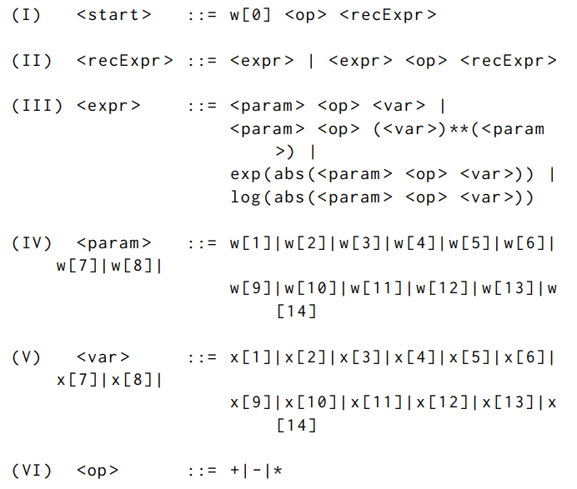
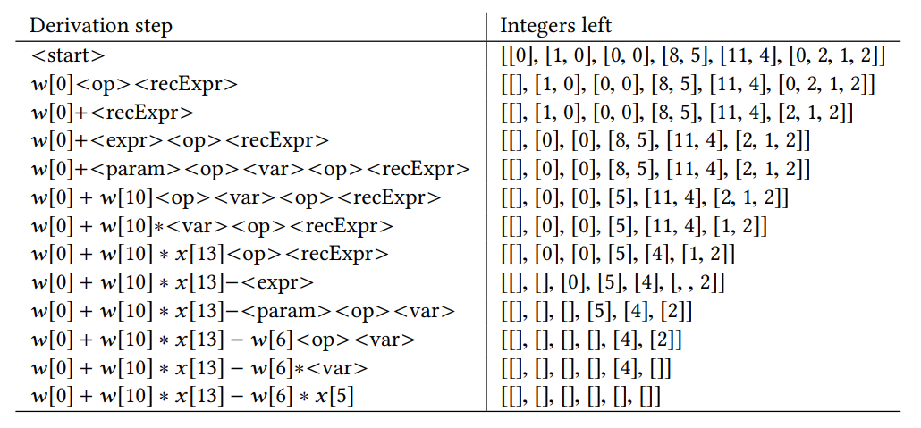
Decoding the grammar to compute the fitness (1)
Grammar
Decoding

Slide 13
Decoding the grammar to compute the fitness (2)
Grammar
Decoding

Slide 14
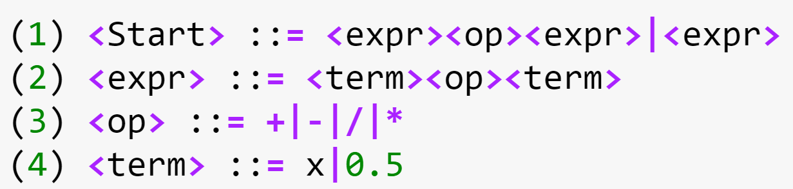
Your turn to play
Please decode the following genotype using the provided grammar :
[ [1] [0] [2] [1,0] ]
Send your answer to www.wooclap.com/Stocha

Slide 15
Proposed Algorithm

Slide 16
Differential Evolution (1)
Initialize Population
Evaluation of initial population
Similar to Genetic Algorithm
Main difference : mutation
DE’s mutation : based on the vector difference of the individuals.
DE shows strong robustness in solving non-convex, multimodal and nonlinear function optimization problems, and is especially good at solving multivariate function optimization problems.
t max ?
yes
Done
no
Mutation
Crossover
Evaluation of experimental individuals
Selection

Slide 17
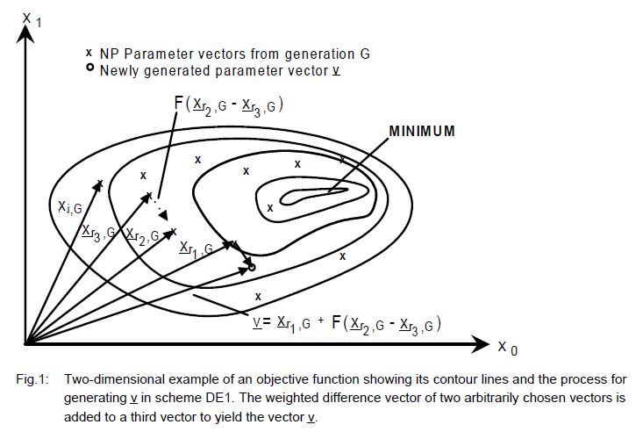

Differential Evolution (2)
Mutation
The weighted difference vector of two arbitrarily chosen vectors is added to a third vector, the one with the smallest fitness in the previous population, to yield the mutant vector.
Contour lines of the cost function

Slide 18
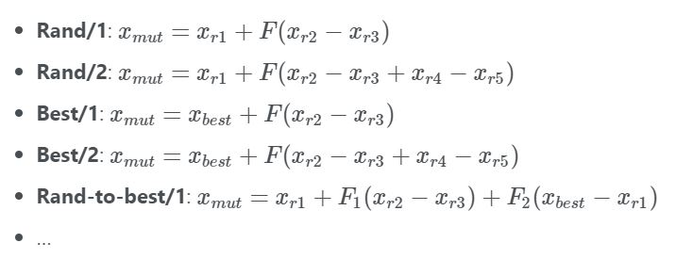
Differential Evolution (2)
Several mutation schema

Slide 19
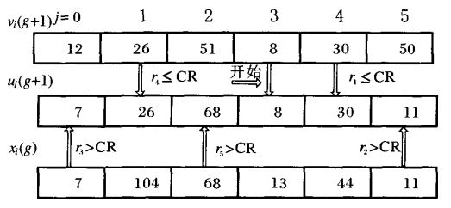
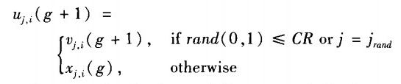
Differential Evolution (3)
Crossover
The Crossover Rate (CR ϵ [0,1], usually 0.3) is used to determine whether the original individual or the mutant individual will be the experimental individual of the next generation.
start

Slide 20


Differential Evolution (4)
Selection
Compare the fitness to select whether the original individual or the experimental individual who can enter the next-generation population.
Fitness function used here : sum of the absolute errors (SAE)

Slide 21
Differential Evolution
Let’s see DE in action

Slide 22
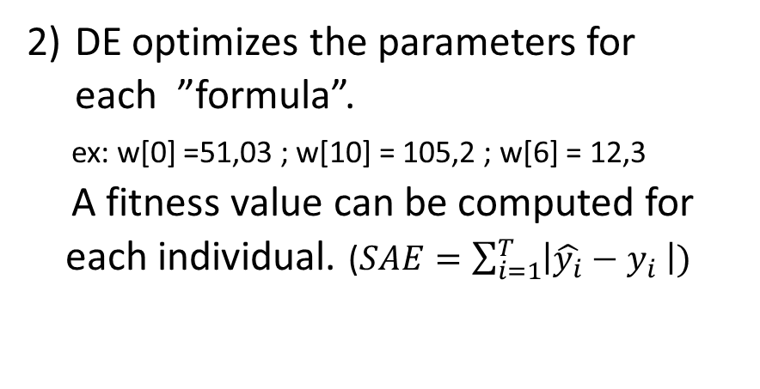
Proposed Algorithm
SGE creates a formula with parameters.
ex: w[0] + w[10] * x[13] – w[6]*x[5]
DE optimizes the parameters for each ”formula”.
ex: w[0] =51,03 ; w[10] = 105,2 ; w[6] = 12,3
A fitness value can be computed for
each individual. ($SAE=\sum_{i=1}^{T}{\left|\hat{y_{i}}−y_{i} \right|)}$

Slide 23
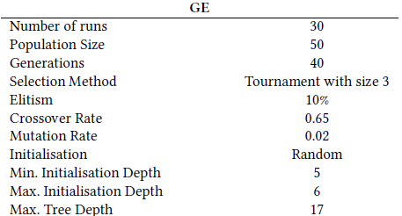
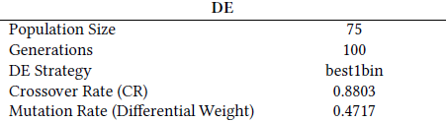
Algorithm Parameters

Slide 24

Result (1)
Best model evolved has the following form :
D = $w_{0}+w_{6}∗x_{1}∗\log\left(abs\left(w_{2}∗x_{1}\right)\right)+w_{9}−x_{11}^{w_{11}} −w_{10}∗x_{12}^{w_{3}}−\exp\left(abs\left(w_{13}∗x_{11}\right)\right)∗w_{13}−x_{1}∗w_{11}−x_{8}∗w_{14}−x_{4}^{w_{5}}−w_{1}∗x_{6}^{w_{13}}$

Slide 25
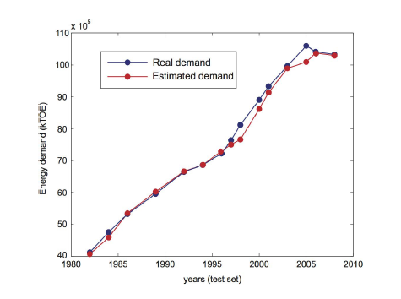
Result (2)
Models have low error on training and testing data. However it tends to underestimate the demand for certain years.
SGE algorithm performs better than GS version.

Slide 26
Link with other subject in the track
Stochastic optimization techniques can be used to tackle practical problems in various fields : antenna design, energy demand estimation, optimization of energy systems, ….
Nasa’s paper on antenna design is close to ours in the Algorithmic ideas: antenna’s design are random just like the model is in this case; Evolutionary method are then used in both cases to evolve towards a better solution.

Slide 27
Conclusion
Two different evolutionary methods (SGE & DE) are used to find a model for Energy Demand prediction.
The obtained model provides good result on the testing data.
The SGE/DE algorithm provides better result than the GS algorithm.
Future work could include the testing of the model on other data (geography and time frame) to analyze whether it is able to capture all changes in Energy Demand

Slide 28
Thank you

Slide 29
Sources
Nuno Lourenço, J. Manuel Colmenar, J. Ignacio Hidalgo, and Sancho Salcedo-Sanz. 2020. Evolving Energy Demand Estimation Models over Macroeconomic Indicators. In Genetic and Evolutionary Computation Conference (GECCO ’20), July 8–12, 2020, CancÃžn, Mexico. ACM, New York, NY, USA,7 pages. https://doi.org/10.1145/3377930.3390153
Lourenço, N., Assunção, F., Pereira, F. B., Costa, E., & Machado, P. (2018). Structured grammatical evolution: a dynamic approach. In Handbook of Grammatical Evolution (pp. 137-161). Springer, Cham.
Lourenço, N., Pereira, F. B., & Costa, E. (2016). Unveiling the properties of structured grammatical evolution. Genetic Programming and Evolvable Machines, 17(3), 251-289.
Kenneth V Price. 2013. Differential evolution. In Handbook of Optimization. Springer, 187–214.
Rainer Storn and Kenneth Price. 1997. Differential Evolution – A Simple and Efficient Heuristic for global Optimization over Continuous Spaces. Journal of Global Optimization 11, 4 (01 Dec 1997), 341–359.

