Slide 1


Analyzing Customer Churn at Databel

Slide 2
Case study from DataCamp
The task is to solve customer churn for a Telecom provider called Databel where I will be using a fictitious churn dataset. I will be analyzing why customers are churning and the churn rate.

Slide 3
Agenda
1. Customer Churn
2. Dataset Overview
3. Churn Analysis and Insights

Slide 4

1. Churn rate
Churn rate is the percentage of customers or subscribers who cease using a product or service during a specified time period.
Churn rate = $\frac{\text{customers} \text{lost}}{\text{total} \text{number} \text{of} \text{customers}}$

Slide 5
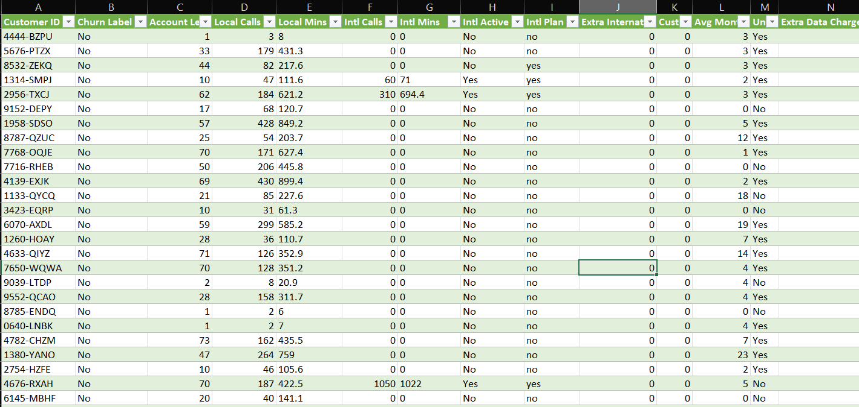
2. Dataset overview
29 different columns with one row per custom
6687 rows

Slide 6
3. Churn analysis & Insights

Slide 7
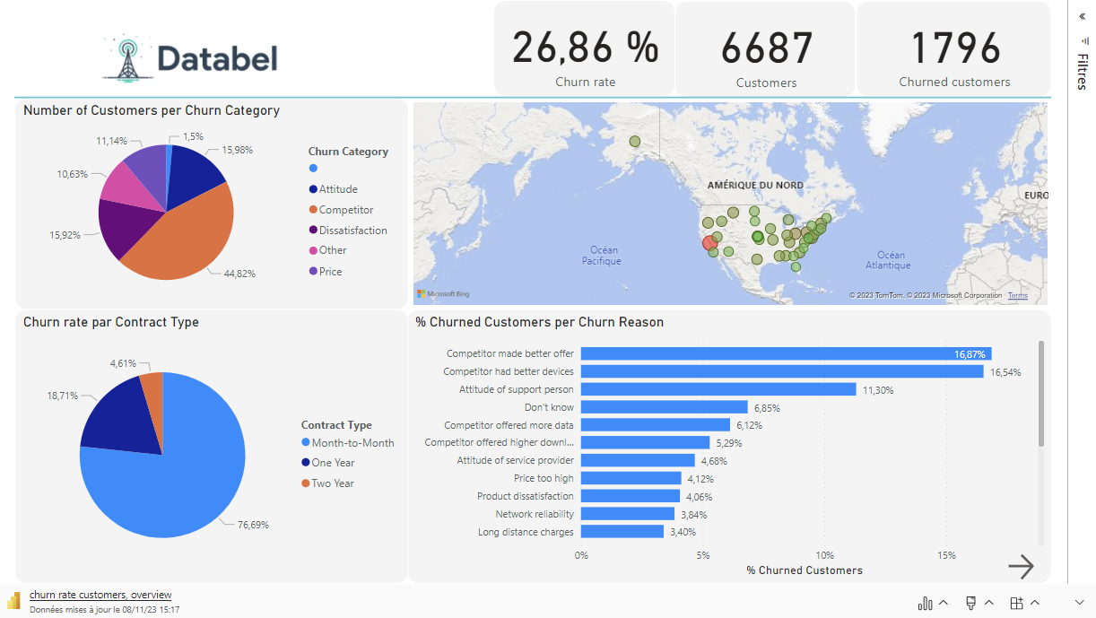

Slide 8
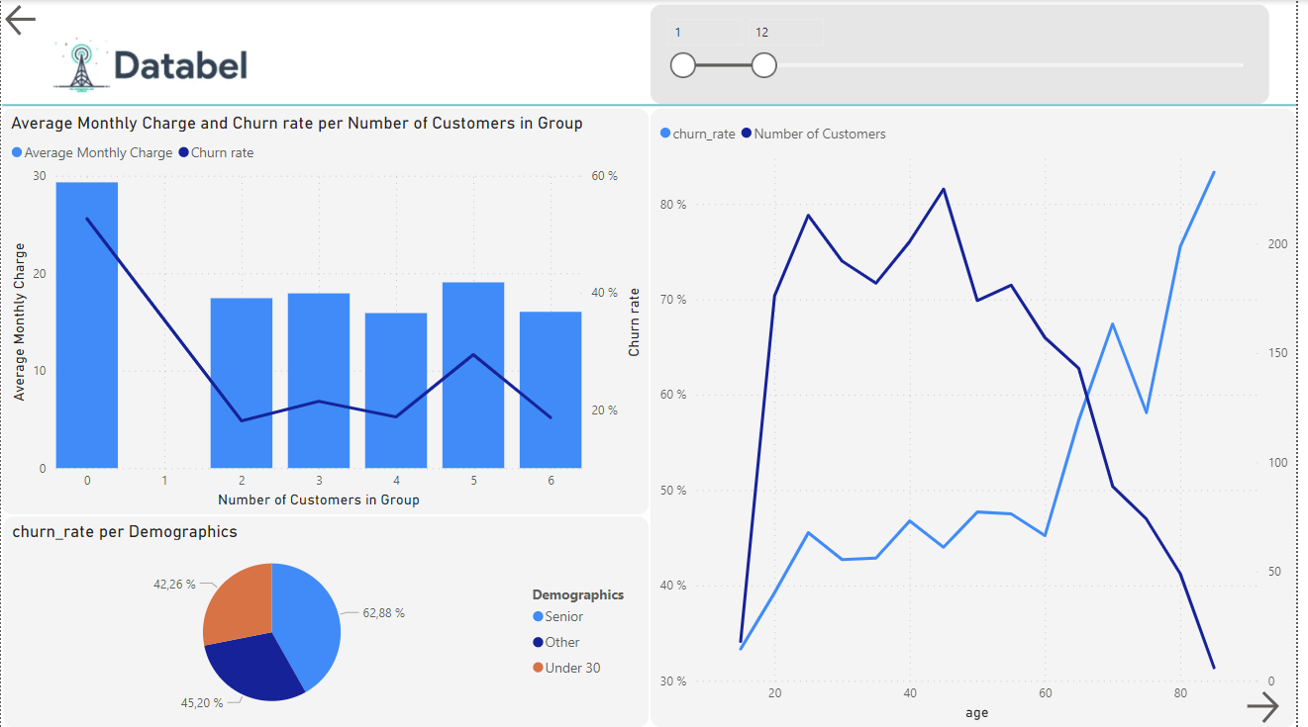

Slide 9
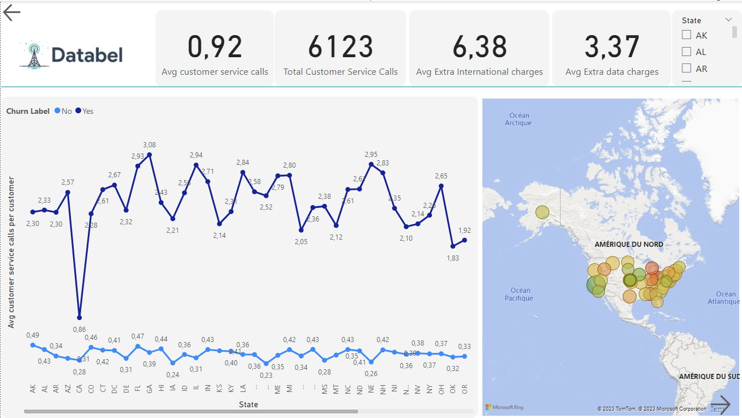

Slide 10
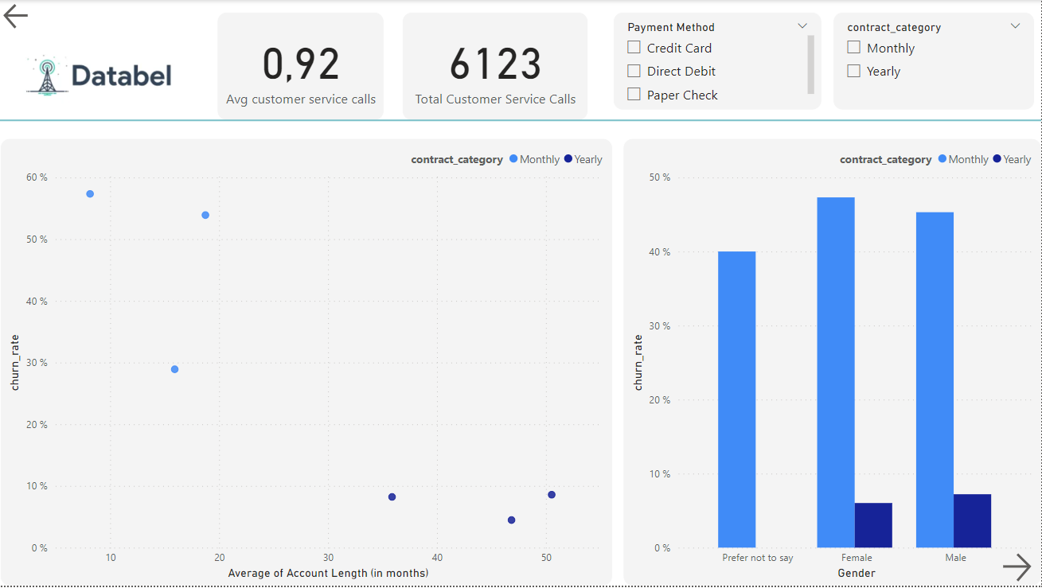

Slide 11
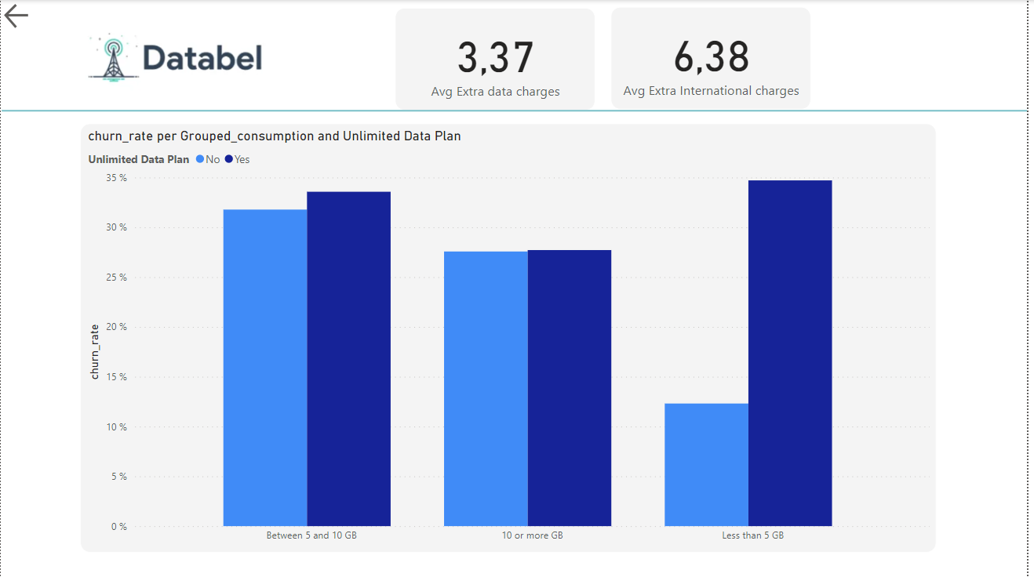

Slide 12
Insights
1. The top reasons why customers churn are :
Competitors who have better offers
Competitors who have better device
The attitude of support person
2. The Churn rate is for Databel is on average 27%
3. The Churn rate in California state is abnormally high and yet it has the lowest sum of customer service calls, CA state’s churn rate is 79 % for clients on month-to-month contracts.
4. Monthly contract customers churn more than yearly contract customers and the larger churning gender is females.
5. Customers who are on an unlimited plan are more likely to churn. Databel should contact these customers suggest that they downgrade their plan.
6. There is a higher churn rate from senior citizens.

Slide 13
Thank you! ☺

