Slide 1

Foundation
Unified AXA Platform

Slide 2




Vision & Mission
A unified platform that groups multiple applications
AXA Standards Alignment
Natural alignment with group standards, ensuring consistency and compliance.
Seamless Interconnection
A seamless interconnection between applications, ensuring efficient information flow.
Modern & Secure Tools
Modern, robust and reliable tools that enhance the quality and security of operations.
Process Simplification
Facilitates the daily work of operational teams in France, UK, Germany and Japan.

Slide 3
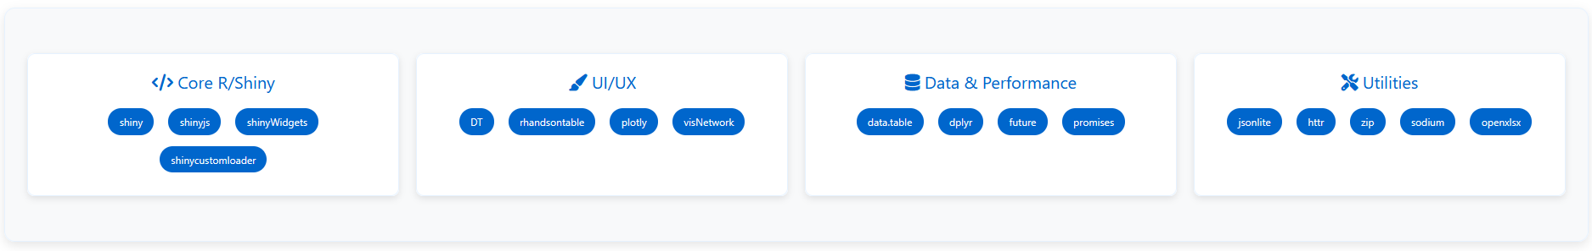
Technical Architecture
Modern and robust technology stack

Slide 4


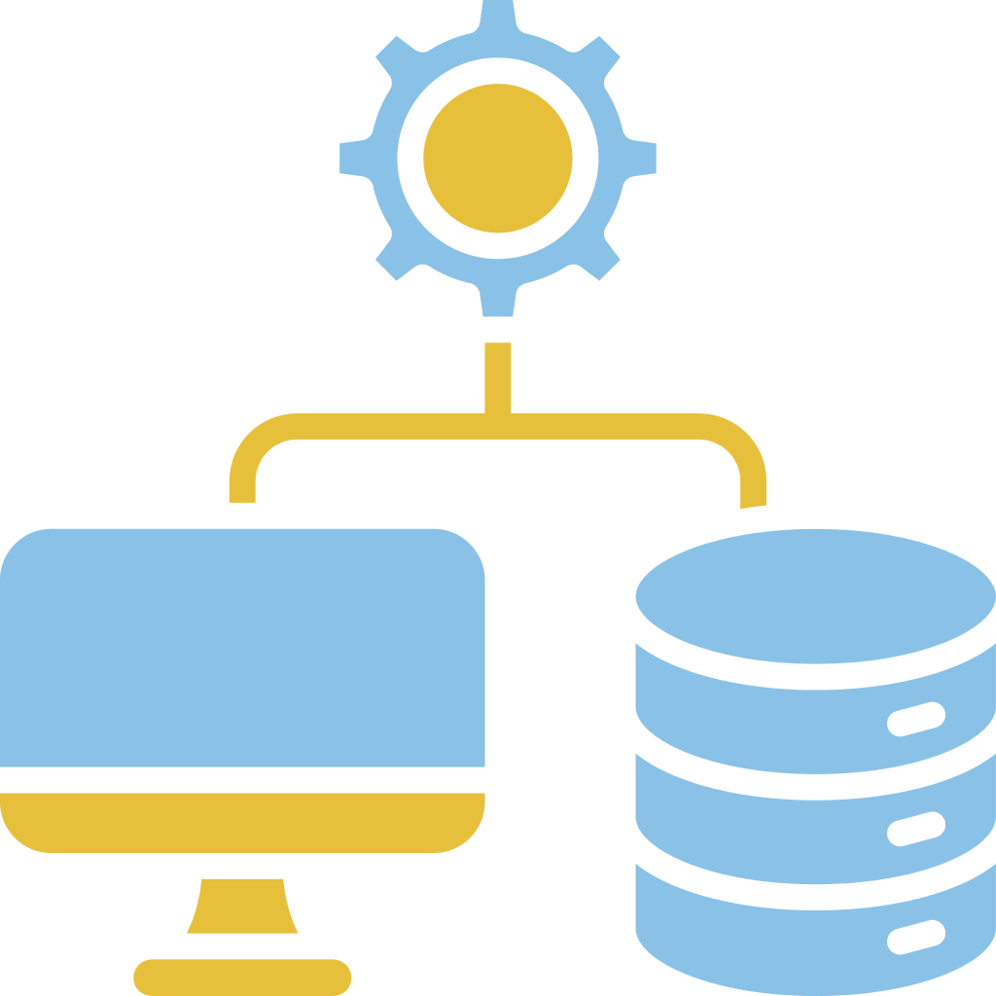
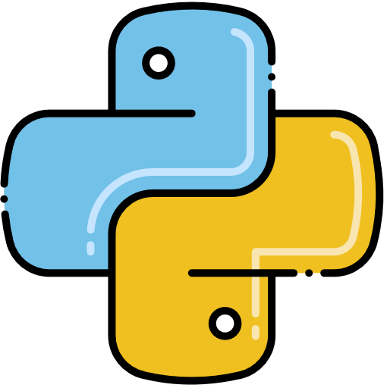

Technical Architecture
Infrastructure
Databricks File System (DBFS) for storage
.env for environment variables
Parallelism via multicore futures
REST API Integration
Python Integration
Frontend
Data quality check
Other tools: docx cleanup
Advanced Analytics
CSS : bootstrap, MDB, swiper, custom styles
JS : jQuery, airDatepicker, CodeMirror, custom...

Slide 5
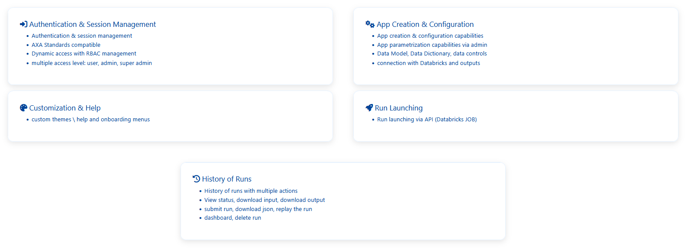
Key Features
A complete platform for all needs

Slide 6
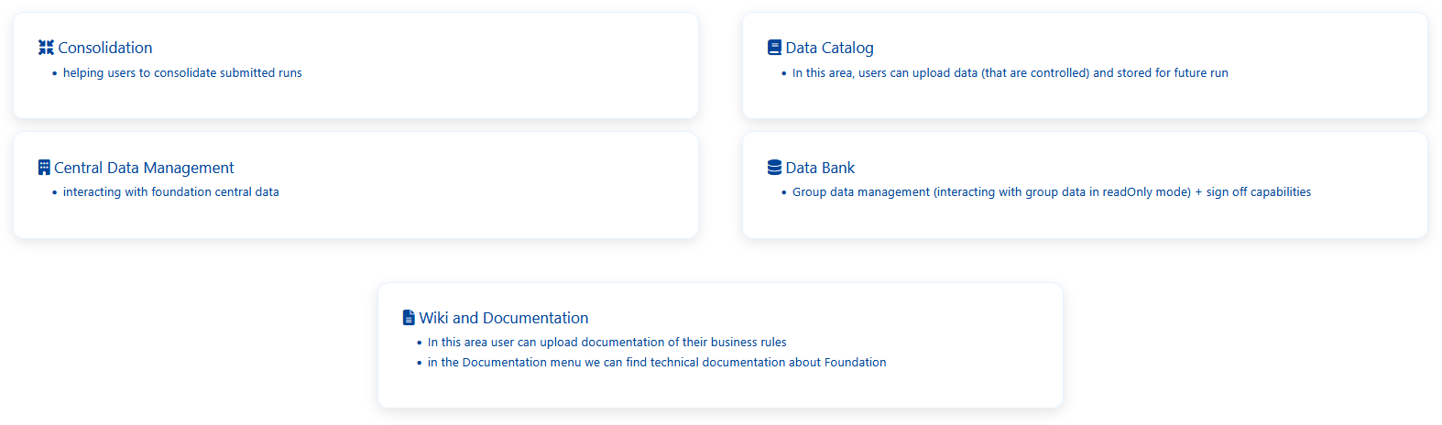
Key Features
A complete platform for all needs

Slide 7
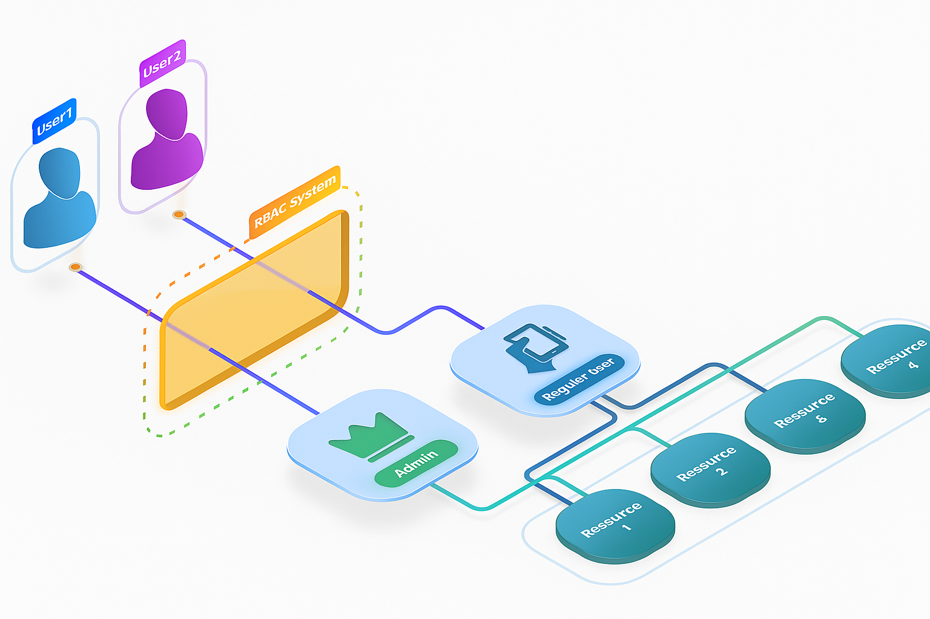
What is RBAC?
RBAC = Role-Based Access Control
Intelligent access rights management system based on roles
Granular control of user permissions
Advanced security for application and feature access

Slide 8




RBAC Principles
Rights Management
Profile Management
A right corresponds to a permission that allows access to a menu, application, or functionality.
A profile is a set of rights. It can be created from scratch or based on an existing profile
RBAC
User Management
A user can have access to one or multiple profiles, depending on their responsibilities and the functionalities they need to access.

Slide 9
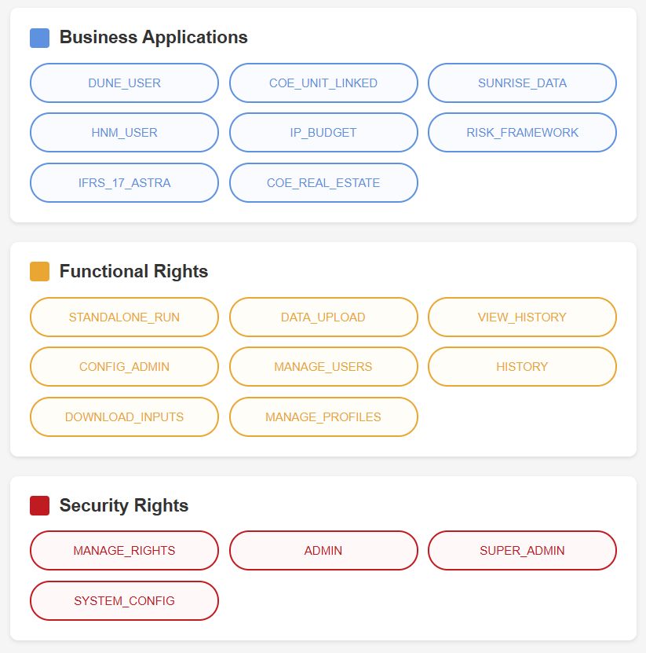
Rights Management
The three types of rights

Slide 10
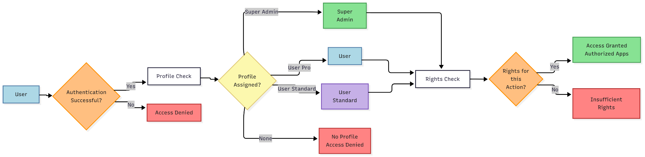
Use case diagram

Slide 11







Competitive Advantages
International Coverage
Multi-entity support
Maximum Flexibility
Advanced configuration and parameterization
Enhanced Security
Granular RBAC
Complete Traceability
Detailed history
Support
Complete documentation and assistance

Slide 12

Demonstration

Slide 13

Demonstration
Foundation
The future of AXA operational management
A Complete Solution
Foundation represents a lever for simplification, harmonization and performance for local teams, while fully integrating into the group's global data strategy.

