Slide 1

Wentworth Air Database Project
By John Bowes and James Houston

Slide 2
Introduction
Our database will represent a airport infrastructure including multiple airports, airlines, planes, as well as staff, customers, and flights
It can successfully organize and display flights and hold customer account information

Slide 3
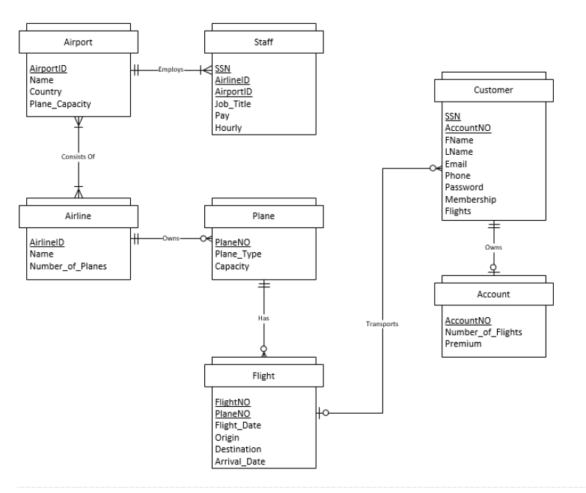
ERD Diagram

Slide 4
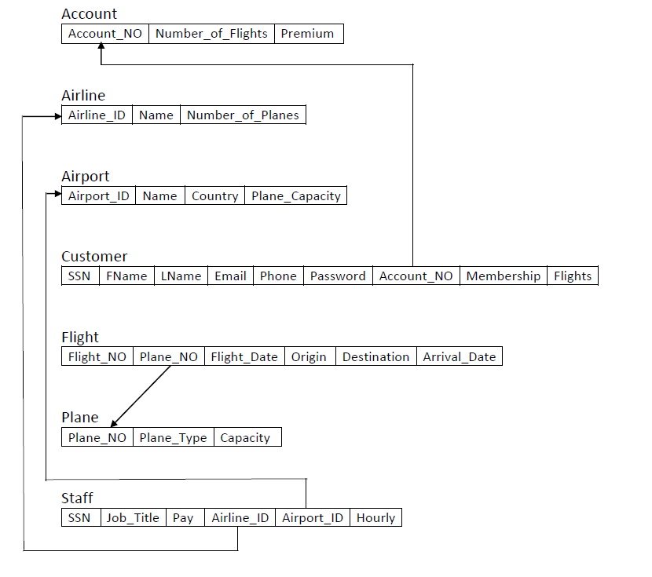
Conceptual Design

