Slide 1
DeepKsite
Scatter Plots & Bar Charts

Slide 2
Scatter Plots - Test Set

Slide 3
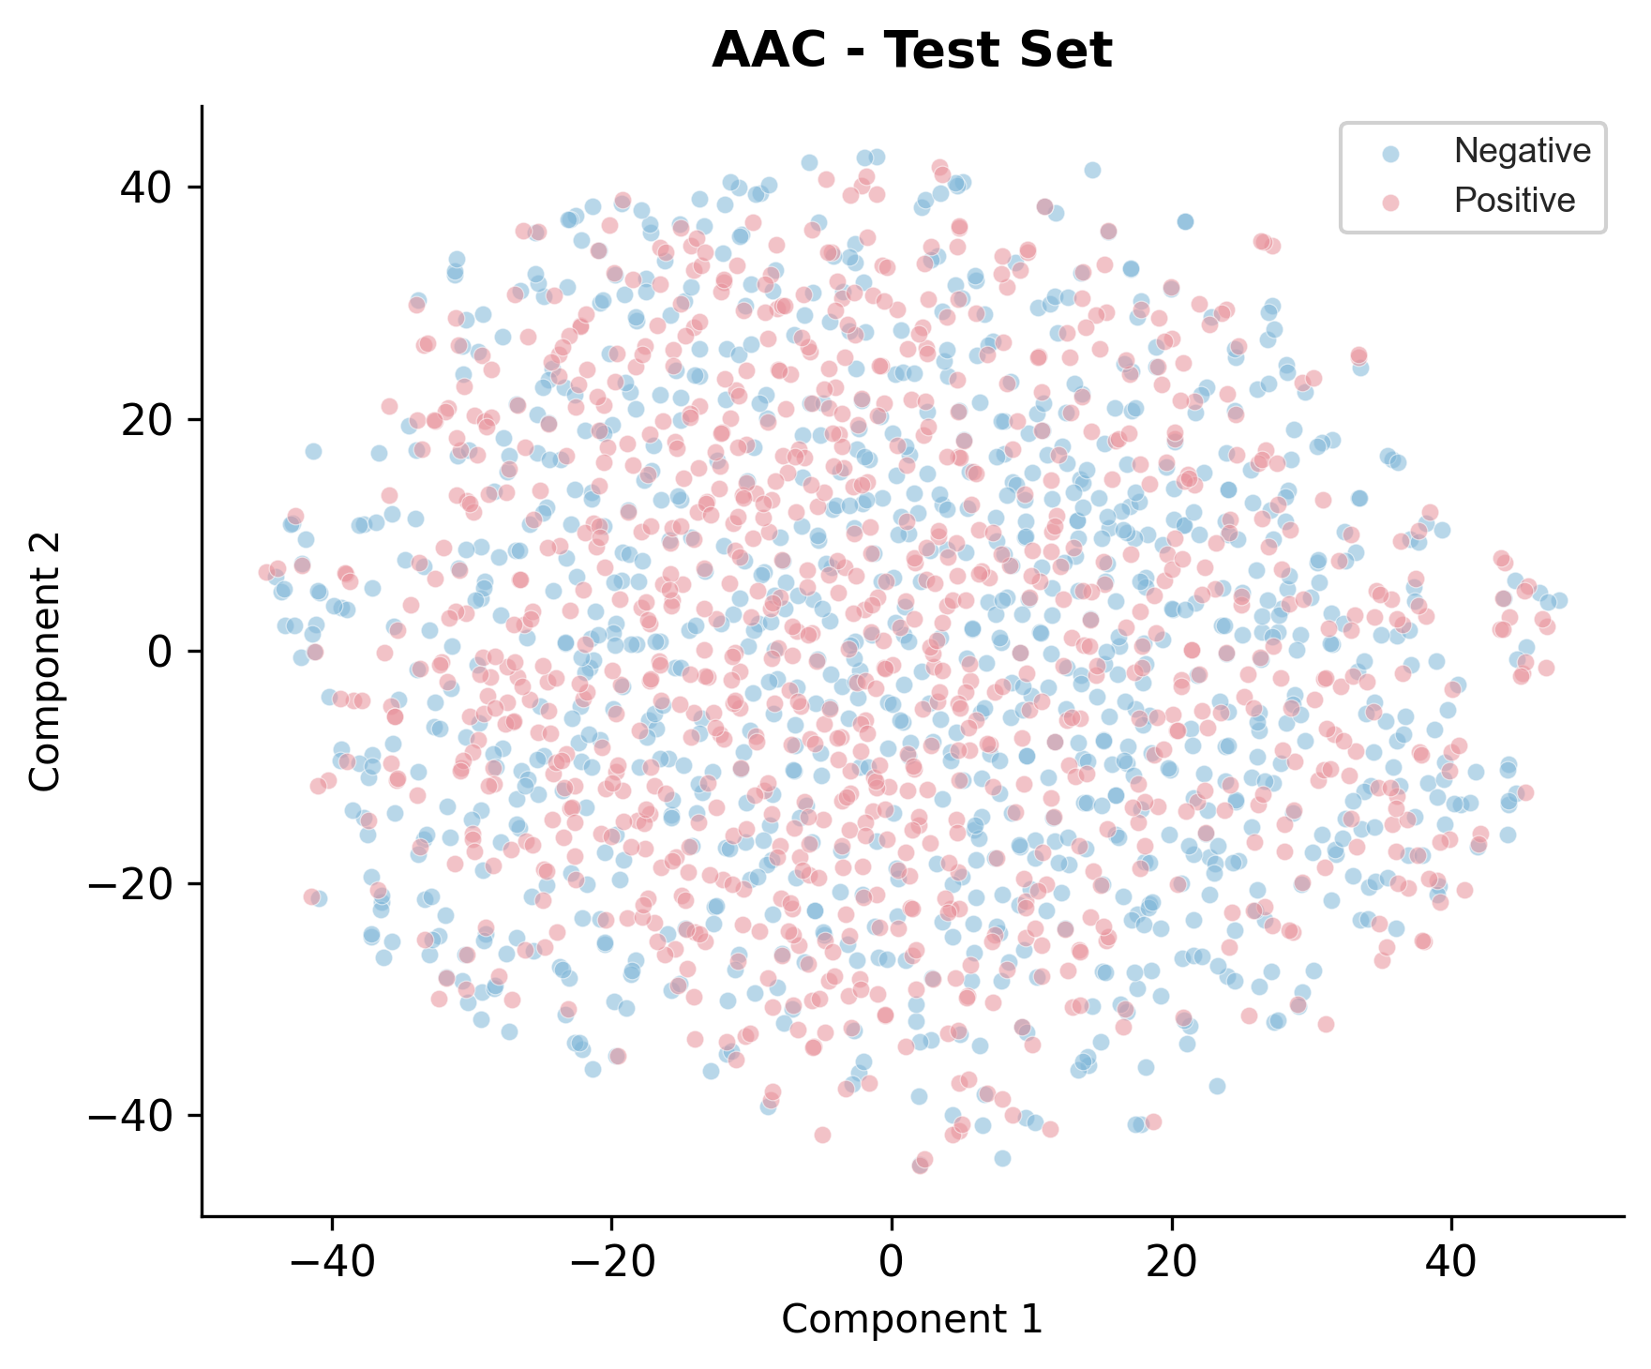
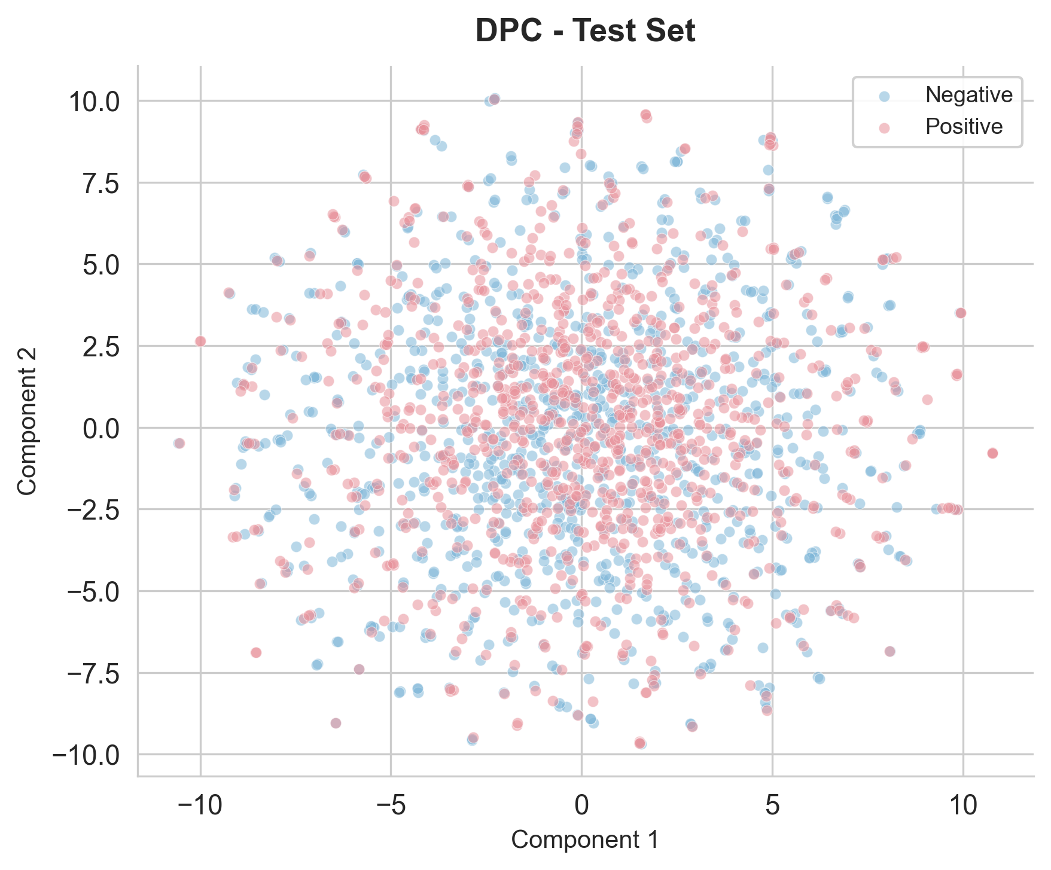
AAC - Test Set | DPC - Test Set

Slide 4
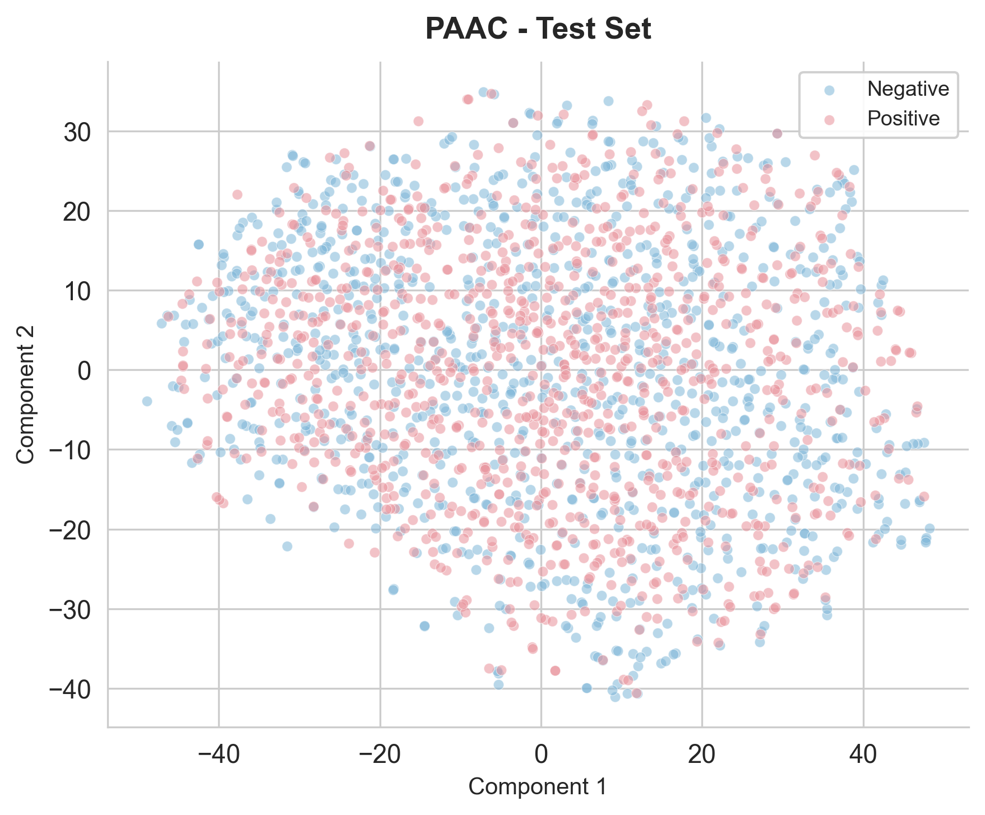
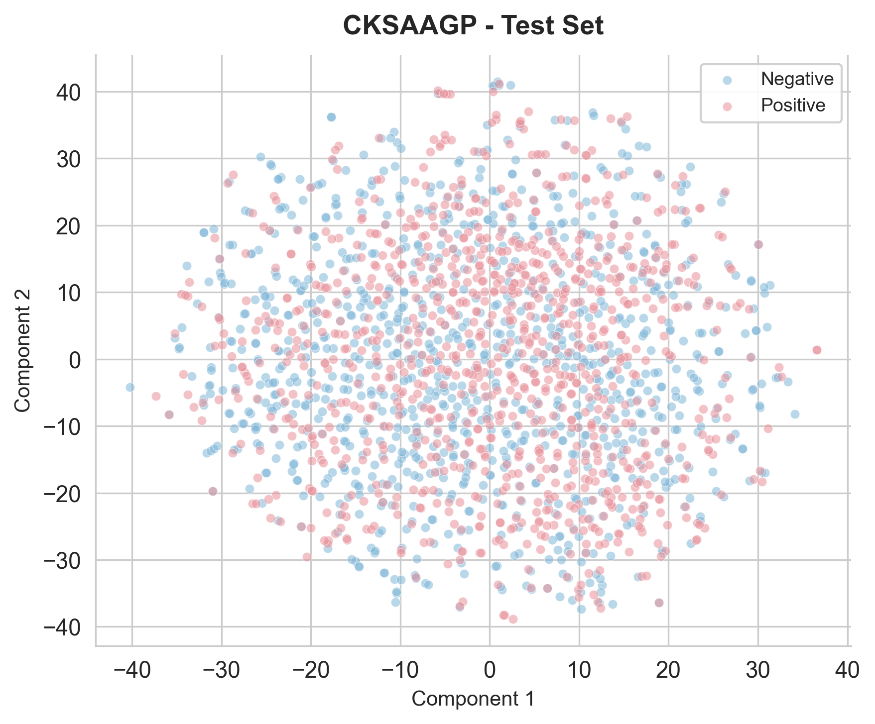
PAAC - Test Set | CKSAAGP - Test Set

Slide 5
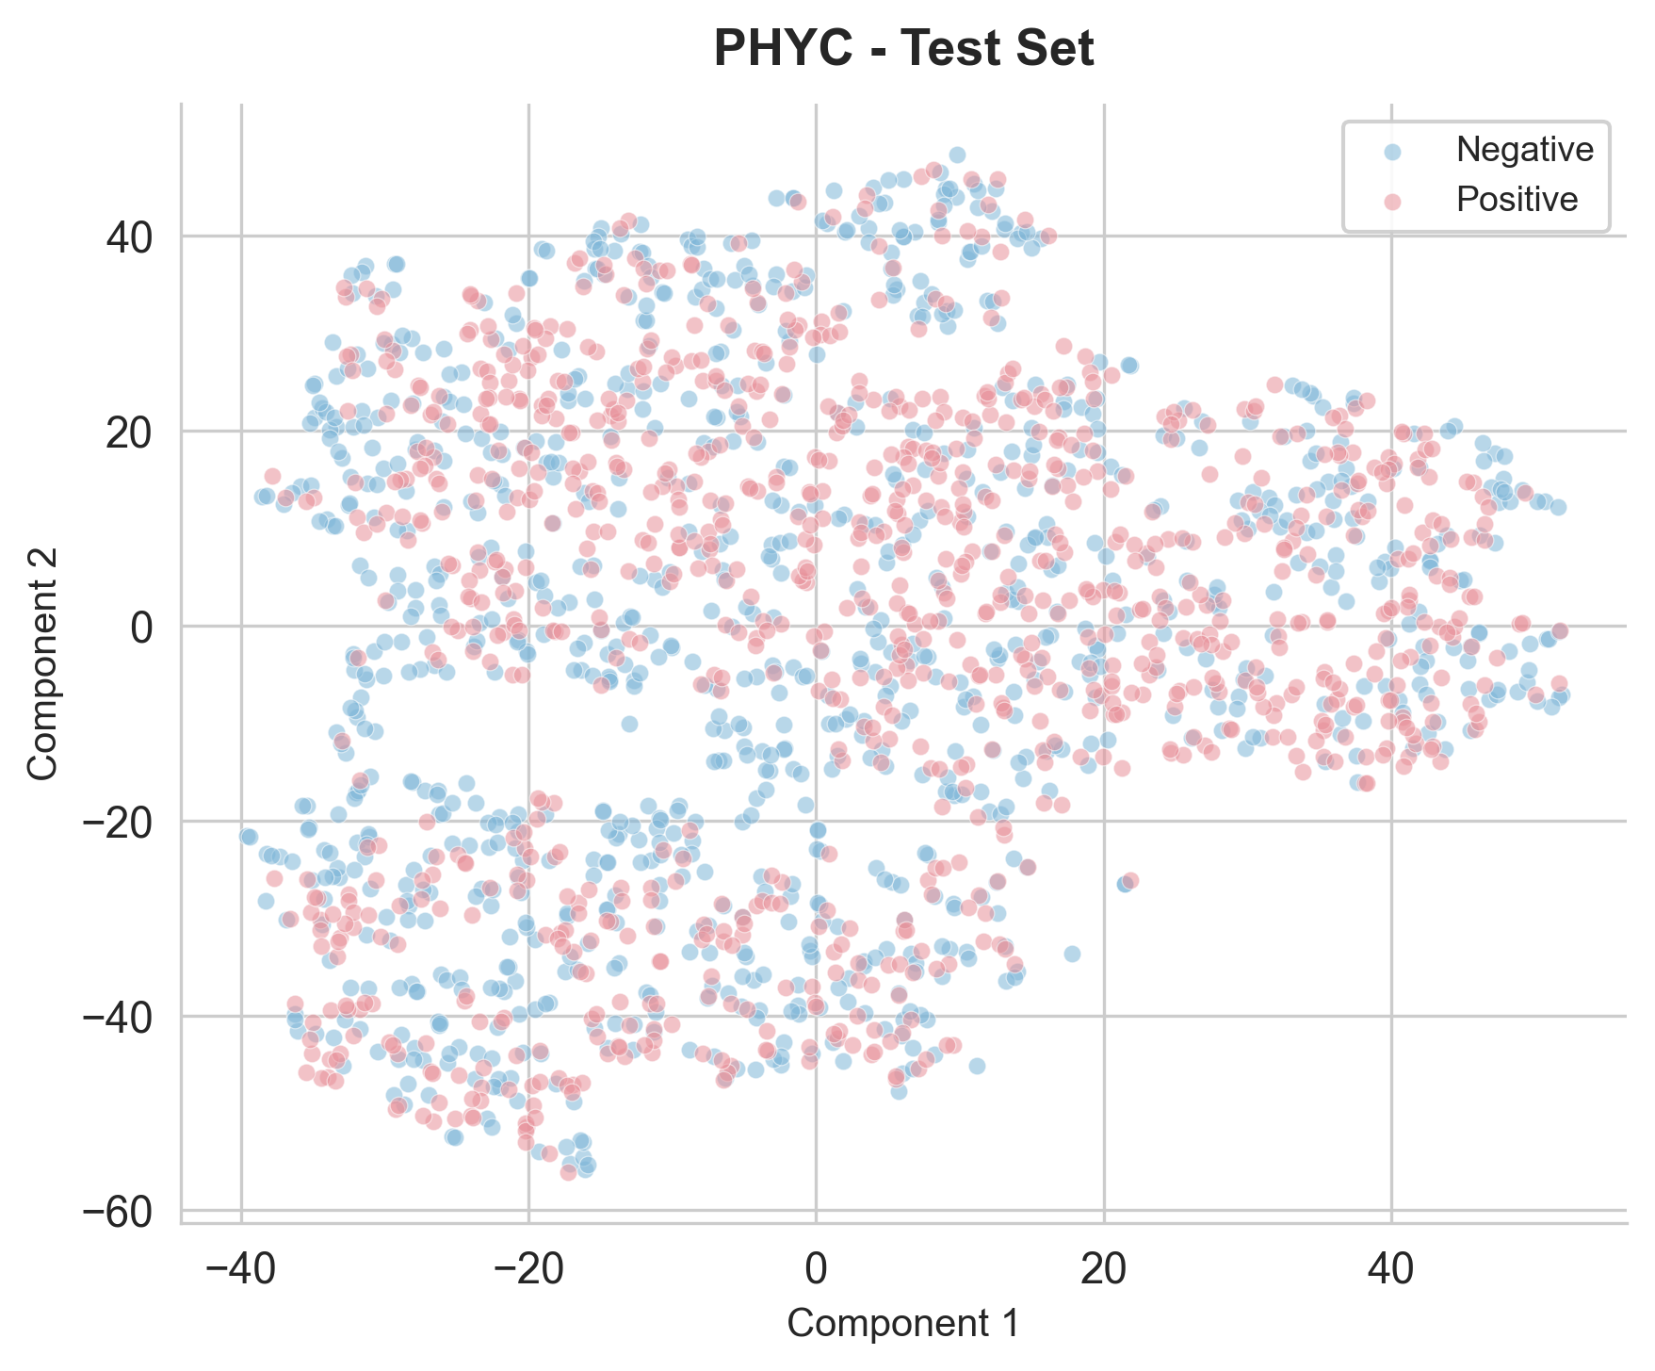
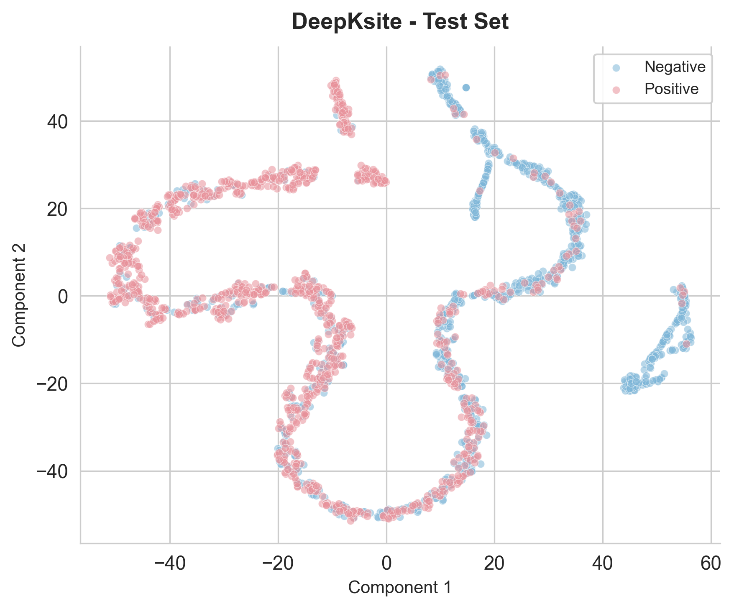
PHYC - Test Set | DeepKsite - Test Set

Slide 6
Scatter Plots - Train Set

Slide 7
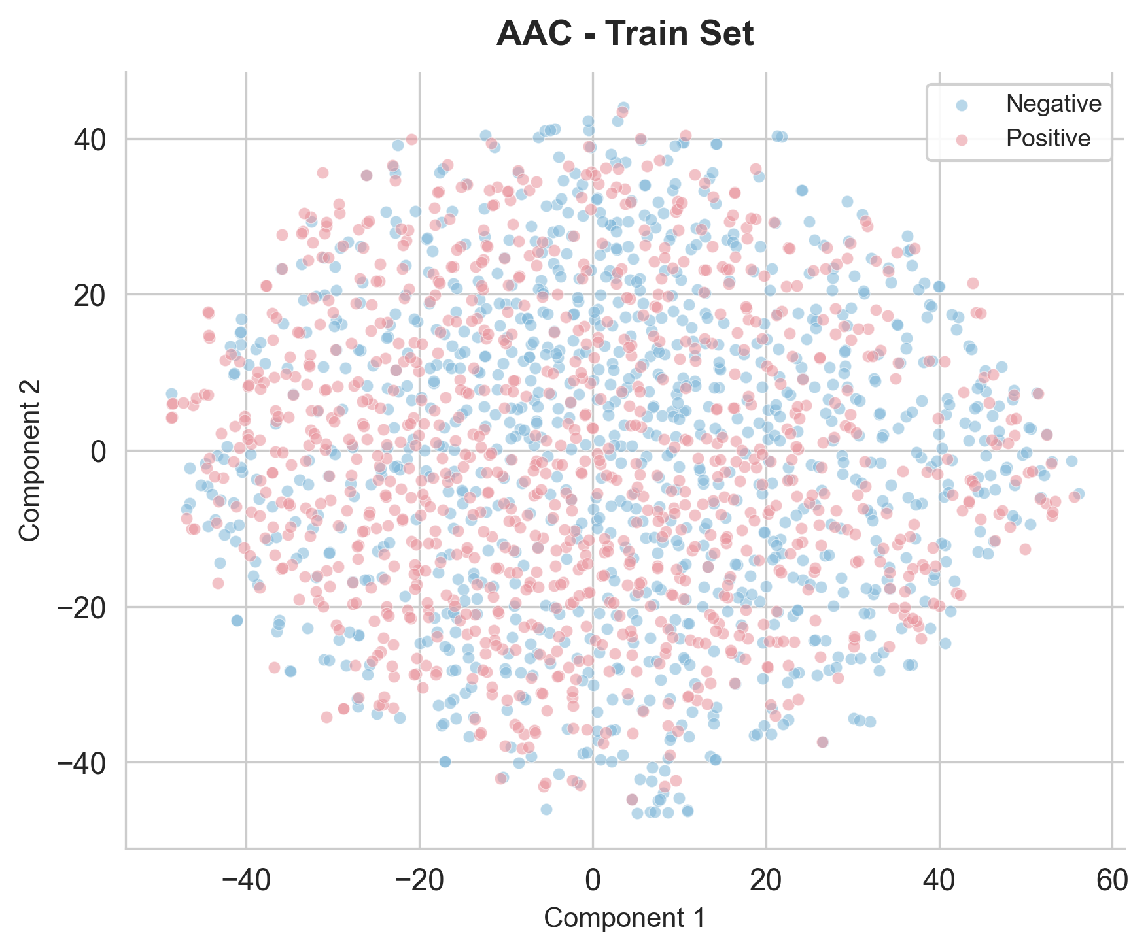
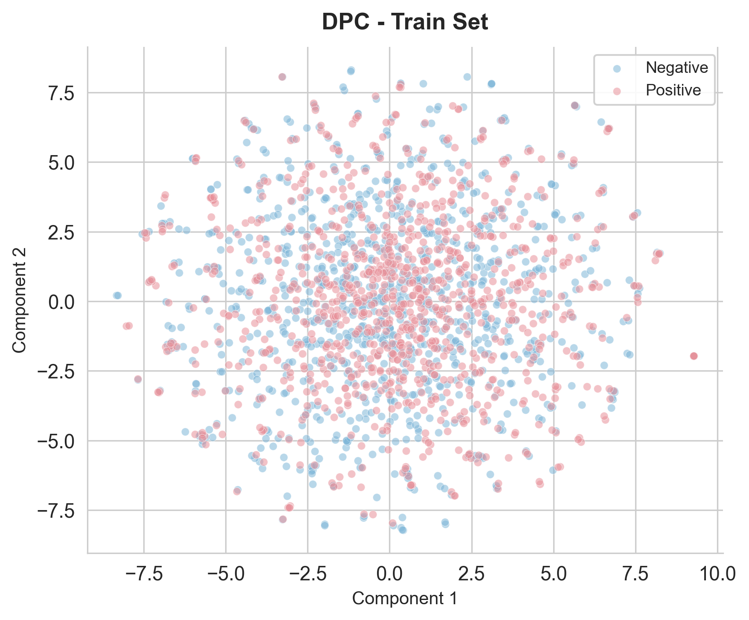
AAC - Train Set | DPC - Train Set

Slide 8
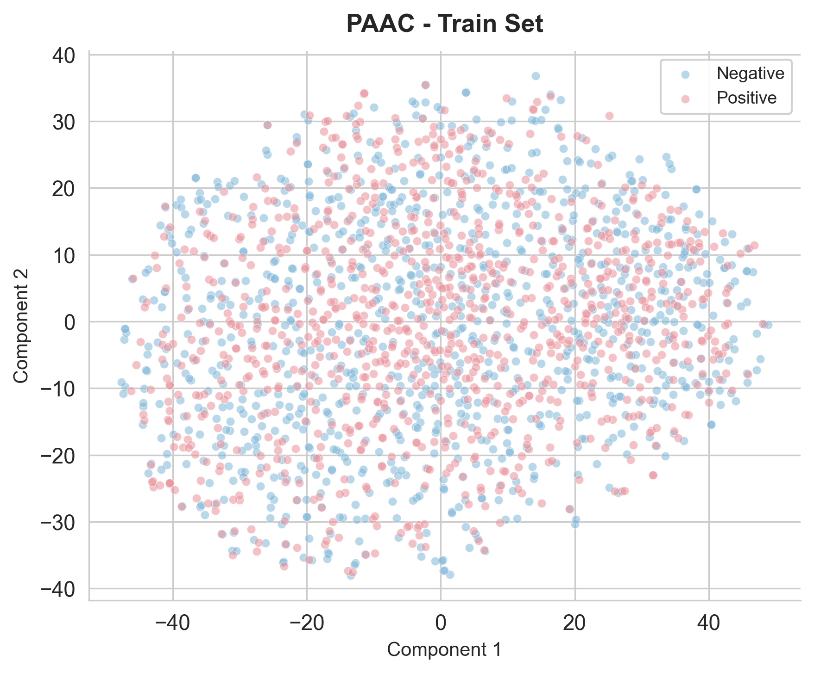
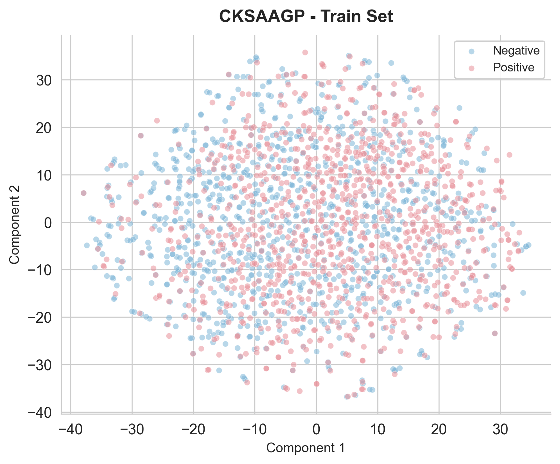
PAAC - Train Set | CKSAAGP - Train Set

Slide 9
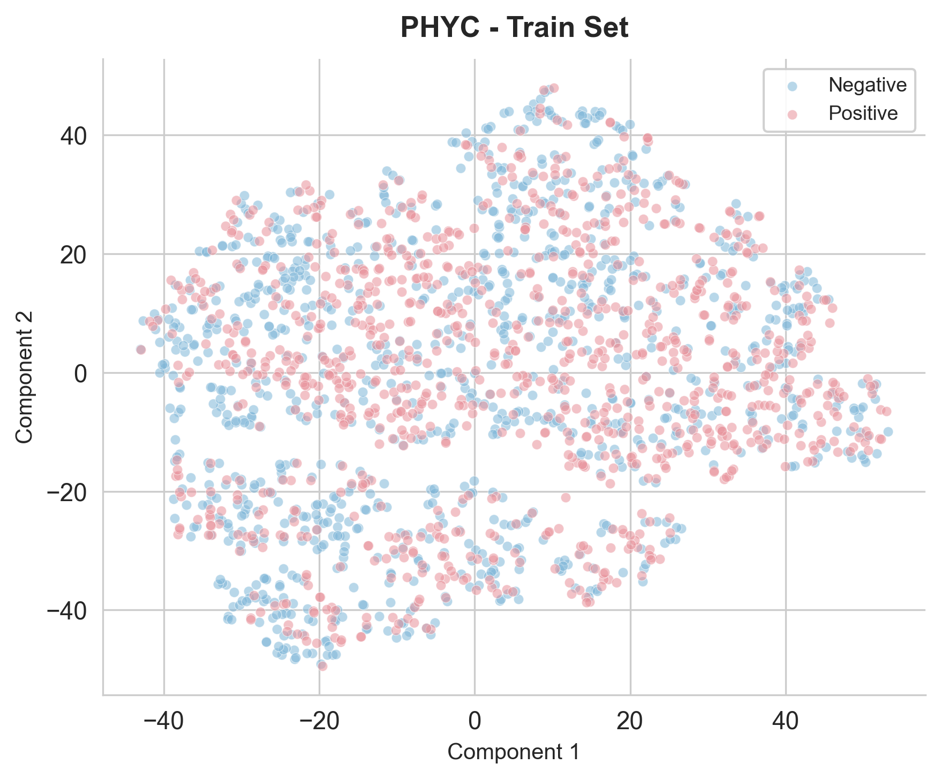
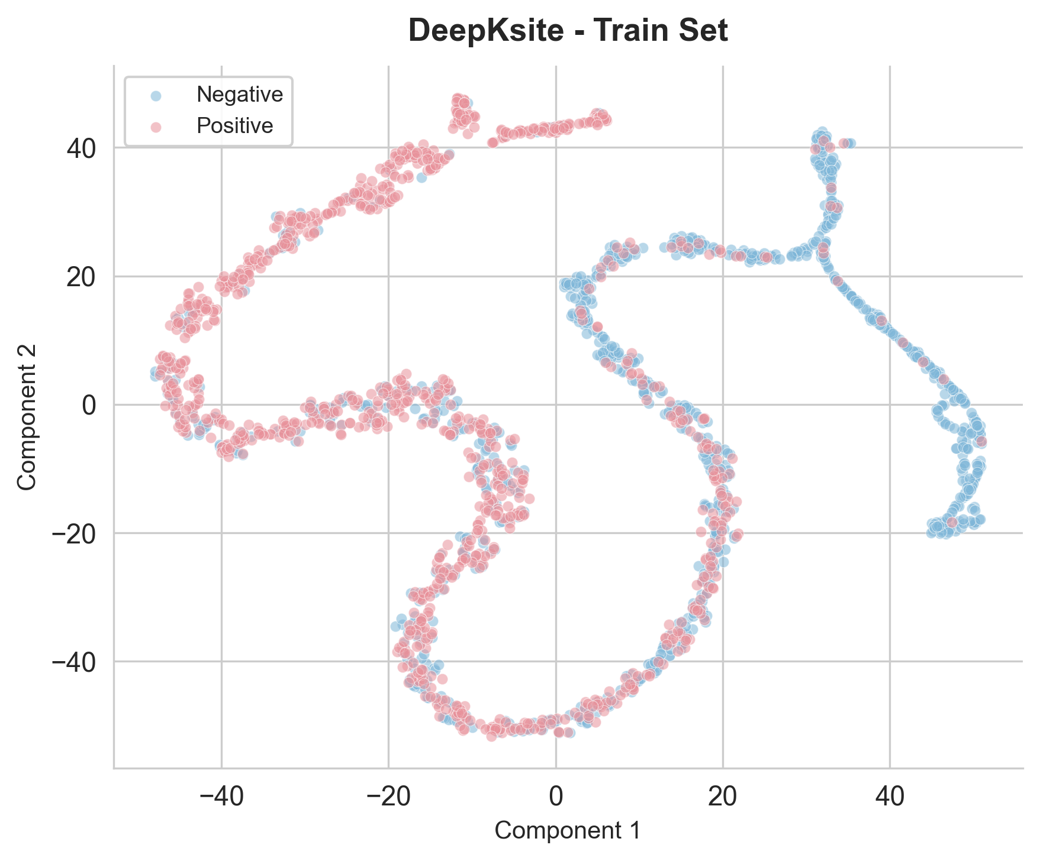
PHYC - Train Set | DeepKsite - Train Set

Slide 10
Bar Charts - Classifier Comparison

Slide 11
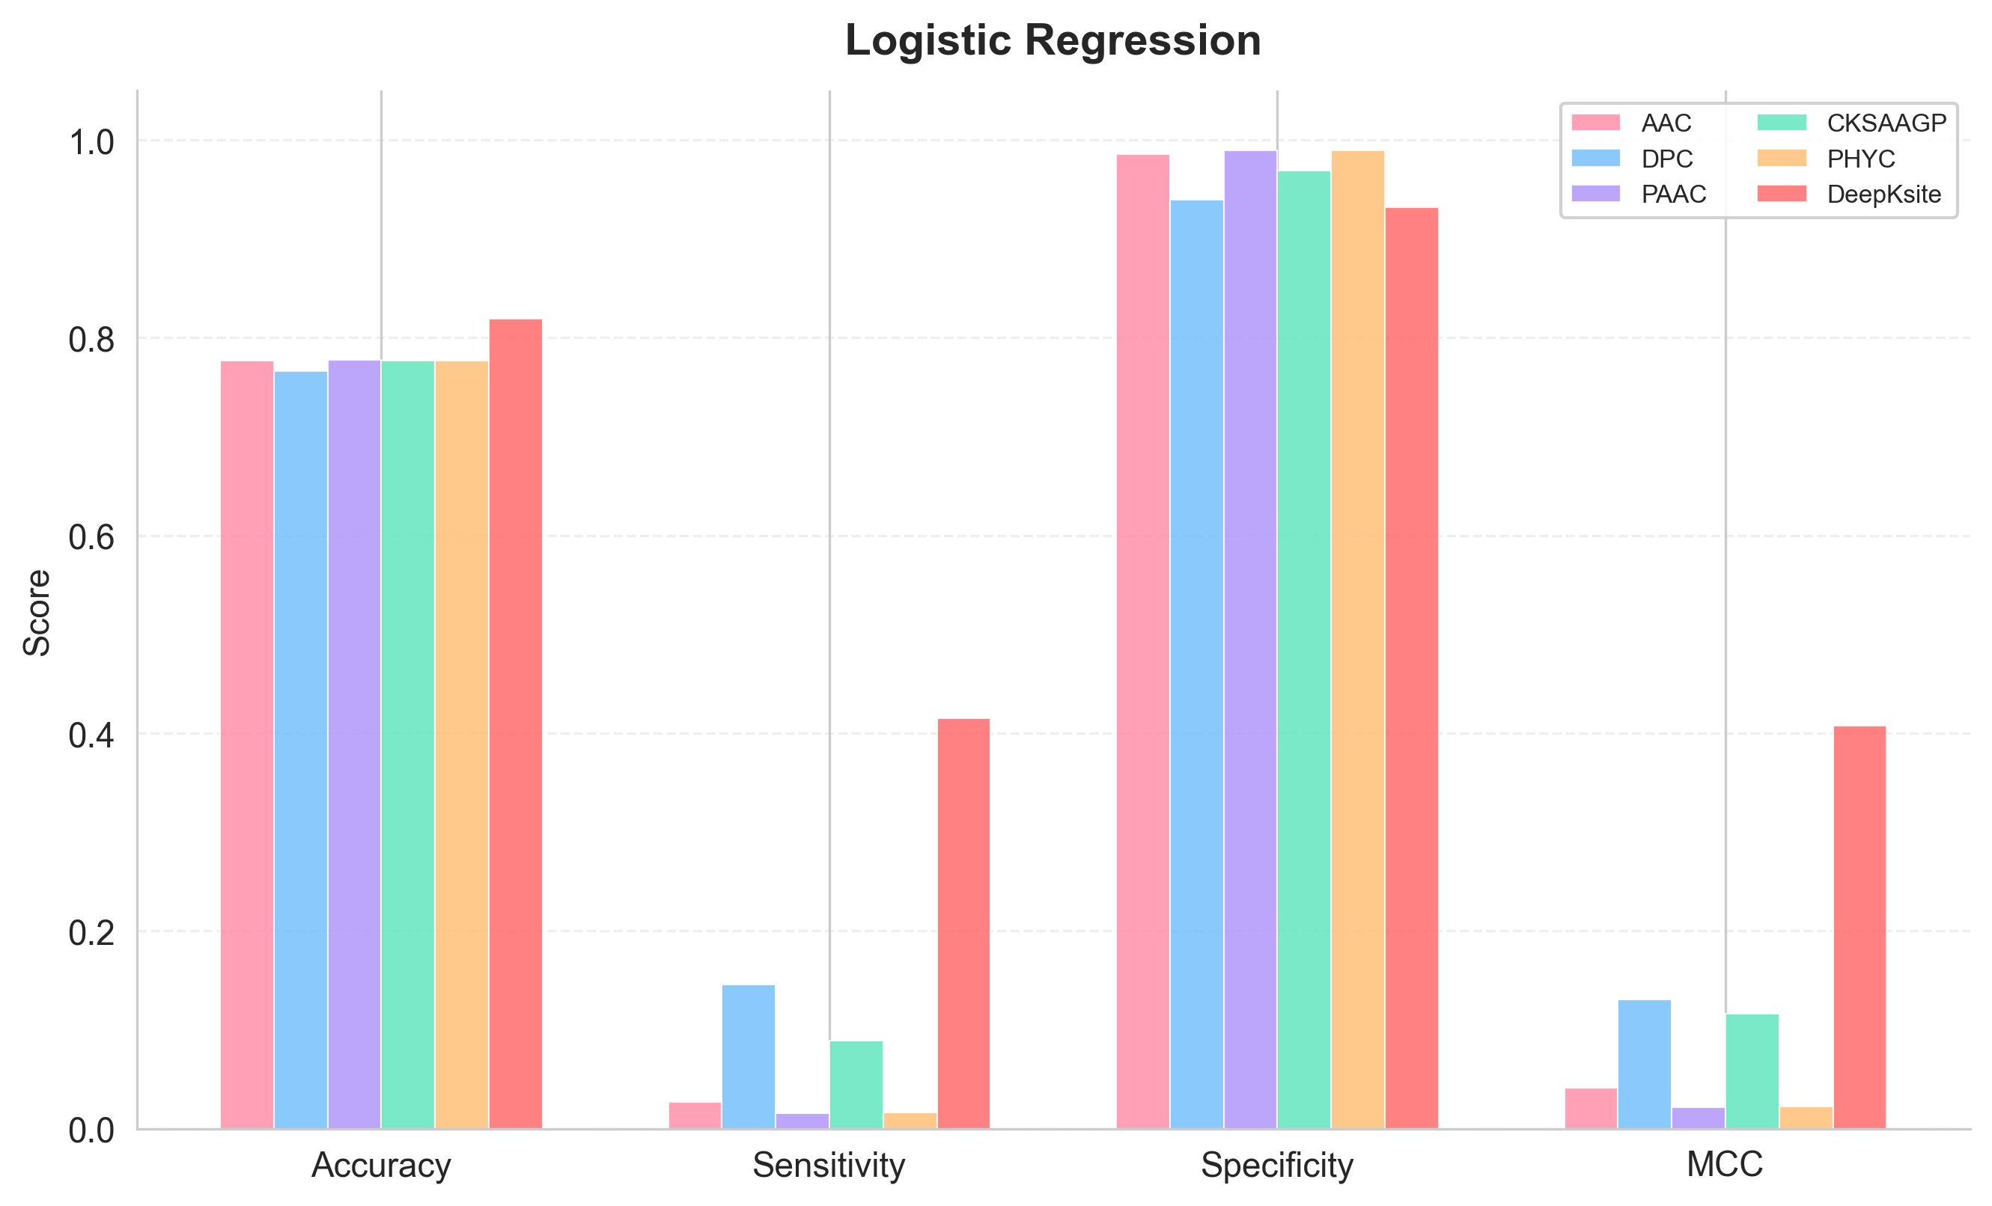
Logistic Regression

Slide 12
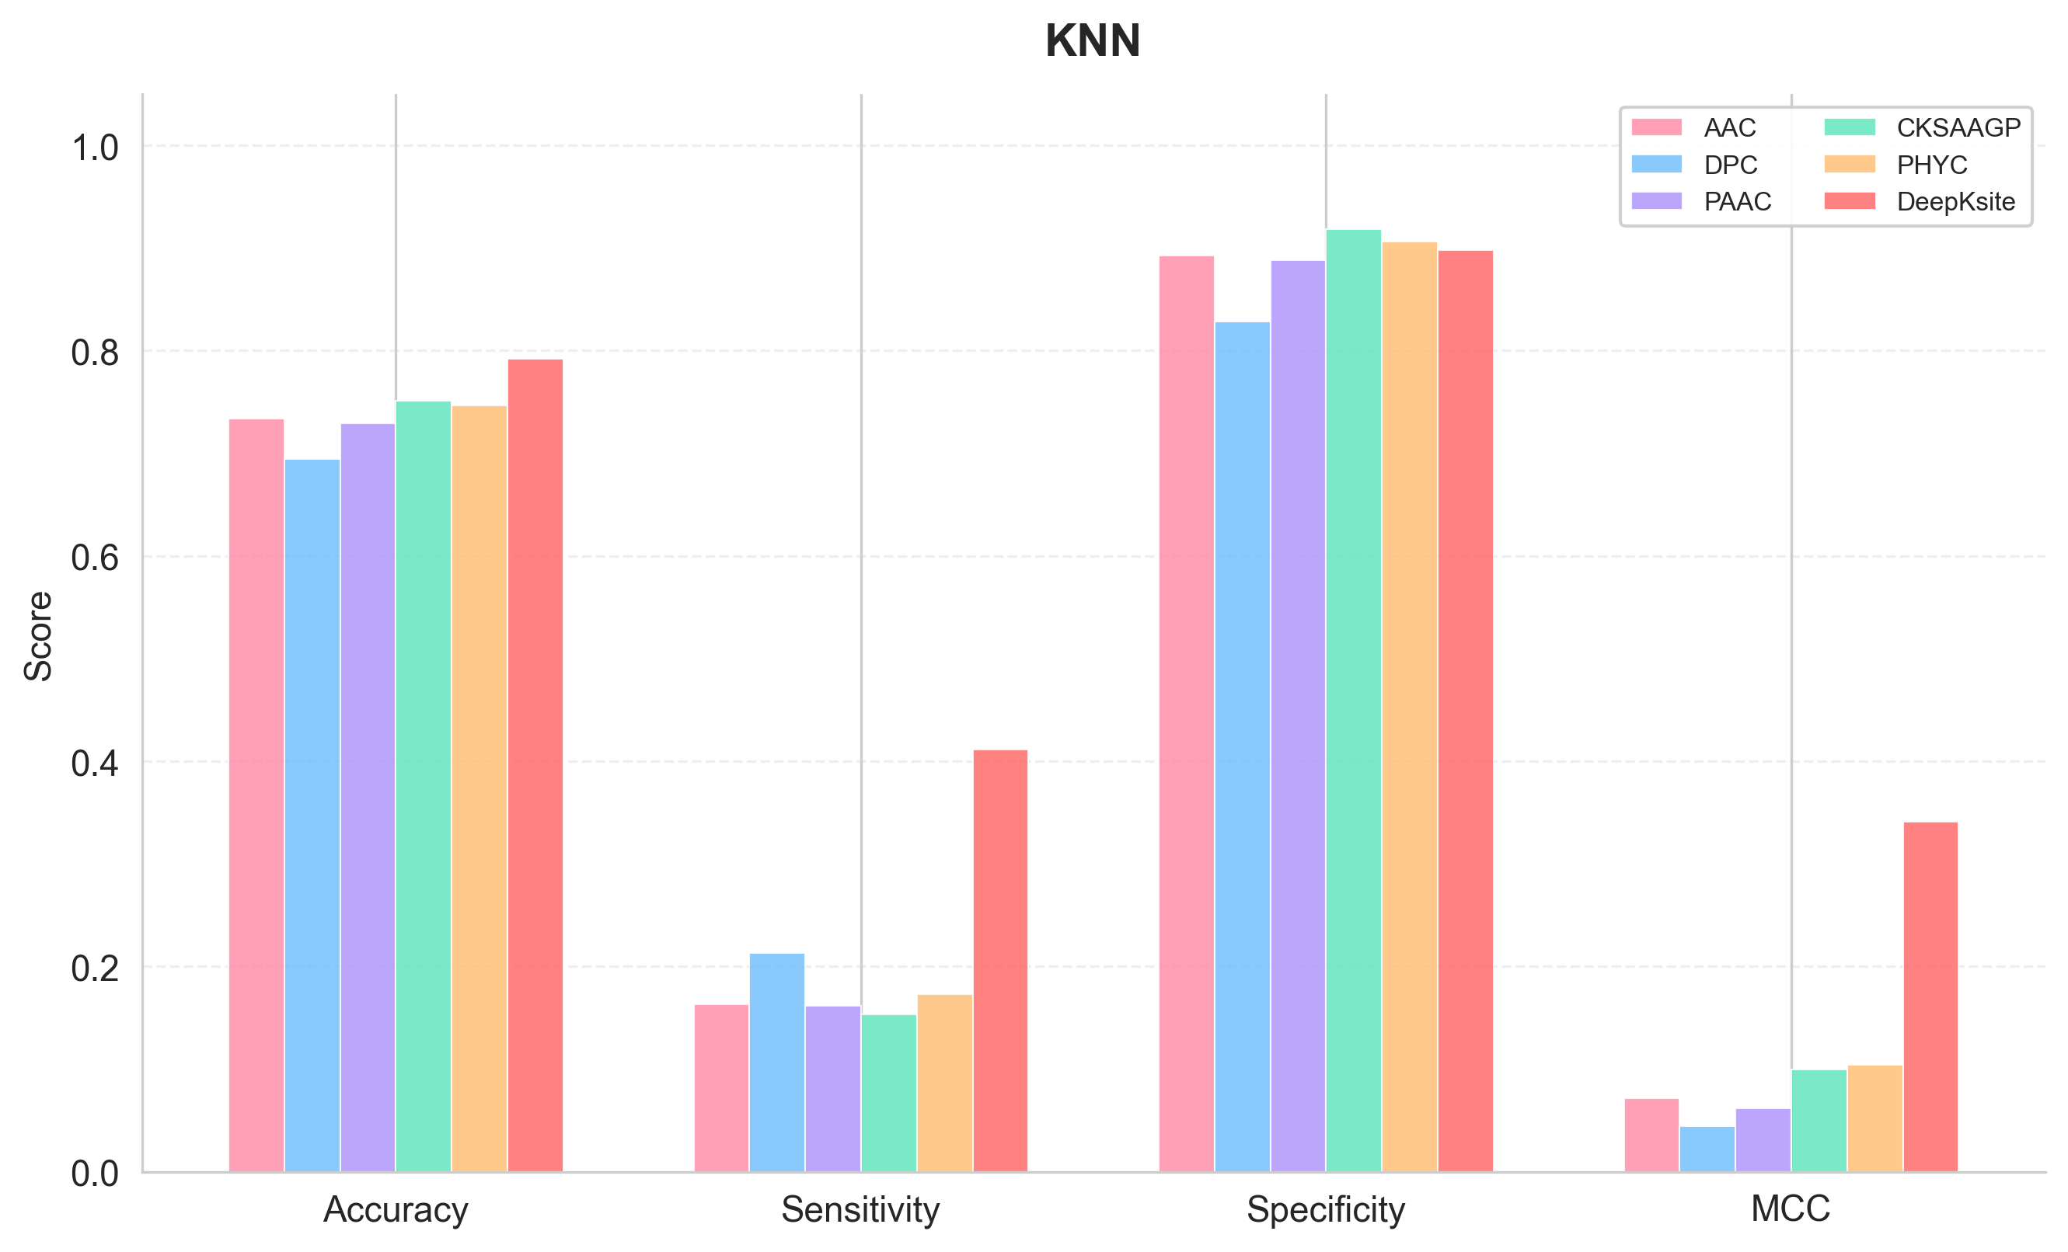
KNN

Slide 13
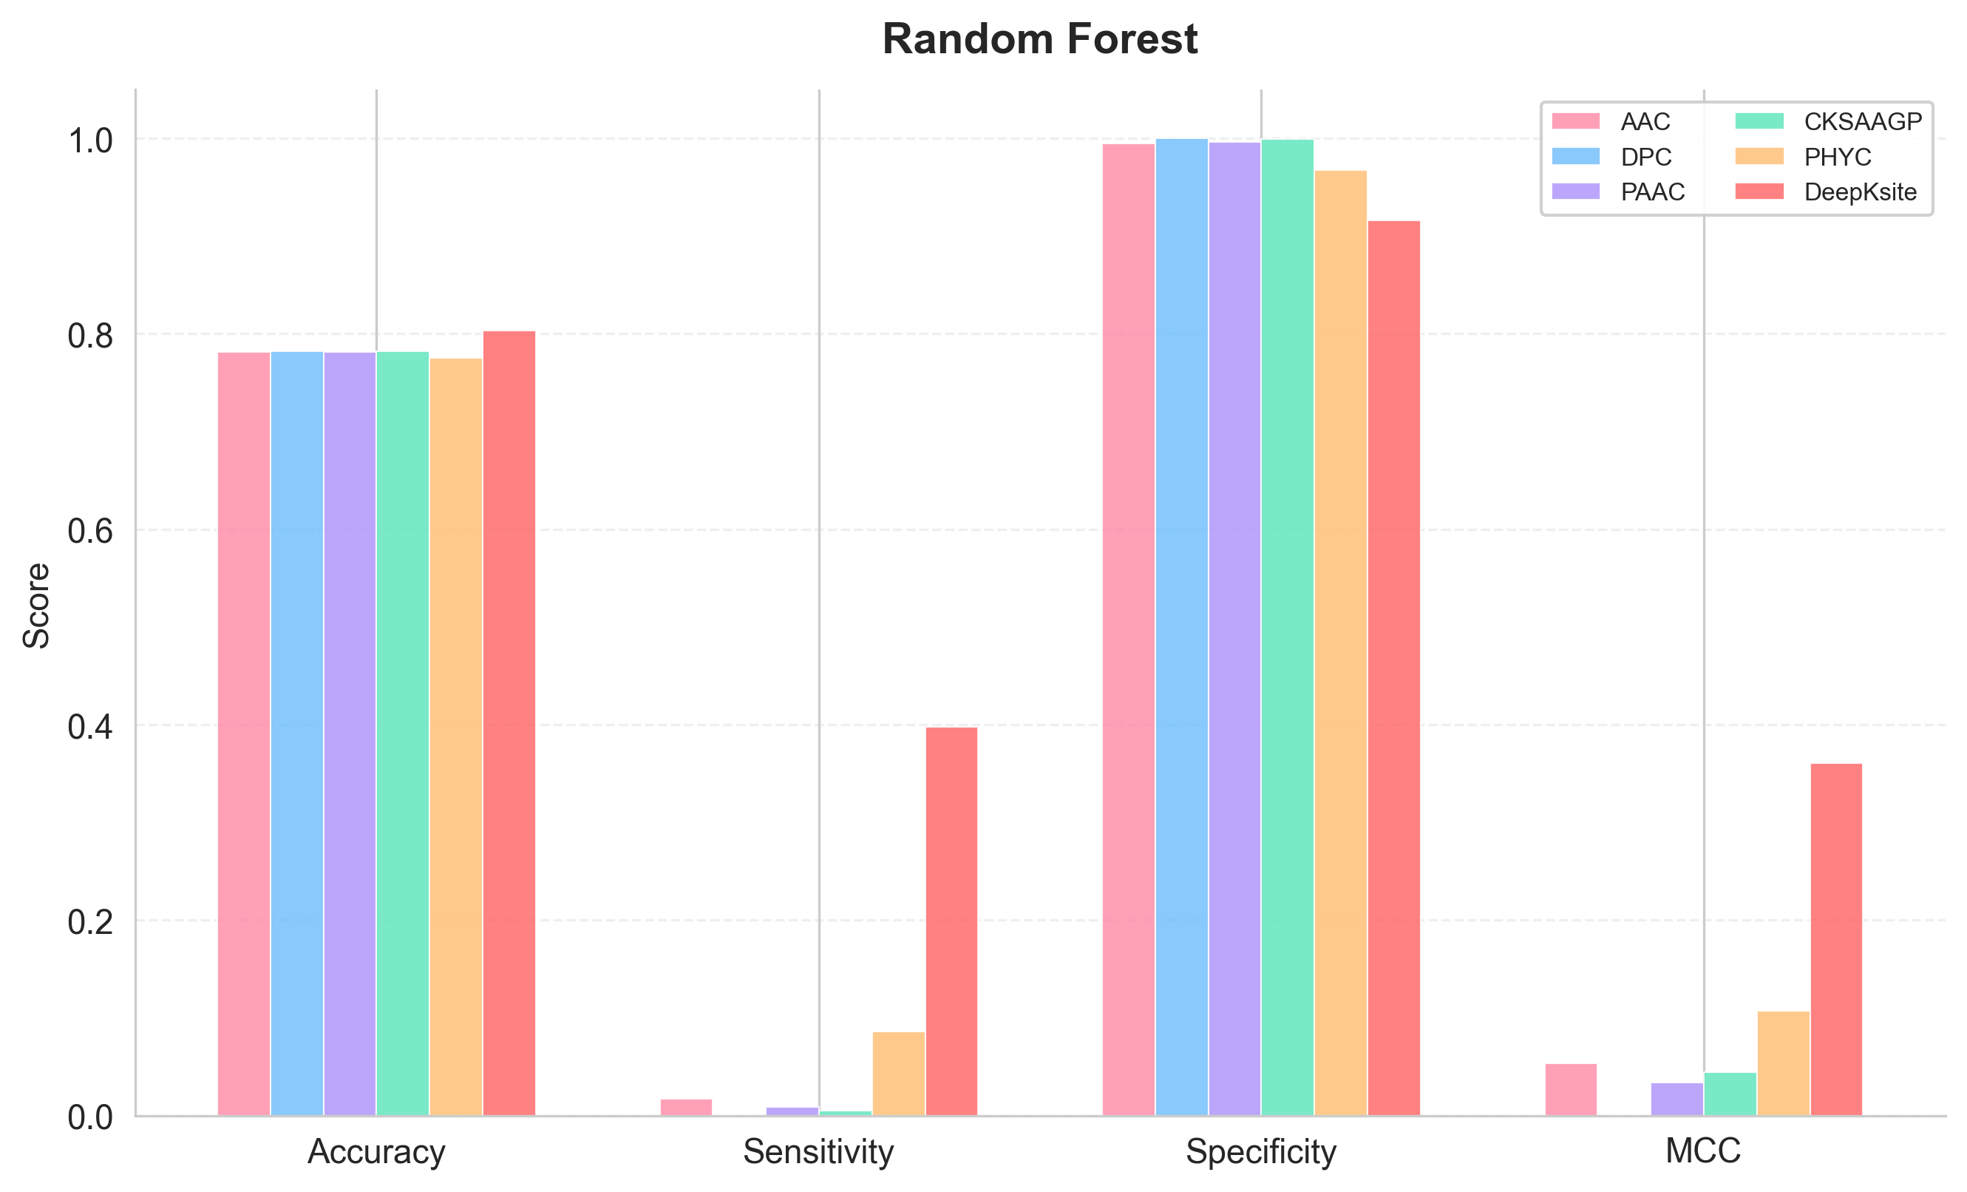
Random Forest

Slide 14
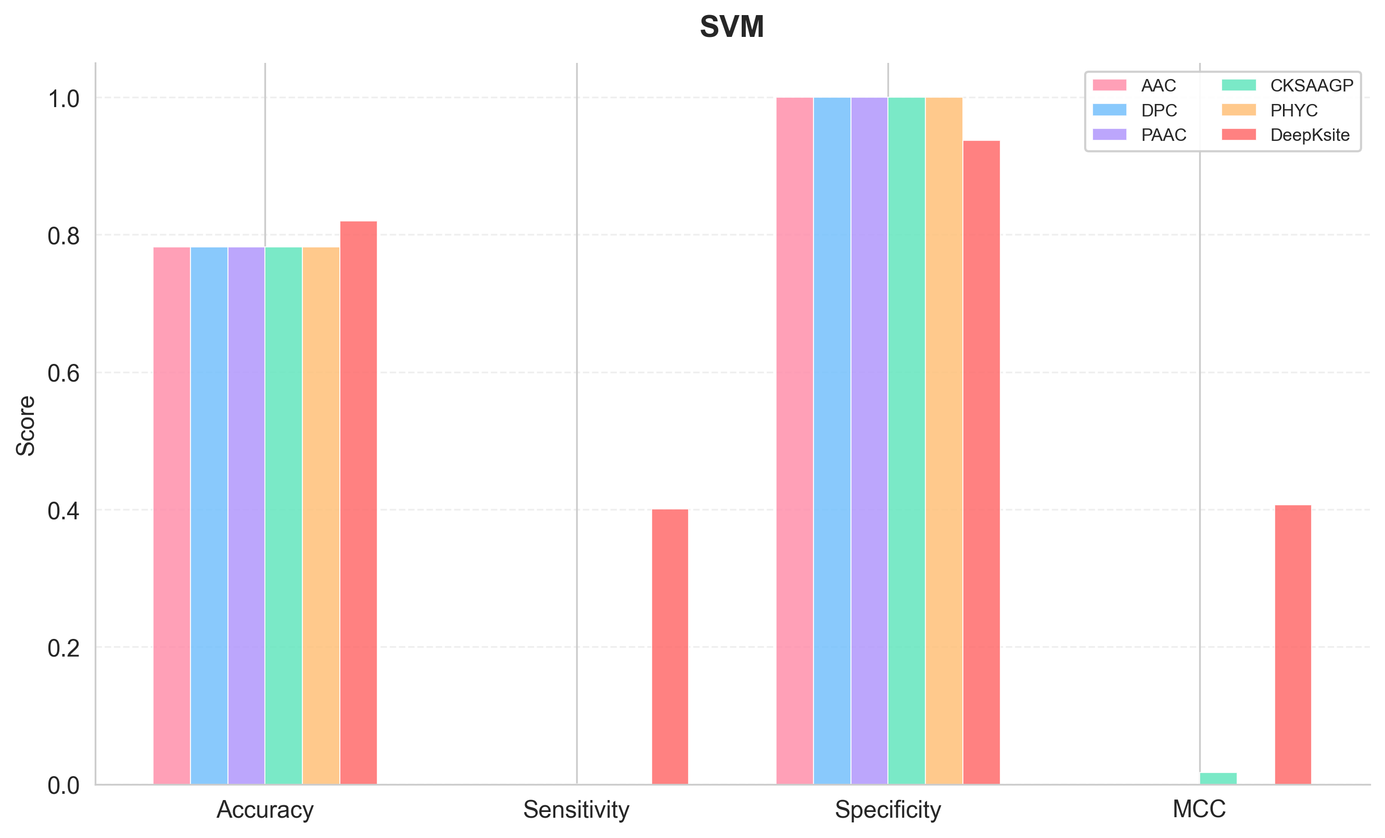
SVM

Slide 15
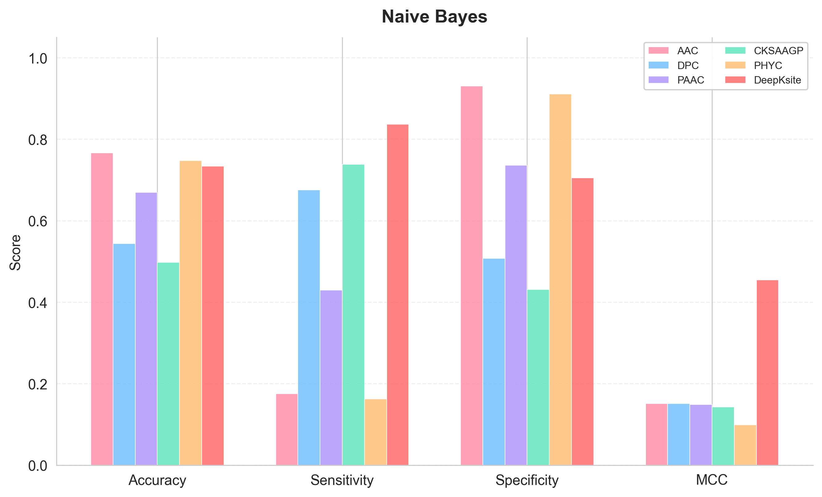
Naive Bayes

Slide 16
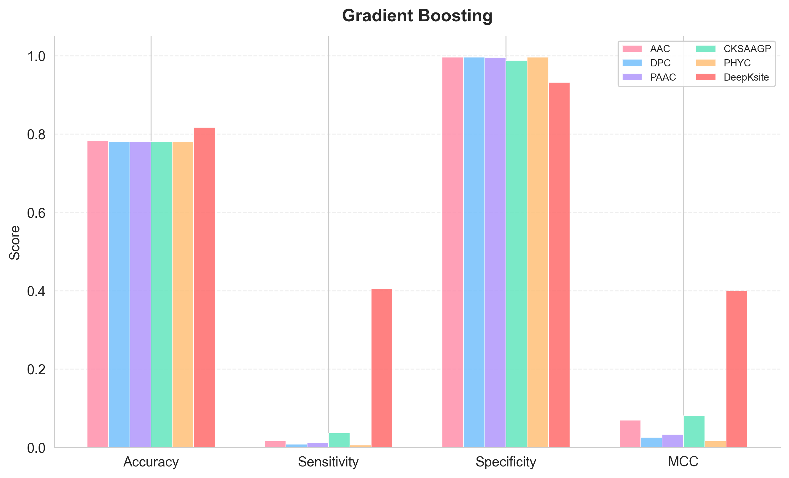
Gradient Boosting

Slide 17
Tables

Slide 18
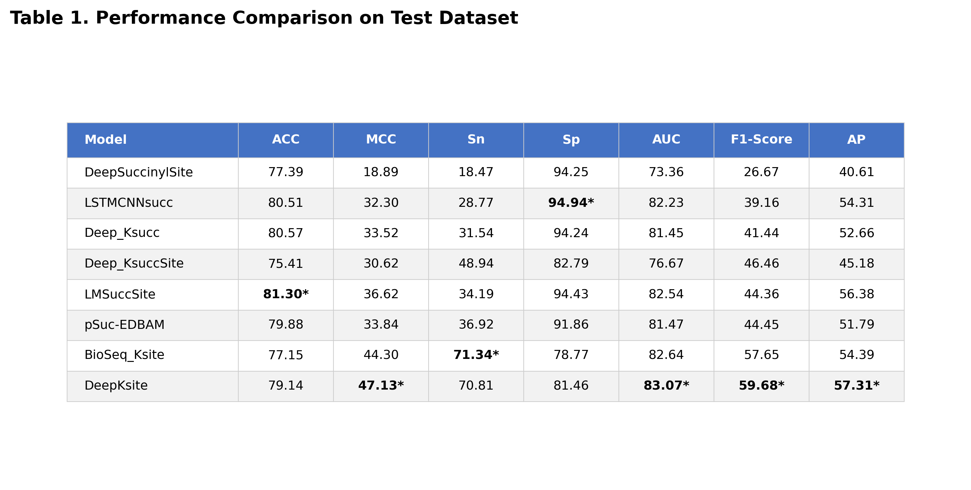
Table 1. Performance Comparison on Test Dataset

Slide 19
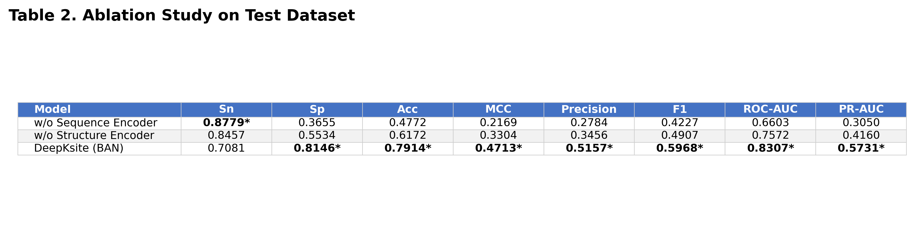
Table 2. Ablation Study on Test Dataset

Slide 20
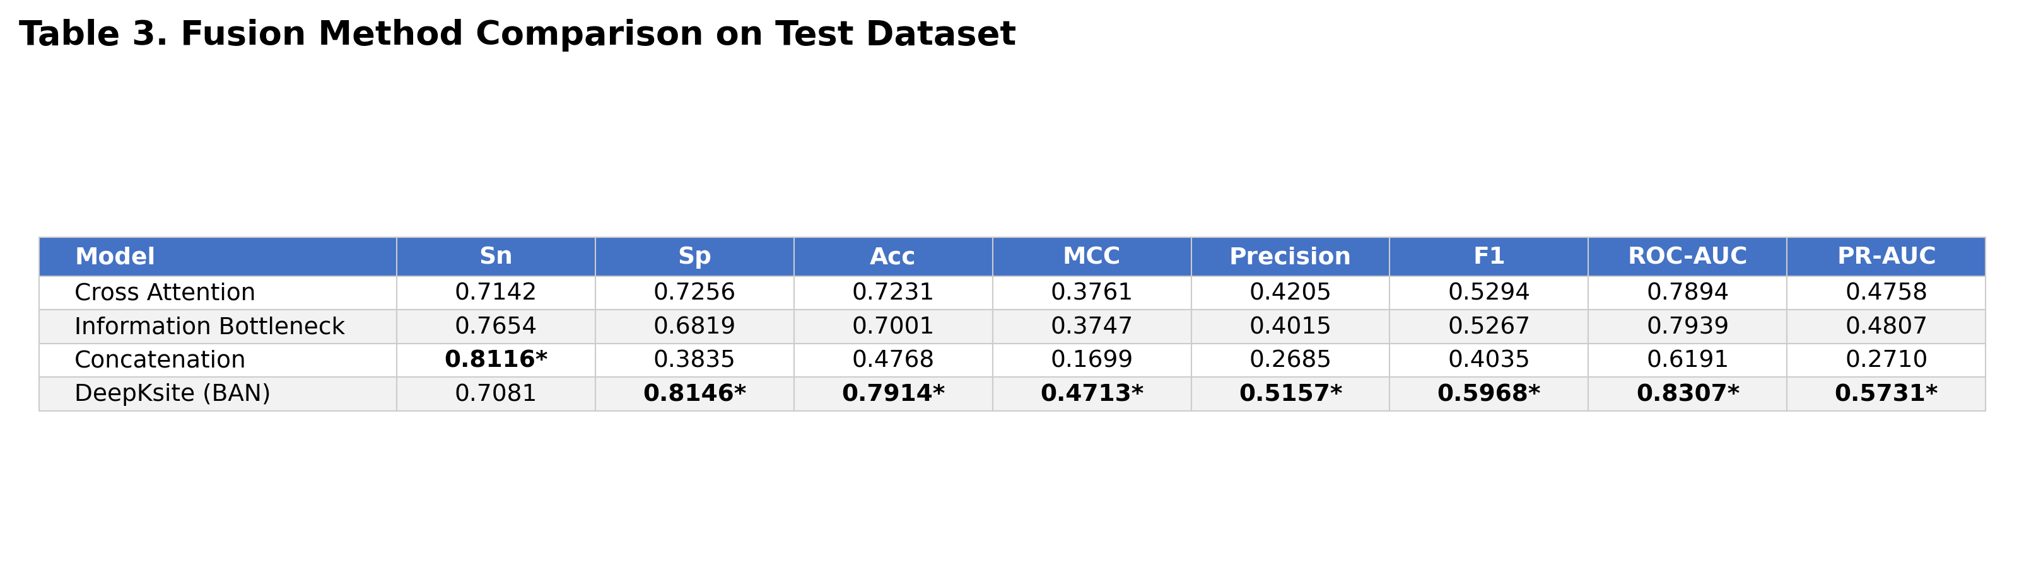
Table 3. Fusion Comparison on Test Dataset

Slide 21
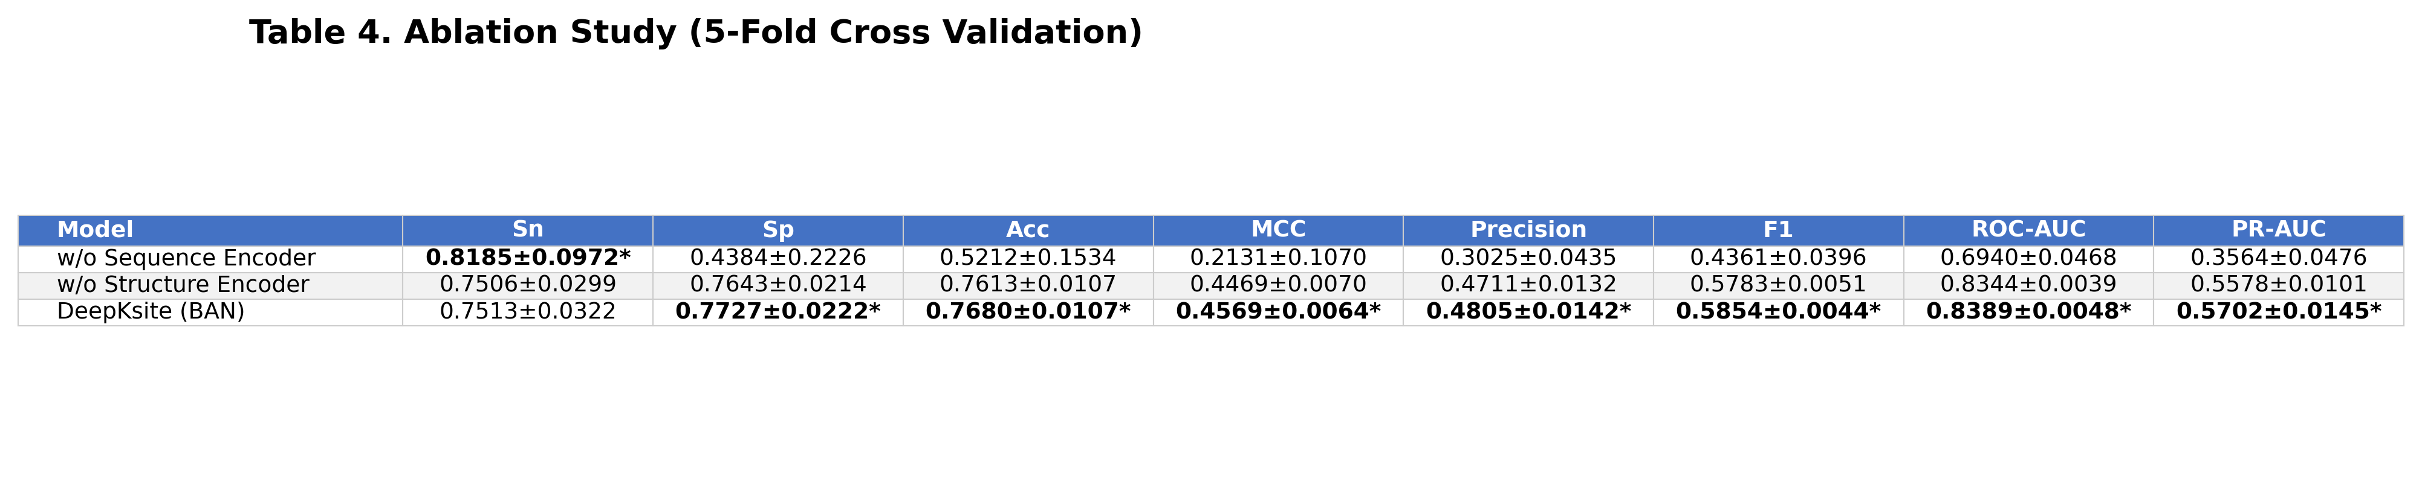
Table 4. Ablation Study (5-Fold Cross Validation)

Slide 22
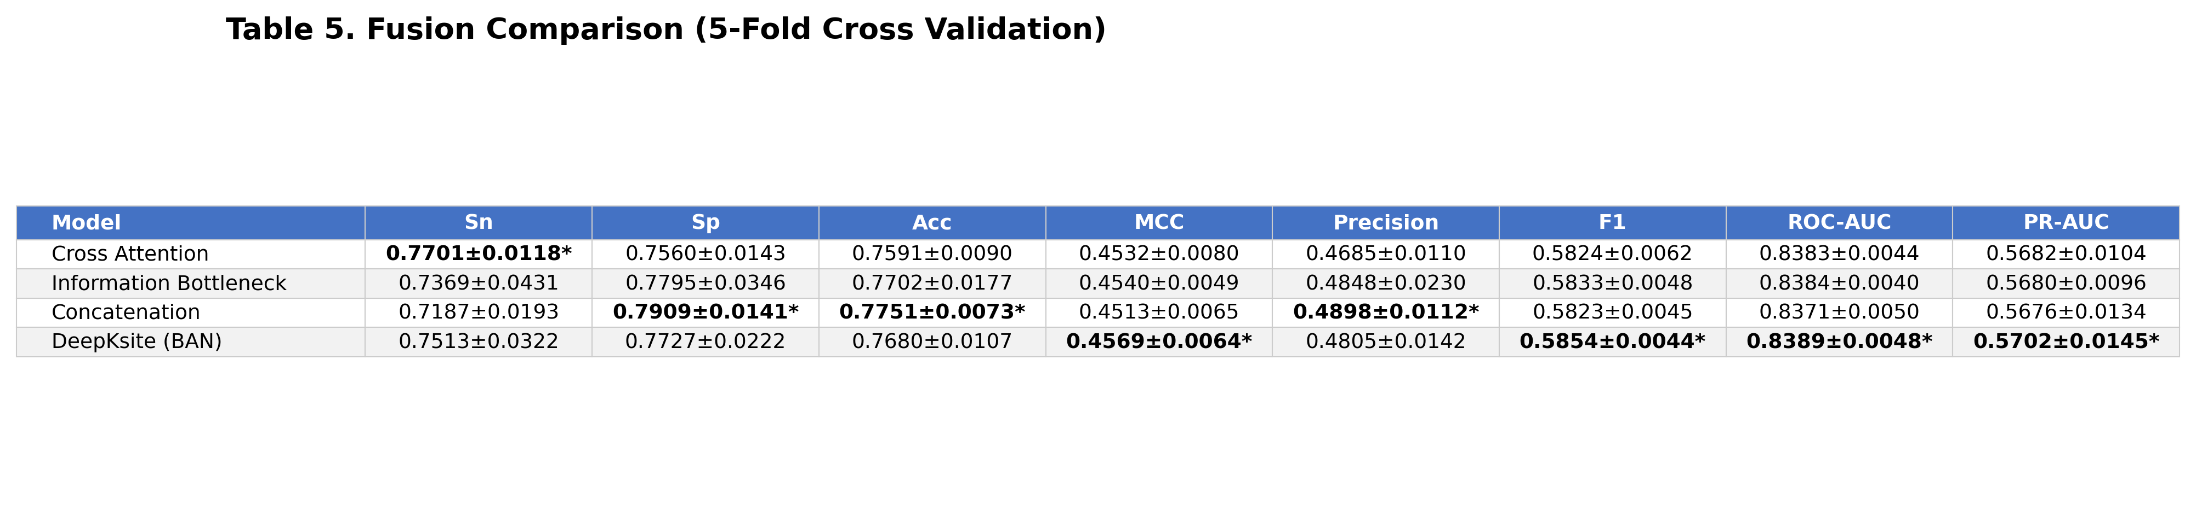
Table 5. Fusion Comparison (5-Fold Cross Validation)

