Slide 1



A Comprehensive Benchmark of Deep Learning Libraries on Mobile Devices
TheWebConf 2022
Qiyang Zhang, Xiang Li, Xiangying Che, Xiao Ma, Ao Zhou, Mengwei Xu, Shangguang Wang, Yun Ma, Xuanzhe Liu

Slide 2
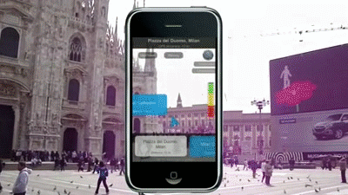
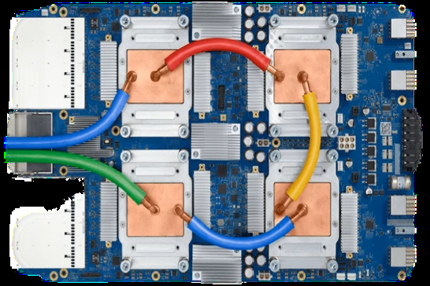




DL Inference on Smartphones
Increasingly popular DL
Object Detection
NN accelerators
Emerging DL libraries
PyTorch Mobile

Slide 3
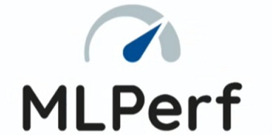


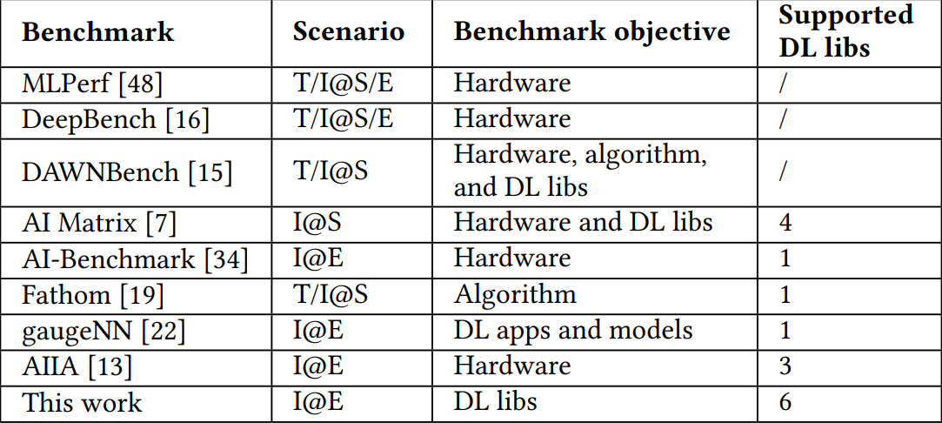


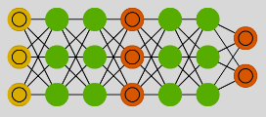
DL libraries are not fully understood
…
Existing Benchmarks mainly focus on:
server
NN design
AI chip
The comparison of existing benchmarks and ours.
A comprehensive benchmark for on-device DL inference
The benchmark triumphs at the aspect of rich support for more various DL libs

Slide 4
Measurement Settings
Rich support
the most popular DL libs: TFLite, NCNN, MNN, PyTorch Mobile, Mace, SNPE.
15 models in total, for various tasks and different model precision.

Slide 5
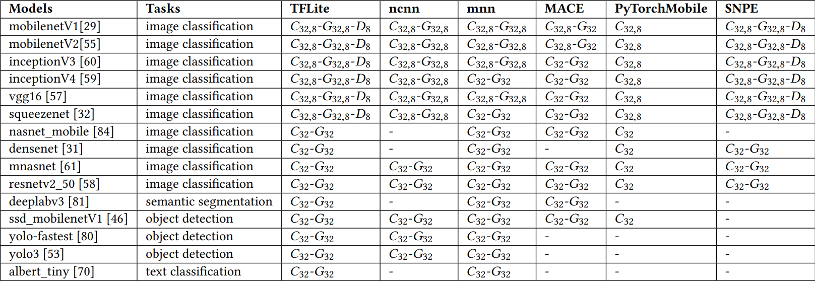
Measurement Settings
Supported DL libs and models in this work.
C/G/D: CPU/GPU/DSP
32/8: FP32/INT8

Slide 6
Measurement Settings
Rich support
The most popular DL libs: TFLite, NCNN, MNN, PyTorchMobile, Mace, SNPE.
15 models in total, for various tasks and different model precision.
Devices
10 different device models with various SoCs and GPUs
Detailed metrics
The inference time and operator-level information.

Slide 7

Research goal
(The first) measurement to understand how DL libs affect inference.
Performance Fragmentation
Impacts of Quantization and Hardware
Operator-level Integration
Cold-start Inference
Longitudinal Inference

Slide 8







Analysis Workflow
Pytorch Mobile
Push libs and models
Run inference
NCNN

Slide 9
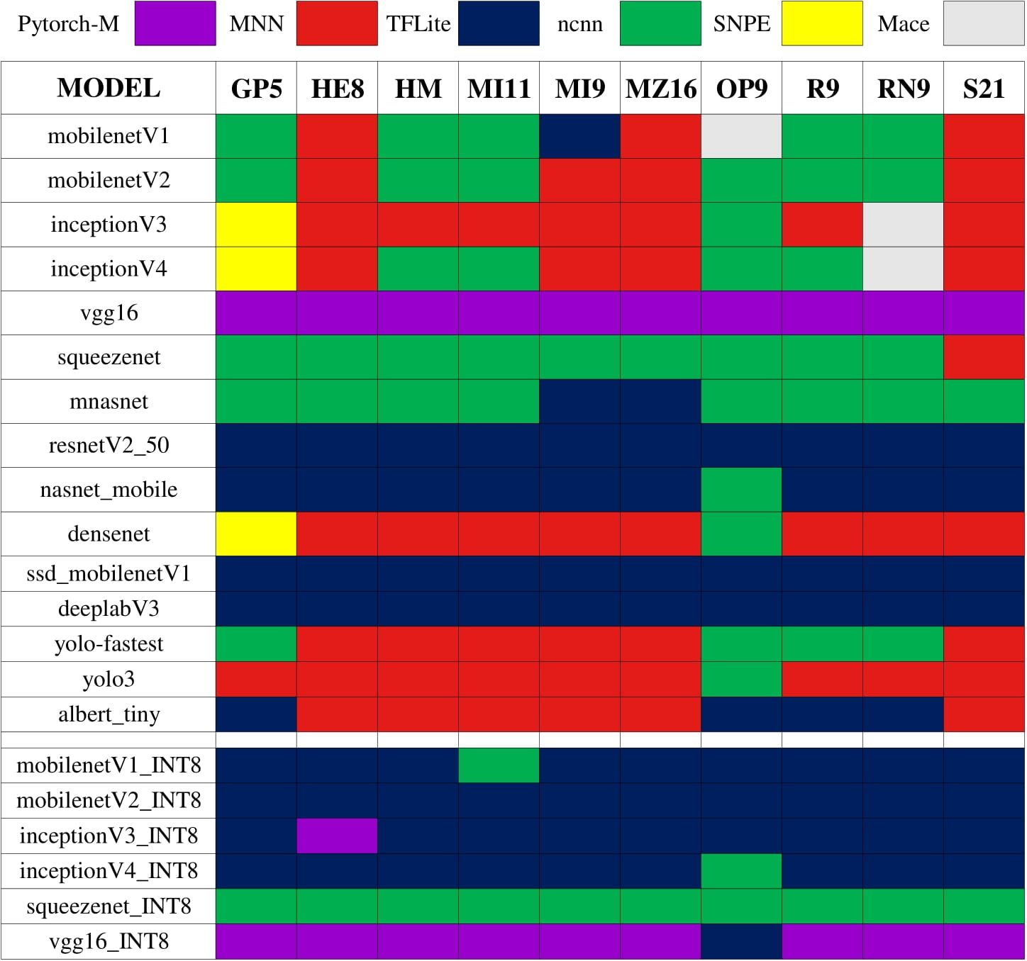

Performance Fragmentation
CPU
DL lib with the smallest inference time in 6 DL libs
The DL lib with fastest speed to run “albert_tiny”on “Samsung S21” is “MNN”.
Best-performing lib on CPU

Slide 10
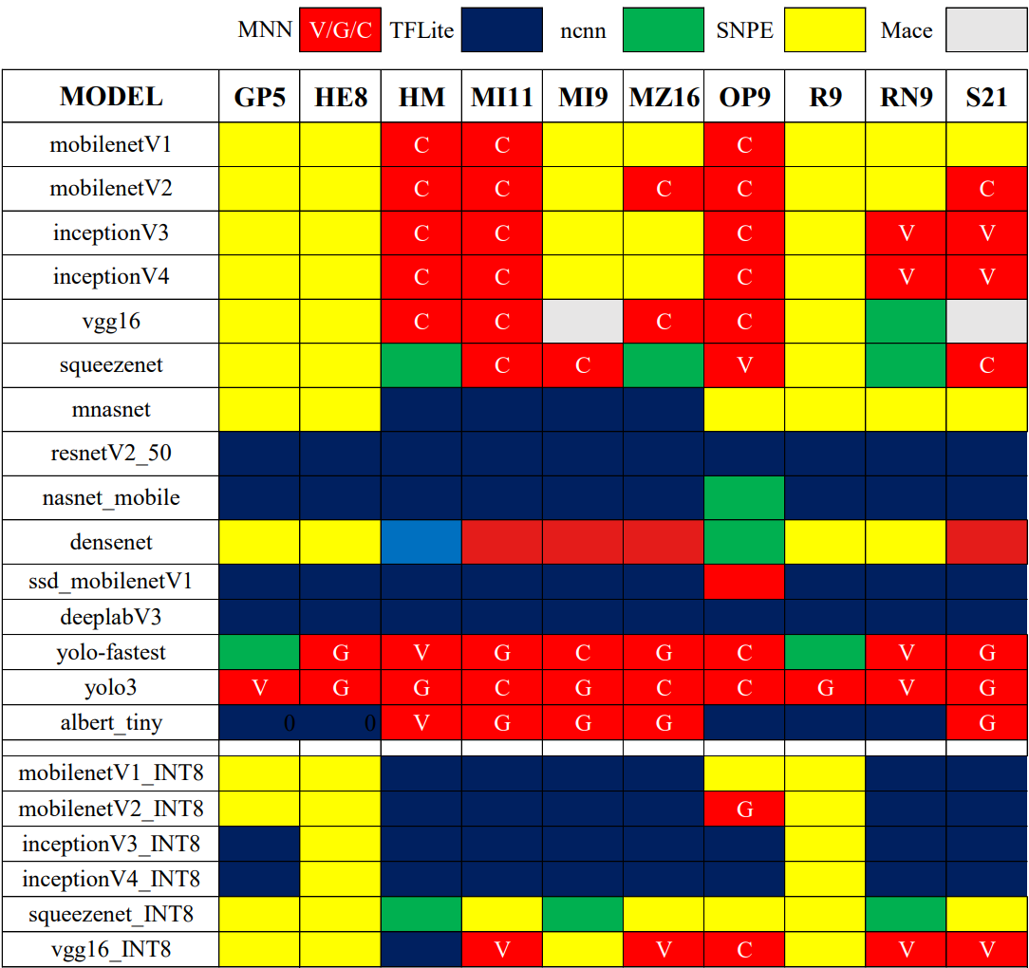
Performance Fragmentation
CPU
There is no one-size-fit-all DL lib for optimal performance across models and hardware.
Best-performing lib on CPU/GPU

Slide 11
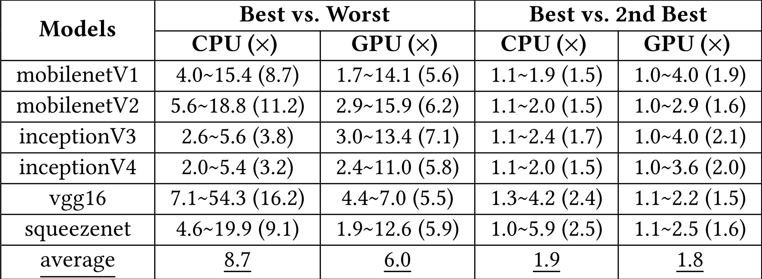
Performance Fragmentation
Performance gap of DL libs can be large.
the longer one divided by the shorter one
the longer one divided by the shorter one
The performance gaps of different DL libs

Slide 12
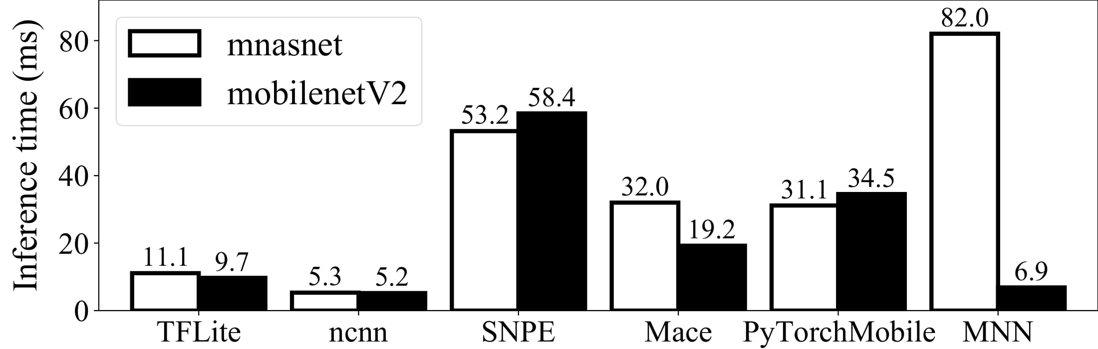
Performance Fragmentation
With software heterogeneity, the model structure is not the sole factor that determines relative performance.
Implication: To pursue the optimal performance, the developers need to incorporate different DL libs and dynamically load one based on the current model and hardware platform.

Slide 13
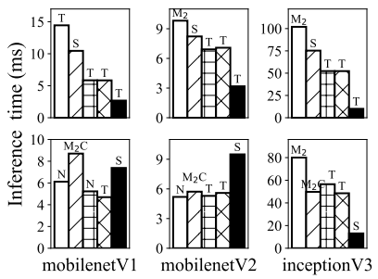
Performance Fragmentation
Benefit brought by INT8 quantization is under expectation.
0.8×–3.0× faster than FLOAT
Best inference speed across all DL libs

Slide 14
Performance Fragmentation
Benefit brought by INT8 quantization is under expectation.
0.8×–3.0× faster than FLOAT
Implication: There exists great potential at software level to accelerate the inference of quantized models.
Best inference speed across all DL libs

Slide 15
Impacts of Hardware
GPU can not always accelerate DL inference.
speedup 1.4×–1.9× compared to CPU
Best inference speed across all DL libs

Slide 16
Impacts of Hardware
On INT8-based models, GPU can hardly bring any benefit.
Implication: Observations motivate developers to focus on GPU optimization. It also motivates researchers to design models suitable for GPU.
Best inference speed across all DL libs

Slide 17
Impacts of Hardware
DSP can significantly accelerate INT8 model in most cases.
reduce inference time of INT8 model by 2.0×–12.9×
Implication: The current DL libs can not fully exploit the capacity of each hardware.
Best inference speed across all DL libs

Slide 18

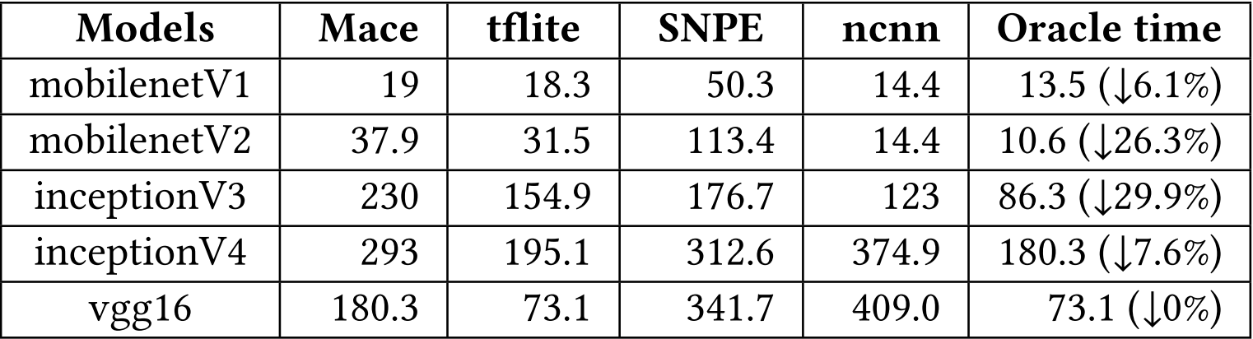
Operator-level Integration
How about integrating the best-performing operator from DL libs?
Oracle lib that combines the fastest operator from those DL libs
Oracle time brings inference time reduction
The benefits that integrate the wisdom of DL libs （ms）
Implication: Those diversities need to be unified before the operator implementation can be combined.

Slide 19
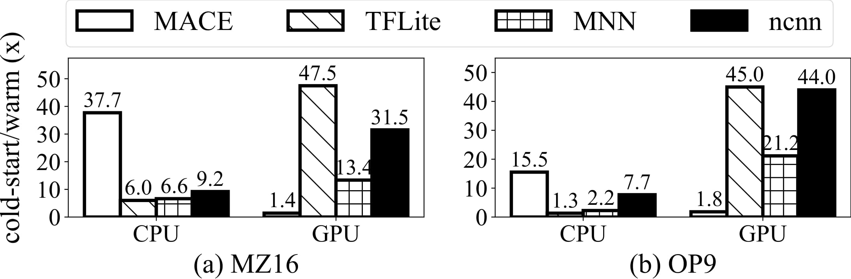

Cold-start Inference
The first inference beginning from model loading
Cold-start inference is significantly slower than warm inference
slow 1.3×–37.7× on CPU than warm inference
slow 1.4×–45× on GPU than warm inference
The ratio of cold-start inference to warm inference

Slide 20
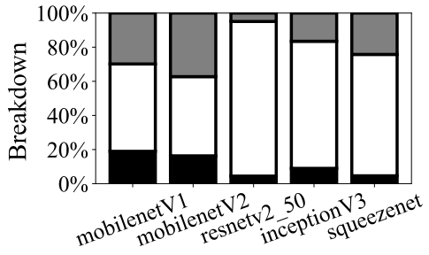
Breakdown of Cold-start Inference
The breakdown of cold-start inference
Memory preparation contributes to the largest overhead in cold-start inference.

Slide 21
Breakdown of Cold-start Inference
The breakdown of cold-start inference
Implication: Potential solutions include speeding up memory preparation using multiple threads and generating pipeline to run model loading memory preparation and inference simultaneously.

Slide 22
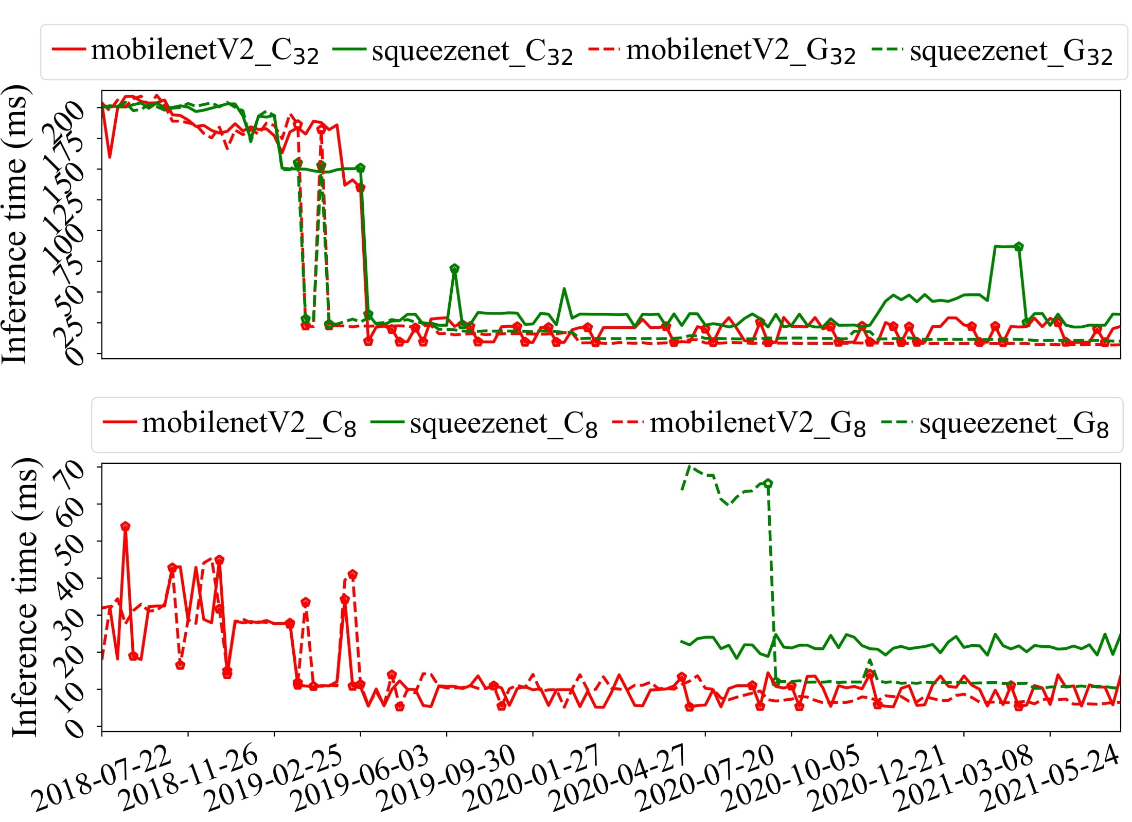
Longitudinal Analysis
Better
Time
The inference performance evolvement across time of TFLite
The performance of DL libs are continuously improving in early years, but becomes relatively stable since 2020.

Slide 23
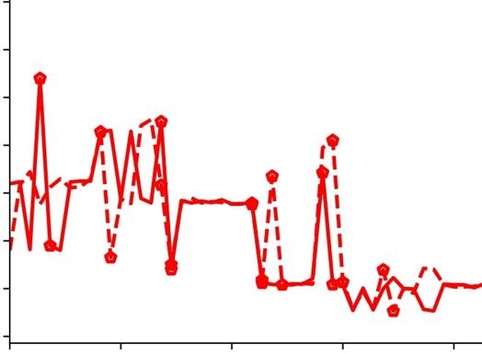
Longitudinal Analysis
Performance bug
Better
Time
The inference performance evolvement across time of TFLite

Slide 24
Longitudinal Analysis
Better
Implication: The current open-source ecosystems is possibly due to a comprehensive benchmarking tool available for developers to test commits.

Slide 25


Summary
A comprehensive benchmark to quantitatively understand inference performance of DL libs.
Lead to insightful implications for complete landscape of DL libs ecosystem.
Please check benchmark at
https://github.com/UbiquitousLearning/MobileDLFrameworksBenchmark

