Slide 1

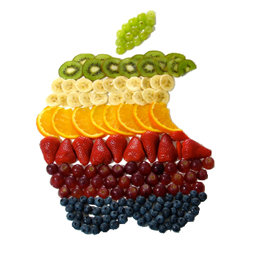
FRUIT KILLER
START
STATISTICS
CHANGE PROFILE
QUIT

