Slide 1

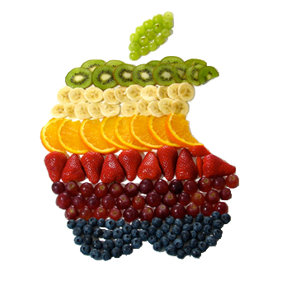
FRUIT KILLER
START
VS-MODE
STATISTICS
CHANGE PROFILE
QUIT

