Slide 1
WFSS Overlap Tool
Kevin Volk, 12 July 2021

Slide 2
Purpose of the Tool
The aim is to allow a user to evaluate spectral overlap in the NIRISS WFSS mode as a function of the rotation angle.
Required in cases such as observation of a photometric standard star where one wishes to avoid contamination.
While one can in principle run Mirage many times for different rotations, this is both time consuming and in some sense limited by the simulation process. So I have made a Python tool to do this in an interface.

Slide 3
Where To Get The Code
The code is stored on github at
https://github.com/KevinVolkSTScI/wfss_overlap
One needs various files to run the code, which are stored on Box at
https://stsci.box.com/s/ih166mw8ded6w0qeiw7znc7xuth7n531

Slide 4
Tool Algorithm
The tool has four steps. One step is to make a scene image, similar to the way Mirage does it but not convolved with the image PSF. The second step is to rotate the scene image to an arbitrary rotation angle. The third step is to convolve with a suitable imaging or WFSS mode PSF to make an output image. Lastly, the resulting image is displayed in a GUI window with some functions available. (The image display code is my own creation, since ginga is too complicated for me.)

Slide 5
Tool Inputs
The tool needs a star list and may also have a extended source list. Both of these are assumed to be in the same format as Mirage uses currently for the point source and extended source lists.
The code reads the RA, Dec, and magnitude values from these files. It also reads the Sersic profile parameters from the extended source list and creates model Sersic images for each source using the astropy.modelling.models Sersic2D functionality. The RA, Dec values are converted to pixels using pysiaf for the NIS_CEN aperture with a specified centre position. Pysiaf does include a distortion model, but in calculating the Sersic profile the pixels are assumed to be square and of uniform size 0.0656″.

Slide 6
Tool Inputs
The basic scene image for the tool is 3631×3631 pixels with nominal sky area 3.96989´ square since each pixel is assumed to be 0.0656″ square. The POM area is assumed to be the central 2322×2322 pixels (sub-array area [655:2977, 655:2977]) and the image area is assumed to be the central 2048×2048 pixels (sub-array area [792:2840, 792:2840]).
One can use an existing image as the input if it conforms to the above dimensions, covers at least the POM area,. and has been deconvolved by the imaging PSF.

Slide 7
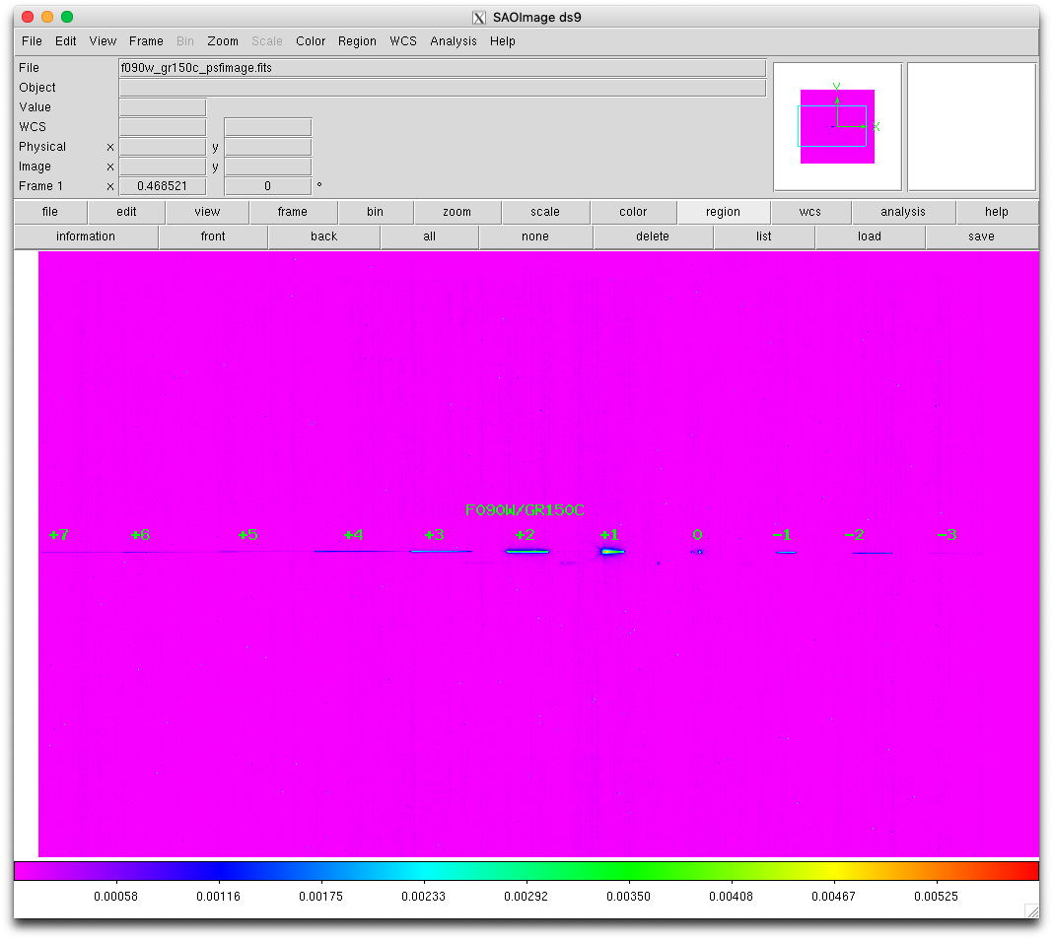

Slide 8
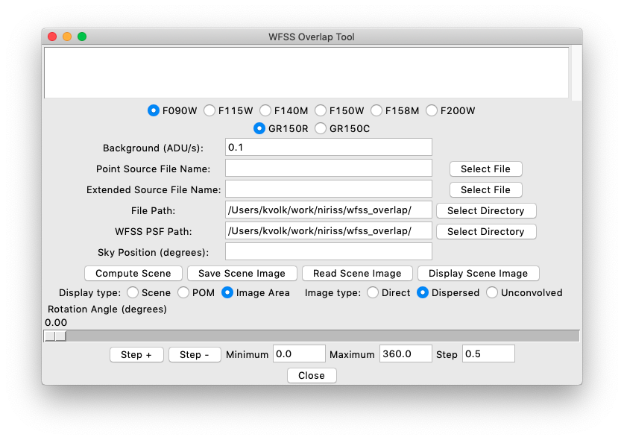
Initial appearance
of the window (on a Mac system).

Slide 9
Select the point source file name with the button or by typing in the file name.

Slide 10
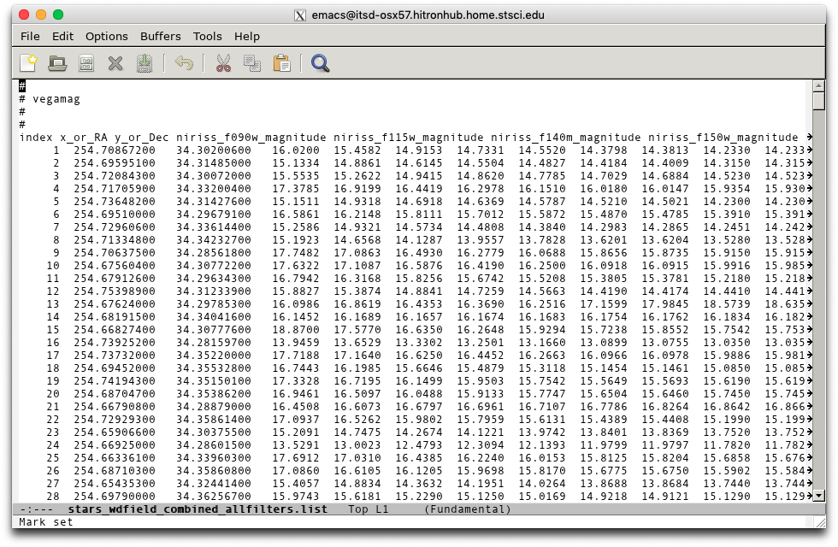
The source lists need to be in the Mirage format as shown here for a point source list.

Slide 11
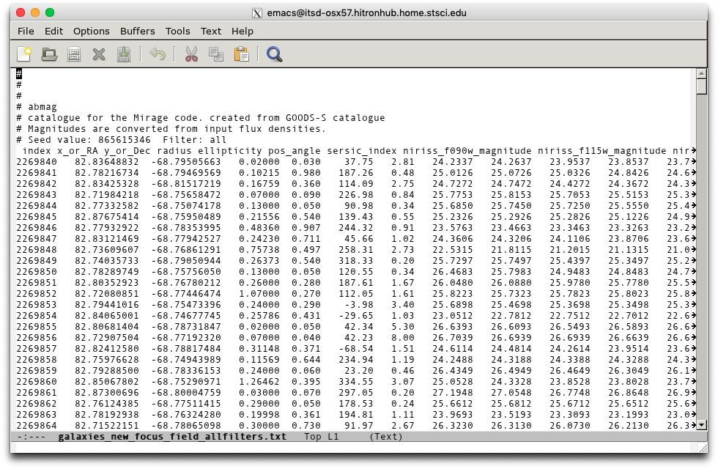
The extended source list also needs to be in Mirage input form.
In both cases, do not try to use the Mirage output source lists.

Slide 12
If needed, select the extended source file name with the button or by typing in the file name.

Slide 13
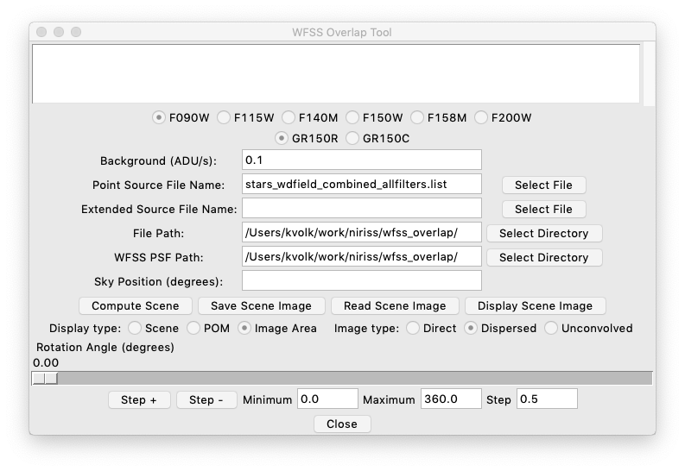
Both source lists need to be in the same directory, set by the file path.
This is populated when one selects a point source file name. Or one can select it with the button, or type the path in.

Slide 14
One also needs to tell the code where to find the PSF files. If this is not the same place as where the source files are, set the WFSS PSF path using the button.

Slide 15
Next, compute the scene image for the filter of interest.
The source catalogue sky area should be large enough to at least cover the POM area at any angle. Hence a minimum radius of 1.8´ should be used.

Slide 16
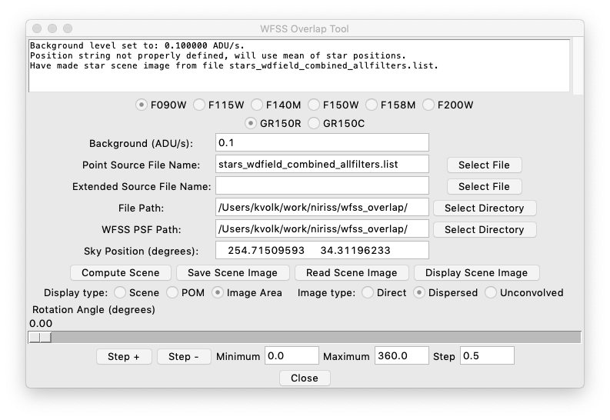
The star image and the galaxies image have no background. A uniform background is added according to the value in the Entry field.

Slide 17
Some log messages are written to the text box as calculations are carried out.

Slide 18
When a star list is read in, if there is no sky position specified the mean star position will be used.

Slide 19
One can save the scene image to a file and read it back in later to save calculation time if the field has many objects.

Slide 20
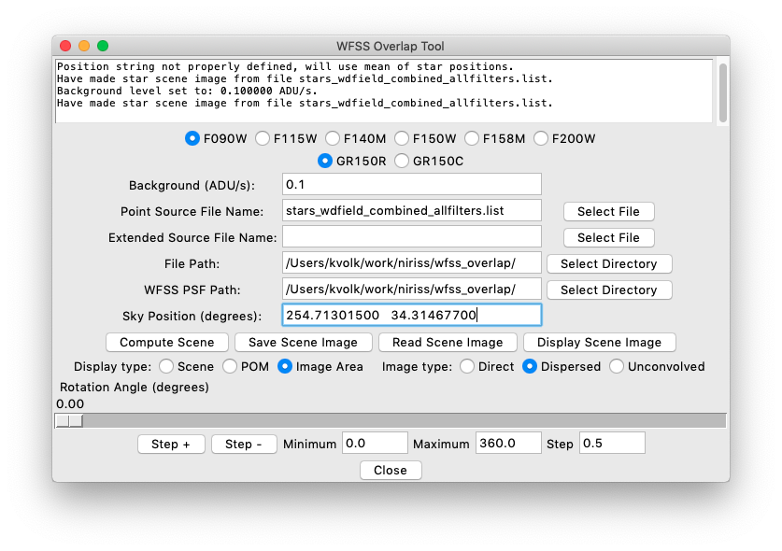
Now the image can be displayed. A new window comes up to show the image.
I have corrected the sky position to the target position, and recomputed the scene image.

Slide 21
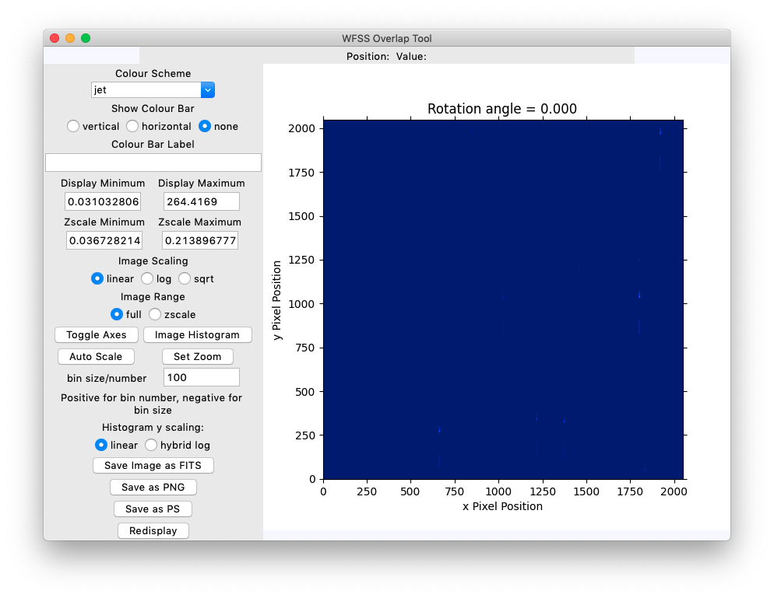
The image display window has some controls at left to help look at the image.
One normally wants to have the “zscale” radio button activated.

Slide 22
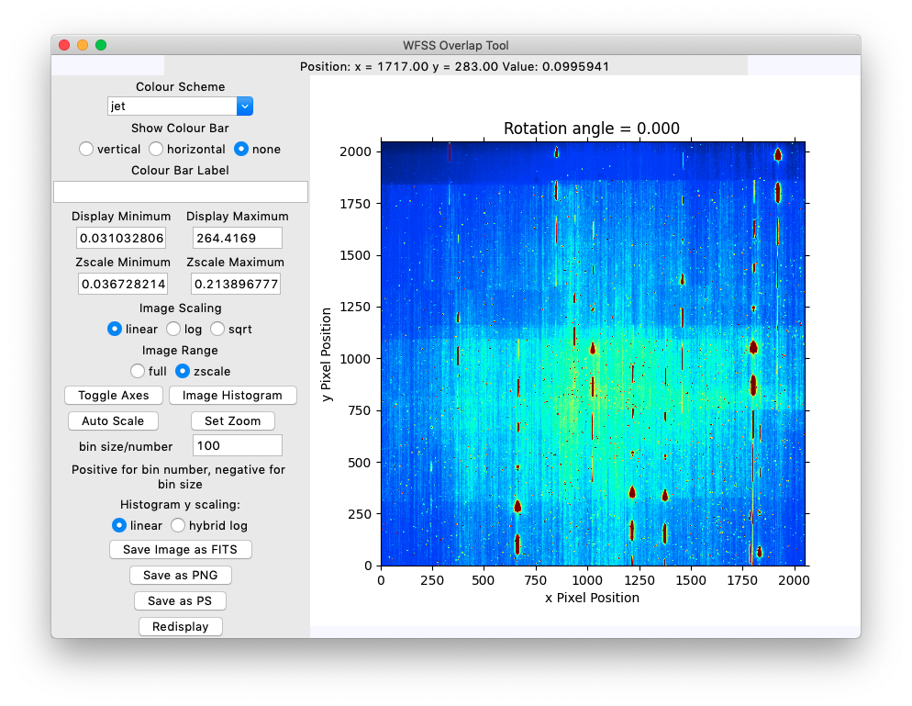
The image display window has some controls at left to help look at the image.
One normally wants to have the “zscale” radio button activated.

Slide 23
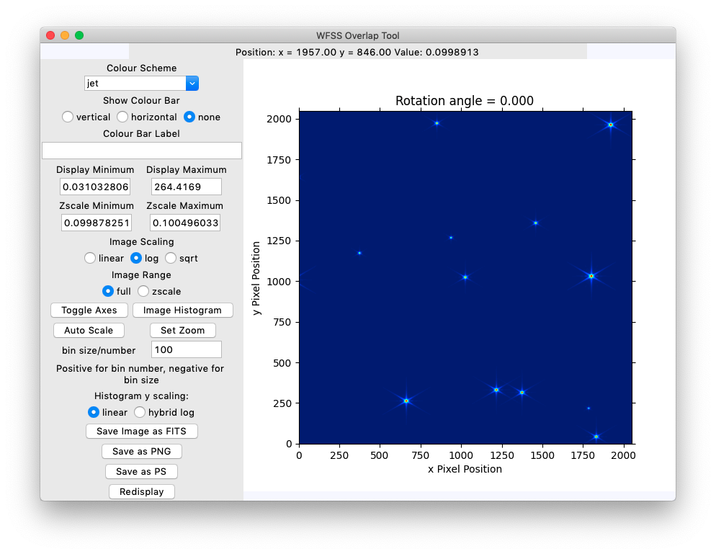
For stars it is often better to adjust the range in the “Display Minimum” and “Display Maximum” Entry fields and “Redisplay” as here. One needs to select the “full” radio button for this.

Slide 24
The photometric standard WD1657+343 is the star close to the centre of the image here.

Slide 25
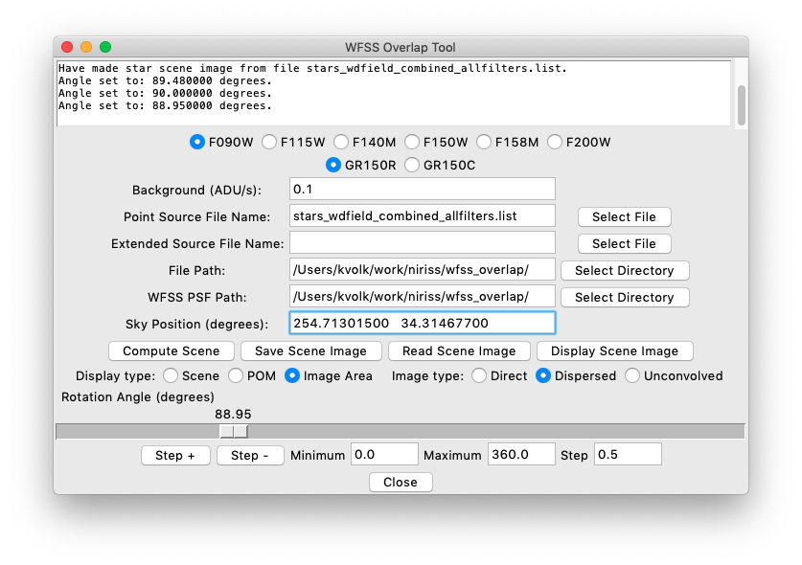
One can use the slider to set the rotation angle in degrees E of N. Each time it is changed, the “output” image is recalculated and displayed.

Slide 26
One can also use the Entry fields to set a range of angles and step through them one by one, forwards or backwards.

Slide 27
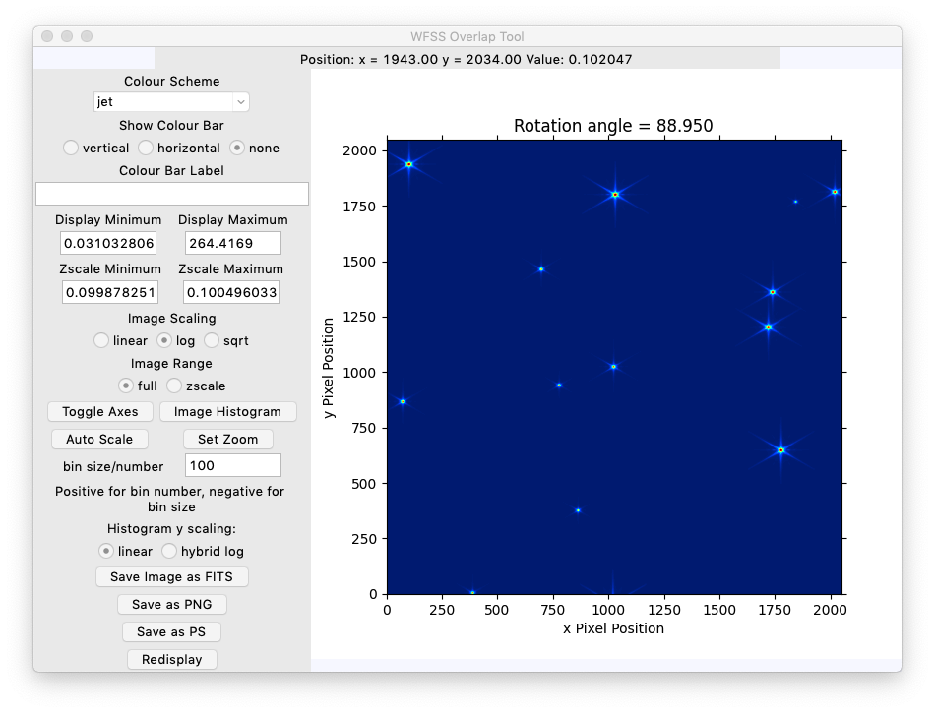
One can use the slider to set the rotation angle in degrees E of N. Each time it is changed, the “output” image is recalculated and displayed.

Slide 28
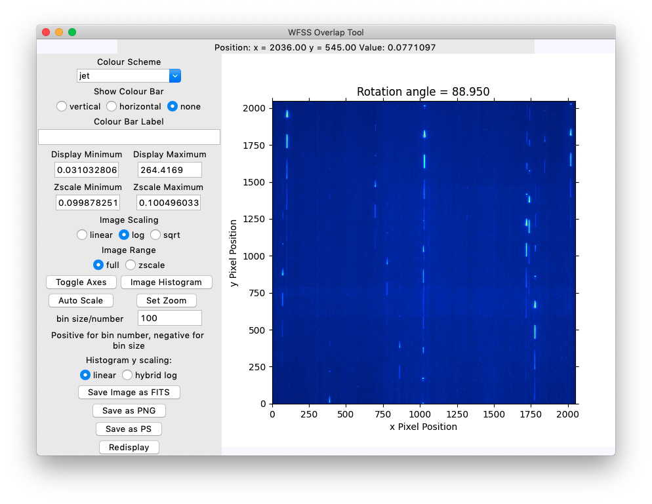
Going back to the dispersed image with the selection button, there is another spectrum near the standard star spectrum.

Slide 29
Going back to the dispersed image with the selection button, there is another spectrum near the standard star spectrum.
To get a better look, use the “set zoom” button.

Slide 30
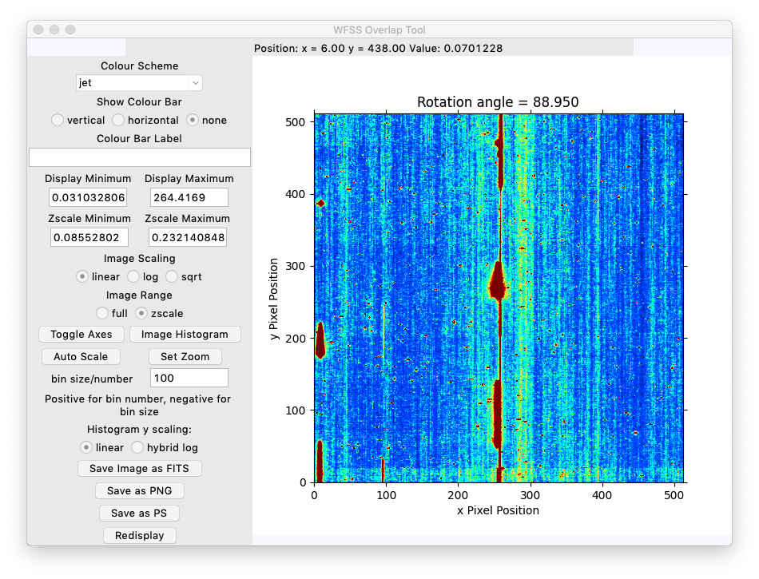
The zoom is around the centre of the image or any position selected by clicking on the displayed image.

Slide 31
The zoom is around the centre of the image or any position selected by clicking on the displayed image.
Source spectrum
Other spectrum

Slide 32
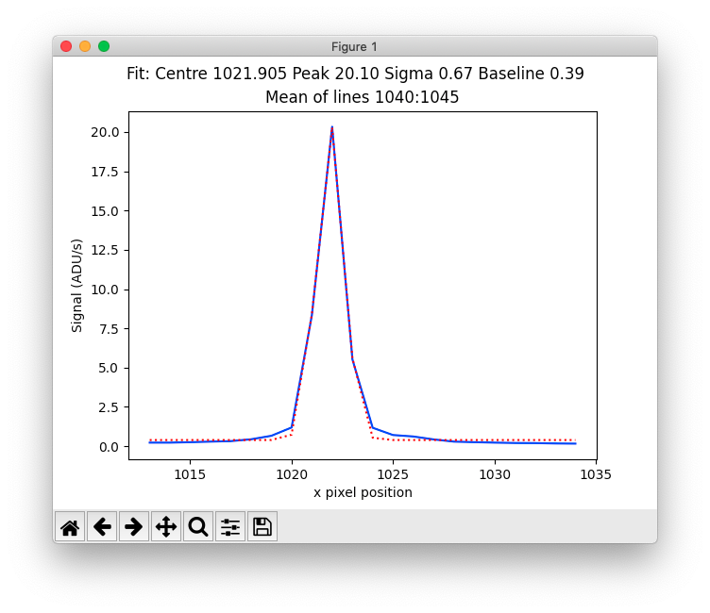
The “j” and “k” keys work as in IRAF to produce a plot of the mean of 4 lines or 4 columns, length 20 pixels, to help estimate separations between spectra.
As in IRAF, a Gaussian fit is overplotted.

Slide 33
Note that when these profile display windows are created, no input can be sent to the main program until the window is closed (at least on my Mac system).

