Slide 1


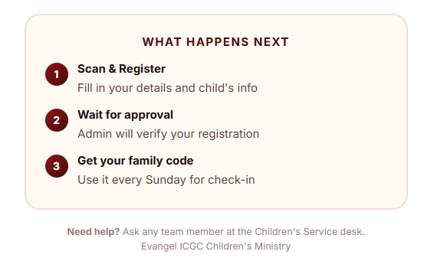
or Visit the link Below
https://emenran.github.io/Kiddie-Log/

