Slide 1

sim2s7 Feasibility Study
Liu Hongwei
Dec. 2021

Slide 2

Introduction
MGTS is old, might be down anytime, we need prepare a plan B
Problem we are facing

Slide 3
How MGTS softshelf works
RCS 0-0-10
RCS 0-0-9
RCS 0-0-2
RCS 0-0-1
MGTS SERVER
SPA
SPA
SPA
EE SOFTSHELF
passThru
passThru
UDP
passThru
Soft shelf S7SCH
passThru
passThru
UDP
passThru

Slide 4
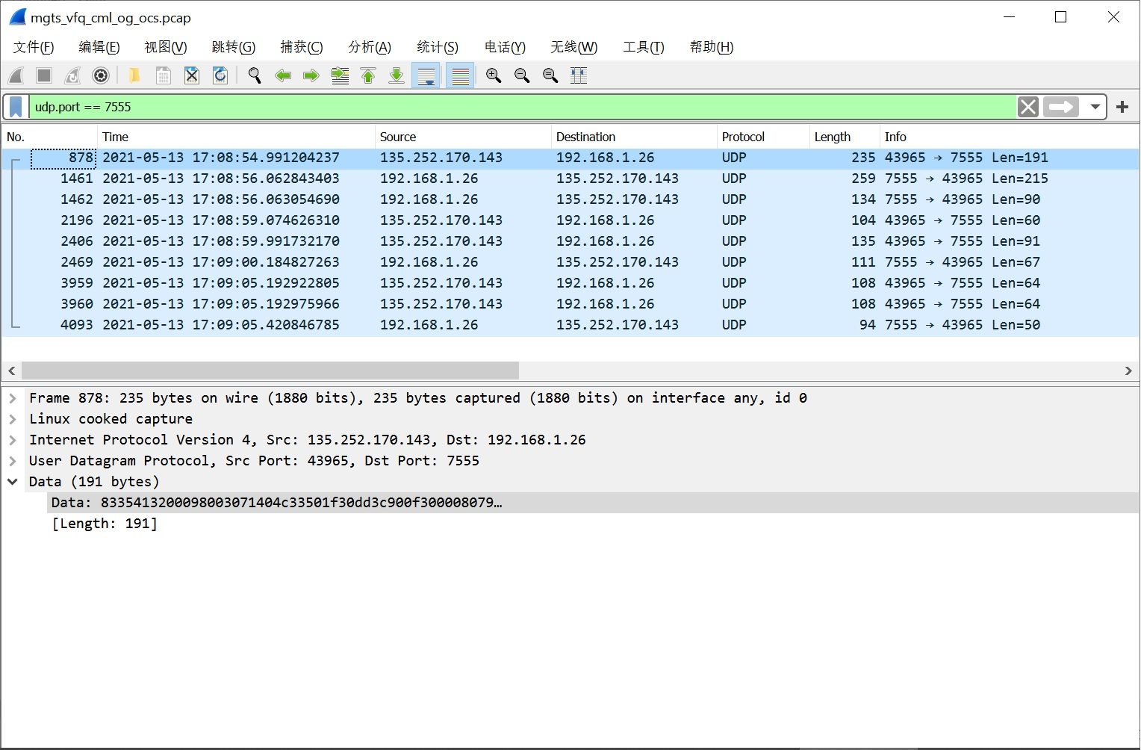
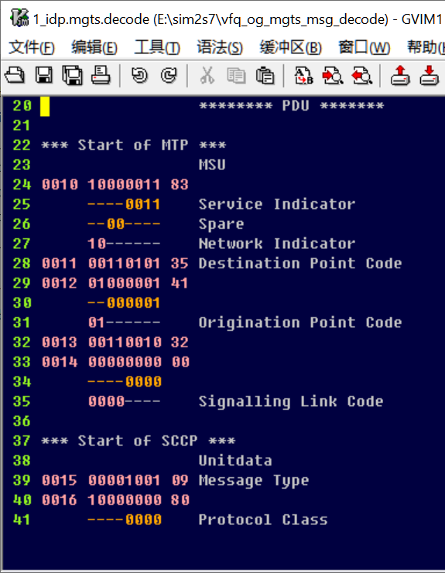
At lower layer, Raw message encapsulated in UDP datagram

Slide 5
Solution Plan
sim2s7
RCS 0-0-10
RCS 0-0-9
RCS 0-0-2
RCS 0-0-1
SPA
SPA
SPA
UDP Client
833541320009…
Soft shelf S7SCH
sim2s7
UDP

Slide 6
Solution: sim2s7/sim2s7.py
1. /cs/sn/utest/s7sch/sim2s7,
http://inu.ih.lucent.com/~ss7team/sim2s7/QIP.html
2. New developed: sim2s7.py
New designed state machine format: <state>.json
sim2s7.py --mcas_host=135.242.107.153 --state=vfq_cml_og_v3.json

Slide 7
Solution: sim2s7/sim2s7.py (Cont.)
<state>.json DOM view
Document
Root
sigstd: "CCITT-SS7"
database
states
rk: 004E
…
calling: 39340048
IDP
RRB
…
REL
Example: inuweb.ih.lucent.com/~hongwehl/sim2s7/vfq_cml_og_v3.json

Slide 8
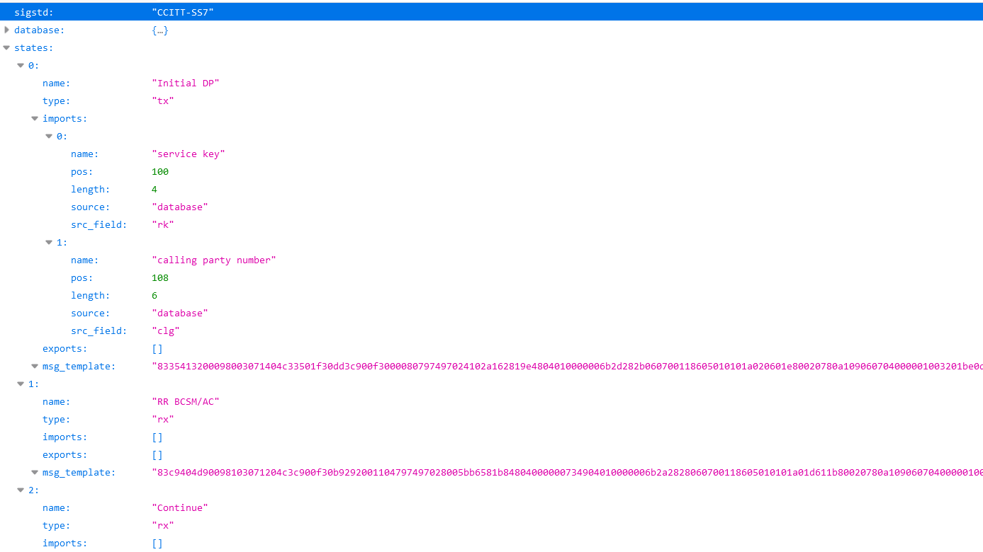
<state>.json example

Slide 9
Solution: sim2s7/sim2s7.py
disadvantage: raw messages
00 00 00 01 00 06
45 00 00 DB 00 00
C0 A8 01 1A AB BD
00 09 80 03 07 14
00 00 80 79 74 97
00 00 00 6B 2D 28
A0 20 60 1E 80 02
00 32 01 BE 0D 28
05 7B 6C 67 A1 65
00 00 00 47 83 08
00 00 31 17 88 70
80 90 9C 01 02 9F
1. NOT easy to edit messages in state machine json file, nor read it
2. NOT easy to debug, because sent/received messages are in raw hex
👎

Slide 10
Solution: sim2s7/sim2s7.py
advantage: fast, stable
1. convenient: running anywhere.
2. stable: faster, higher success rate due to better connection
3. response messages can be received, transaction id or other parameters can be got and used dynamically in later messages
(comparing to /cs/sn/utest/s7sch/sim2s7)
👍

Slide 11

Solution to get state machine json files
We have
START
STOP
states2j.py
We need

Slide 12
Pseudo MGTS Plan
SUnit + MGTS
P250alu
/home/catapult/USERS/<user>/datafiles
/home/auto/bin/test/auto_case_split.sh
/home/auto/bin/test/collect_log.sh
/home/auto/bin/test/kill.sh
ftp upload <state machine>.tar
SUnit
telnet run state machine by calling

Slide 13
Pseudo MGTS Plan
SUnit + Pseudo MGTS
Pseudo MGTS
/home/catapult/USERS/<user>/datafiles
/home/auto/bin/test/auto_case_split.sh
--> states2j.py
--> sim2s7.py
/home/auto/bin/test/collect_log.sh
/home/auto/bin/test/kill.sh
ftp upload <state machine>.tar
SUnit
telnet run state machine by calling

Slide 14
Pseudo MGTS Plan
1. Find a machine as pseudo MGTS ,
open telnet/ftp （export PS1="[\u@\h \W]> "）
make directory structure: /home/catapult/USERS/<username>/datafiles
2. Deploy sim2s7.py and states2j.py
sim2s7.py uses python2, sim2s7py3.py uses python3
state2j.py uses python2/3, python3 brings better readability
They are called by /home/auto/bin/test/auto_case_split.sh
3. Rewrite autorun and other related scripts on MGTS server
/home/auto/bin/test/auto_case_split.sh
/home/auto/bin/test/collect_log.sh
/home/auto/bin/test/kill.sh

Slide 15


Use sim2s7.py(Pseudo MGTS) for testing
Currently, MGTS is mainly used in three test areas
Regression
Feature/Function
Performance

Slide 16
sim2s7.py in regression test
How to do regression test after MGTS is down
sim2s7.py provides:
👍 faster, higher success rate due to better connection
👍 transparency to sunit (as introduction in previous slides)
So, when MGTS is down, sim2s7.py is a perfect solution in regression test, or even better than MGTS itself
Some test was made in SurepayAR regression test

Slide 17

Regression Testing Result of SurepayAR MGTS Cases
On SP18.9 ITU
Customer | Case No. | Pass | Fail | PassRate
BSNL | 5 | 5 | 0 | 100%
GOM | 7 | 4 | 3 | 57%
VFCZ | 11 | 11 | 0 | 100%
VFGH | 7 | 7 | 0 | 100%
VFHU | 3 | 3 | 0 | 100%
VFI | 10 | 10 | 0 | 100%
VFIE | 2 | 2 | 0 | 100%
VFNL | 8 | 7 | 1 | 88%
VFQ | 5 | 5 | 0 | 100%
Total | 58 | 54 | 4 | 93%
Precondition:
Use CentOS lab 135.242.107.130 to deploy sim2s7.py and state2j.py
Rewrote:
/home/auto/bin/test/auto_case_split.sh
/home/auto/bin/test/collect_log.sh
/home/auto/bin/test/kill.sh
Then run cases
Fail Reason
GOM fs4591, fs4592, state machine uses message template that uses var import, sim2s7 can’t handle, so cases must be changed to use fix import message template
GOM fv9892, should work on SP19.9
VFNL fv3282, pass after supporting upload + run_only, fv3283 still failed due to some time issue, need further investigation

Slide 18
Regression Testing Result of SurepayAR MGTS cases
Some sim2s7.py issues and solutions
issue | solution
UDP received might be out of order | rare case, re-run case
call duration between answer and disconnect may variate in 1s (e.g. VFNL fv2969) | sim2s7's delay is shorter than mgts, so the only way is re-run case
var import (e.g. GOM fs4591) results import value incorrect | change cases because sim2s7 can’t handle this scenario
current auto_case_split.sh can't handle combination of "upload" and "run_only" mode | will update auto_case_split.sh Updated auto_case_split.sh by involving “nohup”, and update MGTSTask code timer from 0.01s to 0.03s after starting auto_case_split.sh, because in upload mode, telnet will disconnect, so we have to make it run at background
current pseudo mgts is slow for the second connection, this is another reason that we can't handle "upload" and "run_only" mode | It worked without any action later

Slide 19
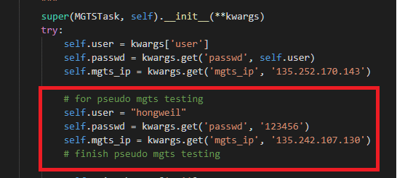
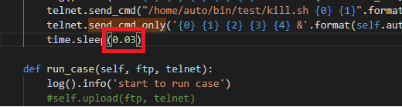
How to use Pseudo MGTS
Share with DFT automation team
DFT automation can try this:
1) Pseudo MGTS
  ip: 135.242.107.130
  username: hongweil
  passwd:123456
2) Update above information and 0.03s timer
in to sunit MGTSTask code
(need restart sunit after updating code)
< dir>\Sublime_text_x64\Data\Packages\Surepay\libs\mgts_task.py
3) Pseusdo MGTS related scripts:
On 135.242.107.130(hongweil/123456):
/home/auto/bin/test/sim2s7.py
/home/auto/bin/test/states2j.py
/home/auto/bin/test/auto_case_split.sh
/home/auto/bin/test/pseudo_auto_case_split.sh
/home/auto/bin/test/kill.sh
/home/auto/bin/test/collect_log.sh
NOTE:
To support upload + run_only mode, update sleep timer from 0.01s to 0.03s

Slide 20
sim2s7.py in feature test
How to do feature test after MGTS is down
There are two scenarios for feature test
1) For basic calls’ state machines, no big change to ss7 messages(e.g. only need update parameter’s value), sim2s7.py can be used in feature test
2) For cases that need add new parameters or update parameter length(USSD, IVR), then it is not convenient to use sim2s7.py, because:
It is hard to get/edit ss7 message’s raw data, so sim2s7.py has no input
It is hard to debug the message received from OCS, because it is raw data too, not readable

Slide 21
sim2s7.py in performance test
How to do performance test after MGTS is down
Because performance test uses hardshelf, it uses different protocols, requires specific hardware, which is a totally different mechanism
So, nothing sim2s7.py can do in performance test

