Slide 1
PROJECT HDB
Presenter: Ho Xuan Vinh
Notes:
Hi everyone, here is my survey about the HDB mechanism.
Housing and Department Board if you wonder what it is. I have thought about which kind of logical order that I can present, yet I still do not think this is the best way. So at some point, you might have some questions, but please note it and ask me later, because it might somewhere in the back of this presentation.

Slide 2


Overview
2-Room Flexi
3-Room
Income
Race
Age
Citizenship
3-Room
4-Room
3Gen
Notes:
In Singapore, the residential property market consists of two main types: public housing and private housing. Public housing, or HDB flats, generally is subsidized by the Singapore government for Singapore citizens and permanent residents. In 2009, HDB homes accounted for about 78% of the 1.13 million residential properties in Singapore.
More than 80% of Singaporeans live in HDB flats, which are developed and closely governed by the Housing and Development Board (HDB), including the resale market. These flats are located in housing estates, which are self-contained satellite towns with schools, groceries, clinics, food courts, and sports and recreational facilities. There are a large variety of flat types and layouts to cater to various housing budgets.
Before going into detail, I will first speaking of general ways people buy house.

Slide 3

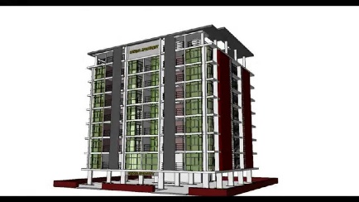

Overview (cont)
Buy house
from government
1
Built-To-Order ~ 4 years
HDB
2
Sale of Balance Flat ~ Immediately
Buy house
from other sources
Flat
Resell
3
Mimimum Occupation Period = 5 years
Notes:
I will focus on mere public housing, Other ways could be considered as private housing, and thus there is no intervention from the government.
The primary avenue for owning a HDB flat is through the purchase of a new flat directly from the HDB. The current mode of sale is known as the Build-To-Order program (BTO program, hereafter), launched in 2001. Qualified Singaporeans apply and, if successful, must wait more than four years before the building is completed. In addition, the eligibility criteria are strict for owning a new HDB flat: only citizens with a family that have an income below the stipulated cap can buy a new HDB flat.
You might also be given priority for Design, Build and Sell Scheme (DBSS) flats and Executive Condominiums (EC).
For these reasons, there is an active resale market for buyers who wish to move in immediately, or for those who do not qualify for new HDB flats. The government does not intervene on house prices in the resale market: existing flat owners are allowed to sell their flats on the open market to any eligible buyer at a mutually agreed upon price. Permanent residents, single citizens who are older than 35, and citizens with high income can own a resale HDB flat. While the government does not regulate the prices in the resale market, most flat owners can only sell their flats if they have met the Minimum Occupation Period (MOP) requirement, which requires HDB owners to live in their flats for a minimum period of time before they are allowed to resell them.
SBF launches allow prospective homebuyers to apply for (i) balance flats from previous BTO flat sales launches, (ii) surplus Selective En bloc Redevelopment Scheme (SERS) replacement flats, and (iii) re-purchased flats.
SBFs are also conducted through a balloting system, similar to the one used for applying for a BTO flat.

Slide 4

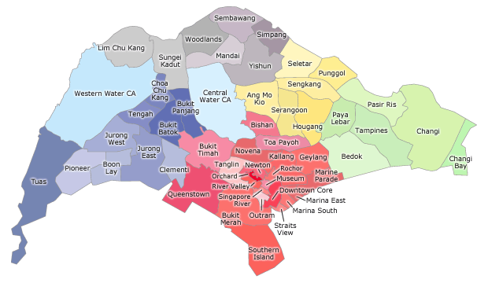

A Sale Launch
Notes:
Once the government have plan for new building, for example a new block in Sangkang, they would announce the news. When the deadline is reached and number of balloter is over a miniumum amount, they would start a procedure to select candidate to choose home. More detail would be mentioned in following slides. One sale launch could be comprised of several block of building in the same area.
One side note is that if they feel like to build in 2 different area at the same time, it could be considered at one sale launch. So people still do the exactly similar procedure, but when it comes to their turn, they can choose a flat in either area A or B, as long as there are empty slots available.
Another thing is that there is a big different between non-mature estate and mature estate: ratio of second timer, racial harmony, price… mature state is where the neighborhood is well-developed, crowded area.

Slide 5
Process (balloter perspective)
Sale Launch
Prepare Document
Submit
Ballot
Priority Scheme
2-3 weeks
Signing
Agreement
Selection
Ballot Result
aka Queue number
Tentatively, depends on people
has low queue number
Notes:
This is a typical process of a balloter (citizen) when they want to buy a new house.
Login to HDB website, look for the date of new launch project
Prepare document, if you are belong to at least one and maximum 2 out of 6 Priority Scheme, prepare for them as well. Choose the type of flat you want, it depends on your income. More detail in the next slide.
Submit the document and corresponding number of tickets would be generated. Now it’s the role of the system to pick up order for candidate to select the house. One side note is that if there are 300 flats. The number of queue would be 300%, which means 900 queue number. This is for the case if some of buyers decline the offer.
It takes 2-3 weeks for the result to come out.
The smaller the number on queue ticket, the more advantage you have.: highly probability that you get your dream flat.
You can either sign agreement and get the flat, or decline the offer, which may lead to a less advantage for you in the future. Explain later.
One possible scenarios is that applying to different sale launches at the same time is possible, but once you chosen a flat in first sale launch, you could not choose flat in other sale launches. I’m not sure about this fact.
Is there penalty if you accept first offer and refuse second offer? Is this considered as down-grade 1 year? Does not matter, you are no longer a first-timer
Note: one do not need to specify the flat type they want at this moment, only when it comes to their turn to select that counted.

Slide 6
Choosing flat type
Most of HDB flats are affordable for first-timer to buy (loan etc…).
Income ceiling: depends on the type of flat you intend to get. If your average gross monthly household income exceeds the income ceiling, you will not be eligible for that flat type.
If you cannot afford any, there is Public Rental Scheme for low income family: 1 or 2-Room flat with approximately 1.500$/month.
Notes:
Expectation to pay: ¼ of your income.
Public Rental Scheme:
http://www.hdb.gov.sg/cs/infoweb/residential/renting-a-flat/renting-from-hdb/public-rental-scheme/flat-types
Income ceiling: http://www.hdb.gov.sg/cs/infoweb/residential/buying-a-flat/new/hdb-flat
http://www.channelnewsasia.com/news/singapore/ndr-2015-income-ceiling-for-hdb-flat-buyers-raised-special-cpf-h-8225062
Income ceiling: if you are rich, you can choose whatever flat type you want, and thus limit the choice of lower income.

Slide 7
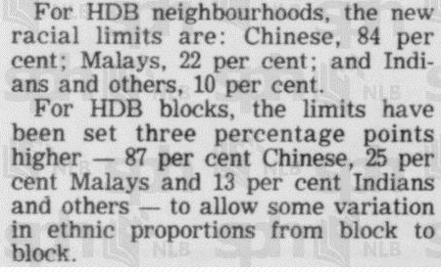
Racial Harmony 1 - Ethnic Integration Policy (EIP)
→ Apply to any buyers
Notes:
You should read this entire paper
http://eresources.nlb.gov.sg/newspapers/Digitised/Article/straitstimes19890217-1.2.2
How can you define neighborhood and block?
This page explain everything:
http://www.hdb.gov.sg/cs/infoweb/residential/selling-a-flat/eligibility
How can you define what is neighborhood?
These number should be checked later on.

Slide 8
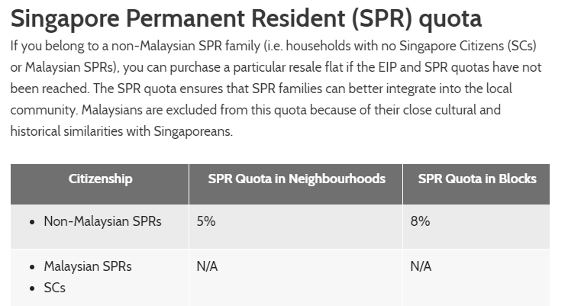
Racial Harmony 2 – Singapore Permanent Resident (SPR)
→ Apply to any Non-Malaysian SPRs

Slide 9
Buyer Type
First-Timer
First-Timer
= 2 tickets
Yes
First-Timer⁺⁺
= 2 tickets
+ # failure
Offered?
Non-mature only
No
First-Timer⁺⁺
Second-Timer
= 1 tickets
Accepted?
No
Yes
2nd Refusal?
No
Second-Timer
Yes
within
1 year
Second-Timer
First-Timer
Notes:
First Timer and Second Timer have their own slot, so there is no conflict between these 2 groups. Each group could have additional point by applying at most 2 Priority Scheme to get additional tickets.

Slide 10
Priority Scheme
Parenthood Priority Scheme (PPS)
Married Child Priority Scheme (MCPS)
Third Child Priority Scheme (TCPS)
Multi-Generation Priority Scheme (MGPS)
Assistance Scheme for Second-Timers (ASSIST)?
Tenants’ Priority Scheme (TPS)
Senior Priority Scheme (SPS)
Notes:
Ratio can vary between non-mature and mature estate.
Link: http://www.hdb.gov.sg/cs/infoweb/residential/buying-a-flat/new/eligibility/priority-schemes

Slide 11
MECHANISM

Slide 12



1st Timer
3rd Failure
1st Timer
2nd refusal
1st Timer
Priority
1
Priority
2
1
2
Priority
3
2nd Timer
Notes:
Is that considered as exploited the system when choosing priority pool gaining advantage for you?

Slide 13
…
Priority Pool
Priority 1
Priority 2
Priority 5
Ordinary
1
2
first-timer pool
Notes:
Clue:
First-timer applicants will be given more chances over the Second-timer applicants in the balloting, subject to the prevailing policy on ethnic ratios and quota of flats available for booking.
Depend on mature that ratio of priority scheme
Additional chances are not given for SBF and
BTO sales launches in mature estates as the supply of those flats is limited.
You can get priority for up to 2 schemes. So long as you meet all of the applicable eligibility conditions, you can apply for 1 priority scheme with the exception of PPS, where PPS applicants can also apply for TCPS and/ or MGPS, and vice versa
To manage repeated non-selection of flats by first-timers, please note that: Those who were invited to select a flat but did not do so, will have their previous unsuccessful applications set to 0
Should an applicant reject 2 chances to select a flat, any and all first-timer privileges will be removed for a period of 1 year. Any flat applications made during this period will be placed together with second-timer applicants, and no additional ballot chances are given. The balloting is conducted for each priority scheme. For example, a married couple with 3 children is eligible for the TCPS and PPS. Their application will first be balloted with other TCPS applicants. If that ballot is unsuccessful, their application is then balloted again under the PPS. First priority in MCPS
The last one raise suspicious in me that maybe each pool has its own priority in comparison to others.

Slide 14
n_{pool}, n_{ordinary}
s.t. n_{pool} + n_{ordinary} = n
Sampling n_{pool} tickets from 6 pool
Choose randomly pool_{i} among 6 pools such that pool_{i} does not reach its quota.
Choose randomly 1 ticket in pool_{i}.
Delete other tickets of this owner in other pools (except ordinary pool).
Sampling n_{ordinary} tickets from ordinary pool
first-timer pool
Notes:
Pool = priority pool
All flat types do not do it at the same time, but in a particular order. This could affect the racial ratio for later buyer.
Proof? One blog post.

Slide 15
Fairness
Evolution: Highest bet, queue -> balloting
Racial Harmony
What happen if you back out of Priority Scheme
Irrelevant: control the price of open market, when HPB flats are way more lower
Notes:
A good post about evolution of mechanism:https://www.reddit.com/r/singapore/comments/4kxgss/why_do_bto_flats_have_an_income_ceiling/
Supported Document: http://www.hdb.gov.sg/cs/infoweb/residential/buying-a-flat/new/hdb-flat
is 2 priority scheme promise more chance?
Flats were allocated under the Waiting List System, Booking System, Registration for Flats System, and currently the Build-To-Order System.:http://www.hdb.gov.sg/cs/infoweb/about-us/our-role/public-housing--a-singapore-icon
Scandal: http://www.straitstimes.com/singapore/housing/hdb-clarifies-stand-on-priority-scheme-withdrawals
Q12: Can I change the ethnic group classification of my flat application if my spouse is of a different ethnic group?
A12: The application and booking of a flat will be subject to the Ethnic Integration Policy. Each application is classified based on the head of household regardless of whether the person is listed as the main applicant, co-applicant or proposed occupier. In an application made by a couple of the same ethnic group, the application will be based on their ethnic group. For couples of different ethnic groups, they can request to classify their household under either ethnic group.

Slide 16
Arisen question
What happen when you are in the queue, but when it comes to your turn, the racial quota reached?
Check the so-called “scandal” in previous slide’s note. It’s a valid result, but rare. What happen when someone lost her priority? To her and other buyers.
Actual relationship between priority pool.
First-timer and Second-timer have separate queue? Then how to handle racial harmony here.
Notes:
Unsure about number of chances: https://blog.moneysmart.sg/property/your-step-by-step-guide-to-buying-a-bto-flat/
Other link:
http://convexset.blogspot.sg/2012/06/operationalizing-hdb-balloting-with.html
https://www.99.co/blog/singapore/ethnic-integration-policy/
http://www.kattytan.com/2012/06/the-process-of-we-got-our-flat.html
Optimized strategy: https://www.homerenoguru.sg/articles/renovation-essentials/maximise-chance-of-winning-bto-ballot/

Slide 17
Source
HDB website:
Application process, definition of relating terms
http://www.hdb.gov.sg/cs/infoweb/homepage
NUS Real Estate Department:
Factors influence the housing’s price: preference in neighborhood have common religions or country, foreign liquidity, price of new house, land prices
http://www.ires.nus.edu.sg/research/papers.aspx
Google
A typical application, how to cheat the system, scandal
FAQ
http://askhdb.hdb.gov.sg/ifaq.aspx?category=60640&topfaqs=0

Slide 18
Abbreviation
HDB: Housing and Development Board
BTO: Build-To-Order
SBF: Sale of Balance Flats
MOP: Minimum Occupation Period
CPT: Central Provident Fund
Notes:
A few abbreviation you might take note when reading following slides

Slide 19
Take-away
Ballotting mechanism
First-timer, second-timer
Priority Scheme
Racial harmony
How to set an appropriate ceiling income to maximize social welfare
Ethnic Integration Policy
Notes:
Negative effect of raising ceiling, seems like existing problem to low-incomer: https://blog.moneysmart.sg/opinion/hdb-income-ceiling-increase/
EIP: https://www.99.co/blog/singapore/ethnic-integration-policy/

Slide 20
Q&A

