Slide 1

Grimoire
A companion for game masters at NLB Chinatown

Slide 2
01
The Challenge
Some observations on how we currently run community sessions

Slide 3


What We've Noticed at NLB Chinatown Sessions
Varied Teaching Approaches
Knowledge Tied to Individuals
Limited Shared Learning
Each GM teaches in their own way — visitors may get a different experience depending on who's at the table.
When a GM is away, their familiarity with a game isn't easily passed on to others.
Teaching tends to improve through personal experience alone, with few structured ways to share what works.
3

Slide 4

02
Meet Grimoire
A shared knowledge base, built by and for your game masters
grimoire-nlb.streamlit.app

Slide 5
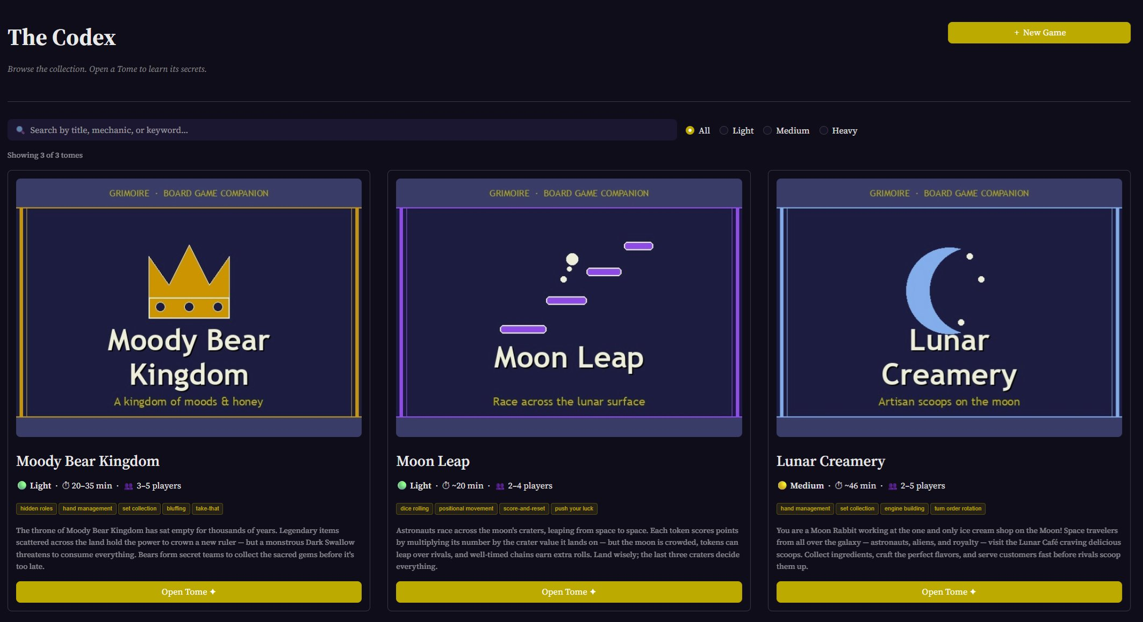
The Codex — Browse & Search Your Game Collection
What it does
Browse all games in the library
Filter by weight: Light / Medium / Heavy
Search by title, mechanic, or keyword
Each card shows play time, player count, and a story blurb
Click “Open Tome” to go deep on any game
GM tip: This is the first page visitors see — it sets the tone for the whole session.
5

Slide 6
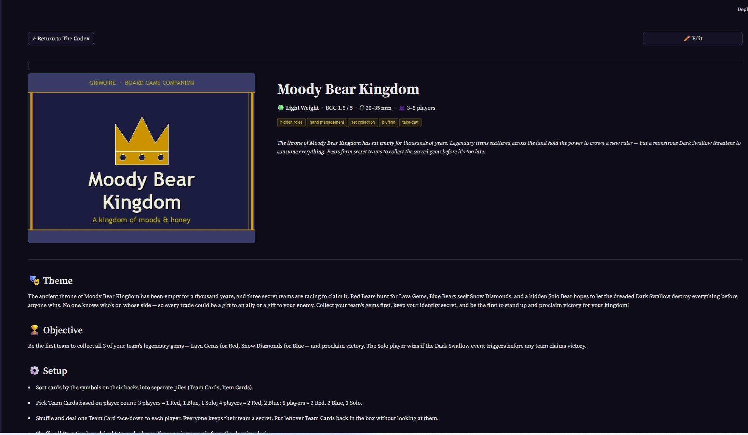
The Tome — Full Game Reference for Every GM
What it contains
Theme story & win condition
Setup steps & round structure
All key player actions
Teaching tips & strategy tips
5-question quiz to test readiness
GM tip: Open this on your phone 2 minutes before a session as a quick refresher.
6

Slide 7
The Tome: What Each Game Entry Contains
Setup
Round Structure
Ordered setup checklist — no step missed
Phase-by-phase turn breakdown
Key Actions
End Condition
Bold-named actions with short descriptions
Exactly when & how the game ends
Teaching Tips
Strategy Tips
4 curated tips from experienced GMs
4 tips to help players play better
Quiz (5 Qs)
Theme Story
Multiple-choice knowledge check
Narrative hook with the win condition baked in
7

Slide 8
03
GM Workflow
How each game master owns, teaches, and improves their game

Slide 9





Your Game, Your Knowledge — The GM Cycle
1
2
3
4
Draft Entry
Teach with It
Collect Feedback
Improve & Repeat
AI (LLM) generates a first draft from the rulebook. GM reviews and adjusts — no blank-page problem.
During GM-to-GM training, use The Tome as the reference. Every rule is in one place, on any device.
After sessions, GMs note what confused players or was missed. Feedback flows back to the entry owner.
Entry is updated. The next GM who teaches this game benefits from all past experience automatically.
Vinh handles final updates to the database. GMs simply submit feedback — no technical skills required.

Slide 10
04
Problems Observed & Benefits
What we've noticed, and what Grimoire helps address

Slide 11
Problems Observed & What Grimoire Helps With
Situation
Problem Observed
With Grimoire
Teaching consistency
Each GM has own style & gaps
Shared checklist, same key points
Knowledge retention
Lost when GM is absent
Always-on web reference
New GM onboarding
Shadow sessions + memory
Read the Tome, take the quiz
Improving over time
Only personal experience
Collective feedback, updated entries
Visitor experience
Depends on who's at the table
More reliably covered sessions
11

Slide 12
05
Your Concerns, Answered
We heard you — let's address each concern directly

Slide 13


Concern: "What about games in Chinese?"
The Concern
The Answer
Chinese-language games aren't captured. Grimoire only works for English games — it doesn't help with our full game library.
No language restriction. Game content is free-text — entries can be written in Chinese, English, Malay, or any mix. The platform places no language limits. Open for enhancement. As the site grows, additional language features or display options can be added based on what the team finds useful.
13

Slide 14

Concern: "Too much time and effort to maintain"
The Concern
The Answer
Writing up all these game entries from scratch is too much work on top of running sessions.
AI does the first draft. The coordinator feeds the rulebook to an LLM (like ChatGPT or Claude), which generates a structured entry in minutes. GMs only revise. Review takes 10–15 minutes — spot-checking for accuracy, not writing from zero. Updates are micro-edits. After a session, one or two bullet points updated is all it takes.
14

Slide 15

Concern: "No visuals — easier to just watch YouTube"
The Concern
The Answer
Grimoire has no visual cues. A YouTube video or playing the game is a much better way to learn. Why use a text app?
Grimoire is not competing with YouTube — or any other way to learn. People learn games differently. Some prefer videos, some prefer playing, some like reading. All of those are valid. Grimoire fills a different gap: a quick memory jogger for GMs. "I haven't taught Moody Bear Kingdom in 3 weeks — let me do a 2-minute refresh before the session starts." That is the use case. Think: cheat sheet, not tutorial.
15

Slide 16

Let's Build This Together
Grimoire doesn't replace the way you teach — it gives every GM a shared foundation to teach from.
Consistent Sessions
Empowered GMs
Better Visitor Experience
NLB Chinatown · Board Game Sessions · Grimoire v1

