Slide 1
talk.md
# talk.md
Web Dev for Data People
> Choosing a stack, working with an LLM, and staying in control
$
Notes:
[~1 min]
Welcome. ~90 minutes total, including four live demos. Questions welcome any time, or hold them - your call as speaker.

Slide 2
what-we-ll.md
What we'll cover
› Why this matters for data people
› A ladder for picking the lightest tool that works
› Two gaps that quietly turn a demo into a product
› How to use an LLM without losing control of your own codebase
› Four live demos - screenshots included as a backup
Notes:
[~2 min]
Set expectations for the shape of the talk before diving in.

Slide 3
the-moment-every.md
The moment every analysis hits
In [1]:
A chart in a notebook
Convinces you. It rarely convinces a colleague who's never going to open that notebook.
A small web app
Move a slider, filter to their own region, type a value - watch the answer change.
› That feels very different from a screenshot.
Notes:
[~2 min]
Open with the everyday moment - this is the 'why' before any tooling talk.

Slide 4
where-this-quietly.md
Where this quietly pays off
Explore
Makes exploring a dataset more interactive
Demonstrate
Demonstrates a model as a live service
Prototype
Prototypes a product idea before anyone spends engineering time on it
An LLM can write most of the boilerplate for you now… but the difficulty didn't disappear. It moved: to picking the right tool.
Notes:
[~2 min]
Land the hook: the assistant will build whatever you name - the costly mistake now happens earlier, picking wrong and finding out three days in.

Slide 5
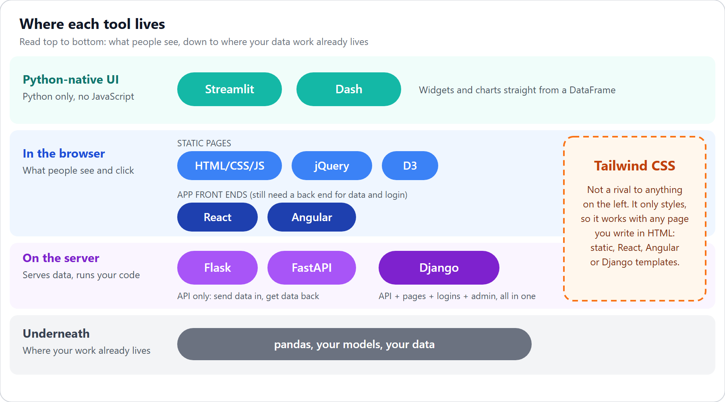
where-each-tool.png
Where each tool lives
Same band = alternatives. Different bands = usually combine.
Notes:
[~2.5 min]
Walk top to bottom: Python-native UI, browser, server, and underneath it all, the pandas/model work that's already there.

Slide 6
two-easy-things.md
Two easy things to miss
› Tailwind (styling only) isn't a rival to Django or React - it works with either.
› React and Angular (both JS UI libraries) sit on the same rung: both still need something else to supply data and handle login.
› If you live in Python: Streamlit and Dash need zero JavaScript, and for many tasks that's the whole answer.
Notes:
[~2.5 min]
These two misconceptions cause most of the 'framework wars' confusion. Keeping the map on screen means nobody has to hold these names in their head.

Slide 7
stop-asking-which.md
Stop asking 'which framework?'
› Ask instead: what does this app actually have to do?
› Any web app is some combination of the same 12 capabilities.
› Tick the rows your use case needs - the ticks are the decision.
Notes:
[~2 min]
This reframe is the whole method the rest of the talk builds on.

Slide 8
the-12-functionalities.json
The 12 functionalities
# | Functionality | What it means
1 | Presentation | Show static content
2 | Styling & layout | Make it look decent and consistent
3 | Client interactivity | Filters and tooltips, no page reload
4 | API: providing | Expose data or a model over HTTP
5 | API: consuming | A page or service calls an API
6 | Server-side compute | Run pandas or a model per request
7 | Persistence | Save records
8 | Forms & CRUD | Validated create, edit, delete
9 | Authentication | Who is this user?
10 | Authorization | What may they do or see?
11 | Session & state | Remember a user's choices
12 | Background / long jobs | Work that outlives one request
Notes:
[~3 min]
Dense slide on purpose - give it room. Don't read every row; point at a few (7-10) since they come back in the 'two gaps' section later.

Slide 9
worked-examples.md
Worked examples
Share a chart you're proud of → Presentation, Styling & layout, Client interactivity
3 of 12
Explore a dataset → Client interactivity, Server-side compute
2 of 12
A labeling tool → Persistence through Authorization, plus everything before it
10 of 12
› The number of ticks is the signal: each tick from Persistence onward is a reason to reach for a heavier tool.
Notes:
[~3 min]
Bridge straight into the ladder section. The dots are the same 12 rows from the functionalities table - nobody has to remember a number.

Slide 10
climb-only-when.md
Climb only when you must
[1]
Static HTML + D3 — show a finished result, no server at all
no install, or: npm install http-server
[2]
Streamlit or Dash — explore data, or build a tool for peers. Python only
pip install streamlit / pip install dash
[3]
Flask or FastAPI — serve a model or data over HTTP
pip install fastapi uvicorn / pip install flask
[4]
Django + a Tailwind kit — users, a database, forms, and an admin
pip install django → django-admin startproject | Tailwind: standalone CLI, or a CDN link (one hosted script tag, zero install) - no Node required
[5]
React or Angular over an API — only when the UI is genuinely app-like
npm create vite@latest -- --template react
Notes:
[~3.5 min]
Read the pull-quote: start at the lowest rung that covers every tick; climb only when you can name the specific thing the rung below can't do.

Slide 11
applied-to-concrete.json
Applied to concrete cases
Use case | Functions | Pick
Share a finished chart | 1, 2, 3 | Static HTML + D3
Explore a dataset | 3, 6 | Streamlit
Peer dashboard | 3, 6 | Dash
Demo a model | 4, 6 | FastAPI - /docs is a free test form
Labeling or review tool | 7-10 | Django
Pipeline that ends in a page | 1, 3 | Python writes JSON, D3 renders it
Notes:
[~3.5 min]
Mention the honest caveat: React+Tailwind is 2 projects, a build step, and auth you write yourself - climb there only for app-like UI needs.

Slide 12
pretty-enough-for.json
Pretty enough for business users
Option | Good for
Django templates, Tailwind, daisyUI | A clean prototype with no React - the default
React, Tailwind, shadcn/ui | The best-looking and most customizable, highest setup cost
Dash + dash-bootstrap-components | Tidy dashboards out of the box
Django admin | Back-office screens for free
Notes:
[~4 min]
Raw Tailwind gives utility classes, not a design - a component kit is what makes it look 'standard'. Mention the standalone CLI, no-Node option.

Slide 13
multi-user-six.md
Multi-user: six things to solve
› Authentication — who is this user?
› Authorization — what may they do?
› Data isolation — user A never sees user B's rows
› Per-user state — remembering each user's own choices
› Concurrent writes — two people editing at the same time
› Audit trail — who changed what, and when
Notes:
[~2.5 min]
This and background jobs are the two gaps that bite the moment a demo becomes a product. None of this shows up in a 'build a dashboard in 10 minutes' tutorial.

Slide 14
the-tools-differ.json
The tools differ sharply here
Tool | What you get
Django | Auth, sessions, groups & permissions (role-based access) - all built in
FastAPI | Nothing built in - docs show an OAuth2/JWT pattern (a token you send with every request) to write yourself
Streamlit | Built-in OIDC login (“log in with Google/Microsoft”) - but no roles
Dash | dash-auth: HTTP Basic only (a plain browser login popup, no real session) - no logout
React, Angular | Login screens only - real security lives on the server
→ Django is the only one with real roles out of the box - with everything else, you build authorization yourself.
Notes:
[~2.5 min]
The rule to repeat: authorization is enforced on the server. Hiding a button in React protects nothing. Streamlit's cache is shared across all users.

Slide 15
a-request-must.md
A request must answer in seconds. Retraining a model doesn't.
[1]
The request starts the job and returns at once
[2]
The job runs somewhere else
[3]
Its status is stored
[4]
The page checks back every few seconds
Notes:
[~2.5 min]
The fix is always this same shape. This exact sequence reappears in demo 3, coming up shortly.

Slide 16
surprising-traps-in.json
Surprising traps in background-job tooling
Tool | What it is | Example | Catch
FastAPI BackgroundTasks | Runs a function after the response is sent, same process | background_tasks.add_task(fn) | In-process - no persistence or retries
Huey + SQLite | A small task queue; SQLite instead of Redis (an in-memory store other queues use as a shared hand-off point) as its broker | huey_consumer.py tasks.huey | Smaller ecosystem than Celery/RQ
RQ | A Redis-backed job queue | rq worker (a separate process) | Uses os.fork - no native Windows support
Celery | The most full-featured distributed task queue | celery -A proj worker | Windows is unsupported by the project
Django's django.tasks (6.0) | Django's own built-in task API | tasks.enqueue(my_task) | Defines enqueue, ships no worker - you still supply one
Notes:
[~2.5 min]
My default for a laptop: polling + a job-status table, Huey with SQLite for the worker - verified on Windows. We'll prove that live in a few minutes.

Slide 17
# Web is secondary here
/*
An LLM makes writing the code cheap. That makes the choice of what to write - and who owns the logic - the one part worth your care.
*/
Notes:
[~2.5 min]
This is the thesis of the whole talk, not just the blog's closing line. Everything before this was building the vocabulary to make that choice well.

Slide 18
let-the-llm.md
Let the LLM write boilerplate. You hold the backend logic.
› ✅ 'Write a Django view that filters by request.user' — you already decided the ownership rule
› ✅ 'Scaffold this FastAPI route from my Pydantic model' — you own the model
› 🚫 'Build me a labeling tool' and walking away — now the LLM decided your data model, your auth, your schema
› The 12-functionality list is exactly how you stay the one deciding, not just the one asking
› If everything is LLM-driven end to end, you stop being able to explain your own codebase
Notes:
[~2.5 min]
Land this before the head-to-head comparison - it reframes why the Django-vs-FastAPI contrast coming up matters beyond 'which is prettier'.

Slide 19
the-test-case.md
The test case: a labeling tool
› A model has predicted a category for a batch of support tickets.
› Reviewers label rows; admins see everyone's labels and manage users.
› A reviewer sees only the rows assigned to them.
› A long job re-scores the data with a new model.
› That touches almost all 12 functionalities — a fair test.
Notes:
[~2 min]
Set up the comparison before showing the table.

Slide 20
django-vs-fastapi.py
Django vs. FastAPI + React + Tailwind
 | Django | FastAPI + React
Login & users | Built in | You build it
Back-office screens | Admin gives users & labels for free | You build them
API for other systems | Add Django REST Framework | Built in, with automatic docs
Interface feel | Page loads, a little JS | Instant, app-like
Notes:
[~2 min]
For a small team, Django wins on time. FastAPI+React wins when the UI must be fast/keyboard-driven, another system needs the API, or a front-end engineer owns the UI.

Slide 21
run-it-django.md
Run it: Django demo
[1]
Activate the venv — so python resolves to the repo's shared packages
.venv\Scripts\Activate.ps1 (bash: source .venv/Scripts/activate)
[2]
Migrate — creates the database tables from Django's models
python demos/labeling-django/manage.py migrate
[3]
Seed demo data — creates alice/bob/admin and their sample tickets
python demos/labeling-django/manage.py seed_demo
[4]
Start the server — serves the app locally
python demos/labeling-django/manage.py runserver
[5]
Open it — alice/bob/admin, password demo-<name>-pw
http://127.0.0.1:8000/
Notes:
[~1 min]
All from the repo root. Nothing to configure by hand beyond these steps.

Slide 22
live-demo-django.md
Live demo: Django labeling tool
› Log in as alice → see only her queue
› Try one of bob's item ids as alice → 404, not a data leak
› Log in as admin → /admin/ shows every reviewer's labels, zero view or template code written for it
Notes:
[~3.5 min]
SWITCH TO THE BROWSER NOW. http://127.0.0.1:8000/ - alice/demo-alice-pw, bob/demo-bob-pw, admin/demo-admin-pw. Fallback screenshots on the next slide.

Slide 23
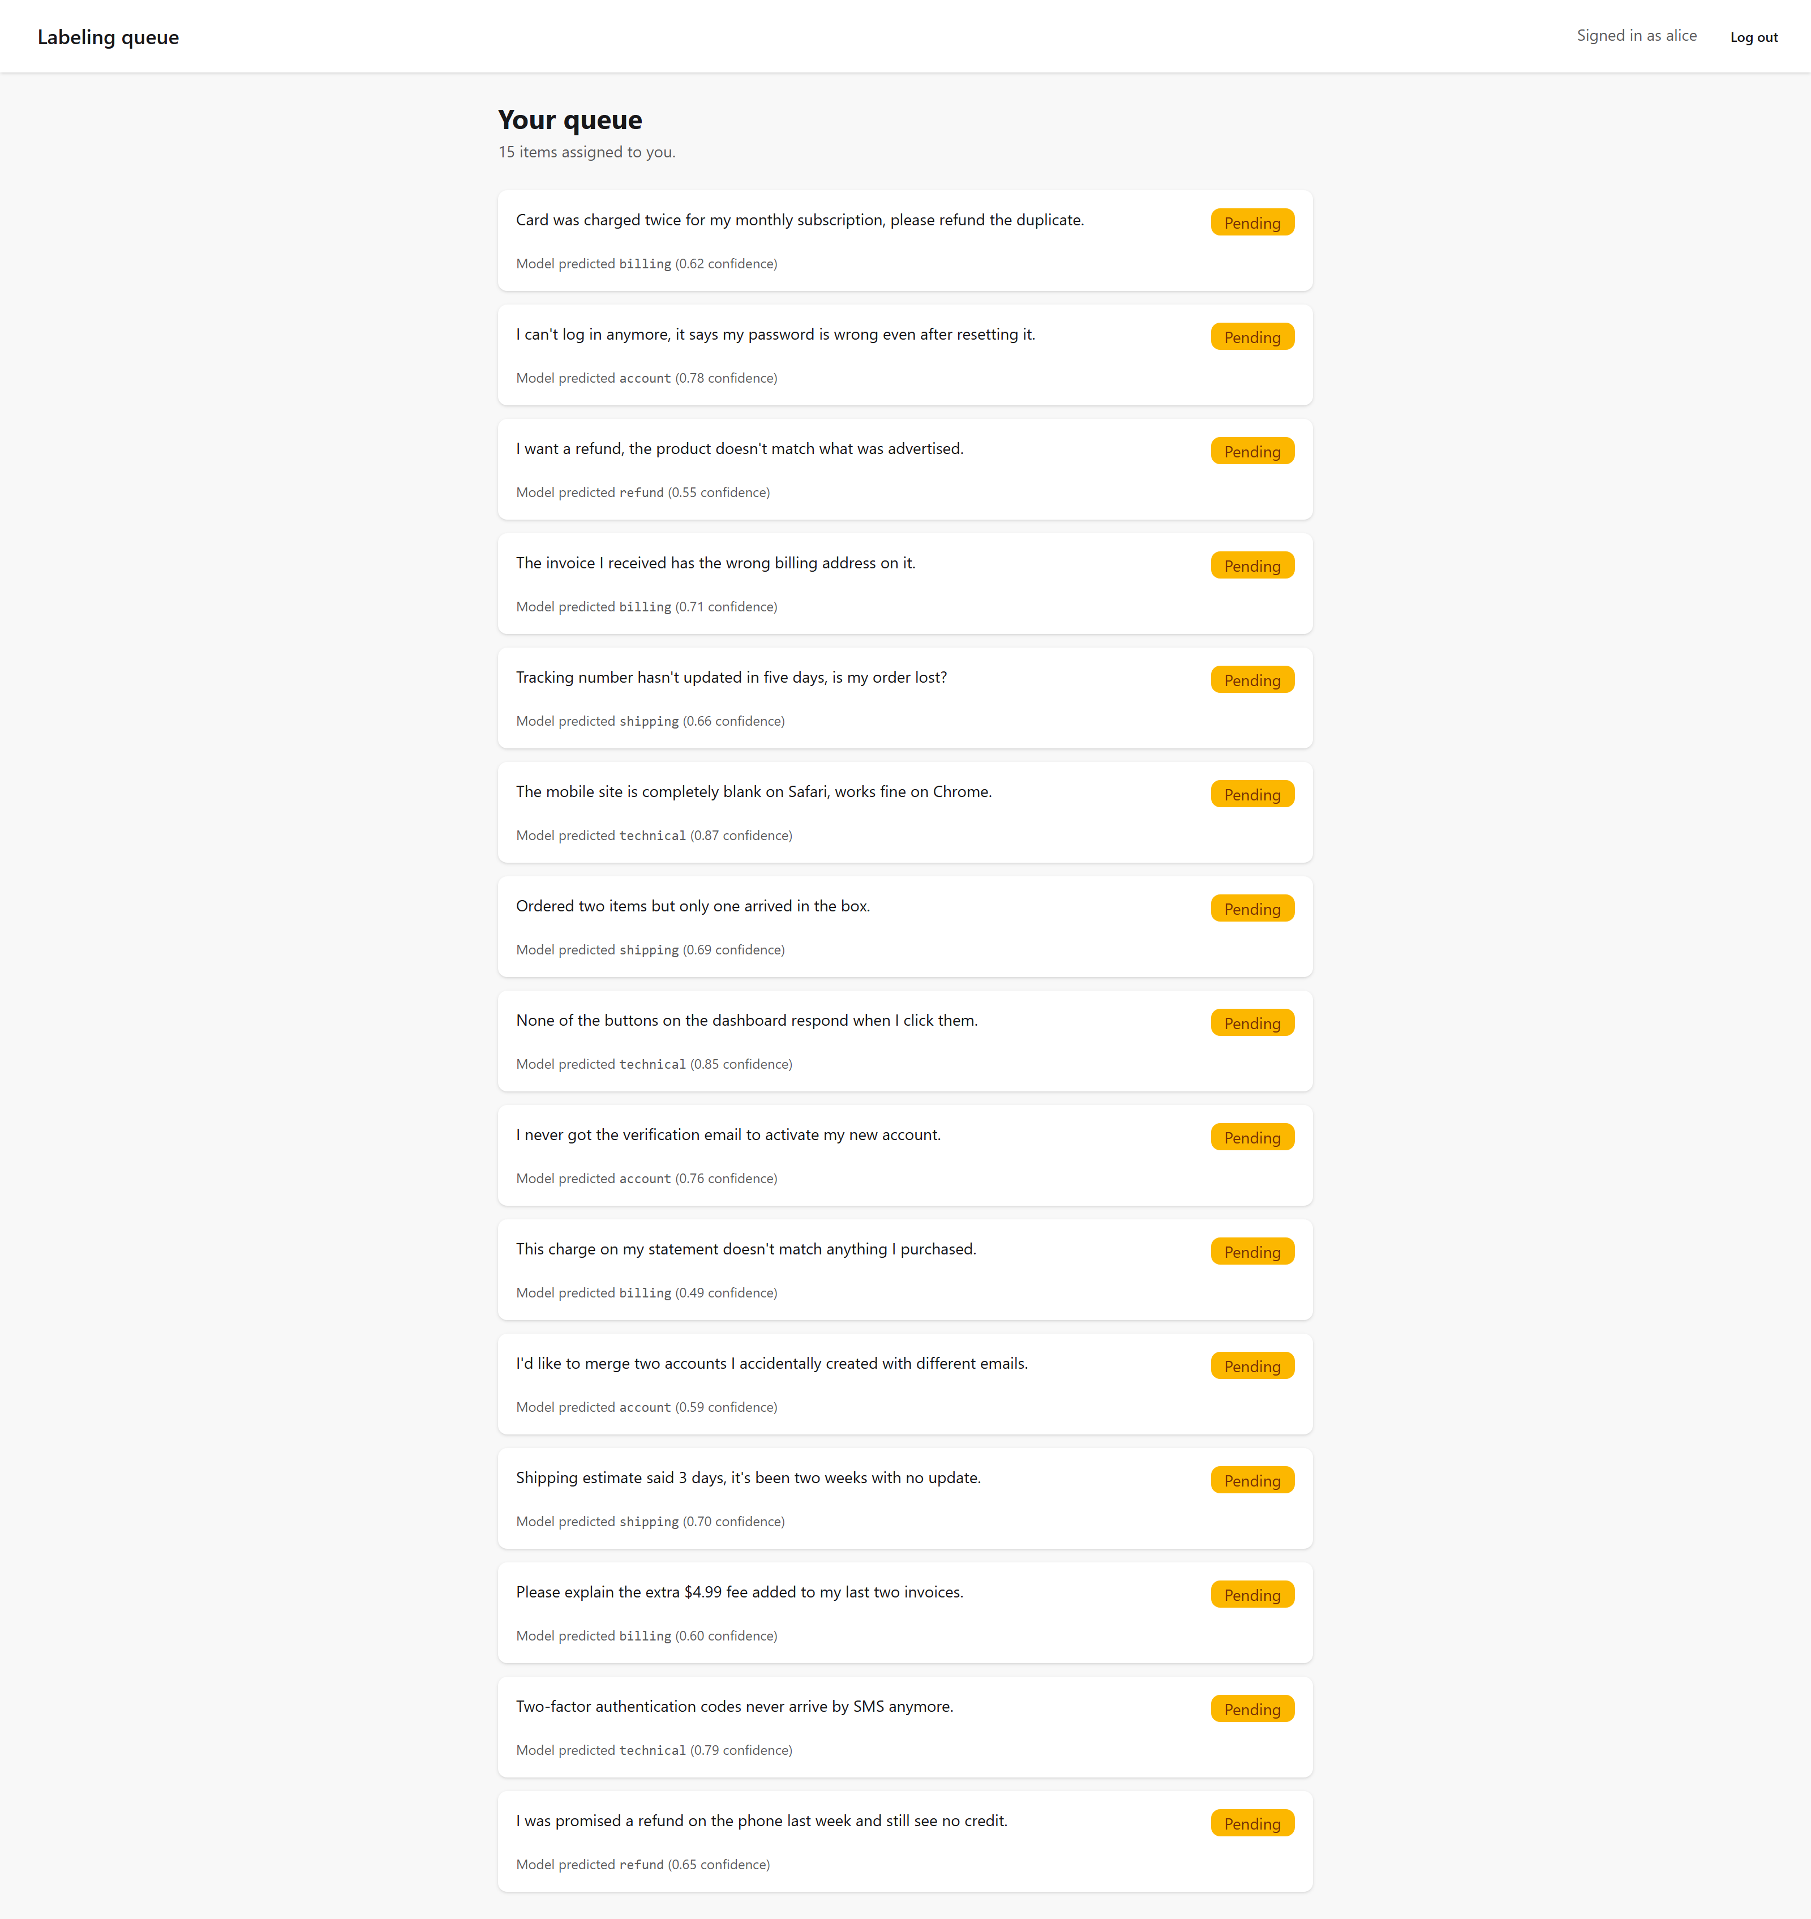
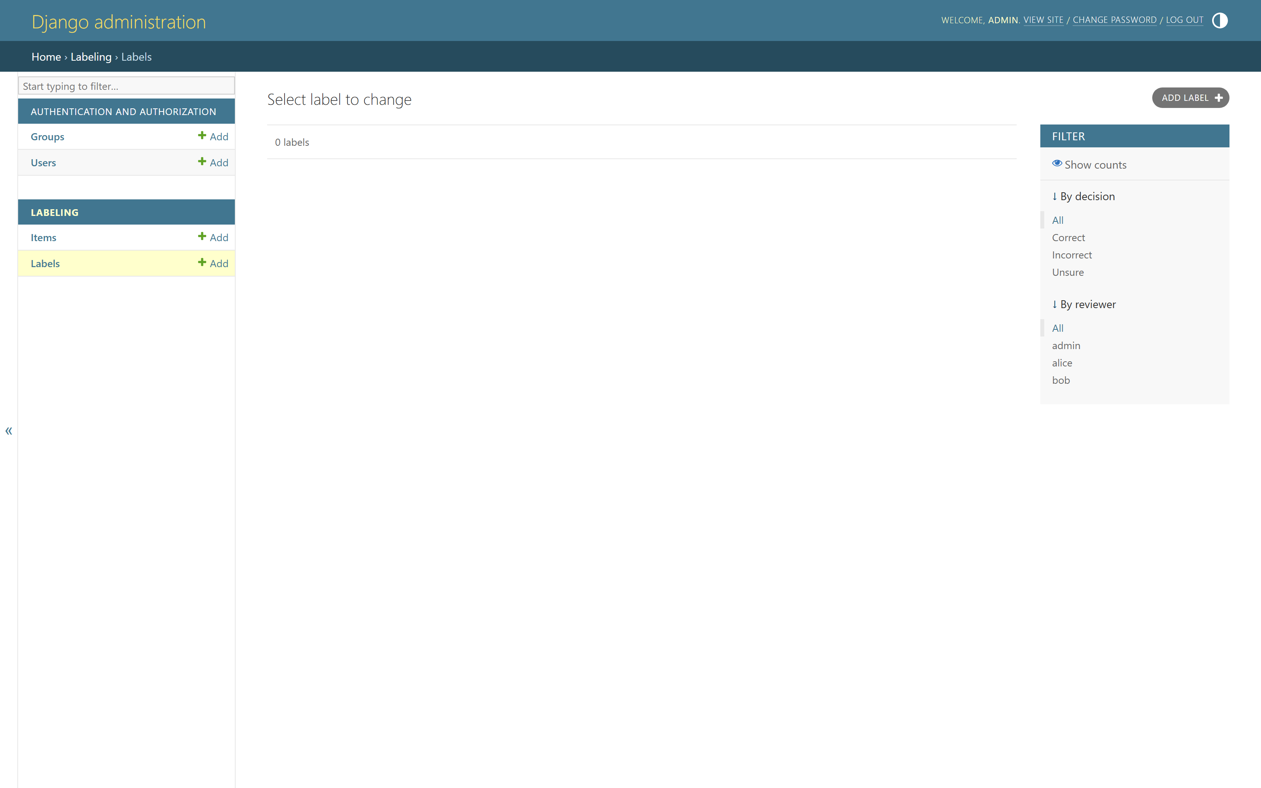
what-we-just.png
What we just saw
Alice's queue — only her tickets
Admin: every reviewer's labels, free
Notes:
[~3.5 min]
`Item.objects.filter(assigned_to=request.user)` is the whole ownership rule, one line. Auth is django.contrib.auth.urls - zero hand-written view code.

Slide 24
run-it-fastapi.md
Run it: FastAPI + React demo
[1]
Seed demo data — terminal 1, .venv active - creates alice/bob/admin
python demos/labeling-fastapi-react/api/seed.py
[2]
Start the API — terminal 1 - serves FastAPI, docs included
uvicorn main:app --reload --app-dir demos/labeling-fastapi-react/api
[3]
Install + start the front end — terminal 2 - npm install once, then the dev server
cd demos/labeling-fastapi-react/web → npm install → npm run dev
[4]
Open it — same alice/bob/admin credentials as the Django demo
App: http://localhost:5173/ API docs: http://127.0.0.1:8000/docs
Notes:
[~1 min]
Two terminals, both from the repo root.

Slide 25
live-demo-fastapi.md
Live demo: FastAPI + React labeling tool
› Same task, same data, same three users
› Log in as alice, label with the 1 / 2 / 3 keys — watch it auto-advance, no page reload
› Open /docs — FastAPI's free Swagger test form
› Ownership is checked in three separate places, not one
Notes:
[~3.5 min]
http://localhost:5173/ for the app, http://127.0.0.1:8000/docs for Swagger. Same credentials as the Django demo.

Slide 26
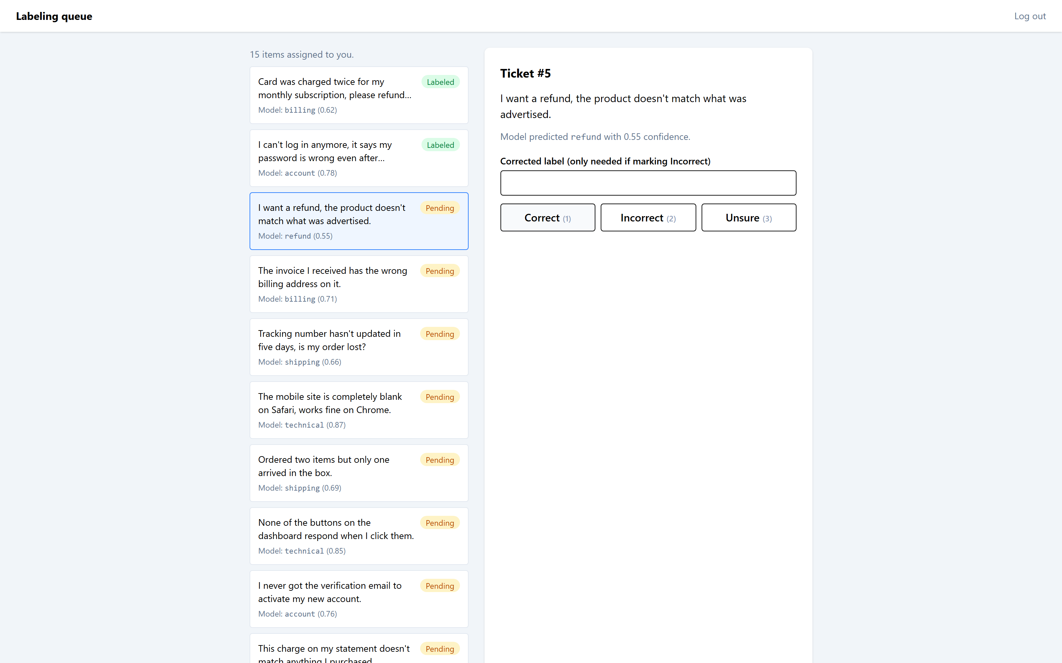
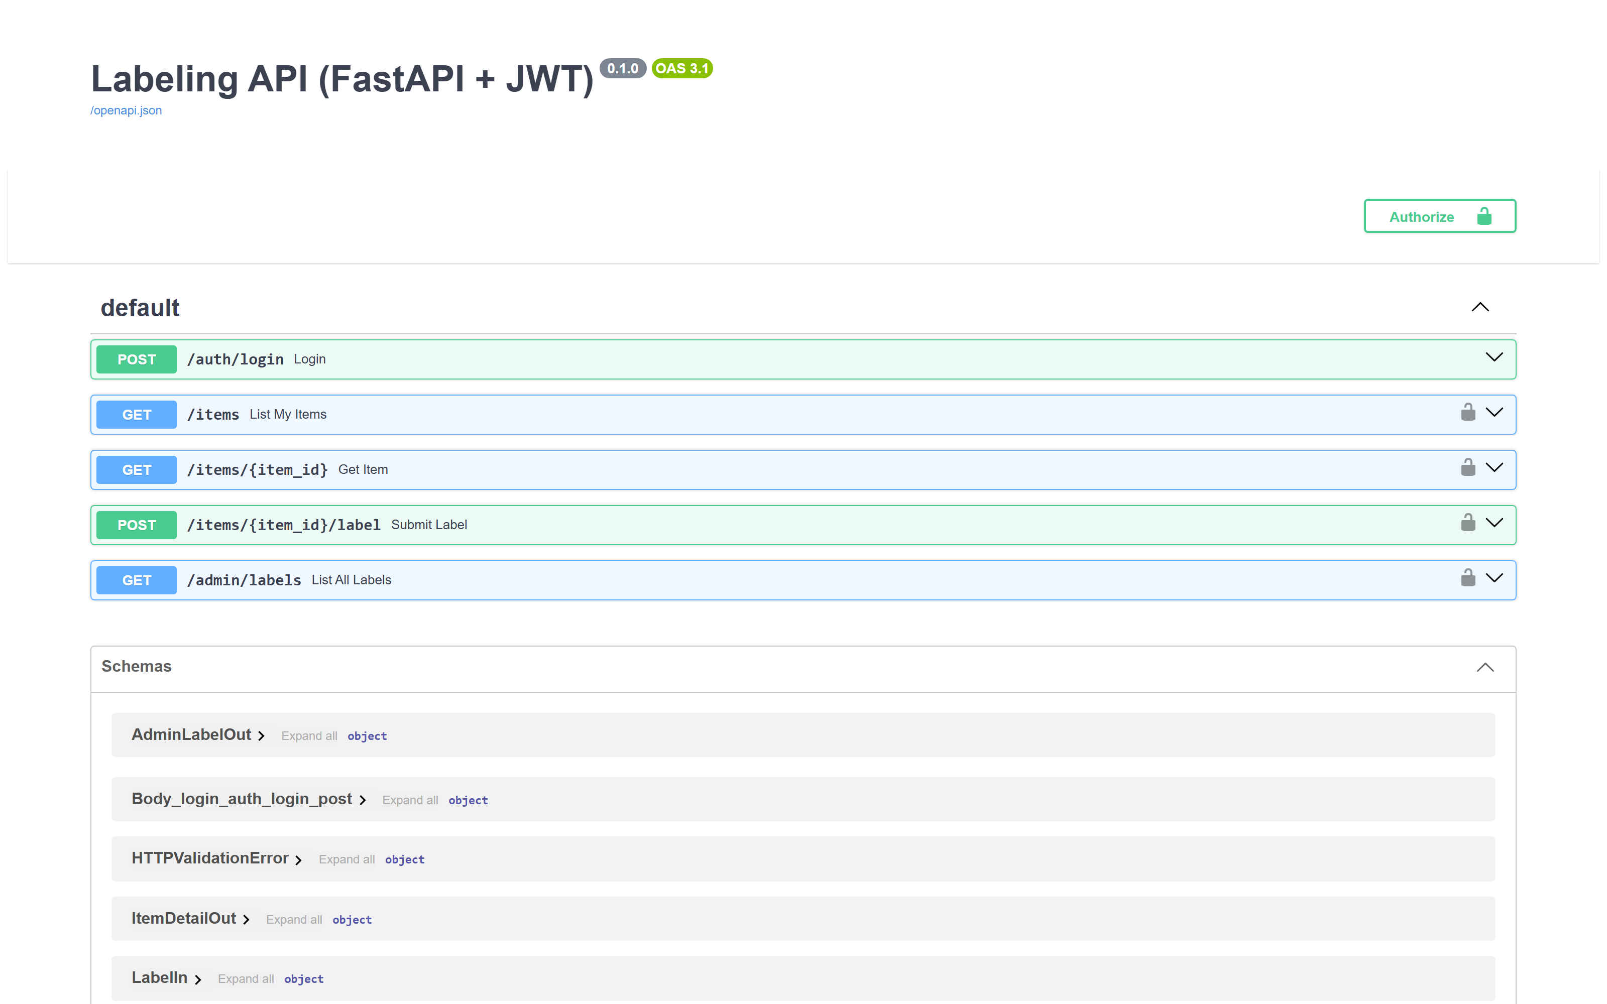
what-we-just.png
What we just saw
Keyboard-driven, instant, app-like
/docs — the free test form
Notes:
[~3.5 min]
The payoff cost more code: JWTs minted by hand, ownership repeated across GET/POST/list endpoints instead of one queryset filter.

Slide 27
same-guarantee-two.md
Same guarantee, two very different bills
› Django: less code, an admin for free, a queryset filter for the hard part
› FastAPI + React: more code, but an instant, keyboard-driven feel and a separate API other systems can call
› Start with Django, outgrow it, add an API and put React in front later — you don't have to throw away the data model
› Common question: can't I get the best of both? → yes - Django REST Framework as the API layer, React only on the screens that must feel instant (see the backup slide at the end)
Notes:
[~3 min]
Close the loop on the comparison before moving to the next demo.

Slide 28
run-it-long.md
Run it: long-jobs demo
[1]
Start the API — terminal 1, .venv active - serves FastAPI
uvicorn app:app --reload --app-dir demos/long-jobs
[2]
Start the worker — terminal 2 - runs the actual queued jobs; -k thread is required on Windows
cd demos/long-jobs → huey_consumer tasks.huey -k thread
[3]
Open it — no migrate/seed step needed; the jobs table is created automatically on startup
http://127.0.0.1:8000/
Notes:
[~1 min]
Two terminals, both from the repo root.

Slide 29
live-demo-blocking.md
Live demo: blocking vs. queued
› Click 'Start blocking rescore' — the tab just sits there for ~15s, nothing to show for it
› Click 'Start queued rescore' — a job id appears instantly, and a progress bar climbs 0 → 30 while the page stays fully responsive
› Huey + SQLite: no Redis, nothing to install beyond Python — verified working on Windows with -k thread
Notes:
[~3 min]
http://127.0.0.1:8000/. The blocking button is the whole point: there's nothing to screenshot while it hangs, and that's exactly the problem.

Slide 30
what-s-happening.py
What's happening underneath
 | Blocking | Queued (Huey + SQLite)
Where the work runs | In the request/response cycle, same process | A separate Huey consumer process
What comes back immediately | Nothing - the connection just waits | A job id, instantly
How progress is tracked | It isn't - no signal until it finishes or times out | A status row in SQLite, updated as it runs
What the page does | Sits there, disabled, hoping | Polls the status endpoint every few seconds
Notes:
[~1.5 min]
This is the same 4-step shape from the earlier ladder slide (request starts job / job runs elsewhere / status stored / page checks back), now with the real names filled in.

Slide 31
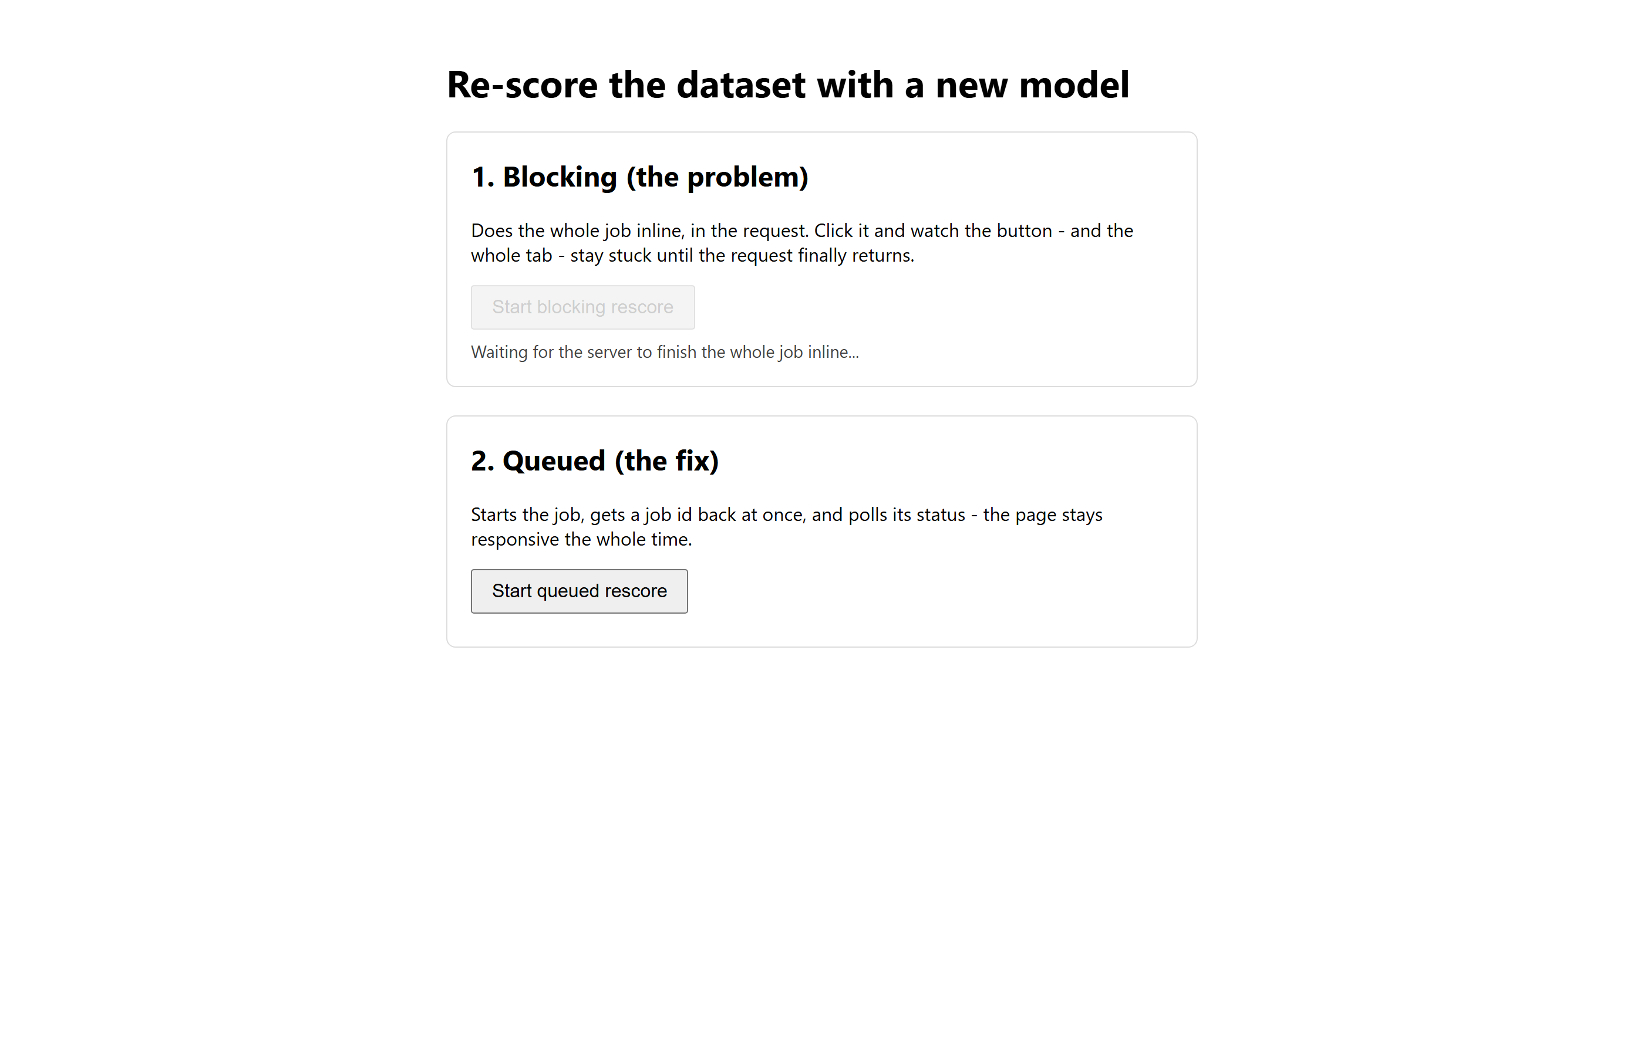
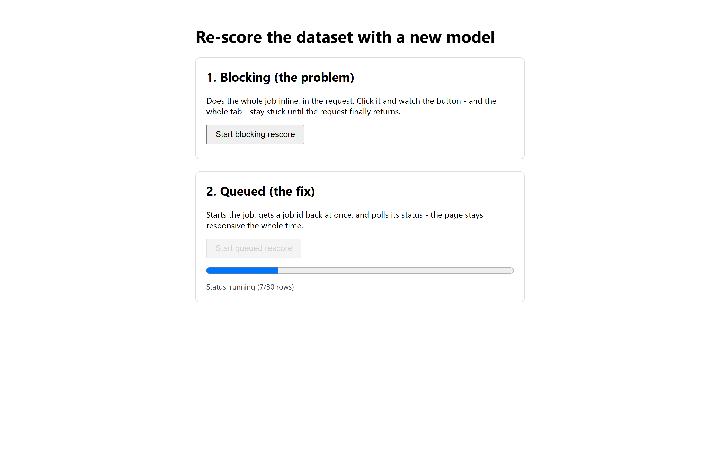
what-we-just.png
What we just saw
Blocking: button disabled, 'waiting for the server' - and that's it
Queued: job id back at once, progress climbing, page stays responsive
Notes:
[~3 min]
The blocking button really does just sit there disabled for ~15s with no progress signal - the contrast with the queued version is the whole lesson.

Slide 32
run-it-psa.md
Run it: PSA map demo
[1]
Install once — only if node_modules/ is absent; no .venv needed
npm install
[2]
Serve it — D3 needs a real server, not file://
npm run serve -- demos/psa-terminal-map
[3]
Open it — the URL http-server prints, in your browser
e.g. http://localhost:8080
Notes:
[~0.5 min]
Pure Node/static demo, run from the repo root.

Slide 33
live-demo-the.md
Live demo: the skill, as a runnable page
› Static HTML + D3 + Tailwind — rung 1 of the ladder, because that's exactly what this use case needs
› 27 PSA container terminals worldwide, cross-filtered map + charts
› The page shows its own working, not just the product
Notes:
[~2.5 min]
Served at whatever URL `npm run serve -- demos/psa-terminal-map` prints (typically http://localhost:8080).

Slide 34
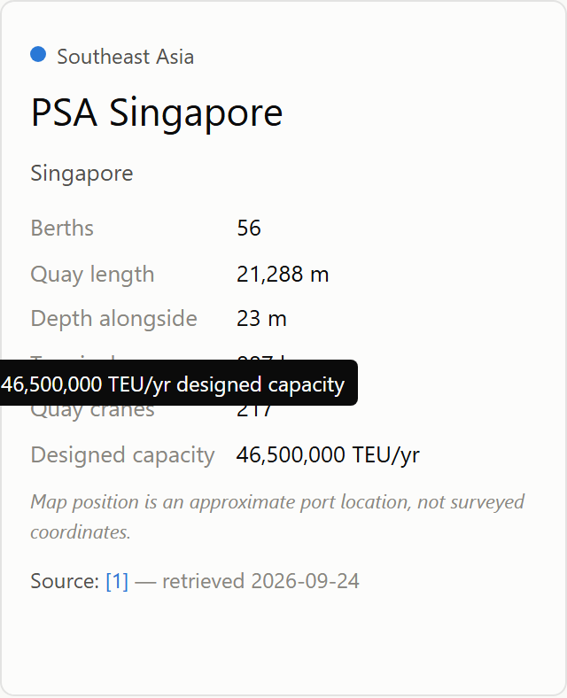
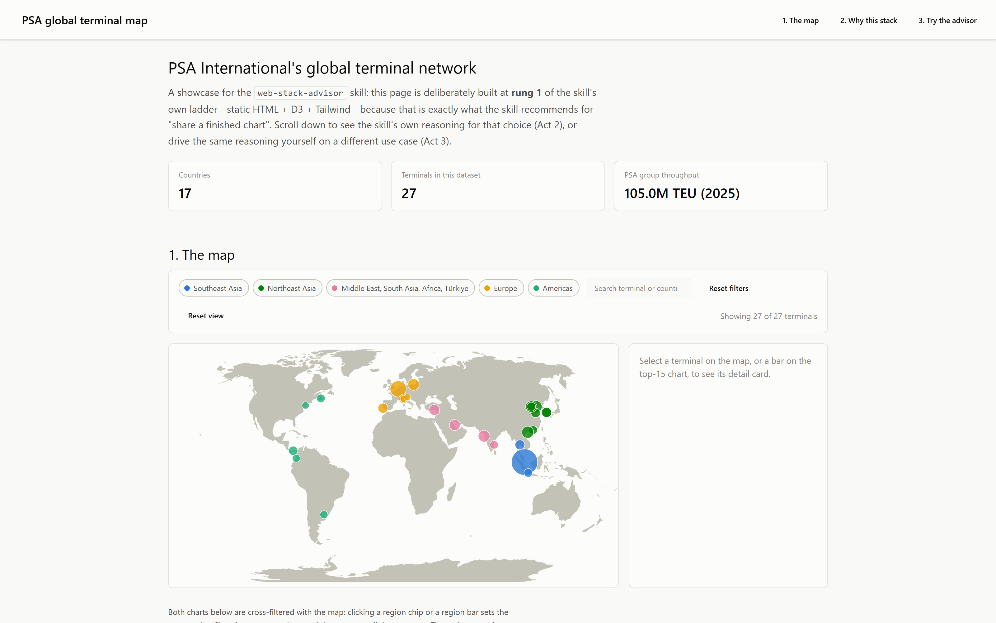
the-product.png
The product
27 terminals, filterable, zoomable
Click a terminal → a sourced detail card
Notes:
[~2.5 min]

Slide 35
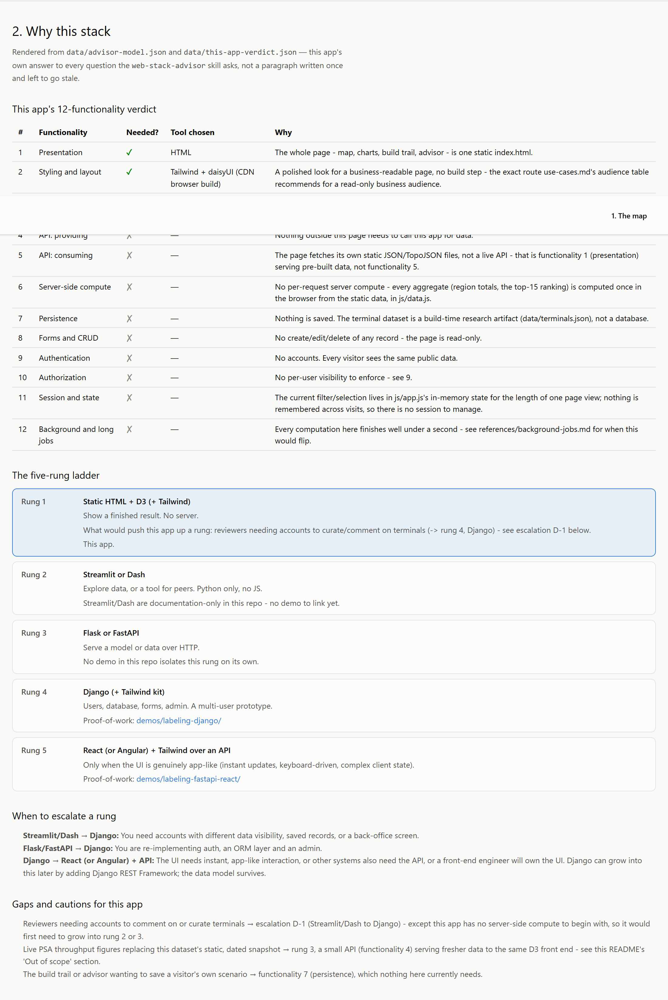
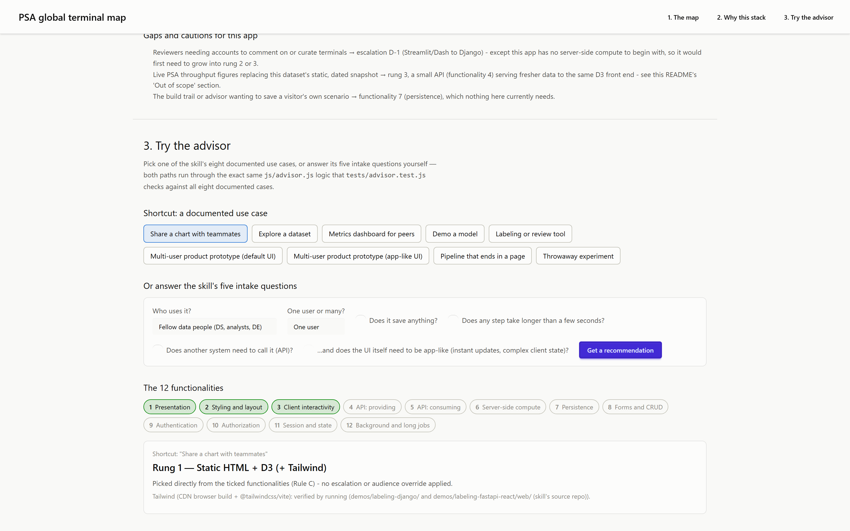
the-skill-showing.png
The skill, showing its work
Act 2 — the 12-functionality verdict for THIS app
Act 3 — try the advisor live, same logic, tested
Notes:
[~3 min]
The point: the skill's advice is a function you can run, not an opinion — asserted by a test suite against all 8 documented use cases.

Slide 36
try-it-a.md
Try it: a skill file
› The whole framework, packaged as a Markdown file your AI assistant loads
› Describe an app idea → it ticks the 12 functionalities and recommends the lightest stack
› Flags the two gaps (multi-user, background jobs) automatically
› Drop the folder into .claude/skills/ of any project
Notes:
[~2 min]
This is the 'go try it yourself' moment.

Slide 37
trigger-it-from.json
Trigger it from VS Code Chat
Where | How
Claude Code (CLI or VS Code extension) | Type / to see it listed, or just describe your use case - it auto-loads from its description
GitHub Copilot Chat (VS Code) | Same / menu - Agent Skills is an open standard both read
Either one | Drop the folder in .claude/skills/ (or .github/skills/) - no conversion needed
→ One skill folder, not one per assistant.
Notes:
[~1 min]
Worth saying explicitly: people assume Claude-authored tooling is Claude-only. Since VS Code's Agent Skills became an open standard (agentskills.io), it isn't - Copilot Chat reads the same .claude/skills/ folder.

Slide 38
setup-cheat-sheet.json
Setup cheat-sheet
Rung | Install
Static HTML + D3 | Nothing — or npm install http-server to preview locally
Streamlit | pip install streamlit
Dash | pip install dash
Flask | pip install flask
FastAPI | pip install fastapi uvicorn
Django | pip install django → django-admin startproject
React (Vite) | npm create vite@latest
Tailwind, no Node | standalone CLI, or a CDN link (hosted script tag) — even pip-installable
daisyUI | npm package, or paired with Tailwind's CDN link
Notes:
[~2 min]
Honest caveat: everything here assumes it runs on your own machine. Deployment is a separate decision.

Slide 39
takeaways.md
Takeaways
› Audience matters as much as architecture — a peer forgives a plain page, a business user doesn't
› Multi-user and background jobs are where a demo silently becomes a product
› An LLM makes writing code cheap — which makes the choice of what to write the one part worth your care
› Decompose before you choose: start at the lowest rung that covers every tick you actually need
› None of it is permanent — add exactly the piece you're missing later (a database, an API, a JS frontend) without a rewrite
Notes:
[~2 min]
Close on the throughline: decompose before you choose. (Title is deliberately count-agnostic - it's been 'three lessons' before and grown; don't re-name it back to a number.)

Slide 40
everything-from-this.md
Everything from this talk lives here
› github.com/hovinh/web-development-learning-lab
› demos/ — the four demos, runnable with the exact commands from this talk
› .claude/skills/web-stack-advisor/ — the skill file, drop it into any project
› blog/ — the post this talk is based on, and this slide deck's own source (content.py says what it says, theme.py says how it looks)
Notes:
[~1 min]
Give people a moment to note the URL down before moving to questions.

Slide 41
talk.md
# talk.md
Questions?
> Decompose before you choose.
$
Notes:
[~2 min]
Thank you. Open the floor.

Slide 42
backup-can-i.md
Backup: can I get the best of both worlds?
› Yes - and it's the normal path, not a special trick.
› Start Django. Add Django REST Framework once another system (or a future React frontend) needs an API - the data model doesn't change.
› Put React (or just htmx/Alpine.js, no build step) in front of only the screens that must feel instant - label review, not the admin.
› django-ninja is a lighter, FastAPI-flavored alternative to DRF if you want typed, automatic-docs endpoints without leaving Django.
› What you don't get: two frameworks' auth merged into one - you still pick a single system of record for who's logged in.
Notes:
Only show this if asked - it's the natural 'can't I have both' follow-up. The honest limit: authentication still has to live in one place.

