Slide 1


Qsearch: Answering Quantity Queries from Text
Vinh Thinh Ho, Yusra Ibrahim, Koninika Pal, Klaus Berberich and Gerhard Weikum
Max Planck Institute for Informatics, Germany

Slide 2
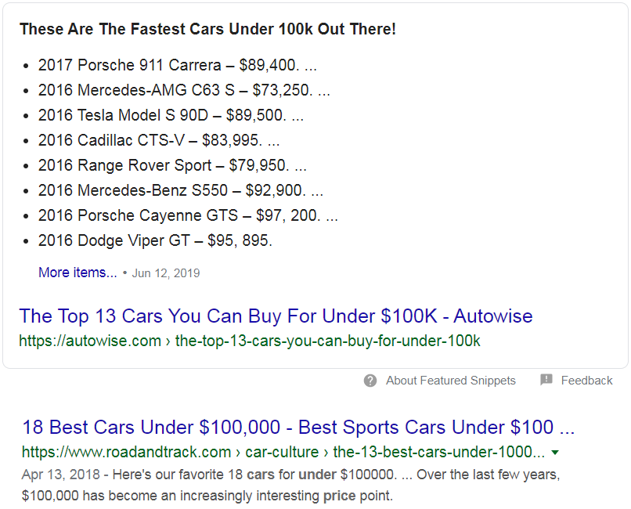
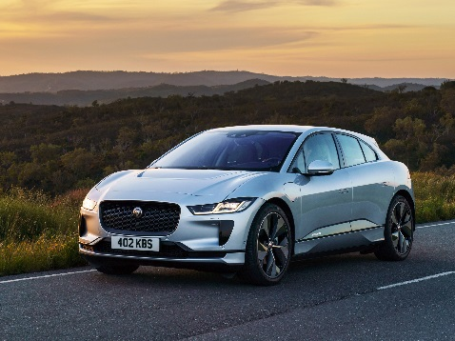

Motivation
Cars with price less than $100k
Results from a single page
Under some special structure
(e.g., list)

Slide 3
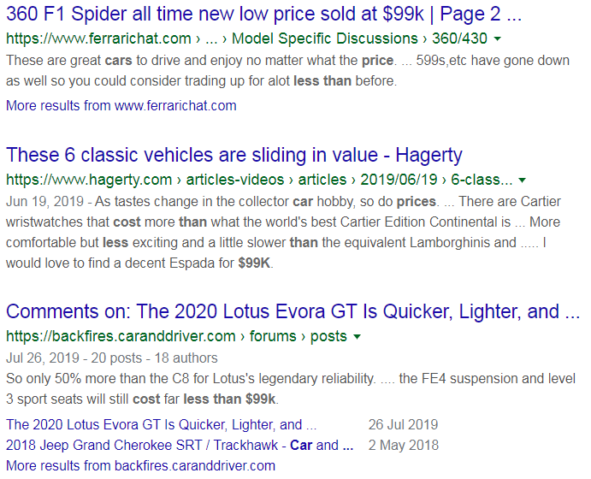
Motivation
Cars with price less than $99k
in 2017
in Germany
more…

Slide 4




Problem Statement
Input:
Quantity query:
Cars with price less than 100k Euro in Germany
Text corpus:
Output: List of entity results
Chevrolet Corvette Z06
$79,495
Chevrolet Camaro ZL1
$61,500
Ford Shelby GT350R
$67,135
etc.
from multiple pages
Notes:
s

Slide 5
Related Work: QALD (Question Answering over Linked Data)
Typical QALD query:
fuel consumption of Toyota Prado
Quantity query:
SUVs with fuel consumption below 20 MPG
in city
Query with
property/quantity lookup
Query with
quantity condition
SELECT ?e ?x WHERE {
?e type SportUtilityVehicle .
?e hasFuelConsumption ?x
}
SELECT ?e ?x WHERE {
?e type SportUtilityVehicle .
?e hasFuelConsumption ?x .
?x < 20 MPG
}
Can return any literal for ?x
Needs to understand the quantity
(measure, value, unit)
Limited amount of quantities in KBs
Notes:
s

Slide 6
Related Work: QALD (Question Answering over Linked Data)
Typical QALD query:
fuel consumption of Toyota Prado
Quantity query:
SUVs with fuel consumption below 20 MPG
Objectives:
High recall of quantities
Understanding quantities
Complex quantity conditions
Tap directly into the text source
in city
Query with
property/quantity lookup
Query with
quantity condition
SELECT ?e ?x WHERE {
?e type SportUtilityVehicle .
?e hasFuelConsumption ?x
}
SELECT ?e ?x WHERE {
?e type SportUtilityVehicle .
?e hasFuelConsumption ?x .
?x < 20 MPG
}
Can return any literal for ?x
Needs to understand the quantity
(measure, value, unit)
Limited amount of quantities in KBs
Notes:
s

Slide 7
Outline
Motivation
Approach
System Overview
Evaluation

Slide 8
Computational Framework
“Cars with price under 100k Euro in Germany”
Quantity-query (Qquery):
Semantic type (t*)
Quantity constraint (q*): {value (v), unit (u), comparison operator (o)}
(equal, approximate, less/more than, interval)
Context constraint (X*): a bag of important words expressing the relation between t* and q*
Example:
Qquery: t*: Car; q*: (< 100.000 €); X*: { price, Germany }

Slide 9
Computational Framework
Quantity-fact (Qfact):
Entity (e)
Quantity (q): {value (v), unit (v), value resolution (r)}
(equal, approximate, less/more than, interval)
Context (X): a bag of important words describing the connection between e and q
Example:
“BMW i8 has price about €138k in Germany and range from 50 to 60km battery only”
Qfact 1: e: BMW i8; q: (= 138.000 €); X: { price, Germany }
Qfact 2: e: BMW i8; q: ([50-60] km); X: { range, battery }

Slide 10
Outline
Motivation
Approach
Qfact Extraction from Text
Query Matching
System Overview
Evaluation

Slide 11
Qfact Extraction from Text
Two steps: Pre-processing and Extracting
Step 1: Pre-processing: Detecting entities (AIDA [Hoffart et al., 2011])
and quantities (Illinois Quantifier [Roy et al. 2015])
Example:
“According to BBC, BMW i8 has price of €138k in Germany and range from 50 to 60 km battery only”
“According to BBC, BMW i8 has price of Q₁ in Germany and range Q₂ battery only”
<KB:BCC>
(138.000 €)
([50-60] km)
<KB:BMW_i8>
<KB:Germany>

Slide 12
Qfact Extraction from Text
Step 2: Extracting:
For each quantity in the pre-processed sentence, detect its linked entity and context
Q₁ in the input:
“According to <KB:BBC> , <KB:BMW_i8> has price of Q₁ in <KB:Germany> and range Q₂ battery only”
Q₂ in the input:
“According to <KB:BBC> , <KB:BMW_i8> has price of Q₁ in <KB:Germany> and range Q₂ battery only”
entity
context
context
entity
context
context

Slide 13
Qfact Extraction from Text
Step 2: Extracting:
For each quantity in the pre-processed sentence, detect its linked entity and context
Tag the sentence with 3 tags: E, X, O
Q₁ in the input:
“According to <KB:BBC> , <KB:BMW_i8> has price of Q₁ in <KB:Germany> and range Q₂ battery only”
Q₂ in the input:
“According to <KB:BBC> , <KB:BMW_i8> has price of Q₁ in <KB:Germany> and range Q₂ battery only”
O O O O E O X O O O X O O O O O
O O O O E O O O O O O O X O X O

Slide 14
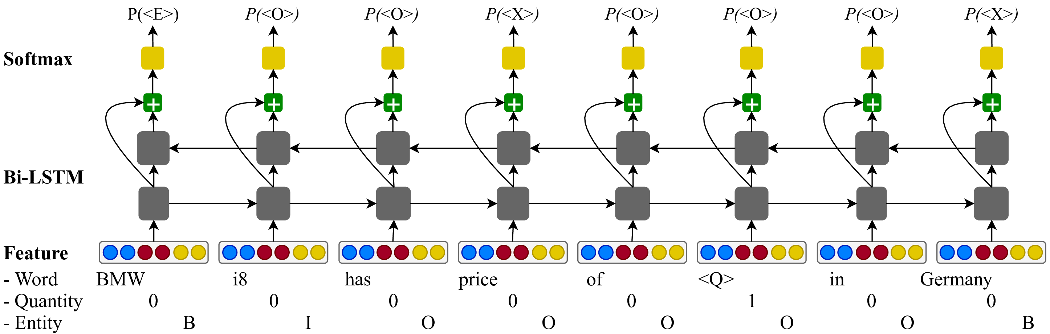
LSTM Tagging Model
[He et al, ACL 2017]
Process one quantity at a time

Slide 15
Training Data?
Match OpenIE outputs with the extracted entities and quantities.
“<KB:BMW_i8> has price of Q₁ in <KB:Germany> and range Q₂ battery only”
Keep tuples with one quantity Q.
The entity e in the subject is chosen to link with Q.
Context tokens X are chosen based on POS tags.
(1)
(2)
(2)

Slide 16
Outline
Motivation
Approach
Qfact Extraction from Text
Query Answering
System Overview
Evaluation

Slide 17
Query Answering
“Cars with price under $100k”
Qquery (t*; q*; X*)
car { price } ( < 100.000 $ )
<KB:BMW_i8> { cost, Germany } ( = 38.000 € )
German car
vehicle
?
rules
type
type
Qfact (e; q; X)
Match (t* with e) && (q* with q) && (X* with X)
Context matching:
Probabilistic approach (KL-divergence)
Embedding-based approach (See paper for detail)

Slide 18
Outline
Motivation
Approach
System Overview
Evaluation

Slide 19
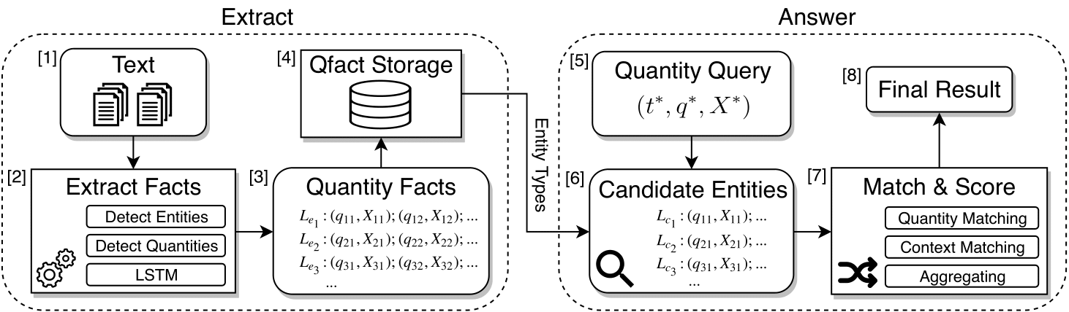
Qsearch Overview

Slide 20
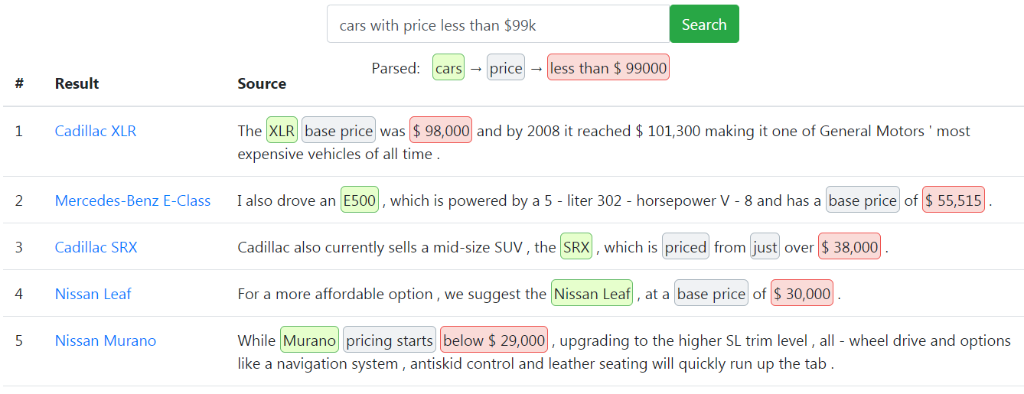
Example

Slide 21
Outline
Motivation
Approach
System Overview
Evaluation

Slide 22
Experimental Setup
Datasets: news articles - 7.6M documents
STICS [Hoffart et al, SIGIR 2014]
New York Times
Query domains:
Finance
e.g.,
Transport
e.g.,
Sports
e.g.,
Technology
e.g.,
Metrics: Precision@K, Hit@K, MRR
Companies whose stock value increased by at least 30 % in a year
Sport utility vehicles with engine power above 150 horsepower
Sprinters who ran 100 meter in less than 10 seconds
Power companies which generate more than 1000 MW electricity

Slide 23
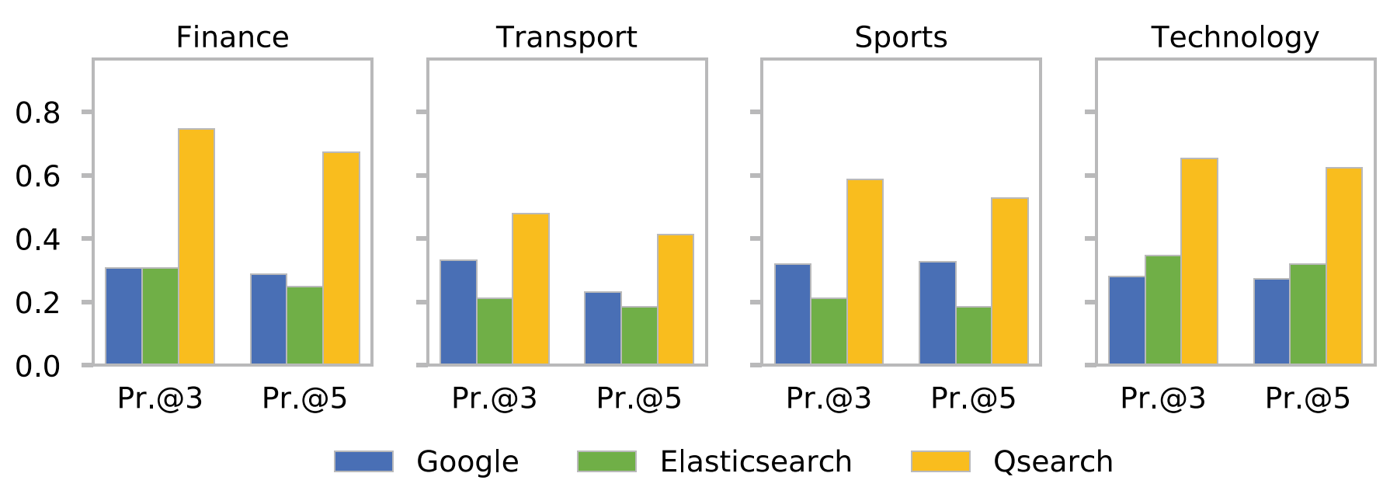
Results
Two baselines: Google & Elasticsearch
See the paper for full evaluation results

Slide 24
Summary
End-to-end QA system for Answering Quantity Queries from Text.
Qquery and Qfact models
Extracting Qfacts & Matching Qfacts against Qquery
Qsearch outperforms baselines for answering quantity queries.
Working system in the following link:
https://qsearch.mpi-inf.mpg.de/ (Ho et al, WSDM 2020)
Thank You!!

Slide 25
Appendix

Slide 26
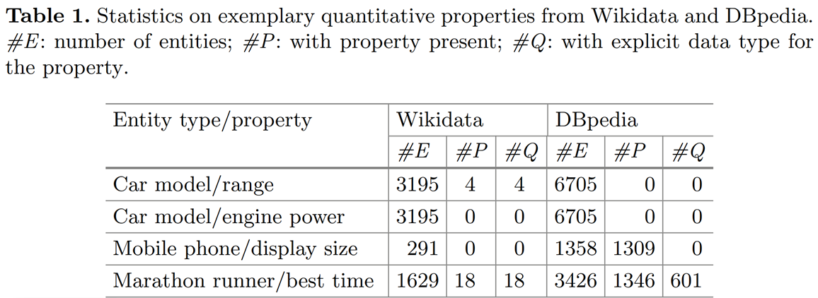
Amount of Quantities in Wikidata & DBpedia

Slide 27
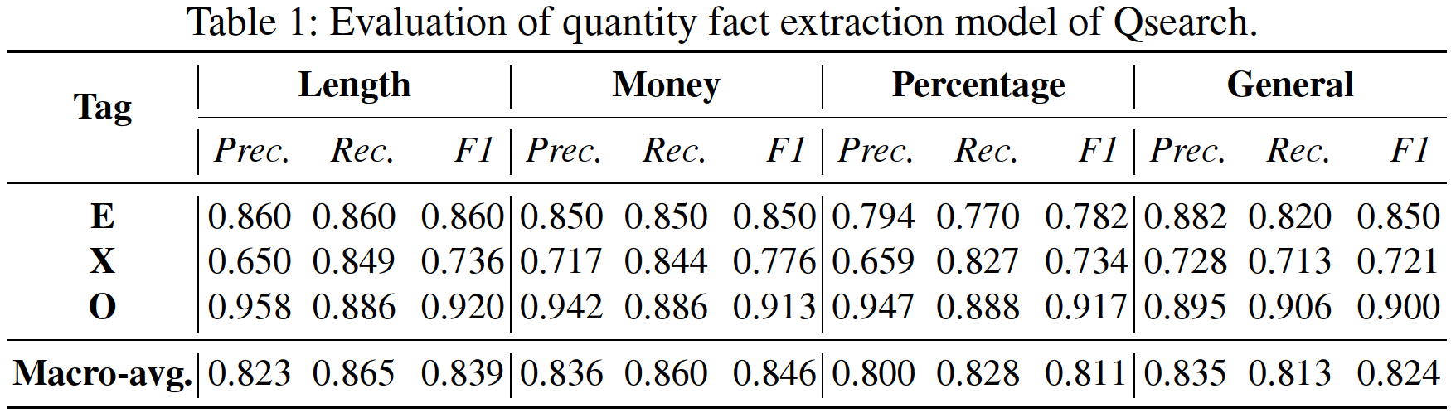
Evaluation – Qfact Extraction Model

Slide 28
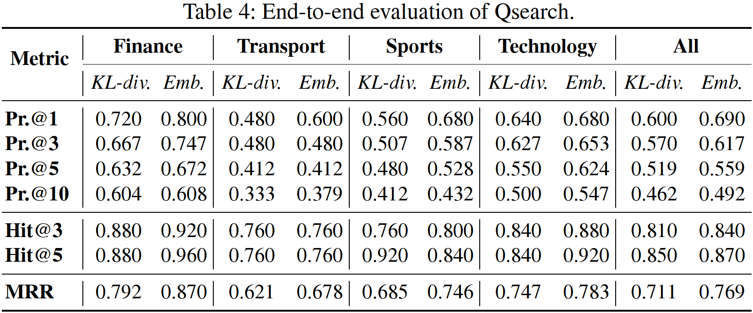
Qsearch with different scoring models
Datasets: news articles (STICS + NYT) – 7.6M documents
Metrics: Precision@K, Hit@K, MRR

Slide 29
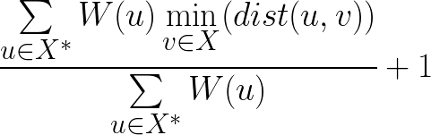
Embedding-based Context Matching
Match each term in query with its closest term in fact:
Query context X* = { price }
Fact context X = { cost, Germany }
directed embedding distance: ded(X*⟶X)

Slide 30
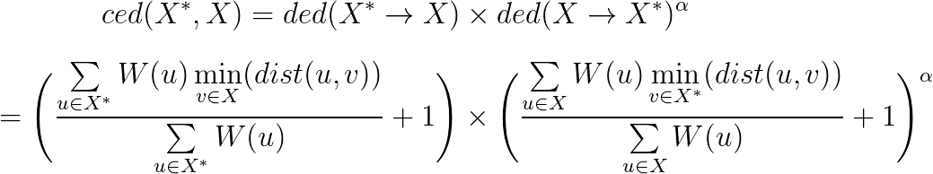
Embedding-based Context Matching
Penalize additional context terms of the facts
context embedding distance: ced(X*, X)
How much additional terms of X shift its meaning
How well X* matches X

Slide 31
Related Work
QA over Knowledge Graphs
[Abujabal et al, WWW 2018], [Zheng et al, PVLDB 2018]
[Xu et al, ACL 2016], [Bast et al, CIKM 2015]
QA on Text
[Yang et al, EMNLP 2018], [Clark et al, ACL 2018], [Chen et al, ACL 2017]
Recognizing numeric expressions from text
[Alonso et al, SIGIR 2018], [Saha et al, ACL 2017]
[Madaan et al, AAAI 2016], [Roy et al, TACL 2015]
Neural-based Sequence Tagging
[He et al, ACL 2017], [FitzGerald et al, EMNLP 2015], [Zhou et al, ACL 2015]

