Slide 1

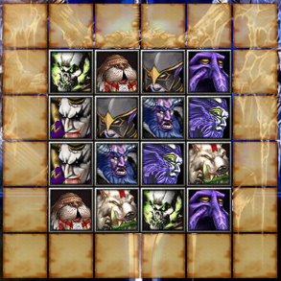


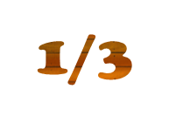

Slide 2





The above figure describes levels. There are 10 levels in total in the games.
Game’s score is showed in this area.
This icon displays left time of games

Slide 3





When you can not find out or take too much time to find a pair of the same puzzles, you can press the HINT button.It will show you a pair of puzzles, but it will burn your time.
Swap all the puzzle in order to play the games easier. But you can swap only 3 times during the games.
Press this button to exit the games.

