Slide 1
GPP Exam: Zombie AI

Slide 2
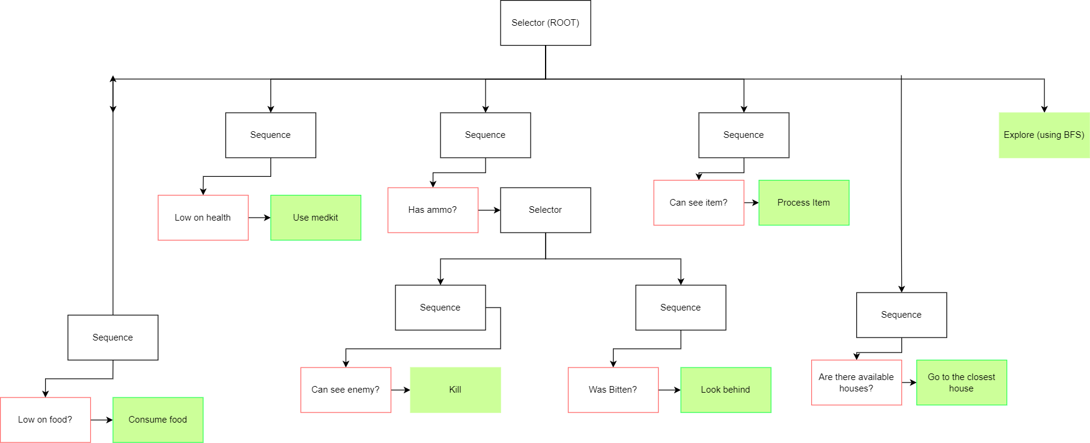
Decision Making

Slide 3
Enemy handling
Can see enemy?
Face & Shoot
Can’t see enemy & was bitten?
Look behind
Shotgun > Pistol
No ammo? Explore

Slide 4

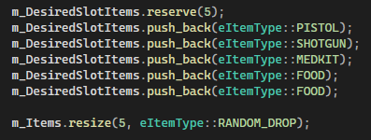
Inventory
Inventory manager handles items when seen
If the item is not needed → Destroy
Items needed are defined inside a vector
Slot empty == RANDOM_DROP
Item used → Remove from inventory

Slide 5
Movement & exploration
Breadth-first search for exploration (Grid based world)
Add starting cell to the queue
Add neighbors to the queue
Pop current cell and mark visited
House in FOV?
Save house (House struct)
Visit house
House goes on cooldown
House to visit?
Sort available houses (off cooldown) & go to closest
Steering Behaviors
Face
Seek

Slide 6
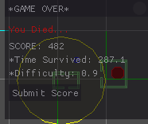
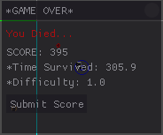
High Score

