Slide 1
CANTP module
Author: VuongHD
Date: 25-Nov-2024

Slide 2

Agenda
1. What is CanTp?
2. CanTp in Communication Stack
3. Services
4. Transport Protocol

Slide 3
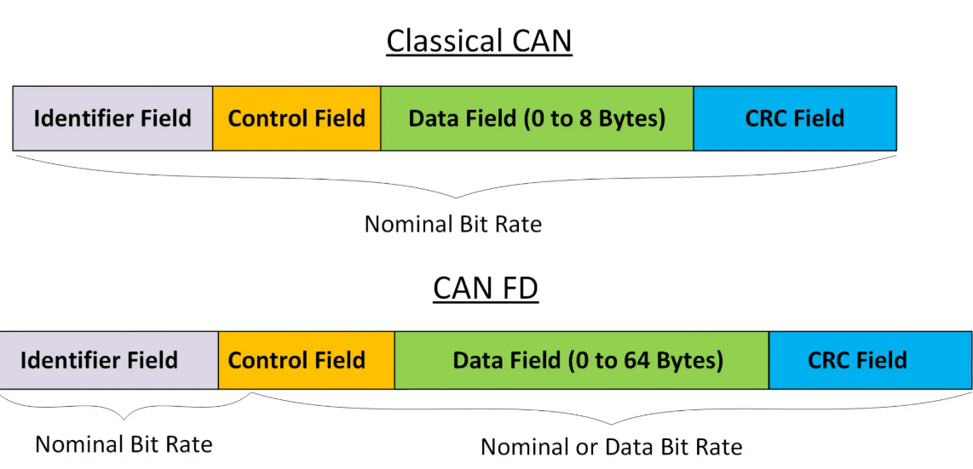
1. What is CanTp?
CanTp responsible for handling the transport protocol used for transmitting large message over CAN when the data exceeds the maximum frames size of the CAN frame

Slide 4
1. What is CanTp?
Main purpose: ensures the larger message that can be transmitted over the CAN network by segmenting and reassembling the data. CAN TP module is to segment and reassemble CAN I-PDUs longer than 8 bytes or longer than 64 bytes in case of CAN FD.
Segmentation:
Breaks down large messages into smaller CAN frames
Data is split into smaller chunks and sent in multiple packets.
Reassembly: On the receiving end, the CAN TP module reassembles the segmented frames back into the original message.
In addition to the main purpose, CanTp provides services for: control of data flow, detection of errors in segmentation session, transmit and receive cancelation.

Slide 5
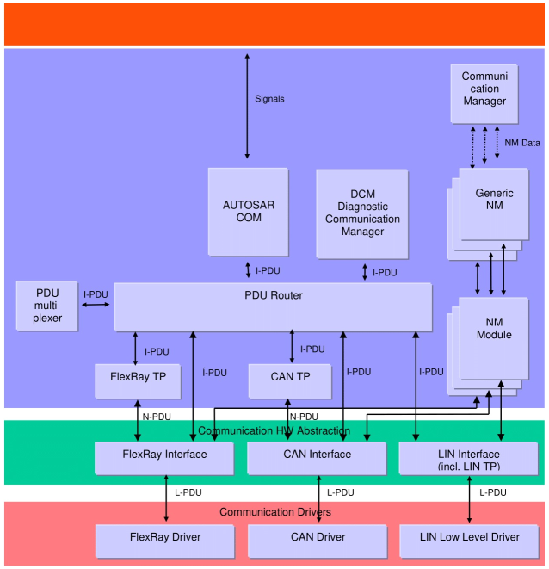
2. CanTp in Communication Stack
CanTp is the module between PduR and CanIf
PduR deploys COM and DCM I-PDUs onto different communication protocols(e.g. CAN, LIN and Flex, Ray).
CanIf provides equal mechanisms to access a CAN bus channel
PduR determine if a transport protocol has to be used or not.
Depending on the N-PDU ID, CanIf has to forward an I-PDU to CanTp or PduR.

Slide 6
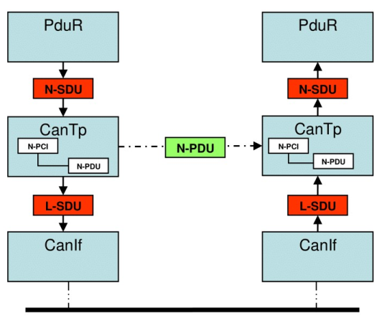
2. CanTp in Communication Stack
Interactions:

Slide 7
2. CanTp in Communication Stack
Processing Mode: The AUTOSAR communication stack supports both polling and event triggering mode. In the case of the CAN Transport Layer, only the event triggering mode is supported
Data consistency: To optimize the communication stack, AUTOSAR limits CanTp buffering capacity. CanTp copies N-SDU payload directly from the upper layer (DCM, COM or PDU Router - in the case of 1:1 TP routing) to the CAN driver and viceversa.

Slide 8
3. Services

Slide 9
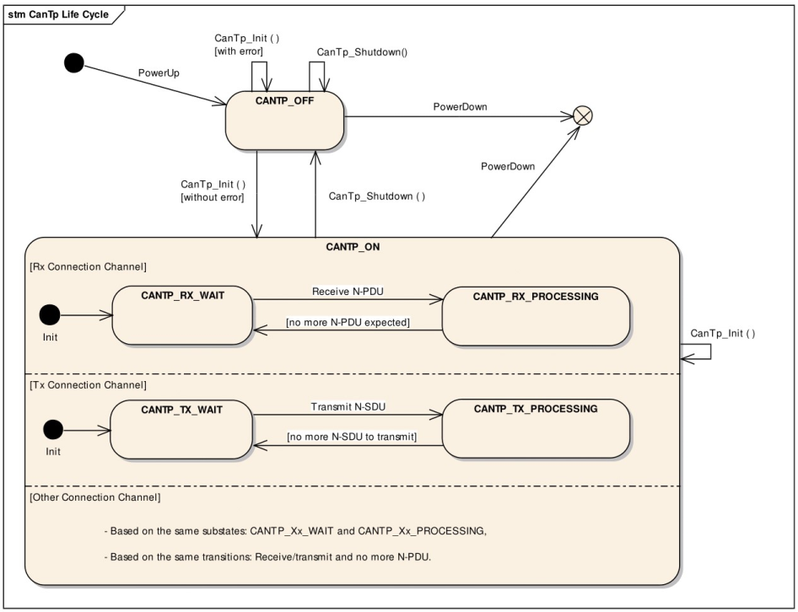
3.1 Services provided to upper layer
3.1.1 Initialization and shutdown
CANTP module have two state: CANTP_OFF and CANTP_ON
CanTp module perform segmentation and reassembly task only when CANTP is in the CANTP_ON
CanTp will be losses all current connections is CanTp_Init() is called when CanTp module is in CANTP_ON state

Slide 10
3.1 Services provided to upper layer
3.1.2 Transmit request
CanTp_Transmit() will allow the upper layers to ask for data transfer using CAN Transport protocol facilities.
More details in sequence diagrams:
Transmit request of SF N-SDU Transmit request of larger N-SDU
3.1.3 Transmit cancelation:
It allows the upper layers to cancel transmission in progress
After the call of the service CanTp_CancelTransmit(), the transfer on this connection shall be aborted.
PduR_CanTpTxConfirmation() shall be called after a transmit cancellation with value E_NOT_OK.
If a transfer is in progress, that will generate a time-out error on the receiver side.

Slide 11
3.2 Services provided to lower layer
3.2.1 Transmit confirmation
CanIf module call CanTp_TxConfirmation() to notify to Cantp that a CAN frame transmission requested by CanTp, has been performed successfully or not
The L-PDU identifier is associated with the call in order to identify the corresponding transmission
The CanTp module shall abort the corresponding session when:
CanTp_TxConfirmation() is not received after a maximum time (equal to N_As)
CanTp_TxConfirmation() is called with the result E_NOT_OK.
3.2.2 Reception indication
CanIf shall call CanTp_RxIndication() to notify the CanTp module that a new CAN N-PDU frame has been received.
More details in sequence diagrams:
Successful SF N-PDU reception Large N-SDU Reception

Slide 12
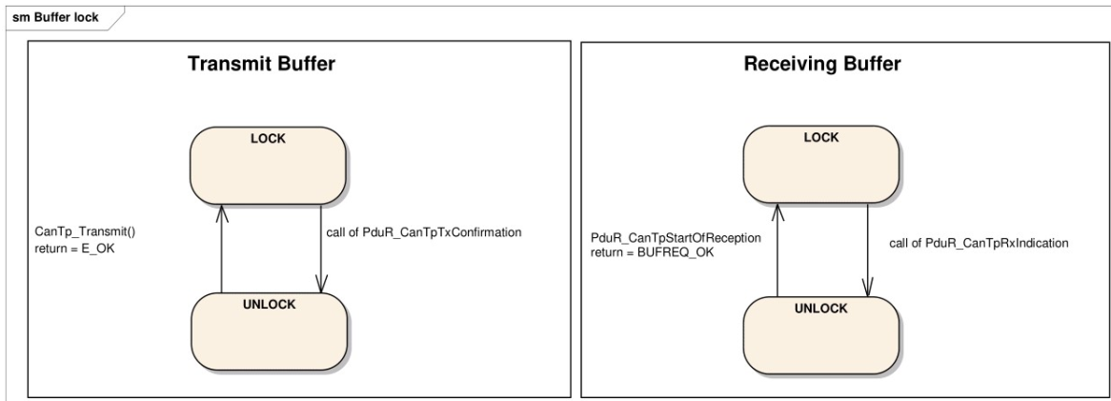
3.3. Internal behavior
3.3.1 Buffer strategy
CanTp has no buffer. So CanTp works directly on the memory of the upper layers (PduR, Dcm, Com)
When a transmit buffer is locked, the upper layer must not write data inside the buffer area.
When a receiving buffer is locked the CAN Transport Layer does not guarantee data consistency of the buffer. The upper layer should neither read nor write data in the buffer area.

Slide 13
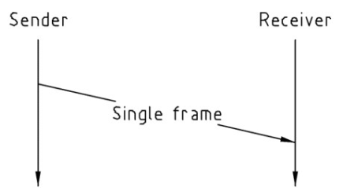
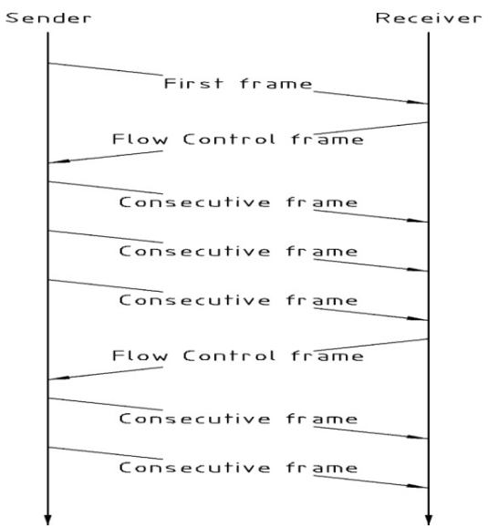
3.3. Internal behavior
3.3.2 Tx and Rx data flow

Slide 14
4. Transport protocol
The CanTp module in AUTOSAR implements the ISO-15765-2 standard, which is the transport protocol used for diagnostics over CAN.
ISO 15765-2 is a standardized communication protocol for the CAN (Controller Area Network) bus used in automotive systems, specifically for diagnostic communication.
Type of frames in ISO 15765-2:
Single Frame (SF)
Multi Frame:
First Frame (FF)
Consecutive Frame (CF)
Flow control Frame (FC)

Slide 15
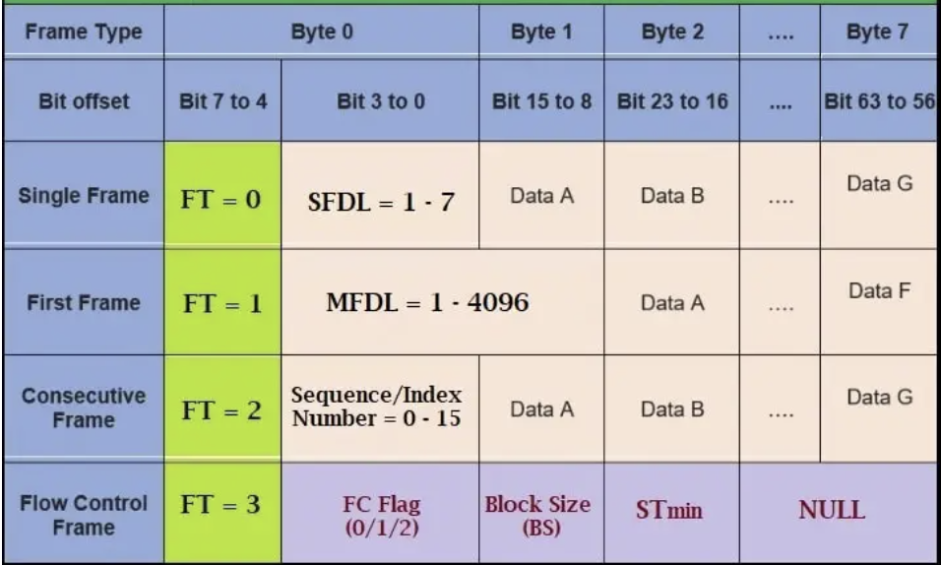
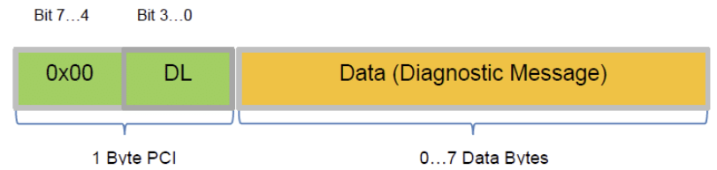
4. Transport protocol
a. Single Frame
Single Frame is a type of message that is used to transmit data that can fit within a single CAN data frame
0xAA or ox55 is filled for NULL data bytes to make sure that no junk or corrupted data sent by the transmitter.

Slide 16
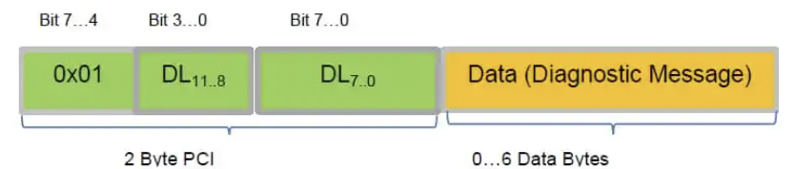
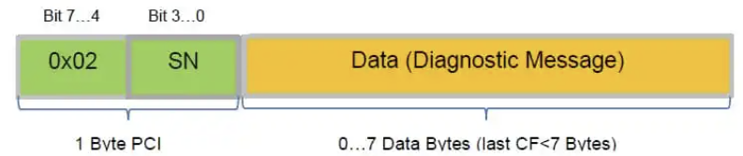
4. Transport protocol
b. First Frame
This message type is used to initiate the transmission of a large data block. It includes information such as the total size of the data block and the size of each subsequent frame.
c. Consecutive Frame
The Consecutive Frame or message type is used to transmit the data in consecutive segments.

Slide 17
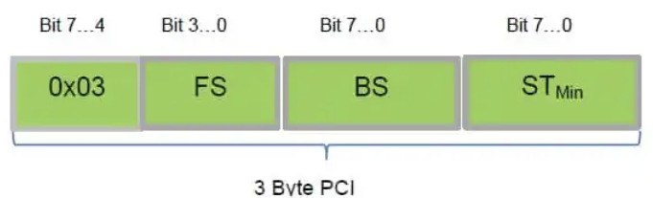
4. Transport protocol
d. Flow Control
The FC frame is sent by the receiver after it receives a CF message from the transmitter.
By using flow control, the receiver can indicate to the transmitter how much data it can receive at any given time, preventing the transmitter from overloading the receiver with data and causing buffer overflow or other Issues.
Flow Status (FS):
FS = 0: Clear to Send.
FS = 1: Wait.
FS = 2: Overload.

Slide 18
4. Transport protocol
d. Flow Control
BS (block size): shows how many consecutive frame need to be sent
Stmin: shows the minimum separation time between consecutive frames to be noticed.

Slide 19
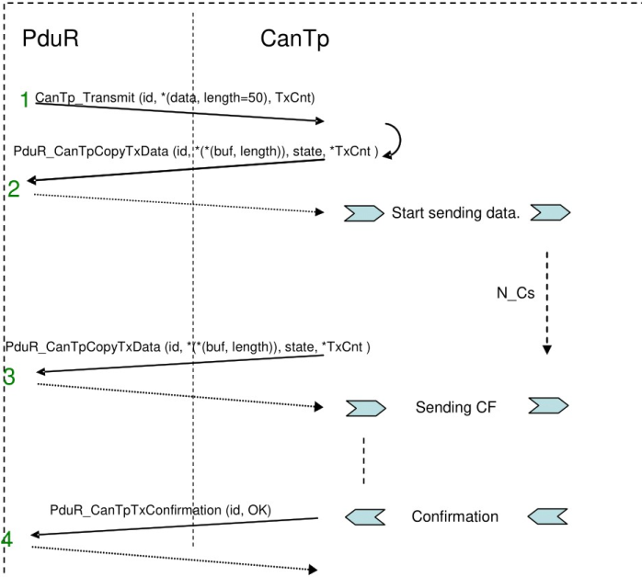
4. Transport protocol

Slide 20
