Slide 1
Welcome to Hell

Slide 2
Content Overview
Travel website for Hell, Michigan
Gives information on the towns history
Information on how to become mayor for the day
Contact information for scheduling wedding
Third page would be a schedule of events in town

Slide 3



Creative Decisions
Used a lot of oranges and reds to play of the theme of Hell.

Slide 4
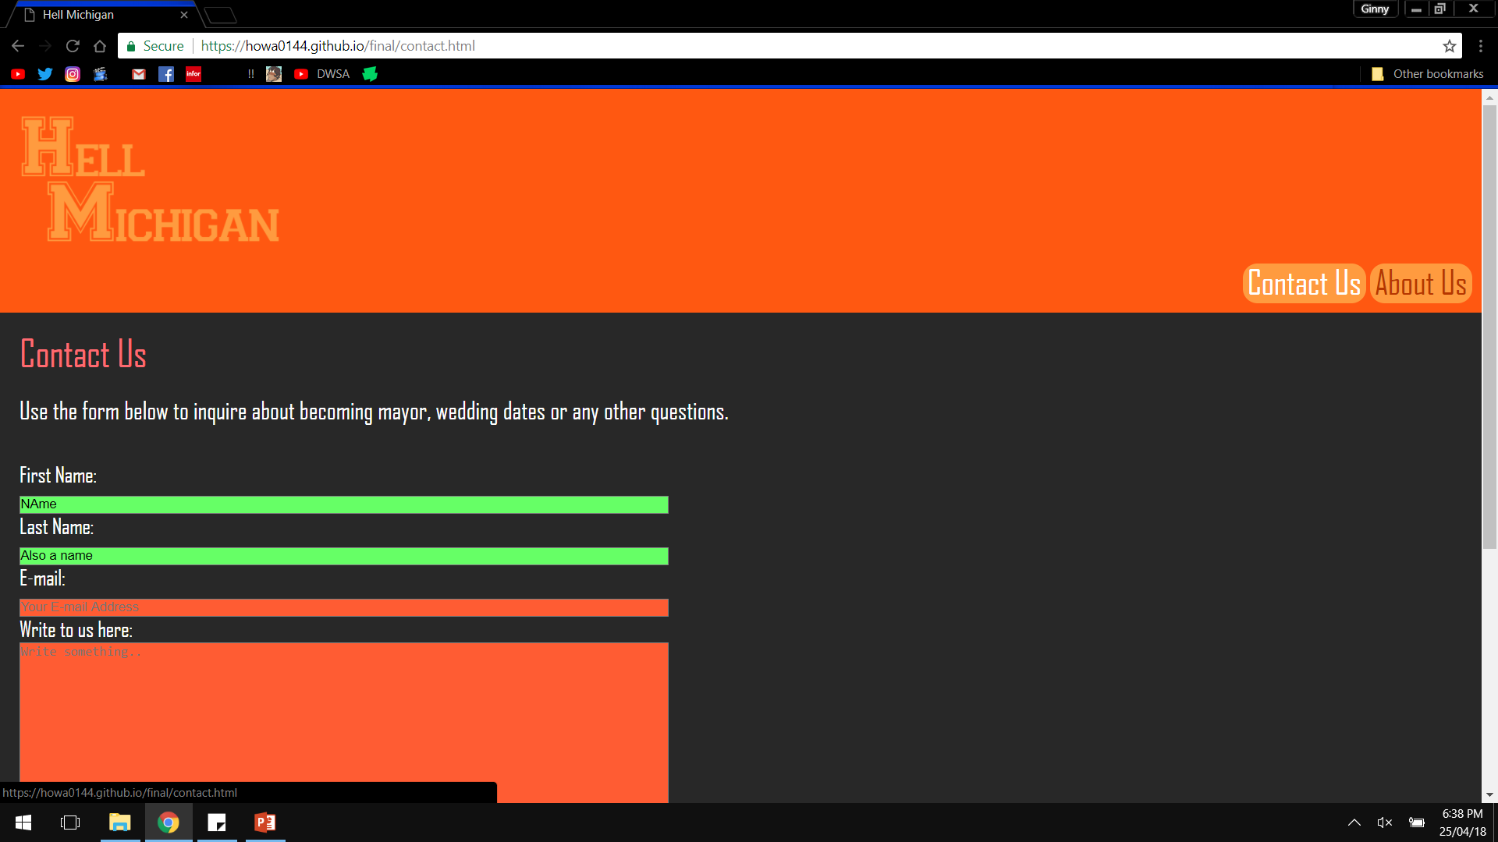

Slide 5
https://howa0144.github.io/final/

