Slide 1
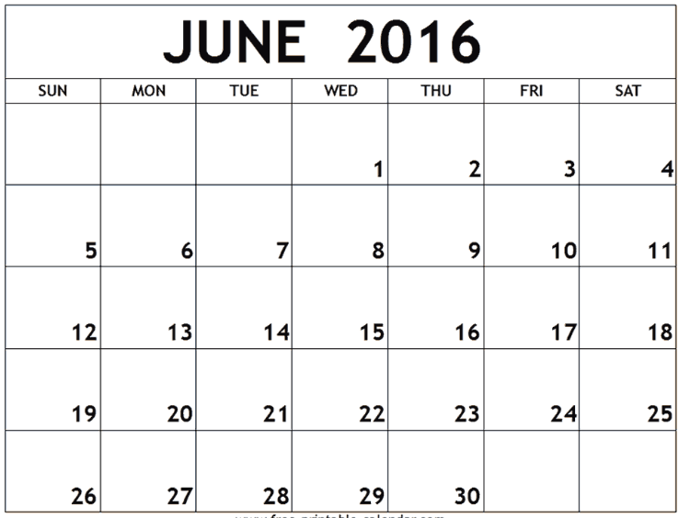
Group meeting
Larry’s exam
Larry’s exam
Group meeting
Ahmad returns
Jason’s RAC
Group meeting
John works with DKS on EPR
<-----------------------------------IMLB------------------------------→
Natalie’s vacation
Group meeting

Slide 2
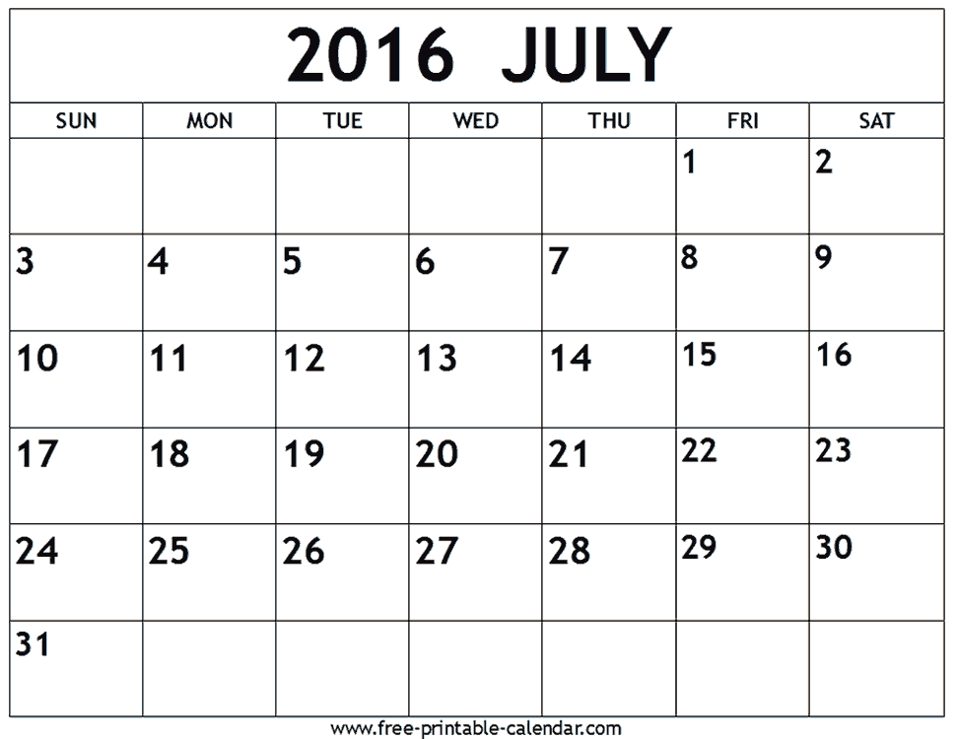
Group meeting & lunch
Group meeting & lunch
Group meeting & lunch
Kanchan Shankar -- ATOMPAW
Group meeting & lunch
Group meeting & lunch
1
2
3
4
Group meeting & lunch
5

Slide 3
Cluster stuff –
rhel6head3 has a new version of the operating system – different from the other nodes; please inform deac-help@wfu.edu of any “issues”
New software:
Quantum-espresso
set PW=/home/natalie/EL6/publiccode/PWscf/espresso-5.4.0/bin/pw.x
set DOS=/home/natalie/EL6/publiccode/PWscf/espresso-5.4.0/bin/dos.x
set PDOS=/home/natalie/EL6/publiccode/PWscf/espresso-5.4.0/bin/projwfc.x
pseudo_dir = '/deac/natalieGrp/wfurc4/natalie/EL6/PAWatoms/Recommended/‘
Abinit
set AB=/home/natalie/EL6/publiccode/abinit/abinit-8.0.6/bin/abinit

Slide 4
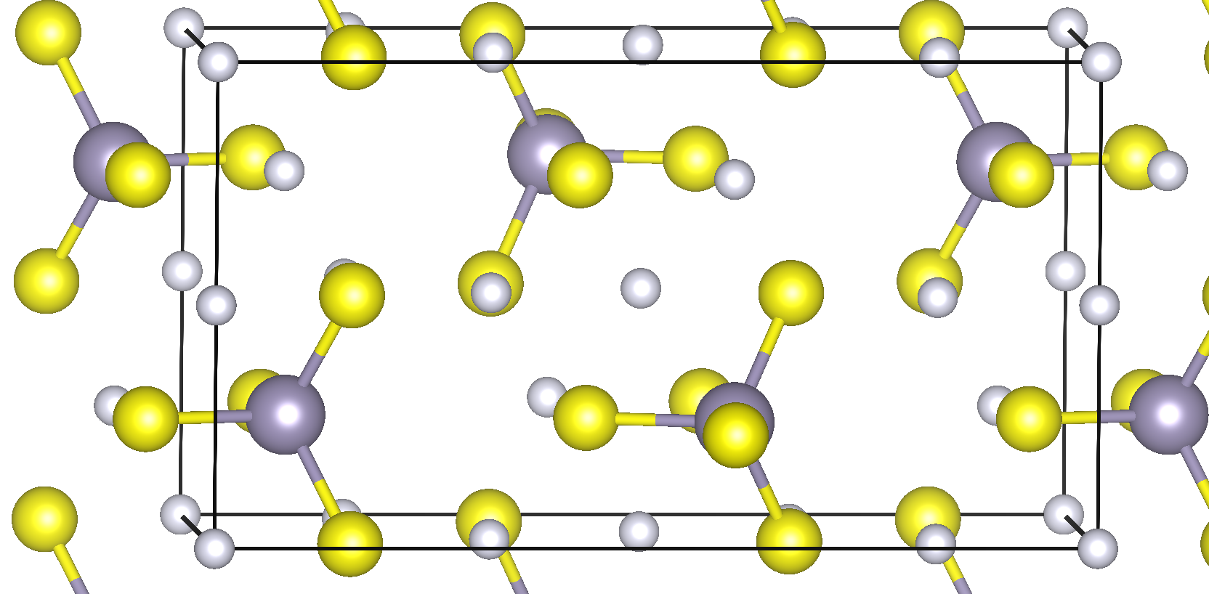
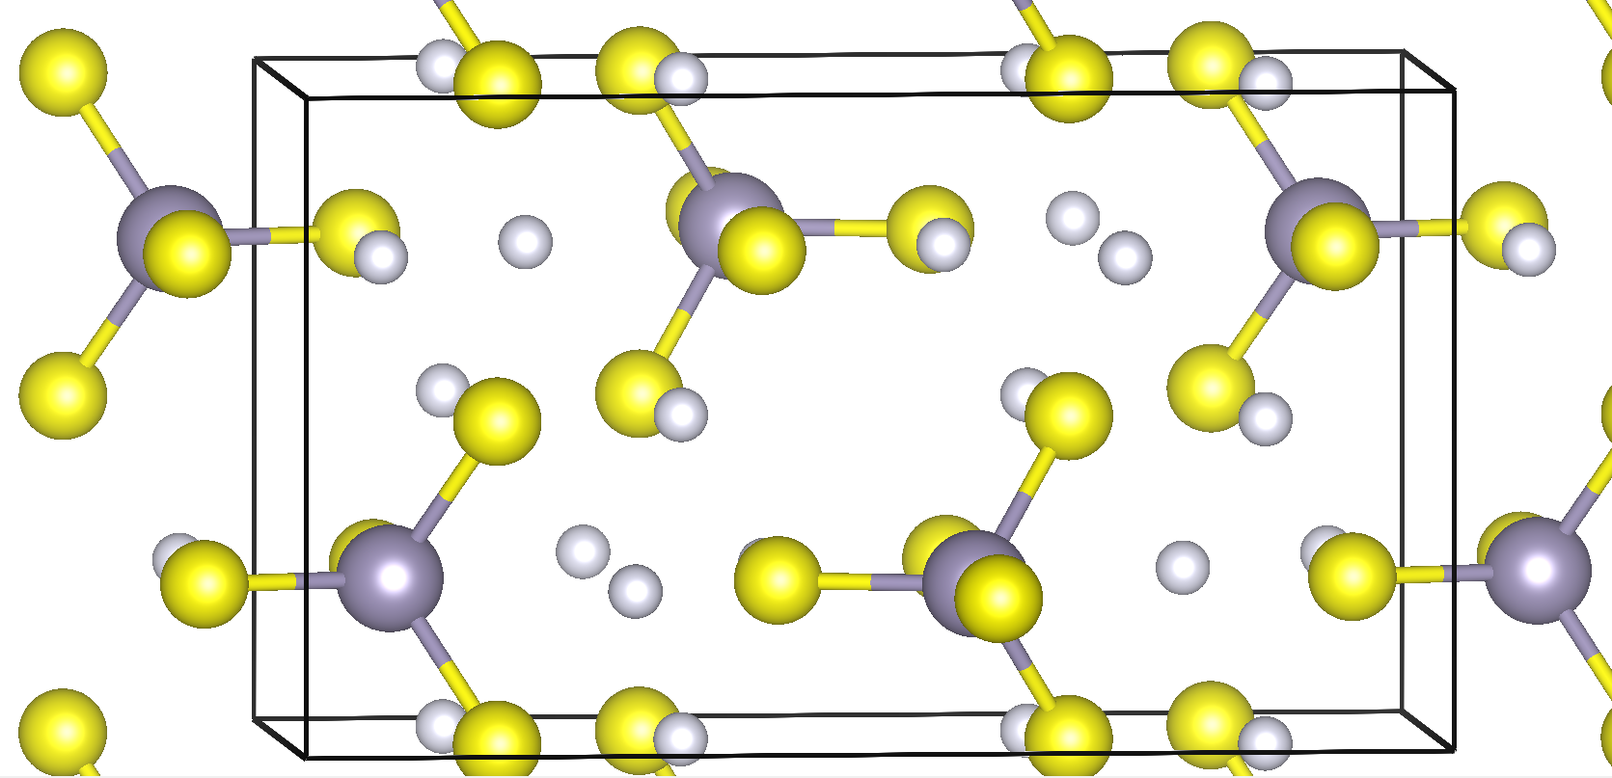
/Li4GeS4
Possible collaboration – Li4SnS4 story + As?
\Li4SnSe4
Duquesne Structure
Marburg Structure
E_{D}-E_{M} = -0.02 eV/FU

Slide 5
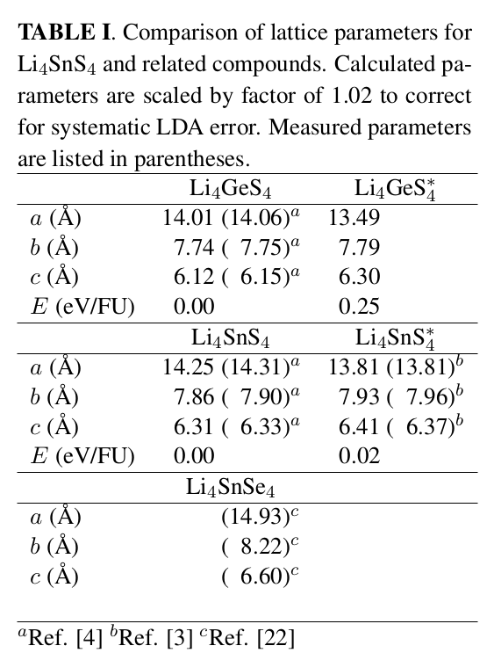
Calculations needed??

Slide 6
Possible questions:
How to control phase? Mechanism of phase transition?
More analysis of ion migration; compare with literature and molecular dynamics
Differences of Sn/Ge S/Se

Slide 7
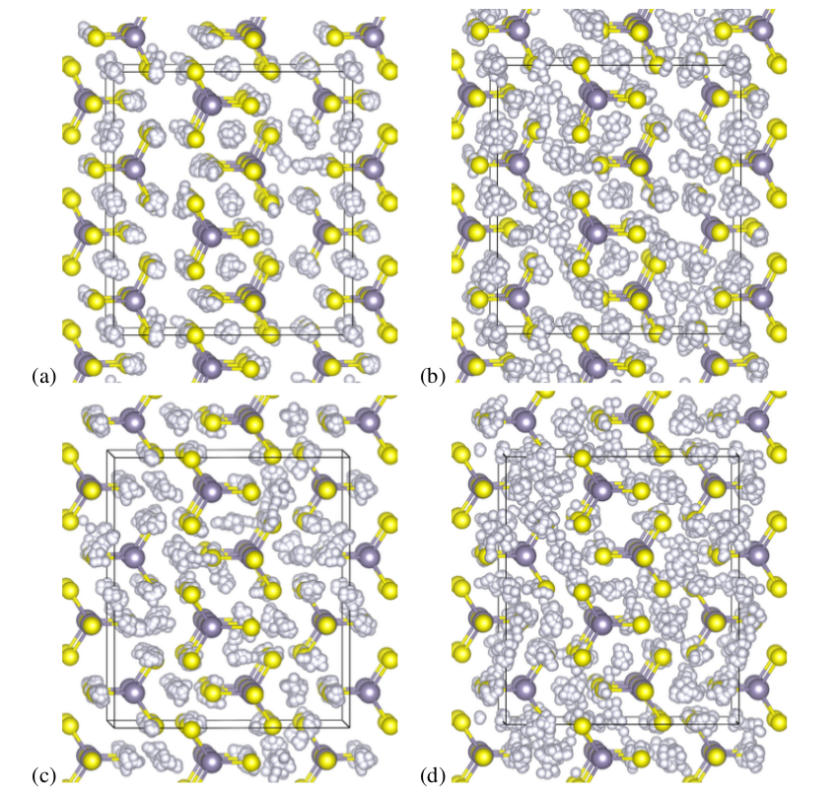
T=600K T=1100K
Li₄SnS₄
Li₄SnS₄*

Slide 8

Estimation of diffusion coefficient

Slide 9
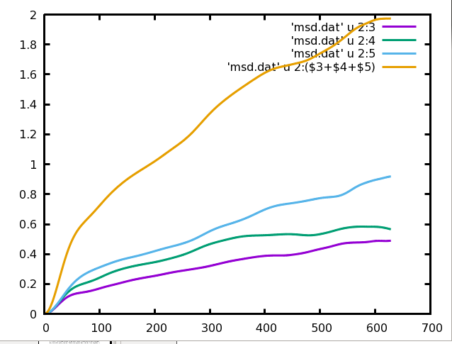
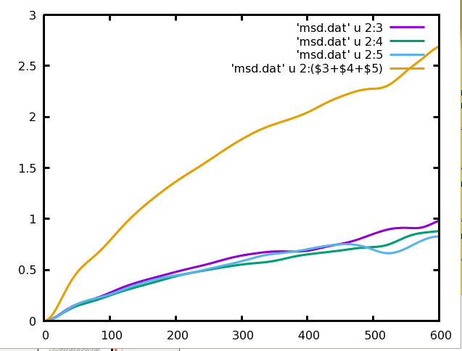
Li₄SnS₄
Li₄SnS₄*
MSD (Ang²)
c-axis
t (fs)

Slide 10
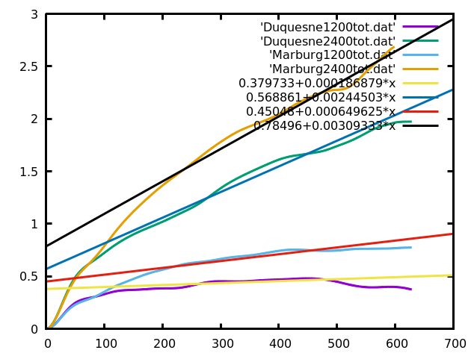
MSD (Ang²)
t (fs)

Slide 11
moble carriers/volume
Comments on conductivity
Nernst-Einstein or Haven factor

Slide 12
Some comments on relation between D and σ:
Treatment from Pathria and Beale’s textbook based on Brownian motion
random force

Slide 13
Now consider the same situation with an added electric field

Slide 14
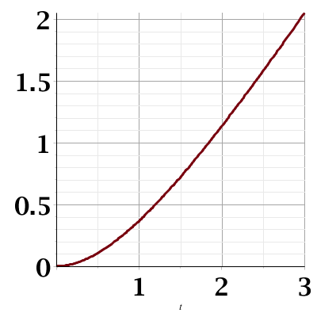
<r²>
t

Slide 15
Questions:
How can we control the temperature (currently – microcanonical ensemble which has the advantage that all variables are continuous)
How does the simulation rely on the time step?
How can we estimate the Haven ratio?
How should we use the ideas which were developed for fluids in the analysis of solids?
What might be the physical origin of the dissipative contribution; or perhaps we don’t need it??

