Slide 1
Salary of Employee
[CS263] HomeWork_0325

Slide 2
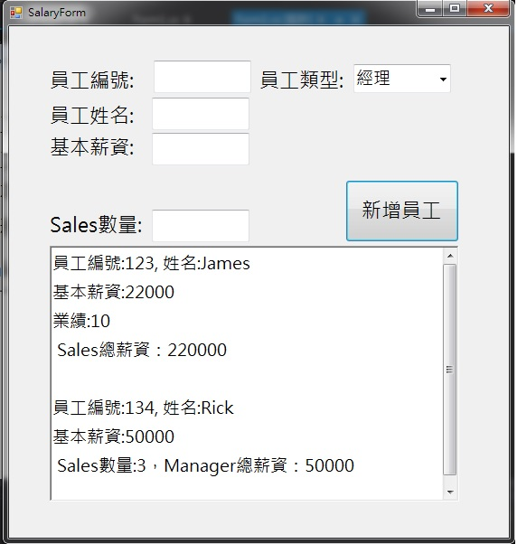
Salary of Employee
一、 執行結果

