Slide 1

Lab 13

Slide 2
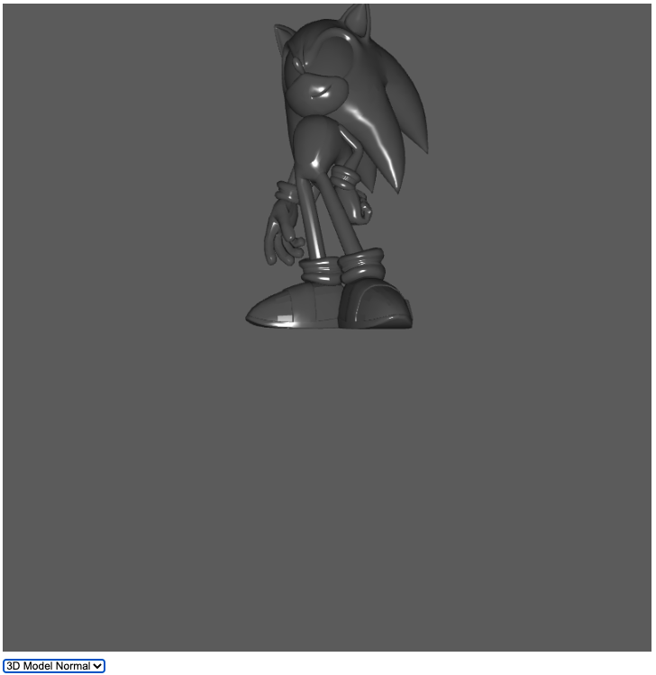
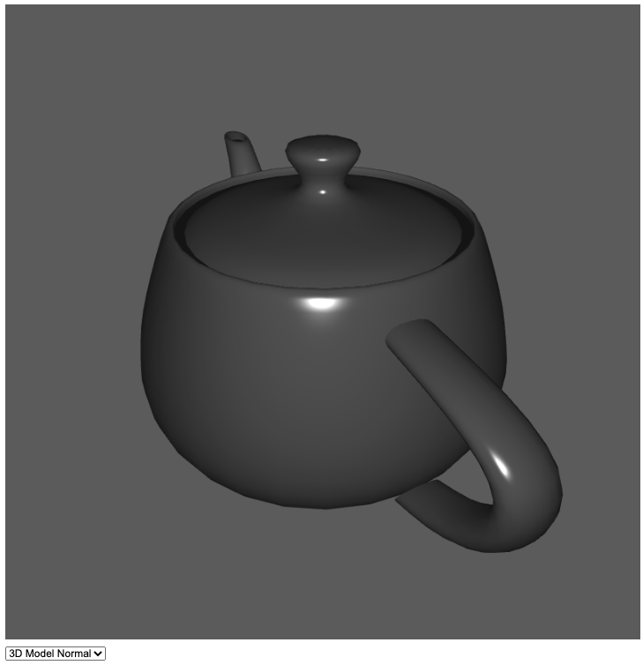
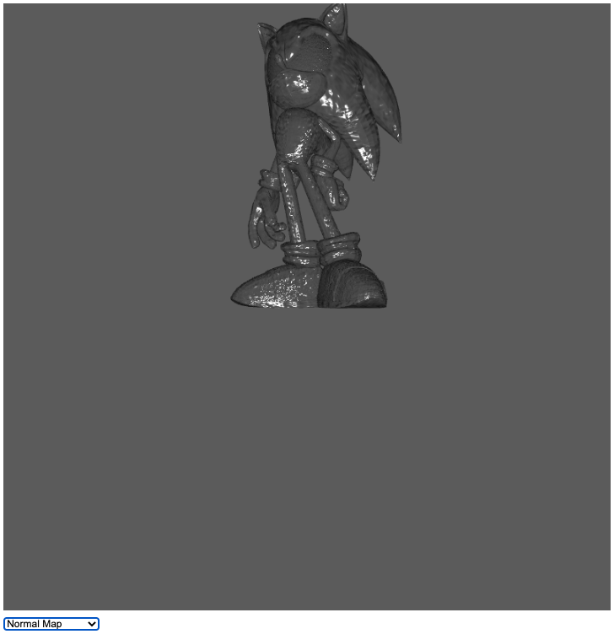
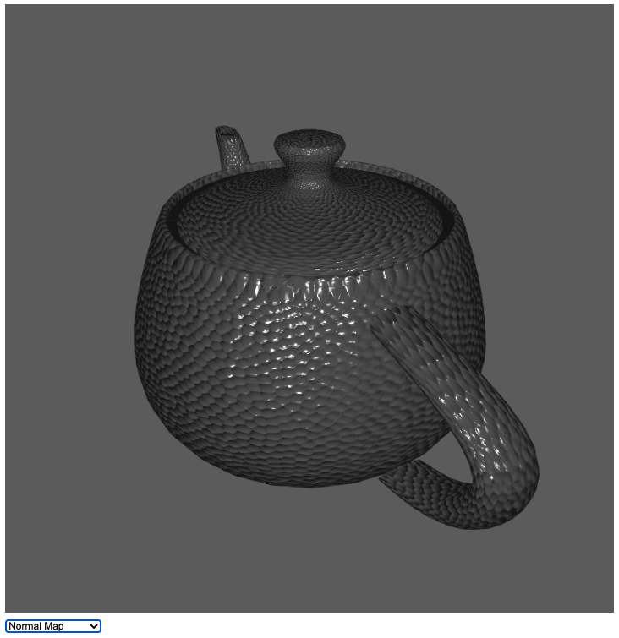
Download lab13 template
This template is very similar to Ex13-3
I add code for you to easily switch the illumination between object model’s normal and normal map
Goal:
Download a 3D Model you like from clara.io
Search and download a normal map on internet
Replace the 3D model and the normal map in the template by yours

Slide 3
Switch between the object’s normal and normal map

Slide 4

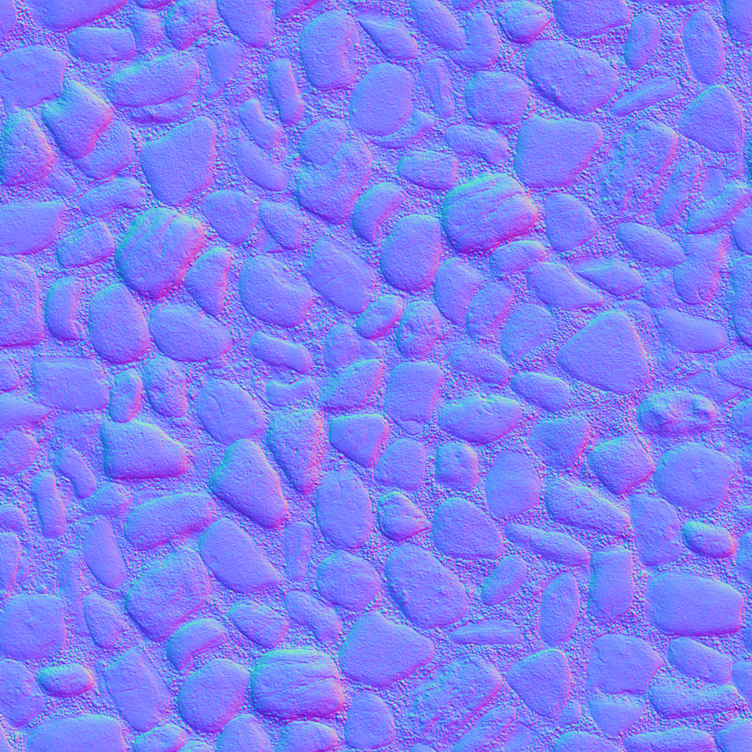
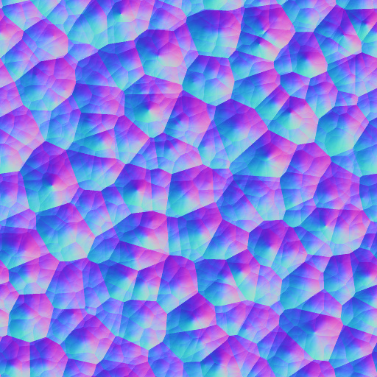
Hint
Because the normal map you can download on internet is not designed for the 3D object you have
You may get a better-looking result if you use a normal map with repeating pattern
For example,

Slide 5
What You Should Do for “Submission”

Slide 6
Submission Instruction
Create a folder
Put the html and js files in the folder
Zip the folder
Rename the zip file to your student ID
For example, if your student ID is “40312345s”, rename the zip file to “40312345s.zip”
Submit the renamed zip file to Moodle
Make sure
you put all files in the folder to zip
You submit the zip file with correct name
You won’t get any point if
the submitted file does not follow the naming rule,
TA cannot run your code,
or cannot unzip your zip file.

