Slide 1
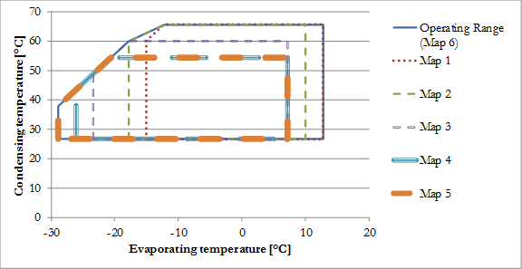
Please update me and add map 7

