Slide 1
Generating Effective Item Recommendations for Etsy Users
Shirmung Bielefeld
Howard Jing
Karen Li

Slide 2
Item Recommendation Systems
important for commercial websites
show users items relevant to their interests
incite users to purchase items

Slide 3
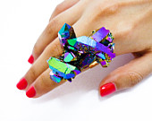
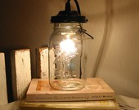
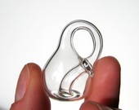


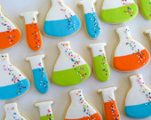
Etsy is the world’s handmade marketplace.

Slide 4
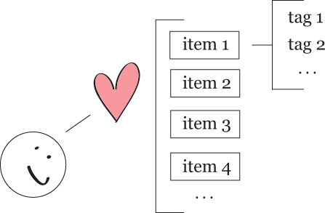

Slide 5
We believe that…
item’s set of tags is a relatively accurate representation of item
users favorite items according to their interests
users’ interests can be discerned by their favorite items’ set of tags

Slide 6
Difficulties
unable to determine what users don’t like (ie: no ranking system)
unable to access private information (ie: user clicks, user purchases)

Slide 7
Our Data
using Etsy’s API
tags of items that one particular user (corduroy) has marked as a favorite item
tags of “randomly” selected items

Slide 9
Experimental Setup
4-fold cross-validation
majority of corduroy’s favorite items as the training set
small portion of corduroy’s favorite items along with random items as the testing set

Slide 10
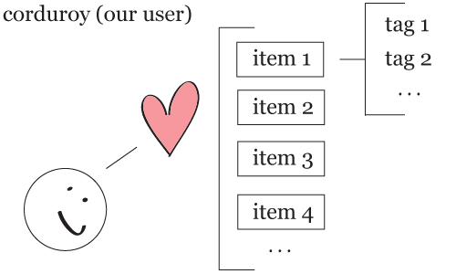
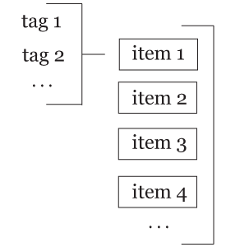
Item-Based Collaborative Filtering Using the k-Nearest Neighbor

Slide 11
Cosine Similarity

Slide 12
Item-Based Collaborative Filtering Using the k-Nearest Neighbor

Slide 13
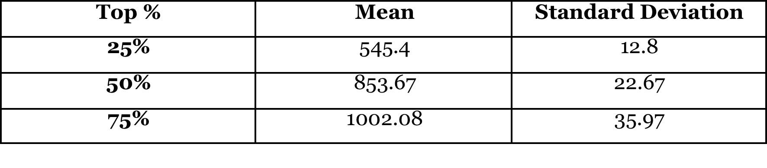
Mean Number of corduroy’s Favorite Items
within the top n% of the 5972 total items (1079 of corduroy’s favorite items + 4893 random items)

Slide 14
2D Line Plot
green lines represent corduroy’s favorite items
red lines represent random items

Slide 15
Cumulative Distribution

Slide 16
//conclusions

Slide 17
//future work

Slide 18

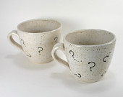


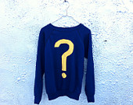
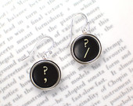
Questions?

Slide 19
References
http://public.research.att.com/~volinsky/netflix/cfworkshop.pdf
http://ilk.uvt.nl/~toine/publications/bogers.2009.recsys2009-workshop.pdf
http://www.springerlink.com/content/m812ng6155r2v7l6/fulltext.pdf

