Slide 1
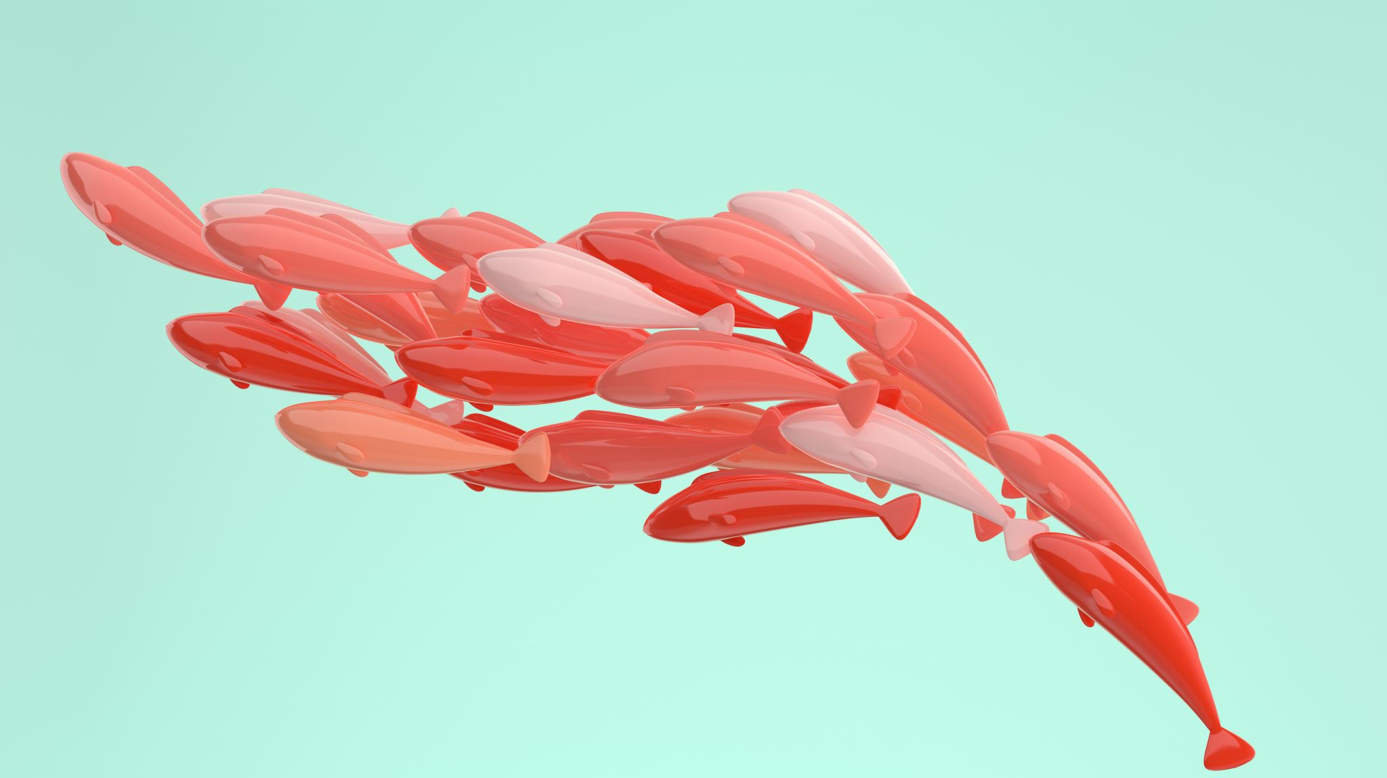
The influence of size and ontogeny on the distribution of pelagic young-of-the-year fish

Slide 2
Objectives
Determine if variability in life history impacts how we can best model the distributions of different fish species
Evaluate the benefit of using size-structured species distribution models compared to size-aggregated models
Investigate whether fish distributions change in response to large-scale climate patterns.

Slide 3
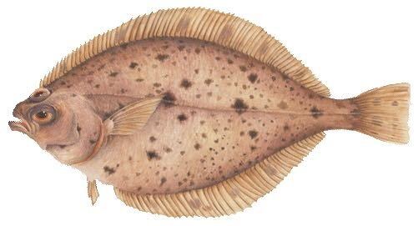
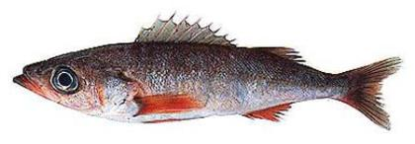
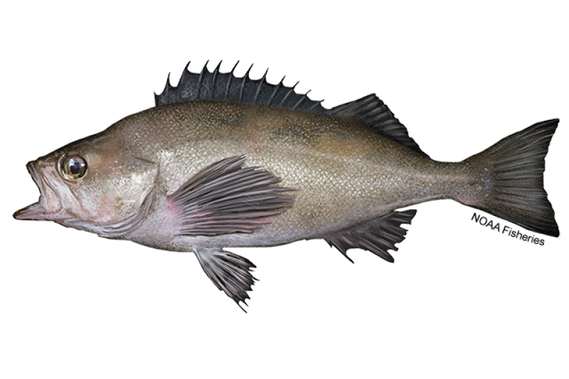
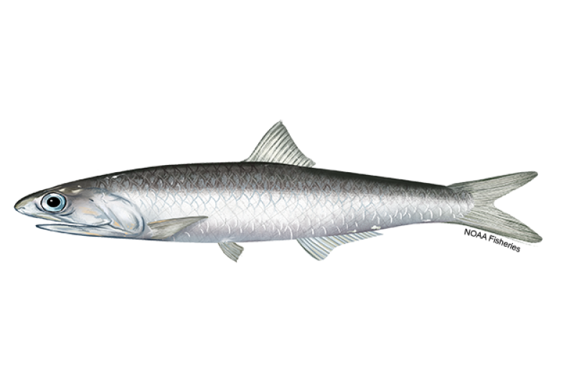
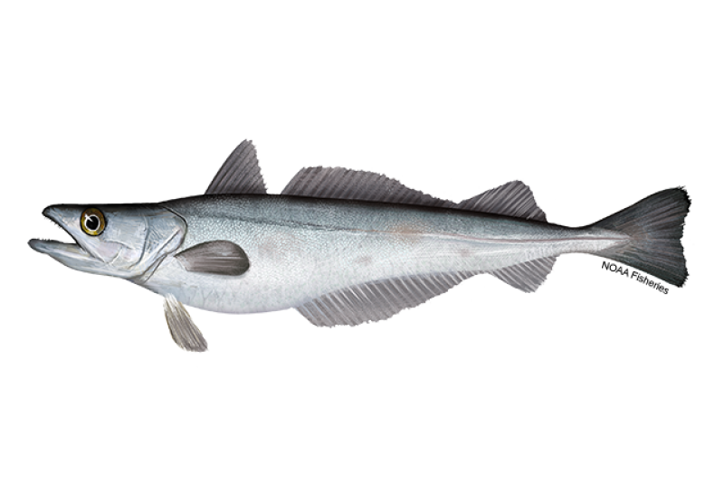
Data
NOAA Rockfish Recruitment and Ecosystem Assessment Survey and Pre-Recruit Survey (1987 - 2018)
Data collected off U.S. West Coast from April to June in the California Current System, spatial extent has varied over time.
Using CTD data (sea surface temperature [SST] and sea surface salinity [SSS]), as well as depth as environmental variables.
Used catch and size data for pelagic young-of-the-year northern anchovy (Engraulis mordax), shortbelly rockfish (Sebastes jordani), widow rockfish (S. entomelas), Pacific hake (Merluccius productus), and Pacific sanddab (Citharichthys sordidus).

Slide 4
Methods
Variable coefficient generalized additive models (GAMs)
Variable coefficient terms (lon, lat, by = climate index) allow location of catch to vary with a given climate index (PDO, NPGO, or ONI).
The average value of the climate index for January through March for each year was calculated to incorporate it into the model.
The best model was selected using Akaike information criterion.
$$ln\left(catch+1\right)=year+s\left(lon, lat\right)+s\left(day of year\right)+s\left(SST\right)+s\left(SSS\right)+s\left(depth\right)+ s(lon, lat, by=climate index)+ ε$$
Size-aggregated:
predictions
Size-structured:
predictions

Slide 5
Methods
Predict on (test data)
Initial model (training data)
Model 1:
2000
2001
2002
2003
2004
2005
2006
2007
Leave-one-group-out cross validation
Iteratively left out one year of data then predicted on left out year’s data.
Calculated yearly root mean square error (RMSE) and overall RMSE for size-aggregated and size-structured models.
Model 2:
2000
2001
2002
2003
2004
2005
2006
2007
Model 3:
2000
2001
2002
2003
2004
2005
2006
2007
Model 4:
2000
2001
2002
2003
2004
2005
2006
2007
Model 5:
2000
2001
2002
2003
2004
2005
2006
2007
Model 6:
2000
2001
2002
2003
2004
2005
2006
2007
Model 7:
2000
2001
2002
2003
2004
2005
2006
2007
Model 8:
2000
2001
2002
2003
2004
2005
2006
2007
Average RMSE

Slide 6
Species | Aggregated Model | Structured Model | Percent Decrease
northern anchovy | 371 | 321 | 13.5%
shortbelly rockfish | 111 | 110 | 0.9%
widow rockfish | 12 | 12 | 0%
Pacific hake | 202 | 197 | 2.5%
Pacific sanddab | 78 | 63 | 19.2%

Slide 7
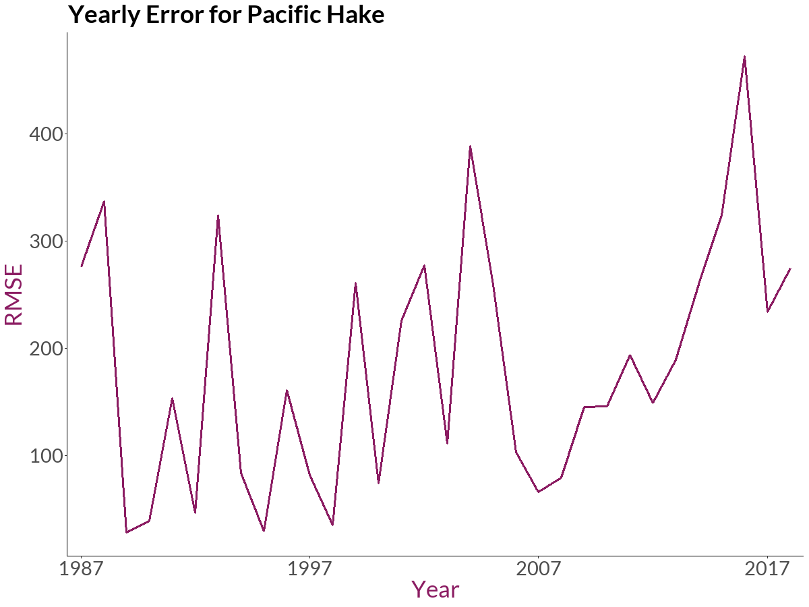
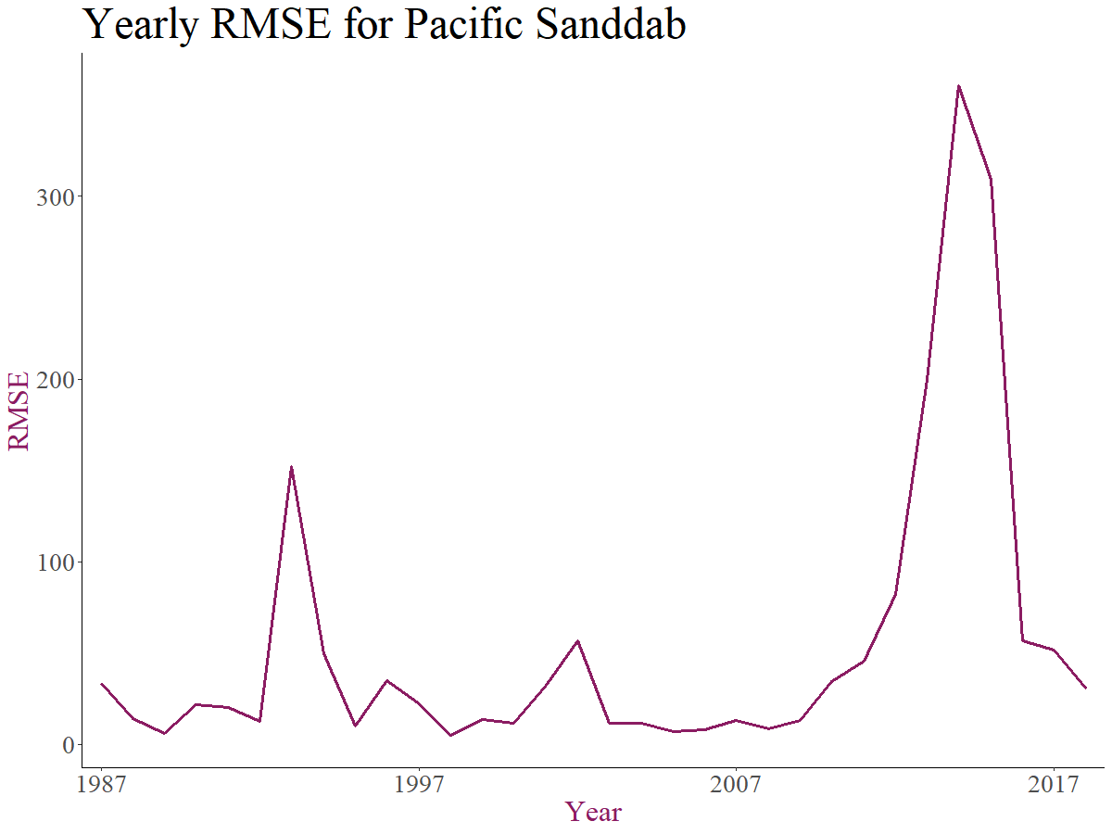
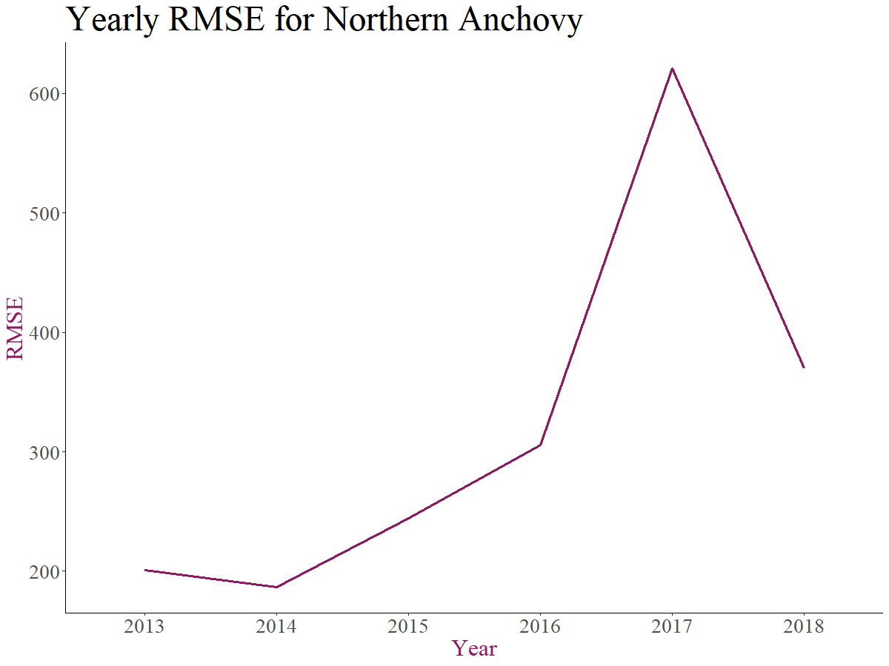
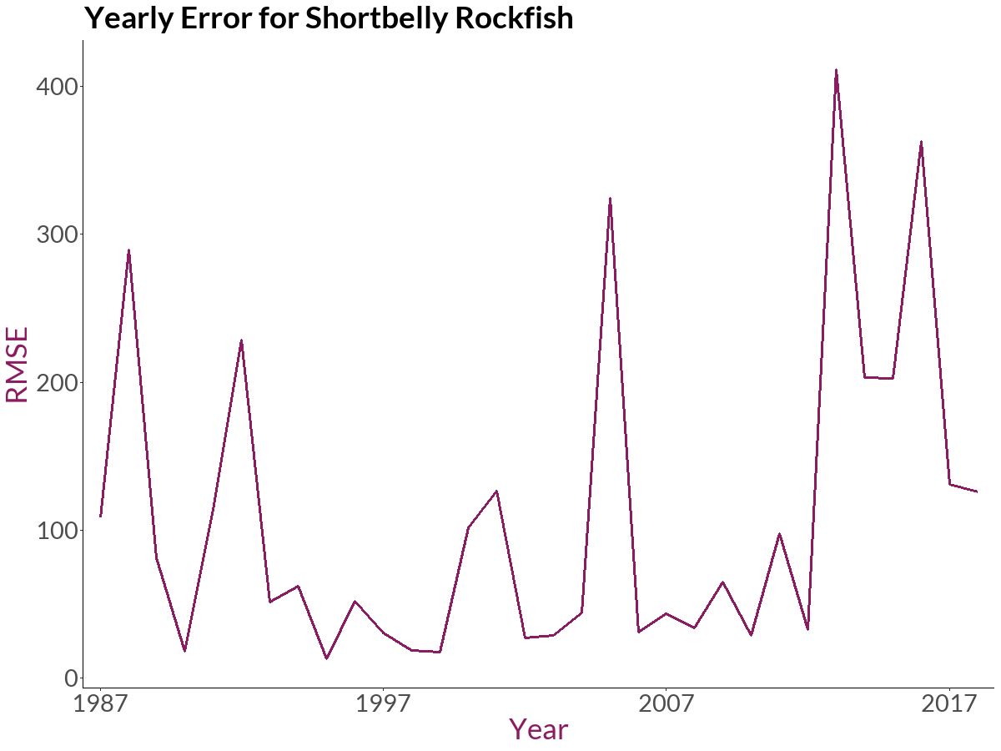
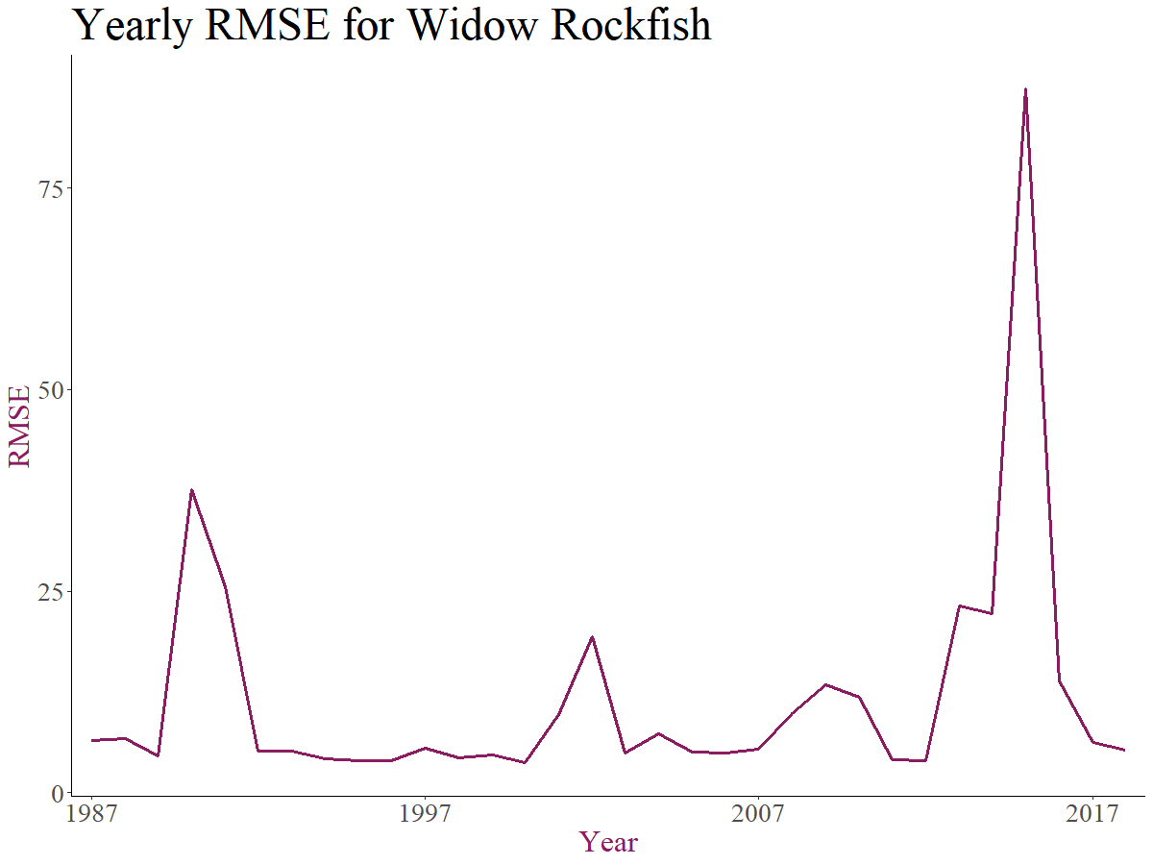

Slide 8
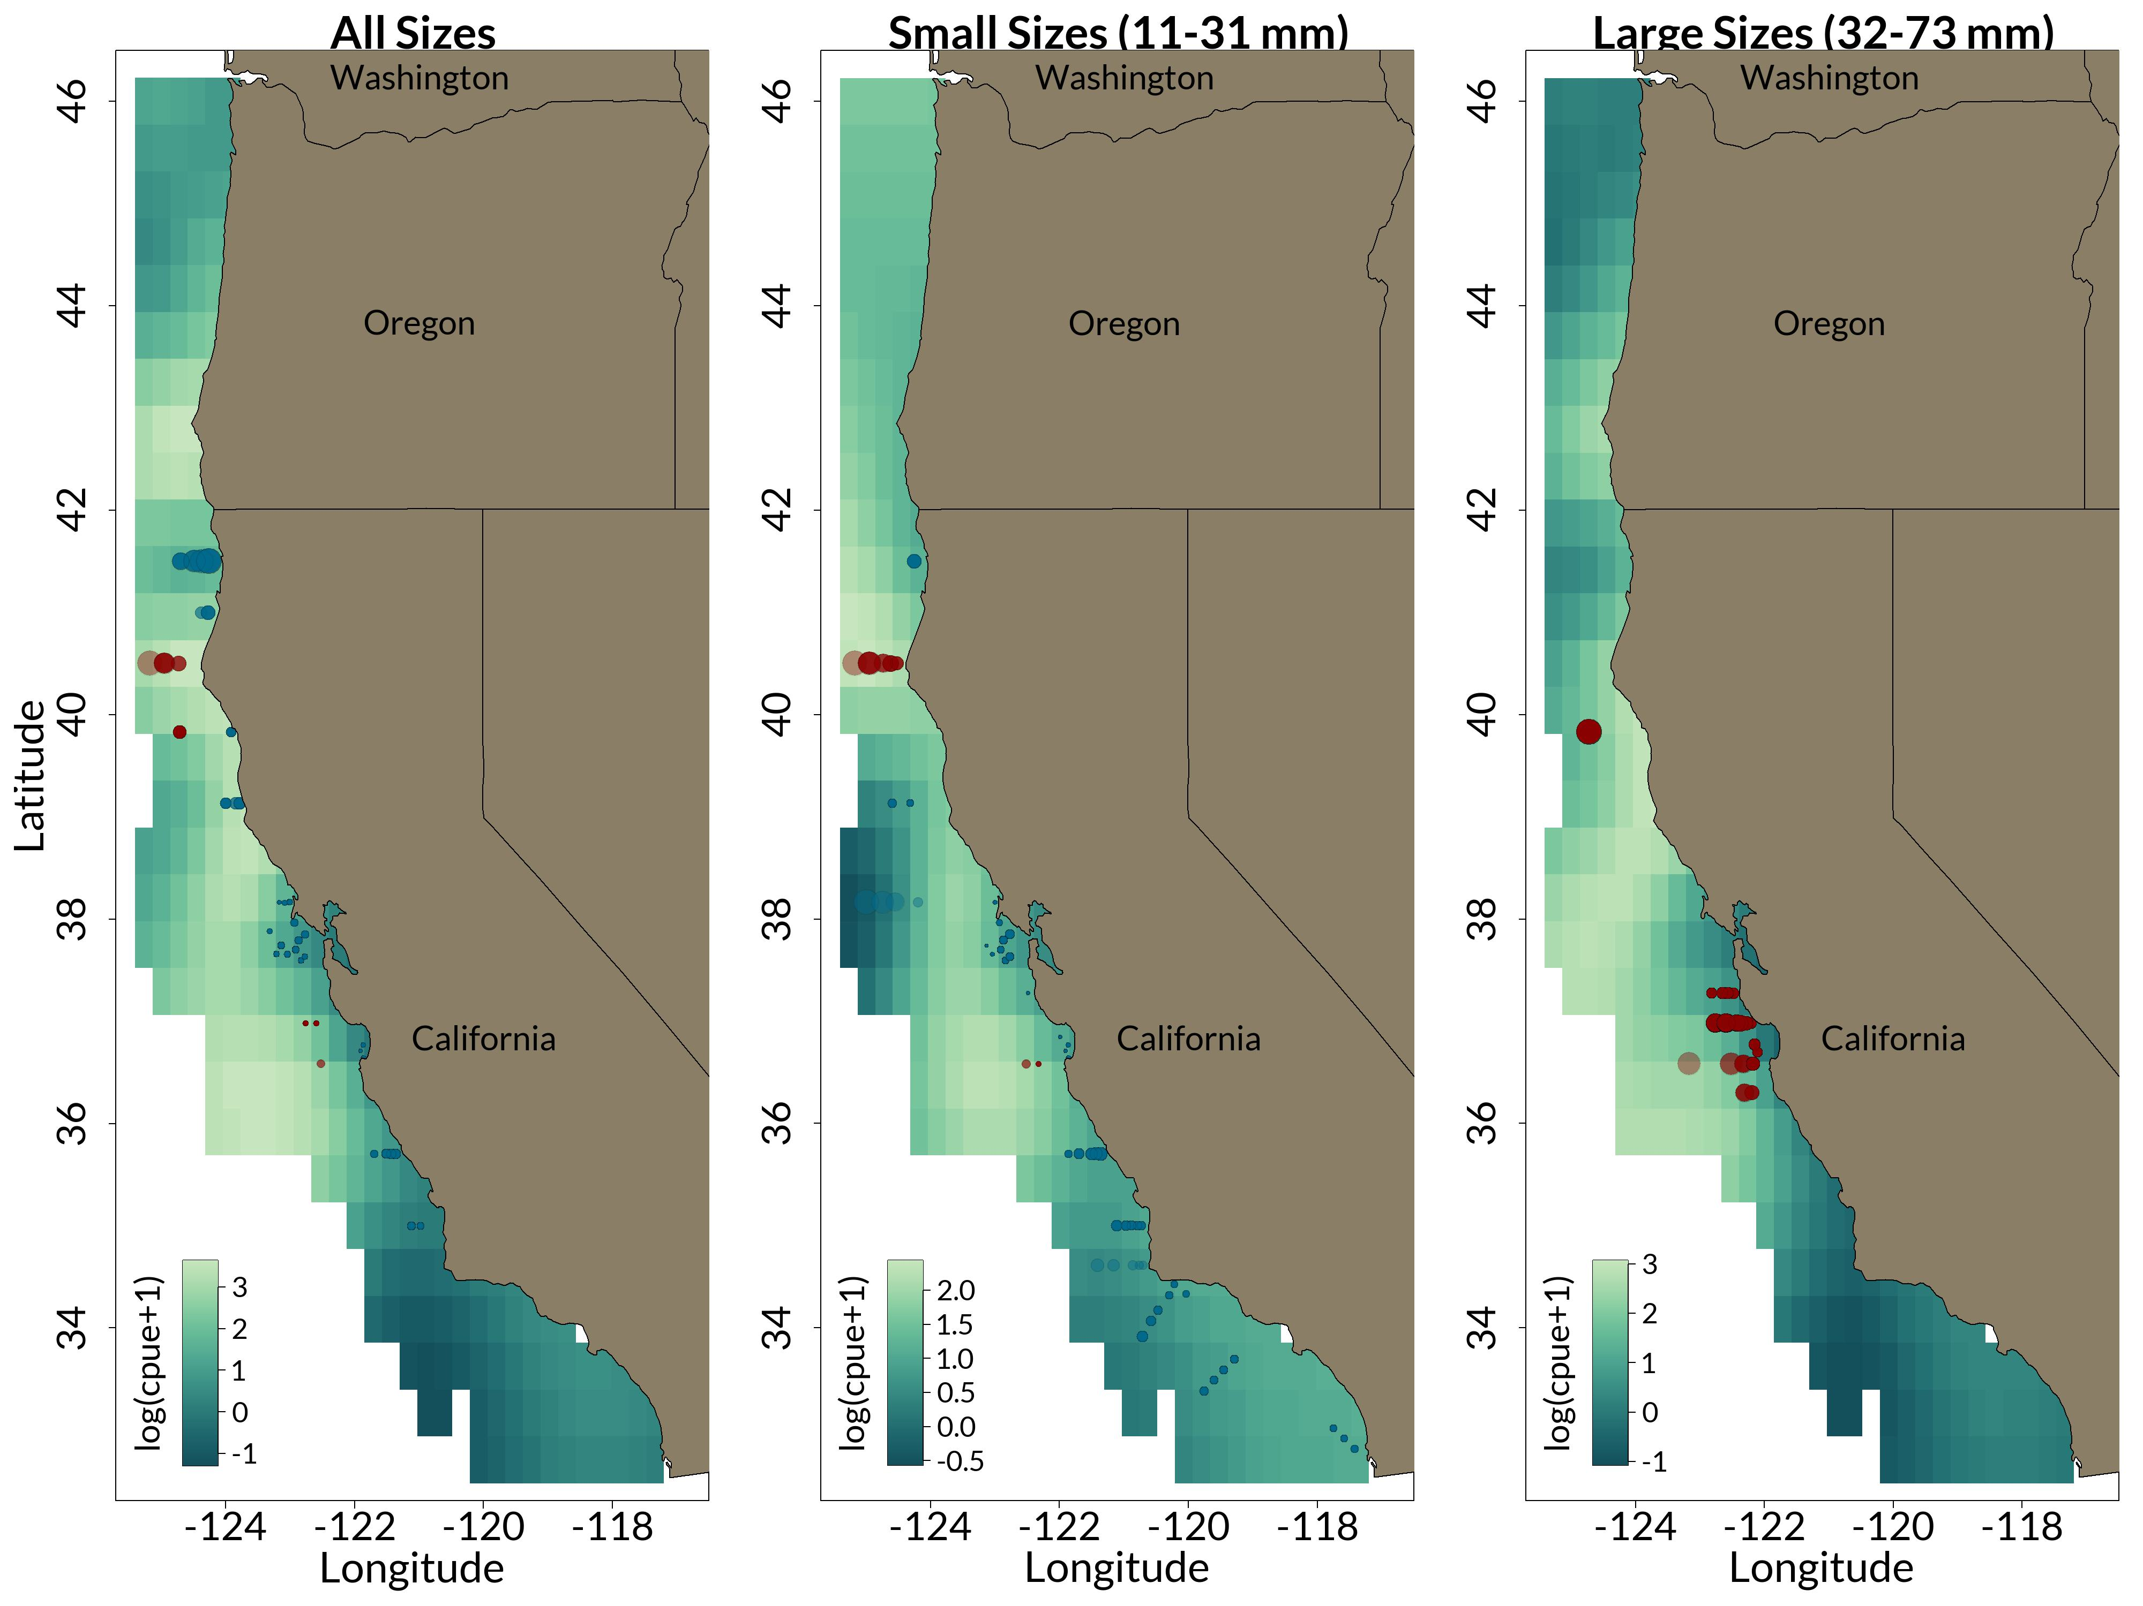
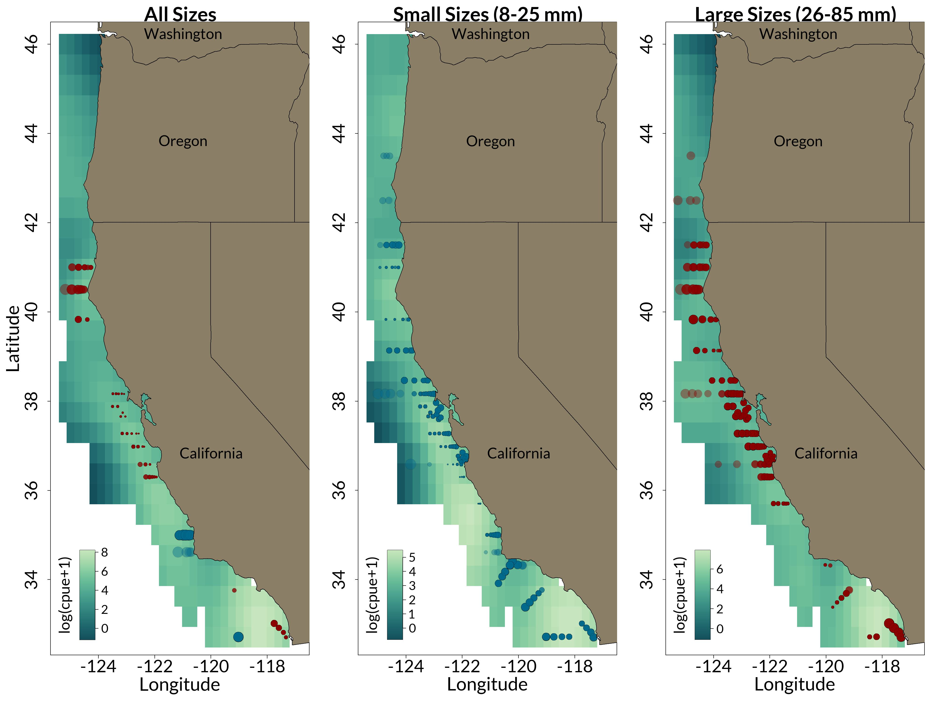
Widow Rockfish
Shortbelly Rockfish
𝐥𝐧(𝒄𝒂𝒕𝒄𝒉 + 𝟏) = 𝒚𝒆𝒂𝒓 + 𝒔(𝒍𝒐𝒏, 𝒍𝒂𝒕) + 𝒔(𝒅𝒂𝒚 𝒐𝒇 𝒚𝒆𝒂𝒓) + 𝒔(𝑺𝑺𝑻) + 𝒔(𝑺𝑺𝑺) + 𝒔(𝒅𝒆𝒑𝒕𝒉) + 𝒔(𝒍𝒐𝒏, 𝒍𝒂𝒕, 𝐛𝐲 = ONI) + 𝜺
𝐥𝐧(𝒄𝒂𝒕𝒄𝒉 + 𝟏) = 𝒚𝒆𝒂𝒓 + 𝒔(𝒍𝒐𝒏, 𝒍𝒂𝒕) + 𝒔(𝒅𝒂𝒚 𝒐𝒇 𝒚𝒆𝒂𝒓) + 𝒔(𝑺𝑺𝑻) + 𝒔(𝑺𝑺𝑺) + 𝒔(𝒅𝒆𝒑𝒕𝒉) + 𝒔(𝒍𝒐𝒏, 𝒍𝒂𝒕, 𝐛𝐲 = PDO) + 𝜺

Slide 9
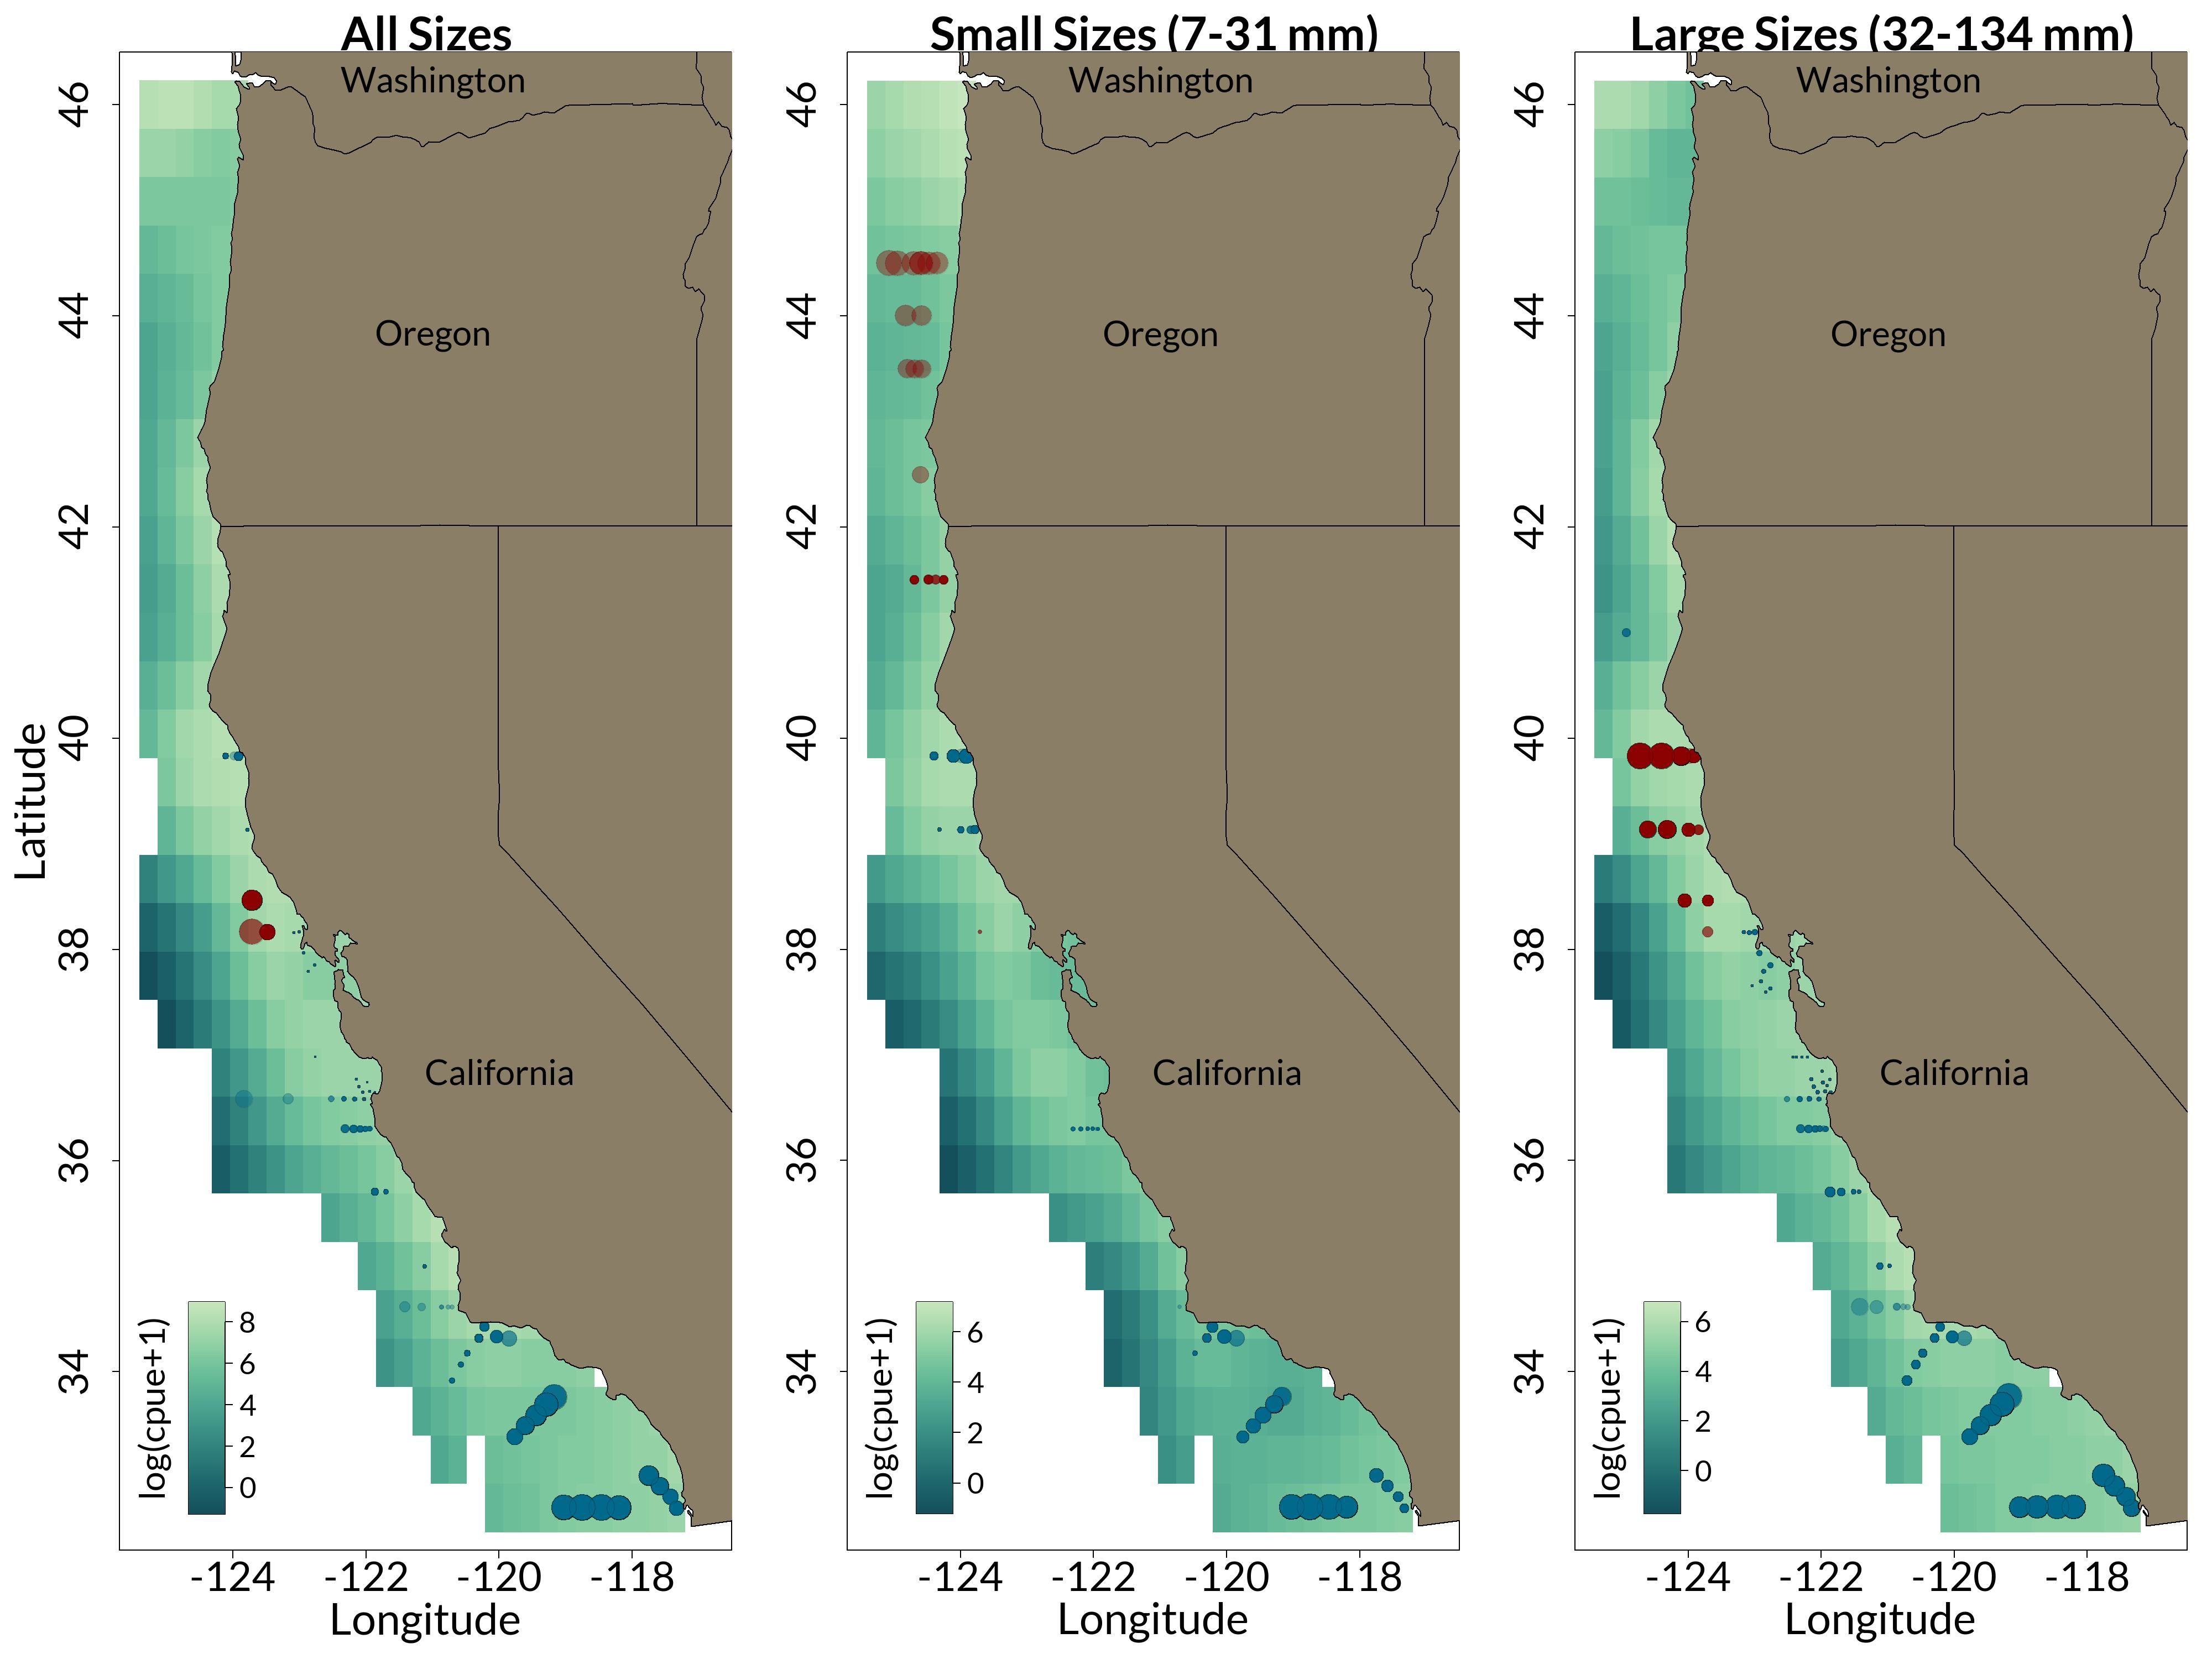
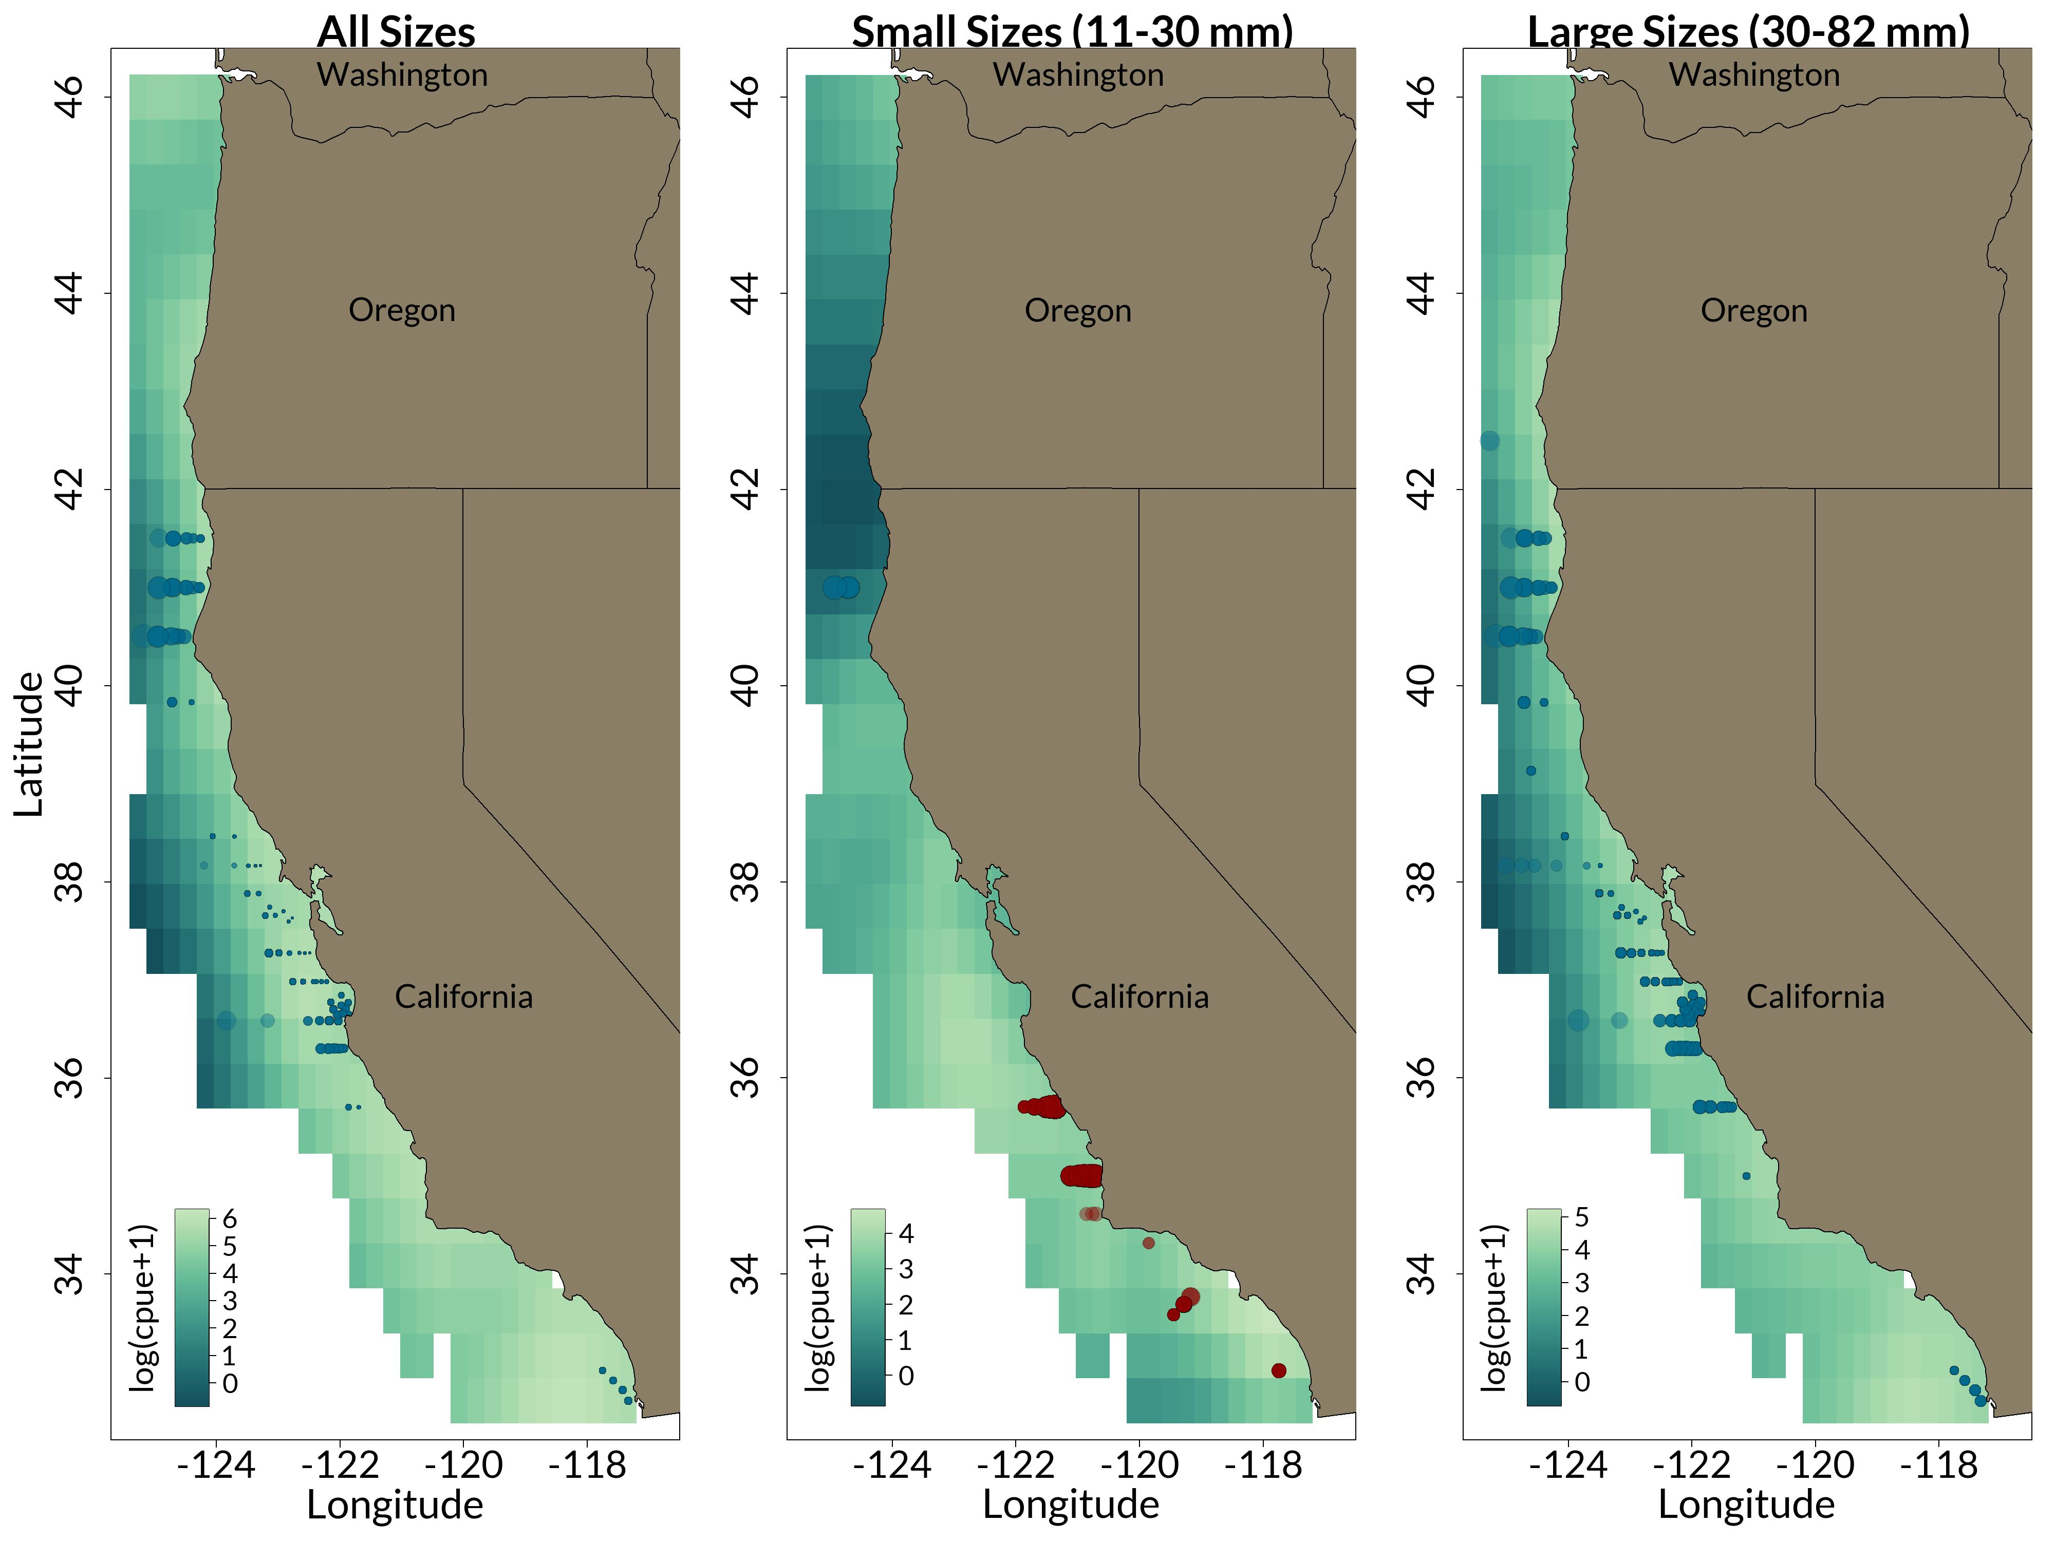
Pacific Hake
Pacific Sanddab
𝐥𝐧(𝒄𝒂𝒕𝒄𝒉 + 𝟏) = 𝒚𝒆𝒂𝒓 + 𝒔(𝒍𝒐𝒏, 𝒍𝒂𝒕) + 𝒔(𝒅𝒂𝒚 𝒐𝒇 𝒚𝒆𝒂𝒓) + 𝒔(𝑺𝑺𝑻) + 𝒔(𝑺𝑺𝑺) + 𝒔(𝒅𝒆𝒑𝒕𝒉) + 𝒔(𝒍𝒐𝒏, 𝒍𝒂𝒕, 𝐛𝐲 = NPGO) + 𝜺
𝐥𝐧(𝒄𝒂𝒕𝒄𝒉 + 𝟏) = 𝒚𝒆𝒂𝒓 + 𝒔(𝒍𝒐𝒏, 𝒍𝒂𝒕) + 𝒔(𝒅𝒂𝒚 𝒐𝒇 𝒚𝒆𝒂𝒓) + 𝒔(𝑺𝑺𝑻) + 𝒔(𝑺𝑺𝑺) + 𝒔(𝒅𝒆𝒑𝒕𝒉) + 𝒔(𝒍𝒐𝒏, 𝒍𝒂𝒕, 𝐛𝐲 = NPGO) + 𝜺

Slide 10
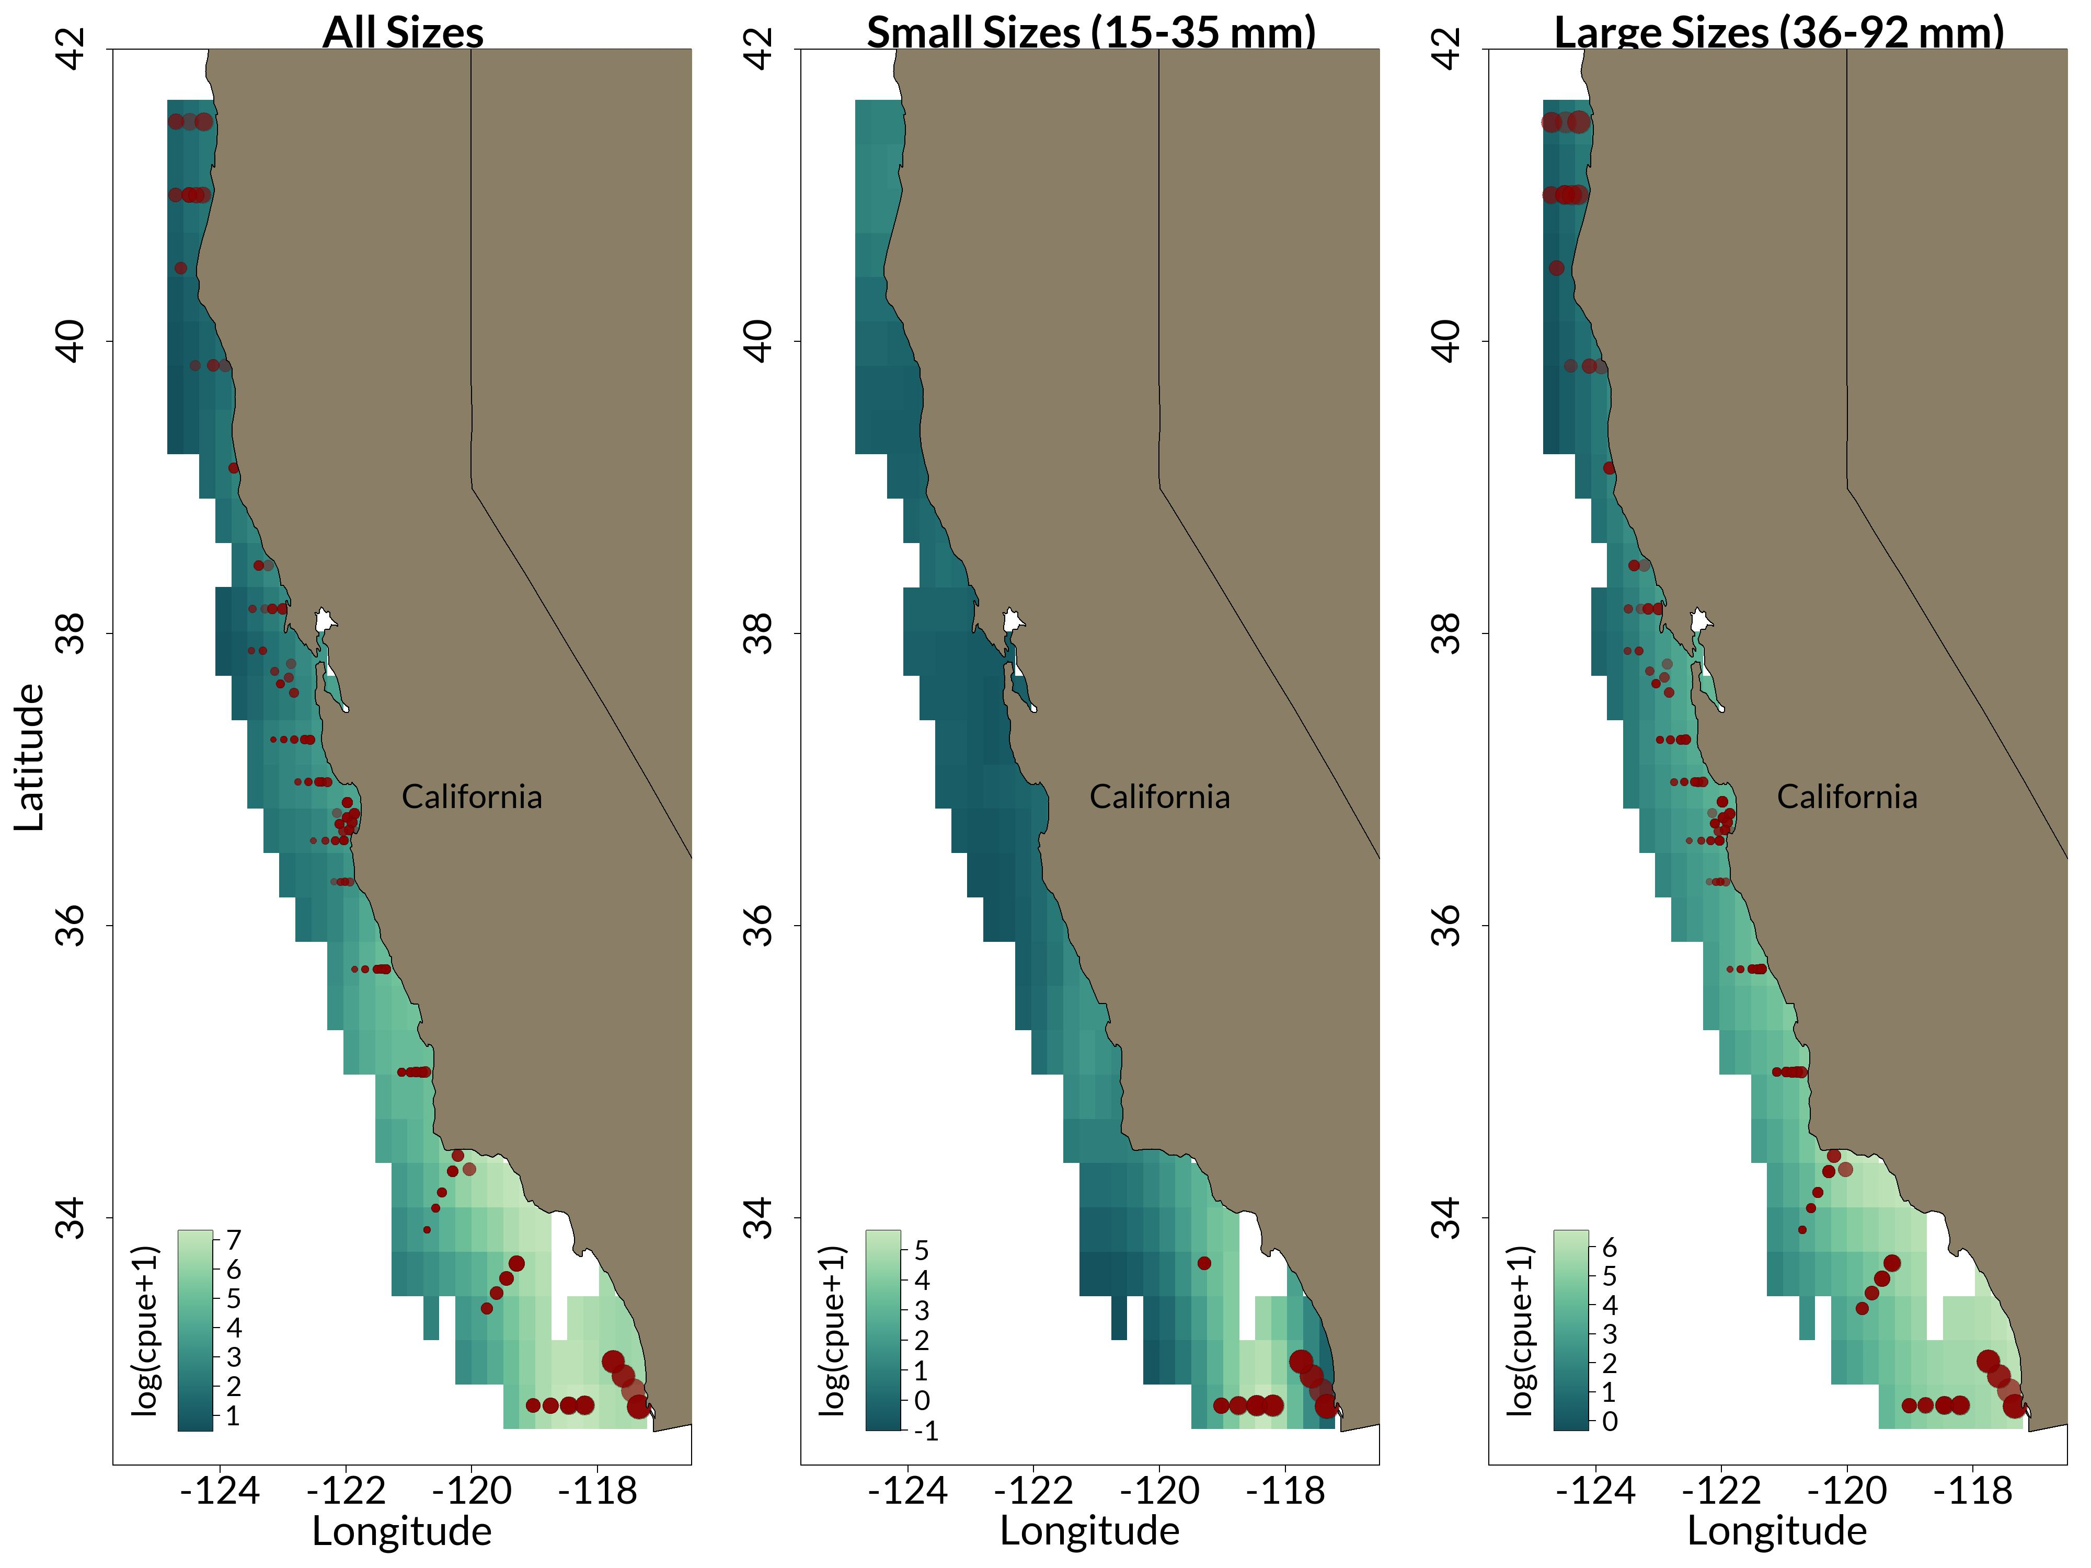
Anchovy
𝐥𝐧(𝒄𝒂𝒕𝒄𝒉 + 𝟏) = 𝒚𝒆𝒂𝒓 + 𝒔(𝒍𝒐𝒏, 𝒍𝒂𝒕) + 𝒔(𝒅𝒂𝒚 𝒐𝒇 𝒚𝒆𝒂𝒓) + 𝒔(𝑺𝑺𝑻) + 𝒔(𝑺𝑺𝑺) + 𝒔(𝒅𝒆𝒑𝒕𝒉) + 𝒔(𝒍𝒐𝒏, 𝒍𝒂𝒕, 𝐛𝐲 = NPGO) + 𝜺

Slide 11
Predictive error increases for anomalously warm years
RMSE noticeably increases during the years the California Current System experienced a marine heat wave (2014-2016).
It’s difficult to forecast species distributions under anomalous environmental conditions as model accuracy is decreased.
Size-structured models improve predictions for some species
For the rockfishes and Pacific hake, the size-aggregated model may be sufficient for modeling species distributions
Climate effects on species abundance differ by size grouping
The effect of climate is different depending on the size grouping, as is the predicted species distribution.
Despite the low reduction in error with the size-structured models for these species, there are still differences in distribution for different size groupings.
For anchovy and Pacific sanddab, it may be better to use a size-structured approach.

