Slide 1
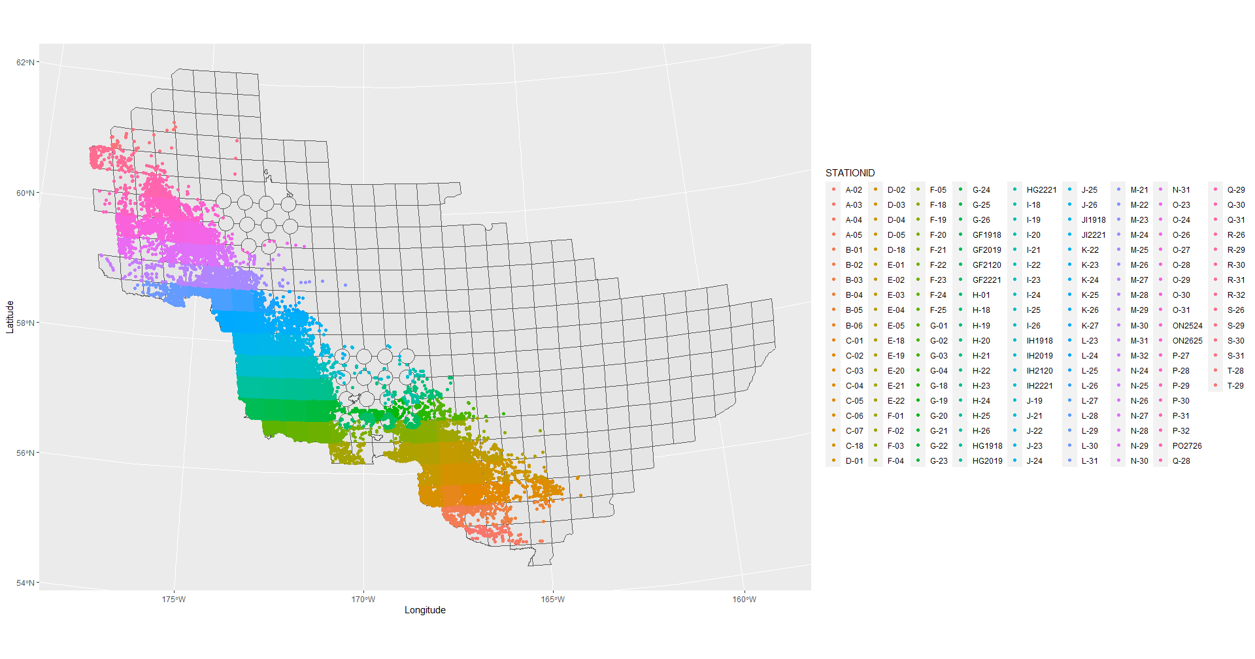

Slide 2
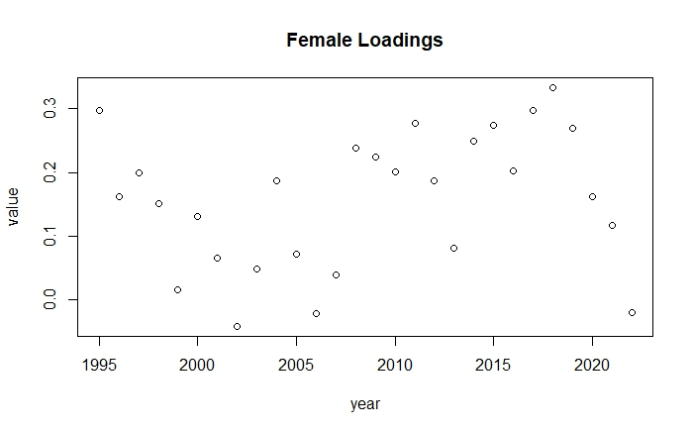
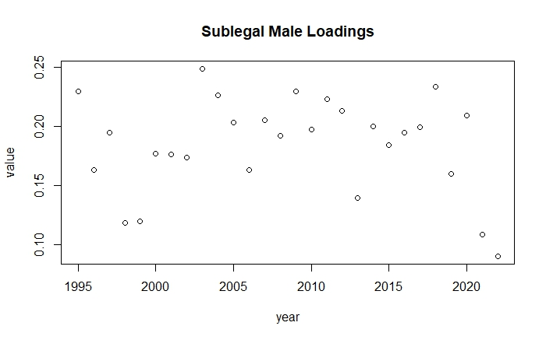
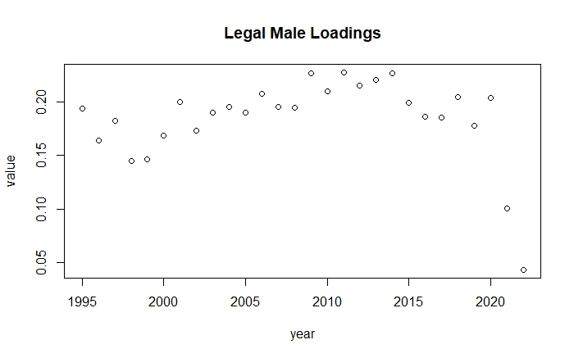
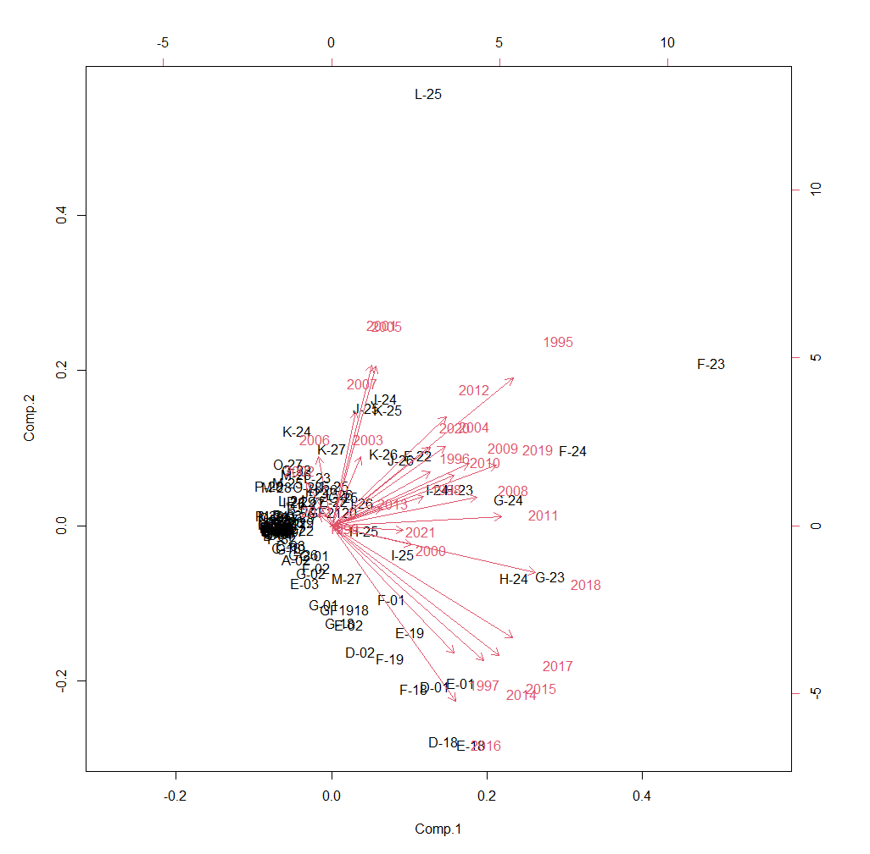
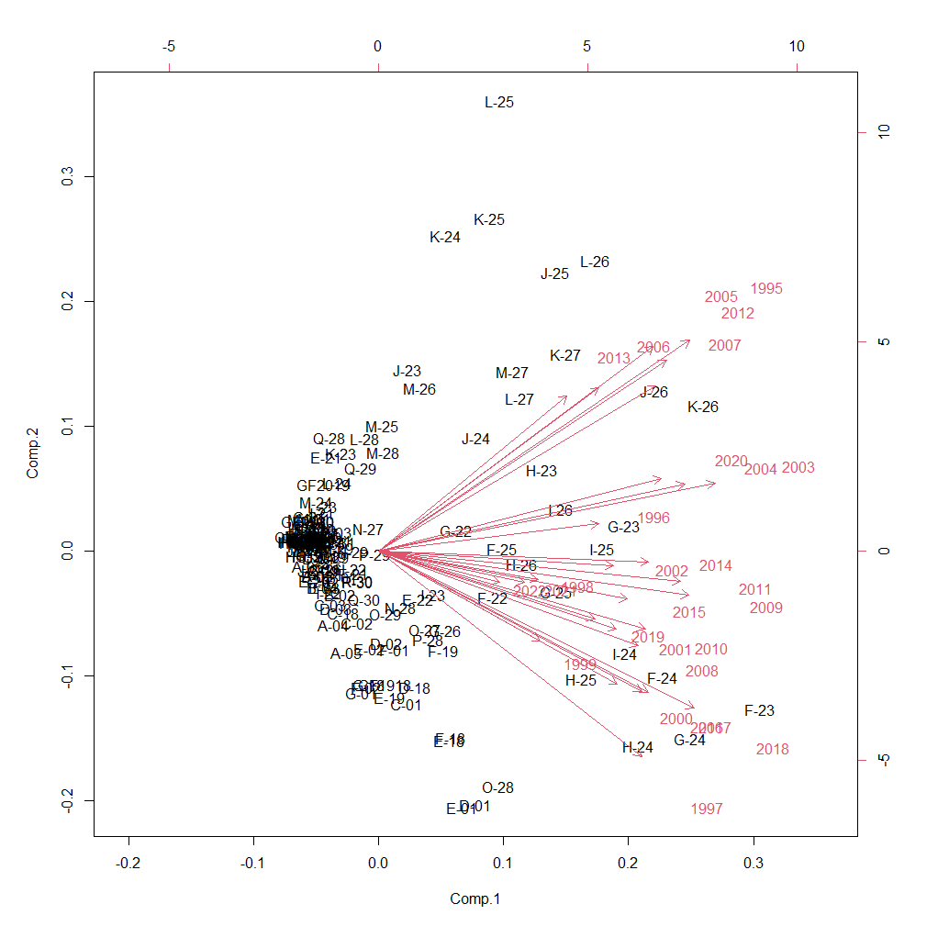
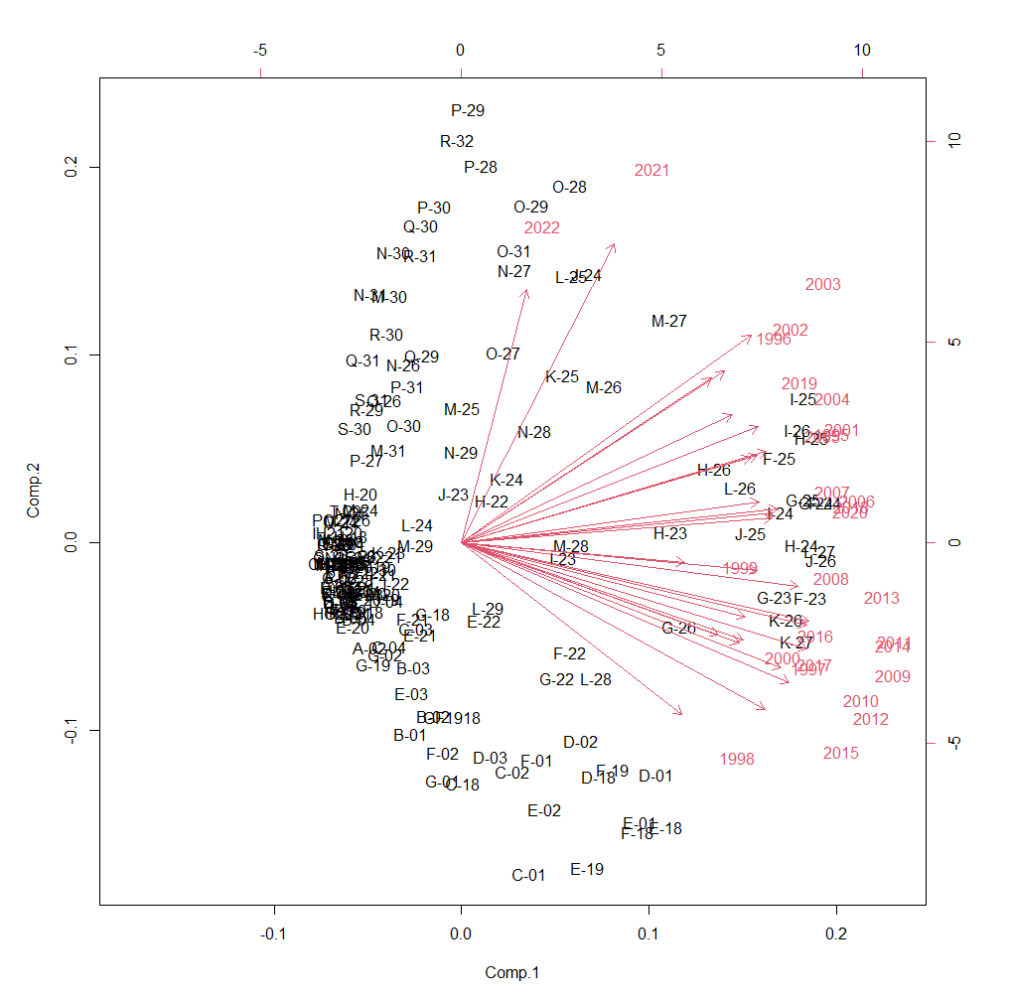
Observer PCA

Slide 3
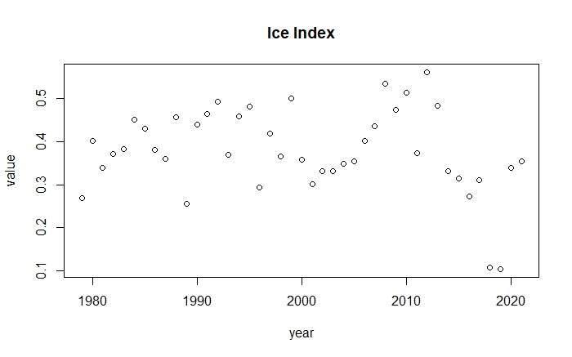

Slide 4
GAMs
Sex | Life Stage | Distribution | Formula | Deviance | R2 | Julian | Depth | Phi | Temperature | Ice | PCA
Female | Mature | Gaussian | year + s(lon, lat) + s(julian) + s(depth) | 44.10% | 0.38 | ^ | *
Female | Mature | Gaussian | year + s(lon, lat) + s(julian) + s(depth) + s(temp) + s(phi) + s(ice) | 44.70% | 0.39 | ^ | * | ^ | ^ | ^
Female | Mature | Gaussian | year + s(lon, lat) + s(julian) + s(depth) + s(temp) + s(phi) + s(ice) + s(lat, lon, by = PCA) | 47% | 0.4 | ^ | * | ^ | ^ | ^ | ^
Female | Mature | Tweedie | year + s(lon, lat) + s(julian) + s(depth) | 48.80% |  | * | **
Female | Mature | Tweedie | year + s(lon, lat) + s(julian) + s(depth) + s(temp) + s(phi) + s(ice) | 52.40% |  | * | ** | ** | ** | **
Female | Mature | Tweedie | year + s(lon, lat) + s(julian) + s(depth) + s(temp) + s(phi) + s(ice) + s(lat, lon, by = PCA) | 54.70% |  | * | ** | ^ | ** | ^ | **
Male | Legal | Gaussian | year + s(lon, lat) + s(julian) + s(depth) | 47.30% | 0.44 | ^ | ^
Male | Legal | Gaussian | year + s(lon, lat) + s(julian) + s(depth) + s(temp) + s(phi) + s(ice) | 50.70% | 0.47 | ^ | ^ | ** | ** | ^
Male | Legal | Gaussian | year + s(lon, lat) + s(julian) + s(depth) + s(temp) + s(phi) + s(ice) + s(lat, lon, by = PCA) | 54.50% | 0.5 | ^ | ^ | ** | ** | ^ | **
Male | Legal | Tweedie | year + s(lon, lat) + s(julian) + s(depth) | 39.60% |  | ** | **
Male | Legal | Tweedie | year + s(lon, lat) + s(julian) + s(depth) + s(temp) + s(phi) + s(ice) | 43.10% |  | ^ | ** | ** | ** | **
Male | Legal | Tweedie | year + s(lon, lat) + s(julian) + s(depth) + s(temp) + s(phi) + s(ice) + s(lat, lon, by = PCA) | 45.60% |  | ^ | ** | ** | ^ | * | **
Female | Immature | Gaussian | year + s(lon, lat) + s(julian) + s(depth) | 22% | 0.15 | ^ | ^
Female | Immature | Gaussian | year + s(lon, lat) + s(julian) + s(depth) + s(temp) + s(phi) + s(ice) | 28.30% | 0.19 | ^ | ^ | ^ | ^ | ^
Female | Immature | Gaussian | year + s(lon, lat) + s(julian) + s(depth) + s(temp) + s(phi) + s(ice) + s(lat, lon, by = PCA) | 28.40% | 0.18 | ^ | ^ | ^ | ^ | ^ | ^
Female | Immature | Tweedie | year + s(lon, lat) + s(julian) + s(depth) | 41.60% |  | ** | **
Female | Immature | Tweedie | year + s(lon, lat) + s(julian) + s(depth) + s(temp) + s(phi) + s(ice) | 43% |  | ** | ** | ^ | ^ | **
Female | Immature | Tweedie | year + s(lon, lat) + s(julian) + s(depth) + s(temp) + s(phi) + s(ice) + s(lat, lon, by = PCA) | 43% |  | ** | ** | ^ | ^ | ** | ^
Male | Sublegal | Gaussian | year + s(lon, lat) + s(julian) + s(depth) | 52.90% | 0.5 | * | ^
Male | Sublegal | Gaussian | year + s(lon, lat) + s(julian) + s(depth) + s(temp) + s(phi) + s(ice) | 55.20% | 0.52 | * | ^ | ^ | ** | ^
Male | Sublegal | Gaussian | year + s(lon, lat) + s(julian) + s(depth) + s(temp) + s(phi) + s(ice) + s(lat, lon, by = PCA) | 57.20% | 0.54 | * | ^ | * | ** | ^ | **
Male | Sublegal | Tweedie | year + s(lon, lat) + s(julian) + s(depth) | 45.90% |  | ** | **
Male | Sublegal | Tweedie | year + s(lon, lat) + s(julian) + s(depth) + s(temp) + s(phi) + s(ice) | 48.40% |  | ** | * | ^ | ** | **
Male | Sublegal | Tweedie | year + s(lon, lat) + s(julian) + s(depth) + s(temp) + s(phi) + s(ice) + s(lat, lon, by = PCA) | 50.40% |  | * | ^ | * | ** | * | **

Slide 5
BRTs
Sex | Life Stage | Tree Complexity | Learning Rate | Bag Fraction | Residual Deviance | CV Deviance | Training Correlation | CV Correlation | Trees
Female | Mature | 5 | 0.05 | 0.5 | 3.54 | 8.69 | 0.9 | 0.73 | 550
Female | Mature | 5 | 0.01 | 0.5 | 2.66 | 8.67 | 0.93 | 0.73 | 4150
Female | Mature | 3 | 0.01 | 0.5 | 4.49 | 8.88 | 0.87 | 0.72 | 3800
Female | Mature | 10 | 0.01 | 0.5 | 3.12 | 8.76 | 0.92 | 0.73 | 1350
Female | Mature | 5 | 0.01 | 0.75 | 3.2 | 8.74 | 0.92 | 0.72 | 2900
Female | Mature | 5 | 0.01 | 0.25 | 3.95 | 8.9 | 0.89 | 0.71 | 2950
Male | Legal | 5 | 0.05 | 0.5 | 2.54 | 4.34 | 0.85 | 0.72 | 250
Male | Legal | 5 | 0.01 | 0.5 | 2.42 | 4.41 | 0.86 | 0.71 | 1300
Male | Legal | 3 | 0.01 | 0.5 | 2.74 | 4.39 | 0.84 | 0.71 | 1950
Male | Legal | 10 | 0.01 | 0.5 | 2.09 | 4.31 | 0.88 | 0.72 | 750
Male | Legal | 5 | 0.01 | 0.75 | 2.32 | 4.33 | 0.87 | 0.72 | 1350
Male | Legal | 5 | 0.01 | 0.25 | 2.41 | 4.3 | 0.86 | 0.73 | 1700
Female | Immature | 5 | 0.05 | 0.5 | 2.77 | 4.41 | 0.73 | 0.45 | 200
Female | Immature | 5 | 0.01 | 0.5 | 2.76 | 4.37 | 0.73 | 0.47 | 950
Female | Immature | 3 | 0.01 | 0.5 | 3.1 | 4.45 | 0.68 | 0.45 | 1250
Female | Immature | 10 | 0.01 | 0.5 | 2.48 | 4.36 | 0.77 | 0.46 | 550
Female | Immature | 5 | 0.01 | 0.75 | 2.7 | 4.35 | 0.75 | 0.46 | 950
Female | Immature | 5 | 0.01 | 0.25 | 2.66 | 4.38 | 0.74 | 0.46 | 1400
Male | Sublegal | 5 | 0.05 | 0.5 | 3.09 | 4.94 | 0.82 | 0.68 | 200
Male | Sublegal | 5 | 0.01 | 0.5 | 2.92 | 4.8 | 0.83 | 0.69 | 1150
Male | Sublegal | 3 | 0.01 | 0.5 | 3.01 | 4.79 | 0.82 | 0.69 | 2100
Male | Sublegal | 10 | 0.01 | 0.5 | 2.36 | 4.76 | 0.87 | 0.7 | 800
Male | Sublegal | 5 | 0.01 | 0.75 | 2.54 | 4.78 | 0.86 | 0.69 | 1500
Male | Sublegal | 5 | 0.01 | 0.25 | 2.97 | 4.7 | 0.83 | 0.69 | 1350
Notes:
Included all terms except ice index

Slide 6
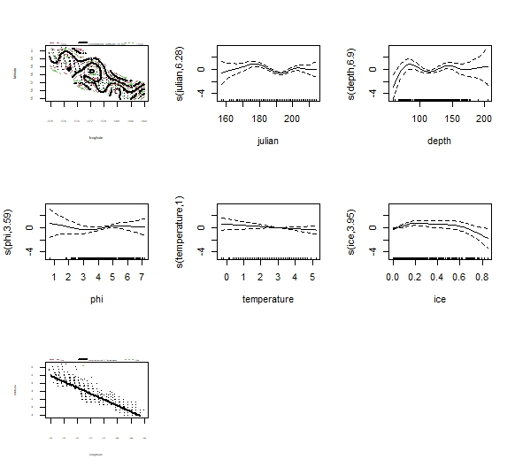
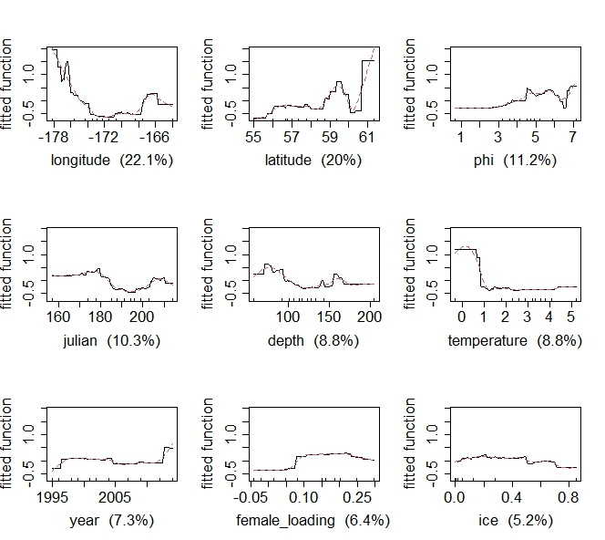
Immature Females
Tweedie GAM
Gaussian BRT

Slide 7
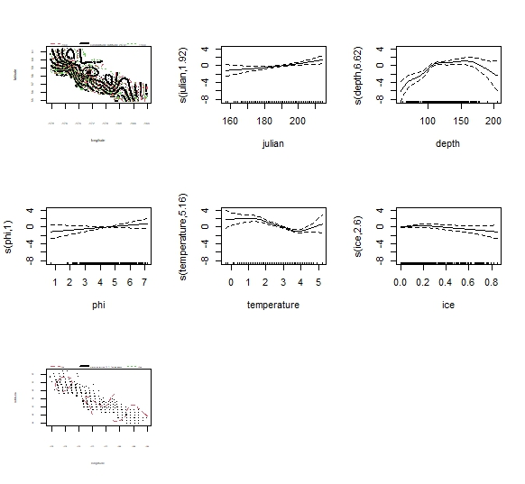
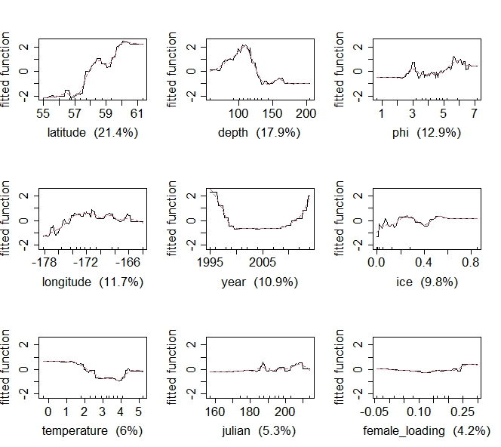
Mature Females
Tweedie GAM
Gaussian BRT

Slide 8
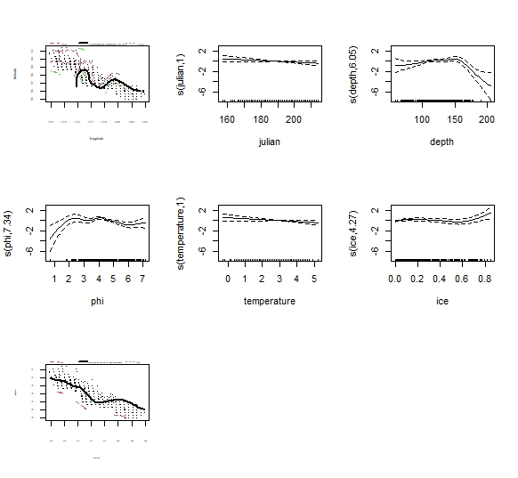
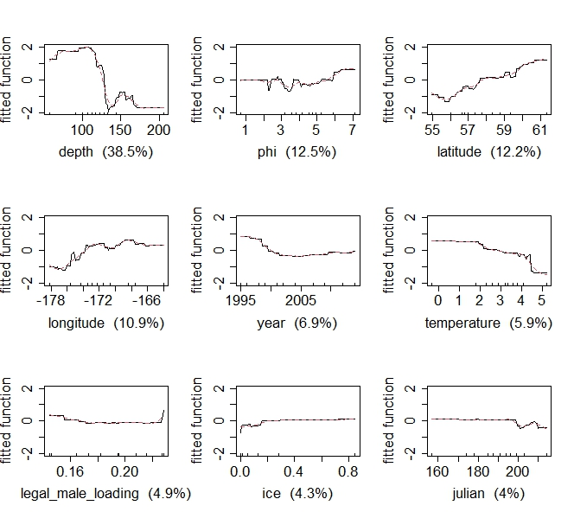
Legal Males
Tweedie GAM
Gaussian BRT

Slide 9
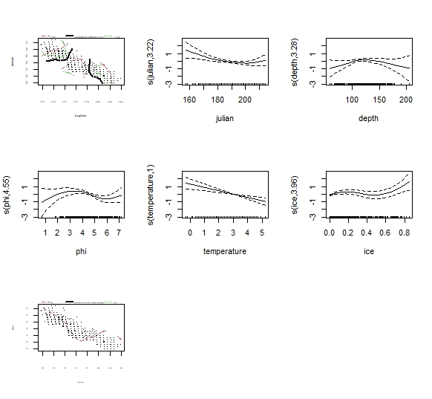
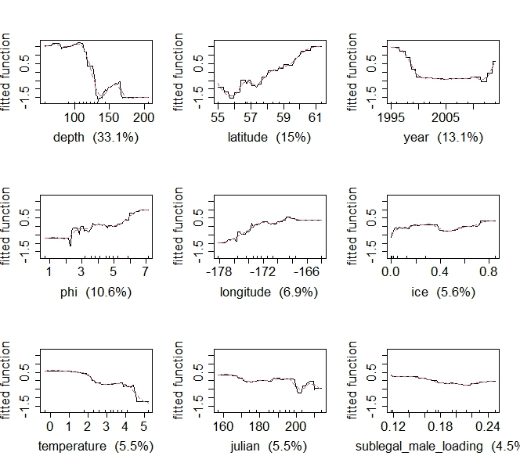
Sublegal Males
Tweedie GAM
Gaussian BRT

Slide 10
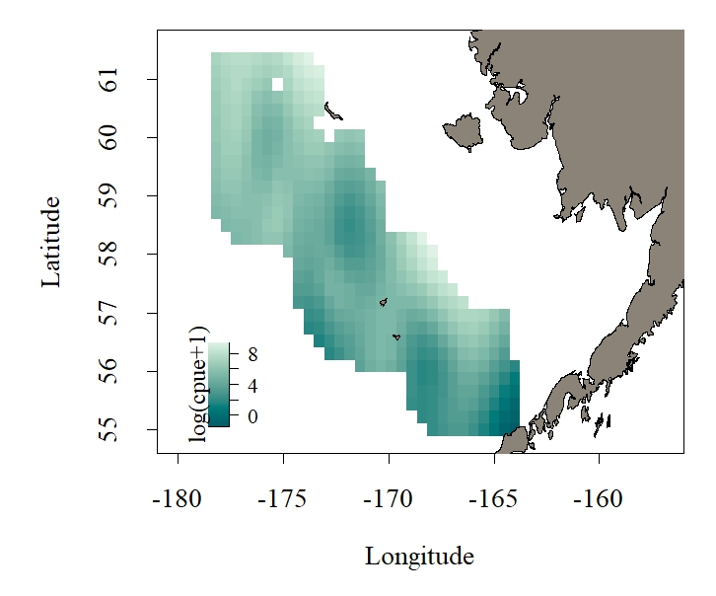
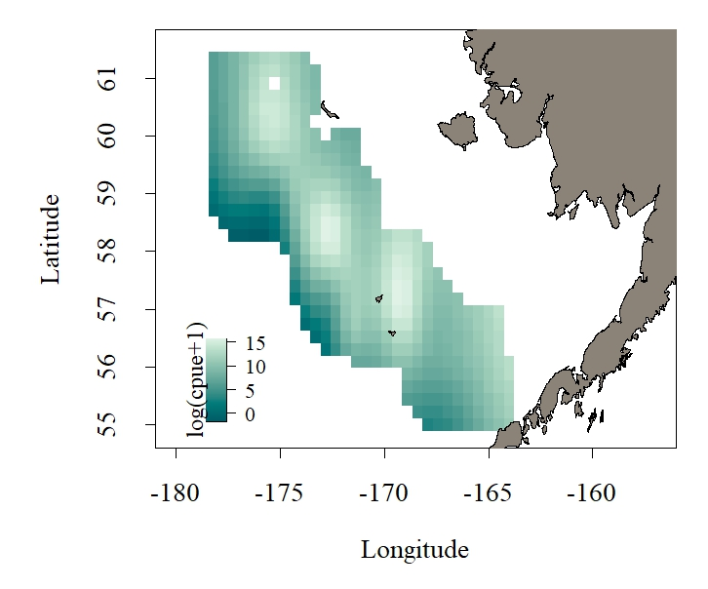
Female Tweedie GAMs
Immature Females
Mature Females

Slide 11
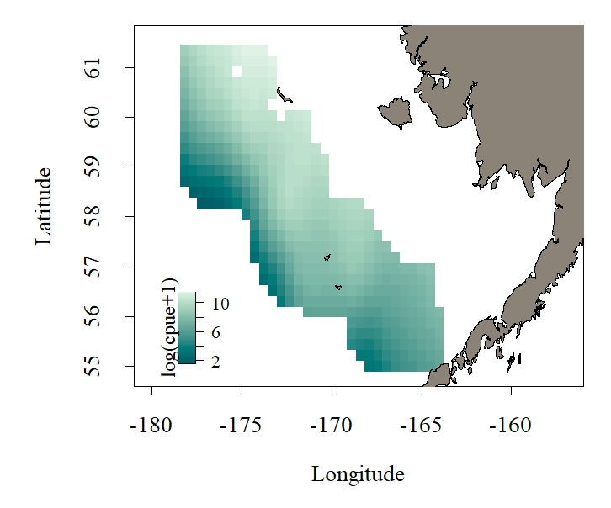
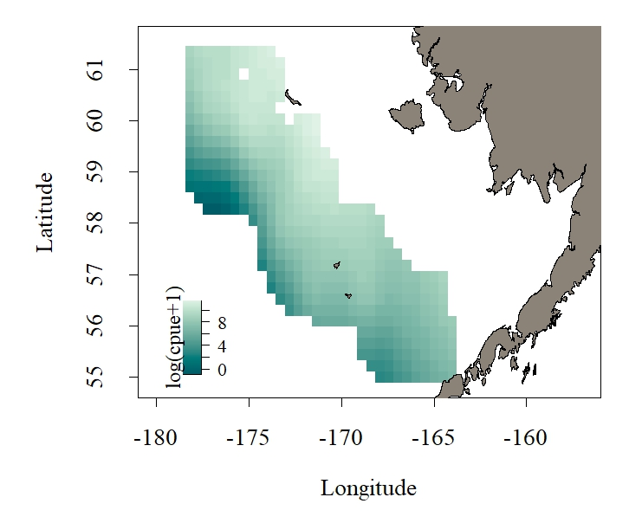
Male Tweedie GAMs
Sublegal Males
Legal Males

Slide 12
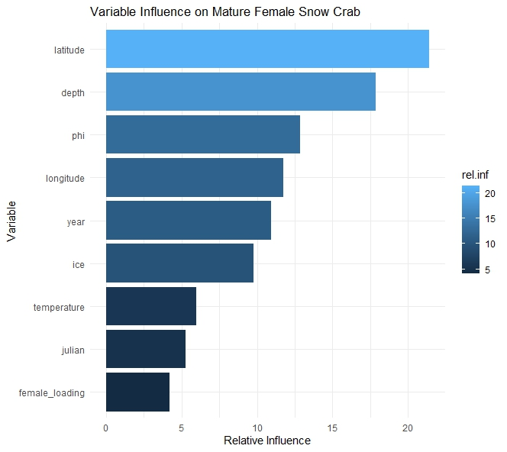
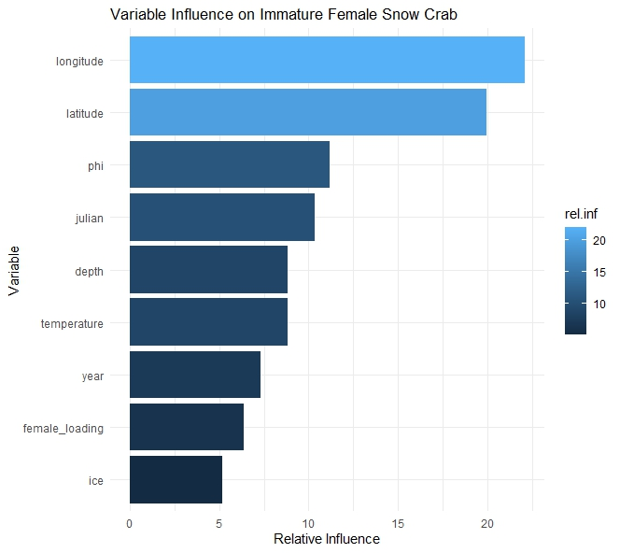
Female Gaussian BRTs

Slide 13
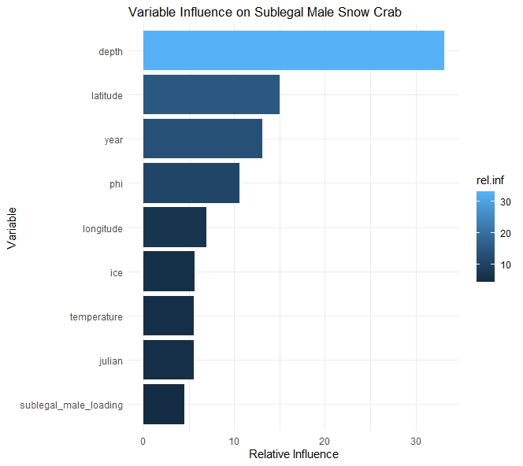
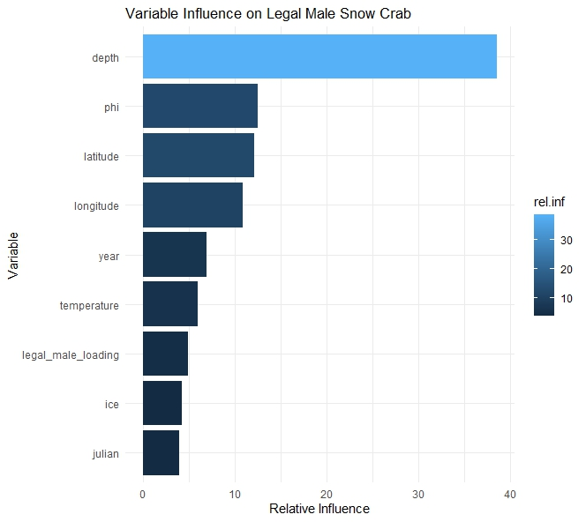
Male Gaussian BRTs

Slide 14
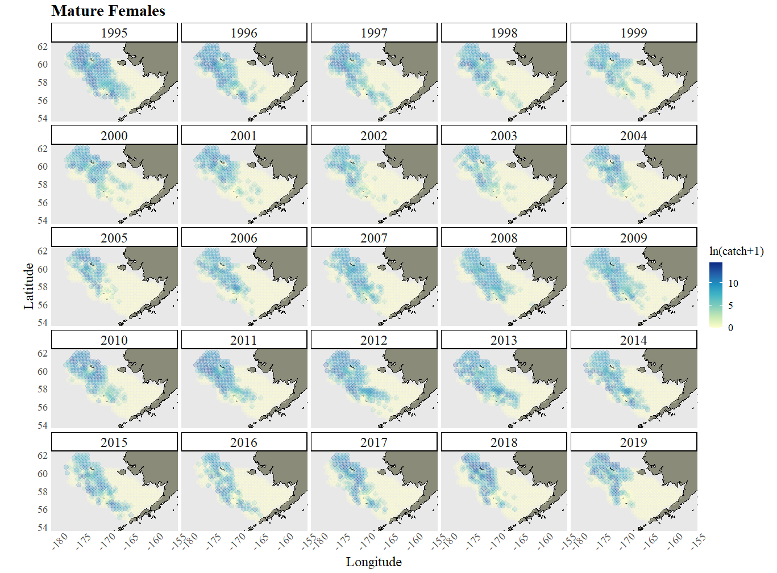
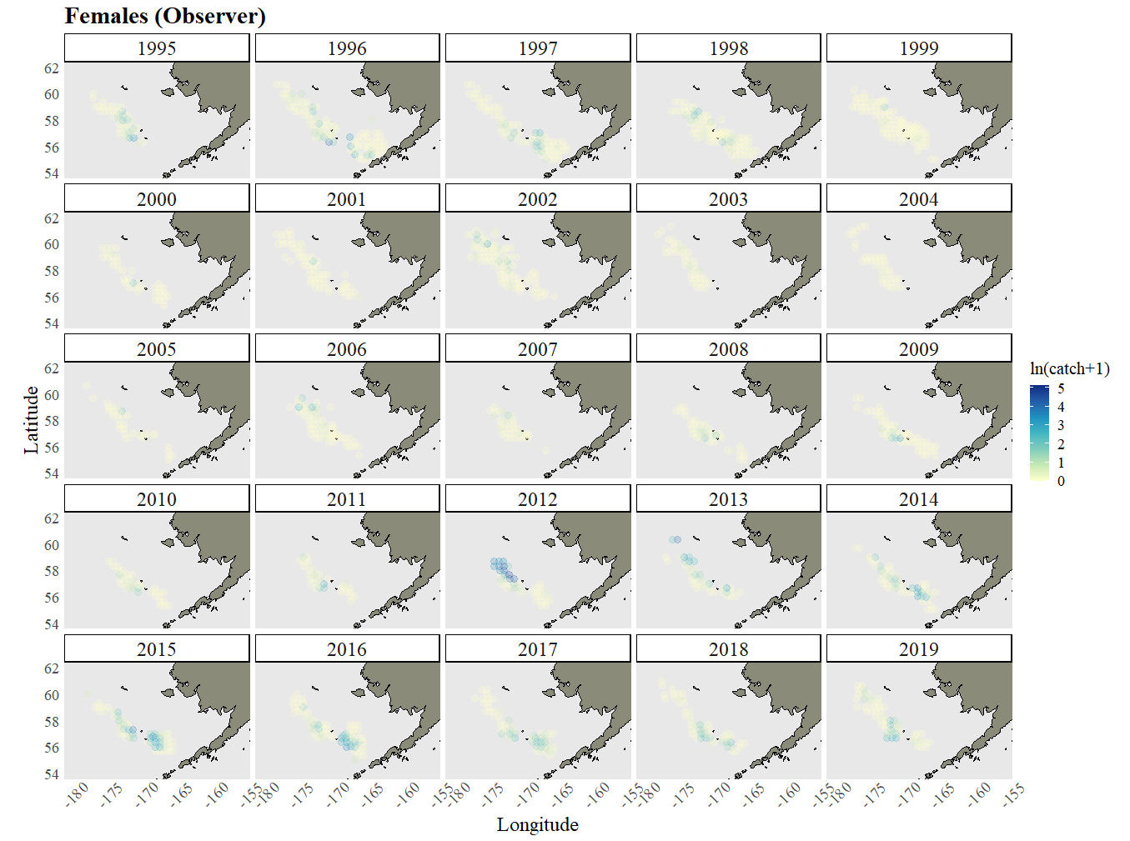

Slide 15
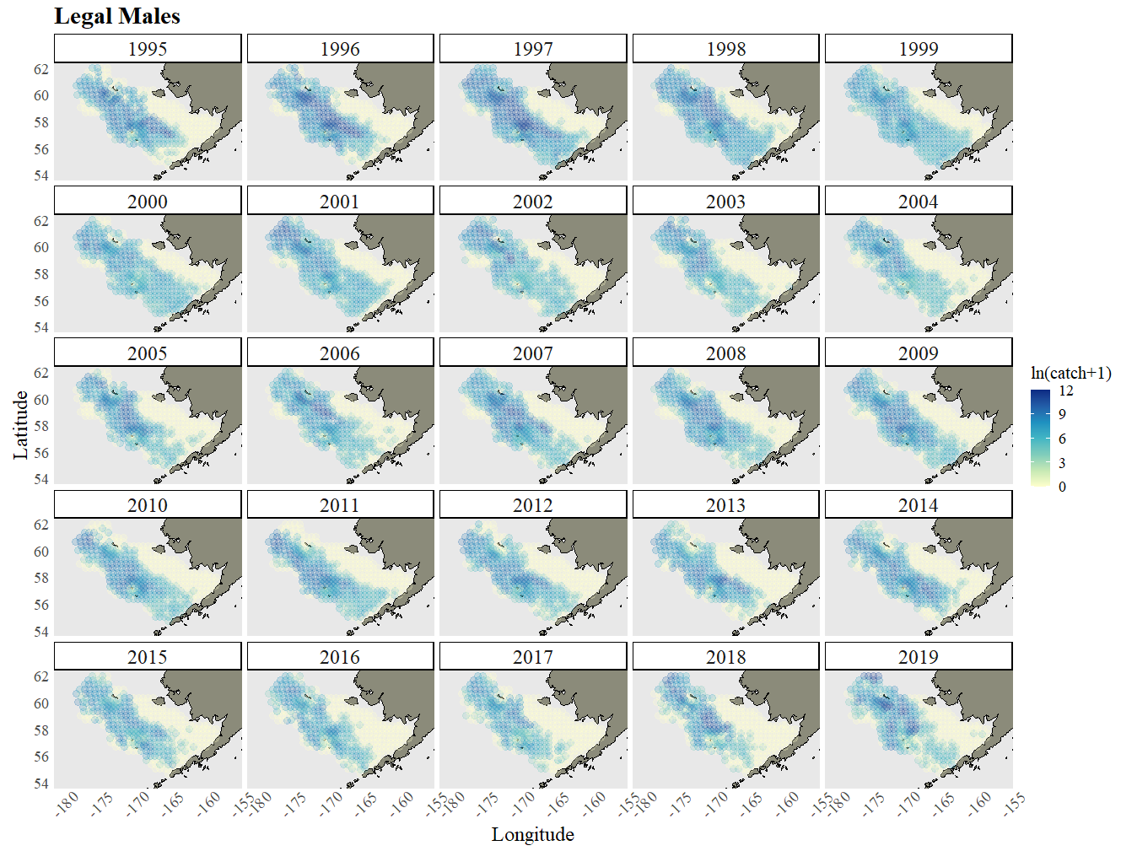
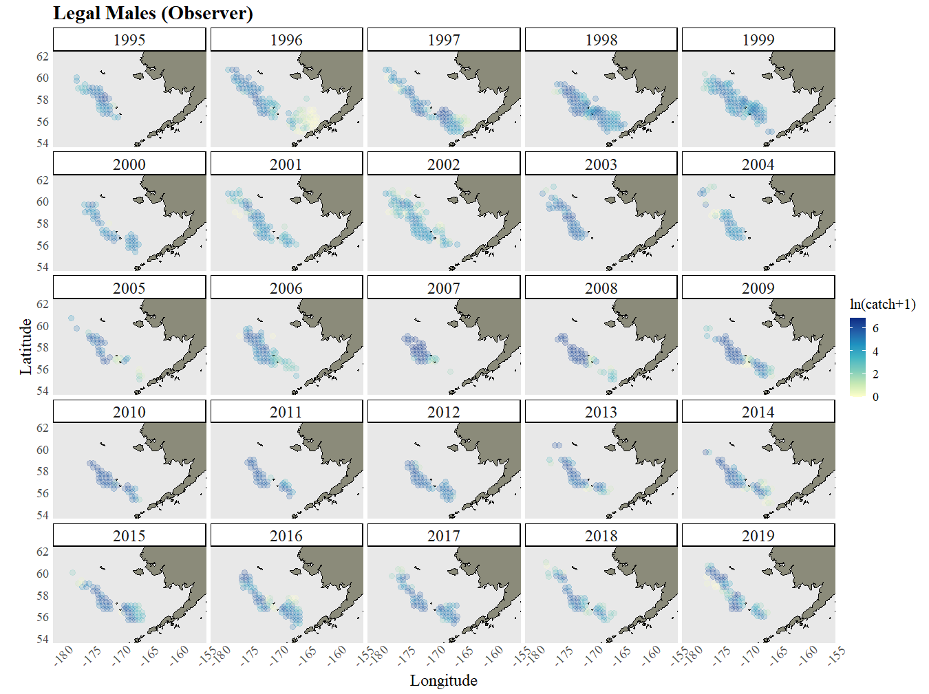

Slide 16
