Slide 1


One Student One Laptop (OSOL)
Dennis Goeken and Han Yang | Verl | Jun 2025

Slide 2
01
What is OSOL?
06
When OSOL - Schedule
02
Why OSOL?
07
OSOL Budget
Appendix A – OSOL-T database metadata
03
Related Resources
08
What OSOL will benefit to Riverty and Bertelsmann?
Appendix B – OSOL-T – why use queue?
04
09
10
Reference
05
How OSOL?

Slide 3
1. What is One Student One Laptop (OSOL)?
One Student One Laptop (OSOL) refurbishes donated, out-of-date IT equipment, including laptops, tablets, flat monitors, mouses, and keyboards. After cleaning and disinfecting the devices, we perform a factory reset. Where possible, we install ChromeOS Flex (a lightweight cloud-based operating system) and a selection of educational content. These refurbished devices are then loaned free of charge to students in developing countries to support their education and personal growth.

Slide 4
1. What is One Student One Laptop (OSOL)?
How OSOL stands out from other IT reuse organizations?
Education First: OSOL is dedicated to helping students by providing technology specifically for learning.
Sustainable Tech Use: Instead of just donating devices, OSOL recalls and replaces them annually, preventing e-waste and keeping technology up to date.
Free Lending Model: Unlike many organizations that sell or give away refurbished devices, OSOL lends them for free, making access more equitable.
Online Learning Recommendation: OSOL recomments students with trusted free online educational resources to improve learning.
Offline Access: For students without the Internet, OSOL pre-installs offline educational content and even an AI-powered local chatbot[1], ensuring they can still learn.

Slide 5
2.1. Why OSOL? - Education would change one life
Why Education is important?
Education can improve your health and well-being.
Education can increase your income and employment opportunities.
Education can enhance your social and civic participation.
Education can promote peace and justice.
How Education Can Empower Individuals and Communities?
Education can empower children and youth.
Education can empower marginalized groups.
Education can empower communities.

Slide 6
2.2. Why OSOL? – The Internet and Education
Unprecedented Access to Information
Enhanced Communication and Collaboration
Expanded Access to Educational Resources
Online Learning and Certification
Flexible Learning Environments
Beyond the Classroom
Cost-Effective Learning Opportunities

Slide 7
2.3. Why OSOL? – The Impact of Artificial Intelligence on Education
Personalized Learning Experiences
24/7 AI-Powered Assistance
Enhanced Learning and Reduced Errors
Streamlining Tasks and Fostering Independent Learning

Slide 8
3. Related Resources
One Laptop Per Child
Labdoo Deutschland
World Computer Exchange
Computer Aid International
Computer for School in Kenya
Camara Education
Close the Gap
Open Educational Resources
eGranary Digital Library
UNESCO

Slide 9

4. What OSOL will benefit Riverty and Bertelsmann?
Increased Brand Awareness
Brand Association with Education
Positive Brand Perception
Sustained Brand Visibility
Cost-Effective Advertising

Slide 10
5.1. How OSOL? - One IT equipment lifecycle

Slide 11
5.1.1. How OSOL? – Equipment stages
Stage 0 - In OSOL Depot
Stage 1 - In OSOL Shop
Hardware: basic repair, clean, disinfect
Software: factory reset, install ChromeOS Flex, install selected education content
Stage 2 - Distribution to Students
less than Grade6 or 12 years old: Tablet
from Grade7 or 13 years old): Laptop
Stage 3 - At Riverty Computer Centre (RCC)

Slide 12
5.1.2. How OSOL? – Equipment score
Each device have an integer score to express this device performance and usability.
Each model (cpu, gpu, laptop, tablet, mouse, keyboard, monitor) have an integer score to express this IT model performance.
The device score is decided by model score, production date and current equipment status.
Large score mentions high performance and good equipment status.

Slide 13
5.1.3. How OSOL? – Equipment annual check
Each year, we could decide on one device score for each equipment type; the device whose score is less than the current-year score will be disused.
The disused device will be collected and sent to Riverty Computer Centre (RCC).

Slide 14
5.2. OSOL 2D barcode on IT equipment
Stage 0 2D barcode data
Stage 1 2D barcode data
Stage 2 2D barcode data
Stage 3 2D barcode data

Slide 15
5.3. OSOL preinstalled education content
Online education content
Math-desmos
OpenAI ChatGPT
Google Gemini
Claude
Open Educational Resources Commons
Khan Academy
OpenStax
MIT OpenCourseWare
ResearchGate
arXiv
Offline education content

Slide 16
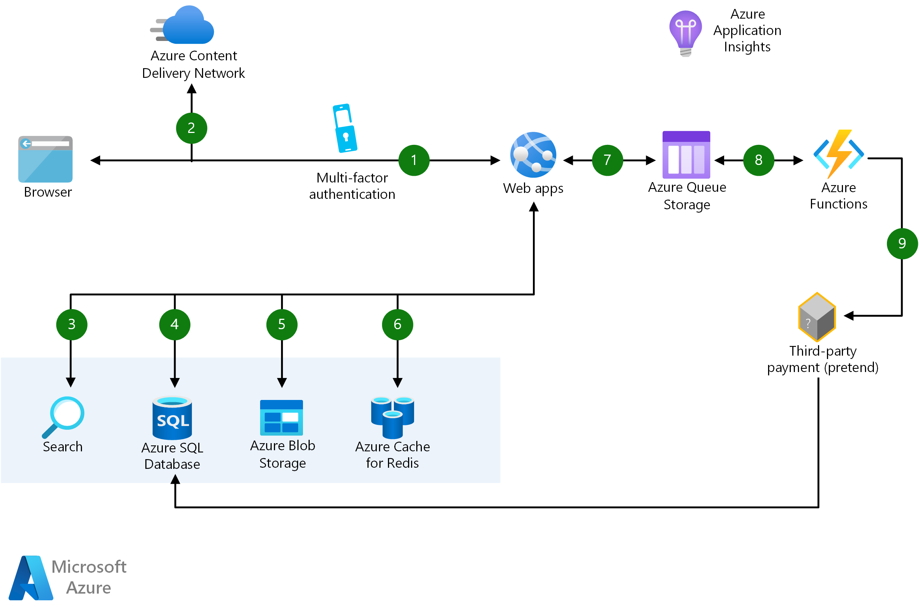
5.4.1. OSOL Tracer - Architecture

Slide 17
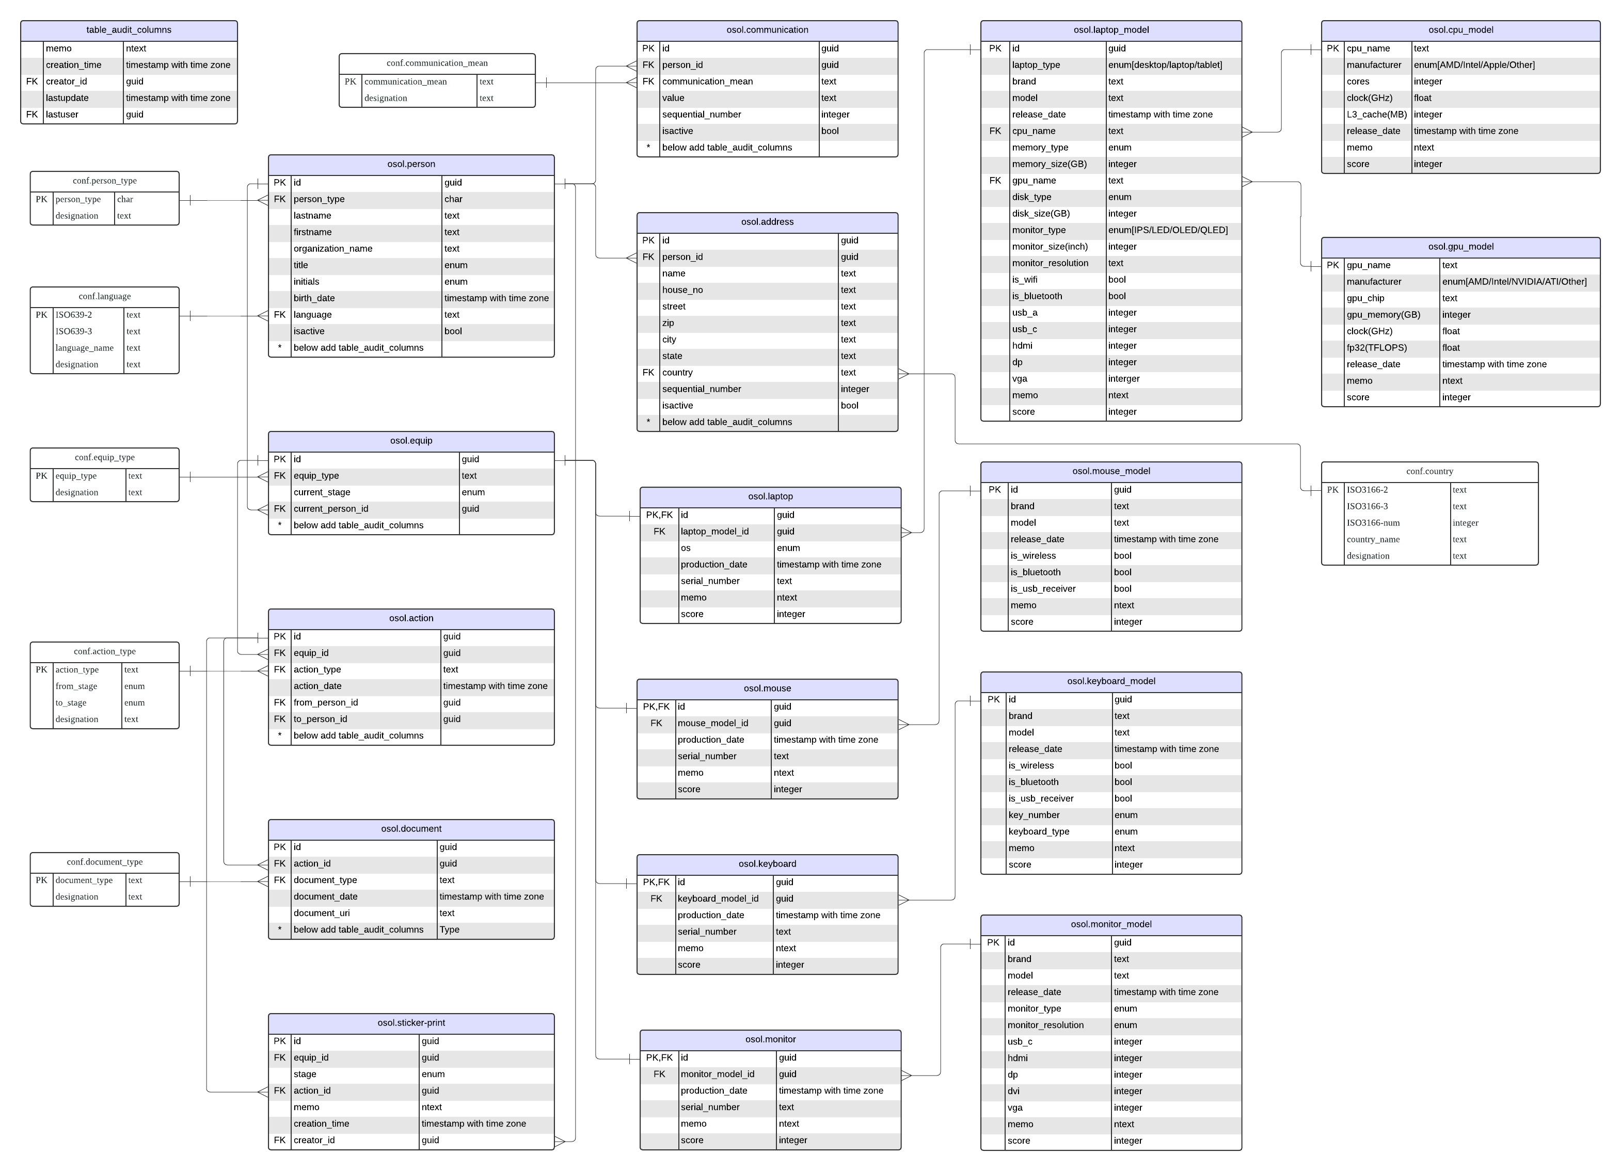
5.4.2. OSOL-T Database

Slide 18
5.4.3. OSOL-T API
OSOL-T API is Restful API for each database object CRUD operations.
OSOL-T API will be deployed as MS Azure Function

Slide 19
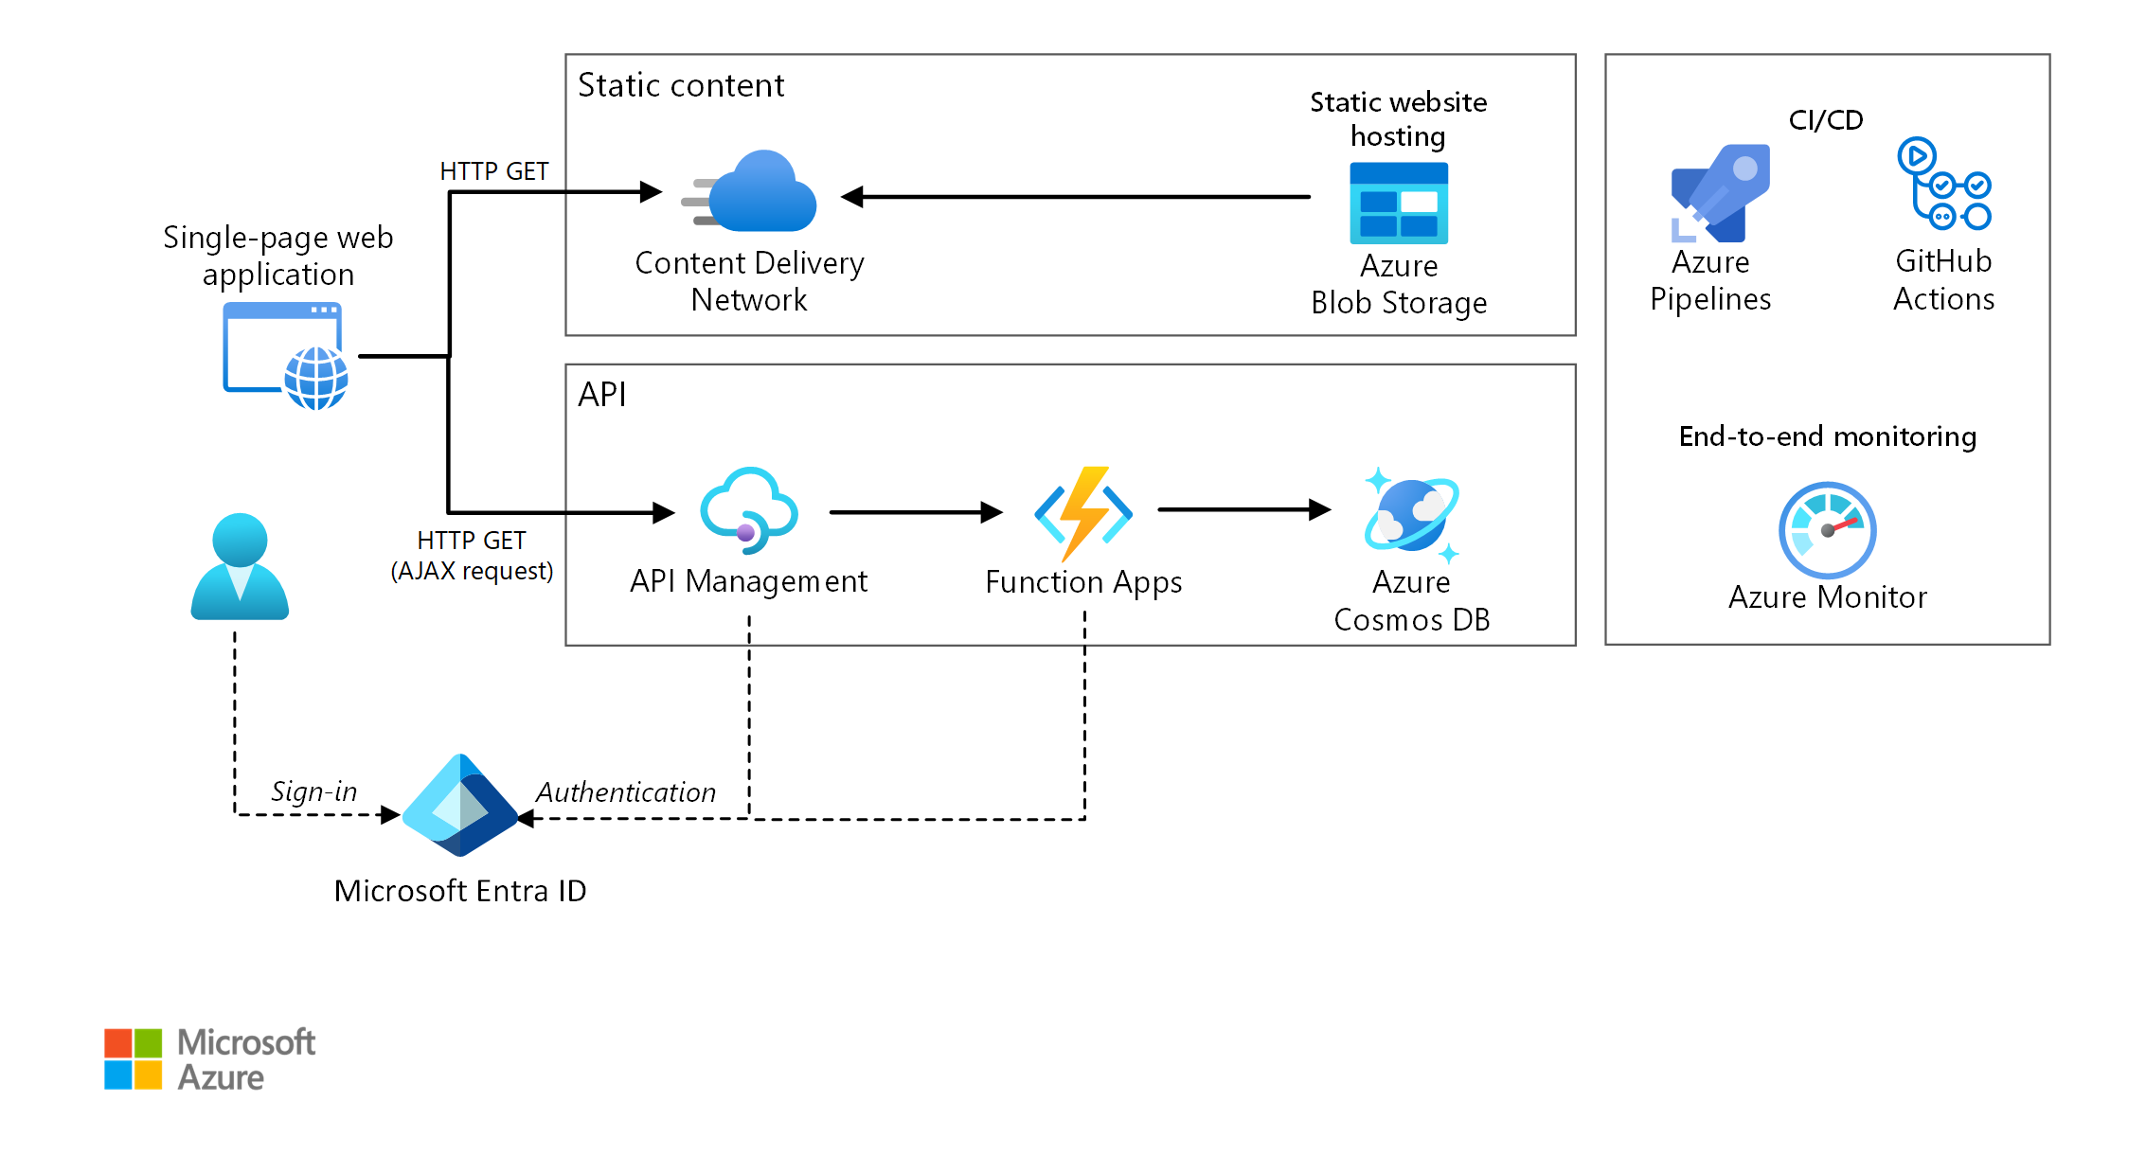
5.4.4. OSOL-T API Management

Slide 20
5.4.5. OSOL-T GUI
Multi-Platform - mobile, web - will be implemented with Flutter/Dart
Search
Equip page (CRUD)
(a) Laptop page (CRUD)
CPU page (CRUD)
GPU page (CRUD)
(b) Monitor page (CRUD)
(c) Keyboard page (CRUD)
(d) Mouse page (CRUD)
Person page (CRUD)
Address page (CRUD)
Communication page (CRUD)
Action page (CRUD)
Print equip stage 2D barcode sticker from one action page
Document page (CRUD)
Scan 2D barcode, show data
AI-powered chatbot

Slide 21
5.5. Riverty Computer Centre (RCC)
The RCC provides centralised computing power and data storage for Riverty by repurposing older, end-of-life IT equipment.

Slide 22
5.6. General Rules
OSOL provides IT equipment to students and schools free of charge.
OSOL retains ownership of all provided IT equipment.
In the event that equipment is lost, the student or school will not be charged. However, a replacement will only be provided when the lost item was scheduled to be recalled, typically after 2 to 3 years.

Slide 23
6. When OSOL - Schedule
Step1:
One place to store these out-of-date IT equipment.
Two persons to confirm and monitor each other.

Slide 24
7. OSOL Budget

Slide 25
Appendix A. OSOL–T database metadata

Slide 26
Appendix B. OSOL–T architecture – why use queue?

Slide 27
References
Gpt4all documentation. https://docs.gpt4all.io/index.html, 2024.
Nwabugwu. How education can change your life and the world: A guide to unlocking your potential and fulfilling your purpose. https://araceliaidfoundation.org/education/how-education-can-change-your-life-and-the-world-a-guide-to-unlocking-your-potential-and-fulfilling-your-purpose/.
Kumar Shivam. How the internet is beneficial to students. https://www.21kschool.com/in/blog/how-the-internet-is-beneficial-to-students/.
Jeff Schultz. How much data is created on the internet each day? https://blogs.opentext.com/how-much-data-is-created-on-the-internet-each-day/, 8 2019.
Khadga Niraula. School students’ experience of using the internet. https://www.researchgate.net/publication/373499349 School Students’ Experience of Using the Internet, 07 2023.
The Internet and why it’s beneficial for students. https://coniferinternet.com/the-internet-and-beneficial-for-students/.
The importance of reliable internet for students. https://www.e8internet.com/blog-post/the-importance-of-reliable-internet-for-students.
Skyler Watkins. Role of the internet in education. https://www.grantford.org/post/role-of-the-internet-in-education.
Ai in education. https://www.21kschool.com/in/pillar/ai-in-education/.
Wikipedia. One Laptop per Child — Wikipedia, the free encyclopedia. http://en.wikipedia.org/w/index.php?title=One%20Laptop%20per%20Child&oldid=1272725415,2025.
Wikipedia. World Computer Exchange — Wikipedia, the free encyclopedia. http://en.wikipedia.org/w/index.php?title=World%20Computer%20Exchange&oldid=1272801766, 2025.
Education transforms lives. https://www.unesco.org/en/education.
Artificial intelligence. https://www.unesco.org/en/artificial-intelligence.
Andrew Harvey. Architect scalable e-commerce web app. https://learn.microsoft.com/en-us/azure/architecture/web-apps/idea/scalable-ecommerce-web-app.
Serverless web application. https://learn.microsoft.com/en-us/azure/architecture/web-apps/serverless/architectures/web-app.

Slide 28
Questions?
Thank You For Attendance!

