Slide 1



AGENTIC WORKFLOW
RheinWeg: Agentic End-to-End Software Development Workflow
Software Development with AI agent end-to-end support, AFK methodology and agents orchestration
Han Yang

Slide 2









Software Development with AI agent end-to-end support
Demo
Agenda
Software developer main task in AI agent era
Memory support AI personal assistant
AI Agentic Workflow
FDE for AI agentic end-to-end
Development team culture in AI agent era
Tips
rheinweg
02

Slide 3
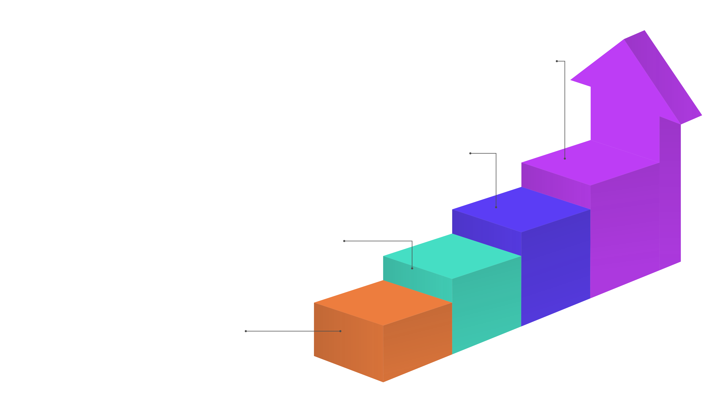
Our Lifecycle Shifts
Maintenance & Resolution
Bug fixes and routine maintenance handled via AI-guided diagnostics to minimize downtime.
AI agents transition production from manual labor to high-integrity automated delivery.
Architectural Enhancements
Agents assist in continuous refactoring and improvements for high-quality software architecture.
AFK Implementation
The AI executes the "Away From Keyboard" method, creating production code.
Analysis & Spec
AI skills translate financial requirements into actionable specifications.
rheinweg
03

Slide 4
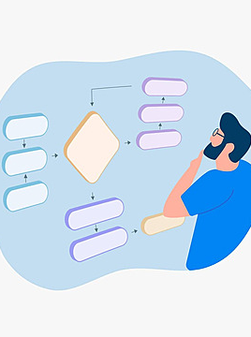
PRODUCT DEMO
Demo
rheinweg
04

Slide 5
Engineers now master AI agents orchestration over coding
Specifications is the Code
Prompt and Skill Fine-tuning
The primary daily output is now specs that AI agents translate into production code.
Enhance skills and prompts to align with company standards of code conduct and responsibility.
Workflow Orchestration
Managing interaction between AI agents to create a seamless, end-to- end development pipeline.
The primary daily output is now clean, high- quality specifications that AI agents can translate into high-quality production code.
rheinweg
05

Slide 6



A Second Brain AI agent
Persistent Memory
Obsidian keeps context and decisions across sessions, so knowledge compounds.
Memory-supported AI agents remember your context, decisions, and preferences to personalize every single interaction.
Personal Assistant
Each person gets a tailored agent that knows their projects, standards, and history. AI agent Microsoft 365 plugin will provide
AI support on daily work.
Shared Knowledge
A shared Second Brain captures team expertise, so onboarding is effortless.
rheinweg
06

Slide 7
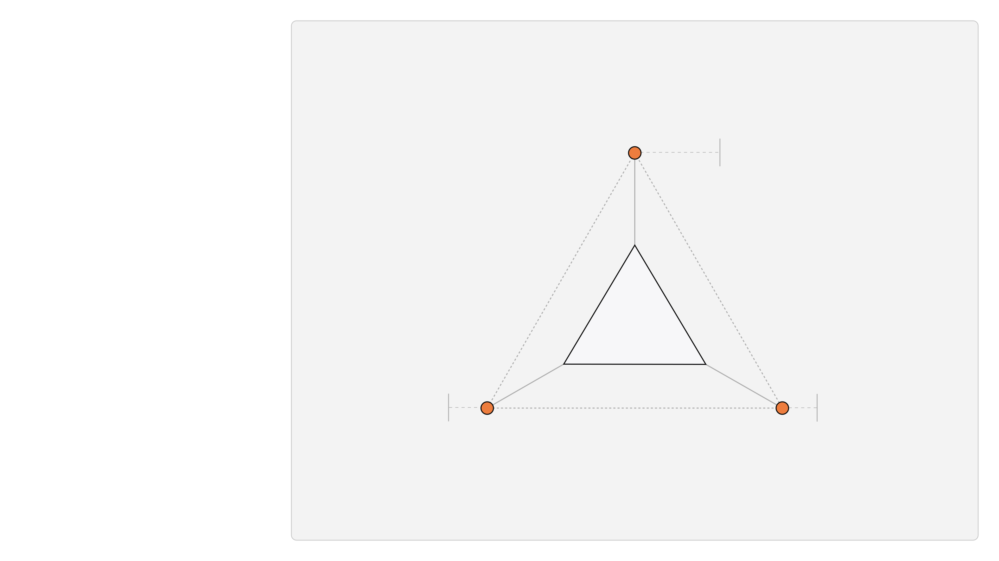
Wrap a recurring job in a saved prompt and run it on a schedule.
Scheduled Prompt Tasks
AUTOMATION
Three ways to automate
Automation Methods
Agent Workflow Tools
Repeated Work Skills
Run end-to-end processes through AI-agent platforms like n8n.
Encode the steps you repeat most as a reusable agent skill.
rheinweg
07

Slide 8

Forward Deployed Engineers for AI agents
1
2
3
4
Train AI Agent Experts
Embed With the Team
Build & Integrate
Bridge to the RheinWeg
Integrate components directly into the client squad to ensure alignment.
Develop and snap-in modular solutions into the existing tech ecosystem.
Develop specialized expertise in AI agent frameworks and model training.
Finalize integration and establish the path for sustained deployment.
rheinweg
08

Slide 9
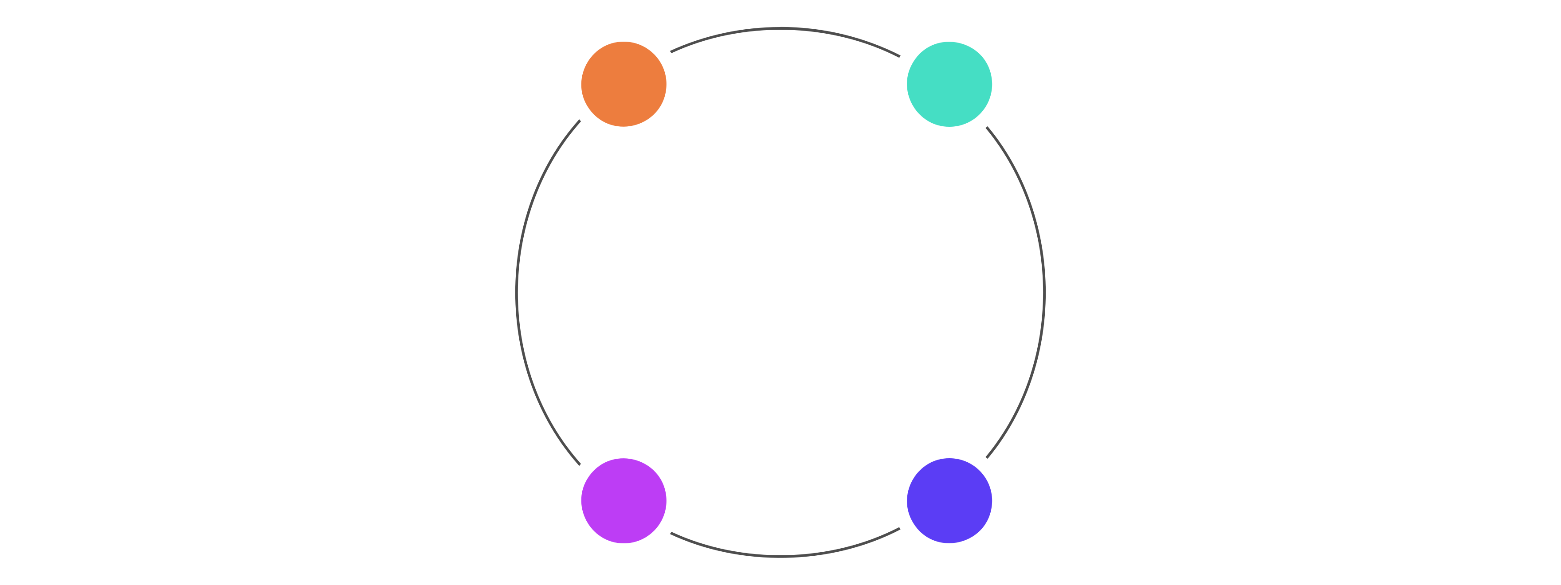




Foster a Culture of the AI agent era - 1
AI-First Mindset
Continuous Learning
Always consider how AI can assist, automate, or optimize your daily work.
Commit to ongoing personal and professional growth to keep your skills sharp.
Rapid Adaptation
Change Agility
Thrive in a fast-evolving landscape by quickly adjusting to new technologies, teams,
and strategies.
Expect shifts and proactively prepare yourself to pivot whenever necessary.
rheinweg
09

Slide 10
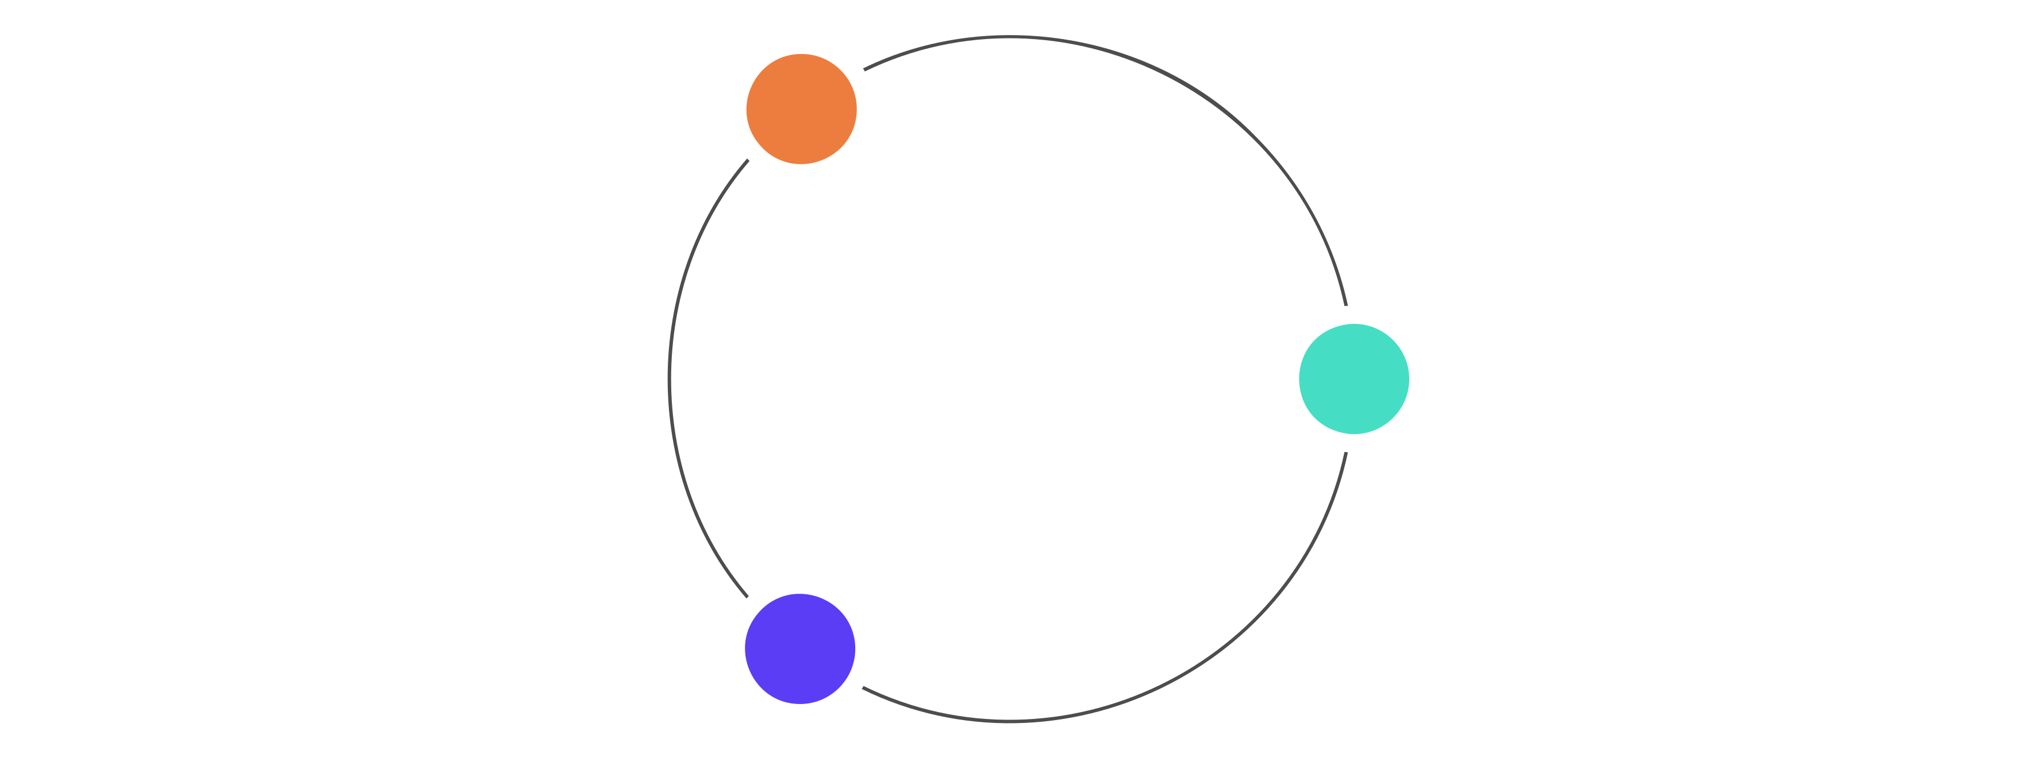

Foster a Culture of AI agent era - 2
Pragmatic Execution
Prioritize modular components that deliver immediate, measurable utility over over- engineered builds.
Frictionless UX
Design snap-in workflows that minimize complexity for the end- user while maximizing system performance.
Radical Openness
Maintain a transparent ecosystem where code and decisions are shared to accelerate collective learning.
rheinweg
10

Slide 11








Restart Claude
Use /handoff
Plugins and hooks
Prompt generation
Save tokens, avoid hallucinations.
Export content to docs as needed.
Leverage Caveman, rtk for tokens.
Let the LLM generate the prompt.
Tips for Claude Development
Testing
Git workflow
Use a container
Manage plugins
Use unit/e2e tests for stability.
Use Git worktrees or branches.
Run AFK in a container.
Disable unused Claude plugins.
rheinweg
11

Slide 12



Vision of next AI era development
Thank you for the discussion on the vision of next AI era development
Software Development with AI agent end-to- end support
AFK methodology
Agents orchestration
rheinweg
12

