Slide 1


Specialist Myeloma Nurse
Elranatamab

Slide 2

I would like to acknowledge the Traditional Custodians of country throughout Australia, and recognise their continuing connection to land, waters and culture. We pay our respects to their Elders past, present and emerging.
Notes:
Good morning, and thank you to Members and
Senators for joining us.
Today, we speak on behalf of more than 22,000 Australians living with multiple myeloma — an incurable blood cancer that remains too often invisible until it is advanced.
A further 348,000 live with precursor conditions
MGUS and SMM.

Slide 3






Learning outcomes
Understand mode of action
Describe patient considerations and eligibility criteria
Outline the administration and scheduling
Understand supportive care considerations
Understand side effects and management
Notes:
2

Slide 4

Mode of action
Elranatamab is a bispecific T-cell engager.
Attaches to B-cell maturation antigen (BCMA) on myeloma cells, and the CD3 receptor on T-cells.
Links the two cells together, allowing the T-cells to release cytokines and enzymes to destroy the myeloma cell.

Slide 5
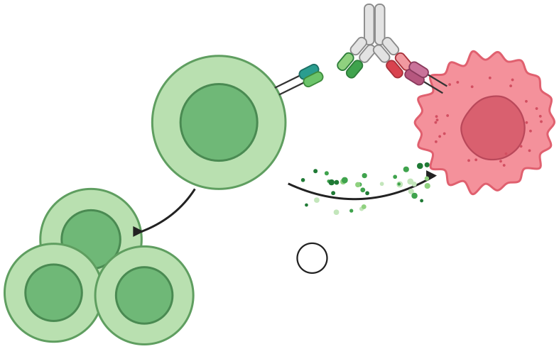
1
Bispecific antibody binding to T cells and tumour cells
T cell
Myeloma cell
CD3
BCMA
3
Myeloma cell death
2b
Activated T cells release cytokines, Granzyme B and perforin
2a
T cells are activated and proliferate
Notes:
Bispecific T cells engagers also called bispecific antibodies are man-made molecules that consist of two components
The first component is an antibody that can recognise and bind to the myeloma cell on the BCMA (B-Cell Maturating Antigen )receptor.
The second antibody component can recognise and bind to the T-cells via the CD3 receptor
BCMA is mostly found on myeloma cells and only small amounts are found on healthy cells. This means Elranatamab can target mostly myeloma cells directly, with less effect on healthy cells.
So to summarise: you have a Tumour specific antibody and a T-cell specific antibody that are linked together like two arms
One arm links to the T-cell and one arm links to the cancer cell
This allows our T-cells to release cytokines and enzymes into the myeloma cell and destroy it
3

Slide 6
Eligibility
To receive elranatamab on the PBS, patients must have had at least 3 lines of therapy including:
Proteasome inhibitor (bortezomib or carfilzomib)
Immunomodulatory agent (lenalidamide or pomalidamide)
Anti-CD38 monoclonal antibody (daratumumab)
Notes:
Myeloma is a disease of plasma cells.
Plasma cells are B cells which form a valuable part of the immune system.
They work with T cells to produce antibodies that fight pathogens.
Treatment for myeloma often weakens the immune system as it targets both good and cancerous immune cells.
Additionally, some treatments may lower your response to previous vaccinations, particularly Stem Cell transplant or CAR T-Cell Therapy.
Whilst Vaccination recommendations are standardized, its important to remember that the risk of different types of infections depends on your social and physical environment.
ie) adult working from home alone vs adult working in busy childcare center.
3

Slide 7
Patient considerations
Patient preference
Patient location
Admission time in metropolitan hospital during step-up doses
Monitoring requirements throughout treatment
Past medical history, particularly neurological comorbidities
Carer availability ongoing
Prior exposure to BCMA targeting therapies
Higher disease burden = higher risk of toxicities
Infection risk
Notes:
Myeloma is a disease of plasma cells.
Plasma cells are B cells which form a valuable part of the immune system.
They work with T cells to produce antibodies that fight pathogens.
Treatment for myeloma often weakens the immune system as it targets both good and cancerous immune cells.
Additionally, some treatments may lower your response to previous vaccinations, particularly Stem Cell transplant or CAR T-Cell Therapy.
Whilst Vaccination recommendations are standardized, its important to remember that the risk of different types of infections depends on your social and physical environment.
ie) adult working from home alone vs adult working in busy childcare center.
3

Slide 8

Supply
Elranatamab is supplied as:
44mg/ 1.1ml vial
76 mg/1.9 mL vial
Ready to use solution, no dilution required
No dose changes for mild/moderate renal or hepatic impairment
Elrexfio®
Notes:
Myeloma is a disease of plasma cells.
Plasma cells are B cells which form a valuable part of the immune system.
They work with T cells to produce antibodies that fight pathogens.
Treatment for myeloma often weakens the immune system as it targets both good and cancerous immune cells.
Additionally, some treatments may lower your response to previous vaccinations, particularly Stem Cell transplant or CAR T-Cell Therapy.
Whilst Vaccination recommendations are standardized, its important to remember that the risk of different types of infections depends on your social and physical environment.
ie) adult working from home alone vs adult working in busy childcare center.
3

Slide 9





Step-up dosing schedule
Administering premedication is recommended prior to each of these 3 doses (details on next slide)
Week 1: Two step-up doses
Week 2: First full treatment dose
Day 1
Day 4
Day 8
+
+
+
12 mg
(0.3 mL)
32 mg
(0.8 mL)
76 mg
(1.9 mL)
A minimum of 2 days should be maintained between step-up doses
Due to the risk of severe reactions, patients should be hospitalised for 48 hours after administration of the first step-up dose, and for 24 hours after administration of the second step-up dose
A minimum of 3 days should be maintained between step-up dose 2 (32 mg) and the first full treatment dose
Weekly dosing
Q2W dosing
Q4W dosing
Week 3 through
Week 24
Week 25 and every 2 weeks thereafter in responding patients
Week 49 and every 4 weeks thereafter in responding patients
76 mg
(1.9 mL)
76 mg
(1.9 mL)
76 mg
(1.9 mL)
A minimum of 6 days should be maintained between full treatment doses
In patients who maintained a response following ≥24 weeks of weekly dosing
In patients who maintained a response following ≥24 weeks of Q2W dosing
Notes:
Myeloma is a disease of plasma cells.
Plasma cells are B cells which form a valuable part of the immune system.
They work with T cells to produce antibodies that fight pathogens.
Treatment for myeloma often weakens the immune system as it targets both good and cancerous immune cells.
Additionally, some treatments may lower your response to previous vaccinations, particularly Stem Cell transplant or CAR T-Cell Therapy.
Whilst Vaccination recommendations are standardized, its important to remember that the risk of different types of infections depends on your social and physical environment.
ie) adult working from home alone vs adult working in busy childcare center.
3

Slide 10
Premedication
Required 1 hour prior to administration:
Dexamethasone 20mg – oral or IV
Paracetamol 1000mg – oral
Loratadine 10mg – oral
First 3 doses only - No routine premedications from C1D15 onwards
Notes:
Myeloma is a disease of plasma cells.
Plasma cells are B cells which form a valuable part of the immune system.
They work with T cells to produce antibodies that fight pathogens.
Treatment for myeloma often weakens the immune system as it targets both good and cancerous immune cells.
Additionally, some treatments may lower your response to previous vaccinations, particularly Stem Cell transplant or CAR T-Cell Therapy.
Whilst Vaccination recommendations are standardized, its important to remember that the risk of different types of infections depends on your social and physical environment.
ie) adult working from home alone vs adult working in busy childcare center.
3

Slide 11
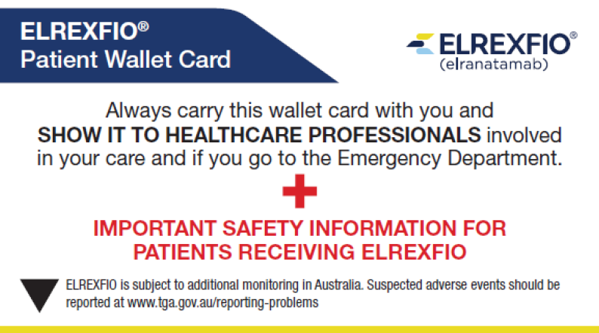
Pretreatment assessment
Check pathology results
Check pre-medications taken
Check patient observations
Perform ICANS assessment
Any new toxicities or issues to report since last dose?
Check patient is, or will be, started on immunoglobulin replacement therapy
Ensure patient has wallet card
Notes:
Myeloma is a disease of plasma cells.
Plasma cells are B cells which form a valuable part of the immune system.
They work with T cells to produce antibodies that fight pathogens.
Treatment for myeloma often weakens the immune system as it targets both good and cancerous immune cells.
Additionally, some treatments may lower your response to previous vaccinations, particularly Stem Cell transplant or CAR T-Cell Therapy.
Whilst Vaccination recommendations are standardized, its important to remember that the risk of different types of infections depends on your social and physical environment.
ie) adult working from home alone vs adult working in busy childcare center.
3

Slide 12
Storage and preparation
Use aseptic technique
Store vial between 2 - 8 °C
Inspect the solution and vial prior to administration (do not shake)
Withdraw the required volume from the vial into a syringe
Use dose immediately. Discard any remaining solution in vial
If not used immediately, dosing syringe can be stored for 24 hours at 2 - 8 °C or for 6 hours below 30 °C
Notes:
Myeloma is a disease of plasma cells.
Plasma cells are B cells which form a valuable part of the immune system.
They work with T cells to produce antibodies that fight pathogens.
Treatment for myeloma often weakens the immune system as it targets both good and cancerous immune cells.
Additionally, some treatments may lower your response to previous vaccinations, particularly Stem Cell transplant or CAR T-Cell Therapy.
Whilst Vaccination recommendations are standardized, its important to remember that the risk of different types of infections depends on your social and physical environment.
ie) adult working from home alone vs adult working in busy childcare center.
3

Slide 13
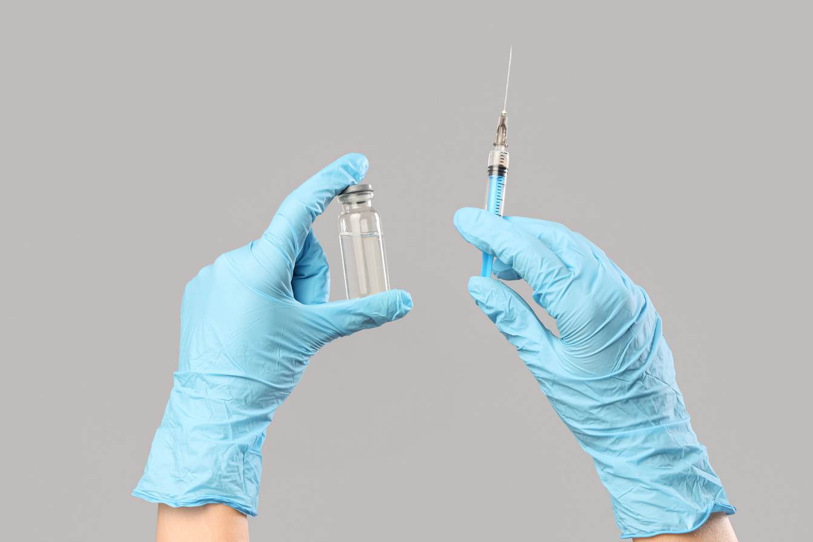

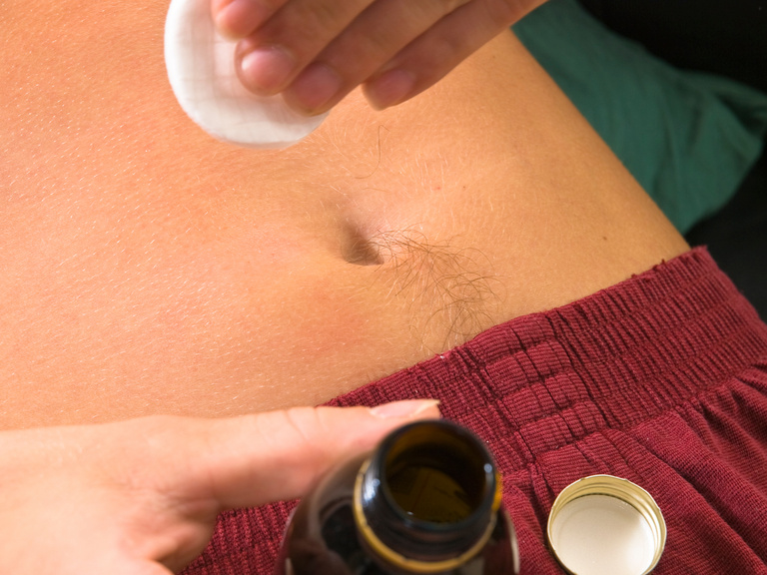
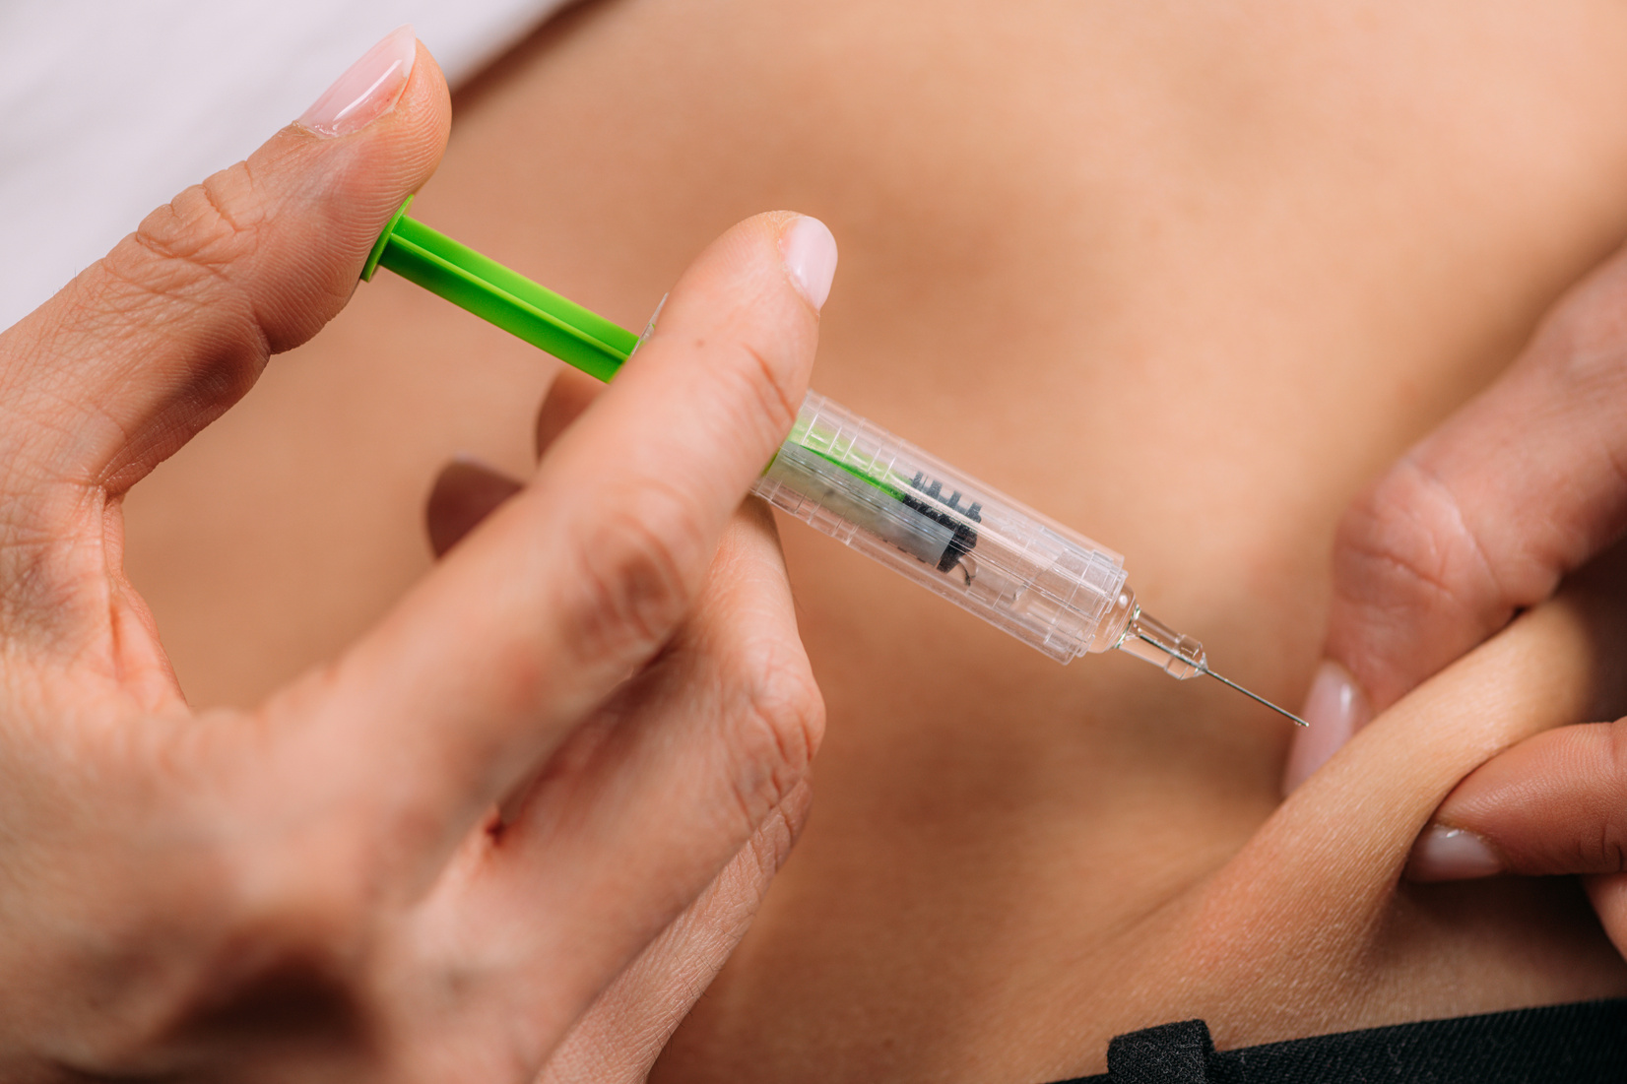
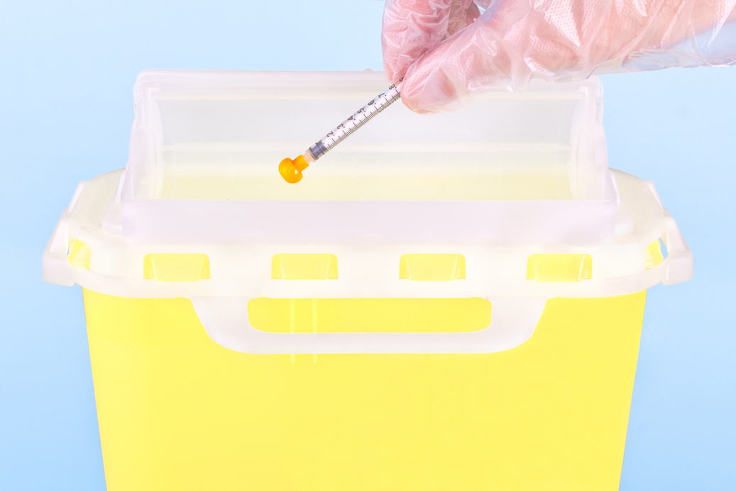
Administration overview
Step 1
Step 2
Step 3
Inspect the product
Withdraw dose from vial
Select the injection site (abdomen preferred).
Step 4
Step 5
Step 6
Clean injection site
Administer elranatamab, subcutaneously
Dispose of needle and syringe
Notes:
Myeloma is a disease of plasma cells.
Plasma cells are B cells which form a valuable part of the immune system.
They work with T cells to produce antibodies that fight pathogens.
Treatment for myeloma often weakens the immune system as it targets both good and cancerous immune cells.
Additionally, some treatments may lower your response to previous vaccinations, particularly Stem Cell transplant or CAR T-Cell Therapy.
Whilst Vaccination recommendations are standardized, its important to remember that the risk of different types of infections depends on your social and physical environment.
ie) adult working from home alone vs adult working in busy childcare center.
3

Slide 14
Common side effects
Cytokine release syndrome – CRS
Neurological toxicities – ICANS
Infection risk
Mild dermatologic toxicities
Injection site reactions
Notes:
Myeloma is a disease of plasma cells.
Plasma cells are B cells which form a valuable part of the immune system.
They work with T cells to produce antibodies that fight pathogens.
Treatment for myeloma often weakens the immune system as it targets both good and cancerous immune cells.
Additionally, some treatments may lower your response to previous vaccinations, particularly Stem Cell transplant or CAR T-Cell Therapy.
Whilst Vaccination recommendations are standardized, its important to remember that the risk of different types of infections depends on your social and physical environment.
ie) adult working from home alone vs adult working in busy childcare center.
3

Slide 15
Cytokine release syndrome (CRS)
Elranatamab interacts with immune cells causing an inflammatory response
Inflammatory proteins (cytokines) are released into the bloodstream
'Cytokine storm' causes widespread inflammation affecting multiple organs
CRS can occur within hours of elranatamab injection
Higher disease burden= higher risk CRS
Notes:
Myeloma is a disease of plasma cells.
Plasma cells are B cells which form a valuable part of the immune system.
They work with T cells to produce antibodies that fight pathogens.
Treatment for myeloma often weakens the immune system as it targets both good and cancerous immune cells.
Additionally, some treatments may lower your response to previous vaccinations, particularly Stem Cell transplant or CAR T-Cell Therapy.
Whilst Vaccination recommendations are standardized, its important to remember that the risk of different types of infections depends on your social and physical environment.
ie) adult working from home alone vs adult working in busy childcare center.
3

Slide 16








FEVER
Most common and earliest symptom. Temperature ≥38°C.
CRS symptoms
CHILLS / RIGORS
HYPOXIA
Reduced oxygen levels. May require supplemental oxygen.
!
Other symptoms may include fatigue, nausea, myalgia, rash, diarrhoea, and capillary leak with oedema in severe cases.
Often occur with fever.
CYTOKINE RELEASE SYNDROME (CRS)
CRS severity is graded according to the presence and degree of fever, hypotension, and hypoxia.
COMMON SIGNS & SYMPTOMS
RAISED LIVER ENZYMES
HYPOTENSION
Elevation in AST and ALT indicating hepatic involvement.
Low blood pressure. May require IV fluids and/or vasopressors in severe cases.
HEADACHE
TACHYCARDIA
Common constitutional symptom.
Elevated heart rate, often secondary to fever or hypotension.
Notes:
Myeloma is a disease of plasma cells.
Plasma cells are B cells which form a valuable part of the immune system.
They work with T cells to produce antibodies that fight pathogens.
Treatment for myeloma often weakens the immune system as it targets both good and cancerous immune cells.
Additionally, some treatments may lower your response to previous vaccinations, particularly Stem Cell transplant or CAR T-Cell Therapy.
Whilst Vaccination recommendations are standardized, its important to remember that the risk of different types of infections depends on your social and physical environment.
ie) adult working from home alone vs adult working in busy childcare center.
3

Slide 17
CRS grading
→
→ temperature >38°C
→ flu-like symptoms
→ nausea
CRS GRADE 1
→
→ temperature >38°C
→ hypotension not requiring vasopressors
→ hypoxia requiring low-flow nasal cannula or blow-by
CRS GRADE 2
→
→ temperature >38°C
→ hypotension requiring one vasopressors
→ hypoxia requiring high-flow or face mask
CRS GRADE 3
→ temperature >38°C
→ hypotension requiring positive airway pressure
→ hypoxia requiring multiple vasopressors (excl. vasopressin)
CRS GRADE 4
→
https://www.researchgate.net/figure/Grading-and-management-of-CRS-Considerations-and-approaches-for-the-grading-and_fig1_332129666
Notes:
Myeloma is a disease of plasma cells.
Plasma cells are B cells which form a valuable part of the immune system.
They work with T cells to produce antibodies that fight pathogens.
Treatment for myeloma often weakens the immune system as it targets both good and cancerous immune cells.
Additionally, some treatments may lower your response to previous vaccinations, particularly Stem Cell transplant or CAR T-Cell Therapy.
Whilst Vaccination recommendations are standardized, its important to remember that the risk of different types of infections depends on your social and physical environment.
ie) adult working from home alone vs adult working in busy childcare center.
3

Slide 18
CRS management
Rule out other causes (infection)
IV tocilizumab
Steroids
IV Hydration (max 2L / 24hrs)
Oxygen therapy as required
Vasopressor support if required
Notes:
Myeloma is a disease of plasma cells.
Plasma cells are B cells which form a valuable part of the immune system.
They work with T cells to produce antibodies that fight pathogens.
Treatment for myeloma often weakens the immune system as it targets both good and cancerous immune cells.
Additionally, some treatments may lower your response to previous vaccinations, particularly Stem Cell transplant or CAR T-Cell Therapy.
Whilst Vaccination recommendations are standardized, its important to remember that the risk of different types of infections depends on your social and physical environment.
ie) adult working from home alone vs adult working in busy childcare center.
3

Slide 19

CRS incidence
No CRS
observed
43.7%
Grade 1
42.0%
MagnetisMM-3 trial
All grades
56.3%
(n=119)
→
CRS: 56.3% overall
Grade 1: 42.0%
Grade 2: 14.3%)
No grade 3 or above reported.
Grade 2
14.3%
→
91% of CRS cases occurred with the first 2 step-up doses.
Median time to onset1,†
Median duration¹
CRS events were manageable and resolved with appropriate interventions¹
2 days
2 days
→
Among patients with CRS, 22.7% (27/119) were treated with tocilizumab (or siltuximab) and 8.4% (10/119) were treated with corticosteroids
(Range: 1-9)
(Range: 1-19)
→
No grade ≥3 CRS events were observed
*Median follow-up: 15.2 months (range: 2.4–24.2 months). Cohort A (N=123); 4 patients who did not receive the two step-up doses were excluded from CRS and ICANS analyses.¹
†After the most recent dose.¹
CRS=cytokine release syndrome.
Notes:
Myeloma is a disease of plasma cells.
Plasma cells are B cells which form a valuable part of the immune system.
They work with T cells to produce antibodies that fight pathogens.
Treatment for myeloma often weakens the immune system as it targets both good and cancerous immune cells.
Additionally, some treatments may lower your response to previous vaccinations, particularly Stem Cell transplant or CAR T-Cell Therapy.
Whilst Vaccination recommendations are standardized, its important to remember that the risk of different types of infections depends on your social and physical environment.
ie) adult working from home alone vs adult working in busy childcare center.
3

Slide 20
Immune effector cell-associated neurotoxicity syndrome (ICANS)
Neurological side effect
Characterised by central nervous system dysfunction
Occurs when immune system becomes highly activated
Inflammation affecting the brain and nervous system
Occurs within days to weeks of treatment
Previous neurological comorbidities= higher risk
Notes:
Myeloma is a disease of plasma cells.
Plasma cells are B cells which form a valuable part of the immune system.
They work with T cells to produce antibodies that fight pathogens.
Treatment for myeloma often weakens the immune system as it targets both good and cancerous immune cells.
Additionally, some treatments may lower your response to previous vaccinations, particularly Stem Cell transplant or CAR T-Cell Therapy.
Whilst Vaccination recommendations are standardized, its important to remember that the risk of different types of infections depends on your social and physical environment.
ie) adult working from home alone vs adult working in busy childcare center.
3

Slide 21










Difficulty speaking or understanding speech (aphasia)
Severe cases: Seizures or brain swelling (cerebral oedema)
Trouble finding words or understanding what others are saying
Confusion and disorientation
Feeling confused, not knowing where you are, or the date/time
Seizures (fits) or swelling in the brain, which can be life-threatening
Agitation
Difficulty writing
Restlessness, anxiety, irritability or combative behaviour
ICANS
Trouble writing clearly or forming letters and words
Immune Effector Cell-Associated Neurotoxicity Syndrome
A potential neurological side effect of T-cell directed therapies (eg. CAR T-cell therapy and bispecific antibodies)
Muscle weakness
Tremor
Weakness in the arms, legs or general lack of strength
Involuntary shaking or trembling
of the hands or body
Cognitive impairment
Reduced alertness
Problems with memory attention, concentration and problem solving
Drowsiness, increased sleepiness or difficulty staying awake
Notes:
Myeloma is a disease of plasma cells.
Plasma cells are B cells which form a valuable part of the immune system.
They work with T cells to produce antibodies that fight pathogens.
Treatment for myeloma often weakens the immune system as it targets both good and cancerous immune cells.
Additionally, some treatments may lower your response to previous vaccinations, particularly Stem Cell transplant or CAR T-Cell Therapy.
Whilst Vaccination recommendations are standardized, its important to remember that the risk of different types of infections depends on your social and physical environment.
ie) adult working from home alone vs adult working in busy childcare center.
3

Slide 22
ICANS assessment
Immune effector cell-associated encephalopathy (ICE) assessment
If the patient’s ICE score is 9 or below, notify physician immediately. | If the patient’s ICE score is 9 or below, notify physician immediately. | If the patient’s ICE score is 9 or below, notify physician immediately.
Orientation | Orientation to year, month, city, hospital | 4 points
Naming | Ability to name 3 objects (e.g. point to clock, pen, button) | 3 points
Following commands | Ability to follow simple commands (e.g. “Show me 2 fingers” or “Close your eyes and stick out your tongue”) | 1 point
Writing | Ability to write a simple sentence (e.g. “The emu is an Australian animal”) | 1 point
Attention | Ability to count backwards from 100 by 10 | 1 point
Notes:
Myeloma is a disease of plasma cells.
Plasma cells are B cells which form a valuable part of the immune system.
They work with T cells to produce antibodies that fight pathogens.
Treatment for myeloma often weakens the immune system as it targets both good and cancerous immune cells.
Additionally, some treatments may lower your response to previous vaccinations, particularly Stem Cell transplant or CAR T-Cell Therapy.
Whilst Vaccination recommendations are standardized, its important to remember that the risk of different types of infections depends on your social and physical environment.
ie) adult working from home alone vs adult working in busy childcare center.
3

Slide 23
ICANS grading
Immune Effector Cell-Associated Neurotoxicity Syndrome (ICANS) grading
Neurotoxicity Domain | Grade 1 | Grade 2 | Grade 3 | Grade 4
ICE assessment score | 7–9 | 3–6 | 0–2 | 0 (patient is unarousable and unable to perform ICE)
Depressed level of consciousness | Awakens spontaneously | Awakens to voice | Awakens only to tactile stimulus | Patient is unarousable or requires vigorous or repetitive tactile stimuli to arouse. Stupor or coma
Seizure | N/A | N/A | Any clinical seizure focal or generalized that resolves rapidly or nonconvulsive seizures on EEG that resolve with intervention | Life-threatening prolonged seizure (>5 min); or repetitive clinical or electrical seizures without return to baseline in between
Motor findings | N/A | N/A | N/A | Deep focal motor weakness such as hemiparesis or paraparesis
Elevated cerebral oedema | N/A | N/A | Focal/local oedema on neuroimaging | Diffuse cerebral oedema on neuroimaging; Decerebrate or decorticate posturing; or Cranial nerve VI palsy; or Papilloedema; or Cushing’s triad (irregular/decreased respirations, bradycardia and systolic hypertension)
Notes:
Myeloma is a disease of plasma cells.
Plasma cells are B cells which form a valuable part of the immune system.
They work with T cells to produce antibodies that fight pathogens.
Treatment for myeloma often weakens the immune system as it targets both good and cancerous immune cells.
Additionally, some treatments may lower your response to previous vaccinations, particularly Stem Cell transplant or CAR T-Cell Therapy.
Whilst Vaccination recommendations are standardized, its important to remember that the risk of different types of infections depends on your social and physical environment.
ie) adult working from home alone vs adult working in busy childcare center.
3

Slide 24
ICANS management
Hospital specific policies govern local management, but these may include:
Supportive care
Neurological consultation + investigations (EEG, imaging)
Increased frequency of ICANS assessments
Aspiration management and IV hydration
IV dexamethasone or methylprednisolone
IV levetiracetam
Subcutaneous or IV anakinra
Cerebral oedema management
Possible ICU admission and ventilation if grade 3 or 4
Notes:
Myeloma is a disease of plasma cells.
Plasma cells are B cells which form a valuable part of the immune system.
They work with T cells to produce antibodies that fight pathogens.
Treatment for myeloma often weakens the immune system as it targets both good and cancerous immune cells.
Additionally, some treatments may lower your response to previous vaccinations, particularly Stem Cell transplant or CAR T-Cell Therapy.
Whilst Vaccination recommendations are standardized, its important to remember that the risk of different types of infections depends on your social and physical environment.
ie) adult working from home alone vs adult working in busy childcare center.
3

Slide 25
ICANS frequency by grade (N=119)¹
ICANS incidence
All grades
3.3%
MagnetisMM-3 trial
Grade 1
0.5%
ICANS was infrequent,
occurring in only 3.3%
of patients
Grade 2
1.6%
Grade 3
1.1%
All cases were grade 1–3 and most commonly occurred after the first dose.
Median time to onset1,†
Median duration¹
3 days
2 days
(Range, 1–4)
(Range, 1–18)
ICANS most commonly developed after the first step-up dose¹
ICANS management:¹
(among those who developed ICANS)
66.7%
received
corticosteroids
33.3%
received
levetiracetam
33.3%
received tocilizumab
or siltuximab
No patients
discontinued
ELREXFIO due
to ICANS¹
*Median follow-up: 15.2 months (range: 2.4–24.2 months). Cohort A (N=123); 4 patients who did not receive the two step-up doses were excluded from CRS and ICANS analyses.¹
†After the most recent dose.¹ ICANS=immune effector cell-associated neurotoxicity syndrome.
Notes:
Myeloma is a disease of plasma cells.
Plasma cells are B cells which form a valuable part of the immune system.
They work with T cells to produce antibodies that fight pathogens.
Treatment for myeloma often weakens the immune system as it targets both good and cancerous immune cells.
Additionally, some treatments may lower your response to previous vaccinations, particularly Stem Cell transplant or CAR T-Cell Therapy.
Whilst Vaccination recommendations are standardized, its important to remember that the risk of different types of infections depends on your social and physical environment.
ie) adult working from home alone vs adult working in busy childcare center.
3

Slide 26
Infection risk
High infection risk​
Neutropenia
Hypogammaglobulinemia
→
Disease and treatment related cytopenias
→
→
On-target off-tumor effect of BCMA from elranatamab
Patients will require concurrent IVIg or SCIg
Notes:
Myeloma is a disease of plasma cells.
Plasma cells are B cells which form a valuable part of the immune system.
They work with T cells to produce antibodies that fight pathogens.
Treatment for myeloma often weakens the immune system as it targets both good and cancerous immune cells.
Additionally, some treatments may lower your response to previous vaccinations, particularly Stem Cell transplant or CAR T-Cell Therapy.
Whilst Vaccination recommendations are standardized, its important to remember that the risk of different types of infections depends on your social and physical environment.
ie) adult working from home alone vs adult working in busy childcare center.
3

Slide 27
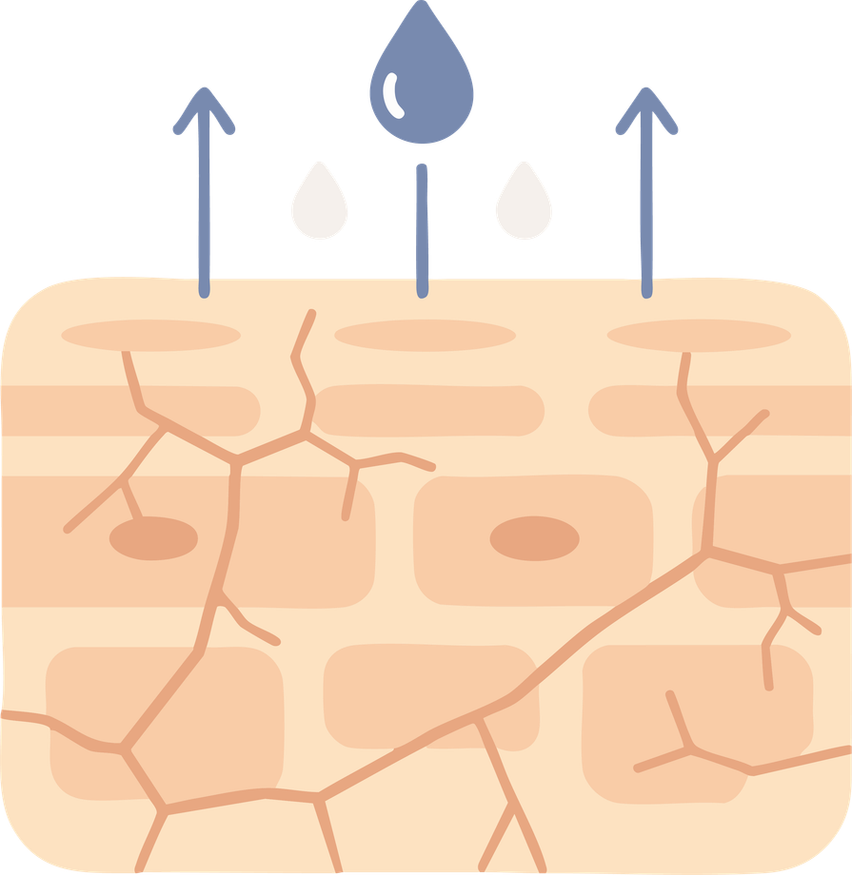
Dermatological toxicities
Use frequent moisturisers &
Soap-free wash
Dry Skin
Hand and/or foot peeling
(uncommon)
Ammonium lactate 12% lotion to soles and palms BID
Notes:
Myeloma is a disease of plasma cells.
Plasma cells are B cells which form a valuable part of the immune system.
They work with T cells to produce antibodies that fight pathogens.
Treatment for myeloma often weakens the immune system as it targets both good and cancerous immune cells.
Additionally, some treatments may lower your response to previous vaccinations, particularly Stem Cell transplant or CAR T-Cell Therapy.
Whilst Vaccination recommendations are standardized, its important to remember that the risk of different types of infections depends on your social and physical environment.
ie) adult working from home alone vs adult working in busy childcare center.
3

Slide 28




Dermatological toxicities
Loratadine 10 mg PO daily for 1–3 days post
Triamcinolone (steroid) 0.1% cream BD​
Injection site reaction
Maculopapular rash
Pruritis
REDNESS
SWELLING
ITCHING
Notes:
Myeloma is a disease of plasma cells.
Plasma cells are B cells which form a valuable part of the immune system.
They work with T cells to produce antibodies that fight pathogens.
Treatment for myeloma often weakens the immune system as it targets both good and cancerous immune cells.
Additionally, some treatments may lower your response to previous vaccinations, particularly Stem Cell transplant or CAR T-Cell Therapy.
Whilst Vaccination recommendations are standardized, its important to remember that the risk of different types of infections depends on your social and physical environment.
ie) adult working from home alone vs adult working in busy childcare center.
3

Slide 29
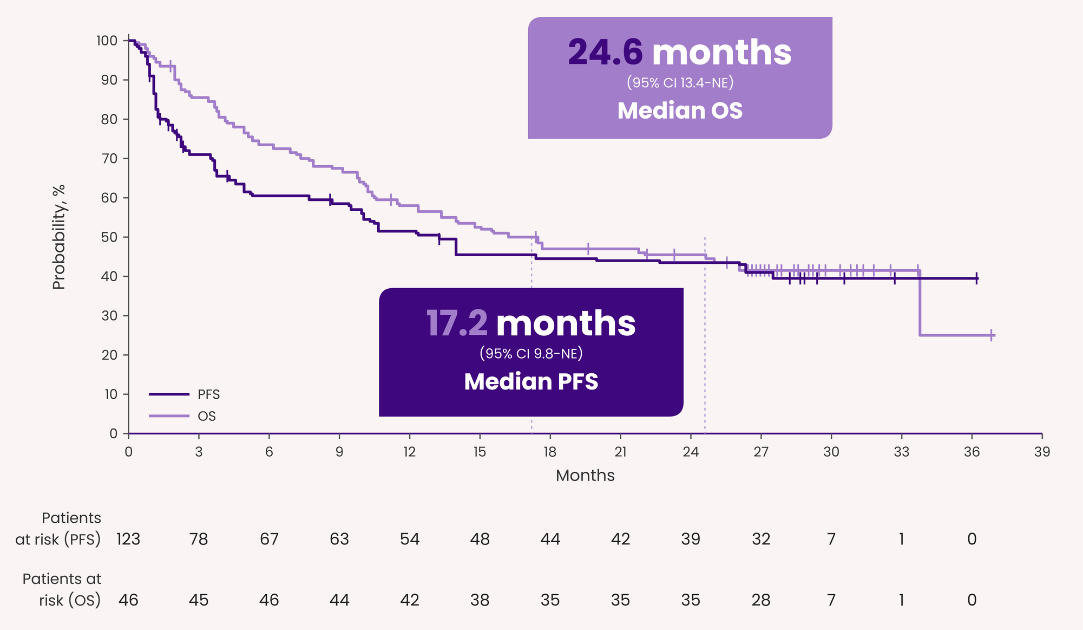
Elranatamab efficacy
MagnetisMM-3 trial
Median progression free survival: 17.2 Months
Overall survival: 24.6 months
Overall response rate: 61%
Complete response rate: 37.4%
Notes:
Myeloma is a disease of plasma cells.
Plasma cells are B cells which form a valuable part of the immune system.
They work with T cells to produce antibodies that fight pathogens.
Treatment for myeloma often weakens the immune system as it targets both good and cancerous immune cells.
Additionally, some treatments may lower your response to previous vaccinations, particularly Stem Cell transplant or CAR T-Cell Therapy.
Whilst Vaccination recommendations are standardized, its important to remember that the risk of different types of infections depends on your social and physical environment.
ie) adult working from home alone vs adult working in busy childcare center.
3

Slide 30
Patient reported quality of life data
Magnetis-MM3 Trial
Pain stabilised, then improved from C3
Disease symptoms improved from C2
Body image and future perspectives improved from C2
Side effects increased between C1-C4, then returned to baseline
BCMA naive patients found the treatment side effects more challenging than BCMA exposed patients
Notes:
Myeloma is a disease of plasma cells.
Plasma cells are B cells which form a valuable part of the immune system.
They work with T cells to produce antibodies that fight pathogens.
Treatment for myeloma often weakens the immune system as it targets both good and cancerous immune cells.
Additionally, some treatments may lower your response to previous vaccinations, particularly Stem Cell transplant or CAR T-Cell Therapy.
Whilst Vaccination recommendations are standardized, its important to remember that the risk of different types of infections depends on your social and physical environment.
ie) adult working from home alone vs adult working in busy childcare center.
3

Slide 31
Questions?
Notes:
Good morning, and thank you to Members and
Senators for joining us.
Today, we speak on behalf of more than 22,000 Australians living with multiple myeloma — an incurable blood cancer that remains too often invisible until it is advanced.
A further 348,000 live with precursor conditions
MGUS and SMM.

Slide 32


Telephone
Support Line
1800 MYELOMA
(1800 693 566)
Monday - Friday
10am - 4pm AEST/AEDT
Or book online
myeloma.org.au
Telephone Support Line

Slide 33
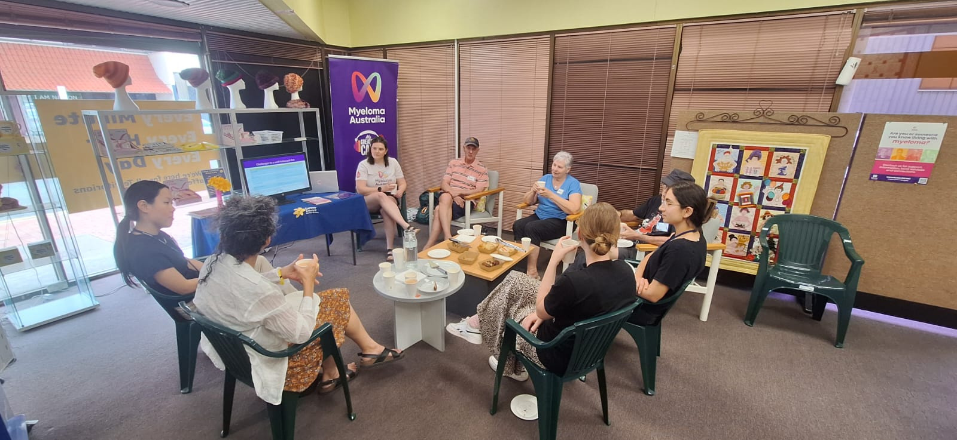
Information and Support Groups
→ run in-person in locations across Australia​
→ online and hybrid options​
​→ national groups (audience specific)

Slide 34


Information booklets
Order copies for your clinical area at myeloma.org.au

Slide 35
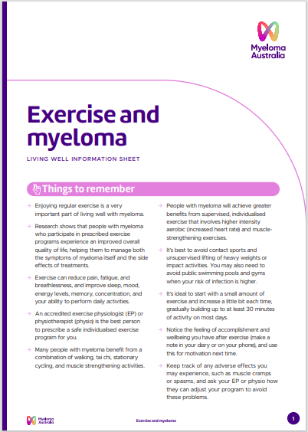
Information sheets
Living well
Treatments
Conditions
Tests
Translated

Slide 36
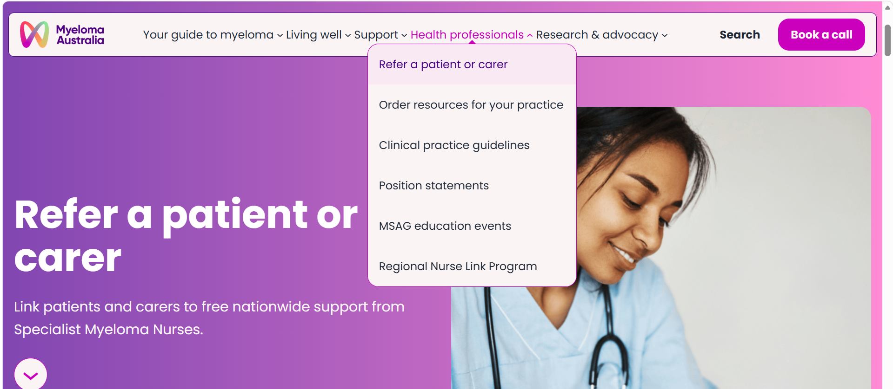
Referring patients and carers
→ Online referral form​
→ Contacted by a Specialist Myeloma Nurse in their state
​→ Sent an introduction pack (digital or hard copy)

Slide 37

Clinical practice guidelines
Evidence-based clinical guidance for myeloma diagnosis and management.
Expert-authored resources to support health professionals in patient care.

Slide 38

Thank You
1800 MYELOMA (1800 693 566)
nurses@myeloma.org.au
myeloma.org.au
Scan to sign up to our
email newsletter →
Notes:
Good morning, and thank you to Members and
Senators for joining us.
Today, we speak on behalf of more than 22,000 Australians living with multiple myeloma — an incurable blood cancer that remains too often invisible until it is advanced.
A further 348,000 live with precursor conditions
MGUS and SMM.

