Slide 1




Slide 2
Telephone
Support Line
1800 MYELOMA
(1800 693 566)
Monday - Friday
10am - 4pm AEST/AEDT
Or book online
myeloma.org.au
Telephone Support Line

Slide 3

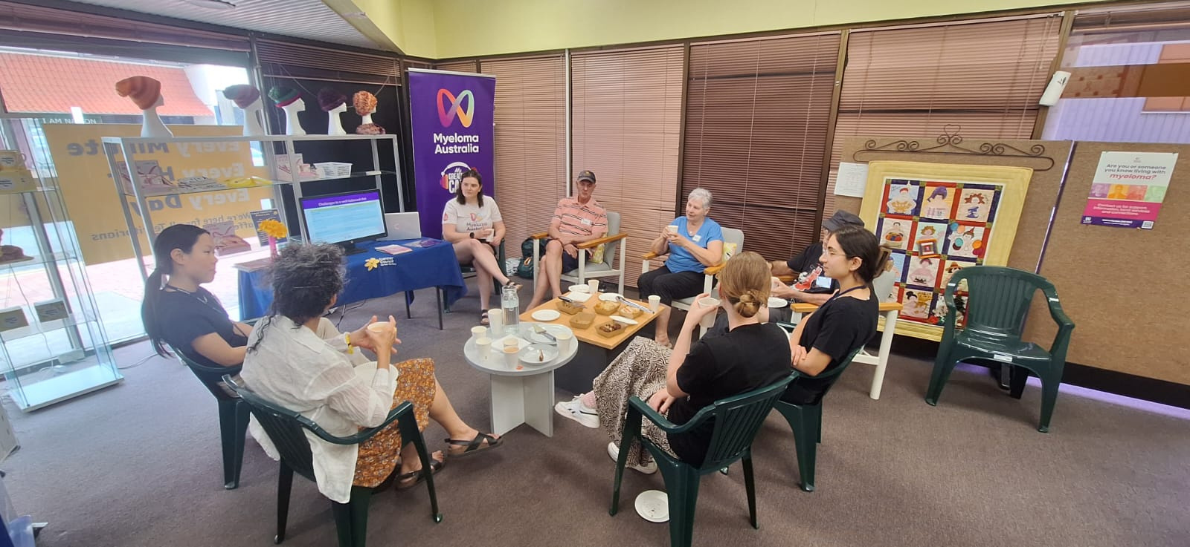
Information and Support Groups
→ run in-person in locations across Australia​
→ online and hybrid options​
​→ national groups (audience specific)

Slide 4


Information booklets
Order copies for your clinical area at myeloma.org.au

Slide 5
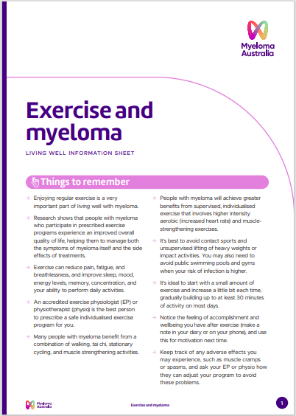

Information sheets
Living well
Treatments
Conditions
Tests
Translated

Slide 6
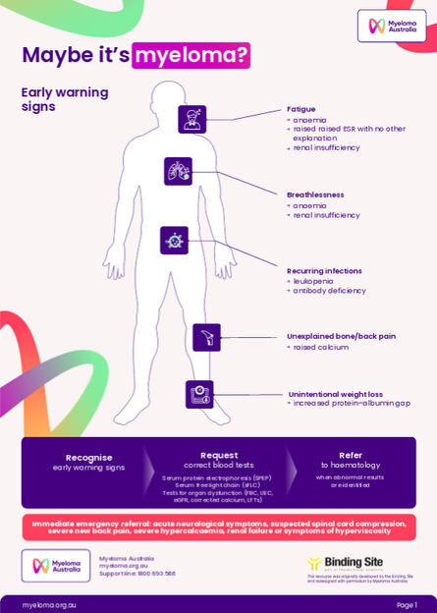
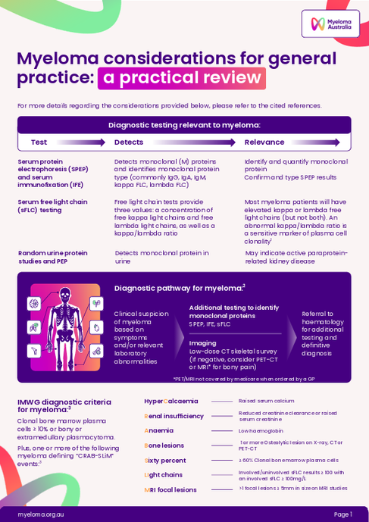
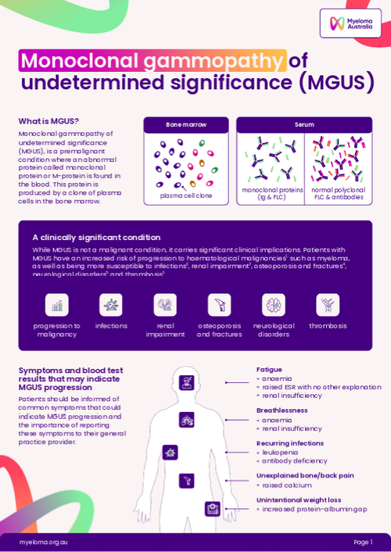
GP learning hub
Resource hub provides clinicians with practical, evidence-based guidance for the diagnosis and management of multiple myeloma and related conditions.

Slide 7

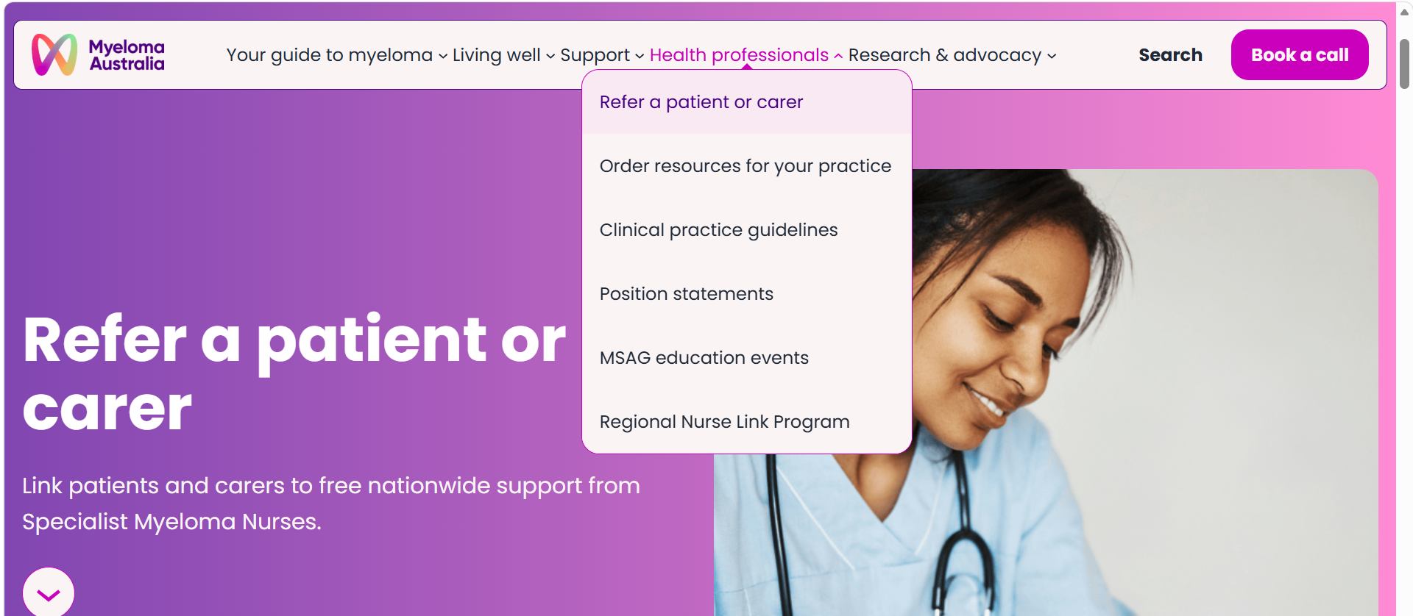
Referring patients and carers
→ Online referral form​
→ Contacted by a Specialist Myeloma Nurse in their state
​→ Sent an introduction pack (digital or hard copy)

Slide 8
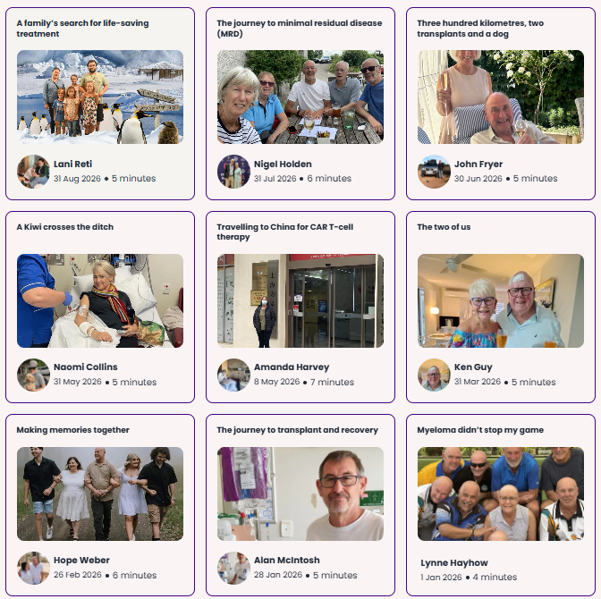
MyStory
Living with myeloma? Caring for someone who is?
Your experience matters.
Share your story today.
Your voice makes a difference.

Slide 9
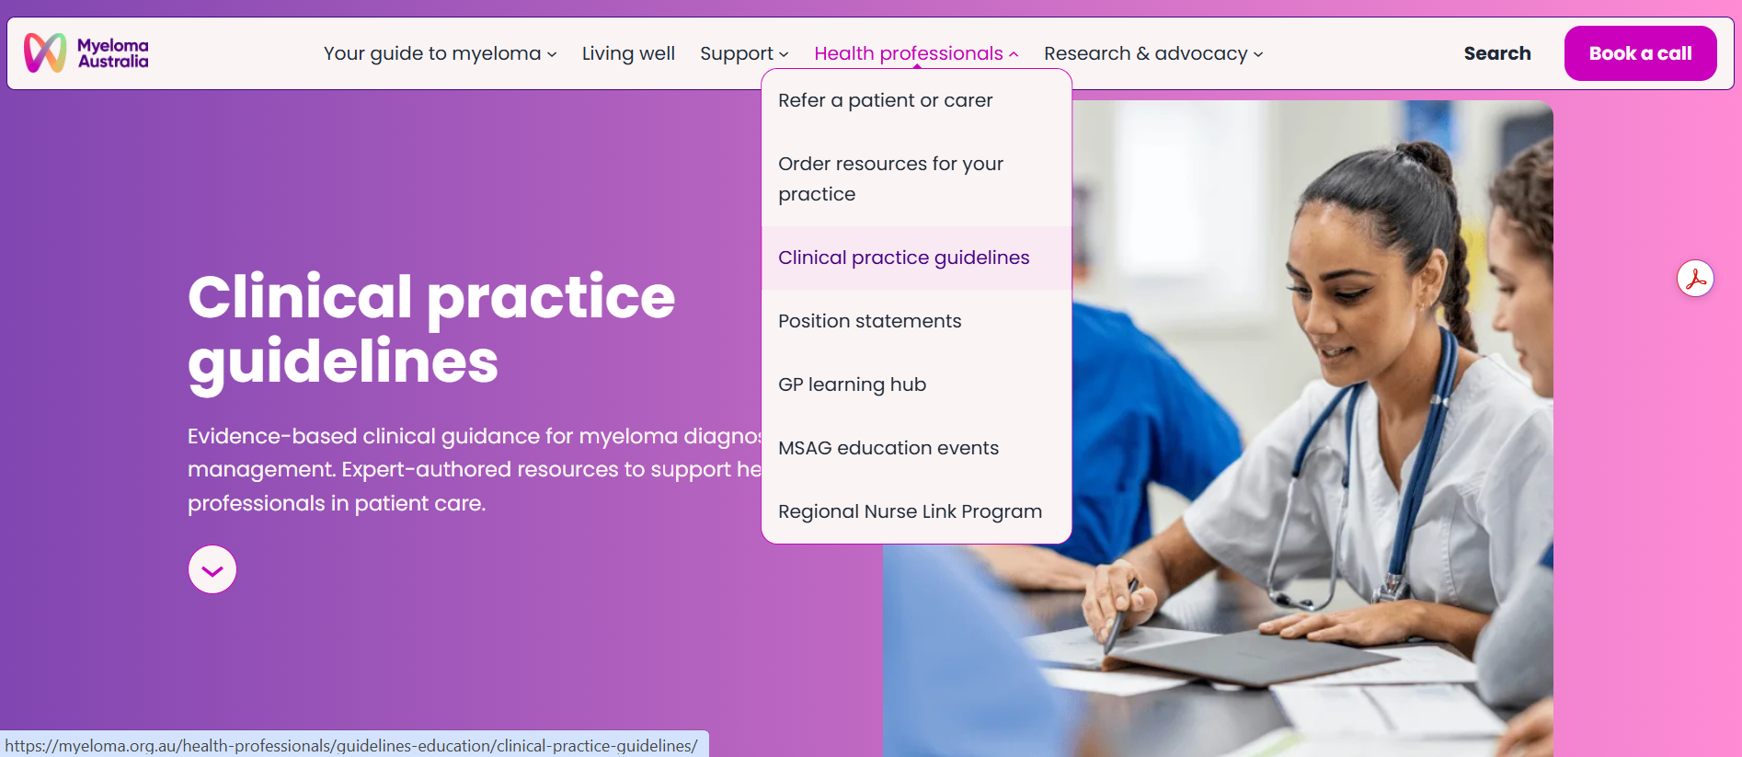
Clinical practice guidelines
Evidence-based clinical guidance for myeloma diagnosis and management. Expert-authored resources to support health professionals in patient care.

Slide 10
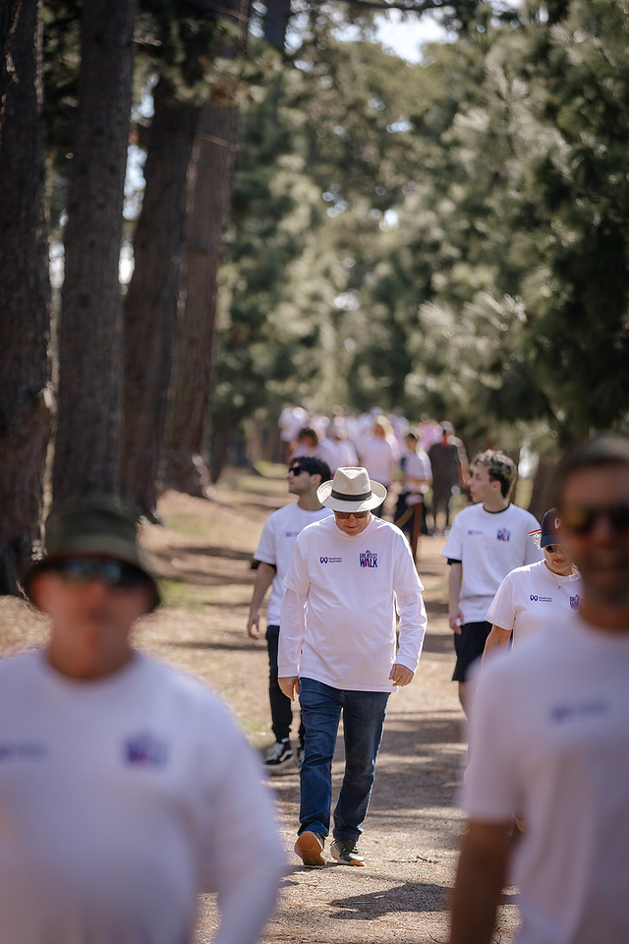
My Greatest Walk
Myeloma Australia’s national fundraising and awareness walk
Sunday 21 March 2027

Slide 11
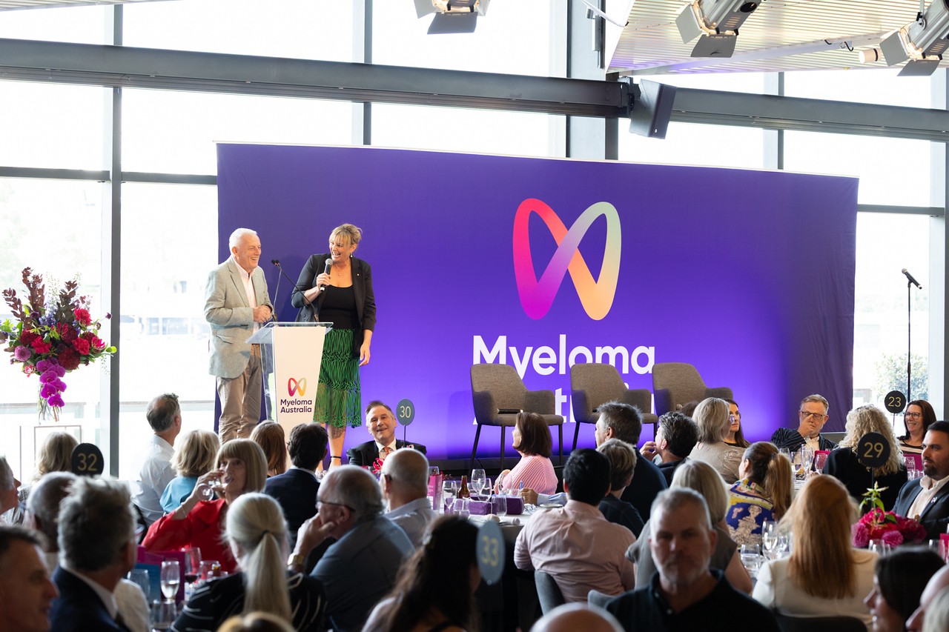
My Greatest Call Luncheon
Myeloma Australia’s “My Greatest Call Luncheon’ is our annual fundraising and networking function.
Friday 26 February 2027

Slide 12
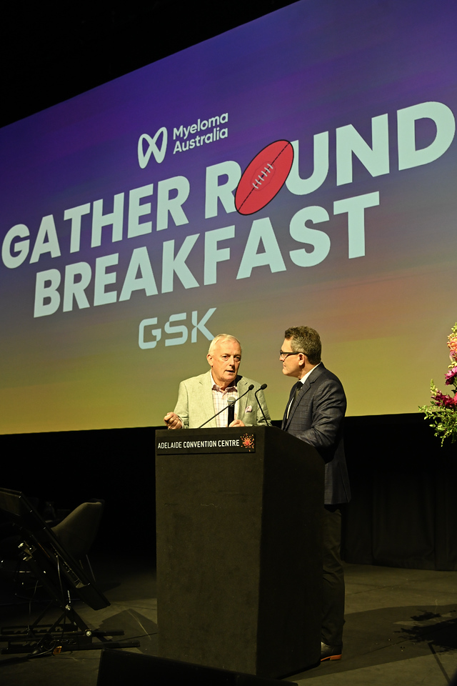
Gather Round Breakfast
An opportunity for travellers and our Adelaide community to come together for networking, connection, and fundraising opportunities.
Friday 9 April 2027

Slide 13



National
Myeloma Summit
21.05.27 - 22.05.27

