Slide 1
House Keeping

Slide 2
Laundry

Slide 3

List of Laundry Items Form
Once confirmed, list can be sorted by Room (in separate page)

Slide 4
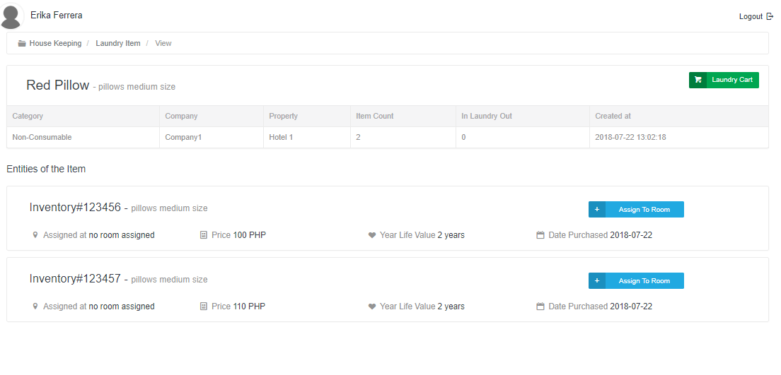

Slide 5
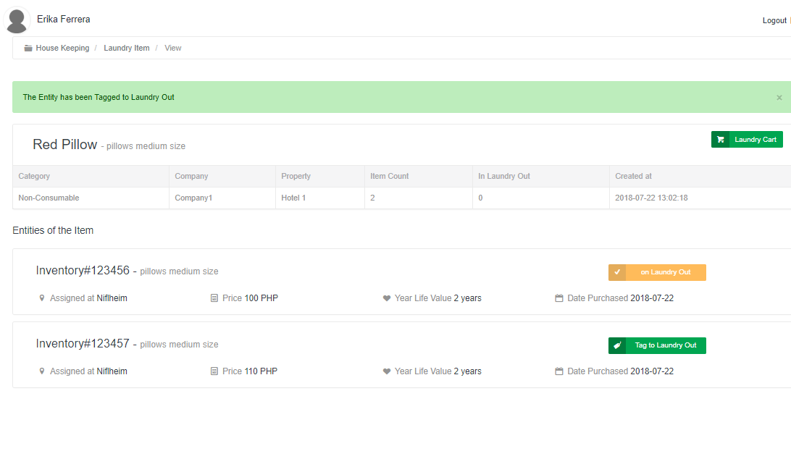

Slide 6

Laundry Cart Form

Slide 7
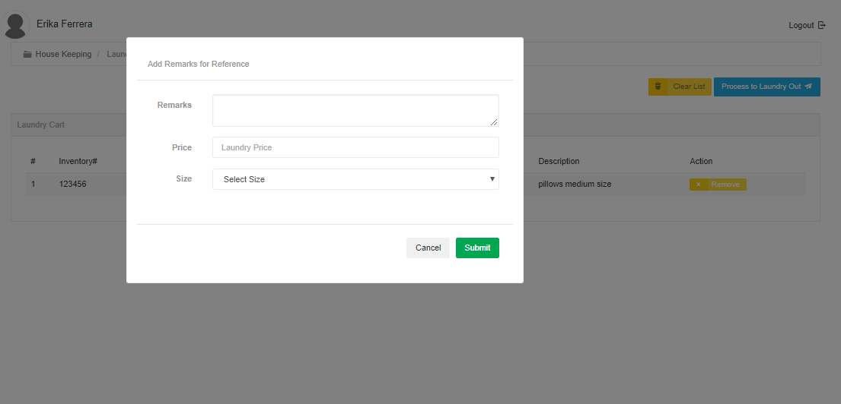

Slide 8



Slide 9
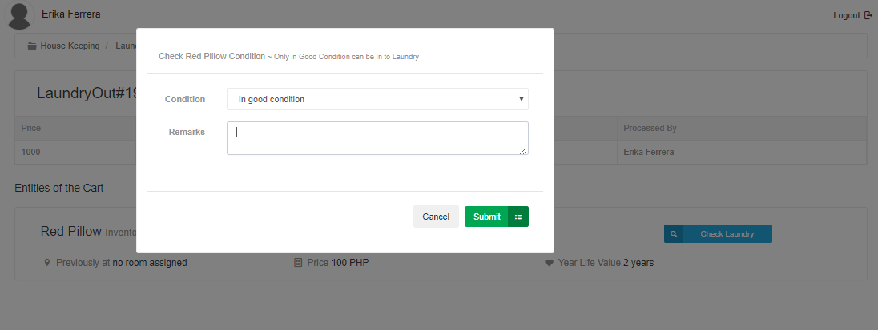

Slide 10
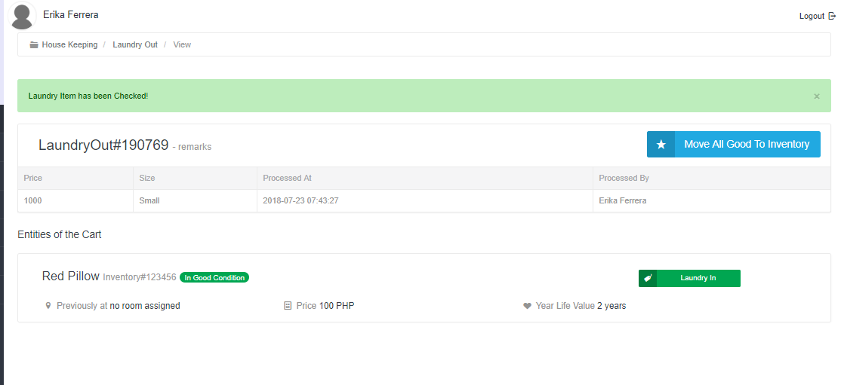

Slide 11
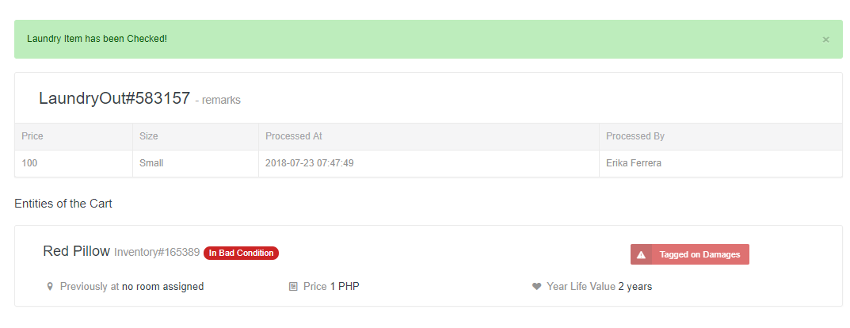


Slide 13
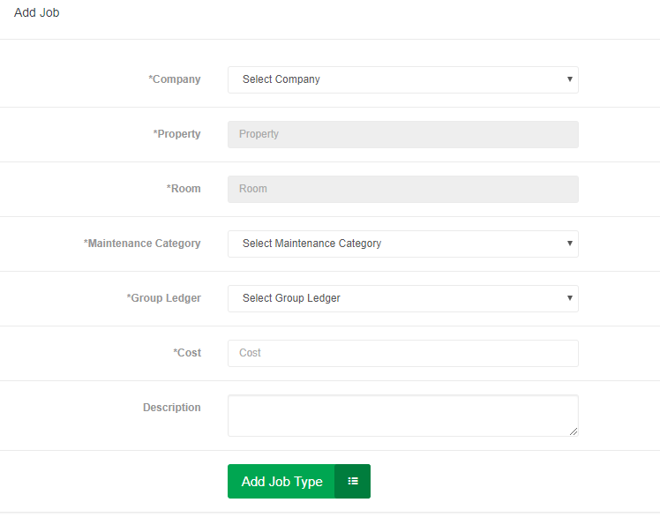
Add Job Form

Slide 14
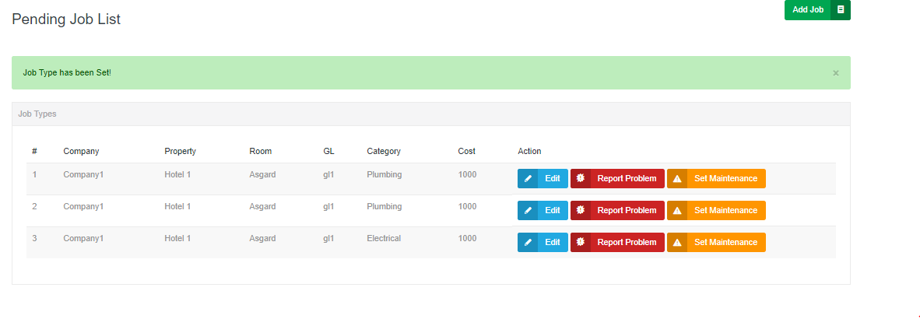

Slide 15
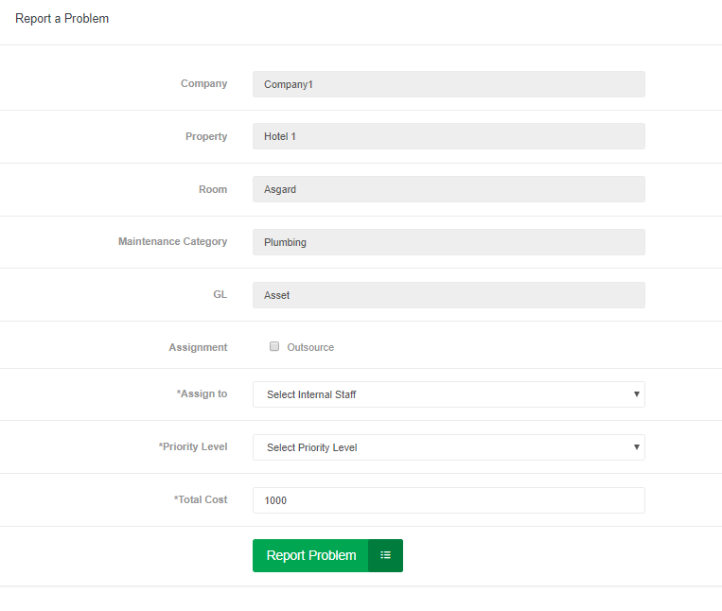
Report a Problem Form

Slide 16
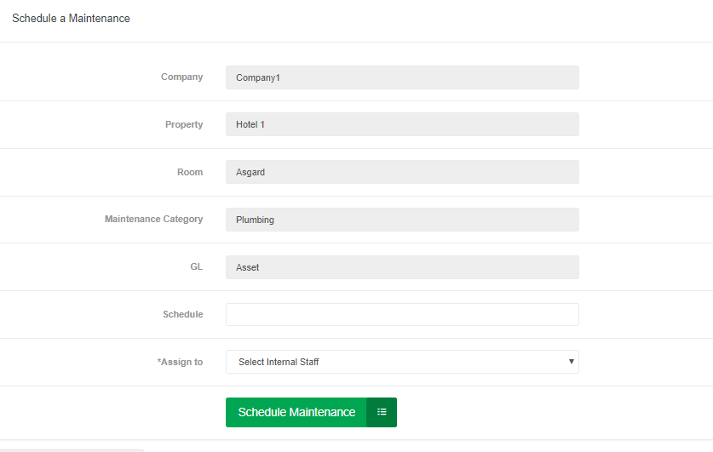
Schedule Maintenance Form

Slide 17
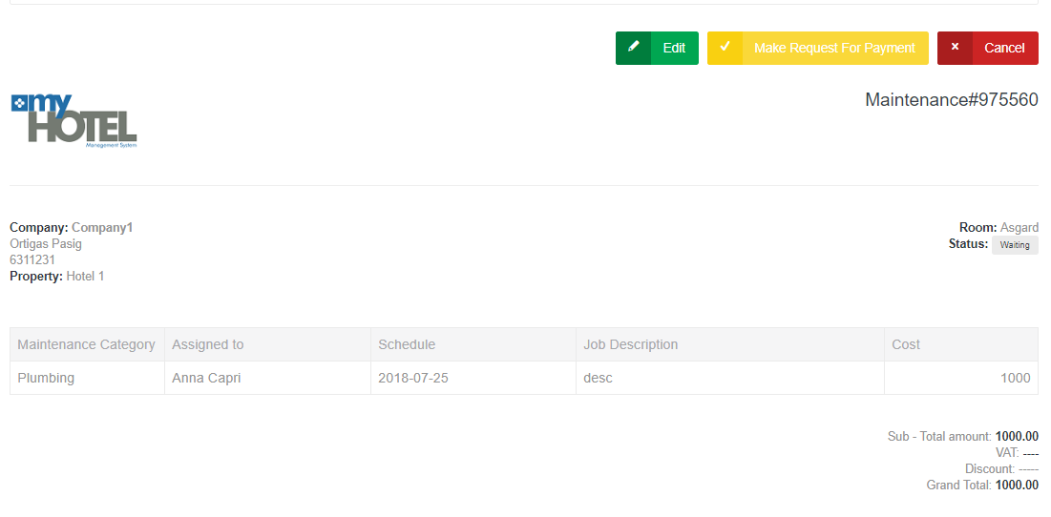

Slide 18
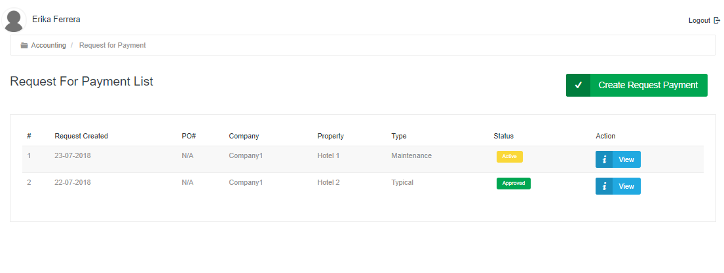
Accounting > Request For Payment Page

