Slide 1
Production of Strange Particles at the LHC from the ALICE Experiment
Barnaby Howells
Project Partner: Thomas Ferguson
Supervisors: Prof. D. Evans and Dr R. Lietava

Slide 2
Outline of Seminar
Introduction to project
Relevant Physics
Workflow of project
Preliminary results and analysis
Outlook for remainder of project

Slide 3
Project Introduction
ALICE collaboration – aims to study properties of Quark-Gluon Plasma (QGP) by colliding heavy ions
AIM: Investigate the enhanced production of singly strange hadrons, K0 and Λ (V0’s), in pp collisions.
Make selection cuts to improve purity of data sample
Use Monte Carlo simulations to calculate reconstruction efficiency
Produce corrected momentum spectra for analysis
Data is taken from ALICE Run 3 - results may be compared to previous runs.

Slide 4
Relevant Physics
Quantum Chromodynamics (QCD):
- Governs strong force interactions between ‘coloured’ particles
- Quarks and gluons confined as hadrons
Formation of Quark Gluon Plasma (QGP):
- Asymptotic freedom of quarks at high energies
→ Deconfinement - liberation of quarks and gluons
Strangeness Enhancement:
- Increased production of strange quarks and hadrons
- Suggests QGP formation - enabling enhanced production processes

Slide 5
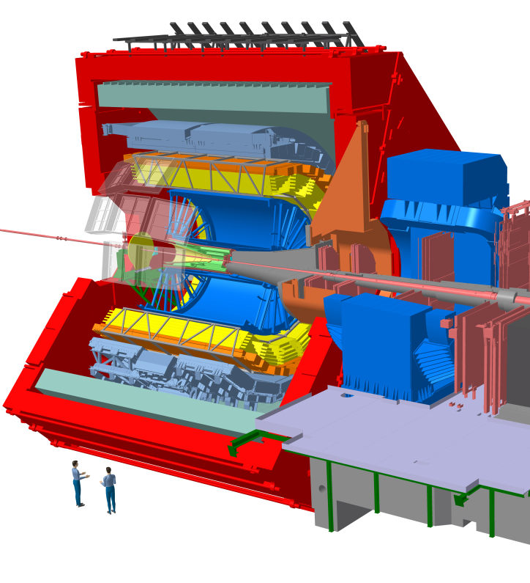
ALICE Detector
Inner Tracking System (ITS):
Comprised of seven layers of silicon pixels arranged cylindrically around beam pipe
Determines decay vertices
Time Projection Chamber (TPC):
Large cylinder filled with gas – particles are ionized as they traverse the chamber
Provides particle identification (PID) by measuring the specific energy loss of each particle
Additional terms:
pT - transverse momentum of particle
ITS
TPC
Figure 1. ALICE detector as in Run 3

Slide 6
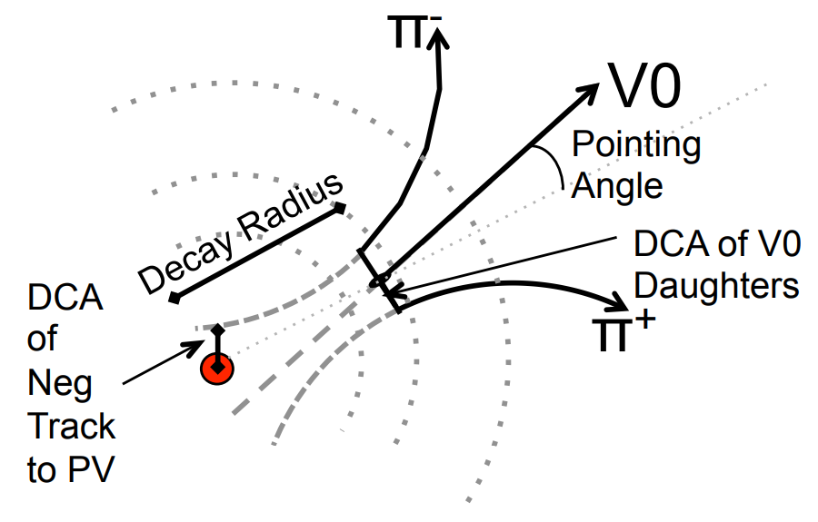
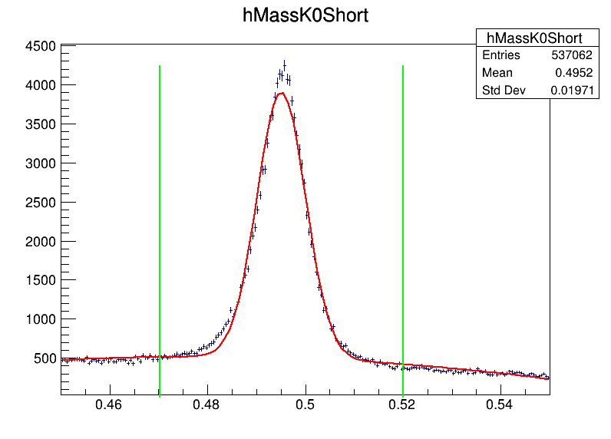
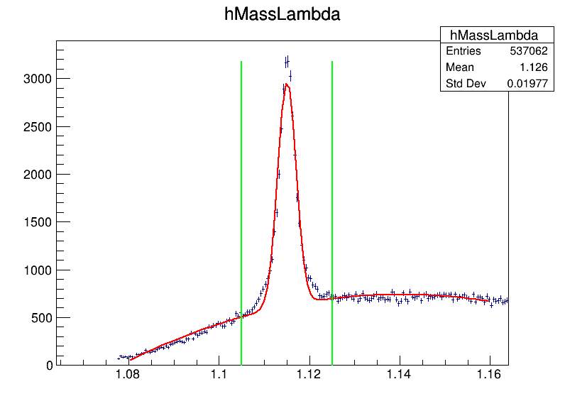



Event Selection
Make selection cuts to ensure detected particle originated from V0 decay:
- Systematically adjust cut values
- Extract signal and background levels from ……resulting mass plots
Figure 2. K0 decay topology with available cuts¹
Plot significance against cut to determine optimal cut values
Counts
Counts
Counts
Counts
Significance $=\frac{S}{\sqrt{S+B}},$
S - signal
B - background
Figure 3: Invariant mass distribution of V0 candidates with fit. The green lines indicate the 5σ region where signal and background were extracted

Slide 7
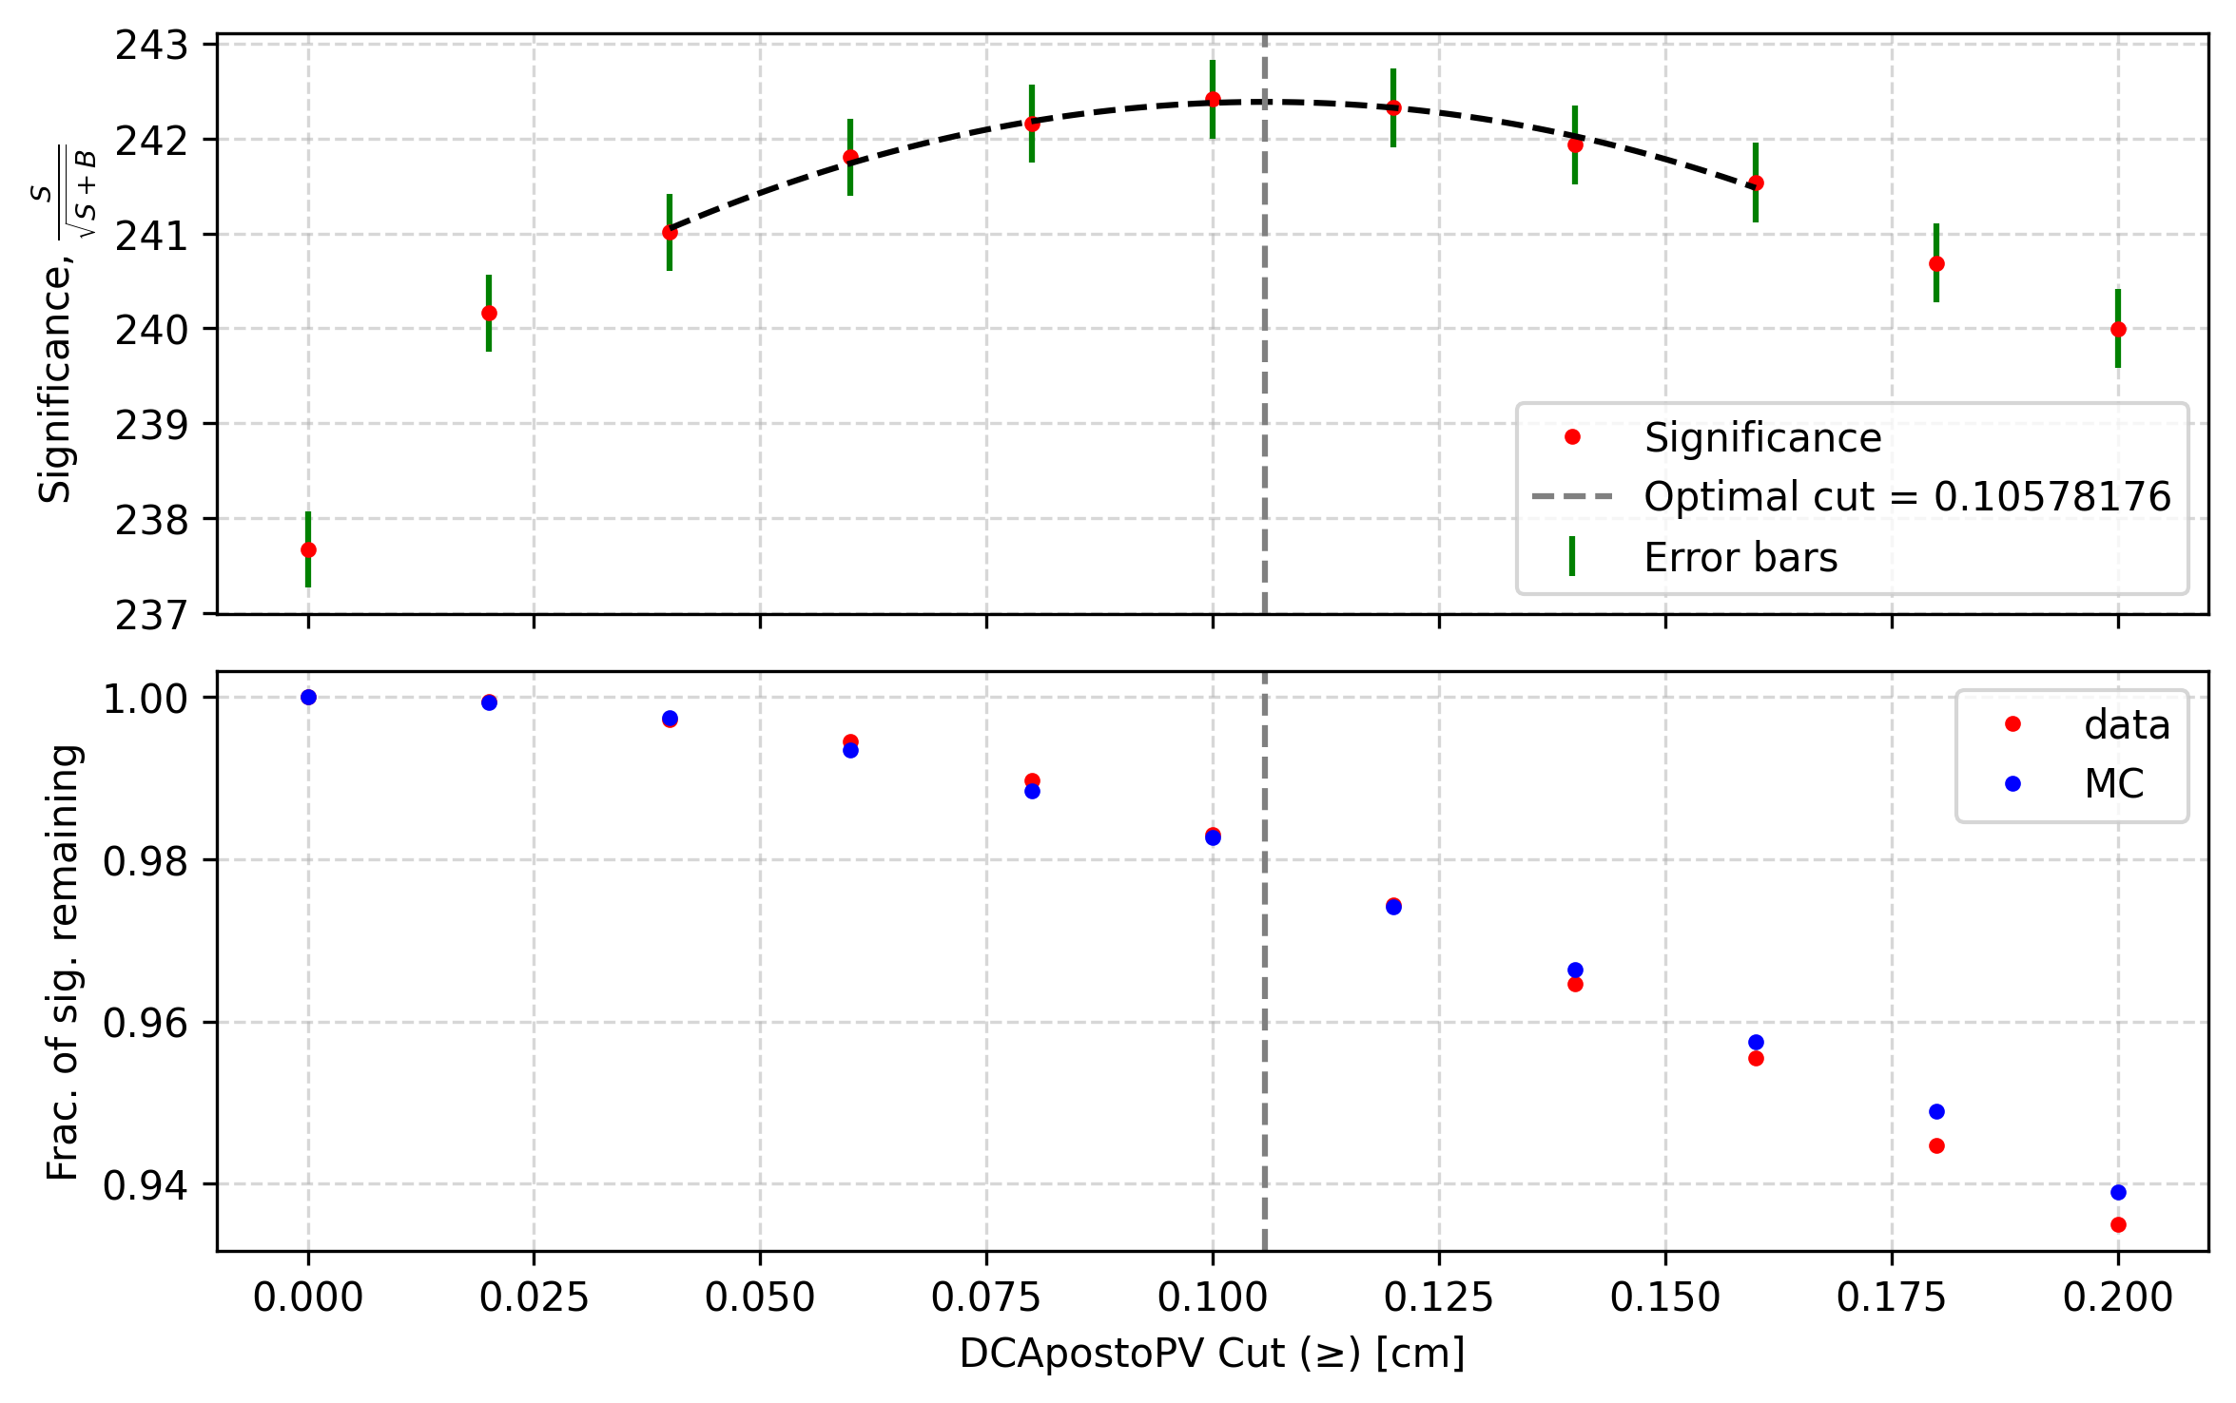
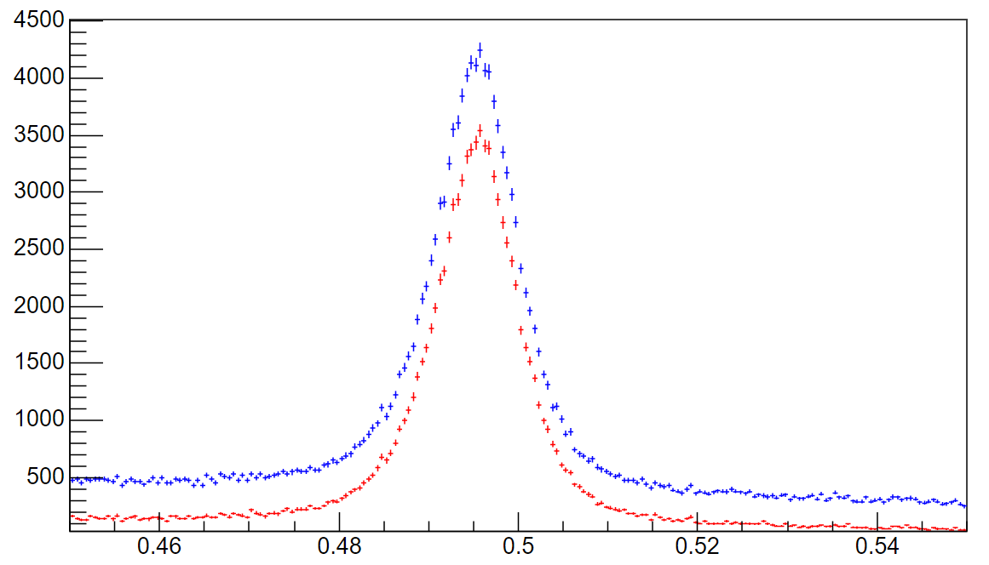
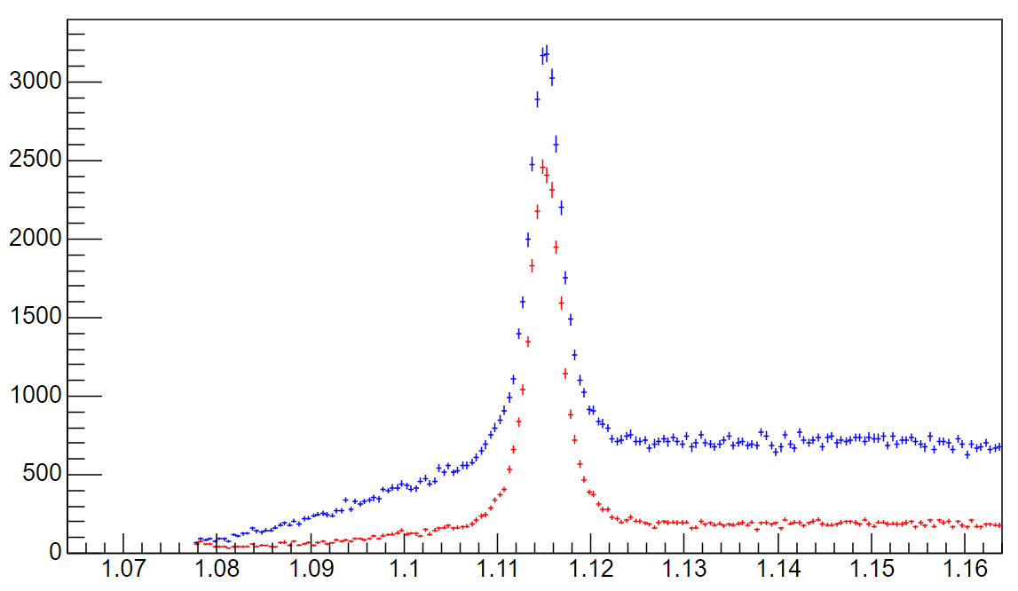
Significance plots
Cut Values | K0 | Lambda
Dcanegtopv [cm] | > 0.101 | > 0.181
Dcapostopv [cm] | > 0.106 | > 0.050
Dcav0dau [σ] | < 0.205 | < 0.250
Cosine of p.a. | > 0.993 | > 0.990
V0radius [cm] | > 0.9 | > 1.4
Choose cuts that:
- maximise significance
- retain at least 90-95% signal
- well described by Monte Carlo (MC) data
Table 1. Final cut values.
Significance
Counts
Counts
Signal remaining
Figure 5. Invariant mass distribution for K0 (left) and Lambda (right). Blue indicates original loose cuts and red indicates the optimal cut values were used.
Figure 4. Significance of K0 mass plot and signal fraction remaining against DCAnegtoPV cut.

Slide 8
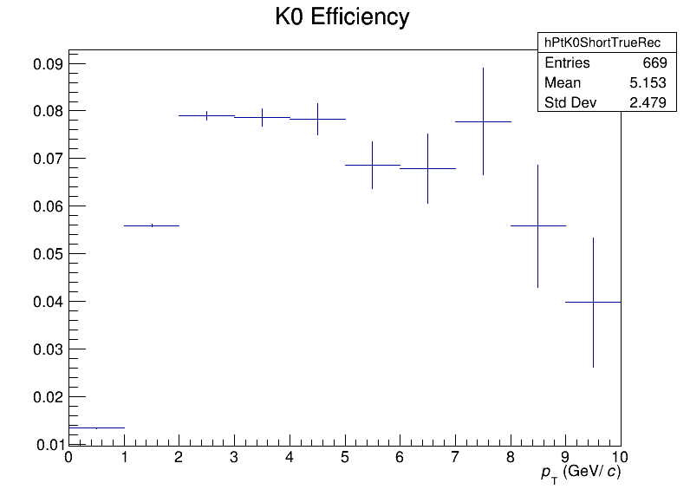
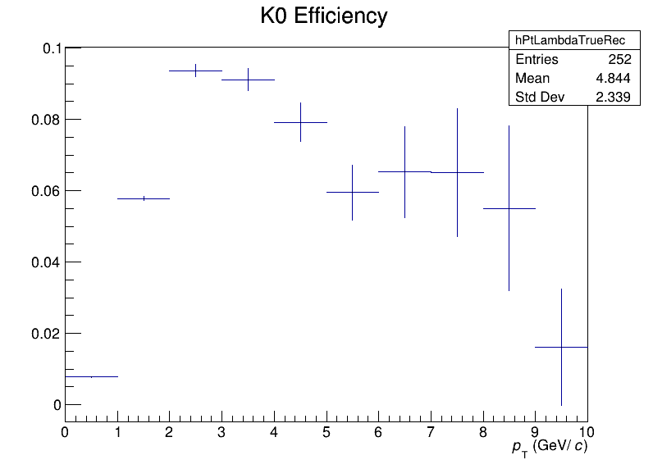
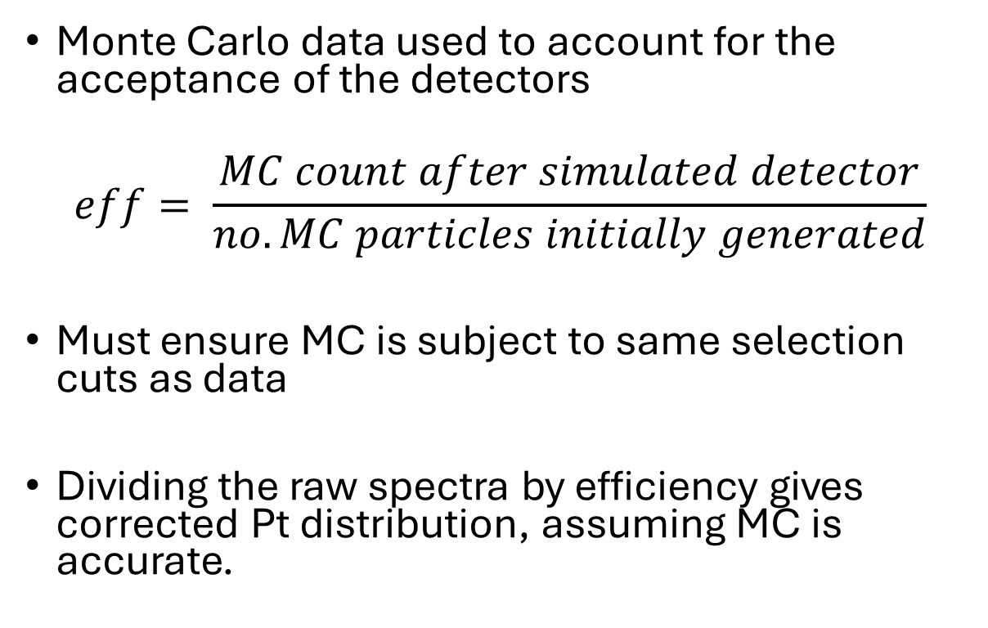
V0 Efficiencies
Efficiency
Monte Carlo data used to account for the acceptance of the detectors
$$eff= \frac{MC count after simulated detector}{no. MC particles initially generated}$$
Must ensure MC is subject to same selection cuts as data
Dividing the raw spectra by efficiency gives corrected Pt distribution, assuming MC is accurate.
Lambda Efficiency
Efficiency
Figure 6. Efficiency for K0 (top) and Lambda (bottom) as a function of Pt

Slide 9
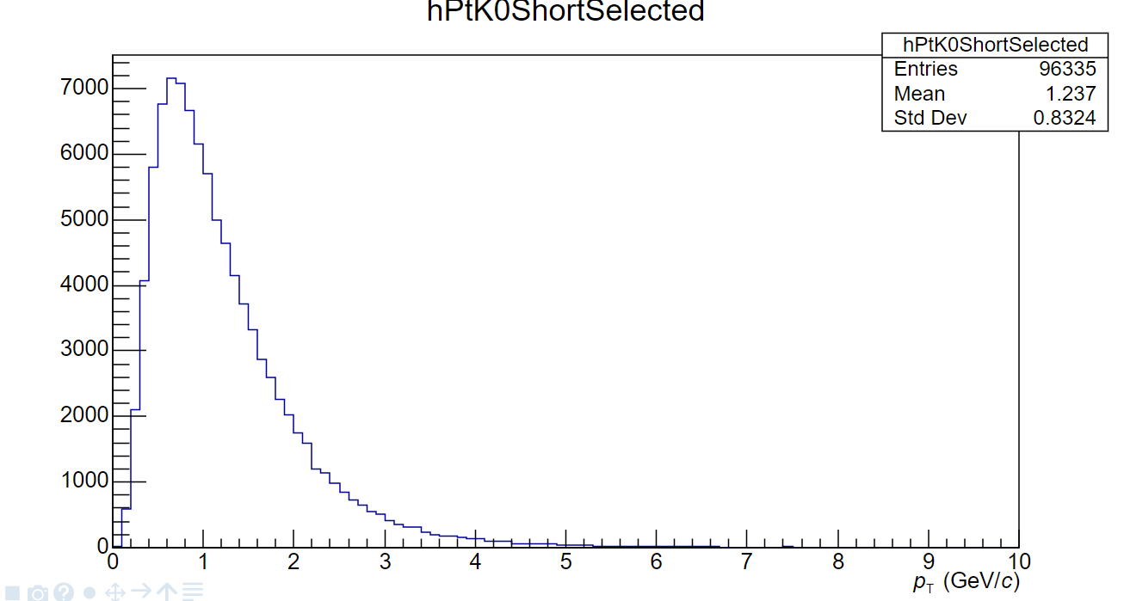
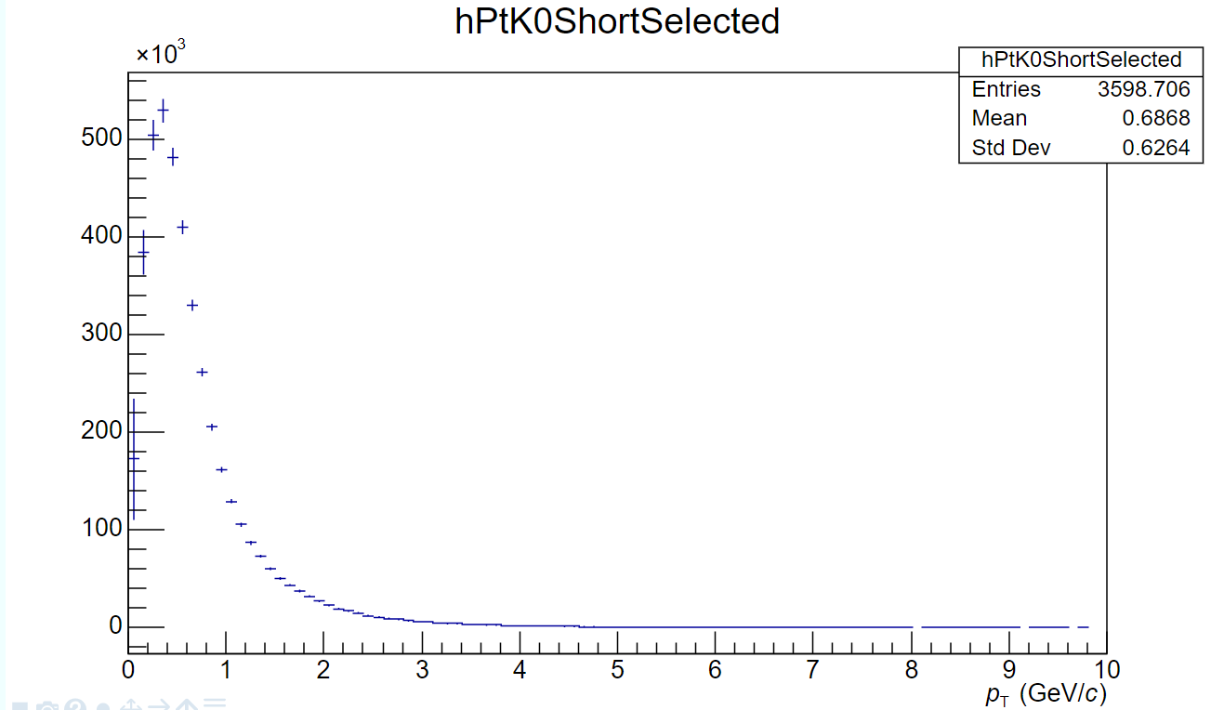
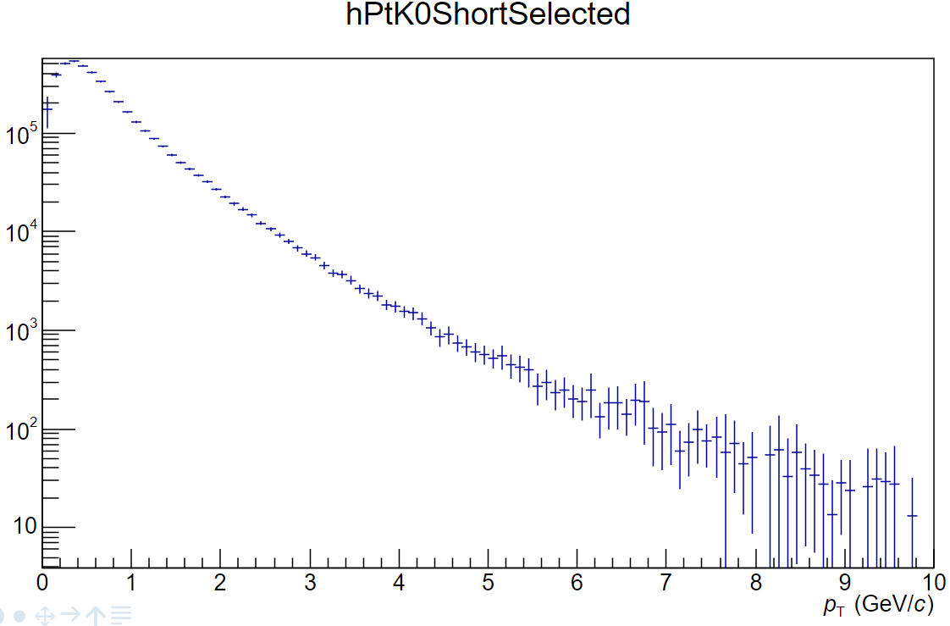
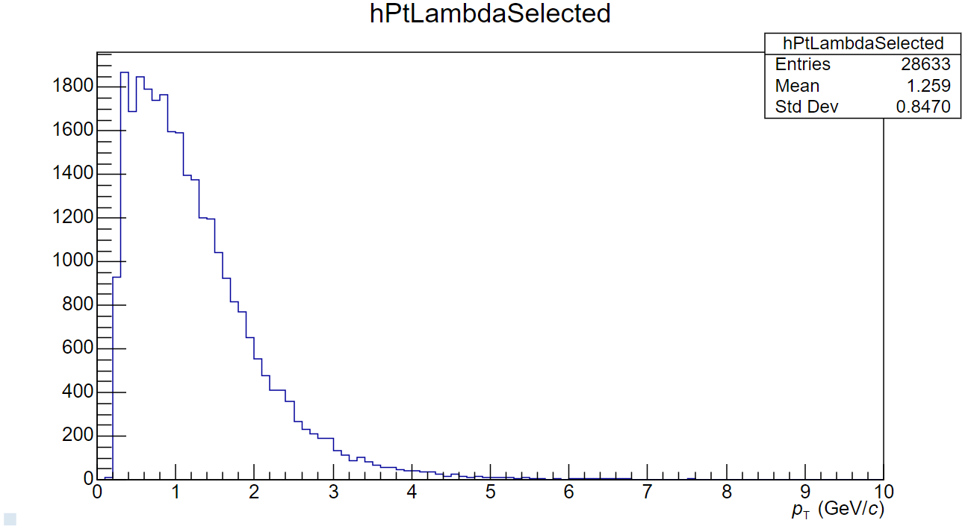
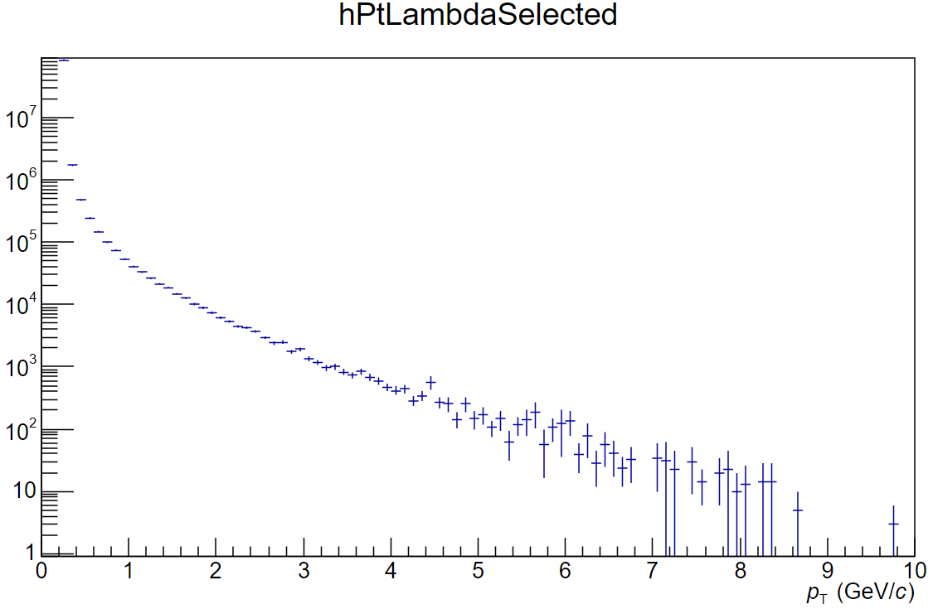
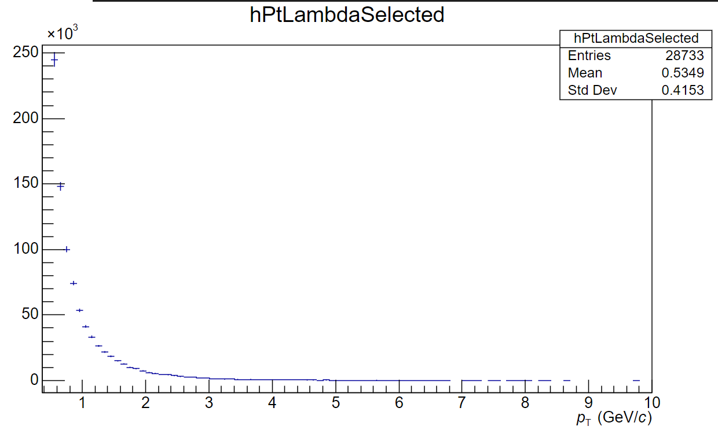
Results: Uncorrected and Corrected pT …….distributions for K0 and Lambda
Uncorrected K0
Corrected K0
Corrected K0
Counts
Counts
Counts
Uncorrected Lambda
Corrected Lambda
Corrected Lambda
Counts
Counts
Counts
Figure 7. Uncorrected pT distributions for K0 (top) and Lambdas (bottom)
Figure 8. Corrected pT distributions for K0 (top) and Lambdas (bottom)
Figure 9. Corrected pT distributions for K0 (top) and Lambdas (bottom) with a log scale

Slide 10

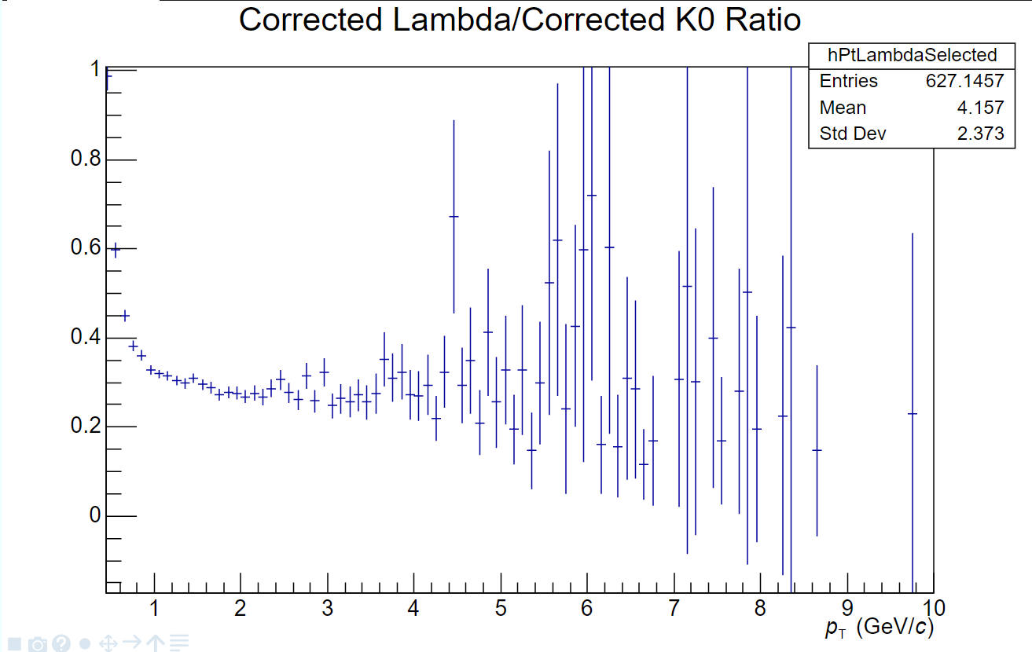
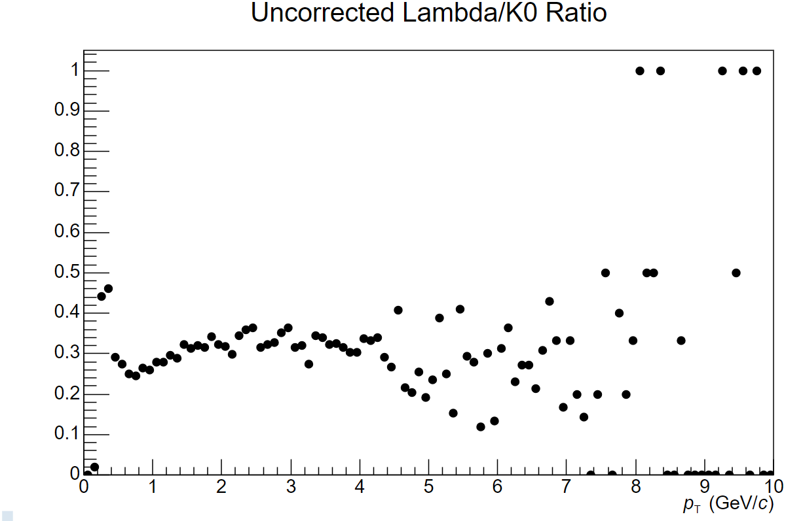
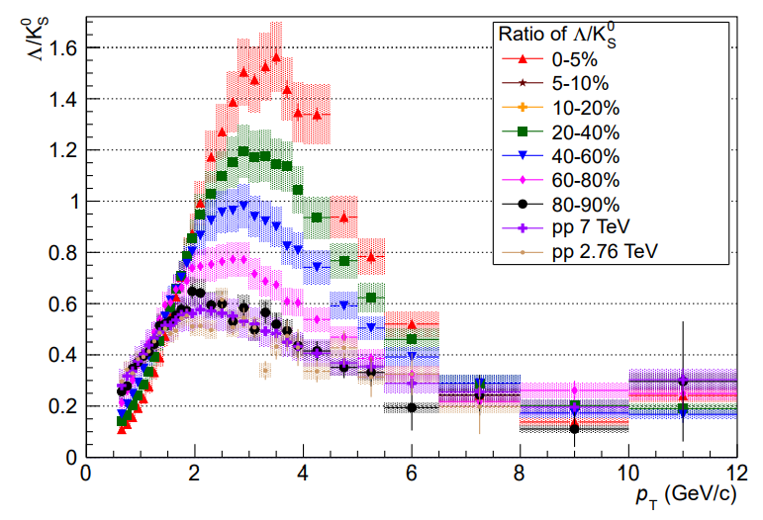

Baryon to meson ratio
Ratio spikes at low pT, before settling at ~0.3
Previous analysis showed ratio peaking at ~0.6 at approximately 2GeV/c
Uncorrected ratio shows a more consistent shape
Figure 10. Lambda/K0 ratio (top) compared with similar analysis of data from 2010¹
Figure 11. Uncorrected Lambda/K0 ratio. Error bars have been omitted for clarity

Slide 11
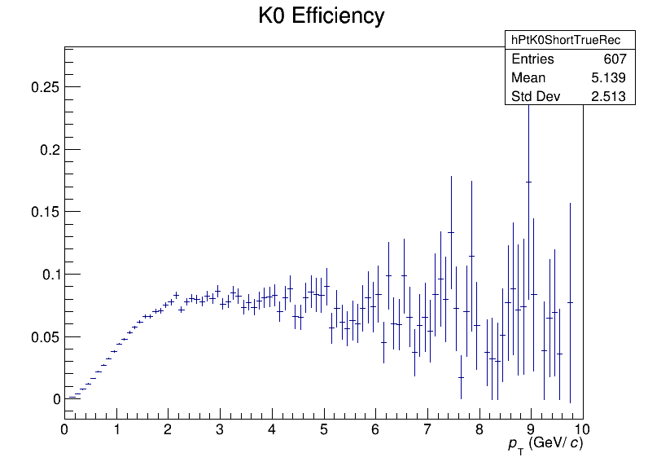
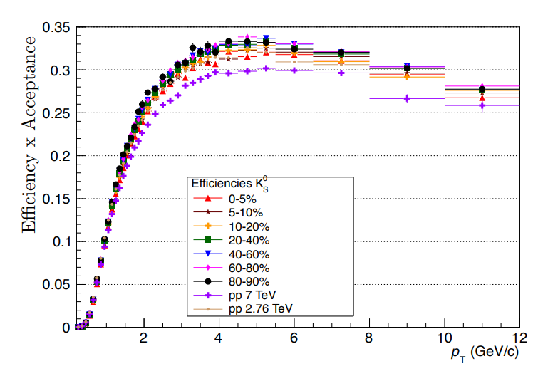
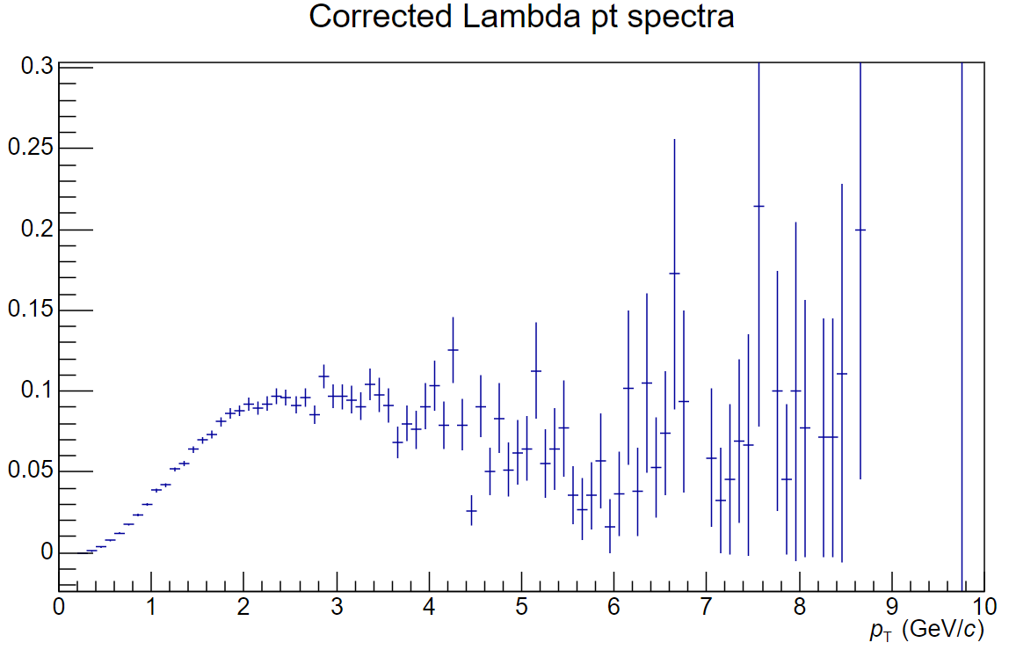
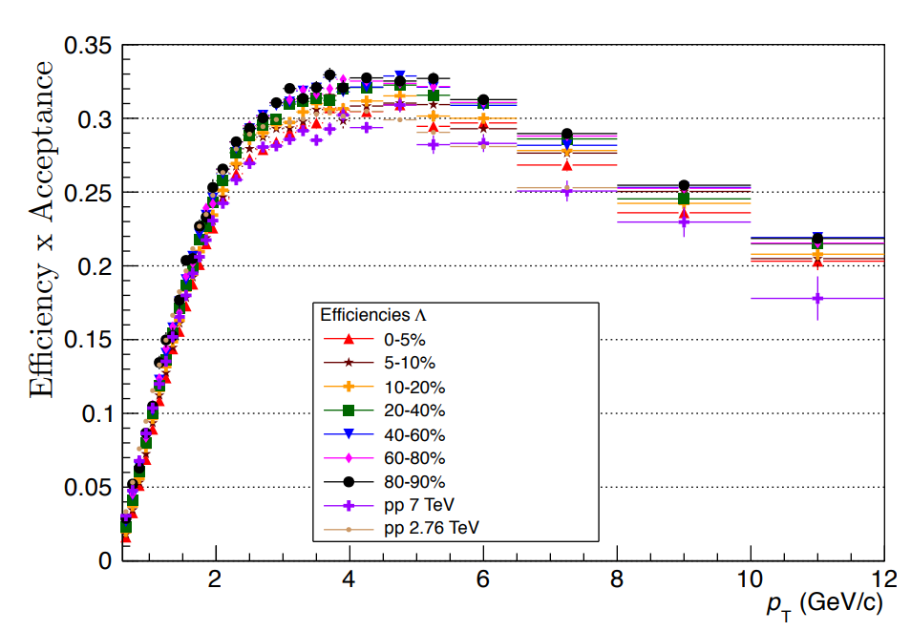
Efficiency Comparison to Previous Analysis
General shape is consistent
However, peak is lower and to the left compared to previous calculations
Efficiencies are a factor of three lower than expected
Efficiency
Lambda Efficiency
Efficiency
¹ Hanratty, L.D. (2014). "Λ and K0S production in Pb-Pb and pp collisions with ALICE at the LHC." Ph.D. thesis, University of Birmingham.
Figure 12. K0 (top) and Lambda (bottom) efficiencies with more bins
Figure 13. K0 (top) and Lambda (bottom) efficiencies calculated using data from previous runs¹

Slide 12
Remainder of Project
Plan:
Compare pT distributions with previous analysis
Plot anti-lambda/lambda (Λ̅/Λ) ratio:
- at high temperatures, production rates are nearly equal
- any deviation from 1 may indicate changes in production mechanisms
- deduce relative abundances of strange and anti-strange quarks

Slide 13
Summary
Project Progress:
Optimised selection cuts for K0 and Lambdas
Obtained efficiencies and corrected pT distributions
Results
Efficiencies are lower than expected
Corrected Lambda/K0 distribution also differs from that obtained in previous analysis
Remainder of Project:
Further comparisons between corrected pT spectra may be useful
Anti-Lambda/Lambda plot

