Slide 1
Data science HW2
Department of Computer Science
National Tsing Hua University (NTHU)
Hsinchu, Taiwan
Date: March 29th, 2022
TA: 簡子昀
TA Email: tfg10232338@gmail.com

Slide 2
HW2
Description
How to submit and choose predictions
Baseline method
Hints

Slide 3

Kaggle
HW2 will be held on Kaggle
Please register a Kaggle account first
A platform of
Machine learning competition
Sharing dataset
https://zh.wikipedia.org/wiki/Kaggle

Slide 4
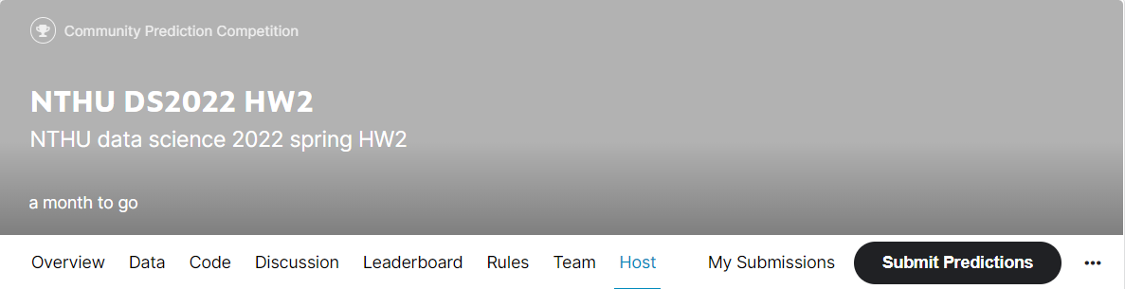
HW2
HW2 Kaggle link
https://www.kaggle.com/t/5e802ad74032485e94a4e1d1d91c0870
Deadline: 2021/04/19 23:59 (3 weeks)
We will use the result on Kaggle to score this homework
Please hand in a python file
Remember to fill your Kaggle name in the google form https://docs.google.com/spreadsheets/d/1nh0shU11SOPmwZFAzIVv71yB2olclMHW/edit?usp=sharing&ouid=108250933224256718627&rtpof=true&sd=true

Slide 5
Problem description
Supervised binary classification problem
Given a data set
Training set with label
Testing set without
You need to predict the labels of testing data

Slide 6
Dataset description
The dataset is transformed from real weather observations dataset
16 numeric features, 5 nominal features, 1 label
Numeric feature are nonlinear transformed
About 20% data become missing value
Our dataset label is ‘Label’

Slide 7
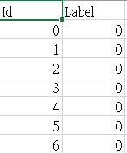
Output format
For each testing instance, there is a unique id
Output your prediction to csv file with the following format and submit to kaggle Remember to output the first line
Id, Label
Id1, Label 1
Id2, Label 2
…

Slide 8
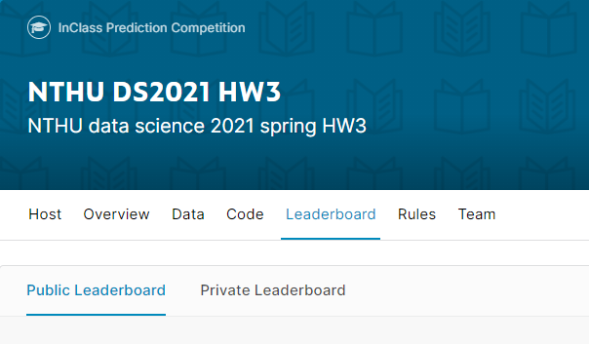

Evaluation
We use F1-score
$2×\frac{precision×recall}{precision+recall}$
There are two leaderboards on Kaggle
Public
Can be seen during competition
Private
Can be seen after competition

Slide 9
Public and Private leaderboard
Public (Can be seen during competition)
30% testing data
For reference
Private (Can be seen after competition)
the other 70%
Use this result for final scoring
30%
Public score
Testing
data
70%
Private score

Slide 10
Scoring
Use private leaderboard result for final scoring
Baseline scores
We will score according to given 7 baseline scores
 | Public | Private
Baseline 88 | 0.44492 | 0.43355
Baseline 83 | 0.40148 | 0.38576
Baseline 80 | 0.36224 | 0.36259
Baseline 70 | 0.32343 | 0.33192
Baseline 60 | 0.29102 | 0.28034
Baseline 0 | 0.26840 | 0.25701

Slide 11
Scoring
Baseline 0
Baseline 60
Baseline 70
Baseline 80
Baseline 83
Baseline 88
Top 20% : 100
20%~80%: 92
Others: 88
0
60
70
80
85
You will get 0, if your private score is between baseline 0 and baseline 60
You will get 60, if your private score is between baseline 60 and baseline 70
You will get 70, if your private score is between baseline 70 and baseline 80
And so on

Slide 12
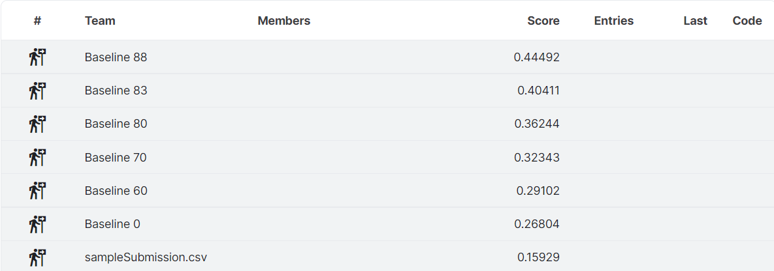
Scoring
Baseline scores
There are benchmarks on the leaderboard for reference

Slide 13
Other rules
You can submit 15 times per day
You can choose 4 predictions for final scoring
Kaggle will use the best one to be your final result

Slide 14
How to submit and choose predictions

Slide 15
How to submit
Click ‘Submit Predictions’ button on the navigation bar

Slide 16
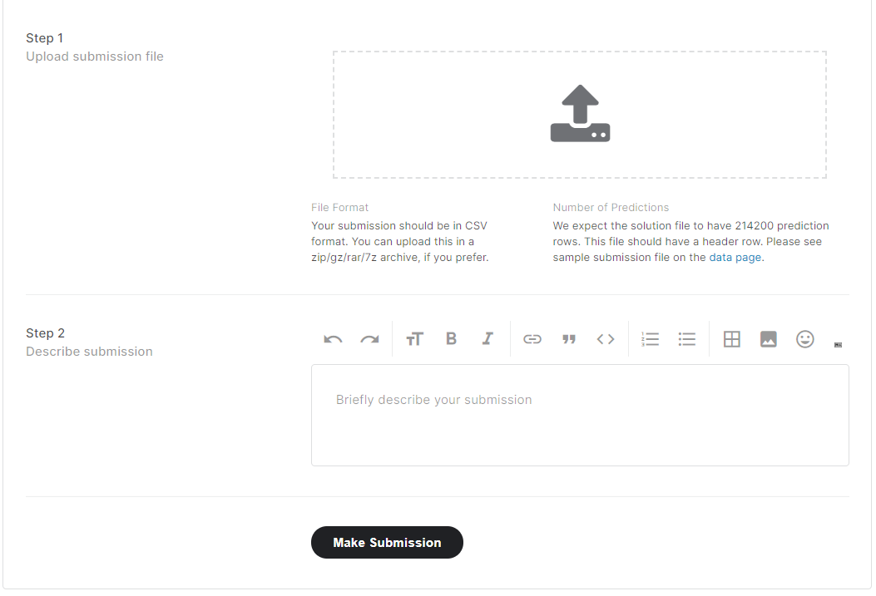
How to submit
Upload your answer csv file here
You can write some description about the answer csv file
Click to submit

Slide 17
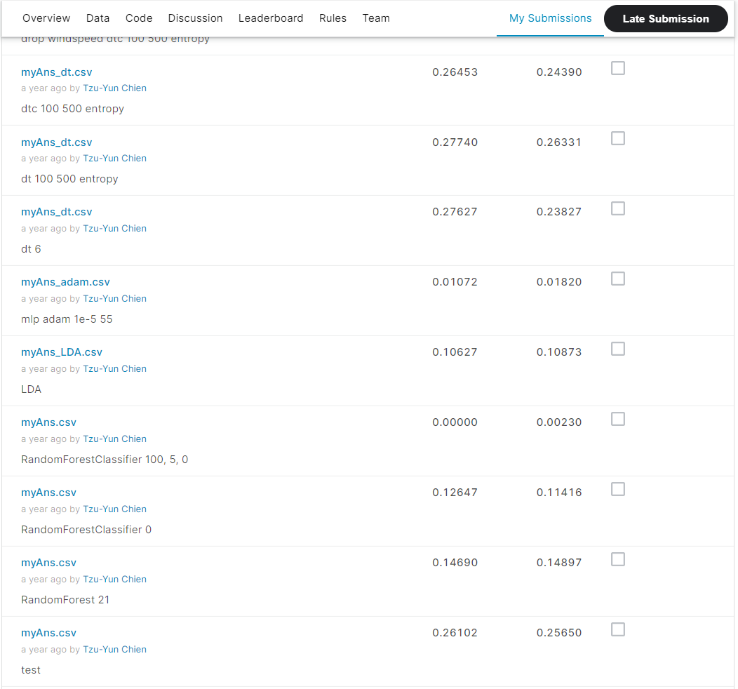
Choose predictions for final scoring
You can see all your submissions in ‘My Submissions’
Remember to choose 4 predictions before the deadline

Slide 18
Baseline method

Slide 19
Baseline method
We provide a simple baseline method code for your reference
Baseline 0
The steps in baseline are as below
Read training/testing data
Drop columns which are not numeric features
Fill missing value
Train a decision tree classifier
Output prediction

Slide 20
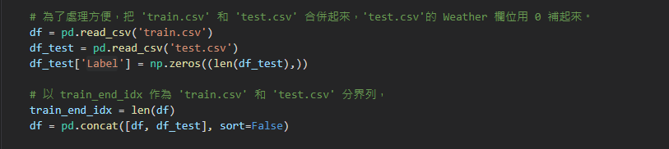
Baseline 0 method
Read training/testing data

Slide 21
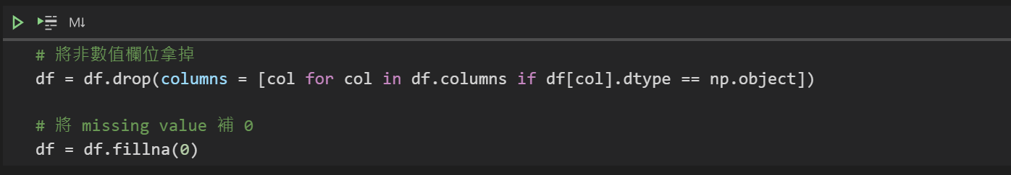
Baseline 0 method
Drop columns which are not numeric features
Fill missing value

Slide 22
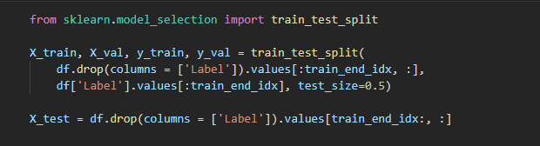
Baseline 0 method
train.csv
test.csv
X_train
X_val
X_test
train_end_id
Split dataset

Slide 23
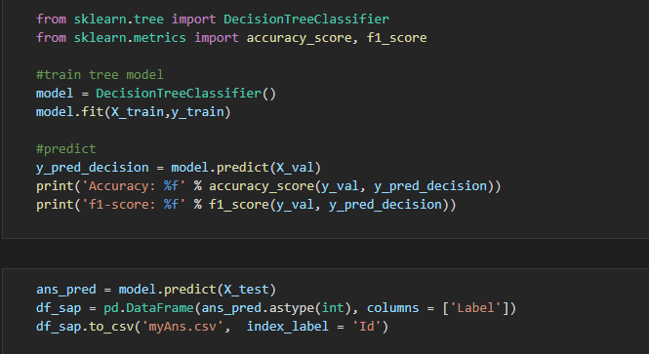
Baseline 0 method
Train a decision tree classifier and output prediction

Slide 24
Hints

Slide 25
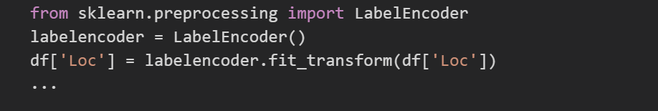
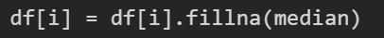
Hints
You can try to encode features in object type
Some features in object type may contain important information
Fillna with median in numeric features instead of 0
Complete these may achieve the same or higher effect as the baseline 60

Slide 26
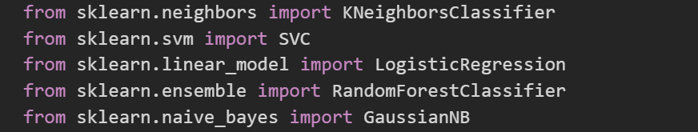
Hints
Try different models
KNN, SVM, Logistic Regression, Random Forest ...
Finetune the model may achieve higher effect than the baseline 70

Slide 27
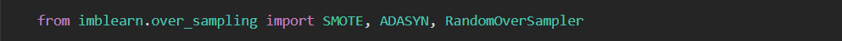
Hints
The numbers of label is imbalance
Deal with data imbalance
There are some sampler you can try
Complete this may achieve the same or higher effect as the baseline 80

Slide 28
Hints
More techniques for better performance
Feature selection
Normalization
Dimension reduction (PCA, TSNE)
Try other different models (AdaBoost….)
…
We use private leaderboard as the final score
Use public score to choose your model is dangerous
It’s better to perform validation

Slide 29
Packages you may use
Scikit-learn
https://scikit-learn.org/stable/index.html
Pandas
https://pandas.pydata.org/pandas-docs/stable/
Imbalance learn (for over sampling and down sampling)
https://imbalanced-learn.readthedocs.io/en/stable/

