Slide 1

Exploring Stock Movements
By Haozhe Zeng & Zixiao Wang

Slide 2
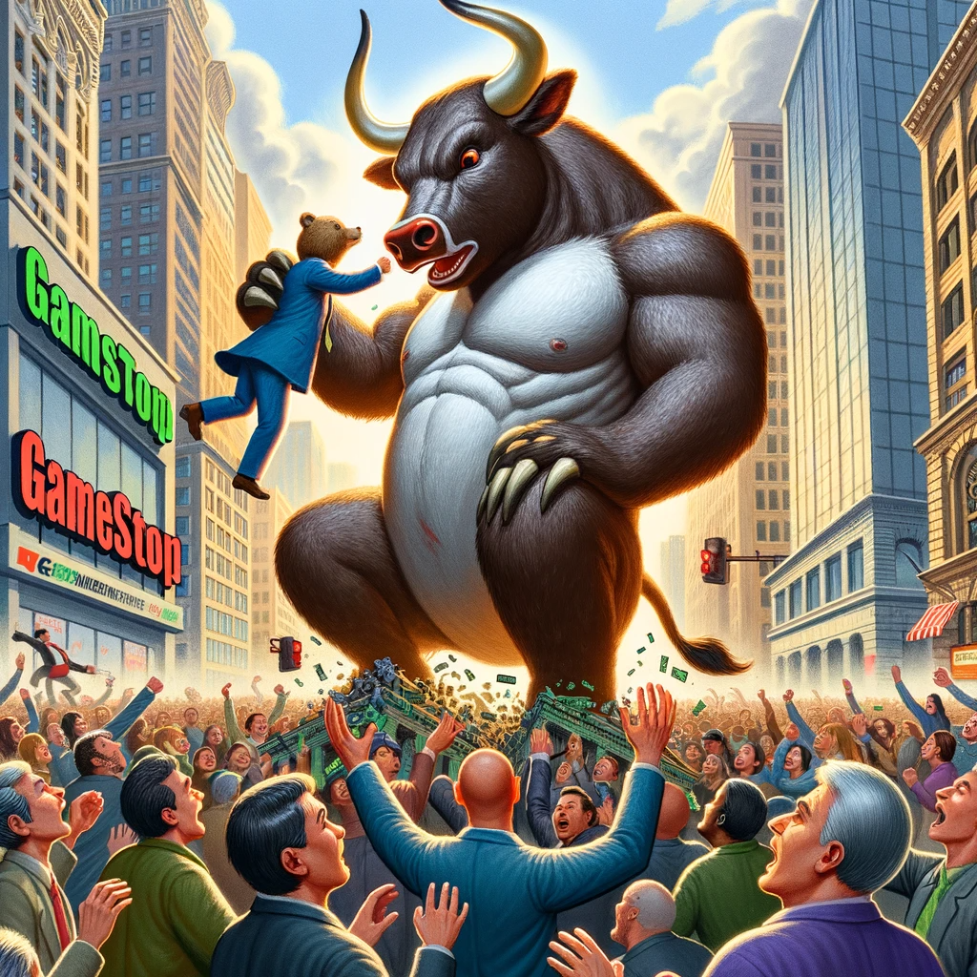
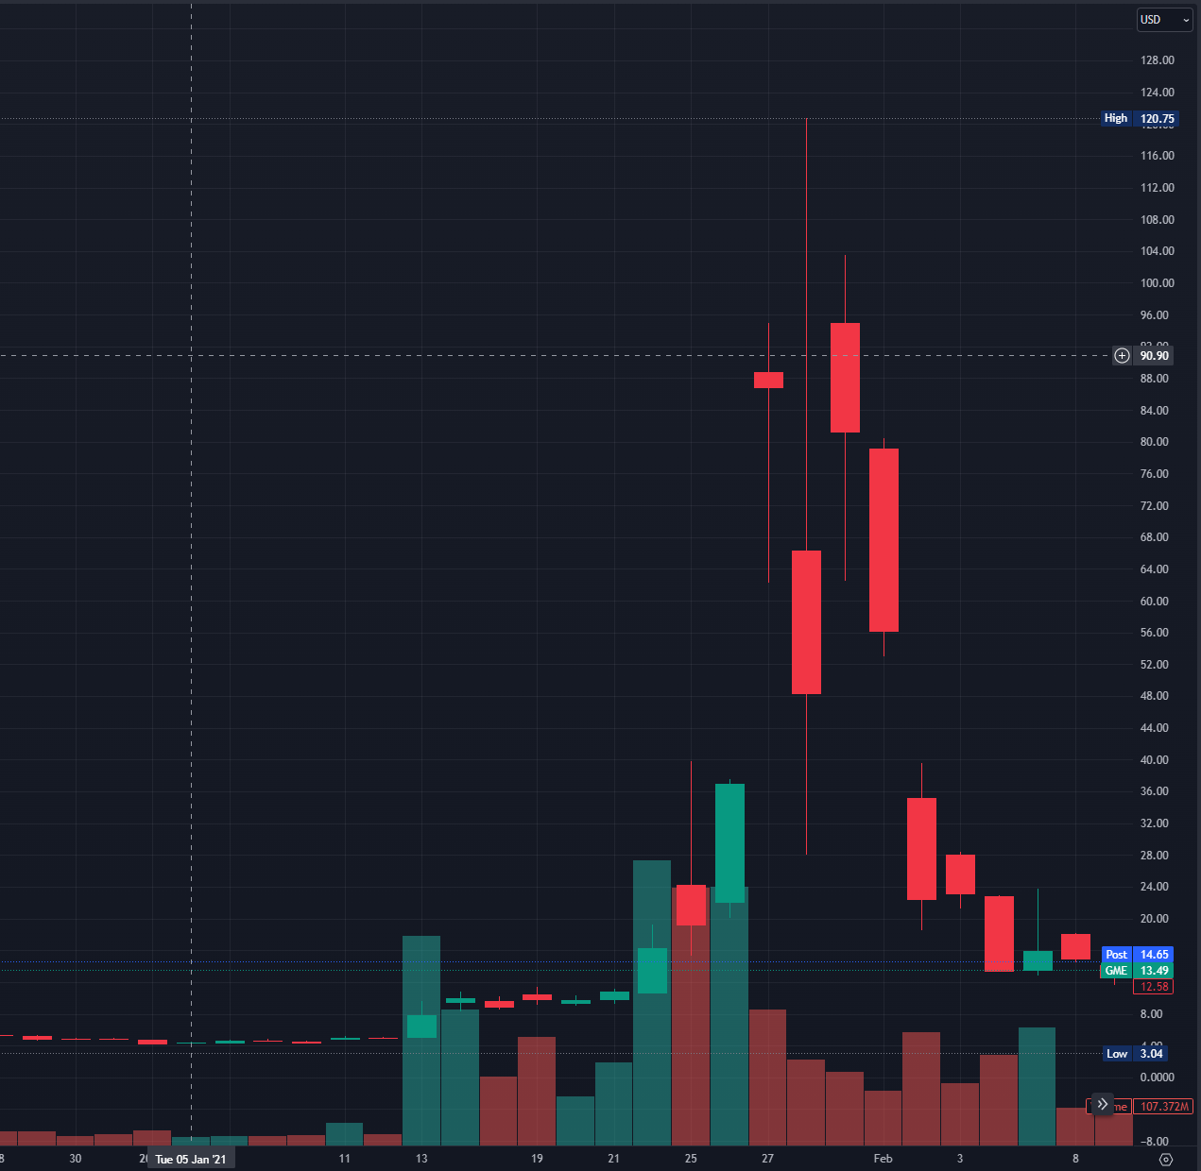
Motivation
GameStop short squeeze

Slide 3
Cleaning, Entity Matching, Merging, etc.
Post from Twitter and Reddit
Sentiment Labeling
Quantify/Normalize Data
Processing, Indicators Calculating, etc.
Stock data: Close, Volume, etc.
Time Series Modeling
Buy/Sell Decision
Return

Slide 4
Problem Definition
Construct a model to capture buying and selling signal of the stock market
Time series modeling to estimate the return
Modeling stock market signals for buying and selling
Decision making using the return from models
Balancing time series modeling with decision-making strategies
Implement sentiment analysis of retail trader on Twitter and Reddit and study their impact
Entity matching
Sentiment analysis
Incorporating sentiment analysis of retail traders from social media

Slide 5
Why this approach
Similarities:
There are paper study the correlation between stock market and retail traders’ sentiment
There are paper about building models to predict stock return
Uniqueness
We implemented a dynamic approach to make short term prediction
We focus both on loss and gain
We incorporate sentiment analysis into our model

Slide 6
Approach: Sentiment Analysis

Slide 7
What we have for sentiment analysis

Slide 8
Approach: Stock Movement Prediction
Objective: capture trading signal
Price Vs. Return
Stationary vs Nonstationary data
Window Size Selection
Hyperparameter tunning
Dynamic Decision Making
Make decision based on the distribution of returns of past 40 days

Slide 9
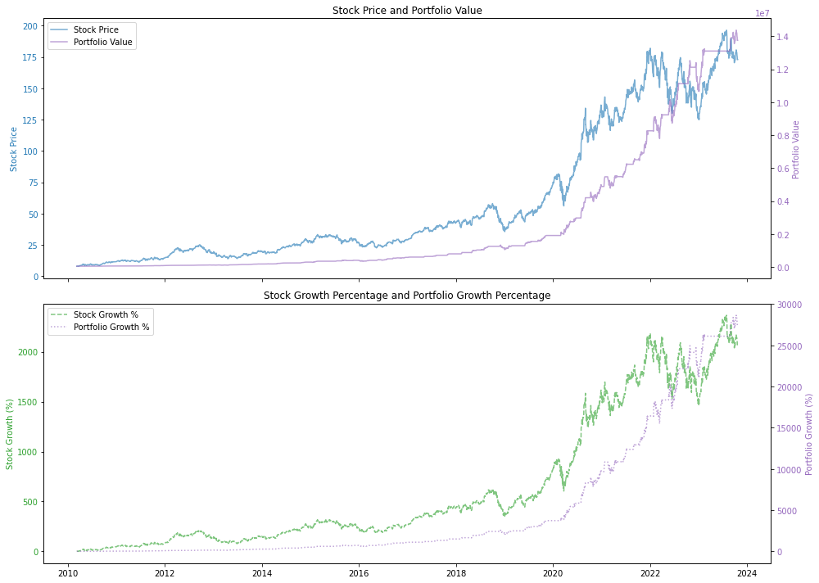
Apple

Slide 10
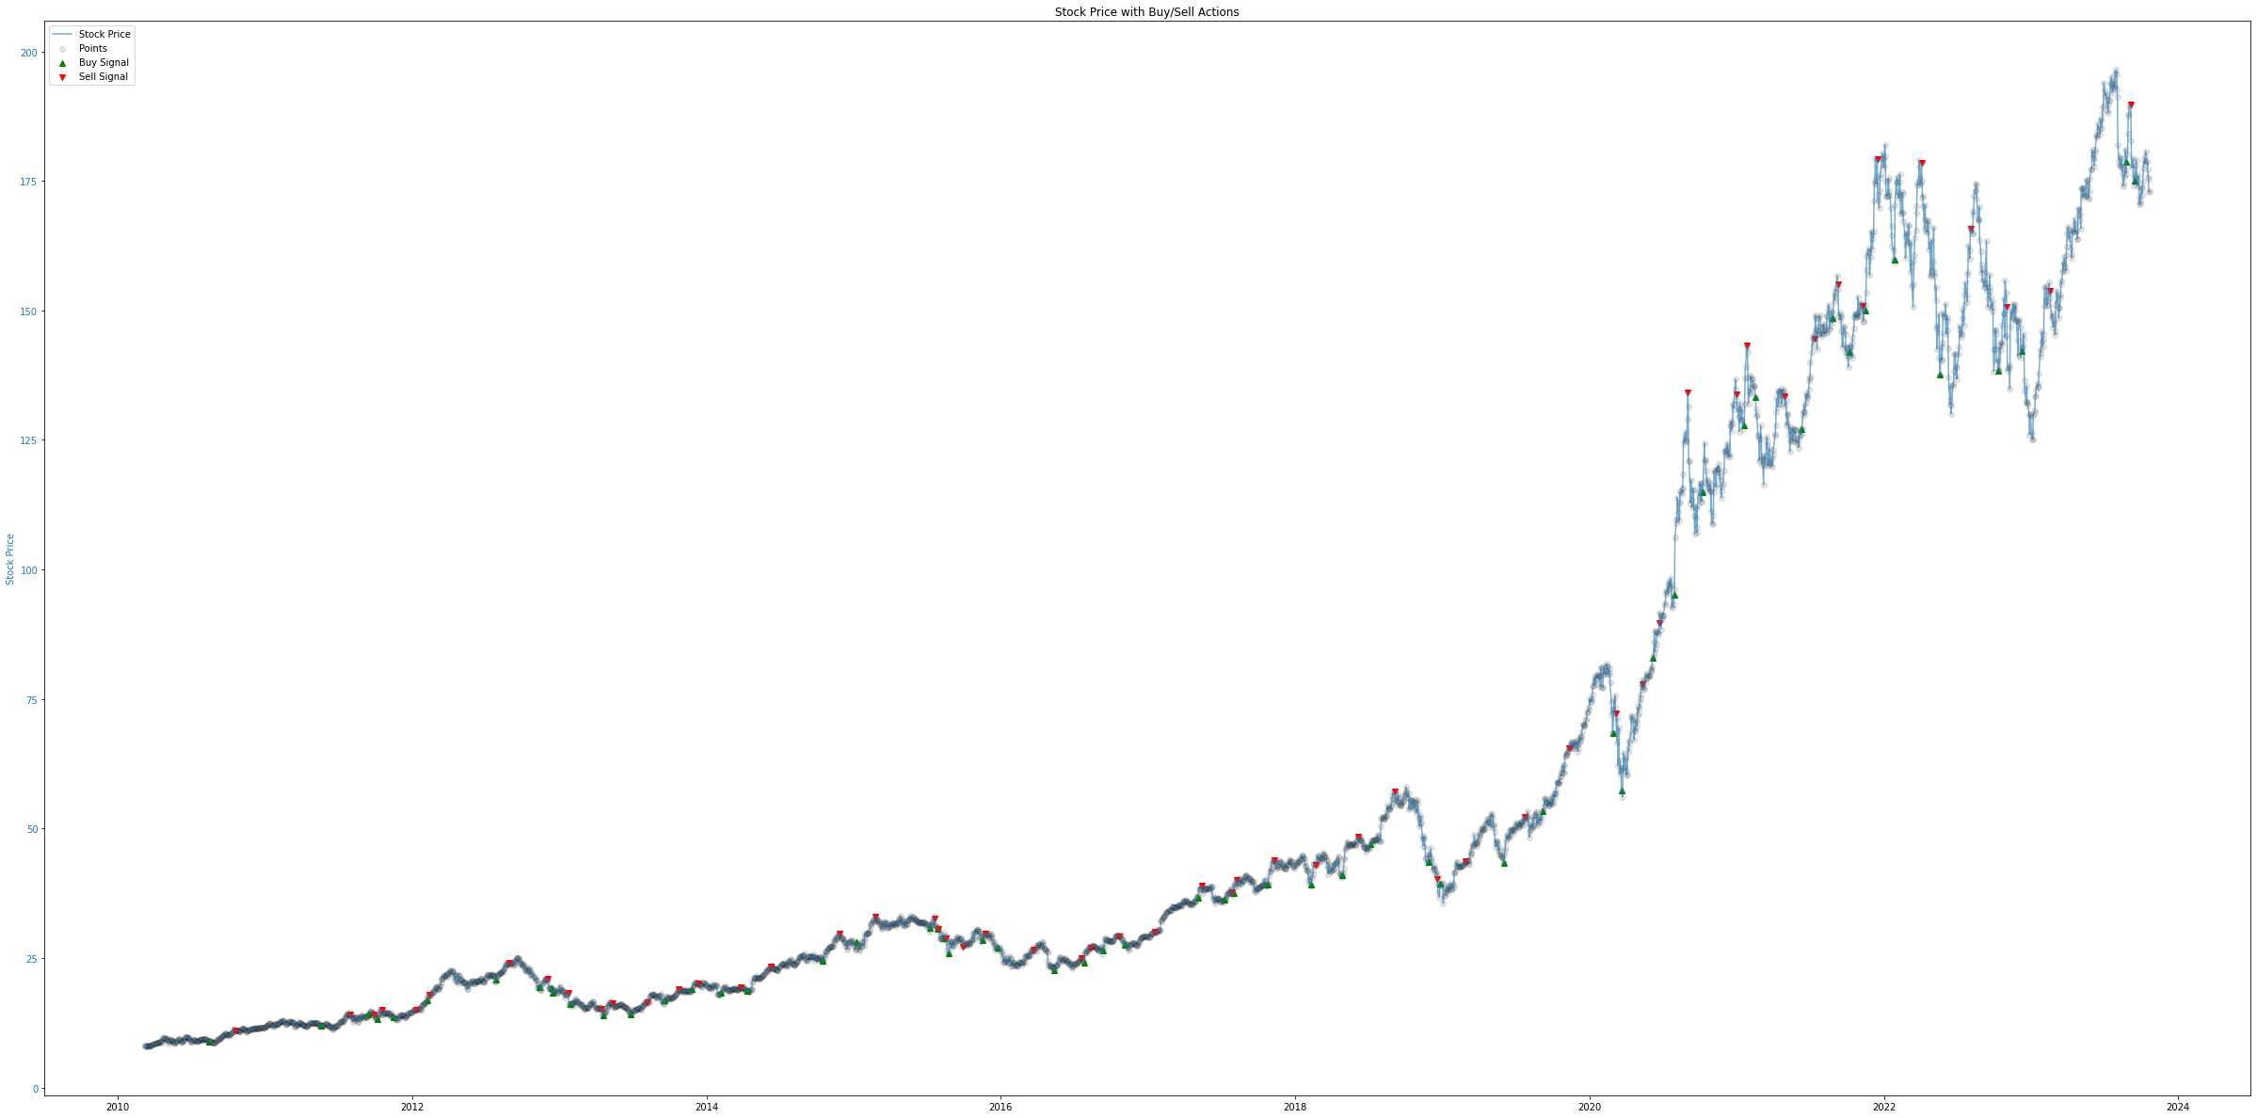

Slide 11
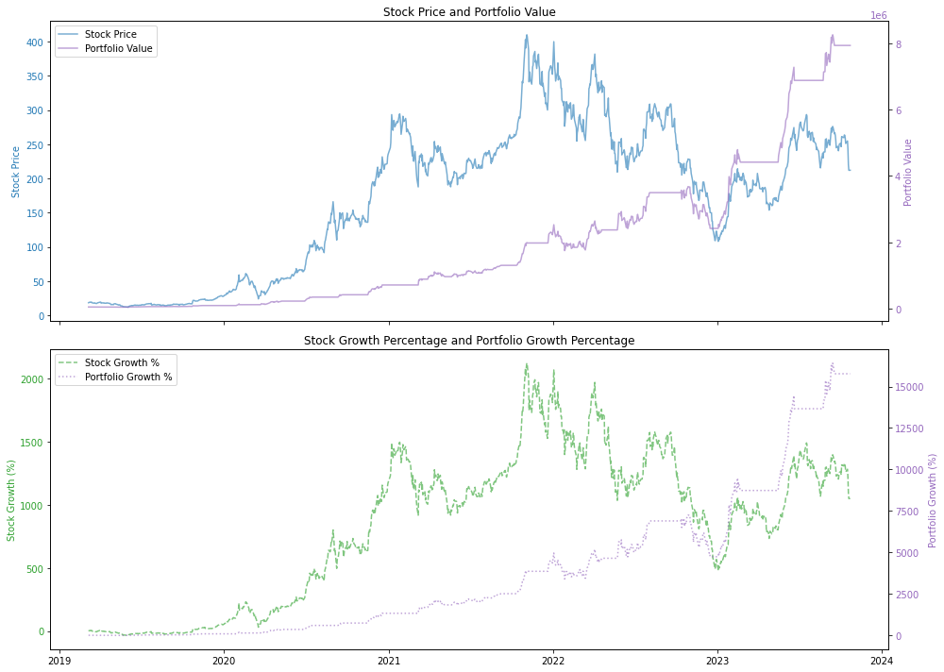
Tesla

Slide 12
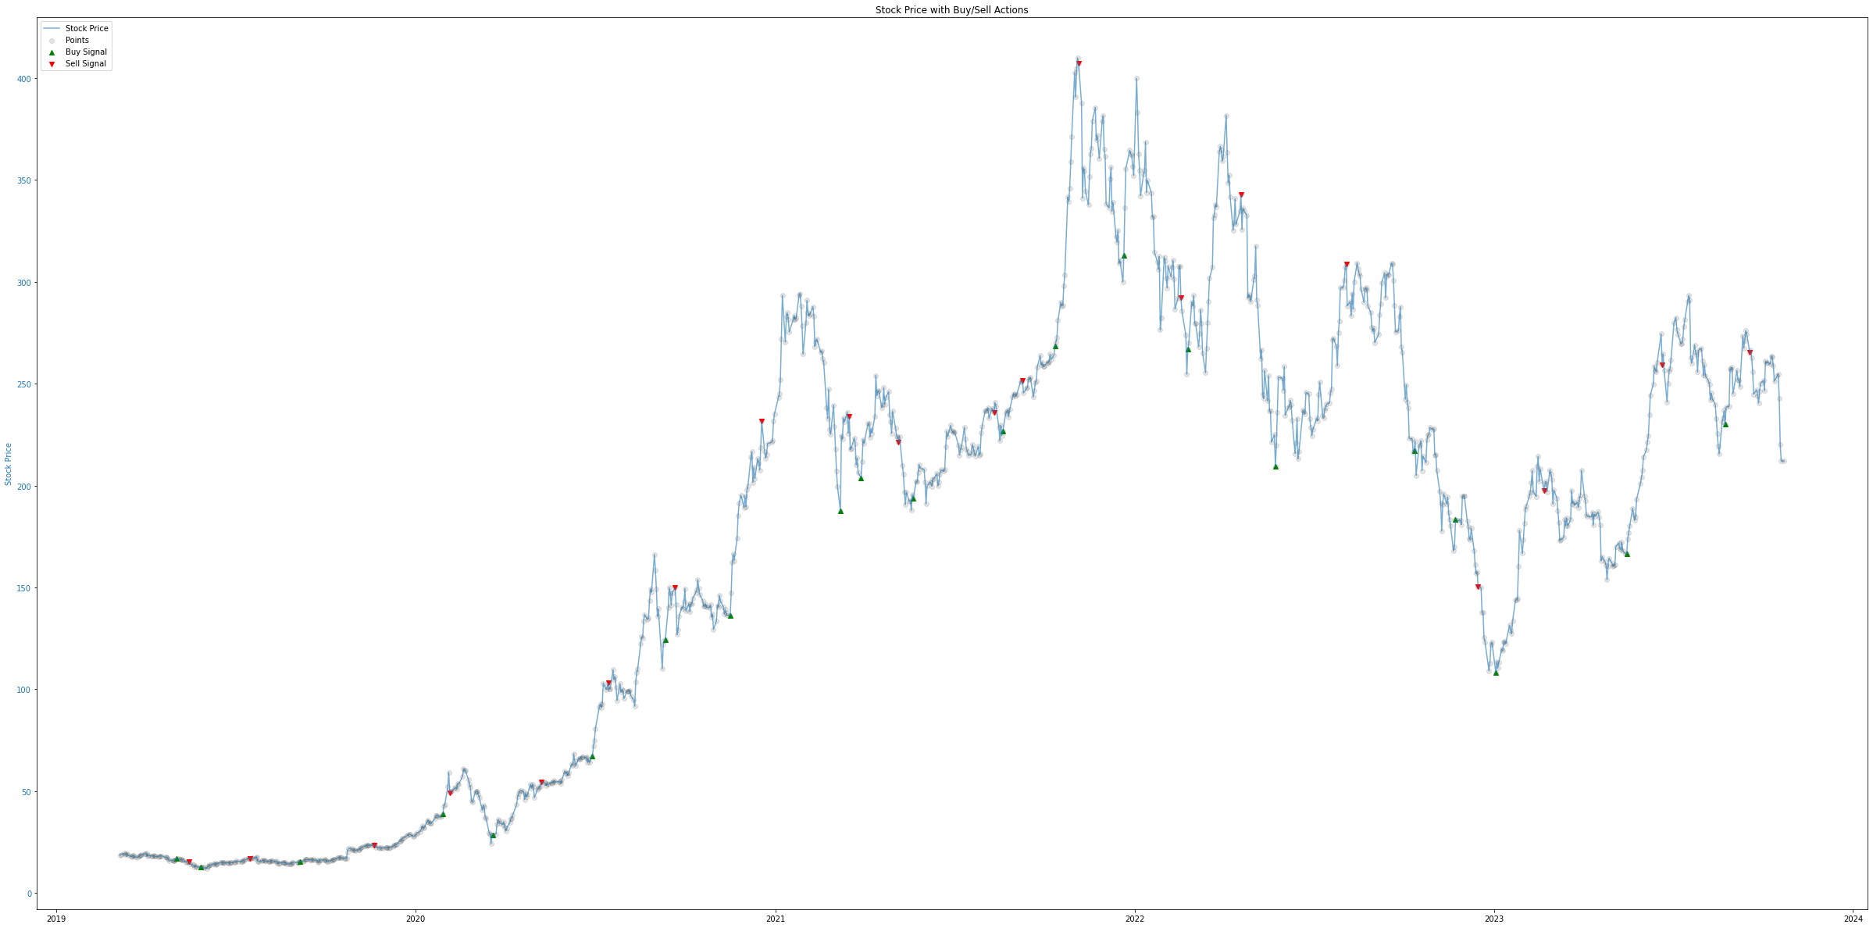

Slide 13
What we can do better
Sentiment Analysis
Capture the sentiment from institutional traders: news, reports published by professional analyst
Stock Prediction
Capture more stocks/sectors: meme stock, health sector, retail sector, etc.
Gather more data: earning reports, unemployment rate (every Friday), Open Interest (Option), etc
Stock selection
Portfolio Optimization

Slide 14

Q&A

Slide 15

Thank you!

