Slide 1

Exploring Stock Movements
By Haozhe Zeng & Zixiao Wang

Slide 2
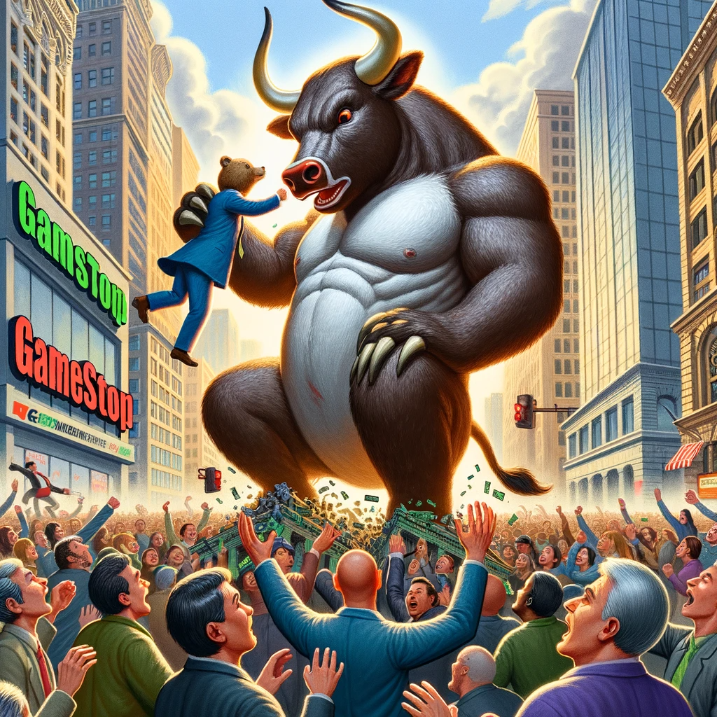
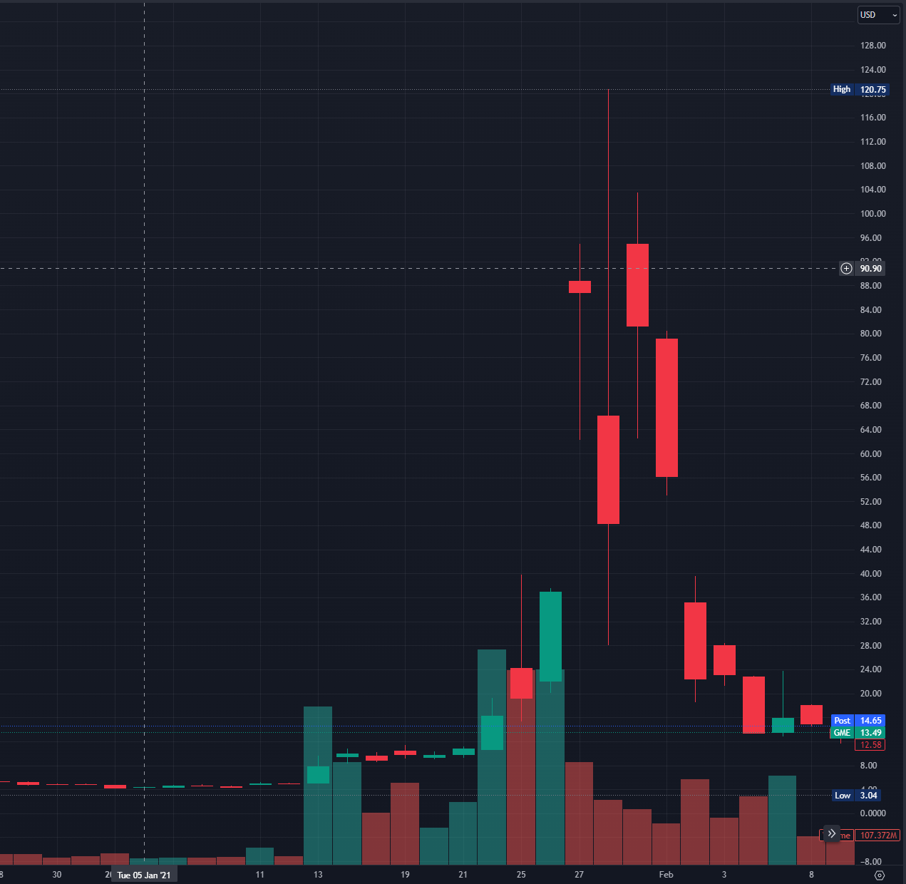
Motivations
Digitization of trading platforms
The relentless rise of retail trading
GameStop short squeeze

Slide 3
Related Works
Similarities:
Study the correlation between stock market and retail traders’ sentiment
Build models to predict stock return
Uniqueness
Implement a dynamic approach to make short to mid term (one week) prediction
Focus on both loss and gain
Incorporate sentiment analysis into model

Slide 4
Cleaning, Entity Matching, Merging, etc.
Posts from Twitter and Reddit
Sentiment Labeling
Quantify/Normalize Data
Processing, Indicators Calculating, etc.
Stock data: Price, Volume, etc.
Time Series Modeling
Buy/Sell Decision
Portfolio

Slide 5
Problems to solve
Construct models to capture buying and selling signal
Time series modeling
Dynamic decision making
Implement sentiment analysis of retail trader and study their impact
Entity matching
Sentiment analysis

Slide 6
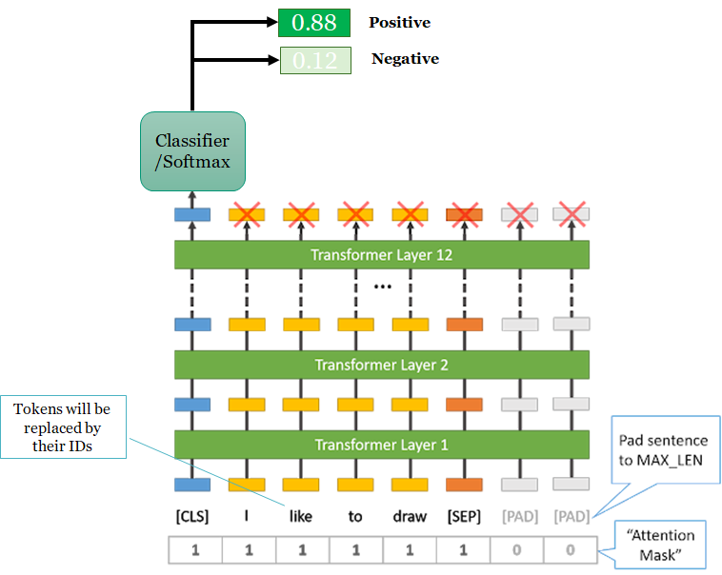
Sentiment Analysis
DatasetDict({
train: Dataset({
features: ['text', 'label', 'input_ids', 'token_type_ids', 'attention_mask'],
num_rows: 8925
})
validation: Dataset({
features: ['text', 'label', 'input_ids', 'token_type_ids', 'attention_mask'],
num_rows: 2232
})
test: Dataset({
features: ['text', 'label', 'input_ids', 'token_type_ids', 'attention_mask'],
num_rows: 876
})
Tweet_filtered_TSLA: Dataset({
features: ['date', 'text', 'stock'],
num_rows: 1123262
})
stock_tweets_filtered_TSLA: Dataset({
features: ['date', 'text', 'stock'],
num_rows: 37422
})
tweets_remaining_filtered_TSLA: Dataset({
features: ['date', 'text', 'stock'],
num_rows: 60836
})
})

Slide 7
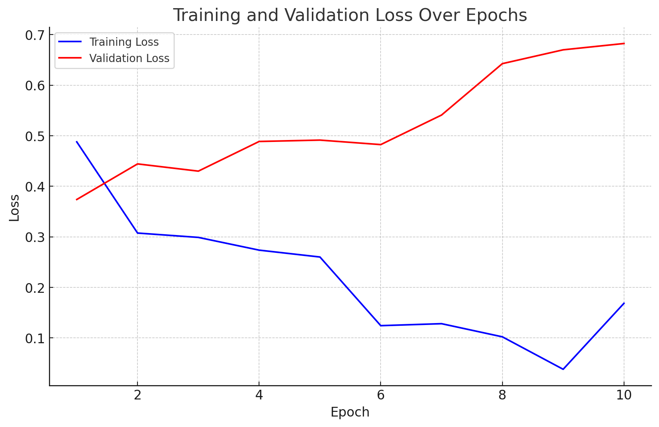
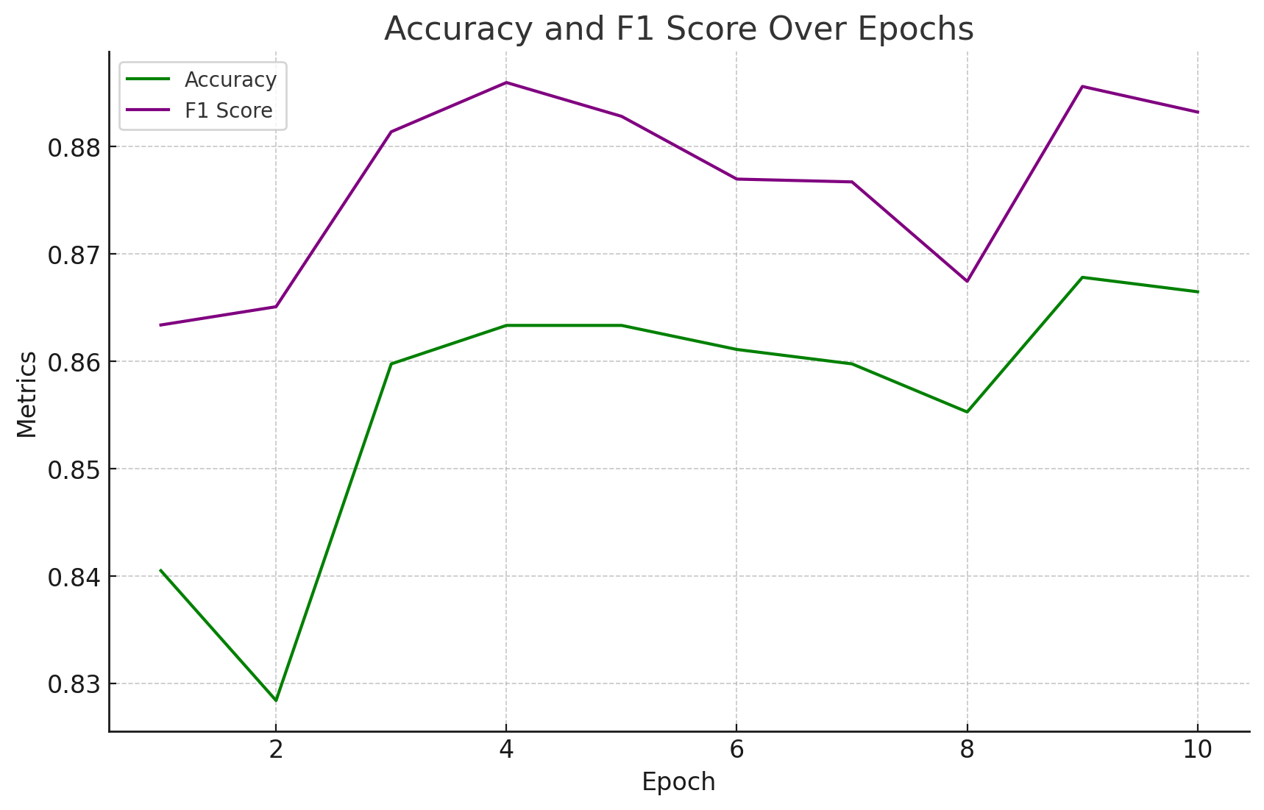
Training

Slide 8
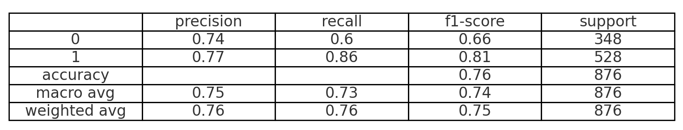
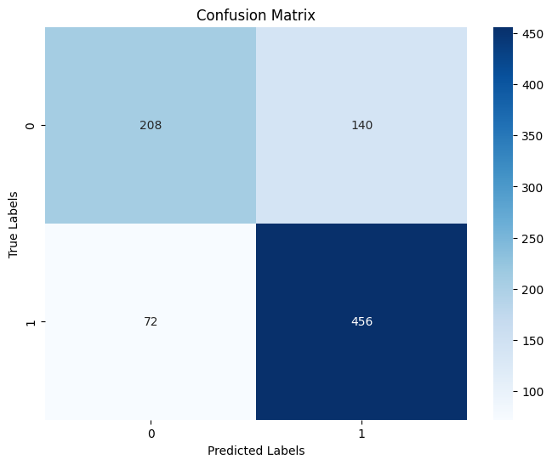
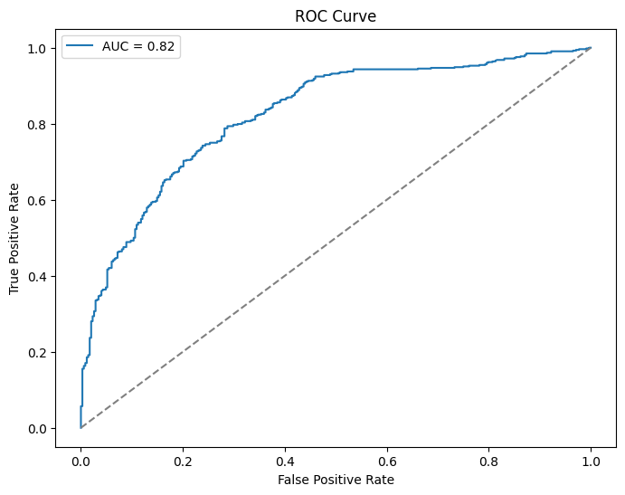
Testing

Slide 9
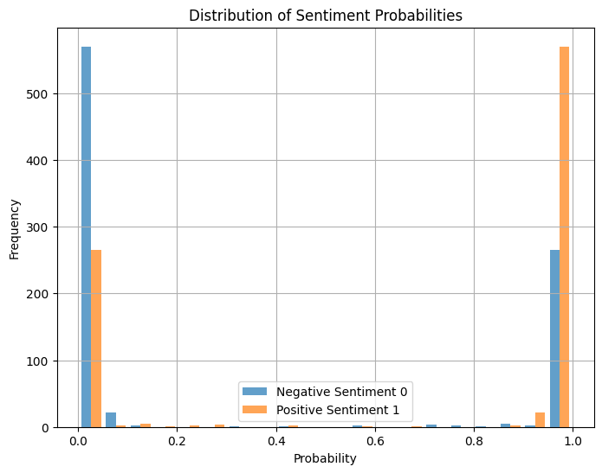
Predictions

Slide 10
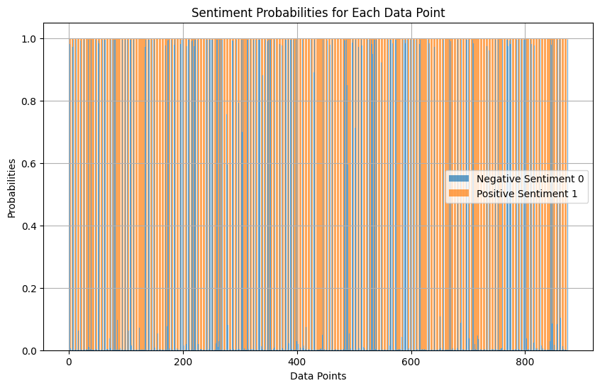
Predictions

Slide 11
Trading Signal Detection
Objective:
Window Size Selection
Hyperparameter tunning
Dynamic Decision Making
Make decision based on the distribution of returns of past “Window_size” days
Price Vs. Return
Feature Selection
Stationary vs Nonstationary data
Data used to train the model
Optuna, A hyperparameter optimization framework

Slide 12
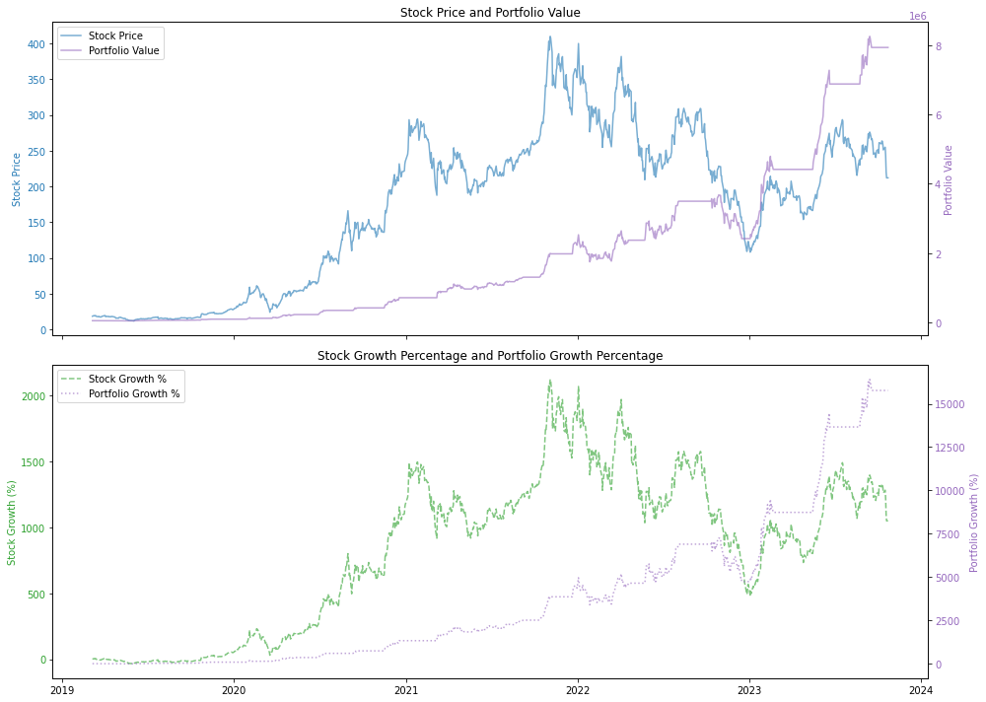
Tesla

Slide 13
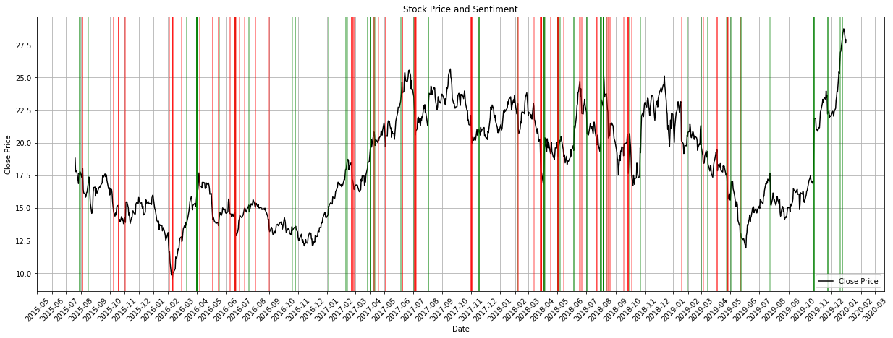
Tesla

Slide 14
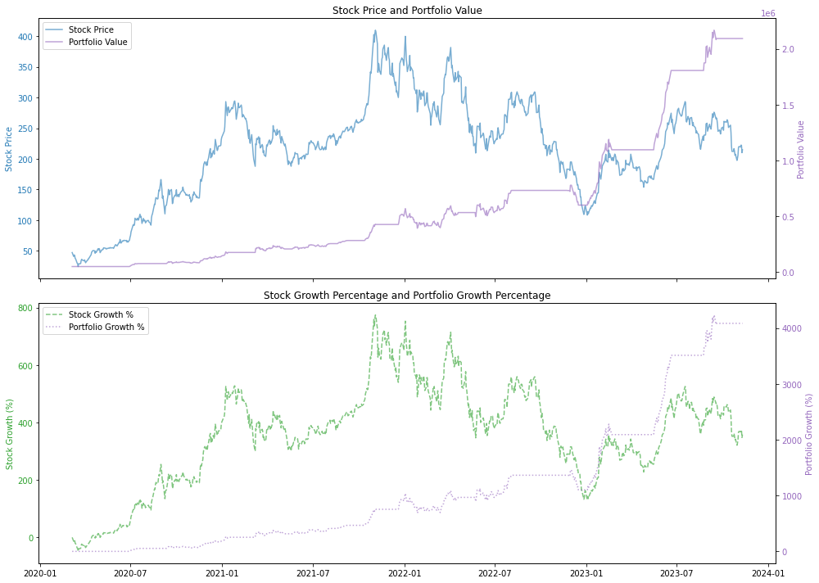

Slide 15
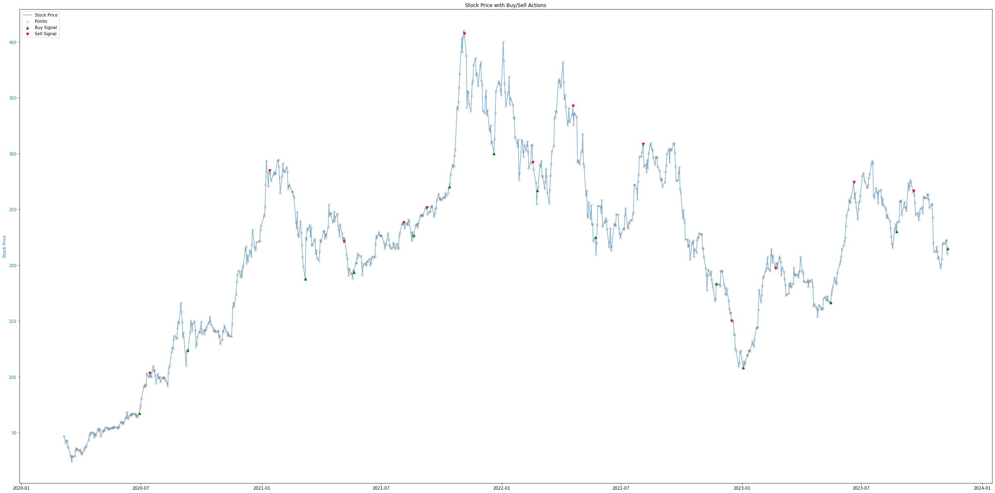

Slide 16
What can we do better
Sentiment Analysis
Include sentiment from institutional traders: news, reports published by professional analyst
Stock Prediction
Include a more diverse number of stocks/sectors: health sector, retail sector, etc.
Gather more financial data: Company performance (earning reports), economic indicator (unemployment rate), derivatives (Open Interest), etc.
Implement stock selection (finding the alpha)
Utilize Portfolio Optimization
Obtain larger datasets that (hopefully) represents the distribution of the population

Slide 17

Q&A

Slide 18

Thank you!

