Slide 1

Analyzing Retail Sentiment & Detecting Trading Signals
By Haozhe Zeng & Zixiao Wang

Slide 2
Dual Objectives
Implement retail trader sentiment analysis to assess market impact
Develop predictive models for real-time detection of buy/sell signals

Slide 3

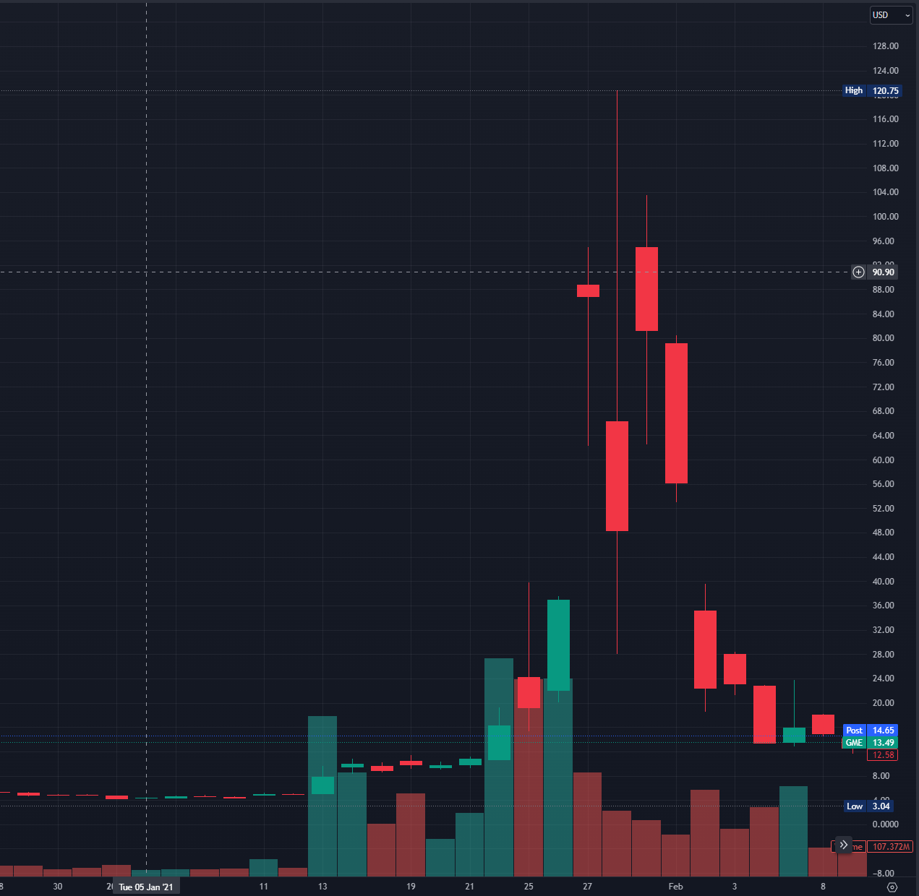
Motivations
Digitization of trading platforms
The relentless rise of retail trading
GameStop short squeeze
Personal interest in Equity Trading

Slide 4
Related Works
Similarities:
Study the correlation between stock market and retail traders’ sentiment
Build models to predict stock return
Uniqueness
Implement a dynamic approach to make short to mid term (one week) prediction
Focus on both loss and gain
Incorporate sentiment analysis into model

Slide 5
Cleaning, Entity Matching, Merging, etc.
Posts from Twitter and Reddit
Sentiment Labeling
Quantify/Normalize Data
Processing, Indicators Calculating, etc.
Stock data: Price, Volume, etc.
Time Series Modeling
Buy/Sell Decision
Portfolio

Slide 6
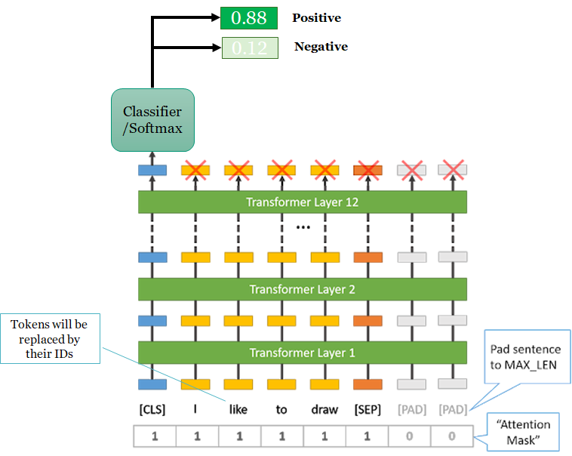
Sentiment Analysis
DatasetDict({
train: Dataset({
features: ['text', 'label', 'input_ids', 'token_type_ids', 'attention_mask'],
num_rows: 8925
})
validation: Dataset({
features: ['text', 'label', 'input_ids', 'token_type_ids', 'attention_mask'],
num_rows: 2232
})
test: Dataset({
features: ['text', 'label', 'input_ids', 'token_type_ids', 'attention_mask'],
num_rows: 876
})
Tweet_filtered_TSLA: Dataset({
features: ['date', 'text', 'stock'],
num_rows: 1123262
})
stock_tweets_filtered_TSLA: Dataset({
features: ['date', 'text', 'stock'],
num_rows: 37422
})
tweets_remaining_filtered_TSLA: Dataset({
features: ['date', 'text', 'stock'],
num_rows: 60836
})
})

Slide 7
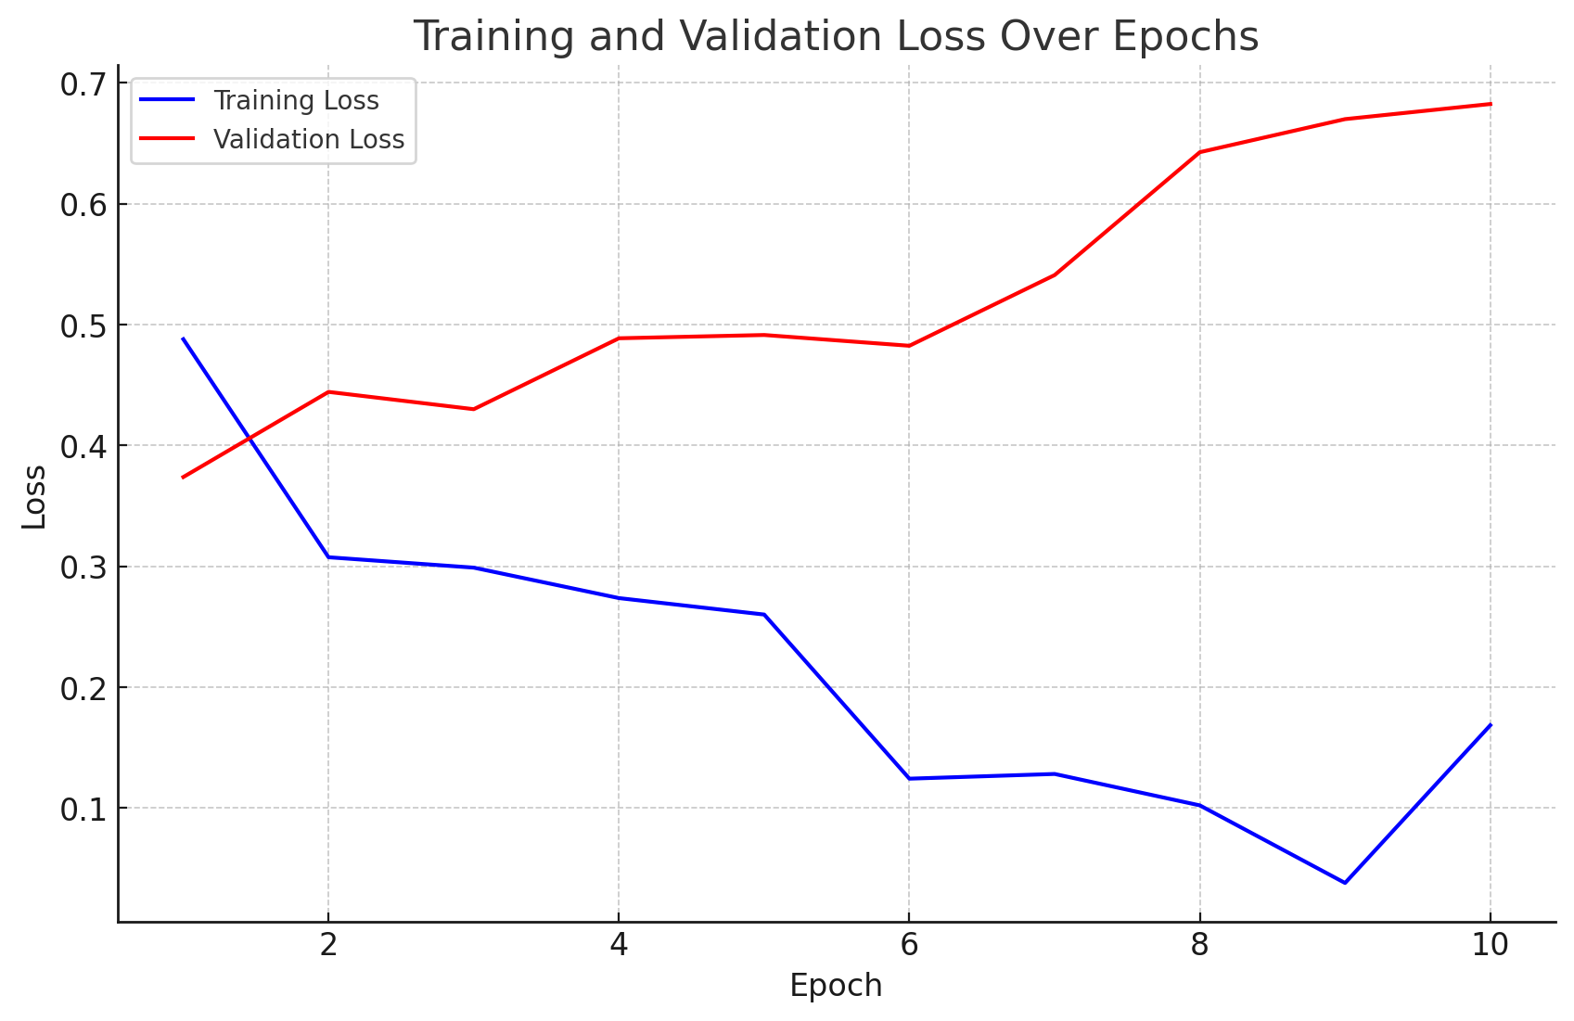
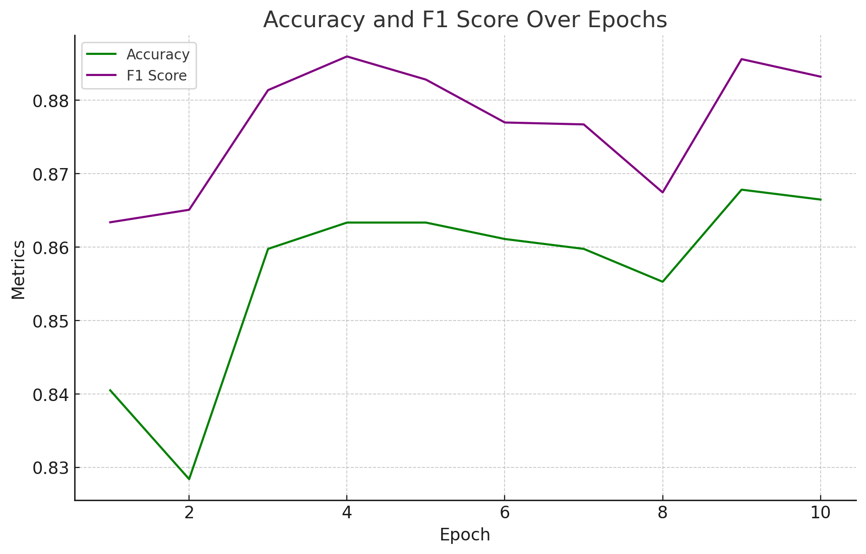
Training

Slide 8
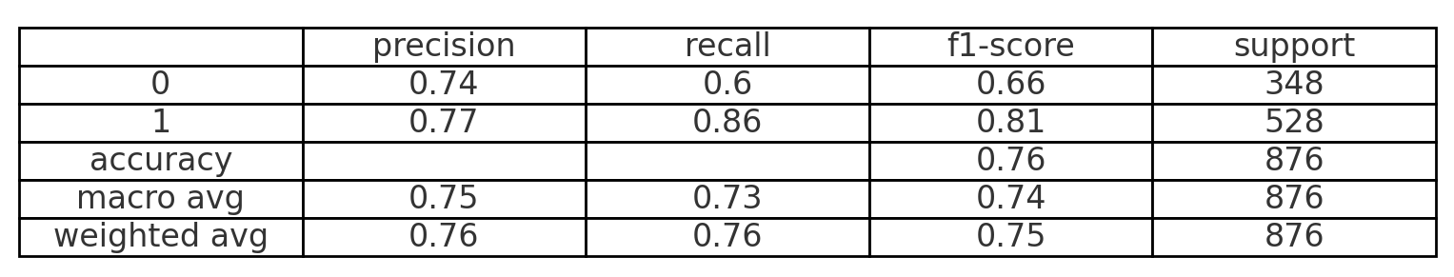
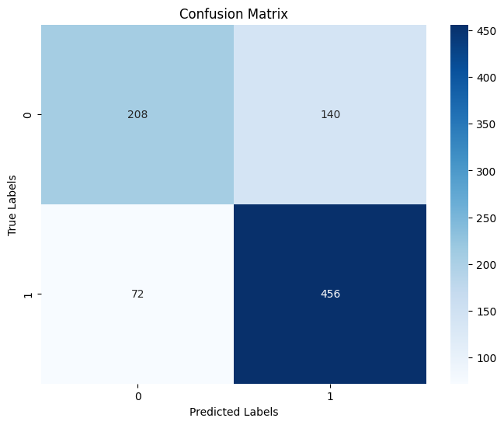
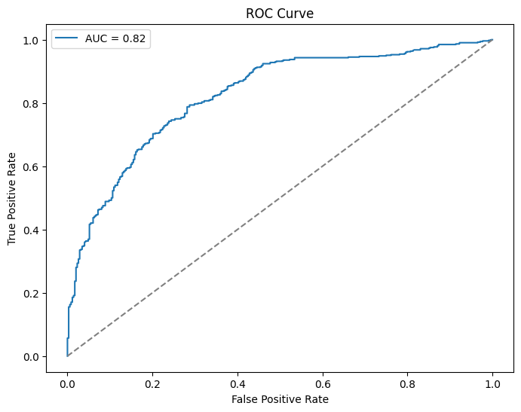
Testing

Slide 9
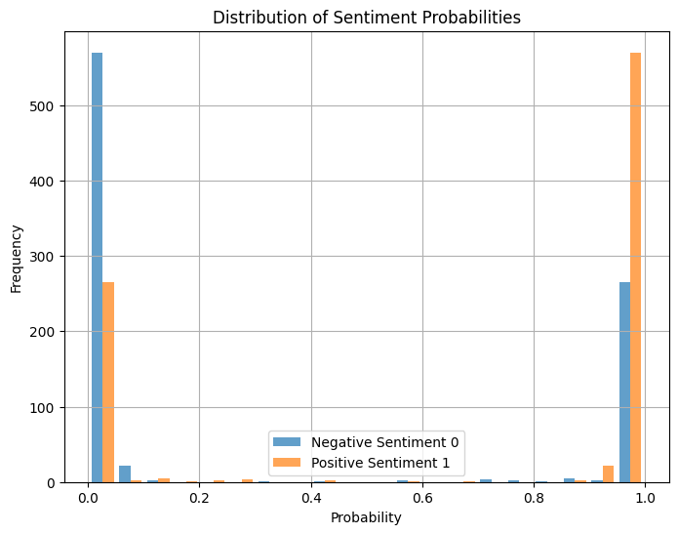
Predictions

Slide 10
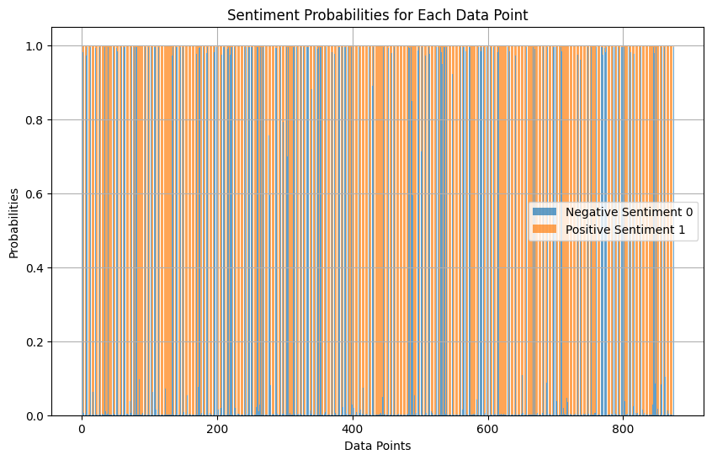
Predictions

Slide 11
Trading Signal Detection
Objective:
Window Size Selection
Hyperparameter tunning
Dynamic Decision Making
Make decision based on the distribution of returns of past “Window_size” days
Return (Stationary) Vs. Price (Nonstationary)
Feature Engineering & Selection
Normalization, Lagged Data (MA 200), Indicators
Data used to train the model
Optuna, A hyperparameter optimization framework

Slide 12
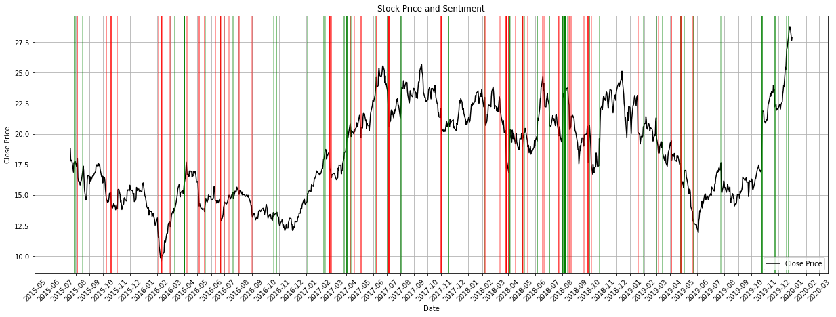
Tesla

Slide 13
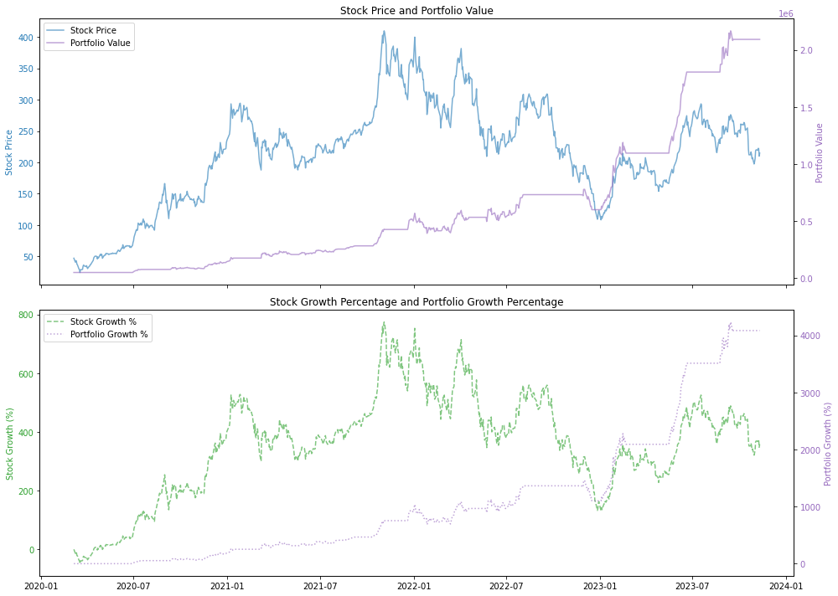

Slide 14
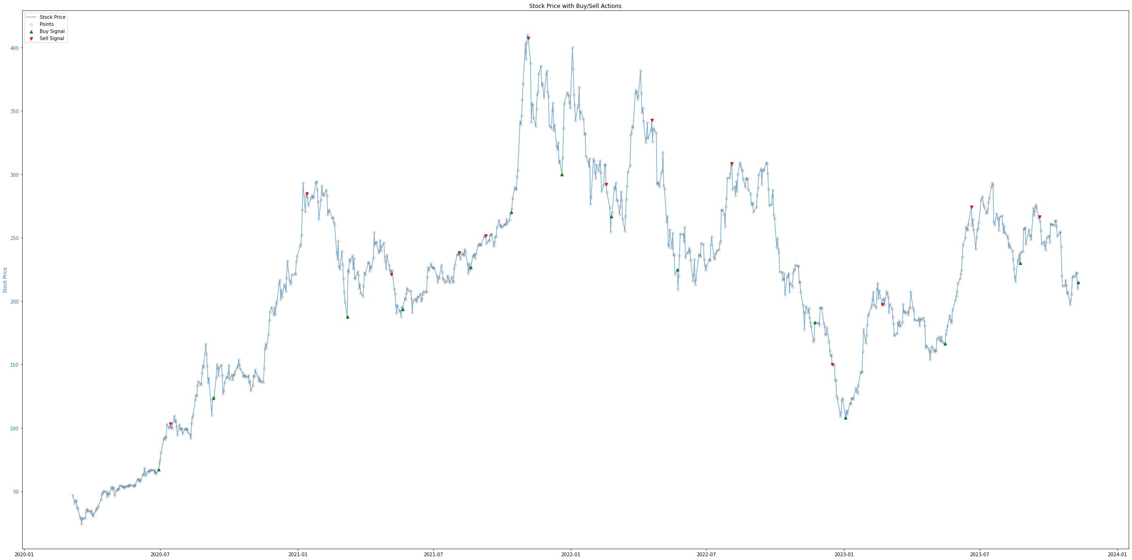

Slide 15
Enhancing Our Approach: Next Steps for Sentiment Analysis and Stock Prediction
Sentiment Analysis
Incorporate insights from institutional traders through analysis of market news and professional analyst reports to enhance sentiment accuracy
Stock Prediction
Expand our analysis to include a broader range of stocks and sectors, such as healthcare and retail, to diversify investment insights
Enrich our financial datasets with comprehensive company performance metrics, key economic indicators, and derivatives data to bolster predictive accuracy
Develop a robust stock selection framework to identify high-potential investments ('finding the alpha') and optimize market positioning
Employ advanced portfolio optimization techniques to maximize returns while mitigating risk across investment strategies
Broaden dataset acquisition to encompass a wider demographic, ensuring a diverse and representative sample of the trading population

Slide 16

Q&A

Slide 17

Thank you!

