Slide 1
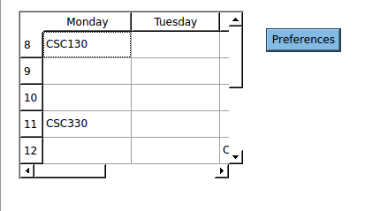
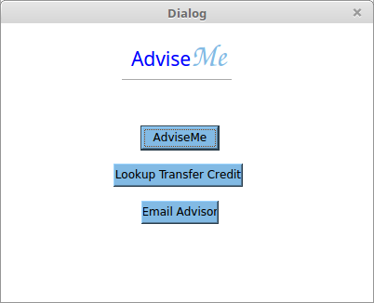
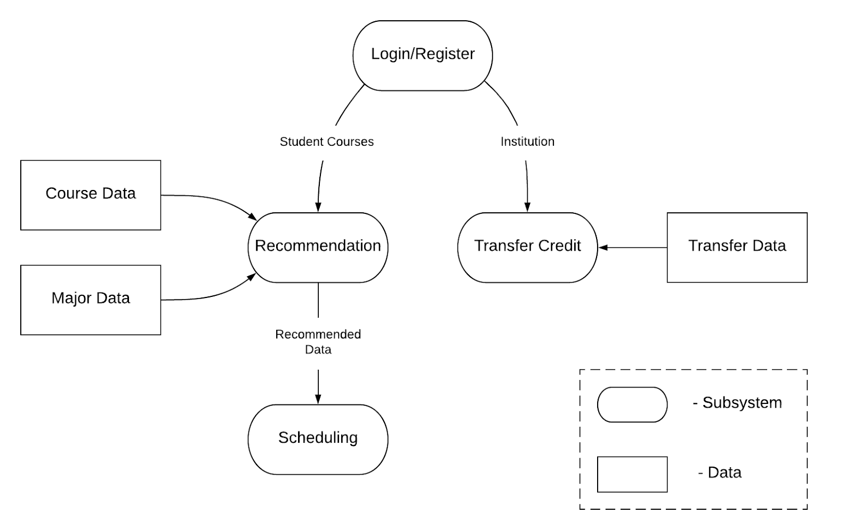
AdviseMe
Howard Aleshire, Timothy Bell,
Philip Osborne, Trevor White
Introduction/Purpose
Login/Registration
Advising for future semesters is not an easy process and many students have trouble, even with current advising systems. AdviseMe aims to simplify this process by providing students with an easy way to plan their schedules.
AdviseME is an automated advising system that recommends classes and provides students with a schedule based on their desired parameters. The system will ensure that it only recommends classes that will be beneficial to the students major, allowing them to graduate in a timely manner. It is achieved using Python, and it provides advising for a Computer Science major at UNCG.
When a student uses the system for the first time they are required to register some information. In addition to a username and password, they must specify their institution, major (even though only computer science is implemented), and a list of courses completed so far. If the student is a freshman, then the last field would remain blank. The completed courses field will return a list of those courses (see Data Flow).
Main System
When the student signs in for the first time, they are brought to the main system screen (pictured below). When the AdviseMe button is clicked, the Recommendation subsystem is executed and the student is brought to the Scheduling subsystem’s GUI. Likewise, if the student clicks Lookup Transfer Credit, then they are brought to the Transfer subsystem’s GUI.
Data Flow
Figure 2. Scheduling GUI
There are three initial datasets that the system needs in order to function:
Course Data: A CSV of the necessary courses needed to graduate (See Table 1)
Major Data: A CSV of the requirements needed to graduate with a computer science major
Transfer Data: A CSV of transfer data across UNCG and test universities.
The Login/Registration subsystem creates additional data in the form of the Student Object. From the Student Object, the Recommendation subsystem takes a list of classes that the student has already completed, and the Transfer subsystem takes the institution in which the student is enrolled.
The Recommendation subsystem uses the Course Data and Major Data to create the Recommended data, which is a dataset of classes that the student can take to progress in their major. This data is sent to the Scheduling subsystem, which uses the data in tandem with preferences set by the user to create an optimal schedule.
Scheduling
The Scheduling subsystem uses preferences set by the user to generate a schedule by day and time (pictures above). Preferences include available days, available times, and desired course marker. The system also allows the student to repeat the advising process and look ahead to the next semester. The Scheduling and Recommendation subsystems work in tandem to complete this by updating Student Courses (see Model 1) and repeating the recommendation process.
Model 1. Data Flow Diagram
Figure 1. Main System GUI
Recommendation
Transfer
The recommendation subsystem uses the student’s completed course list to search through the course data and remove any courses that the student has either already taken or is not eligible to take (i.e. unfulfilled prerequisites). The remaining courses are then sorted based on their “scores”, which is calculated by tallying the relevant course markers. Core courses are also given a higher score than the rest.
The Transfer subsystem allows the user to select a different university and view a list of the classes that they’ve completed that transfer to said university. The subsystem uses the Transfer Data and the student object created by the Login/Register subsystem. It is implemented as such:
university1(courses) n (university2(transfer(university1)) n recommended)
Table 1. Example Course Data
 | CRN | Notes | Course | Title | Instructor | Days | Time | Location | Category | Subject | Prerequisite | Score
0 | 10467 | 168 | MAT 150-01 | Precalculus I | Qi Zhang | MWF | 0800-0850 | PETT 224 | .GMT | math | none | 5
1 | 12134 | none | CCI 201-01 | Intro to Greek Civilization | David B. Wharton | MW | 1400-1515 | FERG 100 | .GHP.GL.GPM | classical civilizations | none | 3
References
The raw course data was generated using a program called HTML Table to CSV/Excel Converter: http://www.convertcsv.com/html-table-to-csv.htm

