Slide 1
HandlerMapping
2
3
HandlerAdapter
1
DispatcherServlet
HttpMessageConveter
Handler
4
6
5
7
View
ViewResolver

Slide 2
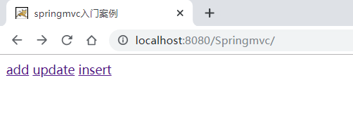
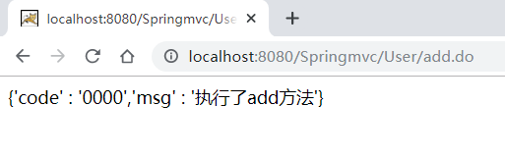
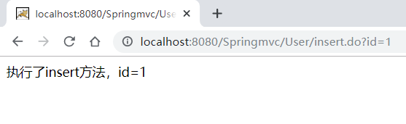

Slide 3
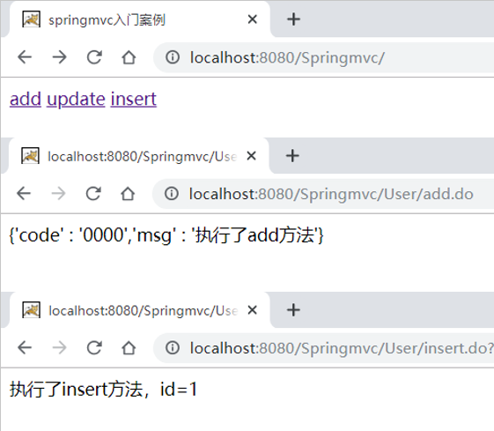

Slide 4
